Slide 1

Team Members
Zewan Lyu (999019888)
Zeyan YIN (999020183)
Weihan Li (999019797)
Xiang Li (999019771)
Noname
Huarong Dao Game Development Report
GTIIT
Noname Team
January
POWERPOINT DESIGN

Slide 2
CONTENTS
1.
Introduction
3.
Technical Explanation
2.
Demo of the Game
4.
Q&A

Slide 3
01
PART
Introduction
POWERPOINT DESIGN
POWERPOINT DESIGN

Slide 4
Team Presentation
Project Overview
Game Concept and Features
Our team developed an eight-level Huarong Dao game in Gameboy z80 assembly. Players choose levels on the home page, where they must move a unique large block to the bottom center of the board. All blocks can move freely without overlapping. After completing a level, players return to the home page to select another.
The game concept is based on the classic Huarong Dao, which is a puzzle-solving game. Our unique features lie in the design of different difficulty levels, providing players with a gradually increasing challenge experience. Also, the carefully designed block layouts and patterns enhance the fun and visual effects of the game.

Slide 5
02
PART
Demo of the Game
POWERPOINT DESIGN
POWERPOINT DESIGN

Slide 6

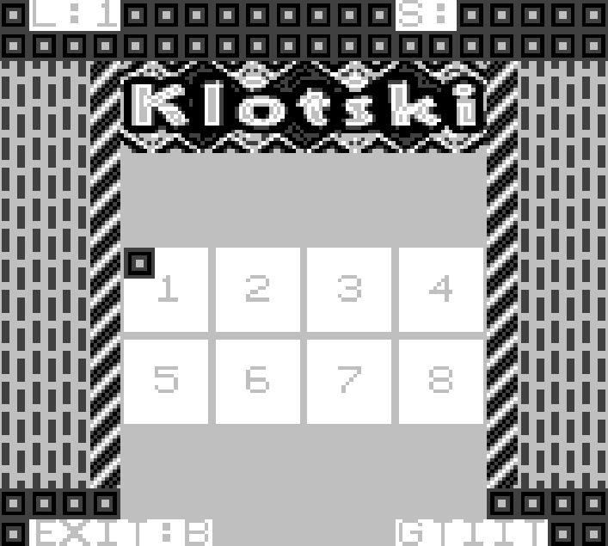
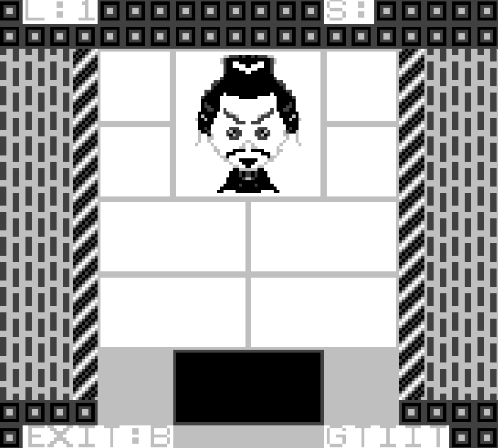
Demo of the Menu and Level
Menu Interface Design
The menu interface uses a simple 3x3 tile selection box, allowing players to choose levels with a moving cursor. Each level option is clearly visible, and dynamic effects like cursor flicker add liveliness.
Level Interface Design
The main interface is clean and informative, displaying current level and step count at the top. The game area features blocks in various colors and sizes, with the largest block highlighted for easy identification. A border surrounds the game area to prevent blocks from moving out, enhancing the game's aesthetic appeal.

Slide 7

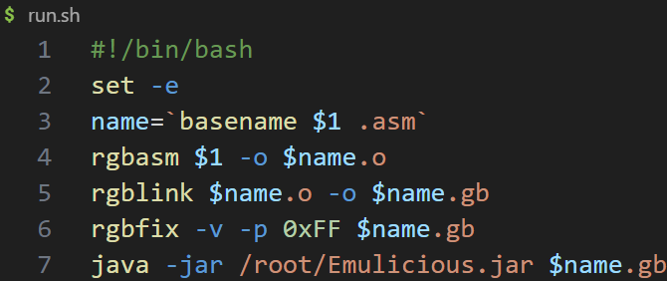
Game Play Demonstration
Now, let's have a real demo of our little game!

Slide 8
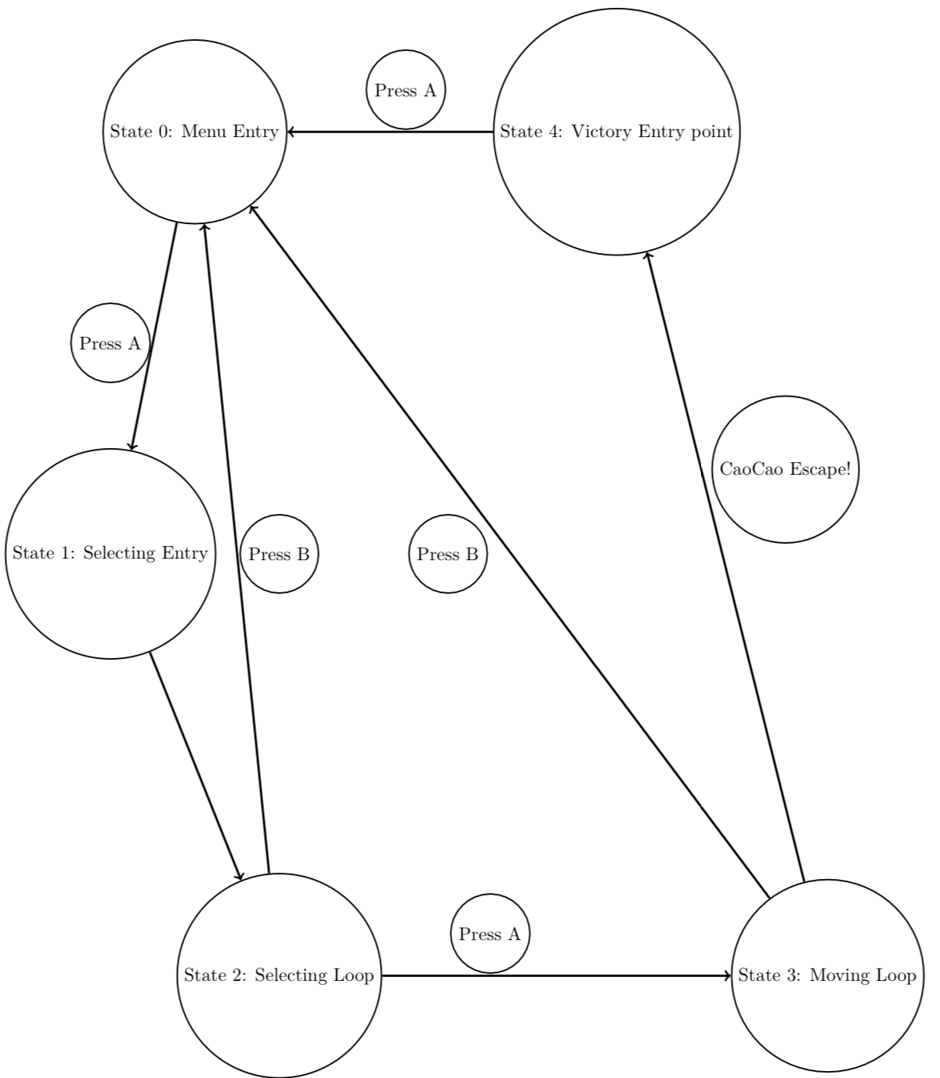
03
See the report.pdf for more details.
PART
Technical Explanation
POWERPOINT DESIGN
POWERPOINT DESIGN

Slide 9
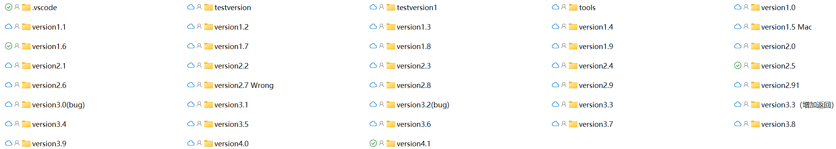
04
PART
Q&A and Feedback
POWERPOINT DESIGN
POWERPOINT DESIGN

Slide 10

Thank
主讲人：AiPPT
时间：20XX.XX
POWERPOINT DESIGN

