Slide 1
IT7075 · APPLIED AI FOR CYBERSECURITY · MODULE 1
The CyberAI Landscape
Three families of AI, where they help a defender, and why every AI system
you build is itself something an attacker will try to break.
Chengcheng Li, PhD · School of Information Technology · University of Cincinnati
Five parts · one live demo

Slide 2
MODULE MAP
PART 1
Why AI for Security
Why AI for Security —
and What AI Is
AI in the SOC: Tool & Target
Your First AI Workflow
Why this is suddenly practical, and the vocabulary you need before we touch any code.
A Little Python
Frameworks, Ethics & Your Week

Slide 3
PART 1 · WHY AI FOR SECURITY
Why this course, why now
The volume of alerts has outgrown the number of people available to read them.
Machine-speed attacks
Alert fatigue
Automation lets one adversary run campaigns that used to need a team.
When everything is urgent, nothing is. Real signals get closed unread.
AI is now practical
AI is also a target
Triage, detection and enrichment that were research demos in 2020 now ship.
Models can be fooled, hijacked and poisoned — a new surface to defend.
The claim this course makes: AI does not replace the analyst — it changes what the analyst spends attention on. The gap in that chart never closes by hiring. It closes by putting a first-pass reader in front of the queue and keeping a human on the decisions that matter. By Week 16 you will have built several of those readers yourself.
Introduction · The CyberAI Landscape
3

Slide 4
PART 1 · WHY AI FOR SECURITY
AI, machine learning, deep learning, LLMs
Four words that nest inside each other — and get used as if they were synonyms.
ARTIFICIAL INTELLIGENCE
Term | What it actually means | A security example
AI | Any system doing something we'd call intelligent | The umbrella word in a vendor pitch
Machine learning | Learns patterns from labelled data instead of hand-written rules | Classifying a URL as phishing from its features
Deep learning | ML using large multi-layer neural networks | Detecting malware from raw bytes
LLM | A deep network trained to predict text; reads and writes language | Summarising an incident; triaging an alert
the broad ambition
MACHINE LEARNING
learn from data, not rules
DEEP LEARNING
large neural networks
LLMs
trained on massive text
House rule for this course: when I say "AI" without qualifying it, I almost always mean an LLM. When I mean something narrower, I will name it.
Introduction · The CyberAI Landscape
4

Slide 5
PART 1 · WHY AI FOR SECURITY
Three families of AI you will use
Knowing which to reach for is half the skill. Real systems combine all three.
Classic ML
LLMs
Agentic AI
Patterns in structured data
Language and code
Plan and act over steps, using tools
Phishing-URL classifier · malware detection · anomaly scoring
Alert triage · incident summaries · code review · log explanation
Orchestrated enrichment · multi-step investigation · automated response
Family | What it eats | What it gives back | Cost to run | Explains itself?
Classic ML | Rows of numbered features | A label and a confidence score | Cents; runs on a laptop | Feature weights — inspectable
LLM | Free text, code, logs | Text: a verdict plus reasoning | Per token, or a local GPU | Writes an explanation you must verify
Agentic AI | A goal, plus tools it may call | A sequence of actions and a result | Many model calls per task | A trace of steps you can audit
Watch the last column. Each family explains itself in a different currency — weights, prose, or a trace. Knowing which kind of evidence you will be able to show an auditor should shape the choice before you write any code.
Introduction · The CyberAI Landscape
5

Slide 6
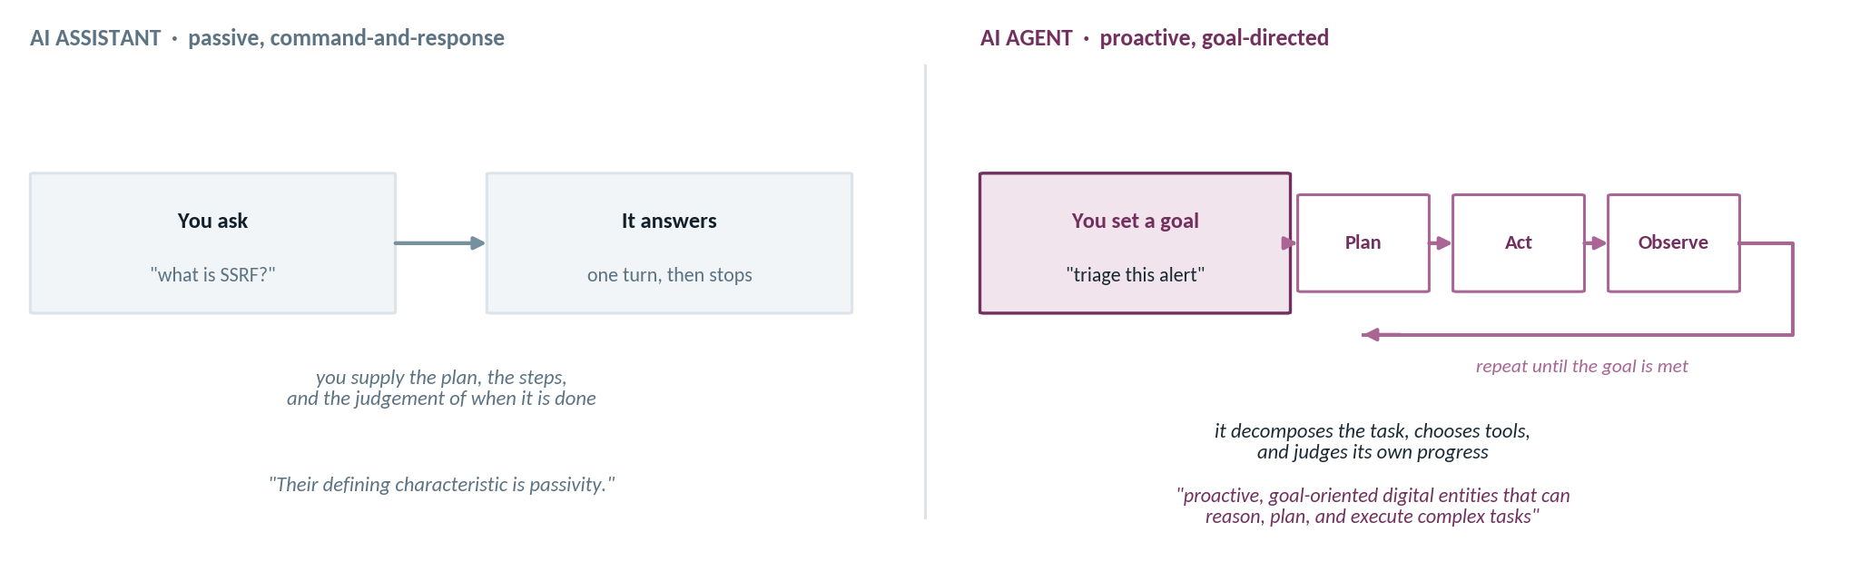
PART 1 · WHY AI FOR SECURITY
From assistant to agent
The shift this course is about, in one picture: from answering a question to pursuing a goal.
The distinction that organises the whole course. Capability and risk arrive together: the moment a system chooses its own next action, “was that authorised?” becomes a real question rather than a hypothetical one.
Where we are going
Modules 1–7 build the parts. Module 8 assembles them into something that acts on its own.
Introduction to AI for Cybersecurity
6

Slide 7
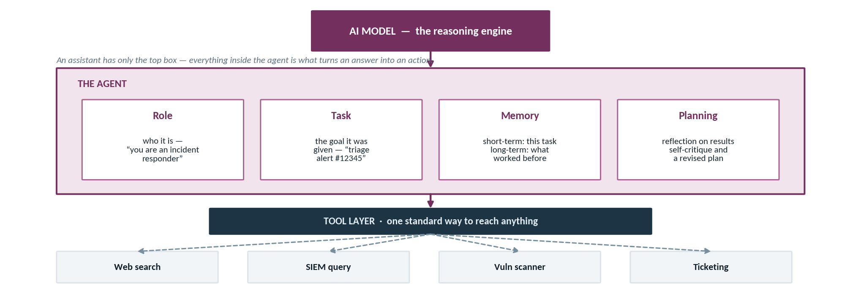
PART 1 · WHY AI FOR SECURITY
What is inside an agent
Role, task, memory and planning — sitting on top of a model, and on top of a layer of tools.
Each box becomes a module. Memory and retrieval in module 4, orchestration in 5 and 6, the tool layer in 7, the whole loop in 8. Structure adapted from Santos, Agentic AI for Cybersecurity, Ch. 1, Fig. 1-4.
Introduction to AI for Cybersecurity
7

Slide 8
PART 1 · WHY AI FOR SECURITY
Four kinds of agent
The reasoning pattern is the design decision. Match it to the task rather than reaching for the most capable one.
 | Routing | Query planning | ReAct | Dynamic planning
Primary goal | Find the single best source, model or tool for a query. | Break a complex query into parts and synthesise a complete result. | Accomplish a goal by selecting and using a sequence of tools. | Form a high-level strategy, execute it, and adjust as new information arrives.
Core mechanism | Classification and selection from a predefined list. | Decomposition and synthesis — route sub-questions, combine answers. | A reason–act loop: reason, act with a tool, observe, repeat. | Plan–execute: a planner LLM writes the plan, an executor runs each step.
When to use it | Several distinct, well-defined sources and the problem is choosing one. | Questions no single source can answer. | The steps are not known in advance. | Long-running tasks where the initial conditions change.
Reach for the simplest pattern that fits. The instinct is that dynamic planning is “best”. It is the most expensive and the hardest to debug — and a great deal of real security work is a routing agent.
Adapted from Santos,
Agentic AI for Cybersecurity, Table 1-1.
Introduction to AI for Cybersecurity
8

Slide 9
PART 1 · WHY AI FOR SECURITY
What an LLM actually does
One mechanism — predict the next token — repeated until it has written a response.
THE MECHANISM
Term | What it means for you
Token | Roughly a word-piece. The unit APIs bill in — cost is token count.
Context window | How much text it can consider at once. Its only short-term memory.
System message | A first instruction that sets the role. Not privileged — just early.
Temperature | How much randomness in the pick. Zero for reproducible security work.
14
failed
root
logins
, then
a
?
your prompt, split into tokens
The consequence you must internalise: nothing in this mechanism consults a database, and nothing checks whether the output is true. The model produces text that is statistically plausible given what came before. A fabricated CVE number is not a malfunction — it is the same machinery working normally on a prompt where plausible and correct happened to diverge.
Then it does it again. It picks one, appends it, and re-runs the whole thing. Fluency is the by-product.
Introduction · The CyberAI Landscape
9

Slide 10
PART 1 · WHY AI FOR SECURITY
Which one do I reach for?
A rule of thumb that keeps you out of most trouble.
Your task
Structured data, clear labels?
Classic ML
Is this URL phishing? Cheap, fast, measurable.
start here
Free text or code, needs an explanation?
An LLM
Triage this alert and tell me why.
Several actions, in sequence, using tools?
An agent
Enrich, correlate, then open a ticket.
Tempting mistake | Why it hurts | What to do instead
An LLM for tabular classification | Slower, costlier, and less accurate than a model you can train in a minute | Train a small classifier; use the LLM to explain its output
One giant prompt for a multi-step job | No trace, no retry, no way to see which step failed | Break it into steps — that is what an agent is
Introduction · The CyberAI Landscape
10

Slide 11
MODULE MAP
PART 2
Why AI for Security
AI in the SOC —
Tool and Target
AI in the SOC: Tool & Target
Your First AI Workflow
Where AI genuinely helps a defender, where it fails, and why the systems you build are themselves something to defend.
A Little Python
Frameworks, Ethics & Your Week

Slide 12
PART 2 · AI IN THE SOC
Where AI helps in the SOC
Five places it shows up — and in every one, a human keeps the decision.
Triage
Detection
Investigation
Automation
Reporting
rank the flood
classify URL, file, behaviour
correlate into a picture
enrich and respond
findings into prose
Stage | What the AI does | What it saves | What still needs a human
Triage | Reads the queue and ranks by likely severity | The first pass over hundreds of alerts | The escalation call on anything ranked high
Detection | Classifies a URL, file or behaviour as malicious | Manual feature inspection | Tuning the threshold; owning the false negatives
Investigation | Correlates events across sources into a narrative | Pivoting between six consoles by hand | Deciding which thread is worth pulling
Automation | Runs enrichment and drafts a response action | Repetitive lookups and copy-paste | Approving anything irreversible
Reporting | Turns messy findings into a readable writeup | The blank page | Verifying every claim before it ships
Read the last column as the syllabus. Everything in it is judgement under uncertainty — which is precisely what does not automate.
Introduction · The CyberAI Landscape
12

Slide 13
PART 2 · AI IN THE SOC
Where AI falls short — so you verify
Four failure modes. All four follow from how the model works, not from it being immature.
Hallucination
No ground truth
Prompt injection
Stale, and blind to you
Invents CVEs, commands and file paths that look entirely real.
Fluent and confident is not the same as correct — and it cannot tell.
Untrusted text it reads can carry instructions that hijack it.
Training has a cutoff, and it knows nothing about your environment.
The format is perfect. That is exactly the problem.
Before you use it | The check
Any CVE or ID | Look it up in the actual database
Any command | Read it. Never paste blind into a shell
Any statistic | Ask where it came from
Any confident tone | Treat as style, not evidence
> Which CVE is the Apache Struts RCE from that breach?
"CVE-2017-5638 — the Jakarta Multipart parser." # true
> And the follow-up advisory for the 2023 variant?
"CVE-2023-50164, disclosed December 2023."
# same tone, same shape. Check it yourself.
The rule for the whole course: every model output is a draft to verify, never a fact to trust. This is not pessimism about the technology — it is the correct operating procedure for a system that produces plausible text and has no mechanism for checking truth.
Introduction · The CyberAI Landscape
13

Slide 14
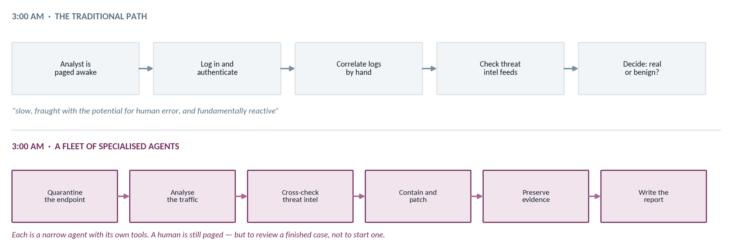
PART 2 · AI IN THE SOC
3 a.m., two ways
The textbook opens on this scene. It is the clearest picture of what the course is aiming at.
Nothing here is a general intelligence. Every one of those is a narrow agent with a role and two or three tools — which is precisely why it is buildable, and what module 8 asks you to build. Scene from Santos, Ch. 1.
Introduction to AI for Cybersecurity
14

Slide 15
PART 2 · AI IN THE SOC
AI as a tool — and as a target
A defender who only knows the left-hand column ships attackable systems.
AI FOR DEFENCE
AI AS AN ATTACK SURFACE
Triage and rank an alert queue no team can read
Classify URLs, files and behaviour at machine speed
Correlate events across sources into a narrative
Draft the incident report and the remediation steps
Adversarial inputs crafted to make a model misclassify
Prompt injection that hijacks an LLM application
Data poisoning that corrupts a model during training
Model and training-data extraction from a deployed system
Reference | What it catalogues | When you reach for it
MITRE ATLAS | Adversarial tactics and techniques against AI systems — the AI cousin of ATT&CK | Threat-modelling anything you build in this course
OWASP Top 10 for LLM Apps | The recurring application-level failures, injection first among them | Reviewing an LLM application before it ships
Introduction · The CyberAI Landscape
15

Slide 16
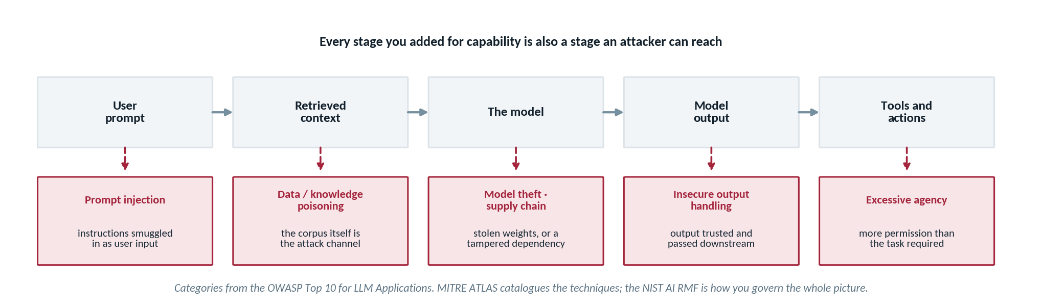
PART 2 · AI IN THE SOC
Where the attacks land
Every stage you added for capability is a stage an attacker can reach. This is the map we return to all term.
Read the red row as a syllabus. Prompt injection and data poisoning arrive properly in module 4, insecure output handling in module 9, excessive agency in module 8, and the governance frameworks in module 10. Nothing on this row is hypothetical — every one has a published incident behind it.
Introduction to AI for Cybersecurity
16

Slide 17
PART 2 · AI IN THE SOC
What makes a good AI security tool
Five criteria. We return to them every time we evaluate something you built.
1
Correct
2
Explainable
3
Safe
4
Bounded
5
Fast enough
Right call on the actual security question
Reasoning an analyst can check
No data leakage; sensible refusals
Respects data and network boundaries
Fits the analyst's real workflow
Criterion | How you actually test it | What failure looks like
Correct | A held-out set of labelled cases; measure, do not eyeball | Demos beautifully, misses the one alert that mattered
Explainable | Ask a colleague to accept or reject the verdict using only the explanation | A confident verdict with reasoning nobody can check
Safe | Try to make it leak its prompt, its keys, or another tenant's data | Real logs pasted into a third-party API without anyone deciding to
Bounded | Name the worst action it can reach. If it takes a sentence, scope is too wide | A read-only assistant that turned out to be able to write
Fast enough | Time it under a realistic queue, not on one alert | Technically accurate; analysts route around it
Introduction · The CyberAI Landscape
17

Slide 18
MODULE MAP
PART 3
Why AI for Security
Your First
AI Security Workflow
AI in the SOC: Tool & Target
Your First AI Workflow
An alert arrives, a model reads it, and an analyst gets a decision with its reasoning attached. Twelve lines of code.
A Little Python
Frameworks, Ethics & Your Week

Slide 19
PART 3 · YOUR FIRST AI WORKFLOW
A motivating example: alert to action
The explanation is what separates a useful assistant from a black box.
Alert arrives
LLM reads it
Verdict + reason
Analyst decides
from a sensor or SIEM
with a role and a task
benign / suspicious, and why
acts, with the reasoning to hand
this box is the whole value — and the whole risk
Without the explanation | With the explanation | Why it matters here
"Suspicious." | "Suspicious — 14 failed root logins in 40 seconds followed by a success." | The analyst can confirm or reject it in five seconds
You trust it or you redo the work | You audit the reasoning, not just the verdict | A wrong verdict with visible reasoning is caught; a wrong verdict alone is not
Nothing to write in the ticket | The justification is already drafted | The output feeds the next step of the workflow
Introduction · The CyberAI Landscape
19

Slide 20
PART 3 · YOUR FIRST AI WORKFLOW
The demo — the whole thing
Do not worry about the mechanics yet. Notice how little there is.
alert_triage.py
Line | What it is doing
load_dotenv() | Pulls the key from a file Git ignores
OpenAI() | Finds the key in the environment by itself
system | Sets the role and the output contract
user | The untrusted content — the alert itself
temperature=0 | Reproducible: re-runs give the same verdict
import os
from dotenv import load_dotenv
from openai import OpenAI
load_dotenv() # reads OPENAI_API_KEY from a .env file
client = OpenAI() # the key is never typed into this file
alert = ("14 failed SSH logins for user 'root' from 203.0.113.45 "
"within 40 seconds, followed by one successful login.")
resp = client.chat.completions.create(
model="gpt-4.1-mini",
temperature=0, # same input, same answer, every run
messages=[
{"role": "system",
"content": "You are a SOC analyst. Classify the alert "
"as benign or suspicious, then explain in "
"one sentence."},
{"role": "user", "content": alert},
],
)
print(resp.choices[0].message.content)
Notice what is in the user message. The alert text is attacker-influenceable — it came from a log. Anything written into a filename or a user agent lands in that field. Hold that thought; it is the whole of the prompt-injection module.
Introduction · The CyberAI Landscape
20

Slide 21
PART 3 · YOUR FIRST AI WORKFLOW
The demo, end to end
SimpleAlertClassifier.ipynb in full. Four cells: load the keys, build the prompt, ask each model, compare.
SimpleAlertClassifier.ipynb — CELLS 4, 6 AND 8
1
Three key sources, one order
# --- cell 4: load the keys, safely -------------------------
try:
from google.colab import userdata # Colab Secrets
for k in ("ANTHROPIC_API_KEY", "OPENAI_API_KEY"):
if userdata.get(k): os.environ[k] = userdata.get(k)
except Exception: pass
try:
from dotenv import load_dotenv, find_dotenv # local .env
load_dotenv(find_dotenv())
except Exception: pass
HAS_ANTHROPIC = bool(os.getenv("ANTHROPIC_API_KEY"))
CLAUDE_MODEL = "claude-haiku-4-5-20251001"
print("Anthropic key:", "found" if HAS_ANTHROPIC else "MISSING")
# --- cell 6: the alert and the prompt ----------------------
alert = "5 failed logins for 'admin' from 203.0.113.7 ..."
PROMPT = f"Classify this security alert as benign or "
f"suspicious and explain in one sentence: {alert}"
# --- cell 8: ask Claude ------------------------------------
def classify_with_claude(alert):
if not HAS_ANTHROPIC:
return "[skipped — no ANTHROPIC_API_KEY set]"
msg = Anthropic(api_key=ANTHROPIC_API_KEY).messages.create(
model=CLAUDE_MODEL, max_tokens=150,
messages=[{"role": "user", "content": PROMPT}])
return msg.content[0].text.strip()
Colab Secrets, then .env, then the shell. Each attempt is wrapped so a missing one is a no-op, not an error.
2
It prints found, never the key
This is what makes the cell safe to project. A key pasted into a cell is a key in your git history.
3
One sentence is the dataset
67 characters. Ask the room for a verdict before you run it — get their judgement on the record first.
4
Note the alert parameter
Both classify functions take one. Hold that thought — it comes back two slides from now.
Introduction to AI for Cybersecurity
21

Slide 22
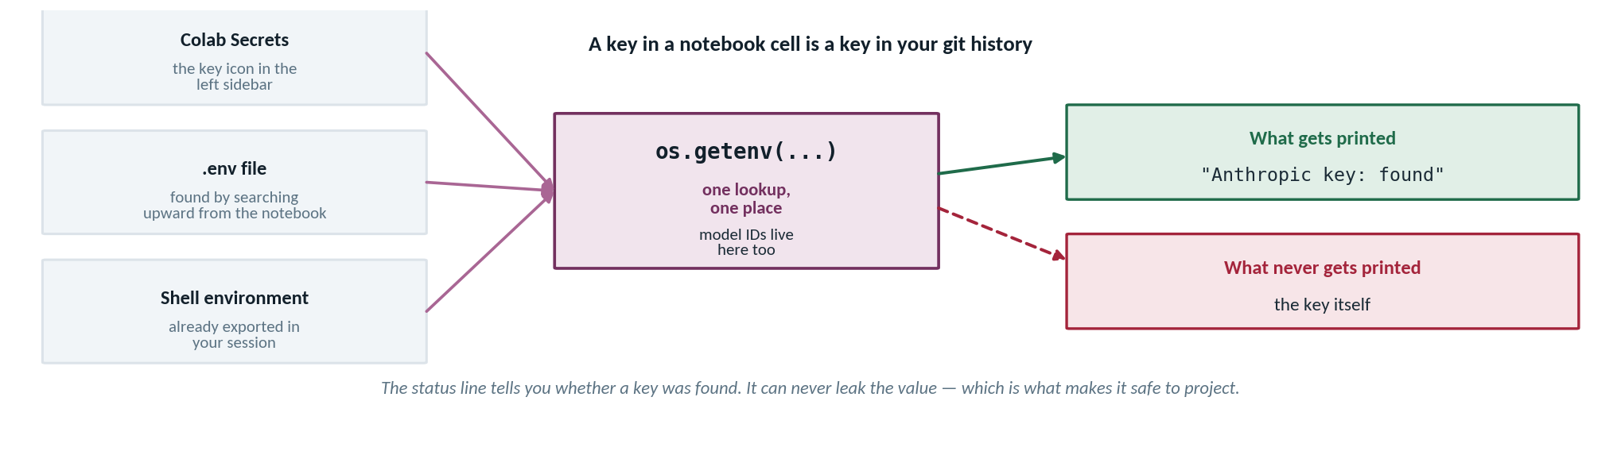
PART 3 · YOUR FIRST AI WORKFLOW
Where the key lives
Three places it may come from, one place the code looks, and one thing that never reaches the screen.
Introduction_to_AI/code/config.py
If a key ever leaks, rotate it
# config.py — the single source of truth
load_dotenv(find_dotenv()) # searches upward
HAS_ANTHROPIC = bool(ANTHROPIC_API_KEY)
CLAUDE_MODEL = "claude-haiku-4-5-20251001"
OPENAI_MODEL = "gpt-5-mini"
Deleting the message does not help — it is already gone. .env is git-ignored; verify that before your first commit. A leaked key spends real money.
Introduction to AI for Cybersecurity
22

Slide 23
PART 3 · YOUR FIRST AI WORKFLOW
The demo — what comes back
A verdict, and a sentence you can check in five seconds.
Output
Why this example is easy
Suspicious. Fourteen failed root logins from a single address in
40 seconds followed by a success is a classic brute-force pattern
ending in a likely compromise; isolate the host and rotate
credentials for that account.
Any analyst spots this pattern instantly. That is deliberate — the demo shows the shape, not the value.
The value appears at 500 alerts an hour with no clean threshold, where a first-pass reader with a stated reason lets a human spend attention where it counts.
What it got right | What it added | What you must still check
The verdict — this is the correct call | A named pattern: brute force | Is 203.0.113.45 actually external?
The reasoning cites the evidence in the alert | An unrequested remediation step | Did the success come from the same source?
Format followed the instruction | Confidence it has not earned | Is this host in scope for isolation?
The habit to build now: read the second column and the third together. The model volunteered a remediation nobody asked for. It may well be right — and it also has no idea whether that host can be isolated, or whether it is a domain controller. Helpfulness beyond the question asked is where automation quietly acquires scope.
Introduction · The CyberAI Landscape
23

Slide 24
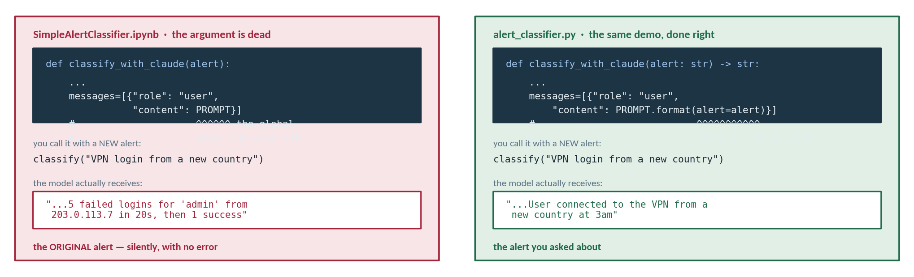
PART 3 · YOUR FIRST AI WORKFLOW
The argument that does nothing
The notebook's classify functions take an alert and then ignore it. No error, no warning — just the wrong answer.
This is the module's thesis, demonstrated on the module's own code. A confident, well-formed answer to a question you did not ask. There is no error and no warning — the only way to catch it is to read the code. Fix: PROMPT.format(alert=alert), exactly as the .py script already does.
Introduction to AI for Cybersecurity
24

Slide 25
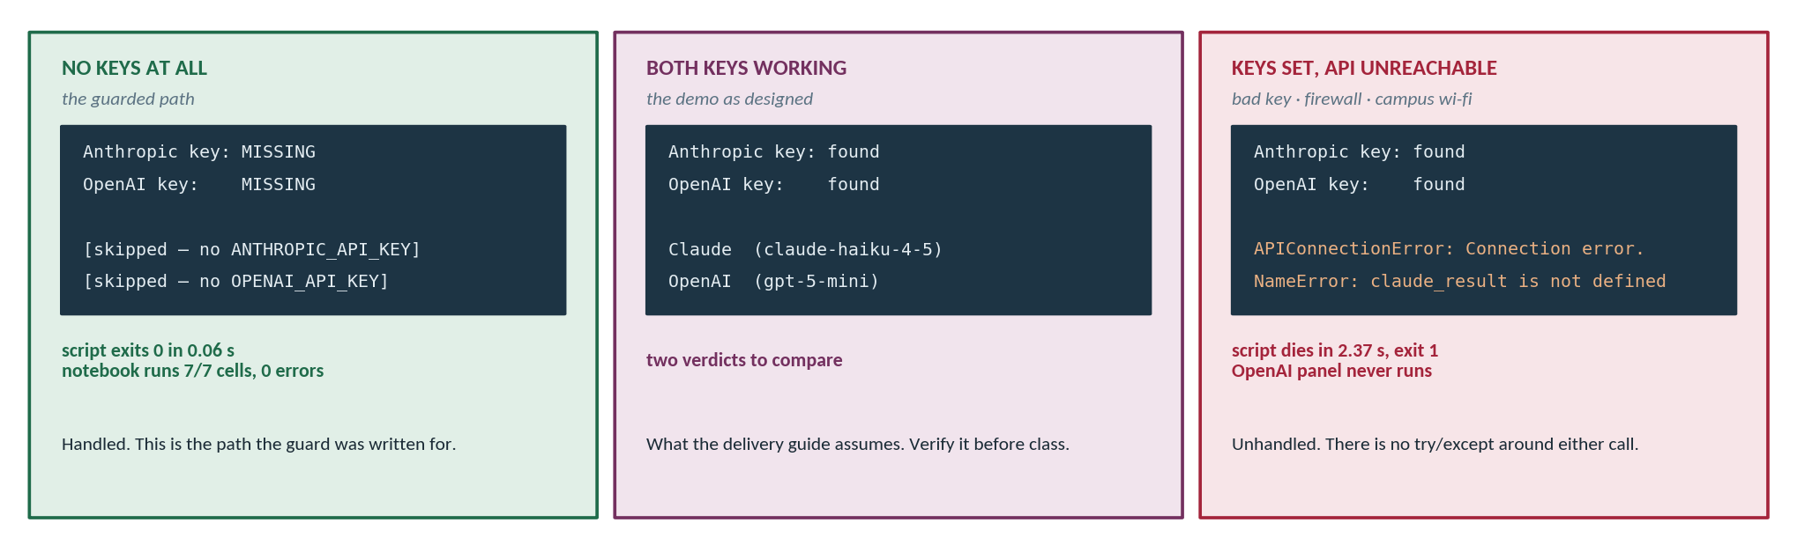
PART 3 · YOUR FIRST AI WORKFLOW
Three ways the demo ends
Measured, not guessed: no keys, working keys, and the one the delivery guide does not plan for.
THE TWO LINES THE NOTEBOOK IS MISSING
test_api_keys.py already does this
try: result = client.messages.create(...)
except Exception as e: result = f"[error — {type(e).__name__}]"
The only file in the module with real exception handling — and the delivery guide never mentions it. Run it before class.
Introduction to AI for Cybersecurity
25

Slide 26
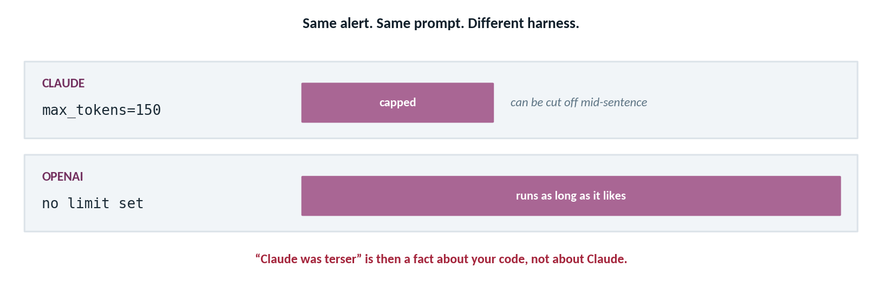
PART 3 · YOUR FIRST AI WORKFLOW
Same prompt, unequal settings
Before you compare two models, check that you gave them the same conditions. This demo does not.
CELLS 8 AND 10
# Claude
max_tokens=150
# OpenAI — no cap
chat.completions.create(
model=OPENAI_MODEL,
messages=[...])
And you cannot just add it
The gpt-5 family rejects max_tokens on chat completions and wants max_completion_tokens. The API surface is not uniform — portable code across providers is harder than it looks.
Before you compare two models, check you gave them the same conditions. Slide 16 asks whether one model is more specific or better justified. As the code stands, a difference in length is a fact about the harness rather than about the models — and gpt-5-mini is a reasoning model, so its latency and cost profile are not comparable to Haiku's in the first place.
Introduction to AI for Cybersecurity
26

Slide 27
PART 3 · YOUR FIRST AI WORKFLOW
Two models, one prompt — and where the key lives
There is no such thing as "the AI says." There is what a particular model said, once.
 | Model A | Model B
Verdict | Suspicious | Suspicious
Names the pattern | "classic brute force" | "anomalous authentication sequence"
Volunteers action | Isolate the host; rotate credentials | None — sticks to the question
Hedging | None | "appears consistent with"
Useful to an analyst? | More actionable, more assumed | More cautious, less immediately usable
.env — and .gitignore
# .env (never committed)
OPENAI_API_KEY=sk-...
# .gitignore
.env
*.key
Same prompt, same alert, different answers. Neither is wrong. They differ in confidence, vocabulary and willingness to volunteer. That variance is a property of the system you are building on, and your design has to survive it.
Keys: the three rules
Never in code, a cell, or a screenshot.
Never in a commit — history keeps it forever, and bots scan public repos within minutes.
If one leaks, rotate it immediately. Assume compromise from the moment of the push.
Introduction · The CyberAI Landscape
27

Slide 28
MODULE MAP
PART 4
Why AI for Security
A Little Python
AI in the SOC: Tool & Target
Your First AI Workflow
How much programming this course actually needs, why reading matters more than writing, and three free ways to get there.
A Little Python
Frameworks, Ethics & Your Week

Slide 29
PART 4 · A LITTLE PYTHON
You will not write much code — but you must read it
Reading is a much lower bar than writing, and it is the one that actually matters here.
If you can follow this, you have enough Python for this course
You need to recognise | So that you can
Variables, strings, f-strings | Follow what a cell is building
Lists and dictionaries | Read an API request and its response
Loops and if/else | See where the logic branches
Functions and imports | Know what came from where
A traceback | Fix your own errors instead of stalling
import pandas as pd
logs = pd.read_csv("auth.log.csv")
failed = logs[logs["result"] == "FAIL"]
by_ip = failed.groupby("src_ip").size()
suspects = by_ip[by_ip > 10]
for ip, count in suspects.items():
print(f"{ip}: {count} failed attempts")
Why bother, if AI can write it?
That is brute-force detection. Nine lines, no machine learning. You do not need to have written it — you need to look at it and know that it filters failures, counts them per source address, and keeps the noisy ones. That is the level.
Because you cannot debug what you cannot read, you cannot adapt an example to your own data, and you cannot tell when generated code is doing something you did not intend. Reading is the review skill.
Introduction · The CyberAI Landscape
29

Slide 30
PART 4 · A LITTLE PYTHON
The Python you actually need
The self-check list is not abstract — every item on it appears in the twenty lines you just read.
alert_classifier.py — AND THE SEVEN THINGS THE SELF-CHECK ASKS ABOUT
1
Imports · functions · arguments
import os
from config import (ANTHROPIC_API_KEY, HAS_ANTHROPIC,
CLAUDE_MODEL, key_status)
PROMPT = ("Classify this security alert as benign or "
"suspicious and explain in one sentence: {alert}")
def classify_with_claude(alert: str) -> str:
"""Classify the alert; skip cleanly if no key is set."""
if not HAS_ANTHROPIC:
return "[skipped — no ANTHROPIC_API_KEY set]"
from anthropic import Anthropic
client = Anthropic(api_key=ANTHROPIC_API_KEY)
msg = client.messages.create(
model=CLAUDE_MODEL,
max_tokens=150,
messages=[{"role": "user",
"content": PROMPT.format(alert=alert)}],
)
return msg.content[0].text.strip()
print(f"Alert: {alert}")
from-import at the top, and again inside the function — which is why the script starts in 0.06 s even before any network call.
2
if / else, and a default
The guard. One conditional is the whole difference between a clean skip and a traceback in front of the class.
3
Lists and dictionaries
messages=[{...}] — a list containing a dictionary. That exact shape is how every chat API takes its input. Worth ten minutes.
4
Strings, f-strings, printing
The prompt, and the output. Six of the seven checklist items are on this screen; the seventh, loops, is in the compare cell.
Introduction to AI for Cybersecurity
30

Slide 31
PART 4 · A LITTLE PYTHON
Python: a recommended review for Weeks 1–3
Three free options. Pick one that matches how you learn — there is nothing to submit.
RECOMMENDED
learnpython.org
A free YouTube course
LinkedIn Learning
Interactive, in the browser
~2 hours, video
"Python for Non-Programmers"
Nothing to install. You run each lesson's code in the page. Best if you learn by doing.
Linked on the module page. Best if you want it playing while you follow along in Colab.
About two hours, video-led, free to you through UC. The one I recommend most for absolute beginners.
Option | Format | Time | Choose it if
LinkedIn Learning — Python for Non-Programmers | Video, structured | ~2 hrs | You have never programmed and want a guided path
learnpython.org | Interactive browser | Self-paced | You would rather type than watch
Free YouTube course | Video | ~2 hrs | You want something to follow along with in Colab
Recommended, not assigned. Nothing to submit, no marks attached. Do only as much as you need to read the code card on the previous slide comfortably.
Introduction · The CyberAI Landscape
31

Slide 32
MODULE MAP
PART 5
Why AI for Security
Frameworks, Ethics
& Your Week
AI in the SOC: Tool & Target
Your First AI Workflow
The three references we lean on all term, the ground rules that start today, and what this week asks of you.
A Little Python
Frameworks, Ethics & Your Week

Slide 33
PART 5 · FRAMEWORKS, ETHICS & YOUR WEEK
Three references we return to all term
Bookmark them today. They come back in almost every module.
MITRE ATLAS
NIST AI RMF
OWASP
Adversarial threat landscape for AI systems
AI Risk Management Framework
Top 10 for LLM Applications
A catalogue of tactics and techniques used against AI — deliberately structured like ATT&CK, so it reads immediately if you know that.
The vocabulary for governing AI risk: govern, map, measure, manage. What you cite when someone asks how the risk was assessed.
The recurring application-level failures, with prompt injection at the top. Our checklist before anything ships.
Reference | Answers the question | Where it shows up in this course
MITRE ATLAS | How would someone attack this AI system? | Threat-modelling every mini-project; the adversarial-ML module
NIST AI RMF | How do we govern and document the risk? | The risk section of your capstone report
OWASP LLM Top 10 | What goes wrong in LLM applications specifically? | The injection module, and every code review this term
Introduction · The CyberAI Landscape
33

Slide 34
PART 5 · FRAMEWORKS, ETHICS & YOUR WEEK
Course roadmap at a glance
Four phases across sixteen weeks — each one builds on the toolchain you set up in the next module.
Weeks 1–3
Weeks 4–8
Weeks 9–12
Weeks 13–16
Foundations
The modern stack
Offence & build
ML, DL & capstone
This module · Tools & Environment · LLMs on local and cloud
RAG · LangChain · LangGraph · MCP
Orchestrated pen-test · vibe-coding a security app
Classic ML · deep learning for detection · the ML capstone
How you are assessed | What it asks of you | What I am looking for
Labs | Stand the thing up and prove it runs | Evidence it worked on your machine, not a copied screenshot
Discussion forum | One insight, in your own words, plus two replies | Your understanding — not a paste from a model
Seven mini-projects | Build something small that answers a security question | Design choices you can defend, and honest limitations
Capstone | An end-to-end ML security project with a written report | The five criteria from Part 2, applied to your own work
Introduction · The CyberAI Landscape
34

Slide 35
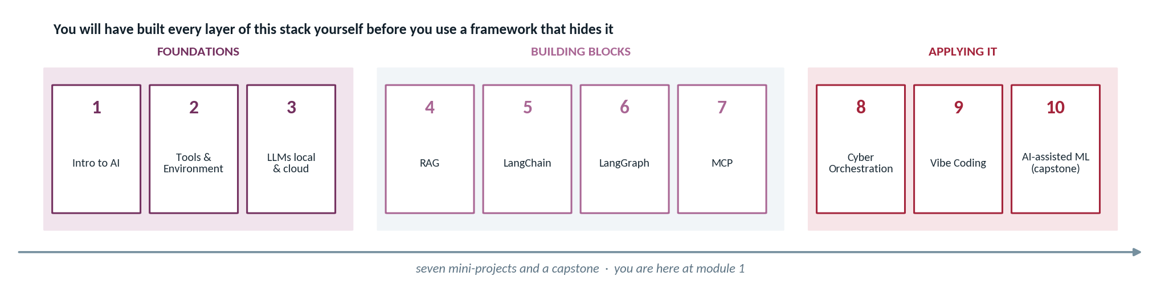
PART 5 · FRAMEWORKS, ETHICS & YOUR WEEK
The ten-module arc
Where each piece arrives, and why the order is what it is.
Framework-free first, on purpose. In module 4 you build a retrieval engine by hand from an embedding model and a dot product. In module 5 you do the same thing in fifteen lines of LangChain. Meet the framework first and it is magic — and when it breaks you have nothing to reason with. Write the pieces yourself and the framework becomes a convenience you can see through.
Seven mini-projects and a capstone
They build on each other. The retrieval you write in module 4 becomes the tool your agent calls in module 8, so falling behind compounds rather than staying local.
Introduction to AI for Cybersecurity
35

Slide 36
PART 5 · FRAMEWORKS, ETHICS & YOUR WEEK
Ethics and responsible use — from day one
These apply from today through the capstone. Two of them carry legal weight.
Rule | What it means concretely | Why
Work only in isolated labs, or on apps you built | Your Kali VM, the provided targets, your own code. Never a live system you do not own | Unauthorised scanning or access can violate the CFAA and equivalent laws
Use synthetic or provided data | Never real PII, secrets, credentials or live incident data in a prompt | A cloud model call is third-party processing — treat prompts as retained
Keep keys out of code and commits | A .env file that .gitignore excludes; Colab Secrets in notebooks | Public repos are scanned within minutes; history keeps a leaked key forever
Rotate anything that leaks | Immediately, before you finish investigating how | The window between exposure and rotation is the whole risk
Set spend limits on paid APIs | A hard cap in the provider console, today | A runaway loop is a real and common way to lose a term's budget
The two that catch good students: pointing a tool at your employer's network to make a project feel realistic, and pasting a real incident log into a model to get better help. Both are done with good intentions. Both are serious. If you are ever unsure whether something is in scope, ask me first — that costs you a day, and the alternative can cost considerably more.
Introduction · The CyberAI Landscape
36

Slide 37
PART 5 · FRAMEWORKS, ETHICS & YOUR WEEK
Your week — and what comes next
One required task, one short self-check, and an optional run of the notebook.
 | Do this | What it involves | Required?
1 | Watch this lecture and the lab demonstration | The recording and the demo walkthrough | Yes
2 | Onboarding assignment on the forum | Introduce yourself, then reply to two classmates | Yes — graded
3 | Python reading self-check (1–5) | Five short snippets; say what each one does | Yes — ungraded
4 | Start the recommended Python review | Only if the self-check felt uncomfortable | No
5 | Run the triage notebook yourself | Then post how it went, and anything that surprised you | Optional
Next module — Tools & Environment
You stand up the toolchain you will use all semester: editor, Python, notebooks, Git, secrets handling, and the isolated security lab.
Plus, optionally, a free cloud GPU VM through NAIRR.
Do the forum post early. The replies are the point, and they only work if people have posted before the end of the week.
On the self-check: it is ungraded and I never see individual answers — it exists so you can calibrate. If three of the five snippets are opaque to you, that is useful information and the review will fix it in an afternoon. If all five are obvious, skip Part 4 entirely and spend the time on the forum instead.
Introduction · The CyberAI Landscape
37

Slide 38
PART 5 · FRAMEWORKS, ETHICS & YOUR WEEK
How to succeed in this course
Five habits that separate the students who finish strong.
1
Run everything yourself
2
Break it on purpose
3
Verify before you submit
Reading a notebook is not the same as running it. The errors are where the learning is.
Change a parameter, feed it bad input, see what happens. Curiosity beats completion.
Every CVE, every command, every statistic. An unverified claim costs marks.
4
Ask early
5
Write in your own words
The one that matters most: number five. Everything else on this slide is technique. That one is the difference between having used AI and having learned something — which is the subject of the next slide.
A question in week two is a conversation. The same question in week twelve is a rescue.
The forum and the reports are where understanding gets demonstrated. Pasted text demonstrates nothing.
Introduction · The CyberAI Landscape
38

Slide 39
PART 5 · FRAMEWORKS, ETHICS & YOUR WEEK
Use AI as a tutor — the Feynman test
There are no restrictions on AI use in this course. There is one condition.
USING IT AS A VENDING MACHINE
USING IT AS A TUTOR
Ask "Write my forum post about RAG."
Ask "My professor asked this and I don't know where to start. Teach me the background with simple examples."
Get A fluent paragraph.
Push "Why does that work? Give me a case where it fails."
Post It, unchanged.
Close Shut the tab. Write the post from memory.
Learn Nothing. And your classmates could have generated the same text themselves.
Learn If you can explain it in your own words, you understand it.
Why I do not block AI tools: blocking does not work — phones, VPNs, and a world that already runs on this — and more importantly it would be pedagogically backwards, because a model is a genuinely excellent tutor with infinite patience. So use it as much as you like. The condition is the Feynman test: if you can explain it clearly in your own words, you understand it. That is what the forum posts, the mini-project presentations, and the capstone report are actually measuring — not what the AI produced, but what you can explain.
Introduction · The CyberAI Landscape
39

Slide 40
PART 5 · FRAMEWORKS, ETHICS & YOUR WEEK
Recap
Five things to carry out of today.
1
Three families, one skill
2
It predicts plausible text
3
Tool and target
Classic ML, LLMs, agents. Matching the family to the task is most of the judgement.
No database, no notion of truth. Hallucination is the mechanism working normally.
Every AI system you build is itself an attack surface. MITRE ATLAS is the catalogue.
4
Read Python, don't write it
5
Verify everything
Next: head into the lab and run your first AI security triage workflow yourself. Then Module 2 — Tools & Environment. Welcome aboard.
Enough to follow a notebook, fix an error, adapt an example. That is the bar.
Every output is a draft. Every CVE gets looked up. Every command gets read.
Introduction · The CyberAI Landscape
40

