Slide 1
IT7075 · APPLIED AI FOR CYBERSECURITY · MODULE 3
LLMs on Local & Cloud
One model idea, three places to run it — a hosted API, a GPU you rent for
a session, and a GPU you keep for the term.
Four parts · two hands-on labs · one fair comparison
Textbook: Santos — hosting & running LLMs

Slide 2
MODULE MAP
PART 1
Concepts & the Landscape
Concepts &
the Landscape
The API and a Rented GPU
A GPU You Keep
The vocabulary, the three places a model can run, and the reframe that makes the choice obvious: who controls the GPU?
Labs, Ethics & Recap

Slide 3
PART 1 · CONCEPTS & THE LANDSCAPE
The vocabulary, fast
Five words. The rest of the module leans on all of them.
TOKENS — THE UNIT OF EVERYTHING
Un
author
ised
access
from
203
.0
.113
.45
The one relationship to memorise
9 tokens, 6 words — an IP address costs more than you would guess
Parameters determine memory.
Quantization reduces bytes per parameter.
Context window consumes memory on top.
Everything in Part 2 is that sentence with numbers in it.
Term | What it means, and why you care
Tokens | The chunks of text a model reads and writes. APIs bill per token, so tokens are cost
Context window | How much text it can consider at once — its entire short-term memory
Parameters | The learned numbers. "7B" is seven billion of them. This determines the memory it needs
Quantization | Storing those numbers in fewer bits so a big model fits a small GPU
Inference | Running the model to generate output. This is the part that uses the GPU
Model size | Roughly
7–8B | A capable general model
14B | Noticeably better reasoning
70B+ | Beyond a single consumer GPU
LLMs on Local & Cloud
3

Slide 4
PART 1 · CONCEPTS & THE LANDSCAPE
Three ways to run an LLM
Ways 2 and 3 are the same skill applied in two places. Learn it once.
1
Cloud API
2
A GPU you rent
3
A GPU you keep
OpenAI · Anthropic
Colab T4
Your NAIRR VM
Someone else's model on someone else's GPU. Most capable, least setup.
You self-host an open model on a remote GPU, for one session.
The same open model, the same way — on hardware that is yours all term.
Cost Per token
Cost Free
Cost Free
Privacy Prompt leaves you
Privacy Stays on the machine
Privacy Stays on the machine
Persists Stateless
Persists Resets each session
Persists Persists all term
Ways 2 and 3 are the SAME skill — self-hosting an open model on a remote GPU
Why that matters for how you study this module: the notebook that loads a model on a Colab T4 is the same notebook that loads it on your VM. Open it over Remote-SSH, pick the VM's kernel, and the cells do not change. You are not learning two techniques — you are learning one and choosing where to point it.
LLMs on Local & Cloud
4

Slide 5
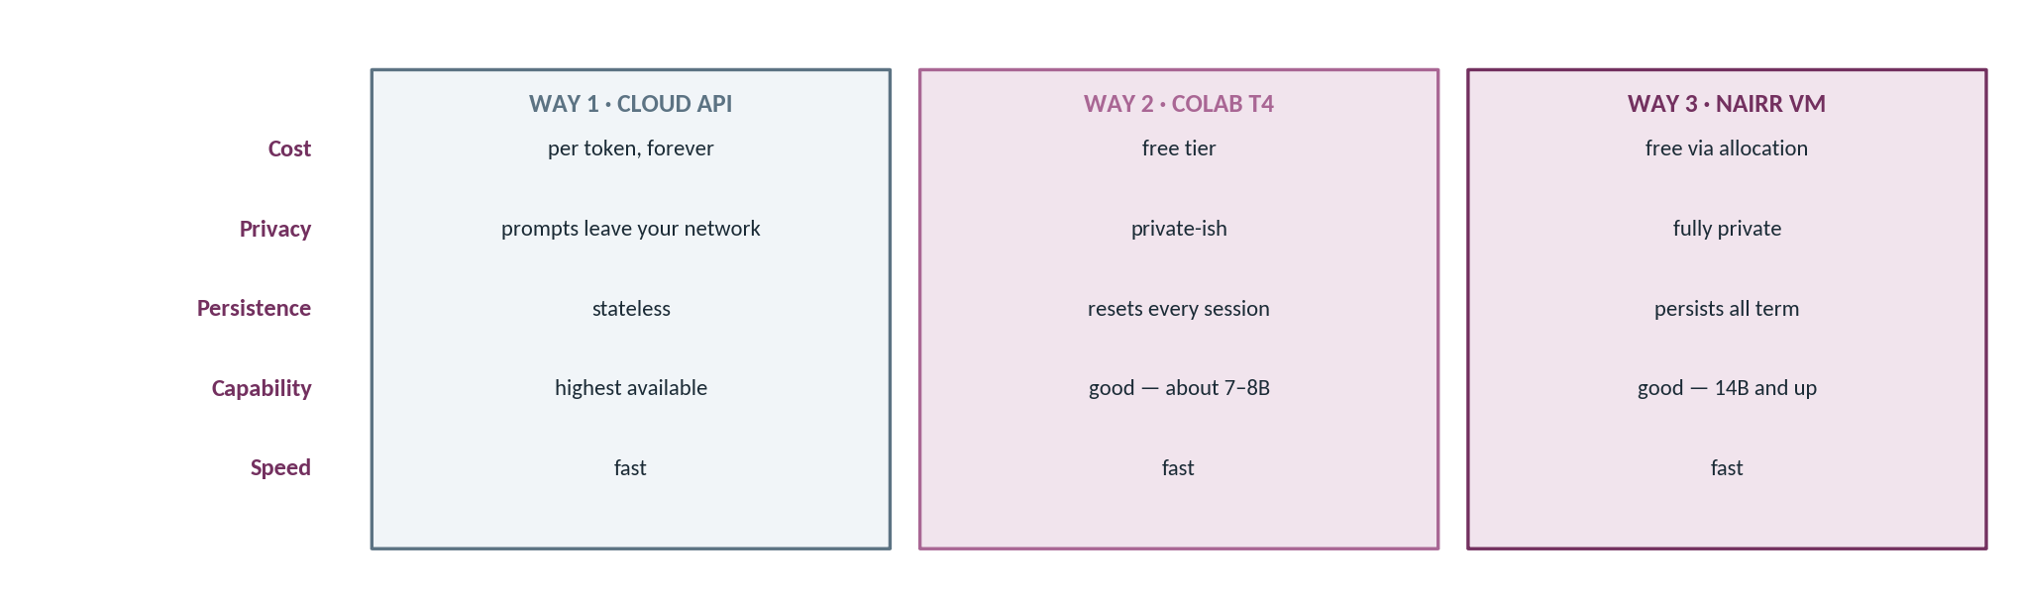
PART 1 · CONCEPTS & THE LANDSCAPE
Three ways, five axes
The same security task, run three ways. Fill this table in yourself during the lab — it is 15 of its marks.
“Self-hosting” does not mean “on my laptop.” It means on a GPU you control. That is the most common misconception in this module according to the solutions key — and Part E of the lab is exactly this table, in your own words, for 15 marks.
LLMs on Local & Cloud
5

Slide 6
PART 1 · CONCEPTS & THE LANDSCAPE
The reframe: who controls the GPU?
"Local vs cloud" is the wrong axis. It puts your VM on the wrong side of the line.
THE NAIVE SPLIT — AND WHY IT MISLEADS
"Local means my laptop. Cloud means someone else's computer."
By that test your NAIRR VM is "cloud" — and therefore not private. That conclusion is wrong.
THE TWO QUESTIONS THAT ACTUALLY DECIDE IT
Your data leaves your control
Your data stays on a machine you control
Cloud API (OpenAI, Anthropic)
Colab T4
Your NAIRR VM
a public service — your prompt is sent to a third party
remote, but yours for the session
remote, and yours all term
Fine for synthetic data and course labs. Not fine for real logs, PII, or anything under a client agreement.
Both are remote hardware. Both are private. "Remote" and "exposed" are not the same property, and conflating them is the mistake this slide exists to prevent.
LLMs on Local & Cloud
6

Slide 7
PART 1 · CONCEPTS & THE LANDSCAPE
Compare on five axes
Read it by row. Each row is one trade-off — and no column is green all the way down.
Axis | Cloud API | Colab T4 (rented) | NAIRR VM (kept)
Cost | Per token — every experiment has a price | Free to you | Free to you
Privacy | Prompt goes to a third party | Stays on the machine | Stays on the machine
Persistence | Stateless — remembers nothing | Resets every session | Persists all term
Capability | Highest — frontier models | Good: 7–8B on a T4 | Good: 14B+ on an A100 slice
Speed | Fast | Fast | Fast
Look at the shape, not the cells. No column is green all the way down. The API is the only one green on capability — and the only one that is not green on privacy. The VM comes closest to sweeping, and it still concedes capability. There is no correct answer here; there is a correct answer for a particular constraint, and part of what the lab report assesses is whether you identified which constraint your task actually had.
"Can I just use the API for everything?"
Yes — until the data is sensitive, or the bill is yours. Those are the two rows that stop you, and in professional work they stop you often.
LLMs on Local & Cloud
7

Slide 8
PART 1 · CONCEPTS & THE LANDSCAPE
This module's files and reading
Two notebooks, two labs, one chapter. Here is what each is for.
The repository for this module
Reading — Santos, Agentic AI for Cybersecurity
code/
host_LLM_GPU.ipynb transformers + 4-bit; runs on Colab OR your VM
llm_compare.ipynb Ollama on the VM; two models, one prompt
assignments/
lab_a_three_ways/ the main lab, plus a sample solution
lab_b_private_ai/ the NAIRR deep dive
forum.md the discussion topic and what a good post does
The chapter on hosting and running LLMs. Read it alongside host_LLM_GPU.ipynb rather than before — the chapter explains why the notebook does what it does, and the pairing works better than either alone.
Same notebook, two targets: host_LLM_GPU.ipynb is written so the cells do not change between Colab and your VM. Only the kernel you select changes.
Start with | If you
The primer video | Found the vocabulary slide unfamiliar
host_LLM_GPU.ipynb | Want to get a model running today
The Santos chapter | Want the reasoning behind the choices
Model versions move fast. Pin what you use; record it in the report.
LLMs on Local & Cloud
8

Slide 9
MODULE MAP
PART 2
Concepts & the Landscape
The API and
a Rented GPU
The API and a Rented GPU
A GPU You Keep
Way 1 as the capability baseline, the quantization arithmetic that makes free-GPU hosting possible, and Way 2 on a Colab T4.
Labs, Ethics & Recap

Slide 10
PART 2 · THE API AND A RENTED GPU
Way 1 — the cloud API, as your baseline
You have already done this. Today it becomes the yardstick, not the destination.
YOUR MACHINE
SOMEONE ELSE'S INFRASTRUCTURE
every call crosses this line
Your prompt
The response
A frontier model
the alert, the log, the code
text, billed per token
on their GPU, under their terms
What you get | What it costs | Why it is the baseline
Highest capability, least setup | Per token — a sloppy loop is an expensive loop | "How close did the self-hosted model get?" needs a reference point
No install, no GPU, no driver versions | Every prompt lands on third-party infrastructure | Same prompt, three runners — keep the prompt you use here
A few lines of code | Nothing persists between calls | It is the ceiling, not the recommendation
Keep the key in .env or Colab Secrets. Not in a cell, and not in a screenshot in your lab report. I have seen keys leak both ways.
LLMs on Local & Cloud
10

Slide 11
PART 2 · THE API AND A RENTED GPU
Fitting a big model on a small GPU
A 7B model at full precision does not fit a T4 — and the failure is confusing when it arrives.
Precision | Bytes | 7B needs
FP16 | 2 | 14 GB
8-bit | 1 | 7 GB
4-bit | 0.5 | ~5 GB
2-bit | 0.25 | research only
T4 = 16 GB
Memorise the multiplication, not the examples: params (B) × bytes-per-param = GB of weights. Then add 2–3 GB. That tells you whether a model fits any GPU you are ever handed.
The top bar crosses the line. 17 GB needed, 16 GB available. You get a CUDA out-of-memory error about four tokens into generation — which is a confusing place to fail, because loading appeared to succeed.
Tool | Where | The cost you pay
bitsandbytes | In transformers — roughly one config flag | A couple of percent on hard benchmarks; invisible on these labs
GGUF | In Ollama and llama.cpp — baked into the file you pull | Same trade: small accuracy hit, four-fold memory win
LLMs on Local & Cloud
11

Slide 12
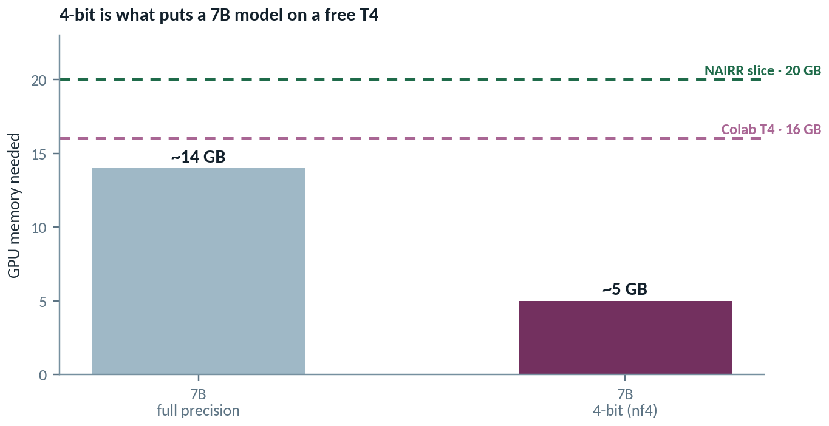
PART 2 · THE API AND A RENTED GPU
How a 7B model fits on a free T4
Quantisation is the whole trick. Four bits per weight instead of sixteen, and the model drops from ~14 GB to ~5 GB.
host_LLM_GPU.ipynb — THE THREE LINES THAT MATTER
bnb = BitsAndBytesConfig(
load_in_4bit=True,
bnb_4bit_quant_type="nf4",
bnb_4bit_compute_dtype=torch.float16)
model = AutoModelForCausalLM.from_pretrained(
MODEL_ID, quantization_config=bnb,
device_map="auto")
Storage and compute precision are separate. The weights live in 4 bits; the arithmetic still runs in float16. nf4 is a format shaped to how weights are actually distributed, which is why the quality cost is small.
If it will not fit, it is one line
MODEL_ID = "Qwen/Qwen2.5-3B-Instruct" — the notebook names this fallback explicitly.
LLMs on Local & Cloud
12

Slide 13
PART 2 · THE API AND A RENTED GPU
Hosting a model, end to end
The core of host_LLM_GPU.ipynb: load a quantised model, then talk to it through the chat template.
host_LLM_GPU.ipynb — CELLS 17 AND 19
1
device_map="auto"
!pip install -q -U transformers accelerate bitsandbytes
import torch
from transformers import (AutoModelForCausalLM, AutoTokenizer,
BitsAndBytesConfig)
MODEL_ID = "Qwen/Qwen2.5-7B-Instruct" # fits a T4 in 4-bit
bnb = BitsAndBytesConfig(load_in_4bit=True,
bnb_4bit_quant_type="nf4",
bnb_4bit_compute_dtype=torch.float16)
tok = AutoTokenizer.from_pretrained(MODEL_ID)
model = AutoModelForCausalLM.from_pretrained(
MODEL_ID, quantization_config=bnb, device_map="auto")
print("Loaded", MODEL_ID, "on", model.device)
def chat(prompt, system="You are a concise cybersecurity assistant.",
max_new_tokens=256):
messages = [{"role": "system", "content": system},
{"role": "user", "content": prompt}]
ids = tok.apply_chat_template(messages,
add_generation_prompt=True,
return_tensors="pt").to(model.device)
out = model.generate(ids, max_new_tokens=max_new_tokens,
do_sample=False)
return tok.decode(out[0][ids.shape[-1]:],
skip_special_tokens=True)
Puts the model on the GPU if there is one. If the print says cpu, stop — everything after will take minutes per answer.
2
apply_chat_template is not optional
Every instruct model has its own turn-marking format. The tokenizer knows its own; hand-rolling the string costs quality silently.
3
Decode only the new tokens
out[0][ids.shape[-1]:] drops the prompt. Without the slice you print your own question back.
4
do_sample=False
Greedy decoding — same input, same output. Required if you want the comparison in Part D to mean anything.
LLMs on Local & Cloud
13

Slide 14
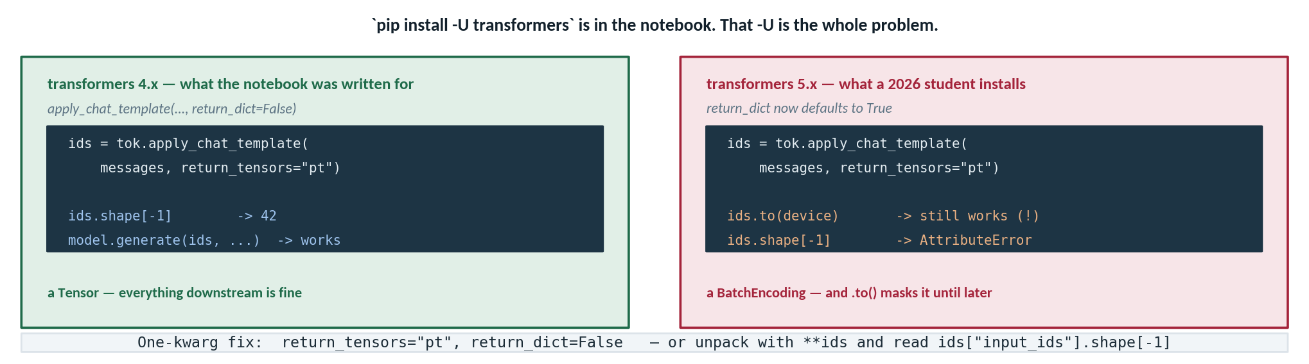
PART 2 · THE API AND A RENTED GPU
The upgrade that breaks the notebook
`pip install -U transformers` pulls 5.x, where one default flipped — and the failure surfaces two lines later.
The error is not where the problem is. `.to()` accepts the wrong type quietly, so the failure surfaces two lines later on a line that looks innocent. That pattern — a permissive method hiding a type change — is worth naming; you will meet it again.
Pin your versions
A tutorial that says `-U` has a shelf life. This affects the core teaching cell of Lecture 2 and graded Parts B and D of the lab.
LLMs on Local & Cloud
14

Slide 15
PART 2 · THE API AND A RENTED GPU
Way 2 — host the model on a Colab T4
The same notebook runs on your VM. Only the kernel changes.
host_LLM_GPU.ipynb — Runtime ▸ Change runtime type ▸ T4 GPU
Choice | Why this one
Qwen2.5-7B-Instruct | Apache-2.0 and ungated — nobody gets stuck on an access token
load_in_4bit | ~5 GB instead of 14 — it fits with headroom
nf4 | The quantization type tuned for normally-distributed weights
device_map="auto" | Puts the layers on the GPU without you enumerating them
from transformers import AutoModelForCausalLM, AutoTokenizer
from transformers import BitsAndBytesConfig
import torch
MODEL = "Qwen/Qwen2.5-7B-Instruct" # Apache-2.0, not gated
qcfg = BitsAndBytesConfig(
load_in_4bit=True,
bnb_4bit_compute_dtype=torch.float16,
bnb_4bit_quant_type="nf4",
)
tok = AutoTokenizer.from_pretrained(MODEL)
model = AutoModelForCausalLM.from_pretrained(
MODEL, quantization_config=qcfg, device_map="auto")
def chat(prompt, max_new_tokens=256):
msgs = [{"role": "user", "content": prompt}]
ids = tok.apply_chat_template(msgs, return_tensors="pt").to("cuda")
out = model.generate(ids, max_new_tokens=max_new_tokens)
return tok.decode(out[0][ids.shape[-1]:], skip_special_tokens=True)
Three front doors on the same VM: a Python call, a ! shell cell, or a terminal. Same machine underneath.
Then run it on your VM without changing a cell: open the same notebook over VS Code Remote-SSH and select the VM's kernel. That is the whole difference between Way 2 and Way 3 at the code level — which is the point I made in Part 1, now made concrete.
LLMs on Local & Cloud
15

Slide 16
PART 2 · THE API AND A RENTED GPU
Shop the Hugging Face Hub
Choosing a model that fits your hardware and your task is a hireable skill.
1
Filter
2
Read the card
3
Check it fits
4
Match the task
Task ▸ Text Generation. Sort by trending or downloads to see what people actually run.
Three things: parameter count, licence, and whether access is gated.
Params × bytes-per-param + 2–3 GB. Do this before you download anything.
A small open model is fine for triage and extraction. Save frontier models for hard reasoning.
On the model card | Looks like | What it decides | The trap
Parameter count | 7B, 14B, 70B | Whether it fits your GPU at all | Names are inconsistent — check the card, not the title
Licence | Apache-2.0, MIT, custom | Whether you may use or redistribute it | "Open weights" is not the same as "open licence"
Gated? | A request-access button | Whether you can download it today | Approval can take days — fine for a project, fatal in a lab session
Base vs Instruct | -Instruct suffix | Whether it follows instructions or just continues text | A base model will not answer your question; it will extend it
LLMs on Local & Cloud
16

Slide 17
MODULE MAP
PART 3
Concepts & the Landscape
A GPU You Keep
The API and a Rented GPU
A GPU You Keep
Self-hosting on your NAIRR VM with Ollama — a private, persistent model server you reach safely over an SSH tunnel.
Labs, Ethics & Recap

Slide 18
PART 3 · A GPU YOU KEEP
Self-host on the VM with Ollama
One command to install. A persistent server that is still running tomorrow.
On the VM, over SSH
Model | Fits the ~20 GB slice?
llama3.1:8b | Yes — ~5 GB, comfortable
qwen2.5:14b | Yes — ~10 GB, still room
qwen2.5:32b | No — falls back to CPU
llama3.1:70b | No — not on one slice
curl -fsSL https://ollama.com/install.sh | sh # detects the GPU
ollama pull llama3.1:8b # ~5 GB
ollama pull qwen2.5:14b # ~10 GB
ollama list # what you have
ollama run llama3.1:8b # an interactive prompt, right now
# and it is serving on localhost:11434 for your code to call
Why Ollama rather than transformers here: it manages quantization, model files and a persistent server for you. transformers works too — Ollama is the fast path.
The difference that matters: this server does not reset. Close your laptop, come back tomorrow, and the model is still loaded and still answering. Nothing you send it ever leaves the VM.
Check it landed on the GPU: ollama ps — the PROCESSOR column should read 100% GPU.
LLMs on Local & Cloud
18

Slide 19
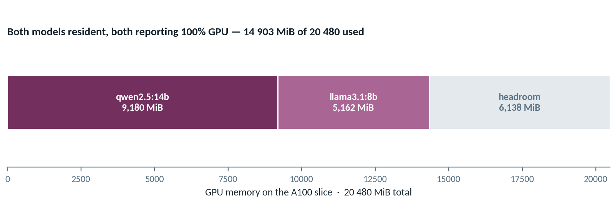
PART 3 · A GPU YOU KEEP
Twenty gigabytes, and what fits in it
Two models resident at once on the A100 slice — measured with `nvidia-smi` and `ollama ps`.
MEASURED — Lab_PrivateLLM_Solutions.md REFERENCE RUN
Run `ollama ps` before you call anything slow
$ ollama ps
NAME SIZE PROCESSOR CONTEXT
qwen2.5:14b 9.9 GB 100% GPU 4096
llama3.1:8b 5.6 GB 100% GPU 4096
$ nvidia-smi
GRID A100X-20C 14903MiB / 20480MiB
llama-server PID 69643 9180MiB
llama-server PID 69838 5162MiB
It tells you what is resident and, in the PROCESSOR column, whether each model is on the GPU or the CPU.
Nine times out of ten “this model is slow” means it quietly landed on the CPU — and nothing told you.
LLMs on Local & Cloud
19

Slide 20
PART 3 · A GPU YOU KEEP
Manage the GPU — and the CPU-fallback trap
"Local LLMs are slow" is almost always a fit problem, not a speed limit.
Healthy — ollama ps
Command | What it tells you
ollama ps | What is loaded, and whether it is on the GPU
nvidia-smi | VRAM in use right now — your dashboard for what fits
ollama stop <model> | Unload it and reclaim the memory
ollama rm <model> | Delete the files from disk entirely
NAME SIZE PROCESSOR UNTIL
llama3.1:8b 6.1 GB 100% GPU 4 minutes from now
The trap — same command, a model that did not fit
NAME SIZE PROCESSOR UNTIL
qwen2.5:32b 21 GB 62%/38% CPU/GPU 4 minutes from now
The fix, in order
Stop the oversized model → confirm VRAM is free in nvidia-smi → pull something at 14B or below → check ollama ps again.
No error is raised. Ollama silently spills the layers that do not fit onto the CPU and keeps working — perhaps twenty times slower. Nothing tells you except that column.
Diagnose before you conclude. Check ollama ps before deciding a model is too slow to be useful.
LLMs on Local & Cloud
20

Slide 21
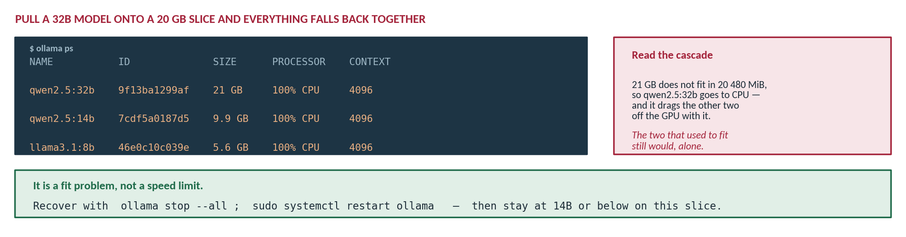
PART 3 · A GPU YOU KEEP
It is a fit problem, not a speed limit
Exercise 2.5 asks you to break it on purpose. Here is what breaking it actually looks like.
A system that silently degrades is harder to operate than one that refuses. Nothing errored. Nothing warned. The only signal is the PROCESSOR column in `ollama ps` — and you only look there if you already suspect the cause. Keep that pattern in mind: you will meet it again in module 4, where a retrieval query happily returns the nearest chunks even when none of them is relevant.
LLMs on Local & Cloud
21

Slide 22
PART 3 · A GPU YOU KEEP
A browser chat of your own — Open WebUI
The payoff of the whole VM path: a ChatGPT-style interface that never phones home.
On the VM — bind to localhost, not to the world
Open WebUI
docker run -d -p 127.0.0.1:8080:8080 \
--add-host=host.docker.internal:host-gateway \
-v open-webui:/app/backend/data \
--name open-webui --restart always \
ghcr.io/open-webui/open-webui:main
Docker container on the VM, port 8080
Ollama
the model server, port 11434
Note the 127.0.0.1 in that port mapping. Without it, Docker binds to every interface and your chat UI is on the public internet. This is the whole of the next slide, in one prefix.
The GPU
your A100 slice
What you now own: a private, persistent, browser-accessible assistant on hardware you control, holding conversation history that belongs to you and to nobody else.
LLMs on Local & Cloud
22

Slide 23
PART 3 · A GPU YOU KEEP
Keep it closed, tunnel in
The security default of this module — and of every internal service you will ever run.
YOUR LAPTOP
THE VM — FIREWALL CLOSED
Browser
encrypted SSH
Open WebUI
http://localhost:8080
listening on 127.0.0.1:8080 only
Port 8080 is never open to the internet. The only way in is a connection you could already make.
From your laptop
Open the port | Tunnel instead
Anyone who scans finds it | Reachable only if you can already log in
Needs its own authentication | Inherits your SSH key
ssh -L 8080:localhost:8080 it7075
# then open http://localhost:8080 in your browser
LLMs on Local & Cloud
23

Slide 24
PART 3 · A GPU YOU KEEP
Compare the models — a fair test
Same prompt, temperature zero, same token limit, timed. Otherwise you are comparing noise.
llm_compare.ipynb
Score 1–5 | Weight | What you are judging
Correctness | ×3 | Did it get the security question right?
Specificity | ×2 | Named the pattern, or hedged vaguely?
Usability | ×1 | Could an analyst act on it as written?
Latency | — | Recorded, not scored
import ollama, time
PROMPT = open("prompt.txt").read() # the SAME one you gave the API
for model in ["llama3.1:8b", "qwen2.5:14b"]:
t0 = time.perf_counter()
r = ollama.chat(model=model, options={"temperature": 0,
"num_predict": 256},
messages=[{"role": "user", "content": PROMPT}])
print(model, round(time.perf_counter() - t0, 1), "s")
The lesson it makes concrete: quality is not speed. The smaller model is faster; the larger one usually answers better.
Hold fixed | Prompt | Temp | Max tokens
Every run | Identical | 0 | 256
Why the rubric matters more than the timings: without it, "which model is better" collapses into a vibe, and vibes are not defensible in a report. A crude rubric applied consistently beats a sophisticated one applied to whichever answer you happened to like. Record the numbers and submit them.
LLMs on Local & Cloud
24

Slide 25
PART 3 · A GPU YOU KEEP
A fair test, and the one the code runs
Same prompt, temperature 0, same token budget, timed. The shipped comparison cell does none of those things.
llm_compare.ipynb — AS SHIPPED
WHAT THE SLIDE ACTUALLY ASKS FOR
def ask(model, prompt, temperature=0.7):
t0 = time.time()
r = requests.post(f"{OLLAMA}/api/generate", json={
"model": model, "prompt": prompt, "stream": False,
"options": {"temperature": temperature}})
return r.json()["response"], time.time() - t0
for model in (MODEL_A, MODEL_B):
text, secs = ask(model, PROMPT) # <- 0.7, and no cap
def ask(model, prompt, temperature=0.0, max_tokens=200):
r = requests.post(f"{OLLAMA}/api/generate",
timeout=120, json={
"model": model, "prompt": prompt,
"stream": False,
"options": {"temperature": temperature,
"num_predict": max_tokens}})
r.raise_for_status()
return r.json()["response"], ...
Deterministic is the point. At temperature 0.7 both models are sampling, so running the cell twice gives two different answers. “Qwen was more thorough” then measures a dice roll.
Measured, and counterintuitive
Temperature barely moves tokens/second — throughput is set by model size and GPU, not sampling.
No timeout, no status check: ask for a model you have not pulled and you get `KeyError: 'response'`, not a readable error — and a 32B model in CPU fallback hangs the cell with no feedback at all.
LLMs on Local & Cloud
25

Slide 26
MODULE MAP
PART 4
Concepts & the Landscape
Labs, Ethics
& Recap
The API and a Rented GPU
A GPU You Keep
Two labs, the data-handling rules that apply to every prompt you send, and a look ahead to grounding models in your own documents.
Labs, Ethics & Recap

Slide 27
PART 4 · LABS, ETHICS & RECAP
Your week — the two labs
Lab A walks the whole arc. Lab B goes deep on the VM path.
REQUIRED
DEEPER DIVE
Lab A — Run an LLM Three Ways
Lab B — Your Own Private AI
Re-run your API baseline and keep the prompt
Host Qwen2.5-7B on a Colab T4 in 4-bit
Self-host the same idea on your NAIRR VM
Pick your own model from Hugging Face and justify it
Compare all three on the five axes
Install Ollama and pull two models that fit
Prove they loaded on the GPU with ollama ps
Run Open WebUI in Docker, bound to localhost
Reach it over an SSH tunnel — port never opened
Trigger the CPU-fallback trap on purpose, then fix it
Submit | Which means | Watch out for
Screenshots, keys hidden | Terminal and notebook output showing it ran, on your machine | A visible key means rotate it and resubmit
A short comparison report | The five axes, your rubric scores, and which you would choose for what | "It worked" is not a finding — say what you measured
A forum post | One thing that surprised you, in your own words | Post early enough that people can reply
LLMs on Local & Cloud
27

Slide 28
PART 4 · LABS, ETHICS & RECAP
Data handling and responsible use
The same rules as Module 1, plus one that is specific to open-weight models.
Rule | Concretely | Why it bites here specifically
Synthetic or provided data only | No real PII, secrets, credentials or live incident data in any prompt | This module sends the same prompt to a third party three times over
Treat cloud calls as retained | Assume anything sent to a hosted API could be stored and reviewed | It is third-party processing, whatever the marketing page says
Open weights still have licences | Check the model card before you use or redistribute anything | "Open" is not "unrestricted" — several major models carry real limits
Spend limits and key rotation | A hard cap in the console; rotate immediately on any leak | A loop over a dataset is exactly how an unbounded bill happens
Bind services to localhost | 127.0.0.1 in the port mapping; tunnel in over SSH | An unauthenticated chat UI on a public IP is found by scanners
The one people get wrong: row three. "Open weights" means you can download and run the parameters. It does not automatically mean you may use the model commercially, fine-tune it, or redistribute a derivative. Several widely used models carry custom licences with genuine restrictions. Read the card before you build something you intend to ship.
LLMs on Local & Cloud
28

Slide 29
PART 4 · LABS, ETHICS & RECAP
Recap and what's next
Four things to carry forward.
1
One model, three homes
2
Ask who controls the GPU
And the honest conclusion
A hosted API, a GPU you rent for a session, a GPU you keep. Ways 2 and 3 are one skill.
Not "local or cloud". Remote and exposed are different properties — your VM is remote and private.
No option wins on all five axes. Choosing well means naming the constraint your task actually has — sensitivity, budget, persistence, or raw capability — and letting that row decide.
3
Do the VRAM arithmetic
4
Keep it closed, tunnel in
Next — RAG: you now have models running in three places, and not one of them knows anything about your organisation. Retrieval-augmented generation is how you ground them in your own documents.
Params × bytes-per-param, plus 2–3 GB. It is why 4-bit exists and why 32B silently crawls.
Bind to localhost, forward over SSH. The right default for any internal service you ever run.
LLMs on Local & Cloud
29

