Slide 1
IT7075 · APPLIED AI FOR CYBERSECURITY · MODULE 4
Retrieval-Augmented
Generation
Ground a model in knowledge you trust — then build the whole pipeline
yourself, with no framework hiding the moving parts.
Six parts · two notebooks · a concept-check lab and a mini-project
Framework-free, and offline by default

Slide 2
MODULE MAP
PART 1
The Problem & the Core Idea
The Problem &
the Core Idea
Embeddings
Vector DB & Chunking
What goes wrong when a model answers from memory, and the two-phase pipeline that fixes it.
The RAG Recipe & Trust
Build It: Notebooks & Practice
Lab & Mini-Project

Slide 3
PART 1 · THE PROBLEM & THE CORE IDEA
The problem: it answers anyway
A model asked something outside its knowledge does not decline. It produces something plausible.
Asked about a corpus it has never seen
It invents
> What does our incident response runbook say about
isolating a compromised domain controller?
"Your runbook specifies immediate network isolation,
followed by a forensic image before any reboot..."
# It has never seen your runbook.
Confident, well-formed, and unsupported by anything.
It is stale
A training cutoff. This week's CVEs do not exist to it.
And you cannot simply paste it all in. The context window is finite, you pay per token, and retrieval quality degrades as you bury the relevant passage in irrelevant ones.
It is not yours
The fix, in one sentence: look up the relevant passages first, hand them to the model, and instruct it to answer only from those. The model stops being a source of facts and becomes a summariser of facts you supplied — which is a much more reliable thing to be.
It knows the public internet, not your policies or assets.
Retrieval-Augmented Generation
3

Slide 4
PART 1 · THE PROBLEM & THE CORE IDEA
What RAG is: two phases, not one
Build the store once. Query it many times. Confusing the two is the most common early mistake.
INGESTION — YOU RUN THIS ONCE, WHEN DOCUMENTS CHANGE
Documents
Chunk
Embed
Store
runbooks, advisories, CVEs
split into passages
each chunk → a vector
vectors + metadata
the store is what connects the two phases
QUERY — YOU RUN THIS ON EVERY QUESTION
Question
Retrieve
Augment
Generate
from the analyst
the k closest chunks
chunks into the prompt
grounded, cited answer
Phase | When it runs | What it costs | What breaks if you get it wrong
Ingestion | Once, then again only when documents change | Slow and compute-heavy — every chunk gets embedded | Re-embedding on every question: correct answers, unusable latency
Query | Every single question | Fast — one embedding, one nearest-neighbour search | Retrieving too few chunks, or too many irrelevant ones
The retrieved passages are the evidence. They are what the answer is built from, and what a citation points at.
Retrieval-Augmented Generation
4

Slide 5
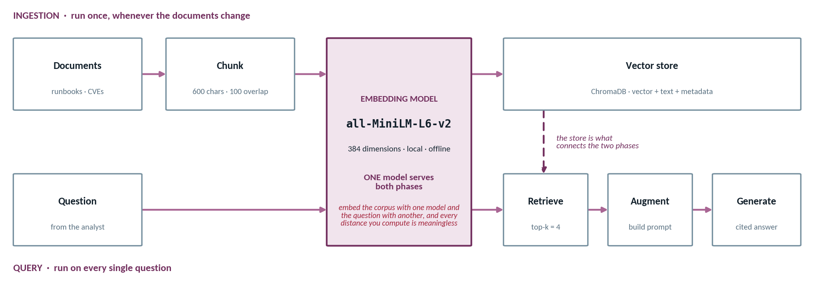
PART 1 · THE PROBLEM & THE CORE IDEA
Two phases, one embedding model
Build the store once. Query it many times. Both sides must be turned into vectors by the same model.
INGESTION — lecture3_rag_pipeline.ipynb, STEP 2
QUERY — lecture3_rag_pipeline.ipynb, STEP 3 · note embed() on both sides
chunks = split_into_chunks(text)
collection.add(ids=ids, documents=chunks,
embeddings=embed(chunks),
metadatas=labels)
def retrieve(query, how_many=4, max_distance=0.75):
results = collection.query(
query_embeddings=embed([query]),
n_results=how_many)
Retrieval-Augmented Generation
5

Slide 6
MODULE MAP
PART 2
The Problem & the Core Idea
Embeddings —
Search by Meaning
Embeddings
Vector DB & Chunking
The engine under retrieval: turning text into vectors so that closeness in space means closeness in meaning.
The RAG Recipe & Trust
Build It: Notebooks & Practice
Lab & Mini-Project

Slide 7
PART 2 · EMBEDDINGS
Embeddings turn meaning into geometry
Text becomes a point in space. Related text lands nearby. That is the whole trick.
EMBEDDING SPACE (2 OF 384 DIMENSIONS SHOWN)
Term | What it means here
Embedding | A fixed-length list of numbers standing for a piece of text
Dimensions | How long that list is. 384 for the small model we use
Cosine similarity | The angle between two vectors. 1 = same direction, 0 = unrelated
Embedding model | The thing that does the mapping. Different from your chat model
"brute force attack"
"SQL injection"
"password spraying"
"XSS in the login form"
"repeated failed logins"
credential attacks
web app attacks
No shared words between the three on the left — yet they cluster.
Why this matters for security work: the embedding model is small enough to run on a laptop CPU. Your corpus — runbooks, incident notes, advisories — never leaves your machine to be turned into vectors. That is a genuine privacy property, and it is why we default to local embeddings rather than an embedding API.
Local, offline, nothing leaves your machine
from sentence_transformers import SentenceTransformer
m = SentenceTransformer("all-MiniLM-L6-v2") # 384 dims, ~80 MB
vecs = m.encode(["brute force attack", "password spraying"])
Retrieval-Augmented Generation
7

Slide 8
PART 2 · EMBEDDINGS
Embeddings in twenty lines
The whole of section 2 of lecture2_embeddings_and_vectordb.ipynb — nothing hidden, no framework.
lecture2_embeddings_and_vectordb.ipynb · SECTION 2 — COMPLETE
1
One model, downloaded once
from sentence_transformers import SentenceTransformer
import numpy as np
# a small, free embedding model that runs on your own computer
model = SentenceTransformer("all-MiniLM-L6-v2")
phrases = ["SQL injection in the login form",
"command injection via crafted input",
"weak TLS cipher configuration"]
# turn each phrase into a vector
vectors = model.encode(phrases)
print("Each phrase became a list of", len(vectors[0]), "numbers.")
# how similar are two vectors? 1.0 = same meaning, 0 = unrelated
def similarity(vector_a, vector_b):
dot = np.dot(vector_a, vector_b)
sizes = np.linalg.norm(vector_a) * np.linalg.norm(vector_b)
return float(dot / sizes)
for i in range(len(phrases)):
for j in range(i + 1, len(phrases)):
print(round(similarity(vectors[i], vectors[j]), 3),
phrases[i], "<->", phrases[j])
~90 MB on first use, then cached. The first run looks frozen — it is downloading, not hanging.
2
encode() takes a list
Returns one row of 384 numbers per phrase. That is the entire embedding step: one function call.
3
Cosine, written out
Dot product over the product of the two lengths. Three lines of NumPy — no framework anywhere.
4
What you should see
The two injection phrases score ~0.5–0.6 despite sharing almost no words. TLS scores far lower. That is semantic search.
Retrieval-Augmented Generation
8

Slide 9
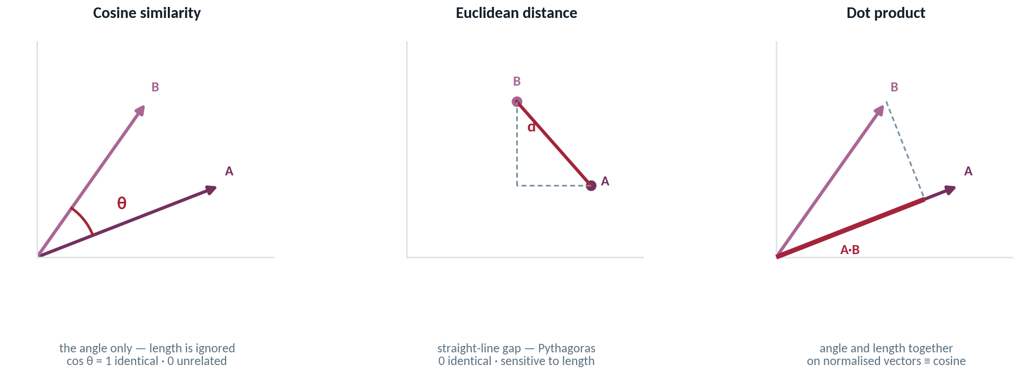
PART 2 · EMBEDDINGS
Three ways to measure closeness
Cosine is the default for text. Know the other two — and know which one ChromaDB uses when you do not say.
COSINE BY HAND — lecture2_embeddings_and_vectordb.ipynb, SECTION 2
SETTING THE METRIC — lecture3_rag_pipeline.ipynb, STEP 2
def similarity(vector_a, vector_b):
dot = np.dot(vector_a, vector_b)
sizes = np.linalg.norm(vector_a) * np.linalg.norm(vector_b)
return float(dot / sizes)
collection = client.get_or_create_collection(
"security_kb", metadata={"hnsw:space": "cosine"})
# omit the metadata and Chroma silently uses L2
The same three matches, two different scales. Lecture 2 with the default L2 reports 0.70 / 0.78 / 0.82. Lecture 3 with cosine reports 0.307 / 0.366 / 0.386. Retrieval did not improve — a threshold tuned on one scale is meaningless on the other.
Retrieval-Augmented Generation
9

Slide 10
PART 2 · EMBEDDINGS
Why embeddings beat keyword search
Security language is varied and paraphrased. Exact-string matching is the wrong tool for it.
KEYWORD SEARCH
SEMANTIC SEARCH
Query: "brute force"
Query: "brute force"
"password spraying detected" — no match
"repeated authentication failures" — no match
"brute force protection enabled" — matched, and irrelevant
"password spraying detected" — 0.71
"repeated authentication failures" — 0.68
"brute force protection enabled" — 0.44, ranked lower
 | Keyword (exact string) | Semantic (meaning)
Finds paraphrase | No — different words, no match | Yes — that is the entire point
Handles a typo or an acronym | Poorly | Usually, if the meaning survives
Explains why it matched | Trivially — you can see the word | Less so — a similarity score is not a reason
Still worth having | Yes, for exact IDs: CVE numbers, hostnames, hashes | Yes, for everything written in prose
Retrieval-Augmented Generation
10

Slide 11
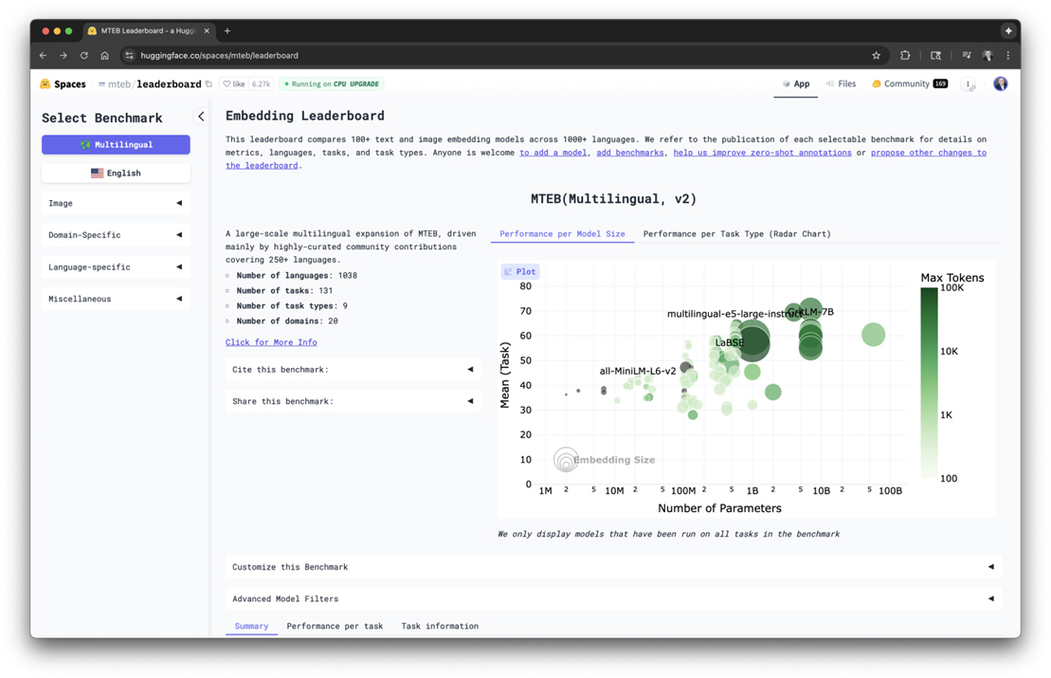
PART 2 · EMBEDDINGS
Choosing an embedding model
MTEB ranks models across dozens of retrieval, clustering and classification tasks. Bigger is not automatically better.
Model | Dims | Notes
all-MiniLM-L6-v2 | 384 | local · offline · ~90 MB · our default
text-embedding-3-small | 1536 | OpenAI · API key · low cost
text-embedding-3-large | 3072 | higher accuracy · higher cost
text-embedding-ada-002 | 1536 | legacy, still widely deployed
More dimensions is not free. Every extra dimension costs storage, memory and query time — permanently. A 384-d model that runs on a laptop CPU with no network is the right default for security work: your corpus never leaves the machine to be vectorised.
Figure 2-2 from Santos, Agentic AI for Cybersecurity — reproduced for classroom use.
THE OPTIONAL CELL — lecture2_embeddings_and_vectordb.ipynb, SECTION 2
What actually decides it
r = OpenAI().embeddings.create(input=text,
model="text-embedding-3-small")
len(r.data[0].embedding) # -> 1536
Your data and your task — not the leaderboard position. Shortlist from MTEB, then benchmark two candidates on your own questions before you commit.
Retrieval-Augmented Generation
11

Slide 12
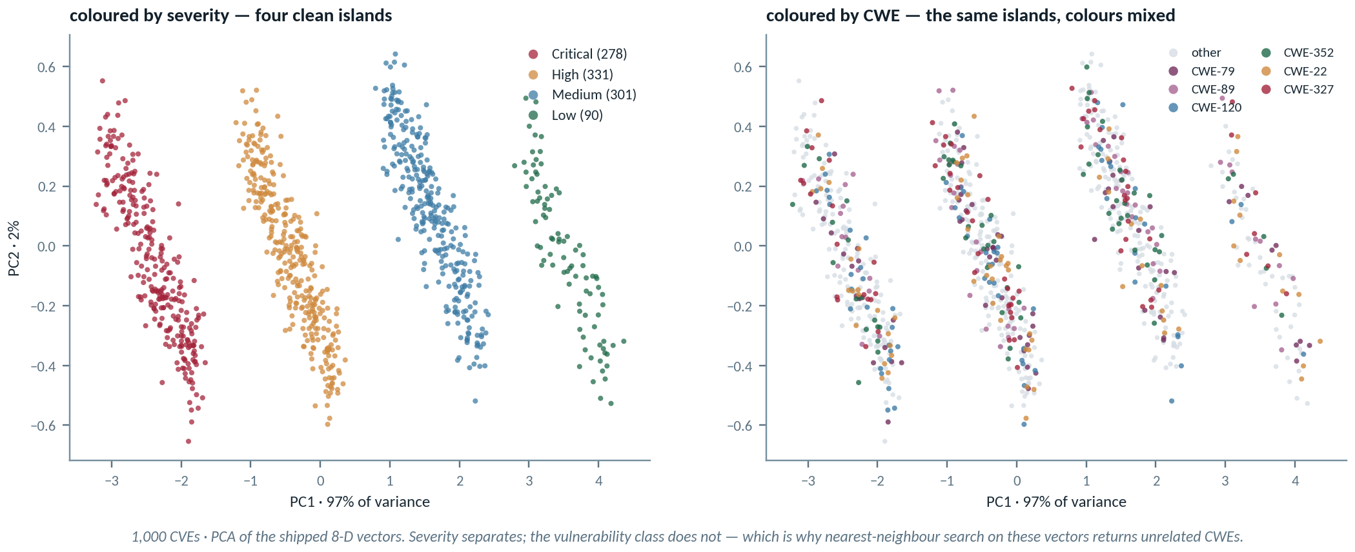
PART 2 · EMBEDDINGS
The meaning-space map
1,000 CVEs projected down to two dimensions — the plot the notebook cannot draw when the matplotlib backend is blocked.
lecture2_embeddings_and_vectordb.ipynb, SECTION 7 — THE CELL THAT OFTEN CANNOT RENDER
What you are looking for
from sklearn.decomposition import PCA
# squeeze each CVE vector down to 2 numbers so we can plot it
flat = PCA(n_components=2).fit_transform(cve_vectors)
Structure. Severity separates cleanly; vulnerability class does not. If the vectors encoded what the CVE says, CWE would cluster too — and it does not.
Retrieval-Augmented Generation
12

Slide 13
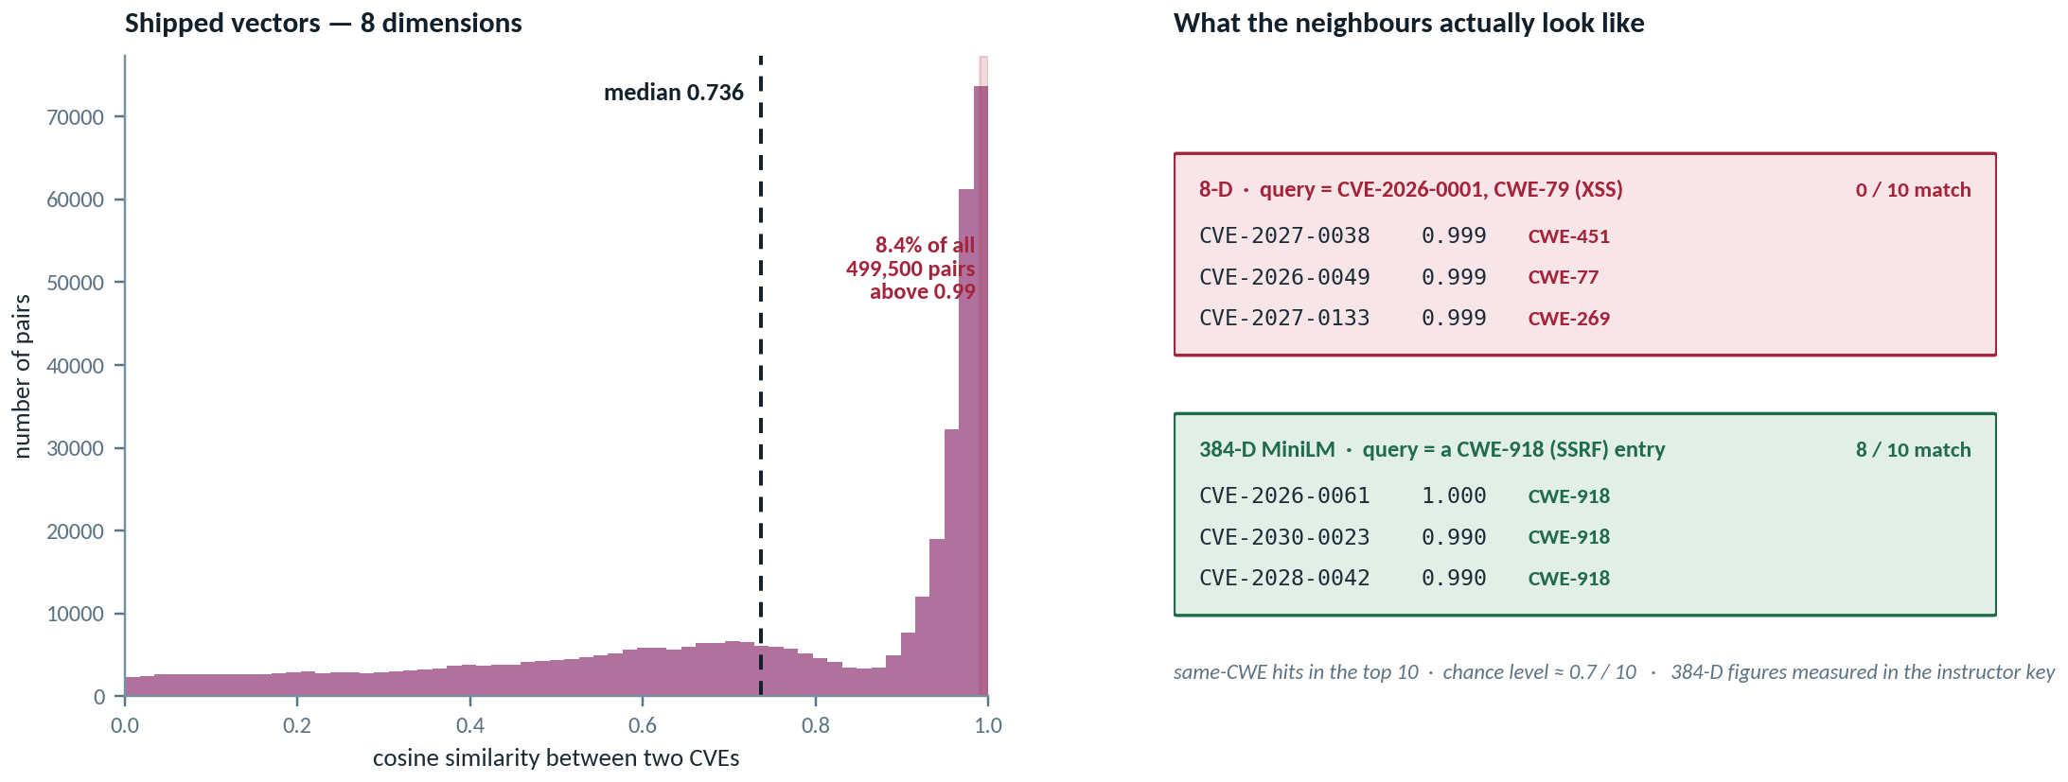
PART 2 · EMBEDDINGS
When embeddings collapse
The vectors shipped with this module have 8 dimensions, not 384. Here is exactly what that does to retrieval.
lecture2_embeddings_and_vectordb.ipynb, SECTION 3 — ADD ONE LINE AND THE MYSTERY DISSOLVES
“The neighbours look unrelated” is the right answer
cve_vectors = np.loadtxt("CVE_vectors_1000.tsv", delimiter="\t")
cve_vectors.shape # -> (1000, 8) not (1000, 384)
for row in range(len(cve_vectors)): # section 3, unchanged
scored.append((similarity(cve_vectors[0], cve_vectors[row]), row))
Report it, and say why. Re-embedding the descriptions with MiniLM and showing the difference goes beyond the rubric.
Retrieval-Augmented Generation
13

Slide 14
MODULE MAP
PART 3
The Problem & the Core Idea
Store It: Vector DB,
Indexing & Chunking
Embeddings
Vector DB & Chunking
Once text is vectors, you need somewhere to keep them, a way to find the nearest ones fast, and a decision about how big a passage should be.
The RAG Recipe & Trust
Build It: Notebooks & Practice
Lab & Mini-Project

Slide 15
PART 3 · VECTOR DB & CHUNKING
Vector databases and indexing
A store that keeps the vector, the text, and where it came from — and finds neighbours fast.
ONE STORED RECORD
Store | When it is the right choice
NumPy array | A few hundred chunks. Transparent, no dependency, fine
ChromaDB | This course. Metadata filtering and persistence, minimal setup
FAISS | Millions of vectors, one machine, you want speed
pgvector | You already run Postgres and want one system to operate
Vector [0.021, -0.114, 0.335, … ] · 384 floats
Document the chunk text itself, returned verbatim
Metadata source file · section · date · classification
ID runbook.md#chunk-14
ChromaDB — and the NumPy equivalent, for perspective
import chromadb
col = chromadb.Client().create_collection("cves")
col.add(ids=ids, embeddings=vecs, documents=texts, metadatas=meta)
hits = col.query(query_embeddings=[qv], n_results=4)
# what it is doing, for a few hundred chunks:
import numpy as np
sims = (M @ qv) / (np.linalg.norm(M, axis=1) * np.linalg.norm(qv))
top = np.argsort(-sims)[:4]
What indexing buys you: approximate nearest-neighbour search, so you do not compare the query against every vector. It trades a little recall for a lot of speed.
At our scale you do not need it. Understand it, because production corpora do.
Retrieval-Augmented Generation
15

Slide 16
PART 3 · VECTOR DB & CHUNKING
Operating ChromaDB: four calls
Section 5 of lecture2_embeddings_and_vectordb.ipynb. Create, add, query, filter — and one commented line that makes it survive a restart.
lecture2_embeddings_and_vectordb.ipynb · SECTION 5 — COMPLETE
1
Create — no server involved
import chromadb
client = chromadb.EphemeralClient() # lives in memory
collection = client.get_or_create_collection("ssrf_kb")
chunk_vectors = model.encode(chunks)
ids = ["chunk-" + str(i) for i in range(len(chunks))]
labels = [{"source": "ssrf.txt"} for _ in chunks]
collection.add(ids=ids,
documents=chunks,
embeddings=chunk_vectors.tolist(),
metadatas=labels)
print("The database now holds", collection.count(), "chunks.")
question_vector = model.encode(
"What is SSRF and how is it exploited?").tolist()
results = collection.query(query_embeddings=[question_vector],
n_results=3)
# filter on the labels you stored earlier
filtered = collection.query(query_embeddings=[question_vector],
n_results=2,
where={"source": "ssrf.txt"})
# to survive a restart, swap one line:
# client = chromadb.PersistentClient(path="my_db_folder")
EphemeralClient runs inside the notebook process. Nothing to install, nothing to start, no port.
2
Add — four parallel lists
ids, documents, embeddings, metadatas: same length, same order. That is the only real invariant in the API.
3
Query — mind the [0]
Results are wrapped in an outer list because you may ask several questions at once. Hence results["documents"][0].
4
Filter — metadata earns its keep
where={...} matches what you stored. Restrict by source, classification or date — this is how access control starts.
Retrieval-Augmented Generation
16

Slide 17
PART 3 · VECTOR DB & CHUNKING
The vector database landscape
Ten systems you will meet. The choice turns on scale, deployment model, and what your team already runs.
Database | Type | Key characteristics / best for
Chroma | Open source | Lightweight and developer-friendly. Local prototyping and small-to-medium RAG — what we use.
FAISS (Meta) | Library | Not a database: the similarity-search library underneath many other systems. Custom infrastructure.
Milvus | Open source | Billion-scale vector search, highly configurable. Large enterprise deployments needing fine control.
Qdrant | Open source | Written in Rust. Advanced filtering and payload management. Performance-critical self-hosted work.
Weaviate | Open source | AI-native with built-in vectorisation modules and GraphQL. Multi-modal search and knowledge graphs.
pgvector | Postgres extension | Adds vector search to an existing PostgreSQL database. The obvious pick if you already run Postgres.
Pinecone | Managed service | Serverless and fully managed. Teams that want to ship without operating infrastructure.
MongoDB Atlas | General-purpose DB | Integrated vector search inside the document database. Natural for existing Mongo applications.
Vespa | Open source | Low-latency serving of search, ranking and recommendation together, including vectors.
AWS S3 Vectors | Object storage | Cheap durable storage for very large vector sets, loaded into a search library for querying.
THE ENTIRE SETUP — lecture2_embeddings_and_vectordb.ipynb, SECTION 5
Adapted from textbook Table 2-1
client = chromadb.EphemeralClient() # in memory, no server
# client = chromadb.PersistentClient(path="my_database_folder")
collection = client.get_or_create_collection("ssrf_kb")
Santos, Agentic AI for Cybersecurity. We use Chroma because it runs in-process; the concepts transfer unchanged.
Retrieval-Augmented Generation
17

Slide 18
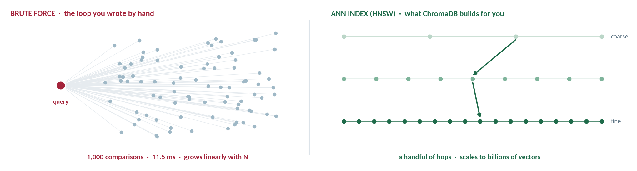
PART 3 · VECTOR DB & CHUNKING
Why the database is fast
You wrote the brute-force loop yourself. A vector database builds an approximate nearest-neighbour index instead.
lecture2_embeddings_and_vectordb.ipynb, SECTION 6 — THE WHOLE COMPARISON
At our scale you do not need an index
start_time = time.time()
hand_scores = []
for row in range(len(cve_vectors)):
hand_scores.append(similarity(cve_vectors[0], cve_vectors[row]))
elapsed_ms = (time.time() - start_time) * 1000 # -> 11.5 ms
Eleven milliseconds over a thousand vectors is fine — do not add one to the mini-project. Understand HNSW anyway: a production corpus is millions of chunks, and a linear scan there is not a slower answer, it is no answer.
Retrieval-Augmented Generation
18

Slide 19
PART 3 · VECTOR DB & CHUNKING
Chunking: the one knob that really matters
Too big and the match is diluted. Too small and the passage cannot answer the question.
OVERLAP KEEPS AN IDEA FROM BEING CUT IN HALF
chunk 1
chunk 2
chunk 3
the shaded overlap appears in both neighbours
A sensible default for security prose
chunk_size = 512 # tokens
chunk_overlap = 64 # ~12% — enough to bridge a boundary
Symptom | Usually means
Right topic, wrong detail | Chunks too large — the answer is buried in the passage
Fragmentary, unusable hits | Chunks too small — no context survived the split
"I don't know" too often | Too few chunks retrieved, or the threshold is too strict
This is the mini-project's tuning experiment. Change the size, measure what happens, and report it. "512 because a tutorial said so" is not an answer.
Retrieval-Augmented Generation
19

Slide 20
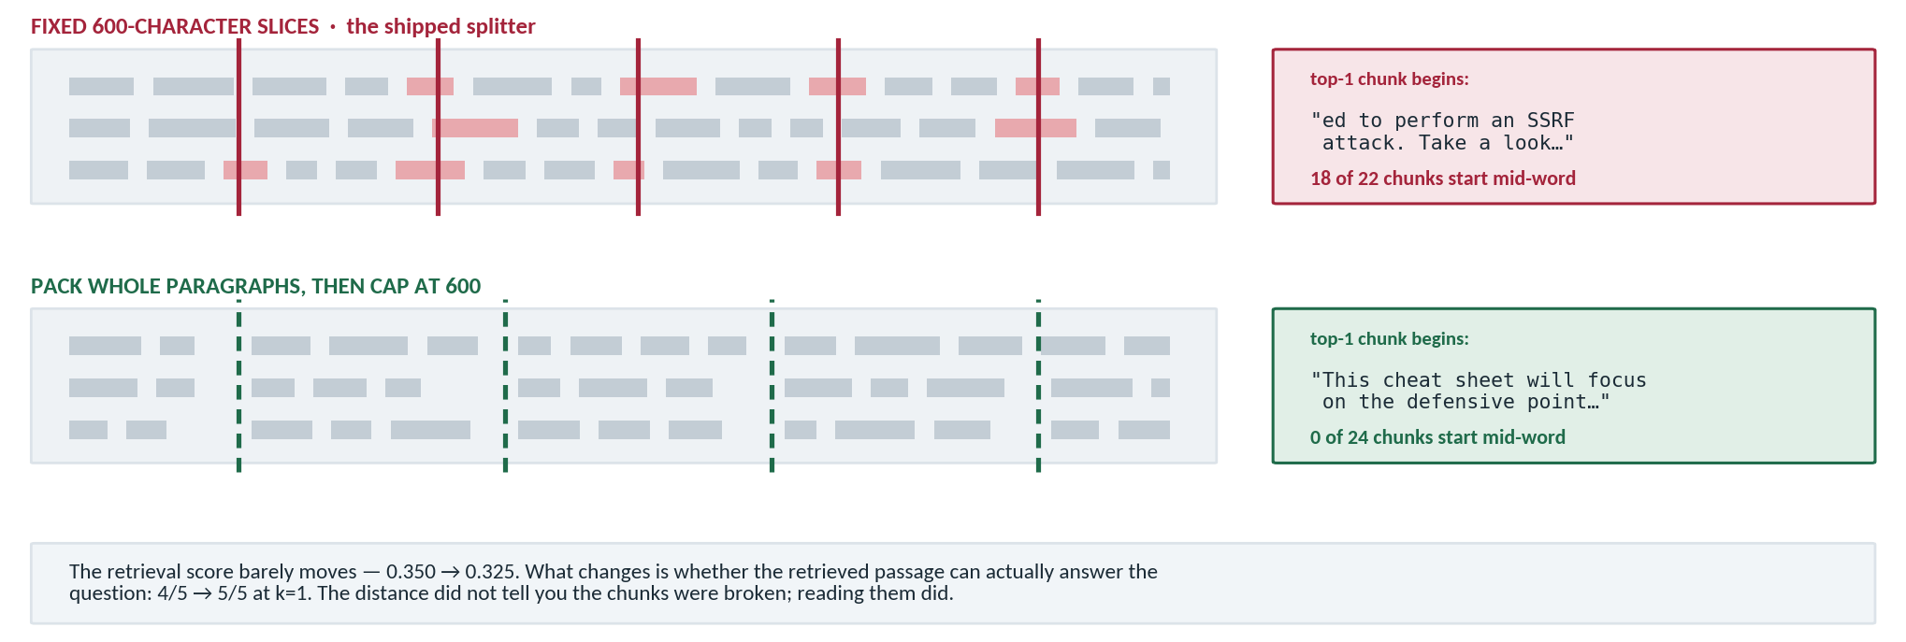
PART 3 · VECTOR DB & CHUNKING
Chunking: where the cuts land
Size is not the only decision. The boundary determines whether a retrieved chunk can answer anything at all.
lecture2_embeddings_and_vectordb.ipynb, SECTION 4 — CHARACTER COUNTING, NOTHING MORE
while start < len(document):
piece = document[start : start + chunk_size].strip() # 600 characters, blind to words
if piece != "": chunks.append(piece)
start = start + chunk_size - overlap # advance 500, take the next 600
Retrieval-Augmented Generation
20

Slide 21
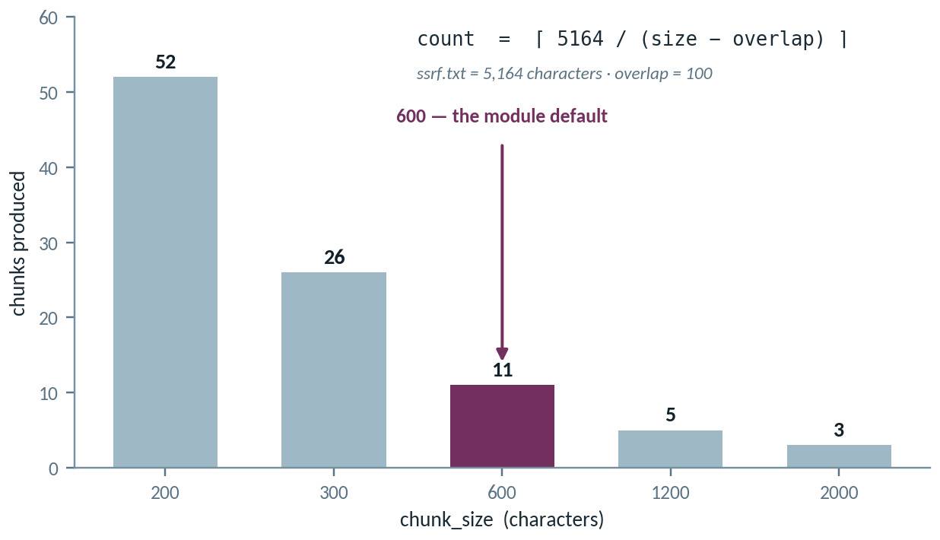
PART 3 · VECTOR DB & CHUNKING
Chunk size, chunk count — and one trap
The count follows from arithmetic. The trap hangs your notebook with no error message at all.
lecture3_rag_pipeline.ipynb, STEP 1 — NOTE WHAT GUARDS THE STRIDE
def split_into_chunks(text, chunk_size=600, overlap=100):
pieces, start = [], 0
while start < len(text):
pieces.append(text[start : start + chunk_size])
start = start + chunk_size - overlap
overlap ≥ chunk_size → the cell never finishes
The stride is chunk_size − overlap. Set overlap to 600 with a chunk_size of 600 and the stride is zero: start never advances and the loop runs forever. No exception, no output. A hung cell in this module is almost always this.
TWO LINES THAT TURN A HANG INTO AN ERROR MESSAGE
if chunk_size <= overlap:
raise ValueError("overlap must be smaller than chunk_size")
Retrieval-Augmented Generation
21

Slide 22
PART 3 · VECTOR DB & CHUNKING
RAG or fine-tuning?
They solve different problems. For facts that change, it is not close.
 | Fine-tuning | RAG
Where knowledge lives | Baked into the model's weights | In an external store you can edit
Cost to update | A training run, every time | Add a file and re-embed one document
Time to reflect a new CVE | Days to weeks | Minutes
Can it cite a source? | No — the knowledge is diffuse | Yes — you retrieved the passage, so you have it
Can you remove a fact? | Hard. Often needs retraining | Delete the chunk
What it is genuinely good at | Teaching style, format, or a task the model performs badly | Supplying facts the model does not have
The security case is decisive: your facts change weekly, you must be able to cite them, and you occasionally need to remove one. Every one of those favours RAG.
When fine-tuning is right
When the problem is behaviour, not knowledge: a consistent report format, a domain vocabulary, or a task the base model performs poorly.
Retrieval-Augmented Generation
22

Slide 23
MODULE MAP
PART 4
The Problem & the Core Idea
The RAG Recipe
& Trust
Embeddings
Vector DB & Chunking
Wire the pieces end to end — and see exactly where the trustworthiness of the answer comes from.
The RAG Recipe & Trust
Build It: Notebooks & Practice
Lab & Mini-Project

Slide 24
PART 4 · THE RAG RECIPE & TRUST
The recipe: retrieve, augment, generate
Three moves. The notebook spells them into six steps, but this is the shape.
1
Retrieve
2
Augment
3
Generate
Embed the question. Return the k closest chunks from the store.
Build a prompt that includes those chunks as labelled context.
The model answers from the context — grounded, and able to cite.
The whole loop, once the store exists
Step | In the notebook
1 | Load and chunk the documents
2 | Embed and store the vectors
3 | Retrieve for a question
4 | Augment — build the prompt
5 | Generate the answer
6 | Wrap it all in one function
def answer(question, k=4):
qv = embed_model.encode([question])[0] # 1 retrieve
hits = store.query(qv, n_results=k)
ctx = "\n\n".join( # 2 augment
f"[{i+1}] {d}" for i, d in enumerate(hits["documents"]))
return llm(SYSTEM, f"Context:\n{ctx}\n\nQuestion: {question}")
# 3 generate
Retrieval-Augmented Generation
24

Slide 25
PART 4 · THE RAG RECIPE & TRUST
The grounded prompt is the guardrail
Retrieval supplies the facts. The prompt is what makes the model stay inside them.
SYSTEM — the three instructions that do the work
Instruction | What it buys
Answer only from context | Turns generation into summarisation
Cite as [n] | Every claim becomes checkable in seconds
Say "I don't know" | Gives it a licence to fail honestly
You are a security analyst assistant.
Answer ONLY from the context provided below.
Cite the source of each claim as [n].
If the answer is not in the context, say
"I don't know based on the provided documents."
Do not use knowledge from outside the context.
The third line is the important one. Without an explicit escape hatch, a model asked an unanswerable question will produce something anyway. "I don't know" has to be permitted.
But notice what you just did. You took text from your corpus and placed it in the prompt, above the question, where the model treats it as instructions-adjacent. If an attacker can write into a document you ingest, they are writing into your prompt. Retrieved text is untrusted input. This is prompt injection, and it is where Module 5 begins.
No API key? Still works. Retrieval runs entirely locally. Generation is the only step that needs one.
Retrieval-Augmented Generation
25

Slide 26
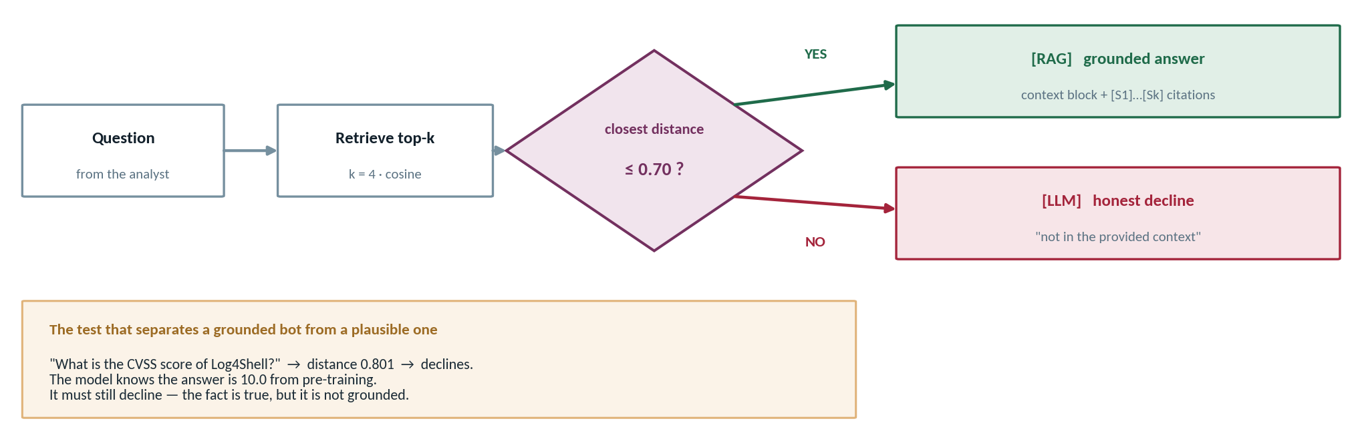
PART 4 · THE RAG RECIPE & TRUST
The gate: [RAG] or [LLM]
Retrieval does not just supply the context. It decides whether the model is allowed to answer at all.
lecture3_rag_pipeline.ipynb, STEP 3 — THE FILTER IS THE GATE
lecture3_rag_pipeline.ipynb, STEP 4 — THE PROMPT ENFORCES IT
def retrieve(query, how_many=4, max_distance=0.75):
...
for k in range(len(found_docs)):
if found_dists[k] <= max_distance:
good_hits.append(...) # else: nothing
SYSTEM = (
"Answer the question using ONLY the context below.\n"
"If the answer is in the context, prefix [RAG]."
"If the context is empty, say so and prefix [LLM]."
"\n\n# Context\n{context}")
Retrieval-Augmented Generation
26

Slide 27
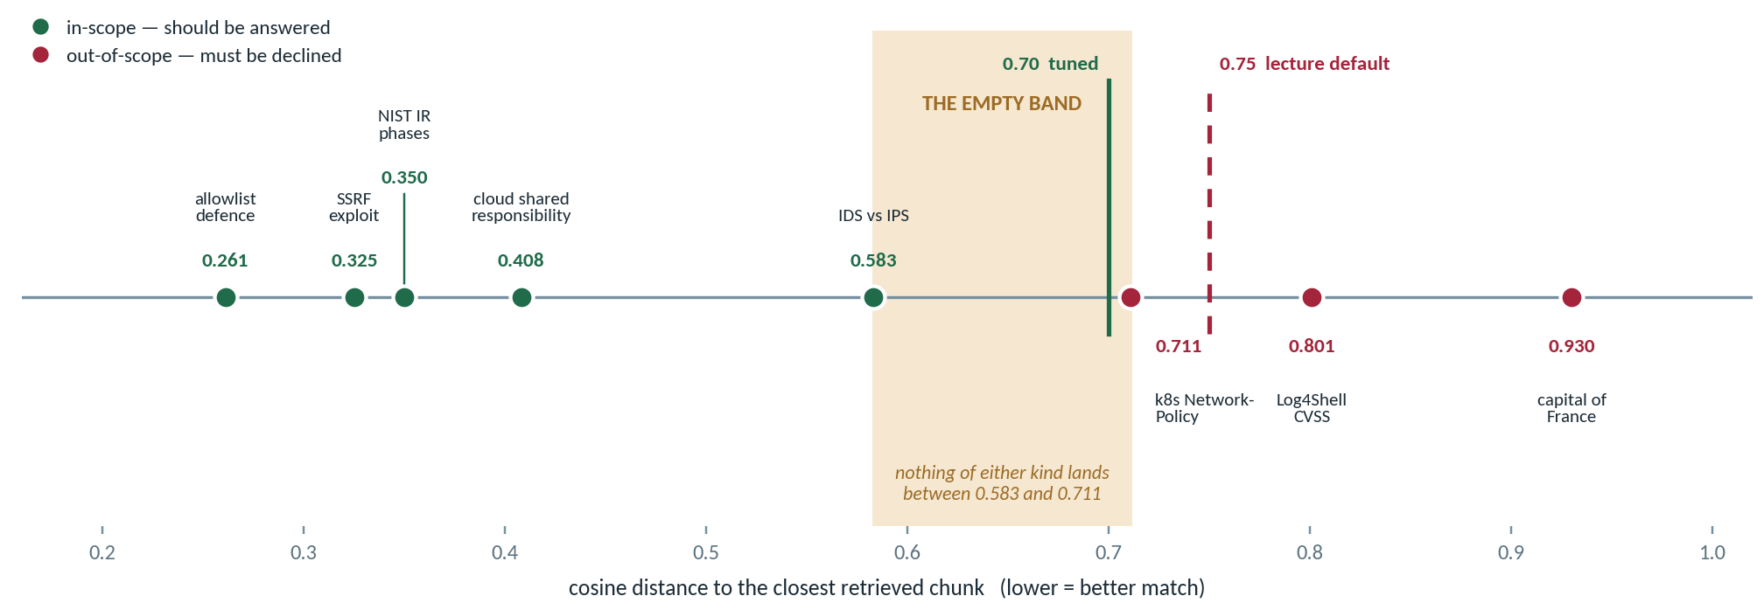
PART 4 · THE RAG RECIPE & TRUST
Tuning the threshold is not guesswork
Plot the distances you actually measured, and the right cut-off becomes something you can see.
THE FIFTEEN-MINUTE EXPERIMENT
0.50
0.70
0.75
for q in in_scope + out_of_scope:
hits = collection.query(
query_embeddings=embed([q]), n_results=1)
print(q, round(hits["distances"][0][0], 3))
4 / 5 answered
5 / 5 · 0 leaks
5 / 5 · 1 leak
too tight — the IDS vs IPS question is wrongly declined
inside the empty band — the tuned recommendation
the lecture default — answers the Kubernetes question
Retrieval-Augmented Generation
27

Slide 28
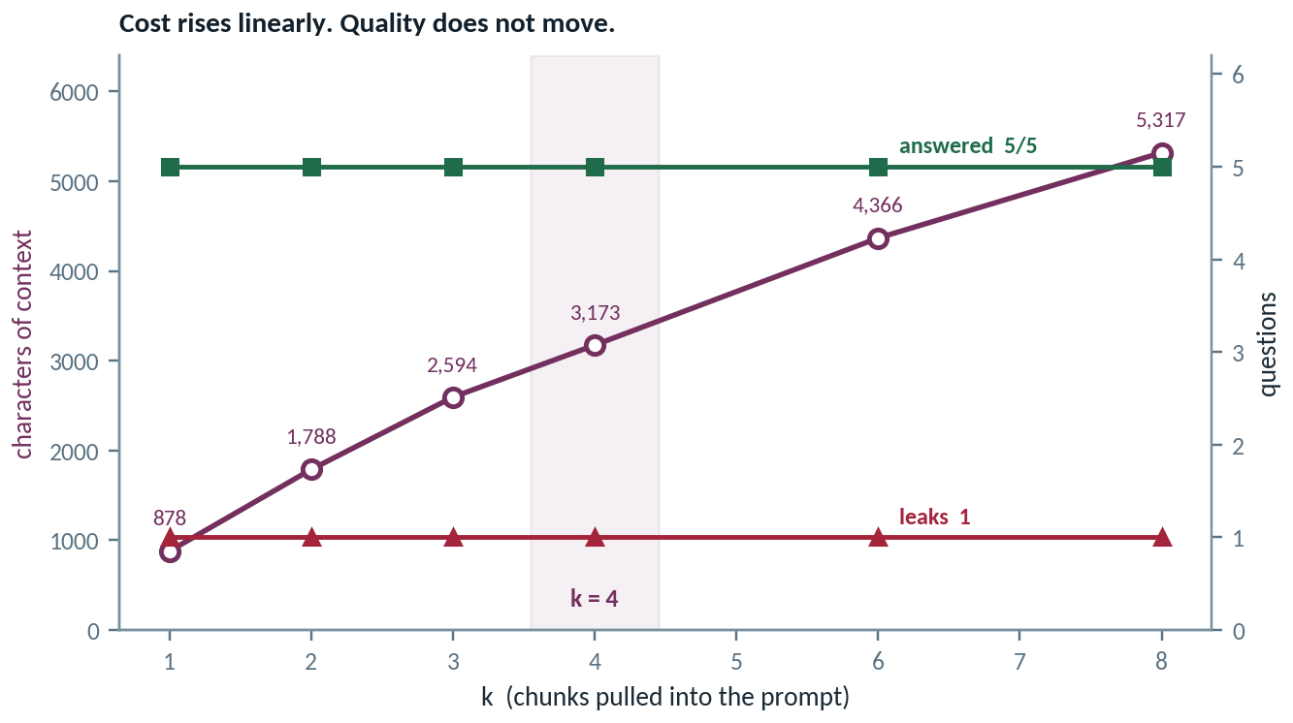
PART 4 · THE RAG RECIPE & TRUST
How much context is enough?
On a corpus this size k is a cost dial, not a quality dial. Say that with numbers rather than a shrug.
k | context chars | answered | leaks
1 | 878 | 5 / 5 | 1
2 | 1,788 | 5 / 5 | 1
4 | 3,173 | 5 / 5 | 1
8 | 5,317 | 5 / 5 | 1
So why k = 4 and not k = 1? Not recall — k = 1 already answers everything. Corroboration and citation: four passages let the answer cite several sources, and let you see when the top hit was a near miss.
And notice what k never fixes
The single leaked out-of-scope chunk is present at every k. Raising k cannot buy grounding — only the distance threshold does that. Two numbers, two entirely different jobs.
for k in [1, 2, 3, 4, 6, 8]: hits = retrieve(query, how_many=k)
Retrieval-Augmented Generation
28

Slide 29
PART 4 · THE RAG RECIPE & TRUST
Evaluating a RAG system
"It gave a good answer" is not evaluation. Four checks make it measurable.
1
Retrieval quality
2
Grounding
3
Honesty
4
Citations
Did the search fetch the chunk that actually answers the question?
Is every claim supported by a retrieved chunk — or did it drift?
Does it say "I don't know" when the answer genuinely is not there?
Can a human trace each claim back to a specific source?
Check | How to measure it without a framework | What a failure tells you
Retrieval quality | Write 10 questions with a known answering chunk. Count how often it lands in the top k | Chunking or k is wrong — the generator is not the problem
Grounding | For each claim in the answer, point at the chunk. Anything unpointable is drift | Your prompt is too weak, or too much irrelevant context got in
Honesty | Ask 5 questions the corpus cannot answer. Count real refusals | The "I don't know" instruction is missing or being overridden
Citations | Pick a claim at random. Time how long verification takes | Citations are decorative rather than functional
Diagnose in that order. Retrieval failures masquerade as generation failures, and people tune the prompt for hours when the answering chunk was never retrieved.
Retrieval-Augmented Generation
29

Slide 30
MODULE MAP
PART 5
The Problem & the Core Idea
Build It: The Notebooks
& Practice
Embeddings
Vector DB & Chunking
Two framework-free notebooks over a thousand real CVE descriptions, what RAG is actually used for in security, and the data rules that come with it.
The RAG Recipe & Trust
Build It: Notebooks & Practice
Lab & Mini-Project

Slide 31
PART 5 · BUILD IT
The notebooks: framework-free and offline
Nothing hidden. You will see every moving part before you let a framework hide it.
This module's files
Real data, not a toy corpus
code/
lecture2_embeddings_vectordb.ipynb embeddings + the store
lecture3_rag_pipeline.ipynb the full six-step pipeline
data/
cve_descriptions.csv 1,000 real CVE entries
kb/ a small security knowledge base
assignments/ lab, mini-project, forum
A thousand CVE descriptions. Pick one, look at its nearest neighbours, and you will find related vulnerabilities that share no keywords with it at all. That moment is the point of the lab.
Why framework-free: next module you will build this in about fifteen lines of LangChain. You should be able to say what each of those lines is doing — and you can only do that if you have written it yourself once.
Dependency | Why it is the only one
sentence-transformers | Local embeddings, ~80 MB, runs on CPU
chromadb | The store — and you see the NumPy equivalent too
No LangChain | Deliberately. That is next module
Runs offline. Retrieval needs no API key at all.
Retrieval-Augmented Generation
31

Slide 32
PART 5 · BUILD IT
The ingestion half, line by line
Steps 1 and 2 of lecture3_rag_pipeline.ipynb. This is a script you run once — not a function you call per question.
lecture3_rag_pipeline.ipynb · STEPS 1–2 — INGESTION, RUN ONCE
1
strip() and the empty check
def split_into_chunks(text, chunk_size=600, overlap=100):
pieces = []
start = 0
while start < len(text):
piece = text[start : start + chunk_size].strip()
if piece != "":
pieces.append(piece)
start = start + chunk_size - overlap
return pieces
chunks, sources = [], []
for filename in ["ssrf.txt", "cybersecurity_kb.md"]:
text = open(filename, encoding="utf-8").read()
file_chunks = split_into_chunks(text)
for piece in file_chunks:
chunks.append(piece) # the chunk text
sources.append(filename) # where it came from
print(filename, "->", len(file_chunks), "chunks")
client = chromadb.EphemeralClient()
collection = client.get_or_create_collection(
"security_kb", metadata={"hnsw:space": "cosine"})
ids = ["c" + str(i) for i in range(len(chunks))]
labels = [{"source": sources[i]} for i in range(len(chunks))]
collection.add(ids=ids, documents=chunks,
embeddings=embed(chunks), metadatas=labels)
Without them the tail of a file produces whitespace-only chunks that match nothing and waste a retrieval slot.
2
Two lists, built in lockstep
chunks and sources stay index-aligned by construction. That alignment is what makes citation possible later.
3
The metric, set explicitly
hnsw:space cosine. Omit it and Chroma uses L2 — every threshold you tuned is then on the wrong scale.
4
embed(chunks) is the expensive line
Every chunk goes through the model. Seconds here, hours on a real corpus — which is why ingestion is a script, not a per-question step.
Retrieval-Augmented Generation
32

Slide 33
PART 5 · BUILD IT
The query half, line by line
Steps 3 and 4 of lecture3_rag_pipeline.ipynb. This is the function you call on every question — and where grounding is enforced.
lecture3_rag_pipeline.ipynb · STEPS 3–4 — QUERY, RUN EVERY TIME
1
Same embed() as ingestion
def retrieve(query, how_many=4, max_distance=0.75):
results = collection.query(query_embeddings=embed([query]),
n_results=how_many)
found_docs = results["documents"][0]
found_dists = results["distances"][0]
found_meta = results["metadatas"][0]
good_hits = []
for k in range(len(found_docs)):
if found_dists[k] <= max_distance: # close enough?
good_hits.append((found_docs[k],
found_dists[k],
found_meta[k]))
return good_hits
SYSTEM = (
"You are a cybersecurity assistant. Answer the question using "
"ONLY the context below.\n"
"If the answer is in the context, prefix your reply with [RAG]. "
"If the context is empty or does not contain the answer, say so "
"and prefix with [LLM].\n\n# Context\n{context}"
)
def build_prompt(query, context):
system_message = SYSTEM.format(
context=context or "(no relevant context found)")
return system_message, query
The rule from slide 5. Different models on the two sides and every distance below becomes meaningless.
2
The [0] everywhere
Chroma supports batched queries, so each result list is wrapped. You asked one question, so you take index zero.
3
The filter is the gate
Beyond max_distance, hits are dropped. An out-of-scope question returns an empty list — which is a decision, not a failure.
4
The "or" in build_prompt
An empty context becomes an explicit “no relevant context found” rather than a blank. Models improvise into blanks.
Retrieval-Augmented Generation
33

Slide 34
PART 5 · BUILD IT
The whole bot, in one function
Step 6 of lecture3_rag_pipeline.ipynb. Retrieve, augment, generate — and two calls that prove it can decline.
lecture3_rag_pipeline.ipynb · STEP 6 — THE COMPLETE PIPELINE
1
Three moves, nothing else
# the complete RAG function: retrieve -> augment -> generate
def ask(query):
hits = retrieve(query)
# join the retrieved chunks into one context block
context_pieces = []
for doc, dist, meta in hits:
context_pieces.append(doc)
context = "\n\n".join(context_pieces)
system, user = build_prompt(query, context)
print("Q:", query)
if len(hits) > 0:
print(" grounded? YES (found relevant context)")
else:
print(" grounded? NO (no relevant context)")
print(" answer:", generate(system, user)[:300], "\n")
ask("What is SSRF and how can it be exploited?")
# -> in the documents -> [RAG]
ask("What is the capital of France?")
# -> not in the documents -> [LLM] fallback
retrieve, join into context, build prompt, generate. The recipe from Part 4, now executable.
2
Keep the grounded flag
Every answer arrives labelled with whether it had evidence. You can audit a transcript at a glance.
3
Two calls, not one
One question the corpus answers, one it cannot. That pair is the acceptance test for your mini-project.
4
The model knows it is Paris
And must still decline. A true fact that is not grounded is exactly the failure this architecture exists to prevent.
Retrieval-Augmented Generation
34

Slide 35
PART 5 · BUILD IT
What RAG is actually used for in security
Four patterns, all of which are somebody's real internal tool.
Query threat intel
Answer policy questions
Search incident history
Ground a SOC assistant
Ask advisories and intel reports in natural language instead of grepping a PDF pile.
"What does NIST AI RMF say about model monitoring?" — with a citation you can check.
During response: has anything like this happened before, and what did we do?
Answers that reflect your runbooks and your environment, not the open internet.
Pattern | The corpus | The property that makes it work
Threat intel Q&A | Advisories, vendor bulletins, intel reports | Currency — add today's advisory and it is searchable now
Policy and framework Q&A | NIST, ISO, internal policy documents | Citation — an uncited compliance answer is worthless
Incident knowledge base | Past tickets, post-incident reviews | Semantic match — nobody describes an incident the same way twice
SOC assistant | Your runbooks and asset documentation | Privacy — local embeddings mean the corpus never leaves
Notice the third column. Each pattern depends on a different property of RAG — which is why "just use RAG" is not a design.
Retrieval-Augmented Generation
35

Slide 36
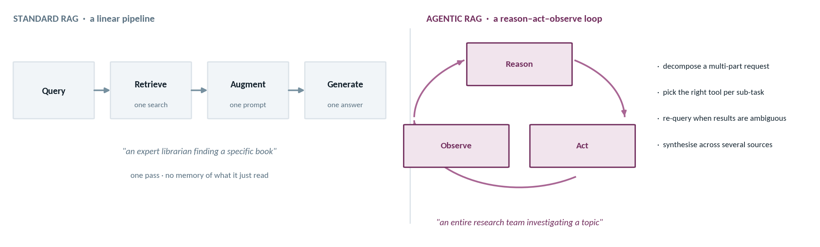
PART 5 · BUILD IT
Beyond one-shot retrieval
Standard RAG retrieves once and answers. An agent decides what to retrieve, looks at what came back, and tries again.
“Agentic RAG transforms the process into a reason-act-observe loop.” The agent reasons about the goal, acts by using its tools, and observes the results to inform its next step. This allows it to handle ambiguity and tackle multifaceted problems. — Santos, Agentic AI for Cybersecurity, Ch. 2
Where this goes next
Module 5 gives you the framework, Module 6 gives you the loop. The retrieve() you wrote this week becomes one of the tools the agent is allowed to call — nothing here is thrown away.
Retrieval-Augmented Generation
36

Slide 37
PART 5 · BUILD IT
Data handling: retrieved text is your prompt
Everything in your corpus can end up in an answer. Plan for that before you ingest.
Rule | Concretely | Why it bites in RAG specifically
Embed locally for sensitive data | sentence-transformers on your machine, not an embedding API | Ingestion sends every chunk of the corpus, not just one prompt
Sanitise the corpus first | Strip credentials, keys, PII and customer names before ingesting | Retrieval will surface whatever is in a chunk, to whoever asks
Treat retrieved text as untrusted | It reaches the model in an instruction-adjacent position | Anyone who can write into an ingested document writes into your prompt
Labs use provided documents only | Synthetic or course-supplied corpora — never real incident data | A corpus is a bigger disclosure than a single prompt
Keys in .env or Colab Secrets | Never in a cell, never in the report | Unchanged from Module 2, and still the most common slip
The one that surprises people: row two. A RAG system has no concept of who is asking. If a runbook chunk contains a service-account password, then anyone who can query the assistant can retrieve that password by asking a question that happens to match. Access control has to live in the metadata filter and in what you chose to ingest — never in the model's discretion.
Retrieval-Augmented Generation
37

Slide 38
MODULE MAP
PART 6
The Problem & the Core Idea
Lab &
Mini-Project
Embeddings
Vector DB & Chunking
A concept-check lab to rehearse the machinery, then your own working RAG Q&A bot with a tuning experiment attached.
The RAG Recipe & Trust
Build It: Notebooks & Practice
Lab & Mini-Project

Slide 39
PART 6 · LAB & MINI-PROJECT
The concept-check lab — your rehearsal
Run the notebooks, poke at them, and confirm the machinery makes sense before you build.
 | Do this | You should be able to say
1 | Run both notebooks top to bottom | Which cell does ingestion and which does query
2 | Pick a CVE, read its nearest neighbours | Why a result with no shared words came back
3 | Change the chunk size and re-run | What happened to the number of chunks, and why
4 | Ask something the corpus cannot answer | Whether it refused honestly, and what made it refuse
5 | Print the retrieved chunks before the answer | Whether a bad answer was retrieval's fault or generation's
The four ideas it checks
Embeddings · cosine similarity · chunking · the three RAG steps.
If any of those still feels vague after the lab, sort it out before starting the mini-project rather than during it.
Step 5 is the one to internalise: printing the retrieved chunks before the answer is the single most useful debugging habit in RAG. It tells you immediately which half of the system is broken, and it will save you hours on the mini-project.
Why a rehearsal at all: the mini-project should be assembly, not discovery. Every component you need is in these notebooks. If you have run them and understood them, building your own bot is a couple of hours of wiring. If you have not, it is an evening of debugging your understanding and your code simultaneously, which is much harder than doing either alone.
Retrieval-Augmented Generation
39

Slide 40
PART 6 · LAB & MINI-PROJECT
Mini-project: build a RAG Q&A bot
Your own framework-free pipeline over your own documents — plus the experiment that proves you understand it.
 | Deliverable | What I am looking for
1 | A small knowledge base | 2–3 security documents, or the course KB. Say why you chose them
2 | A runnable notebook | Ingest → retrieve → augment → generate, with the phases separated
3 | A tuning experiment | Before and after numbers, not impressions
4 | A forum reflection | On grounding and trust, in your own words
Knob | Try | Report the effect on
chunk_size | 256 → 512 → 1024 | Whether the answering passage still lands in the top k
k | 2 → 4 → 8 | Answer quality, and how much irrelevant context got in
distance threshold | Loose → strict | How often it correctly says "I don't know"
The tuning experiment is 30%. A bot that answers questions is the expected outcome. A student who can explain what changed when they moved chunk size from 256 to 1024 — and why — has understood the module.
Provided or synthetic documents only — no real incident data, no credentials.
Retrieval-Augmented Generation
40

Slide 41
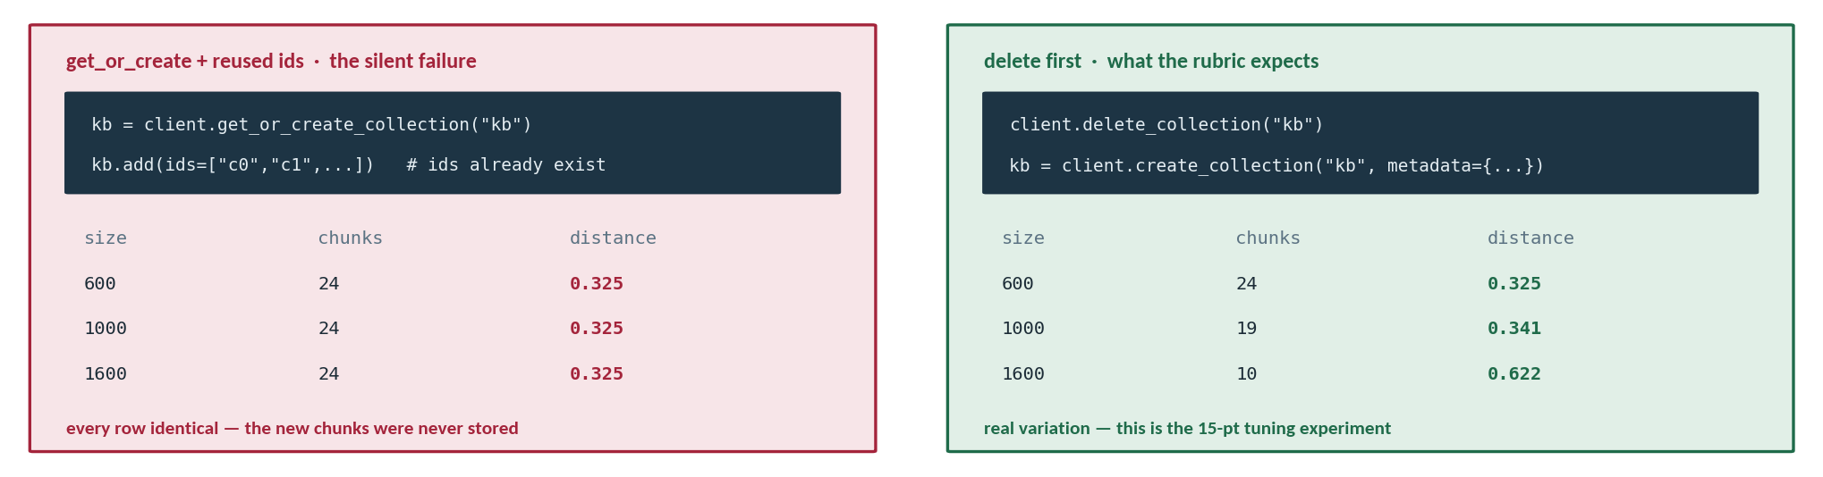
PART 6 · LAB & MINI-PROJECT
Four traps that cost marks
Every one of these has cost a student an afternoon. Not one of them raises an error.
2 · Chroma defaults to L2
3 · overlap ≥ chunk_size
4 · relative paths and the first run
Without metadata={"hnsw:space": "cosine"} your distances are on a different scale and every threshold you tuned is wrong.
The stride goes to zero and the splitter loops forever. No exception, no output — just a cell that never finishes.
Run from RAG/code/. The first model load pulls ~90 MB and looks frozen; pass device="cpu" if the GPU driver mismatches.
Retrieval-Augmented Generation
41

Slide 42
PART 6 · LAB & MINI-PROJECT
Recap and what's next
Four things to carry into the framework modules.
1
Meaning becomes geometry
2
Two phases, not one
And the uncomfortable one
Embeddings map text to vectors; cosine similarity finds related passages that share no words.
Ingest once — chunk, embed, store. Query many times — retrieve, augment, generate.
You built a system that takes text from a corpus and puts it into a prompt. Retrieved text is untrusted input, and every retrieval system is an injection surface.
3
The prompt is the guardrail
4
Diagnose retrieval first
Next — LangChain: the same pipeline in about fifteen lines, so you can see what a framework buys you — and then we go straight at prompt injection.
Answer only from context, cite [n], and permit "I don't know." That last one does the most work.
Print the chunks before you tune the prompt. Retrieval failures look exactly like generation failures.
Retrieval-Augmented Generation
42

