Slide 1
IT7075C · Applied AI for Cybersecurity
Module 8 — Cybersecurity Orchestration
Automating an authorized penetration test: Chains → RAG → Agents + MCP

Slide 2
Part 1
Module Overview & Concept Recap

Slide 3
What we build in this module
• An orchestrated, AUTHORIZED penetration-testing workflow: recon → triage → CVE lookup → report.
• Built three ways, each better than the last:
– Stage 1 — a fixed Chain (LLM answers from memory)
– Stage 2 — RAG (ground the analysis in a real knowledge base)
– Stage 3 — an Agent that orchestrates MCP tools and decides what to call

Slide 4
Recap — the building blocks (RAG, LangChain, LangGraph, MCP)
• RAG : retrieve trusted facts so the model stops guessing — grounding, citations.
• LangChain : compose prompts + tools into a repeatable pipeline.
• LangGraph : stateful, tool-using agents — branch, call tools, keep state.
• MCP : a standard plug so any client/agent can discover and call your tools.
• This module is the payoff: we orchestrate all four on a real security task.

Slide 5
Scope & legality come first
• Only scan or test systems you are explicitly authorized to touch.
• In this module: simulated hosts, the Nmap Project's scanme.nmap.org, and your own isolated VM.
• Guardrails we enforce in code: scope allowlists, human-in-the-loop approval, logging.
• Dual-use reality: the defender's tools are the attacker's tools — behave accordingly.

Slide 6
Part 2
A Simple Orchestration Pipeline (Simulated)

Slide 7
The notebook: part2_orchestration_simulated.ipynb
• Safe and offline: a SIMULATED nmap over fictional lab hosts — reproducible, no packets sent.
• Same three stages you'll see again on real data next part.
• Backed by recon_server_simulated.py (an MCP server) and cve_knowledge_base.md.

Slide 8
Stage 1 — a Chain, and its limitation
• Pipeline: recon → parse services → analyze → report, as a fixed chain.
• The 'analyst' answers from the model's memory only.
• Limitation: it sounds authoritative but hallucinates CVEs and versions — not trustworthy.

Slide 9
Stage 2 — RAG grounds the analysis
• Retrieve real entries from cve_knowledge_base.md for the detected services.
• Feed retrieved facts to the analyst → grounded, cited, far fewer hallucinations.
• Compare Stage 1 vs Stage 2 side by side in the notebook.

Slide 10
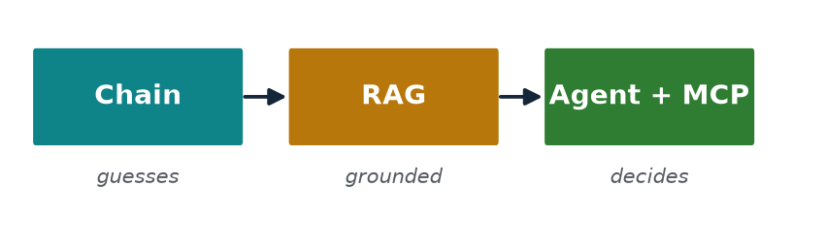
Stage 3 — an Agent orchestrates MCP tools
• recon_server_simulated.py exposes tools: port_scan(), lookup_cve(), list_targets().
• An agent DECIDES which tool to call next instead of following a fixed script.
• Offline deterministic loop shown first; live LangGraph+MCP agent when a key is set.

Slide 11
What the LLM is good and bad at here
• Good: summarizing scans, drafting reports, mapping findings to remediation language.
• Bad: inventing CVE numbers, version facts, and exploit details from memory.
• Design rule: let tools + RAG supply facts; let the LLM do language, not lookup.

Slide 12
Hands-on (Part 2)
• Open code/part2_orchestration_simulated.ipynb and run top to bottom.
• Watch the Stage 1 → 2 → 3 quality improve on the same target.
• Optional: set OPENAI_API_KEY to run the live agent over the MCP server.

Slide 13
Part 3
One Level Further: Real Targets

Slide 14
The notebook: part3_web_pentest_real.ipynb
• Same three stages — now on REAL, authorized targets (default: scanme.nmap.org).
• Recon is non-intrusive: one HTTP GET per call, with an offline cached fallback.
• Backed by recon_server_web.py and web_security_kb.md (OWASP guidance).

Slide 15
Same stages, real data — what changes
• Stage 1 chain now describes a real site — and still hallucinates without grounding.
• Stage 2 RAG grounds findings in OWASP categories and concrete remediation.
• Stage 3 agent chooses tools (headers → guidance) to assemble a grounded report.

Slide 16
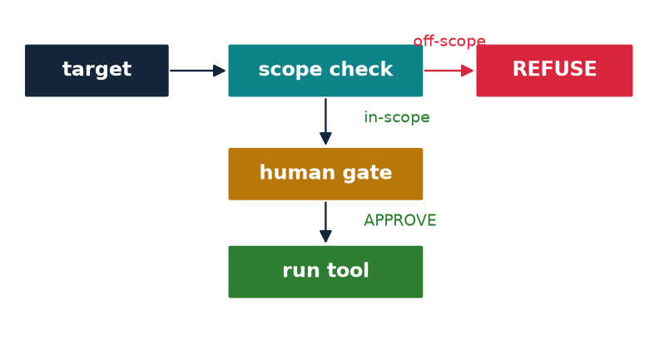
Allowlisting is a control, not a suggestion
• ALLOWED_HOSTS is enforced in the server before any request is made.
• Off-scope target → the tool returns a refusal, not a scan.
• This is how you make automation safe to hand to an agent.

Slide 17
Logging & auditability
• Every tool call and its result should be logged for review.
• Auditability lets a human verify what the agent did — and reproduce it.
• Keep server stderr/logs; never silently swallow a failed or refused call.

Slide 18
Hands-on (Part 3)
• Run code/part3_web_pentest_real.ipynb against an allowed host.
• Try an off-scope host and observe the allowlist refusal.
• Inspect the grounded report, the agent generated report, and compare them to Stage 1's ungrounded draft.

Slide 19
recon_server_web.py — the Stage-3 tools
• fetch_headers() — retrieve HTTP response headers.
• check_security_headers() — flag missing HSTS, CSP, X-Frame-Options, etc.
• get_robots() — read robots.txt.
• lookup_guidance() — OWASP remediation from web_security_kb.md; resource kb://websec.
• Authorization-guarded: calls are refused for hosts outside the allowlist.

Slide 20
Part 4
Final Project: Orchestrated Pen-Test

Slide 21
The task
• Orchestrate a pen-test of your OWN isolated Metasploitable 2 VM (host-only network).
• Start from the simulated pipeline; run it on your REAL scan data.
• Expand the CVE RAG, add tools beyond nmap, and maximize vulnerability coverage.

Slide 22
The scaffold: assignments/project/
• Final_Project_PenTest.ipynb — the student notebook with graded TODOs.
• Final_Project_Requirements.md — full instructions and the rubric.
• project_cve_kb.md — your editable knowledge base to expand.
• solutions/ — instructor Sample Solution notebook + Sample Report (what an A looks like).

Slide 23
Deliverables & rubric highlights
• Completed, runnable notebook with your real scan output.
• Expanded RAG (before/after) — accurate CVEs for Metasploitable services.
• ≥ 2 real tools integrated (MCP-wrapped for full credit) + a second knowledge base.
• Comprehensive report: methodology + an evidence-based chains-vs-RAG-vs-agent comparison.
• Bonus: a live LangGraph + MCP agent making ≥ 2 autonomous tool calls.

Slide 24
Reuse the pattern you already have
• Simulated (Part 2) → Web/real (Part 3) → your own orchestration (project).
• Model new tools on recon_server_simulated.py's @mcp.tool() functions.
• Ground every finding — no ungrounded CVE claims in the report.

Slide 25
Ethics & scope — the rules again
• Everything stays in your isolated lab; report only on your authorized VM.
• Never scan, test, or collect data from systems outside the approved scope.
• Keep API keys and secrets out of any shared or public repository.

Slide 26
Recap & what's next
• You orchestrated RAG + agents + MCP on a real security task, with guardrails.
• Next module (9): Vibe Coding — build, break, and harden an AI-generated web app.
• Questions? Post in the Module 8 discussion forum.

