Slide 1

Self-attention
Hung-yi Lee
李宏毅
Notes:
Check: multi-head attention
=============
Multiple related input example
Same input, different labels
=====
Using DNN to fit
What is the problem? Noisy?
=====
How about
Self-attention
===
All types of ML problems:
Input:
One vector
A set of vectors (seq, image, graph), relation is important
Output:
One vector
Regression (target is a vector: closer is better)
Classification (?????) it is good enough to get a vector
A set of vectors (seq, image, graph)
Output size is known (input-output relation is clear)
Output size is unknown

Slide 2
Sophisticated Input
Input is a vector
Input is a set of vectors
Model
Scalar or Class
Model
Scalars or Classes
(may change length)

Slide 3
Vector Set as Input
this is a cat
One-hot Encoding
Word Embedding
apple = [ 1 0 0 0 0 …… ]
dog
bag = [ 0 1 0 0 0 …… ]
rabbit
run
cat = [ 0 0 1 0 0 …… ]
jump
cat
dog = [ 0 0 0 1 0 …… ]
tree
flower
elephant = [ 0 0 0 0 1 …… ]
To learn more: https://youtu.be/X7PH3NuYW0Q (in Mandarin)
Notes:
給一個需要上下文的例子

Slide 4
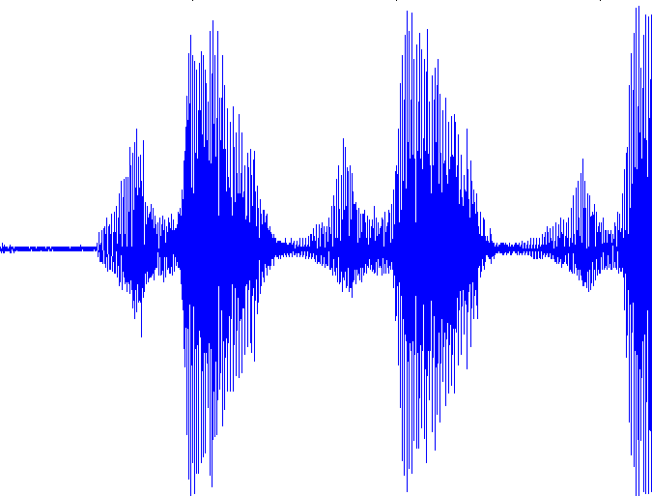
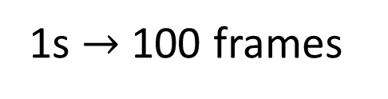
Vector Set as Input
10ms
1s $→$ 100 frames
25ms
400 sample points (16KHz)
39-dim MFCC
80-dim filter bank output
frame
Notes:
數位語音處理 第七章
Speech Signal and Front-end Processing
http://ocw.aca.ntu.edu.tw/ntu-ocw/ocw/cou/104S204/7

Slide 5

Vector Set as Input
https://medium.com/analytics-vidhya/social-network-analytics-f082f4e21b16
Graph is also a set of vectors (consider each node as a vector)
Each profile is a vector
Notes:
http://speech.ee.ntu.edu.tw/~tlkagk/courses/ML2020/GNN.pdf

Slide 6
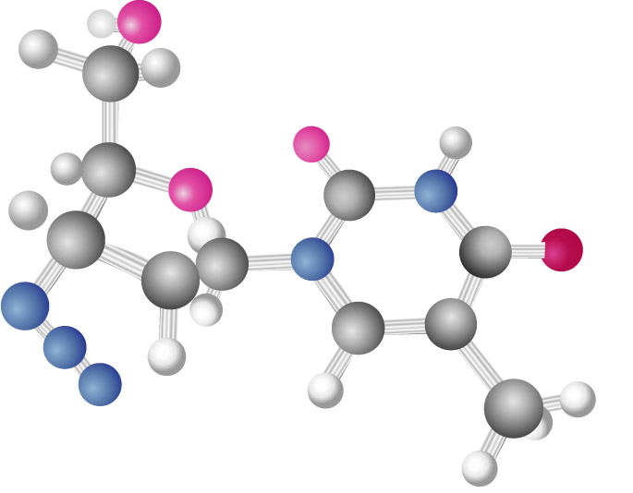
Vector Set as Input
http://www.twword.com/wiki/%E5%88%86%E5%AD%90
Graph is also a set of vectors (consider each node as a vector)
H = [ 1 0 0 0 0 …… ]
C = [ 0 1 0 0 0 …… ]
O = [ 0 0 1 0 0 …… ]
……
One-hot vector
Notes:
http://speech.ee.ntu.edu.tw/~tlkagk/courses/ML2020/GNN.pdf

Slide 7

What is the output?
Each vector has a label.
Model
N
N
Example Applications
not
I saw a saw
N
V
DET
N
a
a
b
b
POS tagging
HW2
buy
buy
Notes:
I don’t have a good example for social network…

Slide 8
What is the output?
Each vector has a label.
Model
N
N
The whole sequence has a label.
Model
Example Applications
this is good
Sentiment analysis
HW4
positive
speaker
hydrophilicity

Slide 9
What is the output?
Each vector has a label.
focus of this lecture
Model
N
N
The whole sequence has a label.
Model
seq2seq
Model decides the number of labels itself.
Model
N
Translation (HW5)
N’

Slide 10
Sequence Labeling
Is it possible to consider the context?
Fully-connected
FC can consider the neighbor
FC
How to consider the whole sequence?
a window covers the whole sequence?
FC
FC
FC
FC
window
I
saw
a
saw
Notes:
Good for HW2, context is good enough

Slide 11

Self-attention
FC
FC
FC
FC
with context
Self-attention
Notes:
https://arxiv.org/abs/1706.03762

Slide 12

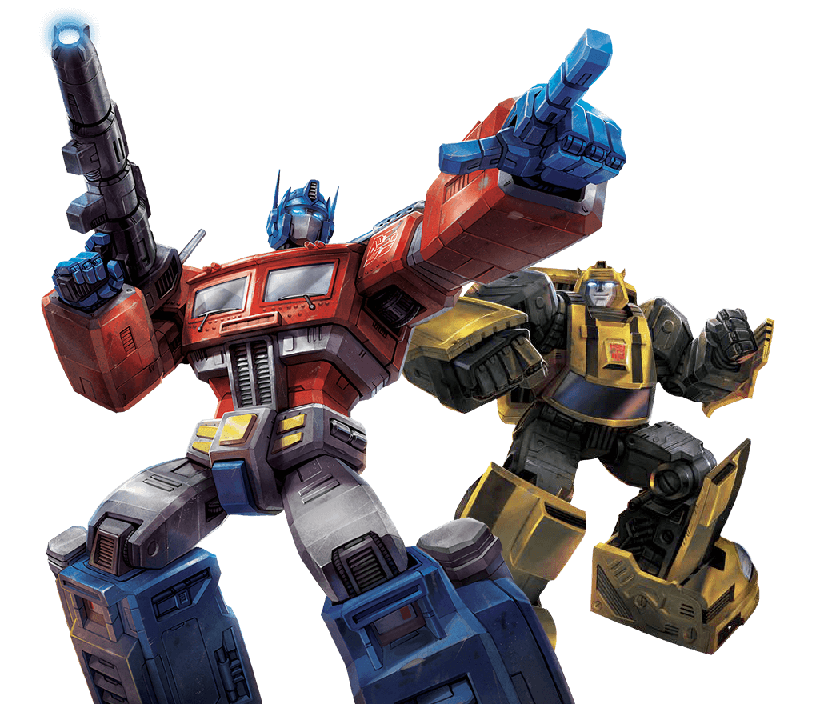
FC
FC
FC
FC
Self-attention
FC
FC
FC
FC
Self-attention
Attention is all you need.
https://arxiv.org/abs/1706.03762

Slide 13








Self-attention
$$b^{1}$$
$$b^{2}$$
$$b^{3}$$
$$b^{4}$$
$$a^{1}$$
$$a^{2}$$
$$a^{3}$$
$$a^{4}$$
Can be either input or a hidden layer

Slide 14

Self-attention
$$b^{1}$$
$$α$$
relevant?
$$a^{1}$$
$$a^{2}$$
$$a^{3}$$
$$a^{4}$$
Find the relevant vectors in a sequence

Slide 15












Self-attention
$$α$$
Additive
$$W$$
Dot-product
$$α$$
$$=q∙k$$
$$tanh$$
$$q$$
$$k$$
$$+$$
$$W^{q}$$
$$W^{k}$$
$$W^{q}$$
$$W^{k}$$
Notes:
Does normalization important???

Slide 16














Self-attention
$$α_{1,2}=q^{1}∙k^{2}$$
$$α_{1,3}=q^{1}∙k^{3}$$
$$α_{1,4}=q^{1}∙k^{4}$$
attention score
$$α_{1,2}$$
$$α_{1,3}$$
$$α_{1,4}$$
$$q^{1}$$
query
$$k^{2}$$
key
$$k^{3}$$
$$k^{4}$$
$$a^{1}$$
$$a^{2}$$
$$a^{3}$$
$$a^{4}$$
$$q^{1}=W^{q}a^{1}$$
$$k^{2}=W^{k}a^{2}$$
$$k^{3}=W^{k}a^{3}$$
$$k^{4}=W^{k}a^{4}$$

Slide 17


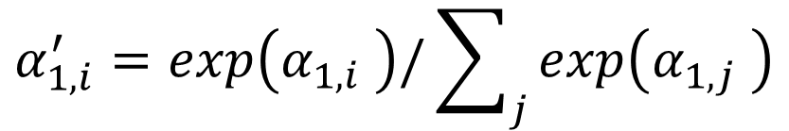





Self-attention
$$α_{1,i}^{′}=exp\left(α_{1,i} \right)/\sum_{j}{exp\left(α_{1,j} \right)}$$
$$α_{1,1}^{′}$$
$$α_{1,2}^{′}$$
$$α_{1,3}^{′}$$
$$α_{1,4}^{′}$$
Soft-max
$$α_{1,1}$$
$$α_{1,2}$$
$$α_{1,3}$$
$$α_{1,4}$$
$$q^{1}$$
$$k^{1}$$
$$k^{2}$$
$$k^{3}$$
$$k^{4}$$
$$a^{1}$$
$$a^{2}$$
$$a^{3}$$
$$a^{4}$$
$$q^{1}=W^{q}a^{1}$$
$$k^{2}=W^{k}a^{2}$$
$$k^{3}=W^{k}a^{3}$$
$$k^{4}=W^{k}a^{4}$$
$$k^{1}=W^{k}a^{1}$$

Slide 18
















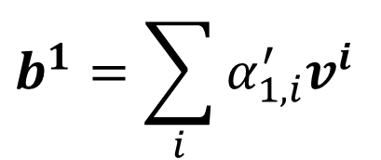
Self-attention
Extract information based on attention scores
$$b^{1}=\sum_{i}{α_{1,i}^{′}v^{i} }$$
$$b^{1}$$
$$α_{1,1}^{′}$$
$$α_{1,2}^{′}$$
$$α_{1,3}^{′}$$
$$α_{1,4}^{′}$$
$$q^{1}$$
$$k^{1}$$
$$v^{1}$$
$$k^{2}$$
$$v^{2}$$
$$k^{3}$$
$$v^{3}$$
$$k^{4}$$
$$v^{4}$$
$$a^{1}$$
$$a^{2}$$
$$a^{3}$$
$$a^{4}$$
$$v^{1}=W^{v}a^{1}$$
$$v^{2}=W^{v}a^{2}$$
$$v^{3}=W^{v}a^{3}$$
$$v^{4}=W^{v}a^{4}$$

Slide 19
Self-attention
parallel
$$b^{1}$$
$$b^{2}$$
$$b^{3}$$
$$b^{4}$$
$$a^{1}$$
$$a^{2}$$
$$a^{3}$$
$$a^{4}$$
Can be either input or a hidden layer

Slide 20




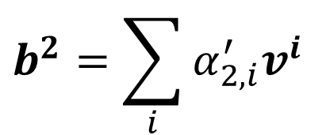




Self-attention
$$b^{2}=\sum_{i}{α_{2,i}^{′}v^{i} }$$
$$b^{2}$$
$$α_{2,1}^{′}$$
$$α_{2,2}^{′}$$
$$α_{2,3}^{′}$$
$$α_{2,4}^{′}$$
$$q^{1}$$
$$k^{1}$$
$$v^{1}$$
$$q^{2}$$
$$k^{2}$$
$$v^{2}$$
$$q^{3}$$
$$k^{3}$$
$$v^{3}$$
$$q^{4}$$
$$k^{4}$$
$$v^{4}$$
$$a^{1}$$
$$a^{2}$$
$$a^{3}$$
$$a^{4}$$
Notes:
Relation between attention and CNN
Global receptive field (compared to convolutional architectures)

Slide 21




































Self-attention
$$q^{1}$$
$$q^{2}$$
$$q^{3}$$
$$q^{4}$$
$$a^{1}$$
$$a^{2}$$
=
$$a^{3}$$
$$q^{i}=W^{q}a^{i}$$
$$W^{q}$$
$$a^{4}$$
$$Q$$
$$I$$
$$a^{1}$$
$$a^{2}$$
$$k^{1}$$
$$a^{3}$$
$$k^{2}$$
$$a^{4}$$
$$k^{3}$$
$$k^{i}=W^{k}a^{i}$$
$$k^{4}$$
=
$$W^{k}$$
$$K$$
$$I$$
$$a^{1}$$
$$a^{2}$$
$$a^{3}$$
$$v^{1}$$
$$a^{4}$$
$$v^{2}$$
$$v^{3}$$
$$v^{i}=W^{v}a^{i}$$
$$v^{4}$$
=
$$W^{v}$$
$$V$$
$$I$$
$$q^{1}$$
$$k^{1}$$
$$v^{1}$$
$$q^{2}$$
$$k^{2}$$
$$v^{2}$$
$$q^{3}$$
$$k^{3}$$
$$v^{3}$$
$$q^{4}$$
$$k^{4}$$
$$v^{4}$$
$$a^{1}$$
$$a^{2}$$
$$a^{3}$$
$$a^{4}$$

Slide 22






















Self-attention
$$α_{1,1}$$
$$k^{1}$$
$$α_{1,1}=$$
$$k^{1}$$
$$q^{1}$$
$$α_{1,2}=$$
$$k^{2}$$
$$q^{1}$$
$$α_{1,2}$$
$$k^{2}$$
$$=$$
$$q^{1}$$
$$α_{1,3}$$
$$k^{3}$$
$$α_{1,3}=$$
$$k^{3}$$
$$q^{1}$$
$$α_{1,4}=$$
$$k^{4}$$
$$q^{1}$$
$$α_{1,4}$$
$$k^{4}$$
$$α_{1,1}$$
$$α_{1,2}$$
$$α_{1,3}$$
$$α_{1,4}$$
$$q^{1}$$
$$k^{1}$$
$$v^{1}$$
$$q^{2}$$
$$k^{2}$$
$$v^{2}$$
$$q^{3}$$
$$k^{3}$$
$$v^{3}$$
$$q^{4}$$
$$k^{4}$$
$$v^{4}$$
Notes:
Relation between attention and CNN
Global receptive field (compared to convolutional architectures)
(ignore $\sqrt{d}$ for simplicity)

Slide 23

















































Self-attention
$$α_{1,1}$$
$$k^{1}$$
$$α_{1,1}=$$
$$k^{1}$$
$$q^{1}$$
$$α_{1,2}=$$
$$k^{2}$$
$$q^{1}$$
$$α_{1,2}$$
$$k^{2}$$
$$=$$
$$q^{1}$$
$$α_{1,3}$$
$$k^{3}$$
$$α_{1,3}=$$
$$k^{3}$$
$$q^{1}$$
$$α_{1,4}=$$
$$k^{4}$$
$$q^{1}$$
$$α_{1,4}$$
$$k^{4}$$
$$α_{2,1}$$
$$α_{2,2}$$
$$α_{2,3}$$
$$α_{2,4}$$
$$q^{1}$$
$$k^{1}$$
$$v^{1}$$
$$q^{2}$$
$$k^{2}$$
$$v^{2}$$
$$q^{3}$$
$$k^{3}$$
$$v^{3}$$
$$q^{4}$$
$$k^{4}$$
$$v^{4}$$
$$α_{1,1}^{′}$$
$$α_{2,1}^{′}$$
$$α_{3,1}^{′}$$
$$α_{4,1}^{′}$$
$$α_{1,1}$$
$$α_{2,1}$$
$$α_{3,1}$$
$$α_{4,1}$$
$$k^{1}$$
$$α_{1,2}^{′}$$
$$α_{2,2}^{′}$$
$$α_{3,2}^{′}$$
$$α_{4,2}^{′}$$
$$α_{1,2}$$
$$α_{2,2}$$
$$α_{3,2}$$
$$α_{4,2}$$
$$k^{2}$$
$$α_{1,3}^{′}$$
$$α_{2,3}^{′}$$
$$α_{3,3}^{′}$$
$$=$$
$$q^{1}$$
$$q^{2}$$
$$q^{3}$$
$$q^{4}$$
$$α_{4,3}^{′}$$
$$α_{1,3}$$
$$α_{2,3}$$
$$α_{3,3}$$
$$α_{4,3}$$
$$k^{3}$$
$$α_{1,4}^{′}$$
$$α_{2,4}^{′}$$
$$α_{3,4}^{′}$$
$$α_{4,4}^{′}$$
$$α_{1,4}$$
$$α_{2,4}$$
$$α_{3,4}$$
$$α_{4,4}$$
$$k^{4}$$
$$Q$$
$$A′$$
softmax
$$A$$
$$K^{T}$$
Notes:
Relation between attention and CNN
Global receptive field (compared to convolutional architectures)

Slide 24







































Self-attention
$$b^{1}$$
$$α_{1,1}^{′}$$
$$α_{1,2}^{′}$$
$$α_{1,3}^{′}$$
$$α_{1,4}^{′}$$
$$q^{1}$$
$$k^{1}$$
$$v^{1}$$
$$q^{2}$$
$$k^{2}$$
$$v^{2}$$
$$q^{3}$$
$$k^{3}$$
$$v^{3}$$
$$q^{4}$$
$$k^{4}$$
$$v^{4}$$
$$α_{1,1}^{′}$$
$$α_{2,1}^{′}$$
$$α_{3,1}^{′}$$
$$α_{4,1}^{′}$$
$$α_{1,2}^{′}$$
$$α_{2,2}^{′}$$
$$α_{3,2}^{′}$$
$$α_{4,2}^{′}$$
$$b^{1}$$
=
$$b^{2}$$
$$b^{3}$$
$$b^{4}$$
$$v^{1}$$
$$v^{2}$$
$$v^{3}$$
$$v^{4}$$
$$α_{1,3}^{′}$$
$$α_{2,3}^{′}$$
$$α_{3,3}^{′}$$
$$α_{4,3}^{′}$$
$$O$$
$$V$$
$$α_{1,4}^{′}$$
$$α_{3,4}^{′}$$
$$α_{2,4}^{′}$$
$$α_{4,4}^{′}$$
$$A′$$
Notes:
Relation between attention and CNN
Global receptive field (compared to convolutional architectures)

Slide 25
















Self-attention
$$Q$$
=
$$I$$
$$W^{q}$$
$$K$$
=
$$I$$
$$W^{k}$$
$$V$$
=
$$I$$
$$W^{v}$$
Parameters to be learned
$$A′$$
$$A$$
=
$$Q$$
$$K^{T}$$
Attention Matrix
$$A′$$
$$O$$
=
$$V$$
Notes:
反正就是一堆矩陣乘法，用 GPU 可以加速

Slide 26
























Multi-head Self-attention
Different types of relevance
$$q^{i,1}=W^{q,1}q^{i}$$
$$b^{i,1}$$
$$q^{i,2}=W^{q,2}q^{i}$$
$$q^{i,1}$$
$$q^{i,2}$$
$$k^{i,1}$$
$$k^{i,2}$$
$$v^{i,1}$$
$$v^{i,2}$$
$$q^{j,1}$$
$$q^{j,2}$$
$$k^{j,1}$$
$$k^{j,2}$$
$$v^{j,1}$$
$$v^{j,2}$$
$$q^{i}$$
$$k^{i}$$
$$v^{i}$$
$$q^{j}$$
$$k^{j}$$
$$v^{j}$$
$$q^{i}=W^{q}a^{i}$$
$$a^{i}$$
(2 heads as example)
$$a^{j}$$

Slide 27

Multi-head Self-attention
Different types of relevance
$$q^{i,1}=W^{q,1}q^{i}$$
$$b^{i,1}$$
$$q^{i,2}=W^{q,2}q^{i}$$
$$b^{i,2}$$
$$q^{i,1}$$
$$q^{i,2}$$
$$k^{i,1}$$
$$k^{i,2}$$
$$v^{i,1}$$
$$v^{i,2}$$
$$q^{j,1}$$
$$q^{j,2}$$
$$k^{j,1}$$
$$k^{j,2}$$
$$v^{j,1}$$
$$v^{j,2}$$
$$q^{i}$$
$$k^{i}$$
$$v^{i}$$
$$q^{j}$$
$$k^{j}$$
$$v^{j}$$
$$q^{i}=W^{q}a^{i}$$
$$a^{i}$$
(2 heads as example)
$$a^{j}$$

Slide 28
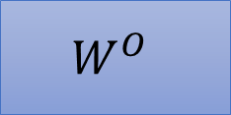

Multi-head Self-attention
Different types of relevance
$$b^{i,1}$$
$$b^{i}$$
=
$$W^{O}$$
$$b^{i,2}$$
$$q^{i,1}$$
$$q^{i,2}$$
$$k^{i,1}$$
$$k^{i,2}$$
$$v^{i,1}$$
$$v^{i,2}$$
$$q^{j,1}$$
$$q^{j,2}$$
$$k^{j,1}$$
$$k^{j,2}$$
$$v^{j,1}$$
$$v^{j,2}$$
$$q^{i}$$
$$k^{i}$$
$$v^{i}$$
$$q^{j}$$
$$k^{j}$$
$$v^{j}$$
$$q^{i}=W^{q}a^{i}$$
$$a^{i}$$
(2 heads as example)
$$a^{j}$$

Slide 29
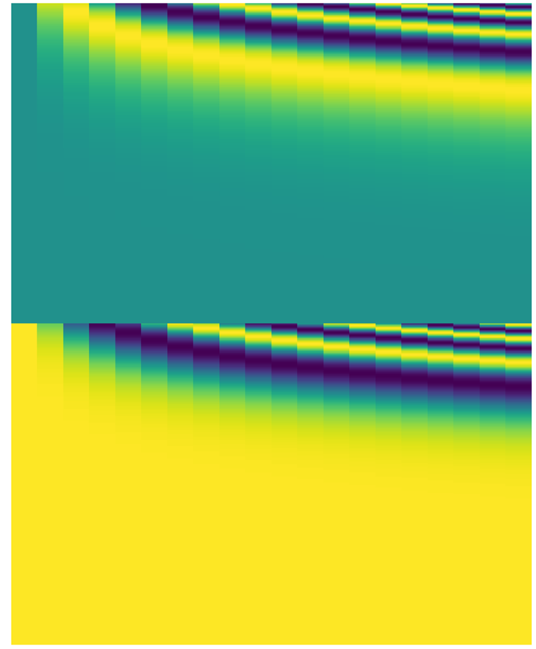

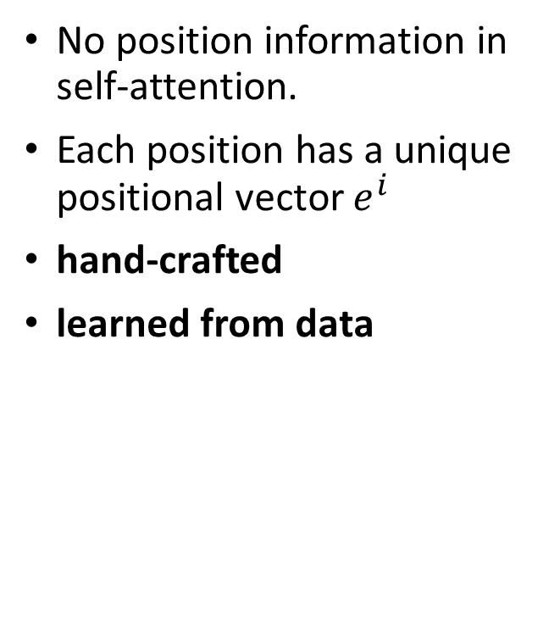




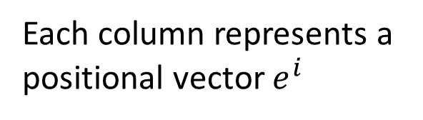
Positional Encoding
Each column represents a positional vector $e^{i}$
No position information in self-attention.
Each position has a unique positional vector $e^{i}$
hand-crafted
learned from data
$$q^{i}$$
$$k^{i}$$
$$v^{i}$$
$$e^{i}$$
+
$$a^{i}$$
-1
1
Notes:
A real example of positional encoding for 20 words (rows) with an embedding size of 512 (columns). You can see that it appears split in half down the center. That's because the values of the left half are generated by one function (which uses sine), and the right half is generated by another function (which uses cosine). They're then concatenated to form each of the positional encoding vectors.

Slide 30
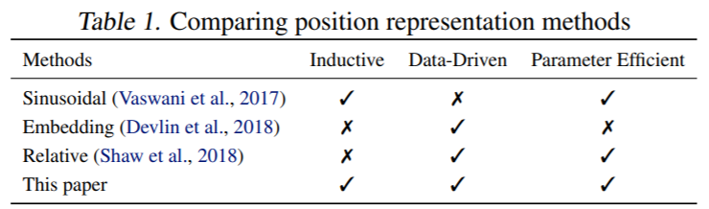
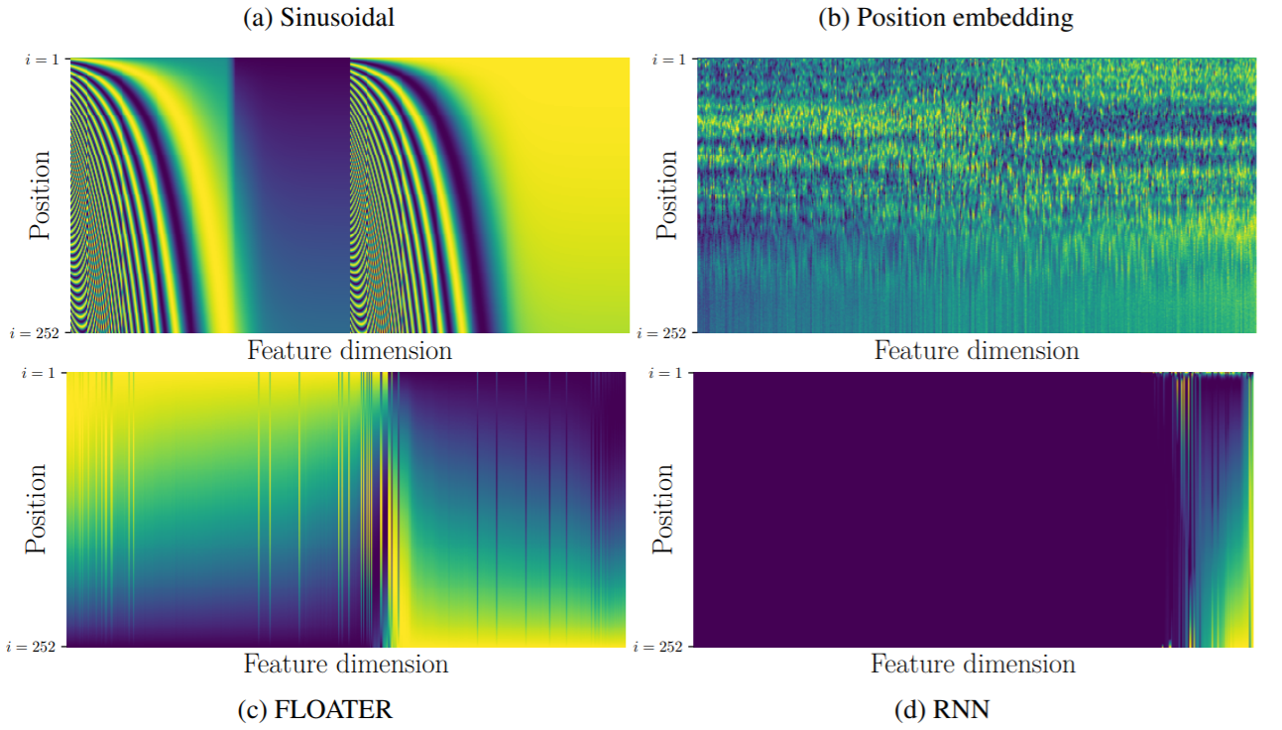
https://arxiv.org/abs/2003.09229
Notes:
Neural ODE
FLOATER is the proposed method in this paper.

Slide 31
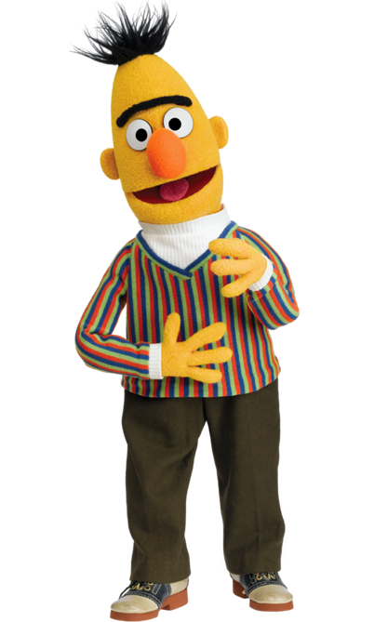
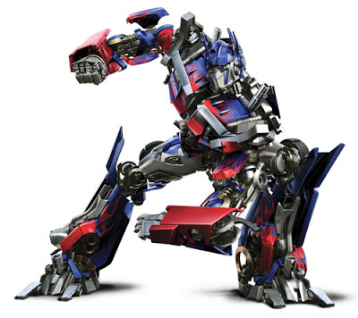
Many applications …
Transformer
BERT
https://arxiv.org/abs/1706.03762
https://arxiv.org/abs/1810.04805
Widely used in Natural Langue Processing (NLP)!

Slide 32

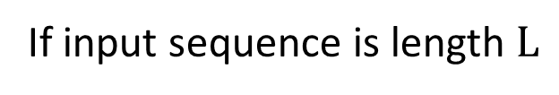










Self-attention for Speech
https://arxiv.org/abs/1910.12977
Attention in a range
Speech is a very long vector sequence.
$$b^{1}$$
$$b^{2}$$
$$b^{3}$$
$$b^{4}$$
10ms
If input sequence is length $L$
$$A′$$
$$L$$
$$a^{1}$$
$$a^{2}$$
$$a^{3}$$
$$a^{4}$$
Attention Matrix
$$L$$
Truncated Self-attention

Slide 33
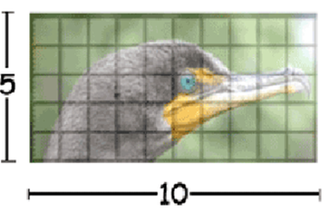
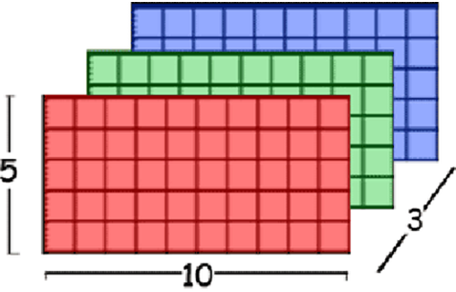
Self-attention for Image
An image can also be considered as a vector set.
This is a vector.
Source of image: https://www.researchgate.net/figure/Color-image-representation-and-RGB-matrix_fig15_282798184

Slide 34
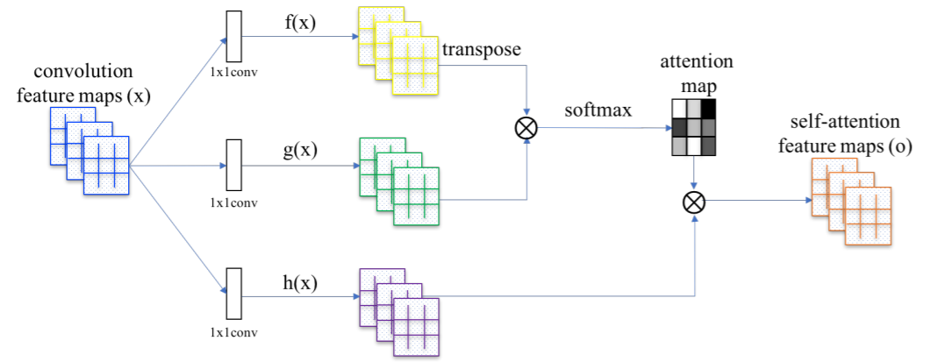
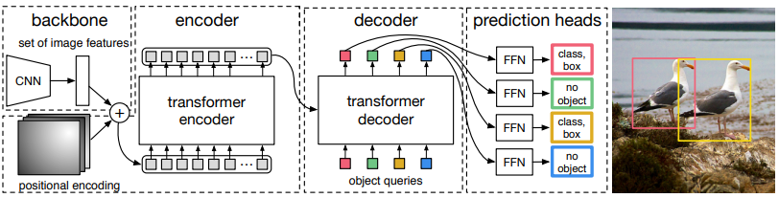
Self-Attention GAN
https://arxiv.org/abs/1805.08318
DEtection Transformer (DETR)
https://arxiv.org/abs/2005.12872
Notes:
https://github.com/facebookresearch/detr
https://arxiv.org/abs/2005.12872
https://analyticsindiamag.com/object-detection-with-transformers/

Slide 35
Self-attention v.s. CNN
1 | 0 | 0 | 0 | 0 | 1
0 | 1 | 0 | 0 | 1 | 0
0 | 0 | 1 | 1 | 0 | 0
1 | 0 | 0 | 0 | 1 | 0
0 | 1 | 0 | 0 | 1 | 0
0 | 0 | 1 | 0 | 1 | 0
CNN: self-attention that can only attends in a receptive field
1 | 0 | 0 | 0 | 0 | 1
0 | 1 | 0 | 0 | 1 | 0
0 | 0 | 1 | 1 | 0 | 0
1 | 0 | 0 | 0 | 1 | 0
0 | 1 | 0 | 0 | 1 | 0
0 | 0 | 1 | 0 | 1 | 0
1 | 0 | 0 | 0 | 0 | 1
0 | 1 | 0 | 0 | 1 | 0
0 | 0 | 1 | 1 | 0 | 0
1 | 0 | 0 | 0 | 1 | 0
0 | 1 | 0 | 0 | 1 | 0
0 | 0 | 1 | 0 | 1 | 0
CNN is simplified self-attention.
Self-attention: CNN with learnable receptive field
Self-attention is the complex version of CNN.

Slide 36
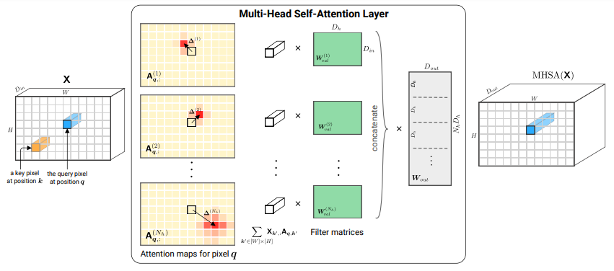
Self-attention v.s. CNN
Self-attention
CNN
On the Relationship between Self-Attention and Convolutional Layers
https://arxiv.org/abs/1911.03584
Notes:
Shall I explain this more …?
ICLR 2020

Slide 37
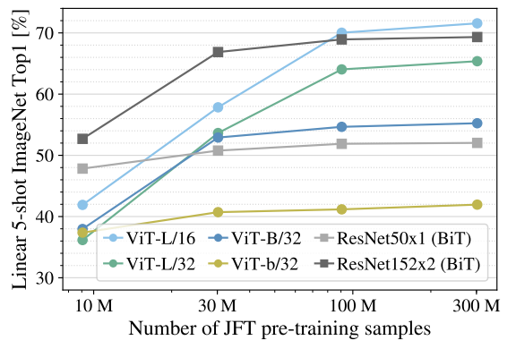
Self-attention v.s. CNN
Good for more data
Self-attention
Good for less data
CNN
An Image is Worth 16x16 Words: Transformers for Image Recognition at Scale
https://arxiv.org/pdf/2010.11929.pdf
Notes:
Self needs more data to work
Vision Transformer (ViT)
ViT-L/16 means the “Large” variant with 16×16 input patch size.

Slide 38

Self-attention v.s. RNN
Recurrent Neural Network (RNN)
FC
FC
FC
FC
memory
RNN
RNN
RNN
RNN
hard to consider
nonparallel
parallel
Self-attention
easy to consider
Transformers are RNNs: Fast Autoregressive Transformers with Linear Attention
https://arxiv.org/abs/2006.16236
Notes:
RNN + attention https://arxiv.org/abs/1611.08656

Slide 39


To learn more about RNN ……
https://youtu.be/xCGidAeyS4M
https://youtu.be/Jjy6ER0bHv8
(in Mandarin)
(in English)

Slide 40
Self-attention for Graph
Attention Matrix
1
2
1
2
3
4
5
6
7
8
1
8
3
2
3
4
7
4
5
6
5
6
7
Consider edge: only attention to connected nodes
8
0
This is one type of Graph Neural Network (GNN).
Notes:
Graph Attention Networks

Slide 41


Self-attention for Graph
To learn more about GNN …
https://youtu.be/eybCCtNKwzA
https://youtu.be/M9ht8vsVEw8
(in Mandarin)
(in Mandarin)

Slide 42
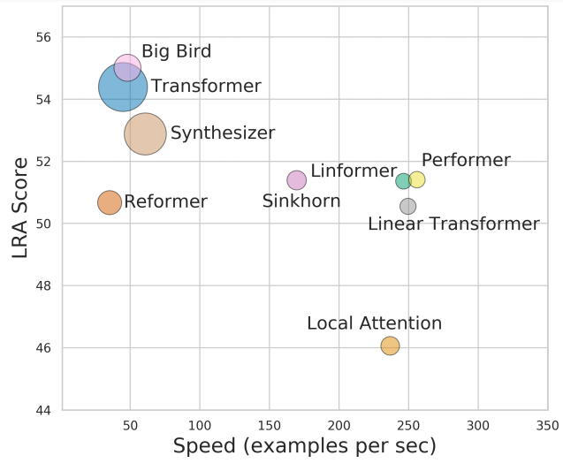
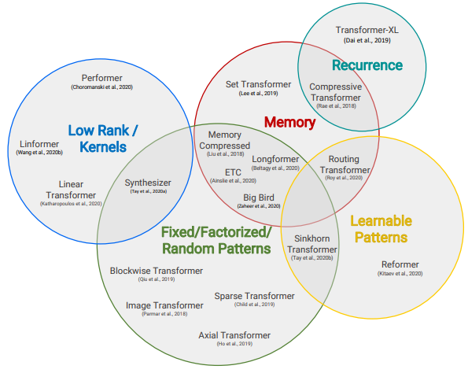
To Learn More …
Long Range Arena: A Benchmark for Efficient Transformers
https://arxiv.org/abs/2011.04006
Efficient Transformers: A Survey
https://arxiv.org/abs/2009.06732
Notes:
Arena 競技場

Slide 43


