Slide 1


Modeling the Impact of MMR Vaccination Strategies on Measles Outbreaks in Texas
Boya Peng, PhD student

Slide 2

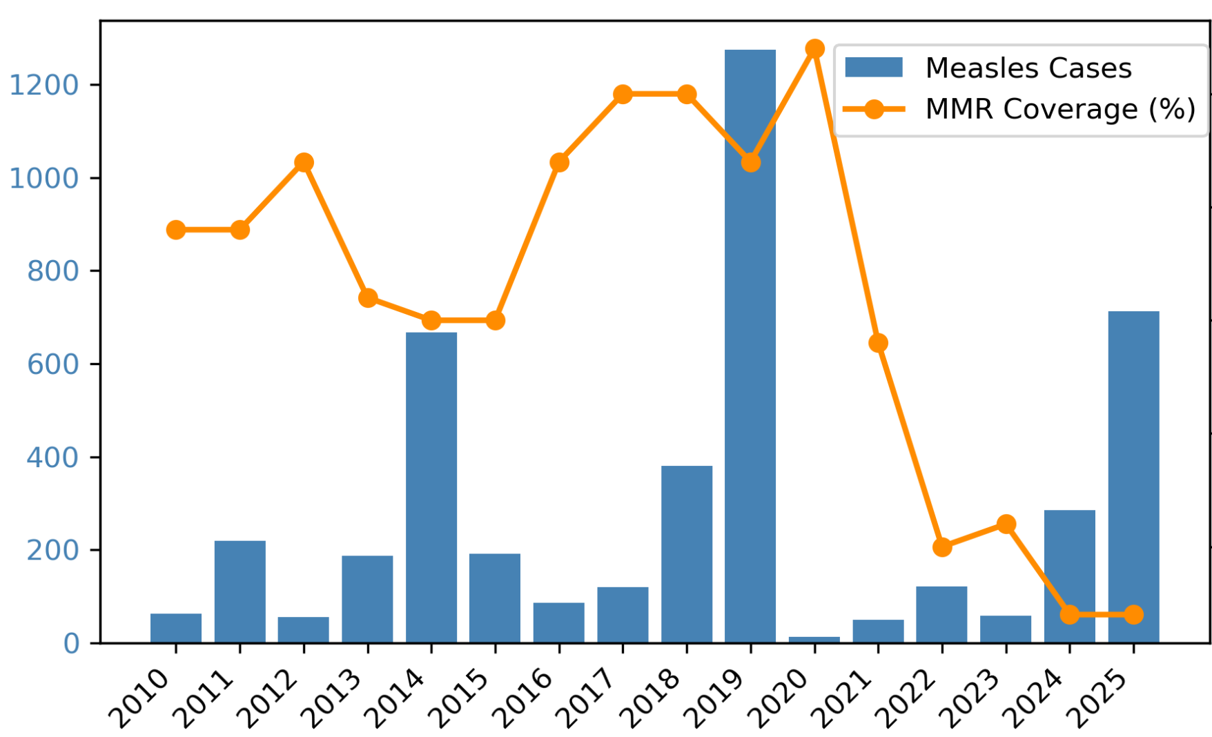
Measles and MMR Vaccination
Negative Relationship between Measles and MMR Coverage
Data Source: CDC
94.7
94
92.7
Notes:
US, significant Negative relationship;
downward trend in coverage alarming, threat people’s health even life

Slide 3
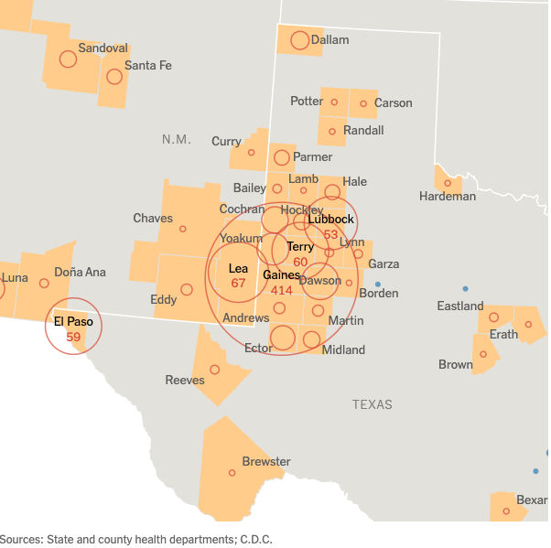
Measles and MMR Vaccination
2025: Measles Outbreak in West Texas and nearby states
(The New York Times, 2025)
Notes:
Texas -> 2 imported cases in Harris -> biggest in Gaines

Slide 4
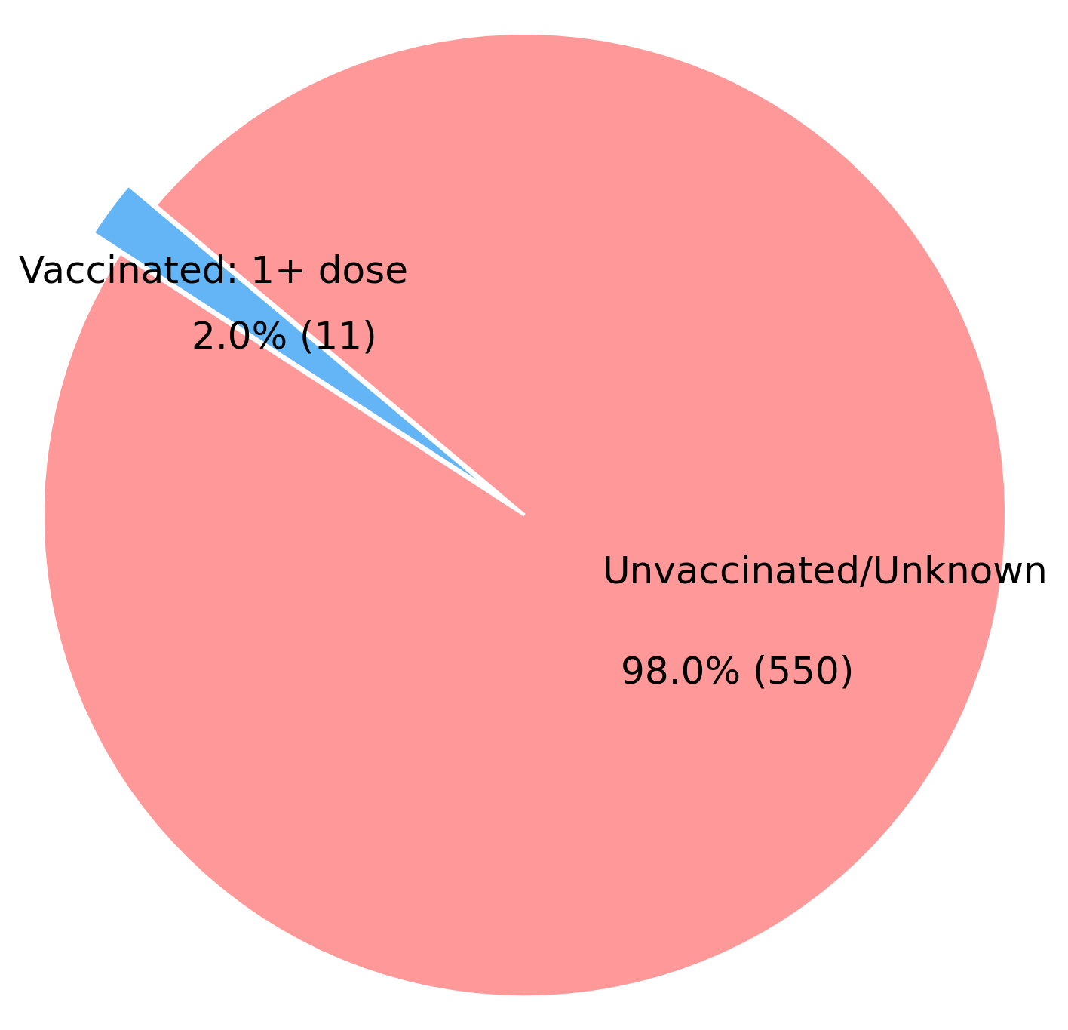
Measles and MMR Vaccination
2025: Measles Outbreak in West Texas and nearby states
98% Cases in Texas outbreak are Unvaccinated
Data Source: DSHS
(The New York Times, 2025)
Notes:
Among all the people recorded, 98% unvaccinated.
-> model transmission dynamics and investigate in vaccination strategies

Slide 5
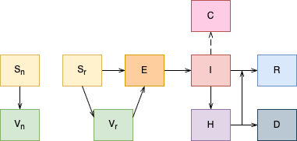
SEIR Modeling
Reported Case
"Non-risk" Susceptible
"At-risk" Susceptible
Leaky vaccination model
Age structure
Reporting rate
Susceptible rate
"Non-risk" Vaccinated
"At-risk" Vaccinated
Notes:
parameters calibration: gaines county through least square fit, age-specific transmission rate and susceptible rate

Slide 6
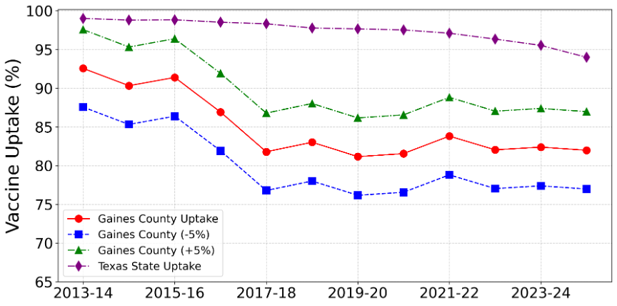
Scenario Analysis
Baseline scenario with reported MMR vaccination rates
Reduced vaccination uptake scenario with 5% reduction in MMR vaccination rates
Increased vaccination uptake scenario with 5% Increase in MMR vaccination rates

Slide 7
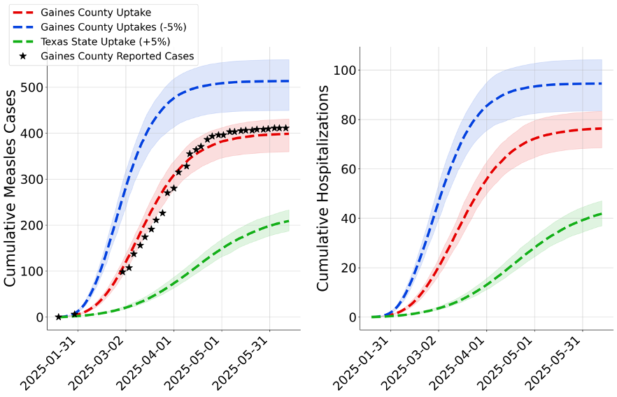
Model Result
Raising vaccination coverage by 5% could prevent 190 cases (95% CI: 144–234), while a 5% reduction may result in 112 additional cases (95% CI: 40-169) in Gaines County.

Slide 8
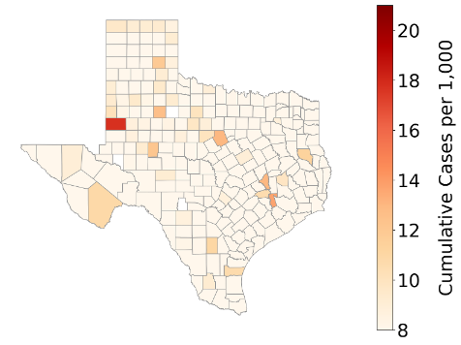
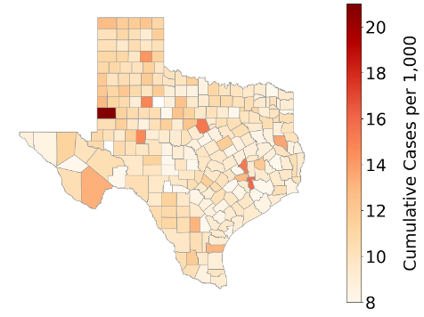
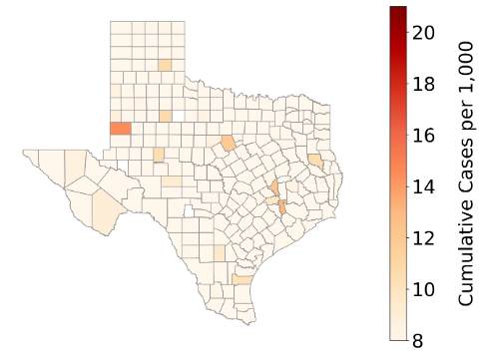
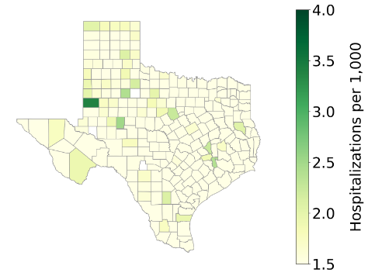
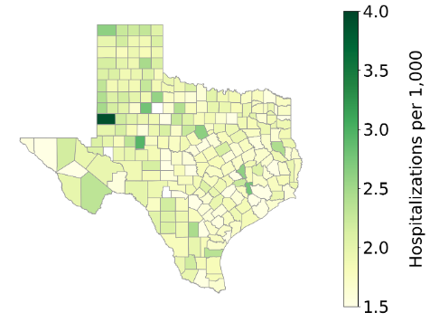
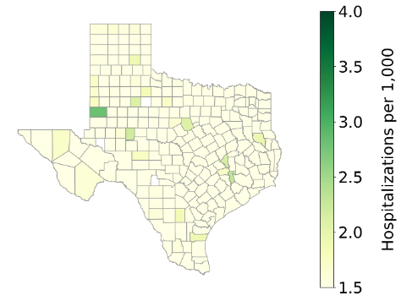
What If …
Apply estimated parameters to all counties
Gaines Uptake
-5% Uptake
+5% Uptake

Slide 9
Take Home Messages
Implication: Efforts to maintain or boost vaccination coverage are critical.
Limitations: The analysis assumes independent county transmission (no spatial correlation).
Future research: Incorporating spatial transmission and heterogeneity in contact patterns.

Slide 10

Thank You
Bi K, Nguyen T, Peng B, et al. Modeling the Impact of MMR Vaccination Strategies on Measles Outbreaks in Texas. JAMA Health Forum. 2025;6(9):e253992. doi:10.1001/jamahealthforum.2025.3992
Boya Peng
boya.peng@uth.tmc.edu

