Slide 1
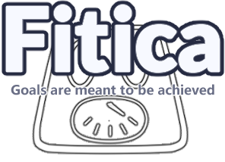
The Effectiveness of User-Centred Design Process

Slide 2
User-Centered Design Process and our Fitness App
- Initially, we utilised investigative methods, such as Questionnaires and Interviews, to understand our target Young Audience.
- Usability testing was the most specific and helpful way for us to improve our prototype
- User-Centred Design Process helped us create the interface that favors Young Users, including Users with hearing impairment.
- The evolution of our interface via User-Centred Design Processes can be seen in the following slides.

Slide 3
Help Users To Navigate The Interface
How User-Centered Design Processes evolved our interface to:
- During our usability testing, we noticed how important clear and well-designed navigation was for ensuring a good user experience.
- Through this, our usability testing tasks had a strong focus on traversing through the prototype, using the various navigation options present.
- With this we were able to realise the issues present, such as a lack of navigation options and lack of navigation labelling.
Notes:
Examples of issues that we can use to discuss for this part:
No back buttons: Issue 11
Adding a navbar: Issue 13
Labels on main navbar: Issue 12
Home page button being a plus icon: Issue 21

Slide 4
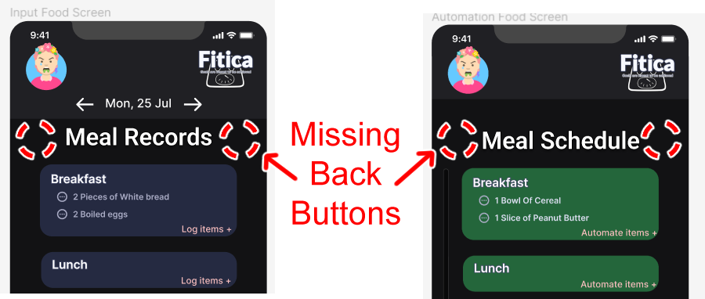
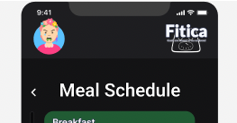
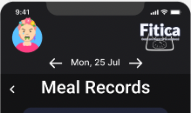
Help Users To Navigate The Interface
How User-Centered Design Processes evolved our interface to:
Issue #11
Lack of back buttons
User Control and Freedom
Final design
#11
Before
Fixes Issues​
Notes:
Examples of issues that we can use to discuss for this part:
No back buttons: Issue 11
Adding a navbar: Issue 13
Labels on main navbar: Issue 12
Home page button being a plus icon: Issue 21

Slide 5


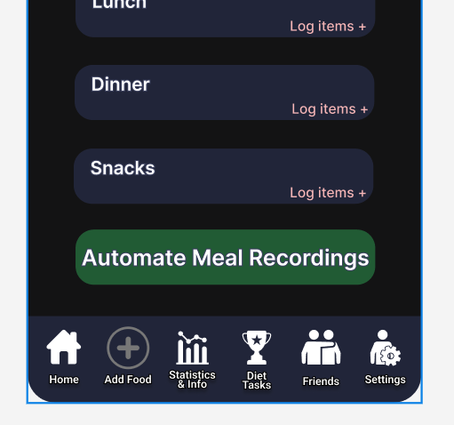
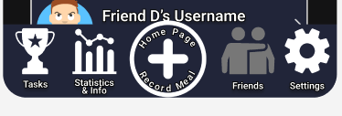
Help Users To Navigate The Interface
How User-Centered Design Processes evolved our interface to:
Issue #12, #13, #17, #21, #24
Issues with Central navbar
User Control and Freedom
Before
First iteration
Fixes Issue #13
Final design
Fixes Issues #17, #21, #24
Second iteration
Fixes: Issue #12

Slide 6
Prevent Unnecessary Errors
How User-Centred Design Processes evolved our interface to:
- During our Usability Tests, we noticed a few times where Participants accidentally tapped on an element that could potentially cause irreversible effects.
- As such, we've introduced popup windows that would ask for confirmation and remapped buttons to fit User's existing smartphone schema.
- Usability Test helped us strengthen the Safety and Utility of our interface by highlighting our lack of Error Prevention Heuristics.
Notes:
Examples of issues that we can use to discuss for this part:
No back buttons: Issue 11
Home page button being a plus icon: Issue 21
Switching the buttons around: Issue 23
Barcode scanning: Issue 9

Slide 7
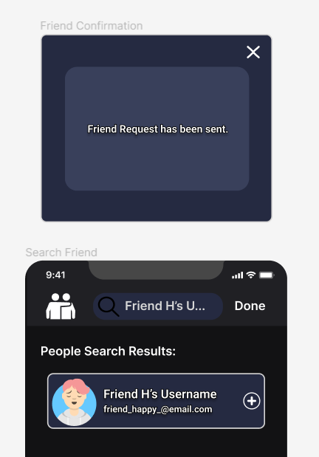
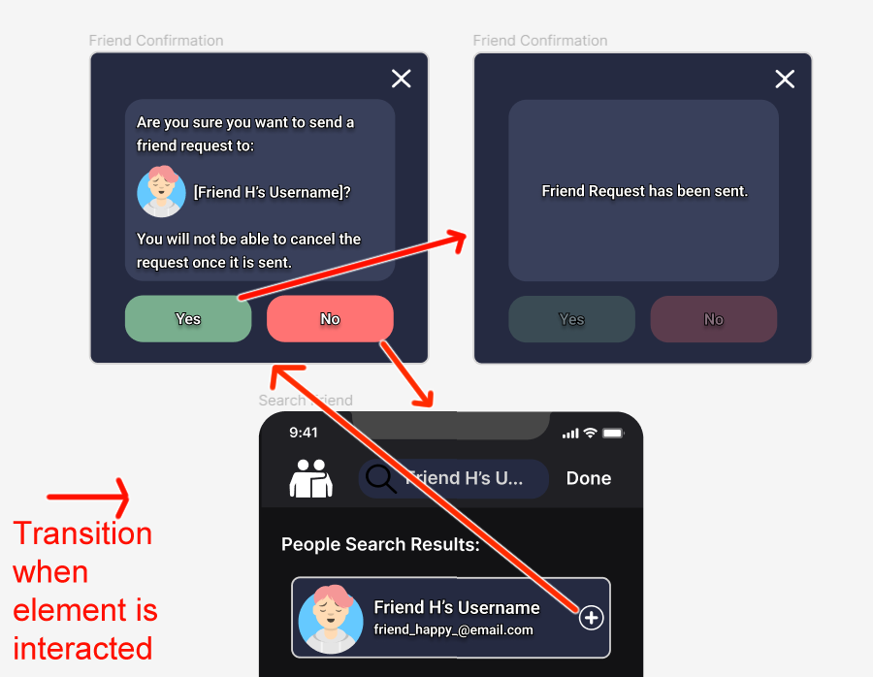

Prevent Unnecessary Errors
How User-Centred Design Processes evolved our interface to:
Issue #3
Lack of Confirmation Pop-ups
Error Prevention
Pop-up
Confirmation
Now prevents accidental friend requests (and awkward situations).
Final design
Fixes Issues #3
Before

Slide 8
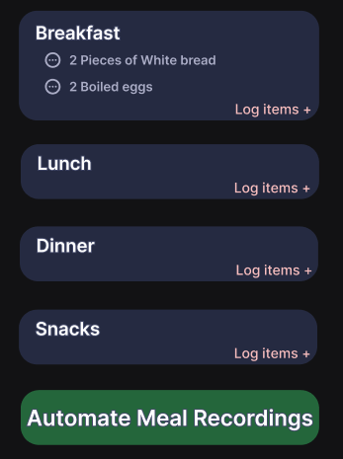
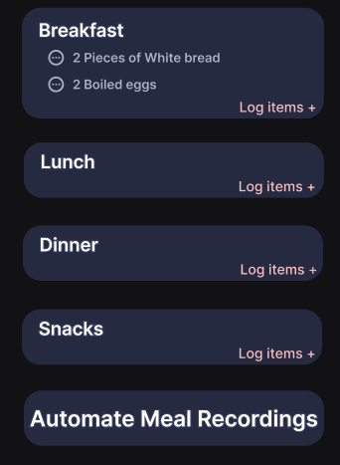
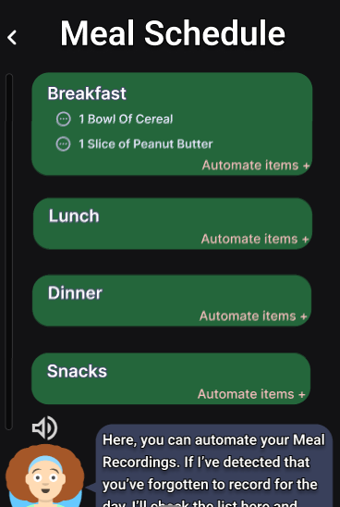
Prevent Unnecessary Errors
How User-Centred Design Processes evolved our interface to:
Issue #4
Hard to differentiate buttons and their purpose
Visibility
Final design
Fixes Issues #4
Automate Meal Recordings are now in a different colour. User's will have an easier time identifying where to automate their meals.
Before

Slide 9
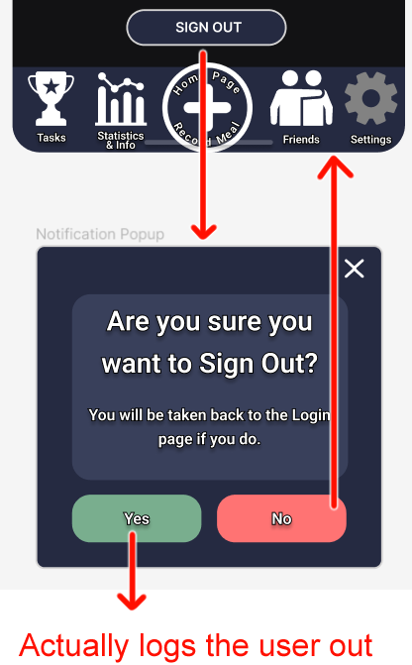

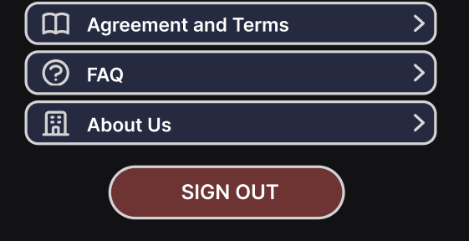
Prevent Unnecessary Errors
How User-Centred Design Processes evolved our interface to:
Issue #7, #8
Lack of Confirmation Pop-ups
Error Prevention
Added a confirmation pop-up and cultural constraints on the button
Before
First iteration​
Fixes: Issue #7
Final design
Fixes Issues #8

Slide 10
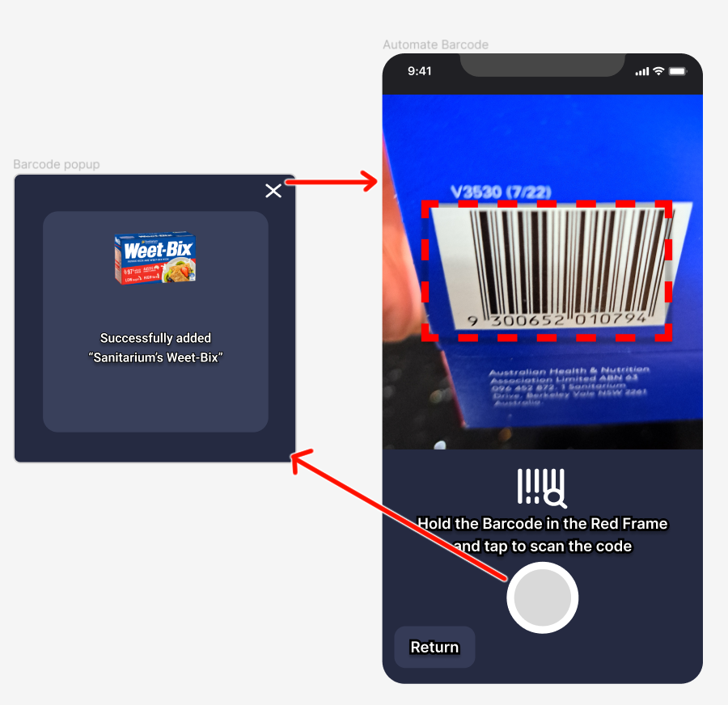
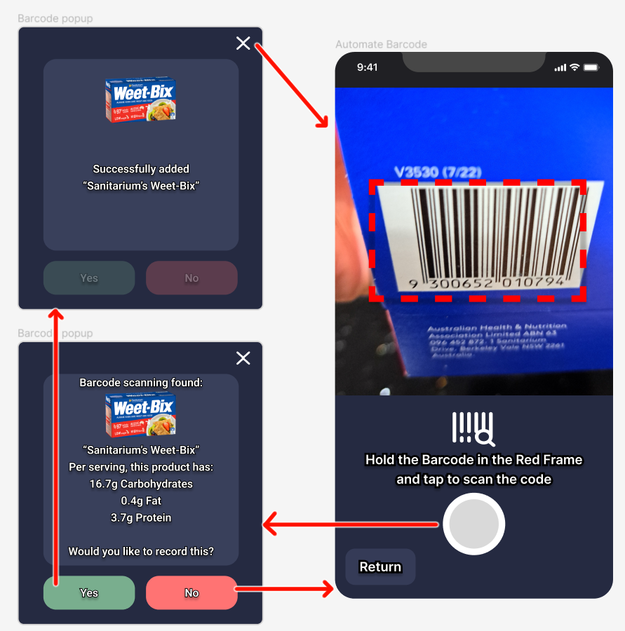
Prevent Unnecessary Errors
How User-Centred Design Processes evolved our interface to:
Issue #9
Lack of Confirmation Pop-ups
Error Prevention
Added Confirmation
Popup when scanning in barcodes
Final design
Fixes Issues #9
Before

Slide 11
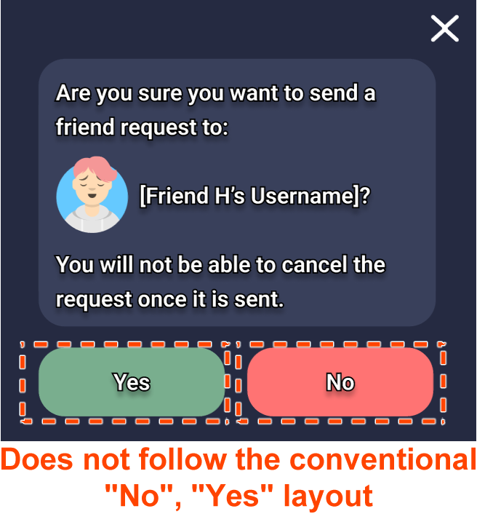
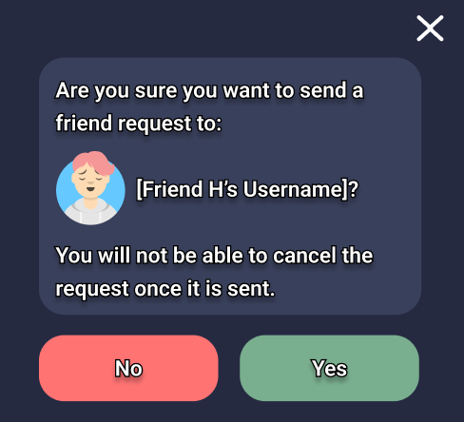
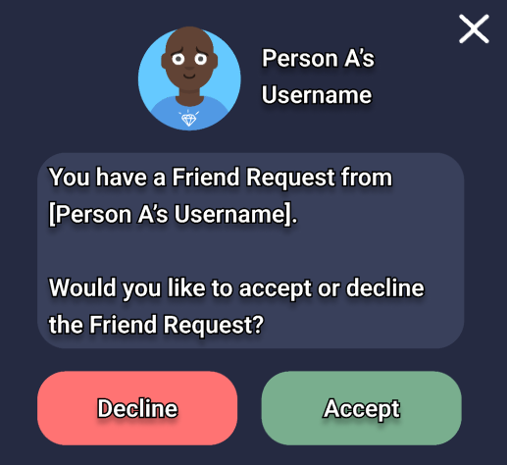
Prevent Unnecessary Errors
How User-Centred Design Processes evolved our interface to:
Issue #23
Poor Button Mappings
Error Prevention
And all other "Yes"/"No" popups...
Before
Final design
Fixes Issues #23
Notes:
Swapped the buttons around, as people are more familiar with the Cancellation button on the far left rather than the far right. Having it the other way around will contradict with the User’s perceived schema, leading to an awkward User experience.

Slide 12

Cater to Audience Who're Hard of Hearing
How User-Centred Design Processes evolved our interface to:
- Fitica features an artificial dietician that communicates with Users via voice prompts.
- As such, it is important that our interface caters to those who can't hear the voice prompts.
- We include a closed caption feature in our interface for users who are hard of hearing.
- Usability Test showed us that there needs to be an indication that there was sound playing in the first place.

Slide 13
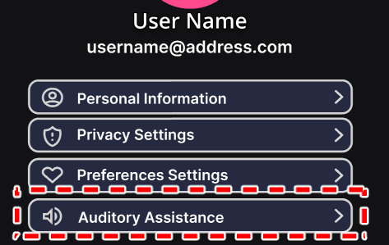

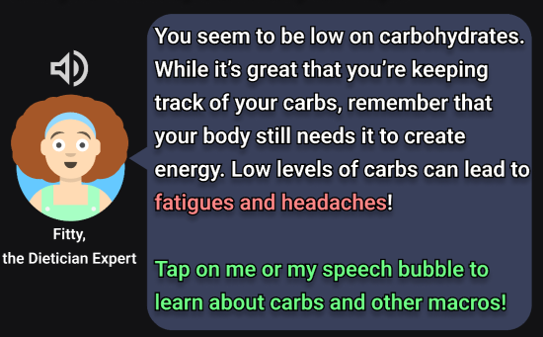
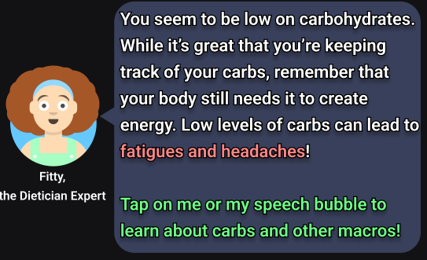

Cater to Audience Who're Hard of Hearing
How User-Centred Design Processes evolved our interface to:
Audio icon shows that a voice clip is currently being played.
Speech bubble acts as the closed captions.
Issue Reference: #6

Slide 14

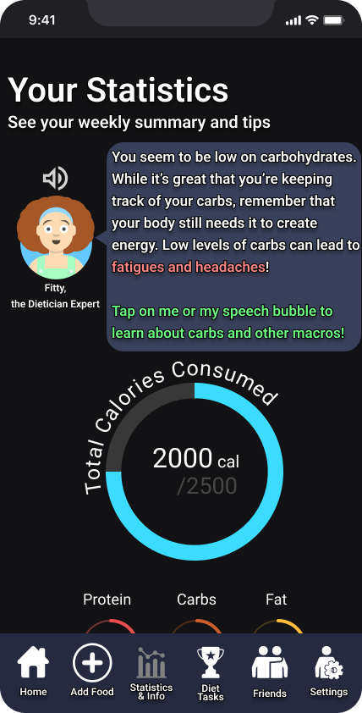
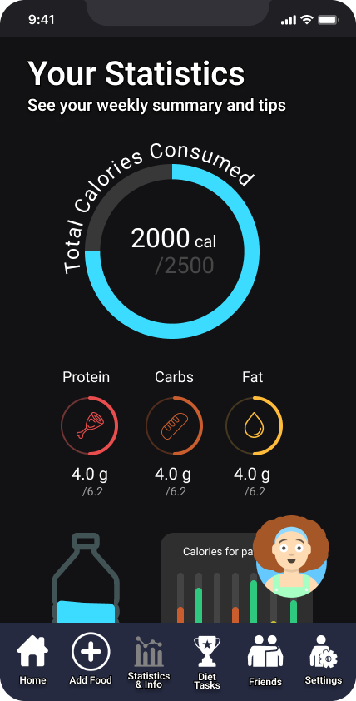
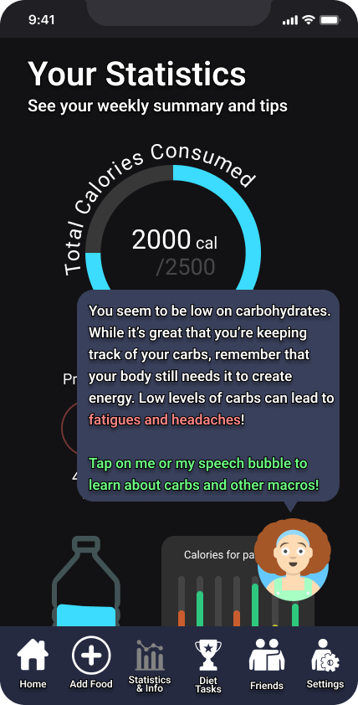
Balance accessibility with design principles
How User-Centred Design Processes evolved our interface to:
BEFORE
AFTER
- Decreased visibility of statistics → decreased efficiency → dissatisfaction
- Solution: The dialog box is hidden by default and only appears when Fitty's icon is clicked
- Allows users with hearing impairments to see the full dialog while not compromising design principles

Slide 15
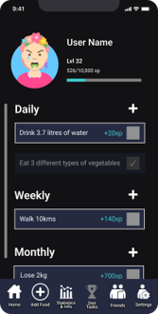
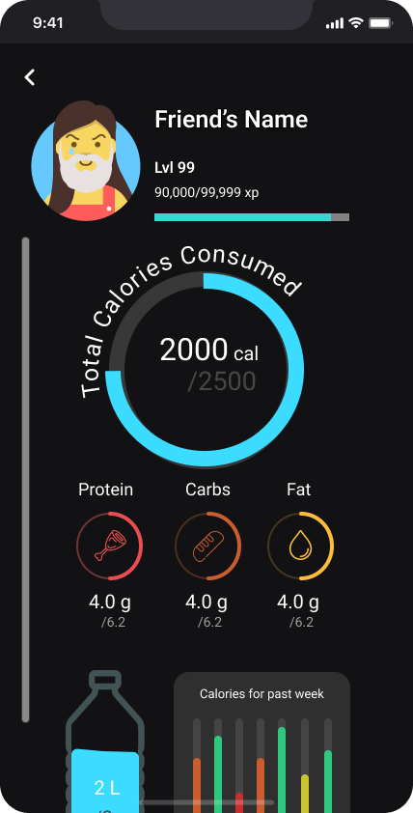
Cater to a Young Audience
How User-Centred Design Processes evolved our interface to:
- Initial focus on gamification elements such as providing goals, and level progression
- Not many participants were interested due to lack of a meaningful reward
- Large interest in friend system, to stay accountable
- Solution: combine the gamification and friend system

Slide 16
Conduct an interview
Design Process that did not work or could be improved:
Process that did not work:
- The initial interviewing process only included 15 participants.
- It would be more beneficial for our interface development if we had a larger sample of participants.
- As we were limited to peers and family members, our findings are potentially very biased. Finding someone with hearing impairments can also be difficult.
Possible solutions:
- Reach a wider audience through remote Questionnaires/Usability Testing. The downside is that we won't be able to observe participants, but we'll get more data from a more diverse set of participants, while limiting bias and determining the data averages.

Slide 17
Pre/Post-Questionnaire
Design Process that did not work or could be improved:
Process that did not work:
- Asking too many questions for Usability Testing which takes up too much time for participants.
- Asking participants to formulate too many Task Scenarios also took up their time.
- A lot of the Task Scenarios were duplicated.
Possible solutions:
- Significantly fewer questions number and focus on asking more open-ended questions.
- Combine various Task Scenarios into one, get rid of management related Task Scenarios such as "Login" and "Logout".

Slide 18
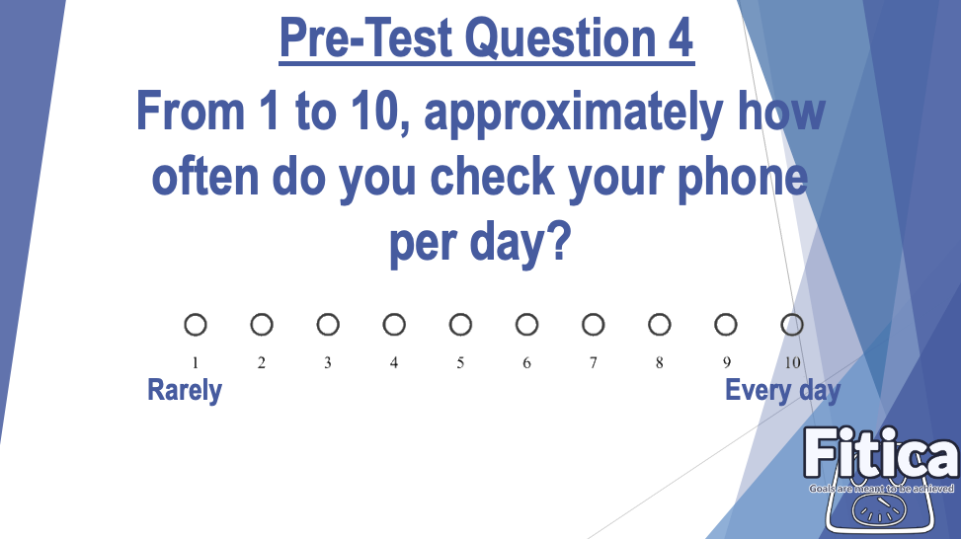
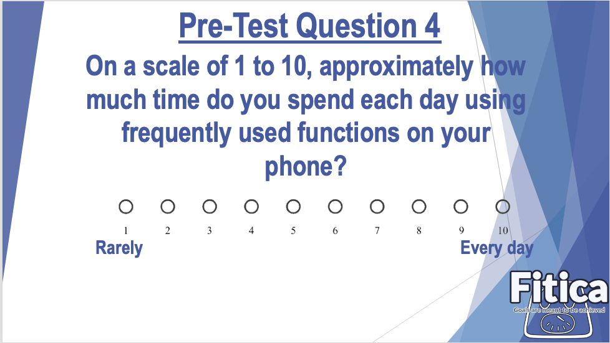
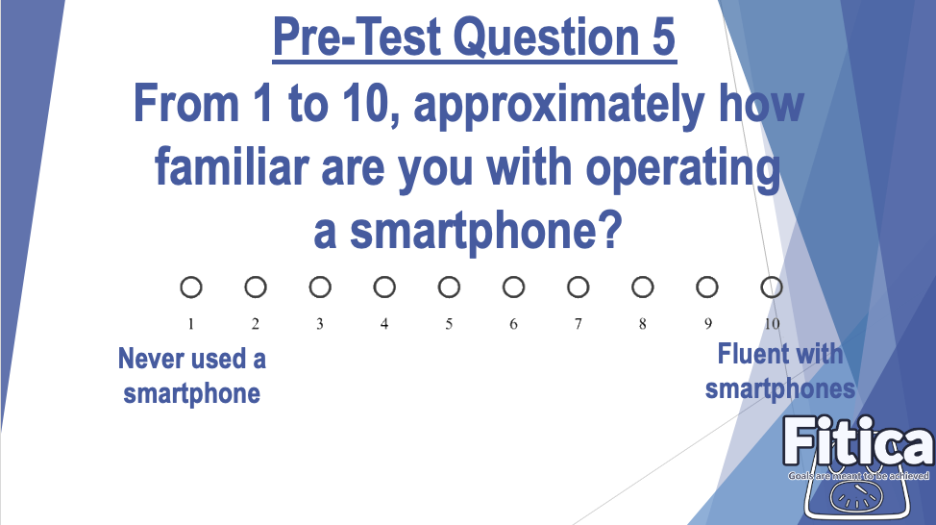
Improvement for Pre-Questionnaire
Design Process that did not work or could be improved:
Issue:
Very similar questions create redundancy in the questionnaire.
Solution:
Merge two similar questions into one question, which can reduce the duplication of questions and save participant's time.

Slide 19
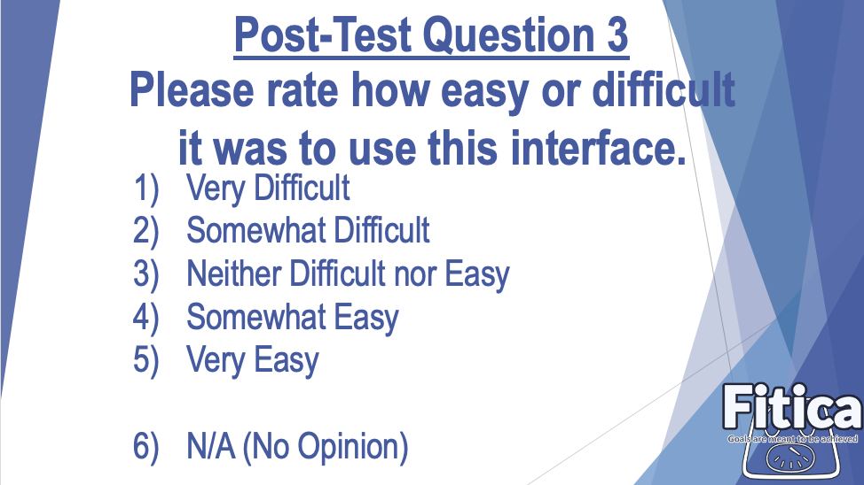
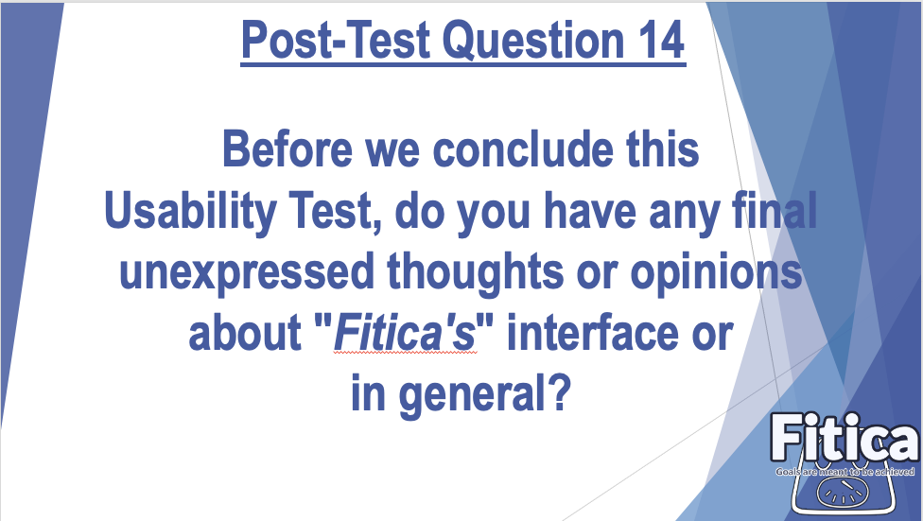
Improvement for Post-Questionnaire
Design Process that did not work or could be improved:
Issue:
Totally 14 post-questions made participants spend too much time.
Solution:
If questions are highly repetitive, delete or merge them into one question.
Eliminate unnecessary, low-product-related questions, thereby reducing the number of questions and saving participant's time.

Slide 20
Reflection Influence of conducting User Research as a Group
Advantage of Group Problem Solving Power:
- More diverse and creative ideas during brainstorming sessions and while designing the Interface.
- Leads to discourse and discussions on features, leading to a stronger product in the end.
- A large group means a wider range of participants for our Interviews and Usability Testing. This means less biased interview results.
Disadvantage of Group Problem Solving Power:
- A group of 5 made it hard to decide on a meeting time due to different Time Zones and schedules. Hard to co-ordinate team members and explore everyone's ideas.
- Difficult to work simultaneously on individual sections due to having to readjust for other's preferences

Slide 21
Reflection Discoveries
- It was very important to make our Participants of our Interviews and Usability Tests as comfortable as possible.
- Be aware of how they're feeling
- Ask Questions about their thoughts and opinions
- Establish a safe and relaxed Environment
- Don't push our own opinions onto the participants
- If any of the above is not met, the process may yield unfavourable or biased results.

Slide 22
Reflection Discoveries
- The evolution of our Interface before and after Usability Testing is very drastic.
- This highlighted to us about the importance of having the target audience involved in Interface designing, as they'll be able to point out flaws quicker than Interface Designers.
- Having them involved is crucial, as the interface is meant to be designed for and used by that target audience, meaning they will have a better understanding of what's required in the interface.

Slide 23
Presented By: Enoch Luu Gordon Wang Noah Gordon Sanojan Thiyagaraja Wang Liao
End.
(z5319999)
(z5309206)
(z5259716)
(z5207855)
(z5306312)

