Slide 1
Welcome to this study!
Use the LEFT and RIGHT arrow keys on the keyboard to navigate through the instructions.
The LEFT key will go back to the previous instruction screen.
The RIGHT key will go to the next instruction screen

Slide 2
Today we will ask you to play a game.
You’re helping a knight slay a dragon.
To do so, you will judge three shapes shown beside each other.
Two are identical and one is the odd one out.
The knight moves forward towards the dragon when you correctly identify which one is the odd one out.
We will show you an example on the next screen.

Slide 3
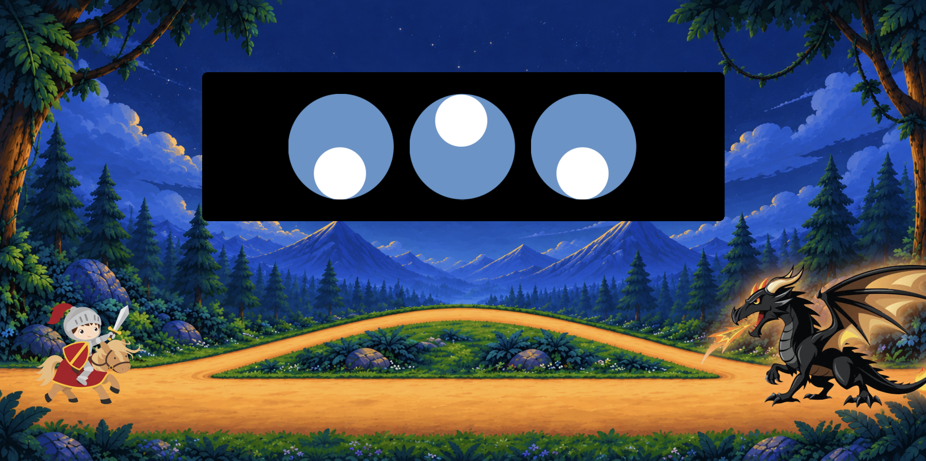
Here, the middle shape is the odd one out.
In other words, the white circle in the left and right shape are pointing down,
but the circle in the middle shape is pointing up.

Slide 4



In this example, the right shape is the odd one out because
the left and middle shape are pointing down and the right
shape is pointing up.

Slide 5
To pick which shape is the odd one out, use the
Q, W, and E keys on your keyboard to choose the
left, middle, or right shape respectively.

Slide 6
So here, you would press the E key because the
right shape is the odd one out.

Slide 7
To get the hang of the game, you will now have the chance to practice.
During this practice phase, you will see three shapes.
You will then have to press the correct key based on which shape is the odd one out.
After you press a key, we will tell you whether you got the answer correct or not.
If you did not understand the instructions so far, press LEFT to go back and read them again.
If you feel ready to start practicing, press RIGHT.

Slide 8
Great job!
You should now have a good understanding of how the game works.
Moving forward, the main rules will be the same but a couple of things will be different.
We’ll review these changes on the next screen.

Slide 9
Time limit
You will now be under time pressure to answer.
If you don't answer in time, the shapes will change.
Because of this, you will need to do your best to answer both quickly and accurately.
NOTE: This time limit may feel fast, so stay focused!
No correct feedback
We will no longer tell you whether you picked the correct shape.

Slide 10
Money
You can now earn real bonus money by reaching the dragon.
Each successfully completed round earns $0.25.
There are 15 rounds, so you can earn up to $3.75 in bonus money.
IMPORTANT:
You will only win the money if you respond accurately. Specifically,
you have to correctly pick the odd shape out 75% of the time.
Otherwise you will not win any money that round.

Slide 11
Picking up a sword
Sometimes, the knight will be missing his sword.
He will need to take a detour to pick it up, before reaching the dragon.
The knight will automatically pick up the sword once he reaches it.

Slide 12
These are all the instructions for today. Here is a quick review.
- Judge which shape is the odd one out of the three.
- Press Q, W, or E for the left, middle, or right shape respectively.
- Correct answers move your knight forward.
- The knight may have to pick up a sword on an alternate path, or already have it.
- Earn $0.25 once you reach the dragon only if you are at least 75% accurate.
- Your bonus will be added to your base pay at the end.

Slide 13
To be sure you understand all the instructions, we will ask you to complete a short quiz on what you have just learned.
Press RIGHT to answer these short questions.

Slide 14
Thank you for answering these questions.
Those are all the instructions for today.
If anything is unclear to you, use the LEFT key to go back through the instructions.
Otherwise, press the RIGHT key to start the game!
Good luck!

