Slide 1


Slide 2

Airbnb
Airbnb is an online marketplace that connects people who want to rent out their homes with people who are looking for accommodations in that locale.
It currently covers more than 100,000 cities and 220 countries worldwide

Slide 3
Research question:
Predict NYC Airbnb Rental Prices
Project Detail
As 2019, this data set contains almost 50 thousand Airbnb listings in NYC. The purpose
of this task is to predict the price of NYC Airbnb rentals based on the data provided and
any external dataset with relevant information.
Research

Slide 4
Project Process
Import packages and data frame creation.
Cleaning data
3. EDA Process
4. Machine learning
5. Conclusion

Slide 5
DATA
Dataset
Since 2008, guests and hosts have used Airbnb to expand on traveling possibilities and
present more unique, personalized way of experiencing the world. This dataset describes
the listing activity and metrics in NYC, NY for 2019.
This dataset contains 16 columns and over 48,800 rows.

Slide 6


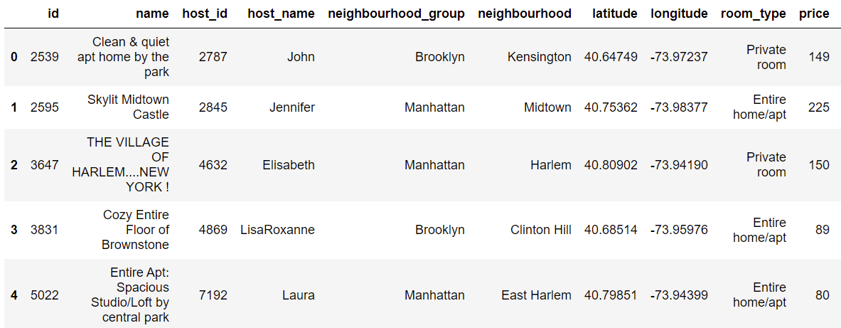
DATA
Data was taken from Kaggle

Slide 7

CLEANING DATA
Find NULL And fill them
Check the data variable like ‘price’
Clear Outliers
Drop the unnecessary columns

Slide 8
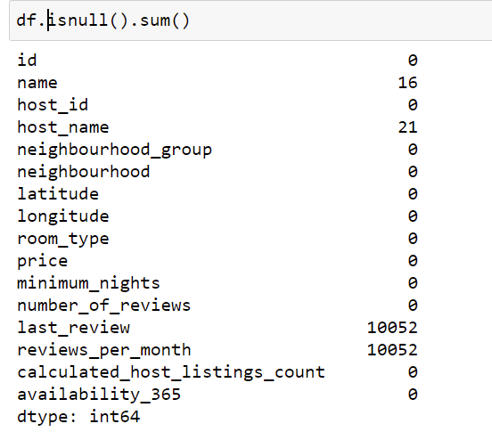
CLEANING DATA
First find NULL And fill them

Slide 9
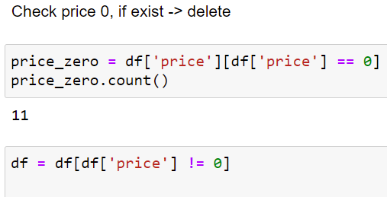
CLEANING DATA
Checking the price variable

Slide 10
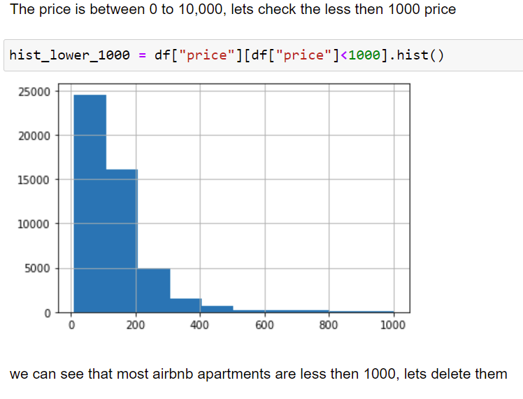
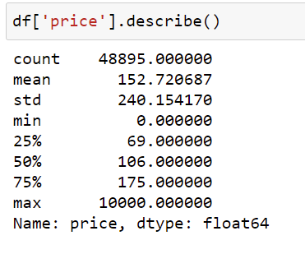
CLEANING DATA
Checking the price virable

Slide 11
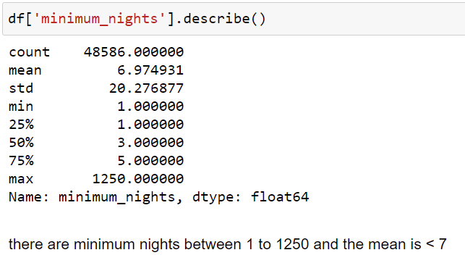
CLEANING DATA
Checking the minimum night
We can see that the minimum nights is between 1 to 1250 and the mean is less then 7, lets check this.

Slide 12

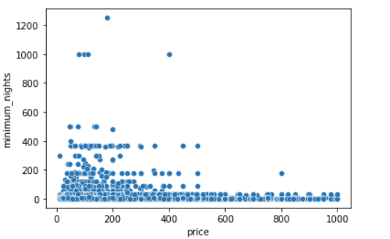
CLEANING DATA
We can see that the most minimum nights are under than 40
We can see clearly outliers

Slide 13

CLEANING DATA
Dropping the unnecessary columns
After the data research, we realize that we have values ​​not useful for machine learning.
Lets drop them.

Slide 14
EDA
Exploratory data analysis (EDA) is used by data scientists to analyze and investigate data sets and summarize their main characteristics, often employing data visualization methods. It helps determine how best to manipulate data sources to get the answers you need, making it easier for data scientists to discover patterns, spot anomalies, test a hypothesis, or check assumptions.
Most of the graphs were used by us to learn the data, find exceptional data and clear the information

Slide 15
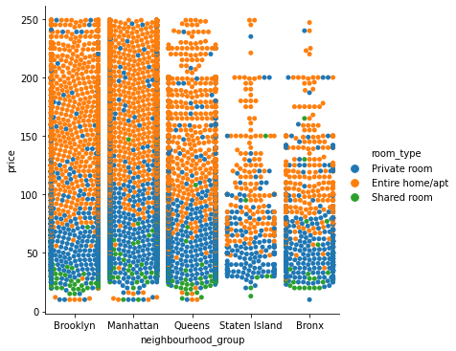
EDA
Check the connection between room type to price, each neighborhood group, easy to see that:
Shared room are the cheapest after the private rooms and the entie home/apt is the most expensive room type

Slide 16
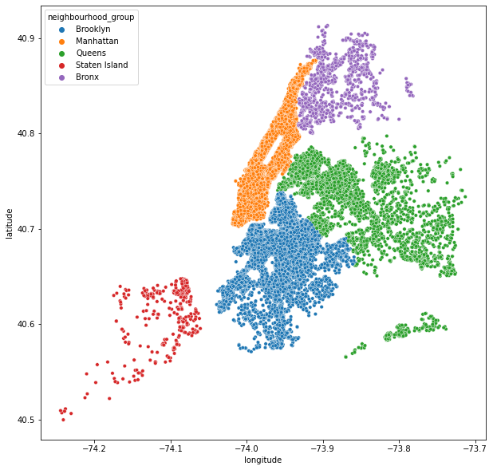
EDA
Distribution of listing in NYC
For each Neighborhood group

Slide 17
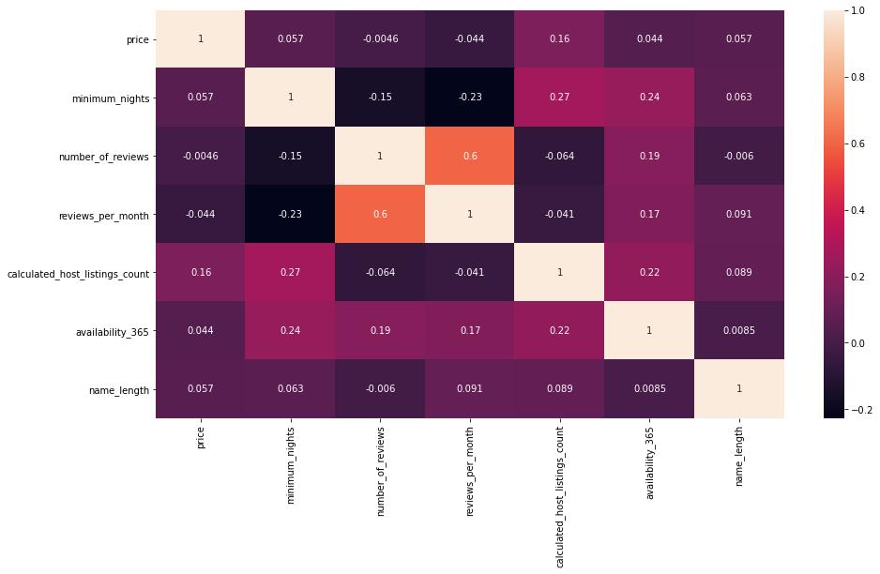
EDA
The Coloration between all the columns

Slide 18
Machine Learning
Machine learning is the study of computer algorithms that improve automatically through experience and by the use of data. It is seen as a part of artificial intelligence. Machine learning algorithms build a model based on sample data, known as "training data", in order to make predictions or decisions without being explicitly programmed to do so
In our project we are using Linear Regression, Lasso Regression

Slide 19
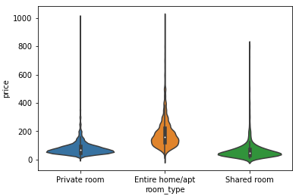
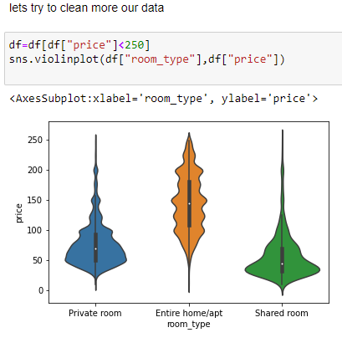

Machine
Learning –
Linear Regression
Lets look on price outlier
Using `sklearn` library and linear regression we were able to train a model that predicts what will be the Airbnb price in NYC.
The R2 is too low lets look on our data

Slide 20


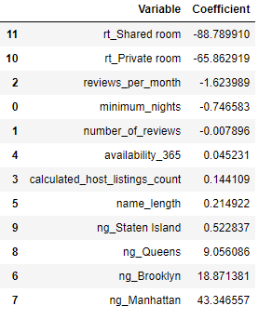
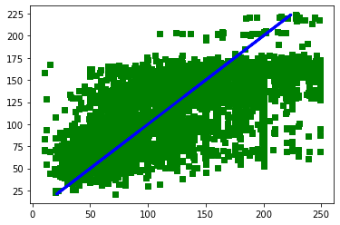
Machine Learning-
Linear Regression
After cleaning the data:

Slide 21
Machine Learning-
Lasso Regression
We will use Lasso regression because it has the ability to nullify parameters that do not improve the model. Also, the dataset isn't large enough and hence Lasso is a good choice as it would add a little bit bias but reduce variance greatly. Starting with alpha=0.1 We can use crossvalidation and check for many values for alpha to find best one, but I will save this process for the next model which I think will procduce better results.

Slide 22

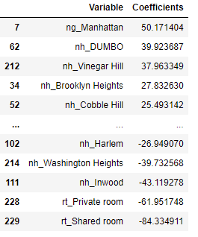
Machine Learning-
Lasso regression
We used the lasso regression on data set that refers to neighborhood
The R2 is :

Slide 23
Conclusion
We first look at the Adjusted R square value since this is a Multiple linear regression. It tell us that our independent variables can explain 50.6% of variations in our dependent variable, which is price.
The constant or the y intercept has a value of 109.56. This means that putting all other x variables at 0, an Entire Apt/Home in Bronx will have a predicted price of 109.56. Remember when we created dummy variables we dropped one dummy from each column which we use as reference. the dropen dummies was: Entire Apt/Home and Bronx.
Let's now look at the coefficients. The coefficient of Manhattan is 43.34. We interpret as: Everything else being constant, an Entire Apt/ Home in Manhattan will cost 43.34 more that same in Bronx. We can similarly interpret coefficient of minimum night as: With everything else being constant, with every one unit increase in minimum number of nights, the predicted price decreases by 0.8075.

