Slide 1
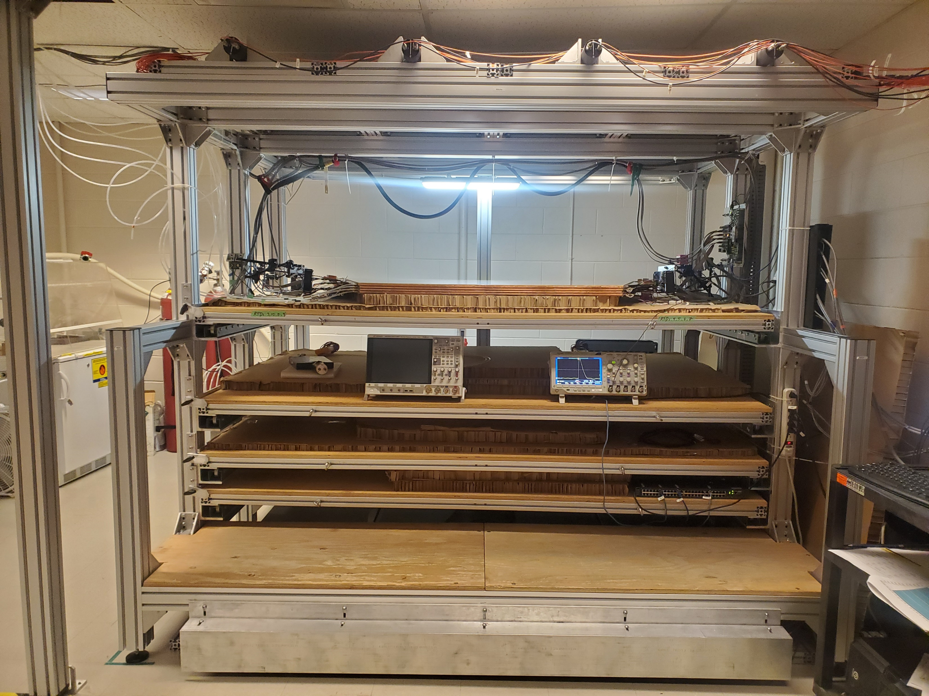
Scintillator PMT array
Quadruplet

