Slide 1
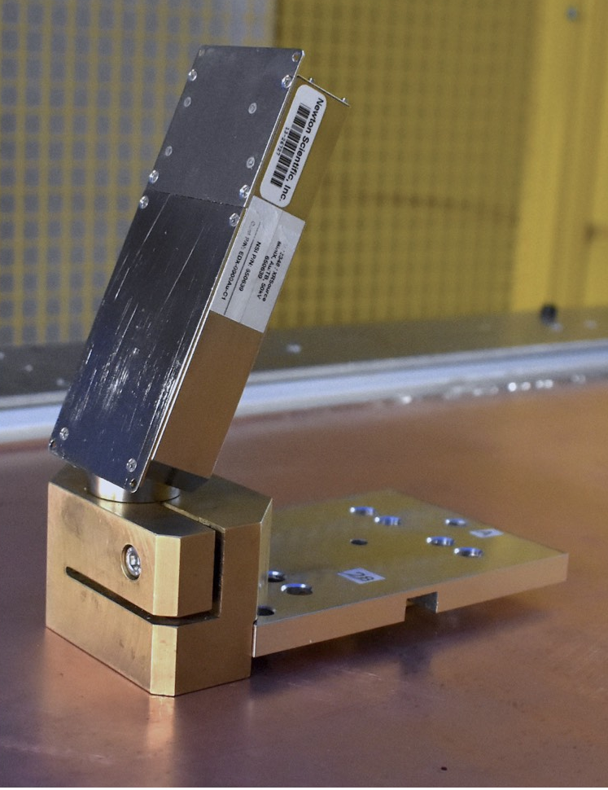
1
2
3
4
5
1. X-ray gun
2. Collimator
3. Gun mount
4. Base plate (attached to source plate underneath)
5. sTGC wedge surface

Slide 2
X-ray gun
Brass holder
Mounting plate
Alignment platform (underneath)
sTGC wedge surface

