Slide 1

Learn to Program
In Javascript

Slide 2
Numbers, Variables & Strings

Slide 3
What is a Program?

Slide 4
What is a Program?
Instructions to your computer.
Programs are written in a code that computers understand.

Slide 5
What does ‘client side’ mean?

Slide 6
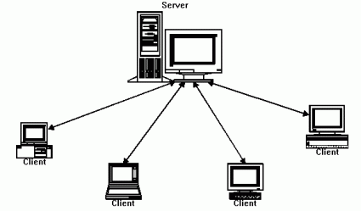
Javascript: Client Side
Web based Javascript is a client side programming language.
This means that the javascript code you write is interpreted by the client computer rather than the server.
The browser is normally responsible for interpreting javascript

Slide 7
Let’s write some code!

Slide 8
Code for this Class:
Clone from github:
  git clone git://github.com/liahhansen/Learn-to-Program-Javascript.git

Slide 9
Firebug
Debugging tool
Console
HTTP requests

Slide 10
alert() & console.log()
Javascript gives us several ways to execute code and see what is happening. Try them out in HTML page & firebug console:
alert(“IT’S AN EMERGENCY”);
console.log(10);

Slide 11
Variables
A variable is a container for a word, number or more complex data.
x = "hi";
console.log(x);
x = "oh, sorry, I thought you were someone else"
console.log(x);
awkwardConversationVariable = x
console.log(awkwardConversationVariable)

Slide 12
Data Types
Programmers create replicas of the real world inside of computers. We need a way to describe the world’s people, places and things.
The first step is to allow for different behaviors of data.
  You want a person represented in your program to have a name
    Use a string
  You want to count all the people in your program.
    Use an number
Some Common data types: String, Number, Array, Boolean

Slide 13
Strings: Quotes
Strings are a group of characters contained within quotes. The quotes can be either single or double:
console.log("silly string")
console.log('silly string')

Slide 14
Single and Double Quotes
console.log('this won't work')
because the quote in "won't" is not escaped
TWO SOLUTIONS:
double quotes around a string with a single quote in it
escape the single quote with a slash
console.log("this won't not work")
console.log('this won\'t not work')

Slide 15
Concatenation
You can add strings together with the plus operator:
console.log("silly" + " " + "string")

Slide 16
Accessing String Characters
We can determine the character at a particular place in a string by including the index of the character we want in square brackets next to the string or charAt method:
alert("stringalicious"[0])
alert("stringalicious”.charAt(2))
We can also access more than one character using substring:
alert("stringalicious".substring(4))

Slide 17
String Length
Sometimes it is very helpful to know how long your string is. For instance, if you want to use substring to return the last three letters of a string.
console.log("How long am I".length);

Slide 18
Changing Capitalization
console.log("I talk loudly".toUpperCase());
console.log("I TALK QUIETLY".toLowerCase());

Slide 19
Quick Exercise:
Log the following to the console:
  Length of the word “ambidextrous”
  The 4th letter in the word “monkey”
  The 6th through 10th letters in the word “demonstration”
  The word “shout” with capital letters
  The word “whisper” with lower case letters

Slide 20
Test First Teaching
& Test Driven Development

Slide 21
Humans Aren’t Perfect
Mistakes
Unforseen Collisions
Bugs, Bugs, Bugs!

Slide 22
Testing: A Solution to Human Error
Tests live together in a folder inside of your codebase
Every time you add a feature, run the tests
You can see if your new code broke any old code

Slide 23
Test Driven Development: TDD
RED
(Test Fails)
GREEN
(Test Passes)
REFACTOR
(Improve Code)

Slide 24
Why TDD?
Design
  Tests specify what behavior is desired of the code. To write a test, the programmer needs to think through how the code will implement a behavior. This leads to a well thought out code design.
Project management
  A tight testing/code-writing cycle often leads to writing less wasted code.
  Separates design from implementation – understanding your code before you start writing it.
Creation of tests
  Programmers who don’t use TDD often see tests as a chore to do as an afterthought, sometimes leading to tests not getting created.

Slide 25
Test First Teaching: TFT
Teacher writes the test
Student runs the test & watches it fail
Student writes the code to make it pass

Slide 26
Jasmine
Jasmine is a Javascript test framework
It is in the repo of this class on github

Slide 27
Exercise
Do the exercises in /materials/strings/

Slide 28
Numbers & Arithmetic Operators
Addition: 4 + 2
>>> 6
Subtraction: 4 – 2
>>> 2
Multiplication: 4 * 2
>>> 8
Division: 4 / 2
>>> 2

Slide 29
Modulus Operator:
The Modulus operator finds the remainder.
>>> 4 % 2
0
>>> 4 % 1
0
>>> 4 % 3
1

Slide 30
Incrementing
When the incrementer comes after the variable the original value of the variable is returned. When the incrementer comes before the variable, the incremented value is returned:
>>> i = 1
>>> console.log(i++)
1
>>> i = 1
>>> console.log(++i)
2

Slide 31
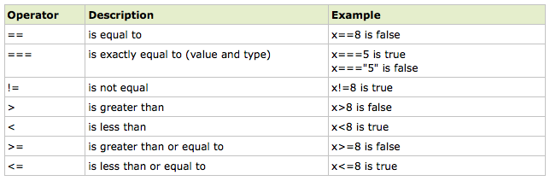
Comparing
If x = 5
(Table is from: http://www.w3schools.com/js/js_comparisons.asp)

Slide 32
Comparison Examples
console.log("1>1000 is ", 1>1000)
console.log("3<=16 is ", 3 <= 16)
console.log("1===1 is ", 1===1)
console.log("4==='4' is ", 4==='4')

Slide 33
Converting a Number to String
var c = 12;
c.toString();
console.log(d);

Slide 34
Number Exercise
Write a program that calculates how old you are in seconds
Do the exercises in /materials/numbers/

Slide 35
prompt() Method
Similar to alert(), but it can interact with the user and receive data from them.
x = prompt("tell me your name")
console.log(x)

Slide 36
Exercises
Full name greeting:
  Write a program that asks for a person's first name, then middle and then last. Finally, it should greet the person using their full name.
Bigger better favorite number:
  Write a program that asks for a person's favorite number. Have your program add 1 to it and then suggest the result as a bigger and better favorite number.
Math
  Write a program that accepts three numbers from the user and alerts back the the user: the sum of the numbers, the total of the numbers multiplied together, the average of the numbers, and, for extra credit, figure out how to find the largest number and smallest number.

Slide 37
Homework
Complete exercises not finished in class
Make a program that tells the first line of a knock knock joke, records the joke reciever’s answer (“who’s there”), and reply with a witty punchline. Some inspiration:
  http://www.google.com/search?q=knock+knock+jokes&ie=utf-8&oe=utf-8&aq=t&rls=org.mozilla:en-US:official&client=firefox-a
Reading:
  http://www.w3schools.com/js/js_comments.asp
  http://www.w3schools.com/js/js_variables.asp
  http://www.w3schools.com/js/js_obj_string.asp
  http://www.w3schools.com/js/js_comparisons.asp
  http://www.w3schools.com/js/js_operators.asp

