Slide 1
LEAD SCORING
CASE STUDY
AUTHORS
CHINMAYEE GURU
LIA ELIZABETH JOHN

Slide 2
CONTENT
Introduction
Data Inspection
Data Preparation
Model Building
Model Evaluation
Predict on Test data
Conclusion

Slide 3
INTRODUCTION
This case study aims to give an idea of applying logistic regression in a real business scenario for an online education company to predict which customer is most likely to convert.
Business Understanding
An education company named X Education sells online courses to industry professionals. Many professionals who are interested in the courses land on the website, browse the courses or fill up a form for the course or watch some videos.
When these people fill up a form, they are classified to be a lead. Once these leads are acquired, employees from the sales team start making calls, writing emails, etc. Through this process, some of the leads get converted while most do not. The typical lead conversion rate at X education is around 30%.

Slide 4
Problem Statement
Although X Education gets a lot of leads, its lead conversion rate is very poor.
The company requires to build a model wherein a lead score is to be assigned to each of the leads such that the customers with higher lead score have a higher conversion chance and the customers with lower lead score have a lower conversion chance.
The CEO, in particular, has given a target lead conversion rate to be around 80%.
Business Objective
Our objective is to help X Education select the most promising leads, i.e. the leads that are most likely to convert into paying customers.
Here we need to analyse and build a logistic regression model with around 80% accuracy to achieve the target set by the CEO. We would also need to assign a lead score between 0 and 100 to each of the leads which can be used by the company to target potential leads.

Slide 5
DATA INSPECTION
Inspection & Cleaning
After reading and inspecting the dataset, we performed missing data analysis and the below points were considered towards data clean-up:
Columns with more than 3000 missing data were dropped
Columns with 50% data as ‘Select’ were dropped as they hold no proper value.
Yes-No columns which were highly imbalanced were also dropped as they did not have any variation in information.
For columns with very low missing data, which seemed important as predictors of conversion rate, the respective rows were dropped.

Slide 6
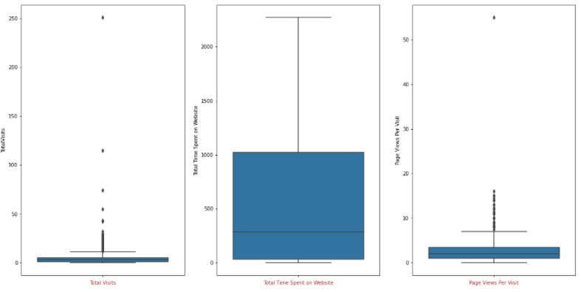
Outlier Analysis
Though there are some high value data points exist in case of 'Total Visits' and 'Page Views Per Visit', they are not exceptional and cannot be considered as outliers.
'Total Time Spent on Website' does not have any outlier.

Slide 7
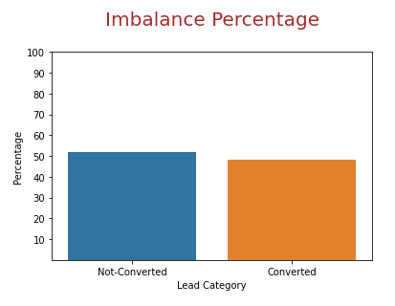
Imbalance Percentage
As per the data at hand, we saw close to 48% leads have got converted.
So, our data set is neither perfectly balanced, which is understandable, nor it is heavily imbalanced to make the dataset unreliable.
We, have a good Imbalance Percentage and we are good to go ahead.

Slide 8
DATA PREPARATION
Categorical to Numerical
In this step we converted the binary yes/no variables into numerical ones by mapping the values to 1 and 0.
The columns were - 'Do Not Email‘ and 'A free copy of Mastering The Interview'
Dummy Variable Creation
For other categorical variables with more than two levels, we created dummy variables using one hot encoding.
The columns were - 'Lead Origin', ‘Lead Source', 'Last Activity', 'What is your current occupation', 'Last Notable Activity‘ and 'Specialization‘.

Slide 9
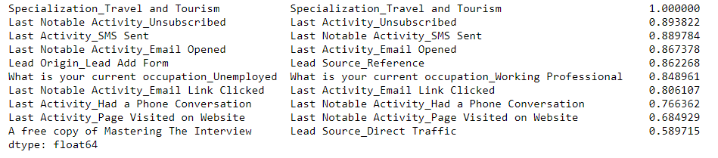
Train Test Split
We used 70-30 ratio to split the data into train and test set.
Scaling Numerical Variables
We then applied MinMaxScaler to scale the numerical data.
Correlation Matrix
We checked the correlation matrix to find out variables that are highly correlated.

Slide 10
MODEL BUILDING
RFE - Feature Selection
At first we used RFE to build a logistic regression model and select top 15 features that would contribute the most towards the probability of a lead getting converted.
Manual Feature Elimination
Then based on P-value and VIF score we performed manual feature elimination to arrive at the desired model.
At the final model we got 10 features with P-values less than 5% and VIF below 2.

Slide 11
Model Summary
In our final model, we got 10 features that contribute the most towards the conversion probability of potential leads.
Feature | Co-efficient | P-Value | VIF
TotalVisits | 11.6125 | 0.000 | 1.35
Total Time Spent on Website | 4.4275 | 0.000 | 1.57
Lead Origin_Lead Add Form | 4.2219 | 0.000 | 1.49
Last Notable Activity_Unreachable | 2.7731 | 0.001 | 1.00
Last Activity_Had a Phone Conversation | 2.7225 | 0.001 | 1.01
What is your current occupation_Working Professional | 2.5929 | 0.000 | 1.20
Lead Source_Welingak Website | 2.1297 | 0.040 | 1.32
Do Not Email | -1.5055 | 0.000 | 1.04
Lead Source_Olark Chat | 1.4546 | 0.000 | 1.04
Last Activity_SMS Sent | 1.1604 | 0.000 | 1.47

Slide 12
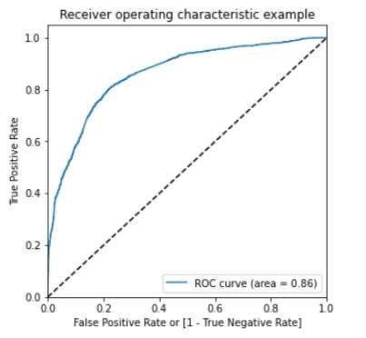
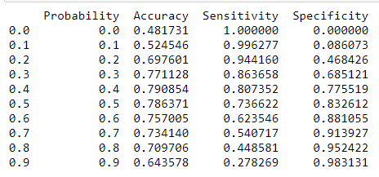
MODEL EVALUATION
ROC curve
We got a good ROC curve with area 0.86.
We also found Accuracy, Sensitivity and Specificity at various probability in order to find out the optimal threshold point.

Slide 13
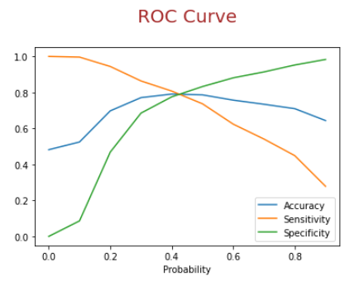
Finding the optimal threshold
After plotting the curve for Accuracy, Sensitivity and Specificity, we found the optimal threshold to be around 0.42 where all of them converge.
Accuracy, Sensitivity & Specificity
Using our model on training data we got -
Accuracy – 79%
Sensitivity – 79.2%
Specificity - 78.9%
Since all these values are close enough, we can say that this is a decent model and can be used to predict lead conversion.

Slide 14
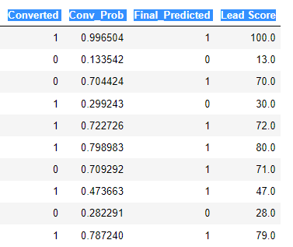
PREDICT ON TEST DATA
Assigning Lead Score
Using our final model at a cut-off value 0.42, we predict the conversion probability of a lead on test data.
We calculated the lead score by multiplying the conversion probability with 100 and assigned that to each lead.

Slide 15
Accuracy, Sensitivity & Specificity
On our test data we got -
Accuracy – 78.2%
Sensitivity – 77.9%
Specificity - 78.4%
Since all these values are close enough, we can say that this is a decent model and can be used to predict lead conversion.
Assumptions
In this case study we have taken below assumptions-
Drop columns with more than 3000 data missing
Drop columns with more than 50% data as ‘Select’
Train-Test split will be in 70-30 ratio
P value < 0.05 and VIF < 5 to be considered while model building
Geographical data are not important since it is an online education website
The initial threshold was taken at 0.5 before calculating the optimal cut-off
We have considered the top 15 feature selection through RFE

Slide 16
CONCLUSION
In this case study, we were able to build a model with 79% accuracy.
As per the top features of the model, the sales team must focus on leads who have very high number of visits to X Education website and those who are spending more time on the website.
Also the team should pay more attention to the customer who are identified to be a lead through Lead Add Form origin identifier.
Last but not the least, the team should target the working professionals and lead who have recently had a phone conversation with the team.

