Slide 1
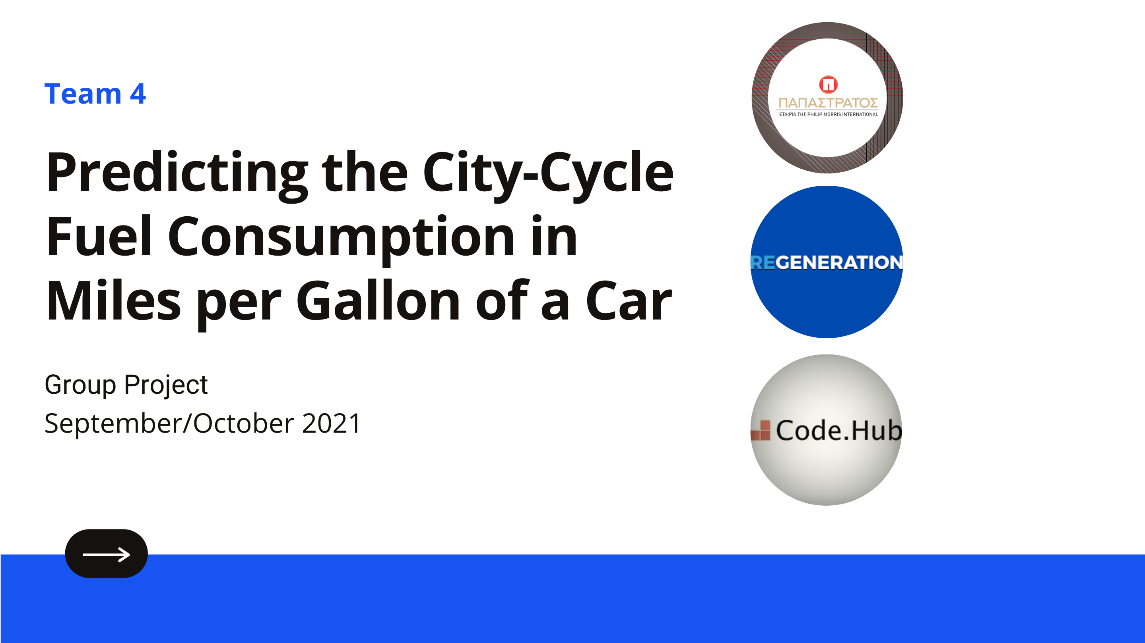

Slide 2

PROJECT SCOPE
Problem
Goal
Predicting the City-Cycle Fuel Consumption in Miles per Gallon of a Car
Machine Learning
Find the best model

Slide 3
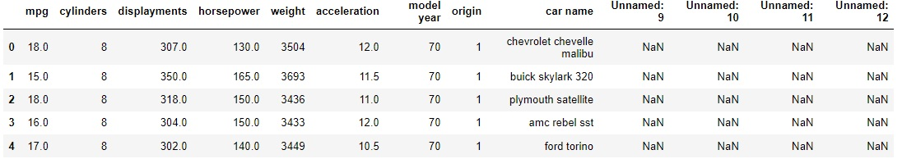
MAKING SENSE OF THE DATASET
Data Set Characteristics | Multivariate | Number of Instances | 398
Attribute Characteristics | Categorical, Real | Number of Attributes | 8
Associated Tasks | Regression | Missing Values? | Yes

Slide 4
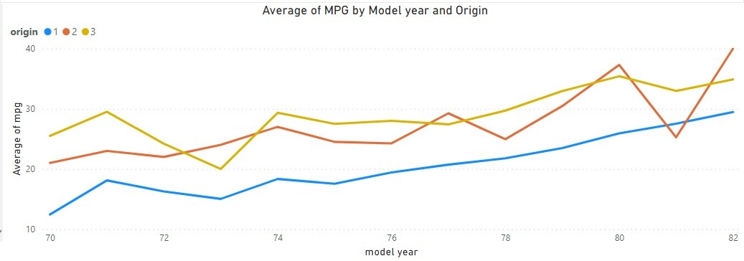
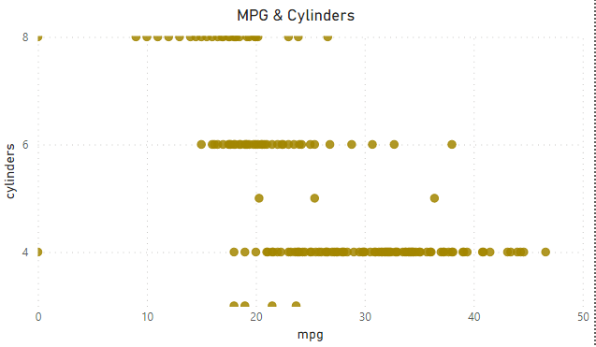
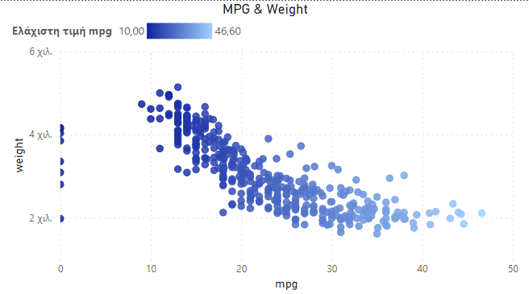
QUICK INSIGHTS OF THE RAW DATA
Origin and Model Year are crucial factors affecting the fuel consumption of a car
MPG and Weight have a strong correlation
Number of cylinders seem to affect the overall fuel consumption of a car

Slide 5
PREPROCESSING
Encoding categorical data
Feature Selection
Using One-Hot encoding technique
Using the Exhaustive feature sequential selection technique
Step 1
Step 3
Step 2
Step 4
Filling Empty Values
Outliers
Replacing them with the average value of each column
Through the exploration it seemed beneficial to keep them in the dataset

Slide 6
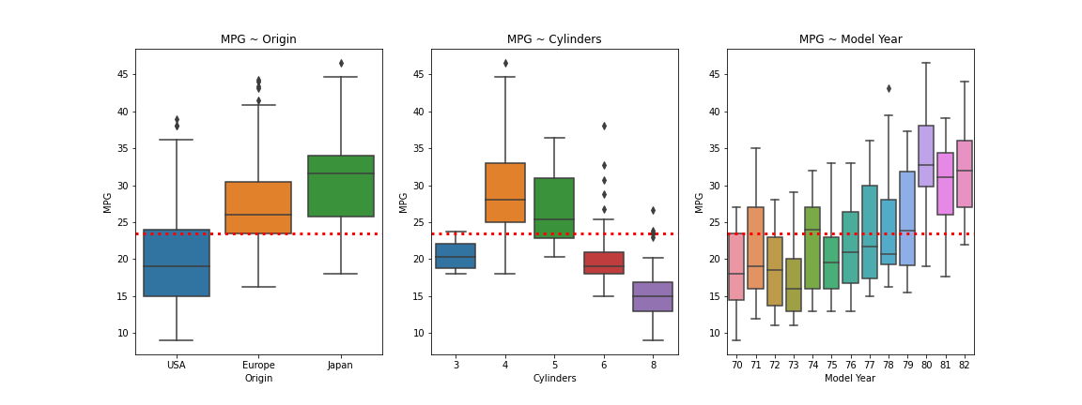
INSIGHTS FROM DATA ANALYSIS
USA affects MPG average greatly due to the fact that most cars are originated there
4-Cylinder and 5-Cylinder cars seem to perform better consumption-wise
As years go by the MPG is increasing, proving that the engine technology is improving

Slide 7
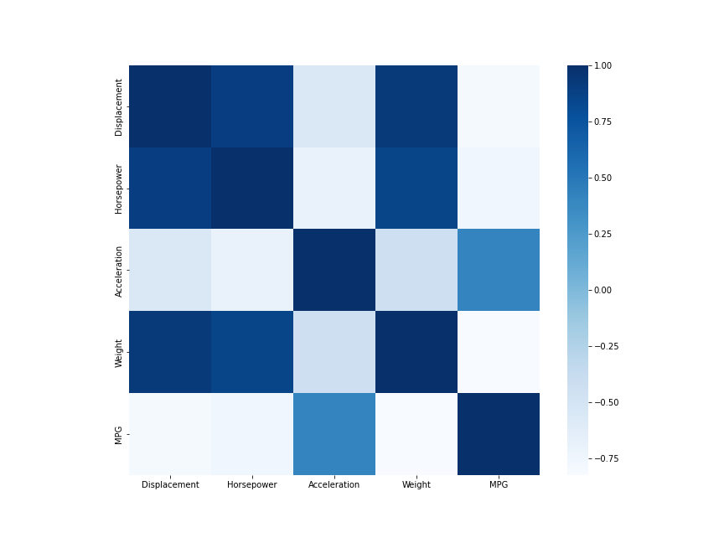
NUMERICAL VARIABLE CORRELATION
MPG has strong correlation with horsepower, weight and displacement
Weight and Displacement are almost linearly correlated
Horsepower and acceleration are negatively correlated

Slide 8
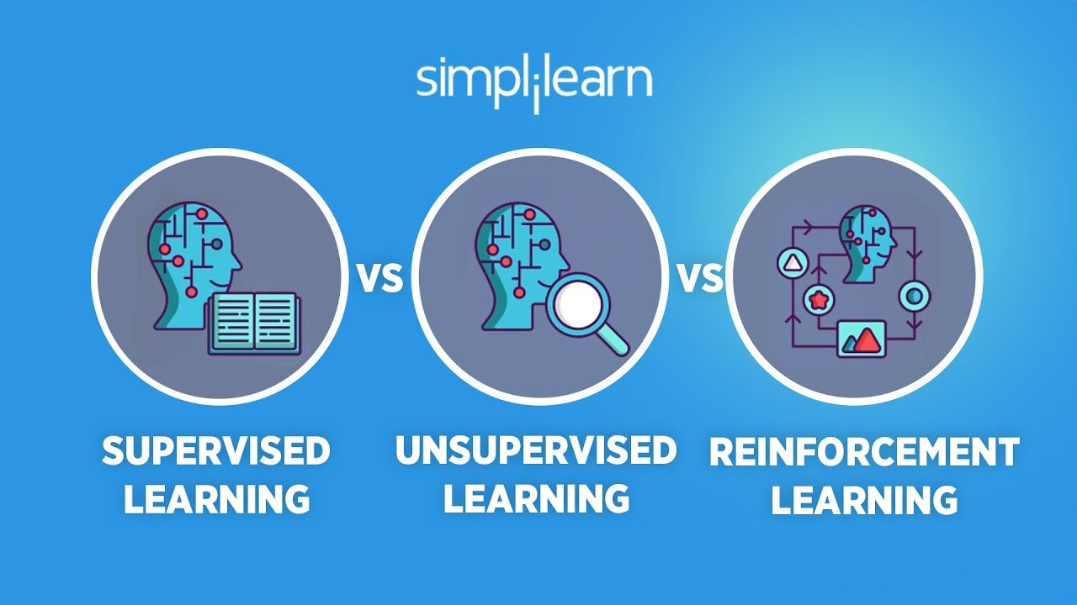
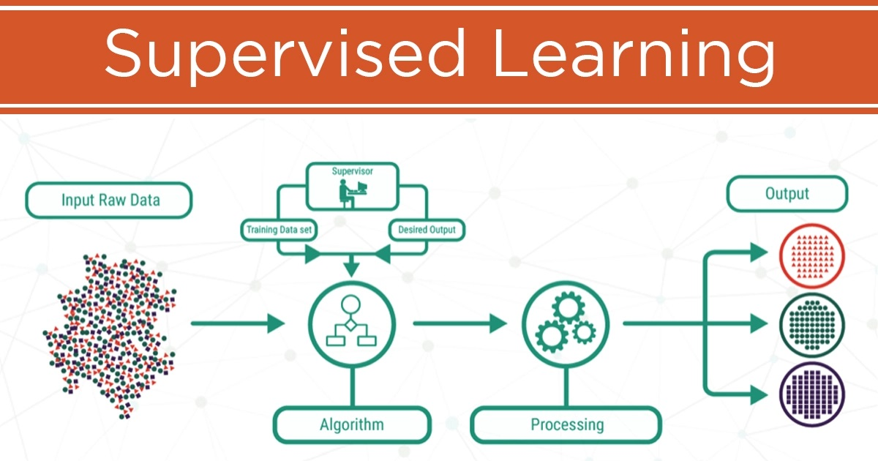
MACHINE LEARNING: THE KEY TO THE SOLUTION
By observing our data it is obvious that Supervised Learning is the ideal method to follow.
We have labeled data with continuous and not discrete output.
So we rule out classification and we choose Regression Methods.

Slide 9
MACHINE LEARNING STEP & CODE
Train Test Split
Fit -Transform-Predict
Accuracy of Model
Results comparison
X_train, X_test, y_train, y_test = train_test_split(X, y, test_size=0.2, random_state=42)
X_train_scaled, X_test_scaled = preprocessing.scale(X_train), preprocessing.scale(X_test)
y_train_scaled, y_test_scaled = preprocessing.scale(y_train), preprocessing.scale(y_test)
model = ()
model.fit(X_train_scaled, y_train_scaled)
pred = model.predict(X_test_scaled)
Use of Grid Search and Randomized Search for discovering the best hyperparameters for our models

Slide 10
RESULTS OF REGRESSION WITH HYPER TUNING
Regression Models | Train Score | Test Score | MSE
Linear | 0.823 | 0.793 | 0.20
Ridge | 0.823 | 0.793 | 0.20
LASSO | 0.782 | 0.781 | 0.21
Decision Tree Regressor | 0.944 | 0.823 | 0.17
Random Forest Regressor | 0.937 | 0.866 | 0.14
Gradient Boosting Regressor | 0.950 | 0.860 | 0.15
XGB Regressor | 0.997 | 0.842 | 0.15
K-Neighbors Regressor | 0.999 | 0.823 | 0.15

Slide 11
CONCLUSIONS
01
02
MPG Evolution
How MPG changes through the years
MPG Sensitivity
03
How MPG is influenced and suggest car rentals to buy cars based on this set of criteria
MPG Prediction
Machine Learning
Fuel consumption decreases through the years as a result of technological evolution
MPG is highly affected by Origin, Horsepower, Weight
The selected Model can predict the MPG of a new car with great confidence

Slide 12
FUTURE IMPROVEMENTS
Improvement of the ML model
Forecasting
A bigger dataset with more variables could provide us with the necessary information in order to improve the accuracy and credibility of the model
Forecasting future MPG of cars by specific brand or origin Recommendations would be much more targeted and accurate

Slide 13
SELF REFLECTION
Application of different techniques in the preprocessing stage
Use of PCA or other dimensionality reduction techniques
Use of different regression models after Data Analysis
Origin and Model Year are crucial factors affecting the fuel consumption of a car
MPG and Weight have a strong colleration
Number of cylinders seem to affect the overall fuel consumption of a car

Slide 14

Team 4
Ilias Dimitrakopoulos
Evangelos Panagiotopoulos
Alexios Lagkaditis
Anna Koutsaki
Georgios Spanos
Thank you for your attention!

