Slide 1
3D Gravity Inversion of a Synthetic Geological Model in SimPEG
How do inversion method and weighting strategy affect recovery of subsurface density structure?
Fengzhu Wu
Notes:
Gravity inversion is non-unique, so the recovered geology depends strongly on regularization and weighting choices.

Slide 2
Why this problem matters?
Gravity data provide only an indirect constraint on subsurface density.
Because gravity inversion is non-unique, inversion choices can strongly affect the recovered geometry.
A synthetic test allows direct comparison between recovered models and the known true model.

Slide 3
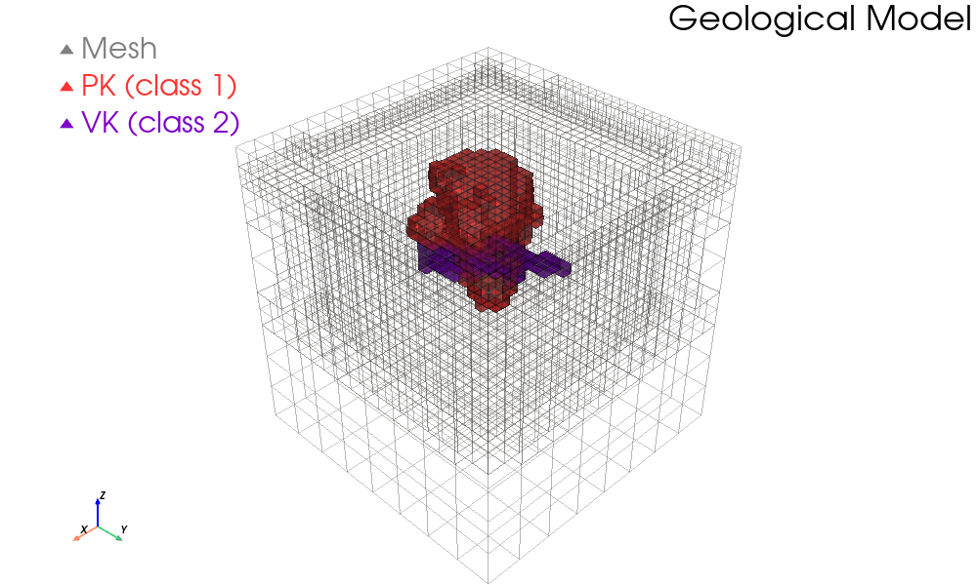
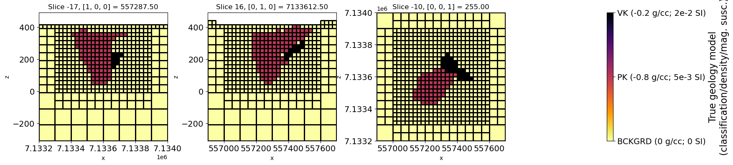
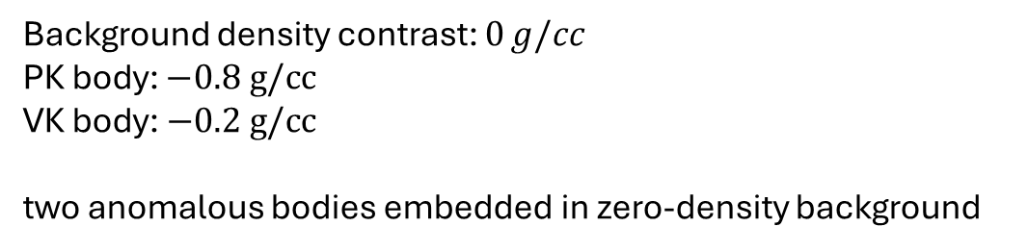
Physical properties
Background density contrast: $0 g/cc$
PK body: $−0.8 g/cc$
VK body: $−0.2 g/cc$
two anomalous bodies embedded in zero-density background
Synthetic density model:

Slide 4
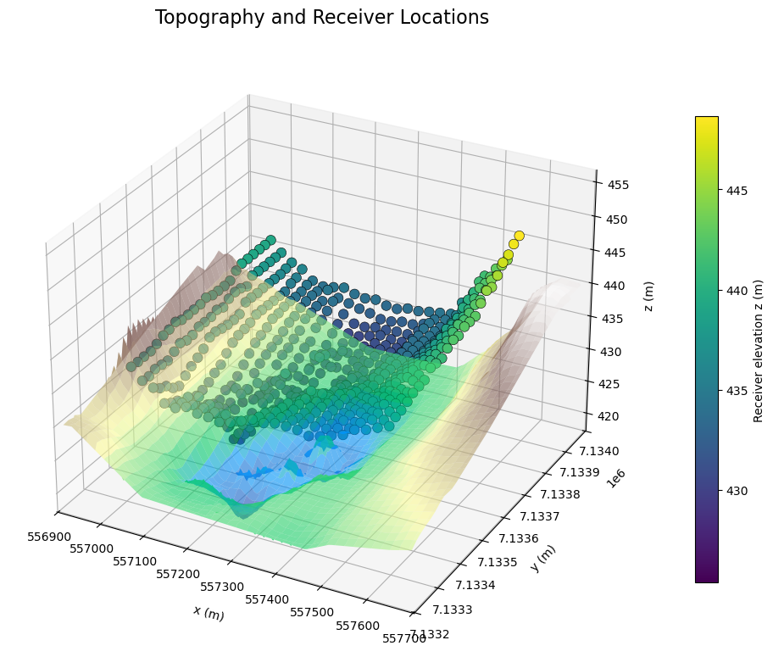
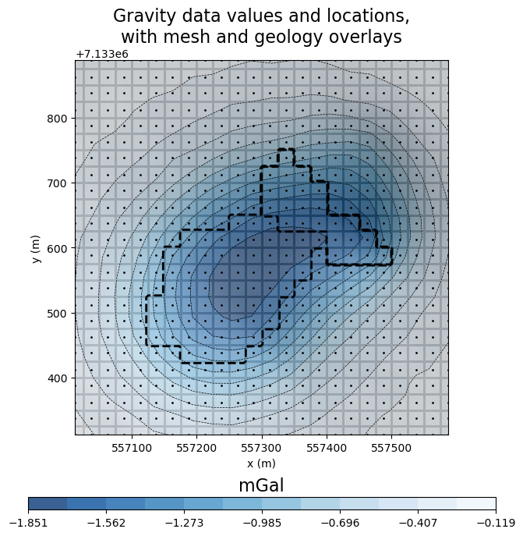
Survey + Data
Gravity observations are calculated over the synthetic model
These data are then inverted to recover subsurface density contrast
The synthetic setup allows direct model-to-truth comparison

Slide 5
Inversion
Least-square L2
Inversion methods
Sparse-norm baseline (IRLS)
Sparse-norm + depth-weighting (IRLS)
Weighting strategies
Sparse-norm + sensitivity-weighting (IRLS)
Iteratively Re-weighted Least-Squares (IRLS) is used to approximate sparse-norm inversion

Slide 6
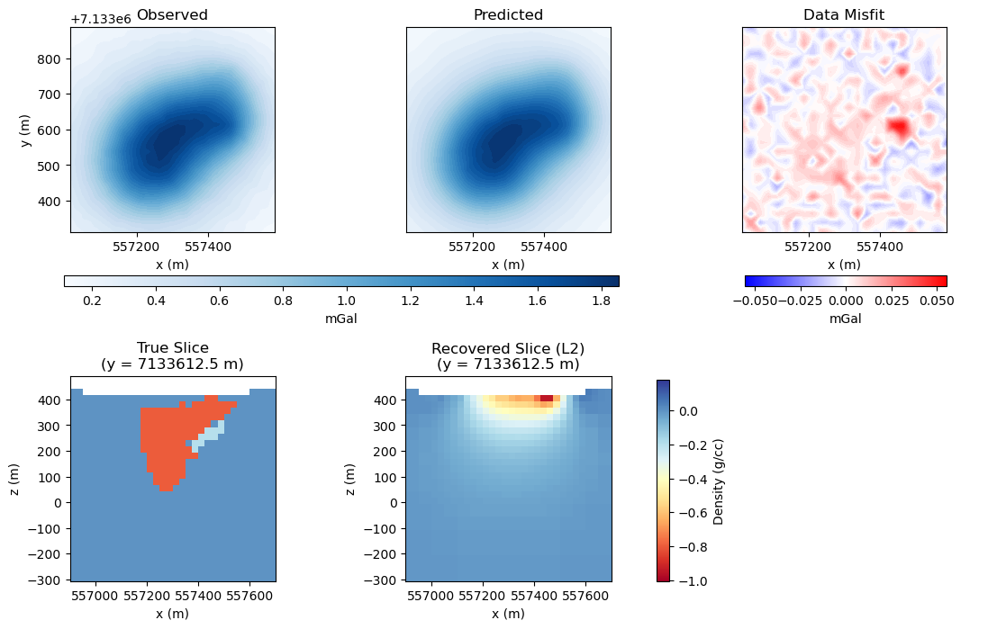
L2 Inversion
Least-square L2

Slide 7

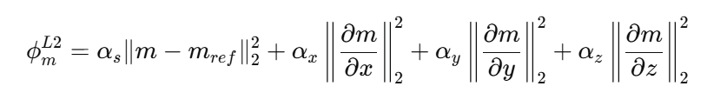
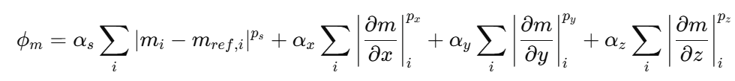
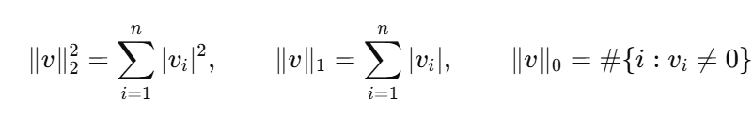
Sparse-norm
L2 regularization:
Sparse regularization:
L2 norm
L1 norm
L0-style norm

Slide 8




Sparse-norm (example)
L2 norm
L1 norm
L0-style norm

Slide 9
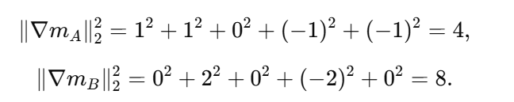
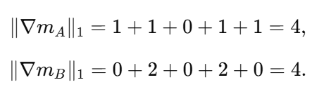

Sparse-norm (example)
L2 norm
L1 norm

Slide 10
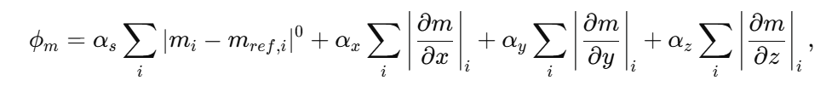
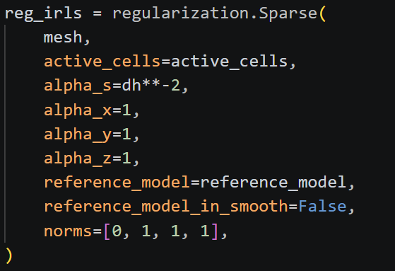
Sparse-norm
Sparse regularization:

Slide 11
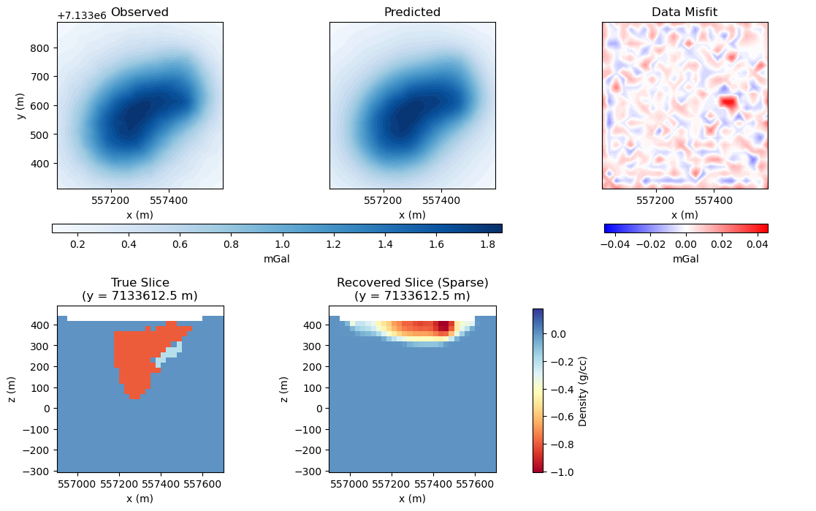
Sparse-norm Inversion
Sparse-norm
Sparse-norm baseline (IRLS)
Fewer non-zero cells
More compact structure

Slide 12
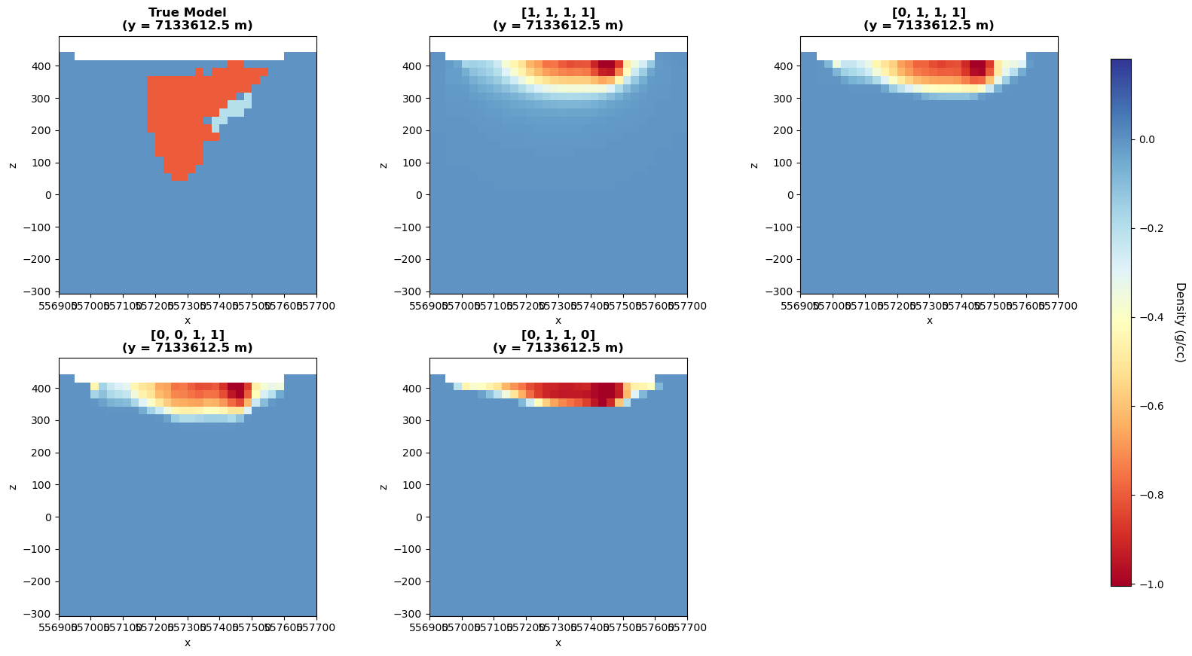
Different norms
Less compact
More compact in x
More compact in z

Slide 13
Why apply weighting?
Weighting
Gravity sensitivity decreases with depth
Model sensitivity is spatially uneven
Weighting helps reduce inversion bias in the recovered model

Slide 14

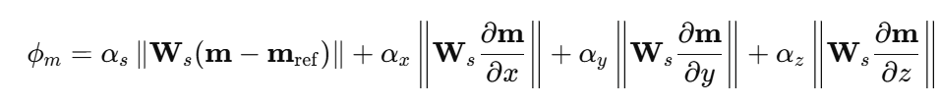

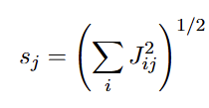

Weighting: Depth v.s. Sensitivity
Depth-weighting:
Sensitivity-weighting:
(Li and Oldenburg, 1998)
Compensates for the natural decay of gravity sensitivity with depth
Reduces the tendency of inversion to place anomalies too close to the surface
Mainly addresses shallow bias
Uses Jacobian-based sensitivities for each cell
Balances regularization according to the actual sensitivity distribution
Accounts for depth, survey geometry, and kernel structure
Key difference
Depth weighting is depth-based
Sensitivity weighting is Jacobian-based and more general

Slide 15
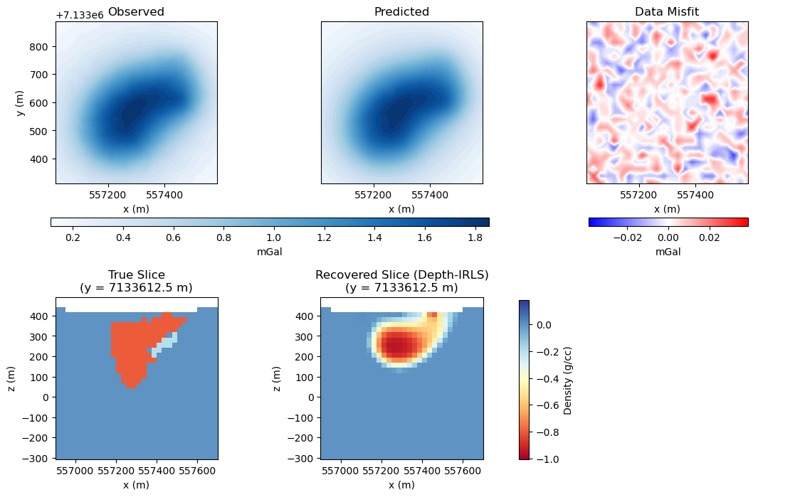
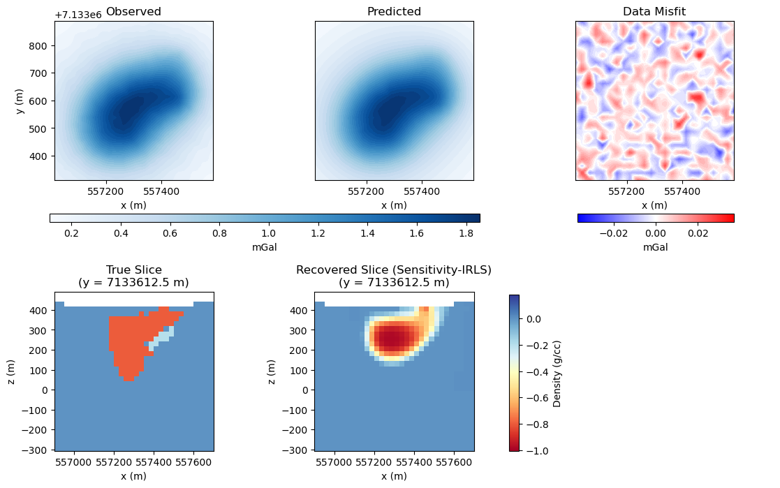
Weighting: Depth v.s. Sensitivity
Sparse-norm + depth-weighting (IRLS)
Sparse-norm + sensitivity-weighting (IRLS)

Slide 16
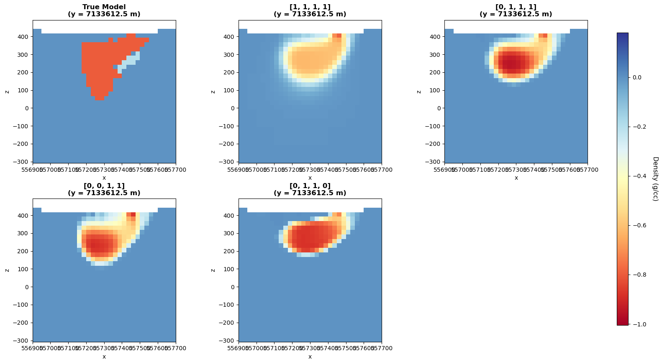
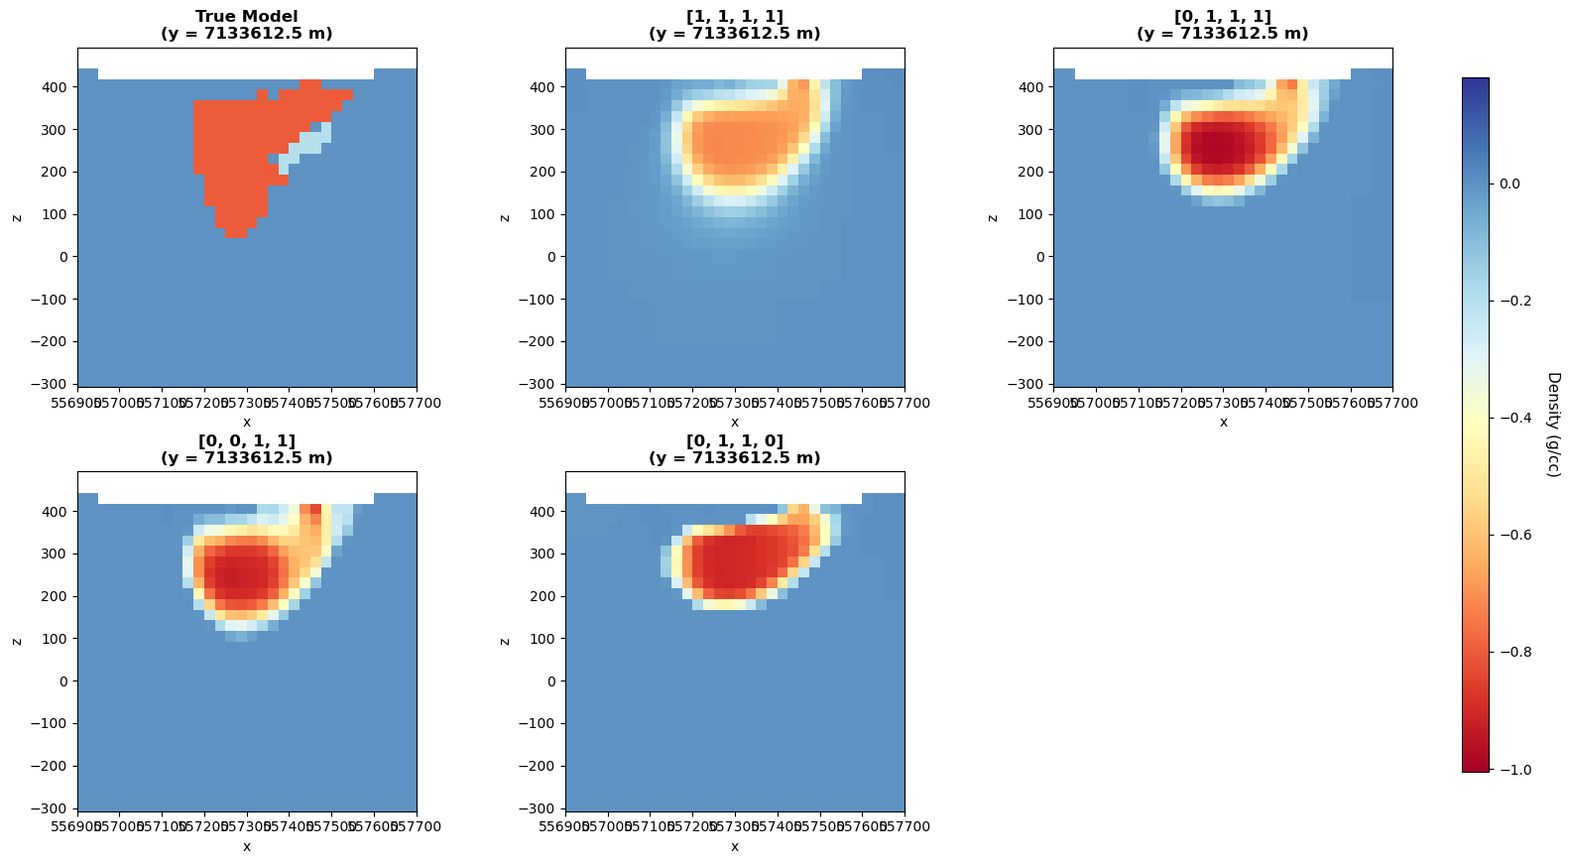
Different norms
Weighting: Depth v.s. Sensitivity
Sparse-norm + depth-weighting (IRLS)
Sparse-norm + sensitivity-weighting (IRLS)

Slide 17
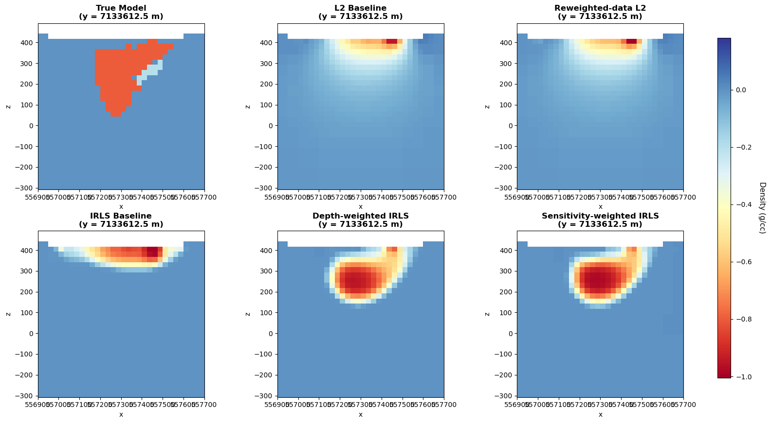
Final Comparison
L2 inversion produces smoother and more diffuse anomalies
Sparse IRLS recovers more compact bodies
Weighting changes the vertical and spatial distribution of the recovered model

Slide 18
Key Takeaways
Gravity inversion results depend strongly on regularization choice
Sparse-norm inversion using IRLS recovers more compact anomalies than L2 inversion
Weighting helps reduce inversion bias, especially for depth and sensitivity effects

Slide 19
Thank you

