Slide 1
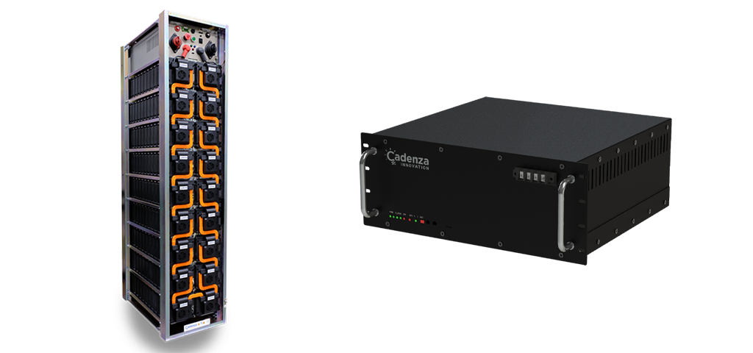




Azure Cloud
Measuring Devices in the field
Energy Monitoring Web Portal
Pre
Processing
Functions
[Web Pages] Cloud Portal
Security Sub System
Web API System
Users and
Administrators
Archiving and Health check Sub System
SQL Server

