Slide 1
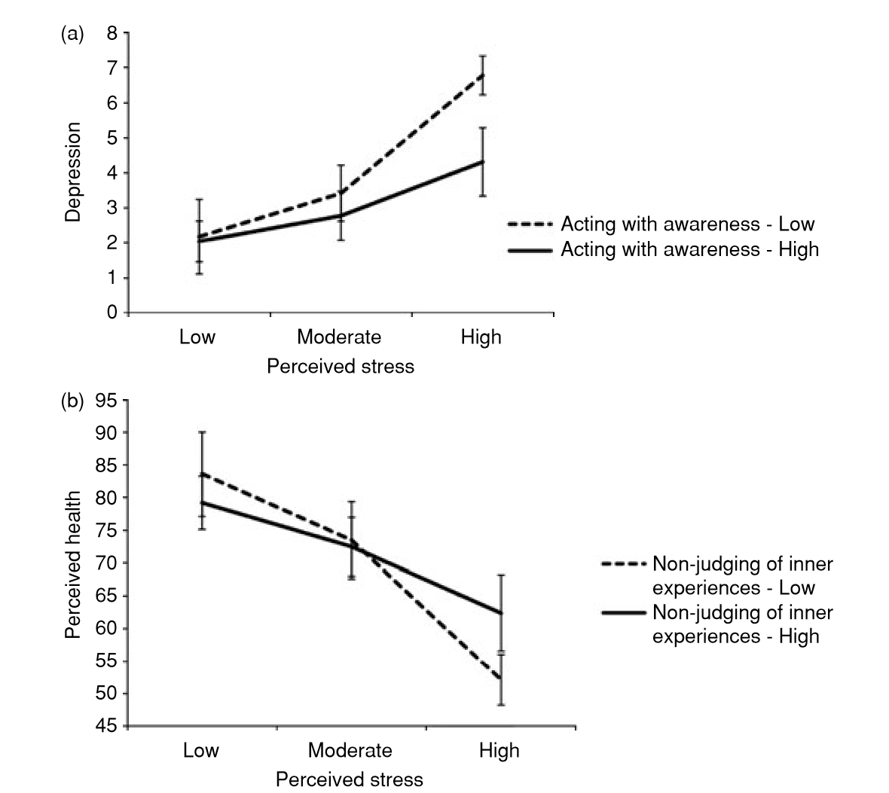
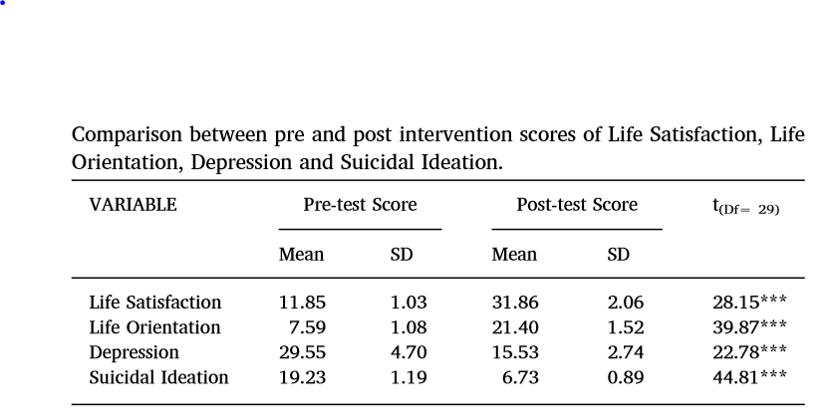
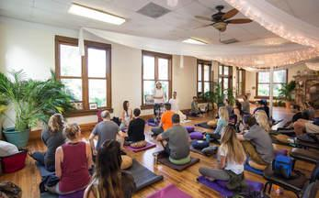

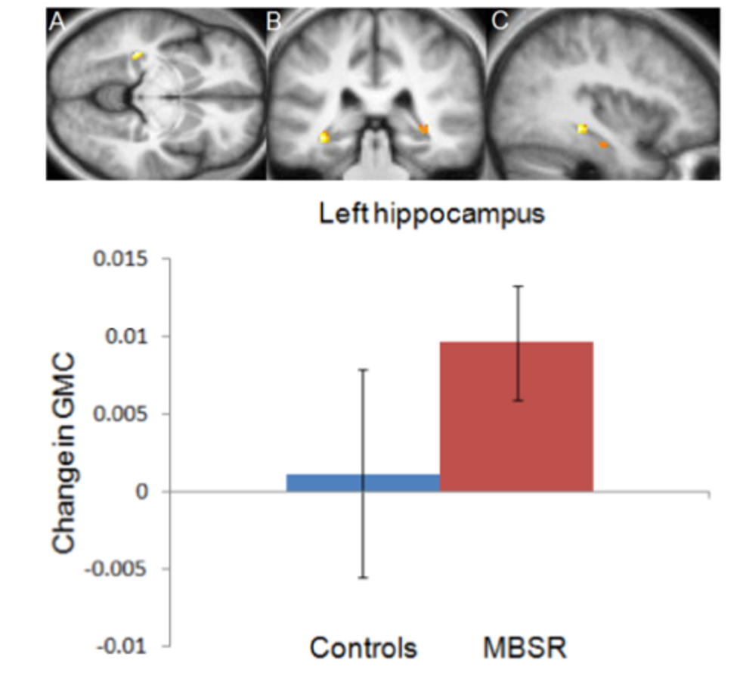
The Effect of Mindfulness Meditation on Life Satisfaction and Self-Esteem Liam Hart Department of Psychology Grand Valley State University
Introduction
Benefits of Mindfulness Meditation
Proposed Study: The Effect of Mindfulness Meditation on Life Satisfaction and Self-Esteem in Retirement Home Residents
Mindfulness meditation has seen a surge in popularity in recent years as a simple practice to improve mental health. As a result, there is an increasing amount of research studies being conducted to determine the actual psychological effects of mindfulness.
Mindfulness meditation has many advantages over other interventions. It is cost-effective, simple to practice, and convenient; it can be practiced at virtually any time and place. The purpose of meditation is to train a specific type of attention and way of thinking, called mindfulness.
Older adults have the highest rates of health care needs of any age group. Consequently, many are prescribed a large amount of pharmaceutical drugs which has only increased over time. Mindfulness meditation offers a non-pharmacological approach to treating psychological negative affect older adults.
On Life Satisfaction and Self-Esteem in Younger Adults
There are not many studies focusing on life satisfaction and self-esteem in an aging population, so we had to generalize the results from studies on younger adults. Both MBSR and MBCT have been shown to be effective interventions to improve life satisfaction and self-esteem
Mindfulness was also found to be associated with lower neuroticism and higher self-esteem, life satisfaction, optimism, and self-actualization. This supports that the cultivation of mindfulness through meditation can increase life satisfaction and self-esteem. (Brown & Ryan 2003)
Rationale
Limited studies on the effect of meditation in an aged population
Less intensive and more accessible to retirement home residents than MBSR and MBCT
Participants: Residents at Lincoln Square Independent Living Center
Pre-test
Satisfaction With Life Scale (SWLS)
Rosenberg Self-Esteem Scale (RSES)
Mini-Mental Status Exam (MMSE): Participants with similar scores on the MMSE will be paired then randomly assigned to the experimental or control group
Intervention
Experimental group meets for 8 weeks with 3 weekly session consisting of a 10-minute guided meditation
Daily meditation will be encouraged
Control group will be told they are on a waitlist to receive the intervention at a later date
Post-test
Life satisfaction and self-esteem will be measured again at the end of the intervention with the SWLS and RSES
Intervention group responses on pre- and post-tests will be compared to examine for significant changes in life-satisfaction and self-esteem
Score differences will also be compared from the intervention group to the control group to assess the effectiveness of meditation as an intervention
Large random sample (N=1000) of Swedish individuals aged 18-60. Increases in well-being and decreases in stress and anxiety showed strong associations with facets of mindfulness (Branstrom et al. 2011)
What is Mindfulness?
Mindfulness is a way of thinking
Originates from the teachings of Buddha and Eastern culture
Deﬁned as the awareness that arises through intentionally attending to one’s moment-to-moment experience in a nonjudgmental and accepting way (Shapiro et al. 2008)
An enhanced attention and awareness of the present moment (Brown & Ryan 2004)
Meditation is the practice of cultivating mindfulness
Simply noticing both internal and external sensations without judgement, openly noticing what is there
Mindfulness-based programs for stress reduction and cognitive therapy are often used in research studies and for clinical applications
MBCT was shown to increase life satisfaction in adolescents with suicidal ideation. Significant improvements were found in all measured psychological constructs (Raj et al. 2019)
On Anxiety, Depression, and Loneliness in Older Adults
Although there is limited research on the effects of meditation in older adults, especially in regard to life satisfaction and self-esteem, there are studies on psychological effects, Anxiety, depression, and loneliness are negatively correlated with measures of life satisfaction and self-esteem (Heady et al. 1993) (Pyszczynski et al. 2004) (Doyle & Forehand 1984)
In a randomized controlled trial, MBCT was shown to improve anxiety symptoms for 52 older adults in residential care (Helmes & Ward 2017)
In a meta-analysis of mindfulness-based programs, MBCT was moderately effective in reducing depression in older people. MBSR was also found to reduce symptoms of worry, anxiety, stress, and chronic lower back pain (Kishita et al. 2017)
MBSR showed a significant decrease in loneliness for 40 older adults. Pro-inflammatory genes, which are increased in lonely adults and play a major role in the development of late-life diseases, were also shown to be down-regulated as a result of the meditation program (Creswell et al. 2012)
Implications of Pilot Study
Adds to the growing research on mindfulness-based interventions
Assess the effectiveness of a less intensive mindfulness program than MBSR and MBCT
Experimental design to determine cause and effect relationship of meditation on life satisfaction and self-esteem, not correlational
Quick guided meditation sessions could be a convenient, non-pharmacological and cost-effective treatment for retirement home residents that have anxiety, depression, or low self-esteem
Potential to be implemented in any retirement home without much difficulty
Mindfulness-Based Programs
Mindfulness-Based Stress Reduction (MBSR)
8 weeks of weekly 2.5 hour mindfulness training sessions with one 6-hour retreat
Sessions include body scan, meditation, and yoga
Moderately effective at reducing depression, stress, anxiety and pain (Khoury et al. 2015)
Mindfulness-Based Cognitive Therapy (MBCT)
8 weeks of weekly 2.5 hour mindfulness training sessions with one 6-hour retreat
Sessions include cognitive behavioral therapy and mindfulness practices
Effective at treating for anxiety (Helmes & Ward 2017) and preventing depressive relapses (White 2015)
Aims to train participants to distance themselves from thoughts and emotions rather than being controlled by them
The cultivation of mindful awareness is the foundation for both programs
Future Studies
Factors That Contribute to Life-Satisfaction and Self-esteem
Need for active control groups that receive clinical treatment
More long term studies - most data is taken within 3 months (Chiesa & Serretti 2009)
Larger sample sizes - most studies have small samples (n=~40)
Long-term follow up assessments to examine whether the effects are transient or long-lasting
Samples of experienced meditators
Different types of meditation - Zen, loving-kindness, transcendental, and mindfulness are only a few of the many meditation techniques
Fredrickson et al. (2018) found that positive emotions increased with minutes of meditation per day in 339 middle-aged adults practicing mindfulness meditation and loving-kindness meditation. In-the-moment positive emotions have been shown to increase life satisfaction (Cohn et al. 2009).
Significant increase in hippocampus volume Scanned two weeks after MBSR intervention (Hozel et al. 2011). The hippocampus regulates emotions and depressed individuals have been shown to have reduced hippocampal volume (Videbech & Ravnkilde 2004)
Contact Information
Liam Hart - hartli@mail.gvsu.edu email me with any questions or for references

