Slide 1

AI-Augmented Data Engineering
A Proof of Concept Proposal
Leveraging Anthropic Claude & MCP Servers to Transform Data Team Productivity
Data & Analytics Team | December 2025

Slide 2

Where We Are Today
Current AI Toolkit
✓ GitHub Copilot access across the organization
Useful for code completion and simple suggestions
Limitations We're Experiencing
✗ Context window truncation in complex projects
✗ Limited to IDE-based interactions
✗ Generic solutions that don't understand our tech stack
✗ No integration with our workflow tools (Jira, DBT, Databricks, etc.)

Slide 3

Beyond Code Completion: The Next Evolution
What if our data engineers could:
Build entire data models from Jira ticket descriptions
Debug complex DBT models with full repository context
Generate Power BI reports from natural language requirements
Create branded presentations automatically (like this one!)
All while maintaining human oversight and control

Slide 4



Why Anthropic Claude?
Superior Context Management
Advanced Agent Capabilities
Full context window utilization (no truncation)
Maintain conversation state across complex tasks
Understand entire codebases and documentation
Claude Agents for autonomous task execution
Skills for specialized functions
Tool use and function calling
Multi-step reasoning with human checkpoints

Slide 5


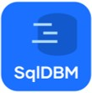

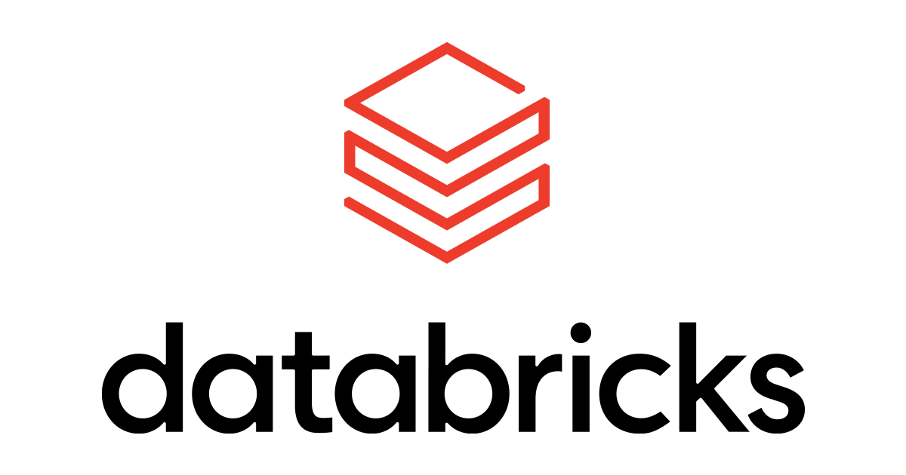

Model Context Protocol: Connecting AI to Our Stack
What is MCP?
GitHub
Atlassian (Jira)
A standardized protocol that allows AI to securely interact with tools and data sources
Our Proposed MCP Servers:
SQLdbm
DBT
Each server provides secure, context-aware access to our tools and data platforms
Databricks
Power BI

Slide 6

Use Case: Autonomous Data Model Development
Workflow
Reads Jira ticket requirements
Reduces model development time from days to hours
1
2
Analyzes existing DBT models and patterns
AI handles the "grunt work" - reading documentation, writing boilerplate, checking standards. Humans control strategy at each decision point.
3
Creates research plan → Human reviews
4
Develops implementation plan → Human reviews
5
Generates DBT code → Human reviews PR
6
Debugs failures using logs and context

Slide 7

Use Case: Natural Language to BI Reports
Workflow
Democratizes BI development, reduces analyst backlog
1
User describes report requirements in natural language
2
Agent queries Databricks for data structure
This doesn't replace analysts - it frees them for complex analysis. Agent understands our data model and maintains JH styling automatically.
3
Designs report layout based on JH standards
4
Generates Power BI report definition
5
Human reviews and publishes
"Create a monthly safety metrics dashboard by region with YoY comparison"

Slide 8

Use Case: This Presentation Was AI-Assisted
What You're Viewing:
Generated using natural language requirements
John Holland color palette and branding applied automatically
Speaker notes drafted by AI
Structured for executive audience
Human reviewed and refined
From Concept to Presentation: Minutes, Not Hours

Slide 9

How It Works: Human-in-the-Loop AI
Three-Stage Review Process
Stage 1: Research Plan
Stage 2: Implementation Plan
Stage 3: Code Generation
AI analyzes repository, documentation, existing patterns
AI generates code following approved plan
AI creates detailed implementation strategy based on ticket requirements
Produces research findings
Pull request includes trace log of all changes and reasoning
→ Human reviews and approves/modifies
Outlines approach, files to modify, patterns to follow
→ Human reviews PR with full audit trail
→ Human reviews and approves/modifies

Slide 10

Expected Outcomes and ROI
Realistic Short-Term (3-6 months)
Long-Term Potential
10-20% productivity improvement on repetitive tasks
Faster onboarding of junior engineers
Better documentation and code consistency
Reduced context switching for senior engineers
Productivity gains scale with model improvements
Team focuses on high-value strategic work
Faster delivery of data products
Innovation through experimentation
Investment: Anthropic Team subscription (~$30-40/user/month)

Slide 11

Addressing Security Concerns
Our Approach
We'll work with Security team to:
✓ Enterprise-grade Anthropic subscription (data not used for training)
✓ MCP servers operate within network security boundaries
✓ Human review required before any code deployment
✓ Full audit trails of all AI interactions
✓ Read-only access where possible
✓ SSO integration and access controls
Define acceptable use policies
Configure appropriate access levels
Establish monitoring and audit procedures

Slide 12



Two Key Approvals Required
Blocker #1: Security Approval
Blocker #2: Network Whitelisting
Procurement of Anthropic Team licenses
Security review and acceptable use policy
MCP servers need network access
Architectural governance typically required
We're trying to run a POC, not production rollout
Our ask: Sponsor security review process
Our ask: Fast-track POC approval with limited scope

Slide 13

The Industry is Moving Fast
What's Happening:
Leading engineering teams are already using AI agents in production
Data engineering specifically identified as high-ROI use case for AI
Model capabilities doubling every 6-12 months
Companies that experiment now will lead tomorrow
Risk of Waiting:
Falling behind in AI-augmented workflows
Missing productivity gains competitors are realizing
Longer catch-up period when we eventually adopt
This POC positions us as innovators, not followers

Slide 14
How We'll Measure Success
3-Month POC Metrics: Quantitative
3-Month POC Metrics: Qualitative
✓ Time to complete standard data modeling tasks (% reduction)
✓ Number of models developed per sprint
✓ Code review cycles required (reduced rework)
✓ Documentation completeness scores
✓ Engineer satisfaction and perceived productivity
✓ Code quality maintained or improved
✓ Learning curve for team members
Decision Point: Continue, expand, or stop based on data

Slide 15

Proposed Path Forward
Phase 1: Approvals
Phase 2: Setup
Phase 3: POC Execution
Phase 4: Review & Decision
Weeks 1-4
Weeks 5-6
Weeks 7-18
Security review and license procurement
Network access approval for MCP servers
Define acceptable use policies
Configure MCP servers
Team training on agent workflows
Establish measurement baselines
Begin with simple use cases
Expand complexity as we learn
Weekly metric tracking
Week 19-20
Present findings and recommendations
Go/No-Go for broader rollout

Slide 16

Let's Experiment Together
What We're Asking For:
What You'll Get:
✓ Sponsorship of security review for Anthropic licenses
✓ Fast-track network approval for MCP servers (POC scope)
✓ Support for 3-month POC with Data & Analytics team
Data-driven insights on AI productivity potential
Proof points for broader organizational AI strategy
A team experienced in cutting-edge AI workflows
Lessons learned to inform future initiatives
Next Step: Security team introduction and kickoff meeting

