Slide 1
RayStation 12A FFF Beam Modelling
Liam Stubbington, RT Physicist

Slide 2
Why FFF?
FFF beams:
Higher dose rate
Shorter fraction/treatment times (for hypofractionated treatment courses)
Less opportunity for intrafraction motion
Decrease in treatment head leakage per MU → lower dose outside the field
Little to no off-axis beam softening → easier to model in TPS
Decrease in beam quality with Varian machines
Higher dose per pulse → higher ion recombination
Reduced output factor variation with field size
Also eventually replace Elements with RayStation:

Slide 3
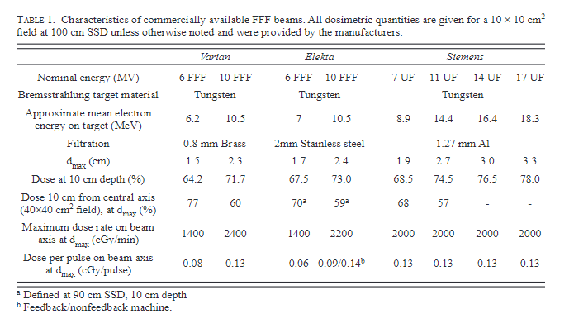
Varian vs Elekta
Xiao, Ying, Stephen F. Kry, Richard Popple, Ellen Yorke, Niko Papanikolaou, Sotirios Stathakis, Ping Xia, et al. “Flattening Filter-Free Accelerators: A Report from the AAPM Therapy Emerging Technology Assessment Work Group.” Journal of Applied Clinical Medical Physics 16, no. 3 (2015): 12–29. https://doi.org/10.1120/jacmp.v16i3.5219.
Notes:
Dose-rates
10FFF 2400 MU/min
6FFF 1400 MU/min

Slide 4

But which energy?
Why not have beam models for both?
Main reason is for practice
6FFF for SRS work
Narrow penumbra
10FFF for SBRT & SABR
High dose rate

Slide 5
RayStation 12 A Beam Commissioning module
Copy the template TrueBeam model
Why would you do anything else?
Verify against archive commissioning reports & manufacturer data
Copy existing 6MV, 10MV model, confirm merging possible
1 Varian machine model for RS users
Tick box that says export Beam Dose (330A,0084) as nominal contribution
Confirm with AH

Slide 6
RayStation 12 A Beam Commissioning module
Scope of Beam Model
No wedges
No cones
No blocks
Will routinely be used for IMRT
Small field profiles and PDDs
What about largest field size?
Primary collimator leads to rounded corners
40x40cm
We will need to model corners for new machines

Slide 7
Recommended Beam Data
Square fields
2cm, 3cm, 5cm, 10cm, 15cm, 20cm, 30cm, 40cm
Rectangular fields
5×20cm, 20×5cm
Curve types
PDDs
Profiles @ 5, 10 & 20cm depth
Shift curves by half an MLC, interleaf leakage
One diagonal for the largest field size
Output factors
Used to normalize the curves, not dose computation so less important
Arbitrary test fields
I suggest Picket Fence & DLG (synchronous and asynchronous)
These should be centered about CAX and corrected for detector volume/noise
Use BEAMSCAN

Slide 8
RayStation 12A Beam Model parameters
Available through auto-modelling scripts
Primary source
Width
Flatting Filter Source
Non-zero for FFF
Effective distance, weight, width
Electron contamination
Weight, width, weight of flattening filter electron source, E₀ and C

Slide 9
RayStation 12A Beam Model parameters
Available through auto-modelling scripts
Off Axis
Beam Profile Corrections
Off axis softening
Photon Energy Spectrum fluence
Output factor corrections
Not the same as what is measured
RayStation calculates a Field Measure used to scale MUs with field size
Not derived from measure OFs

Slide 10
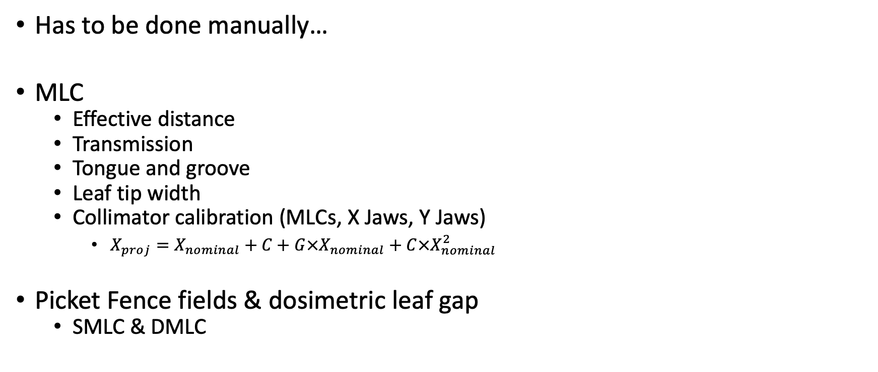
RayStation 12A Beam Model parameters
Has to be done manually…
MLC
Effective distance
Transmission
Tongue and groove
Leaf tip width
Collimator calibration (MLCs, X Jaws, Y Jaws)
$X_{proj}=X_{nominal}+C+G×X_{nominal}+C×X_{nominal}^{2}$
Picket Fence fields & dosimetric leaf gap
SMLC & DMLC

Slide 11
Measuring the MLC modelling parameters
Essentially 4 parameters characterize the MLCs in RayStation
Leaf tip width
Rounded for consistent penumbra
Tongue-and-groove width
Reduce inter-leaf leakage
X-position offset
Transmission
TPSs require these
Some rely on matching beam profiles for static MLC defined fields
Others use 2D Gamma for a set of test beams
Saez, J. et al. (2020) ‘A novel procedure for determining the optimal MLC configuration parameters in treatment planning systems based on measurements with a Farmer chamber’, Physics in Medicine & Biology, 65(15), p. 155006. Available at: https://doi.org/10.1088/1361-6560/ab8cd5.

Slide 12
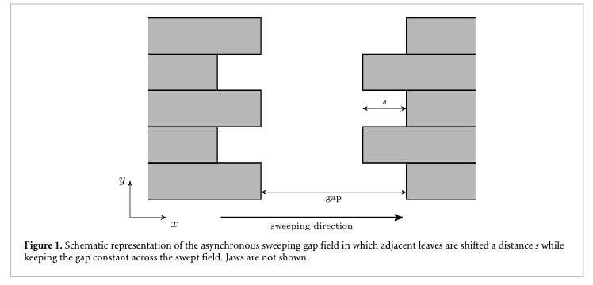
Measuring the MLC modelling parameters
Sweeping gap
DLG or offset
Sliding slit field with all leaf pairs aligned travels a distance d at constant speed
Asynchornous sweeping gap
Tongue-and-groove
Saez, J. et al. (2020) ‘A novel procedure for determining the optimal MLC configuration parameters in treatment planning systems based on measurements with a Farmer chamber’, Physics in Medicine & Biology, 65(15), p. 155006. Available at: https://doi.org/10.1088/1361-6560/ab8cd5.
Notes:
We can measure these parameters experimentally.

Slide 13
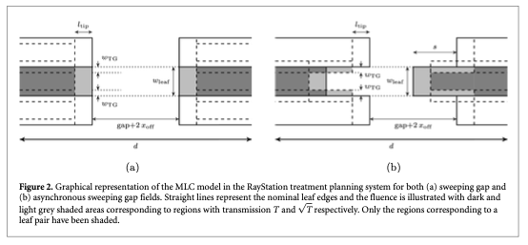
Measuring the MLC modelling parameters
Saez, J. et al. (2020) ‘A novel procedure for determining the optimal MLC configuration parameters in treatment planning systems based on measurements with a Farmer chamber’, Physics in Medicine & Biology, 65(15), p. 155006. Available at: https://doi.org/10.1088/1361-6560/ab8cd5.

Slide 14
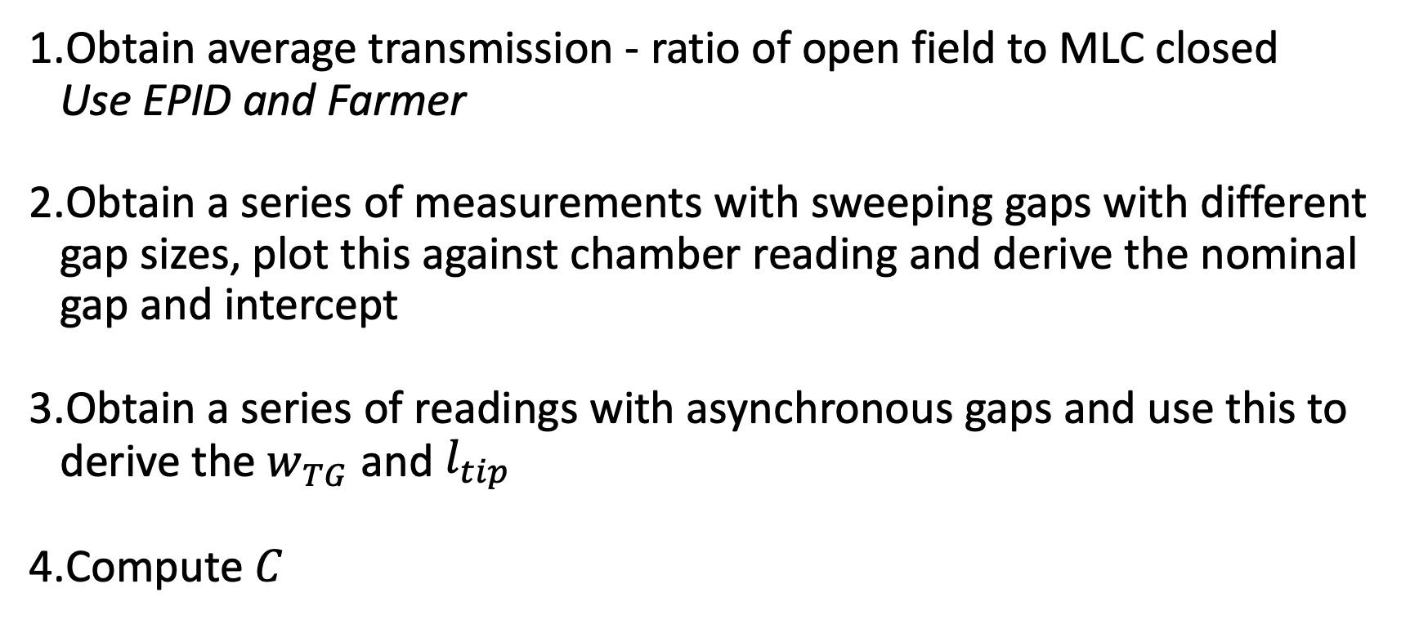
Measuring the MLC modelling parameters
Obtain average transmission - ratio of open field to MLC closed Use EPID and Farmer
Obtain a series of measurements with sweeping gaps with different gap sizes, plot this against chamber reading and derive the nominal gap and intercept
Obtain a series of readings with asynchronous gaps and use this to derive the $w_{TG}$ and $l_{tip}$
Compute $C$
Saez, J. et al. (2020) ‘A novel procedure for determining the optimal MLC configuration parameters in treatment planning systems based on measurements with a Farmer chamber’, Physics in Medicine & Biology, 65(15), p. 155006. Available at: https://doi.org/10.1088/1361-6560/ab8cd5.

Slide 15
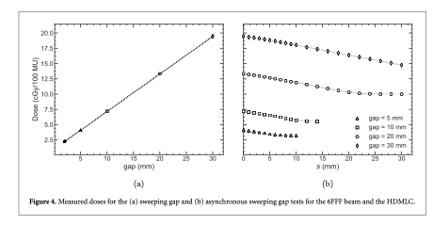
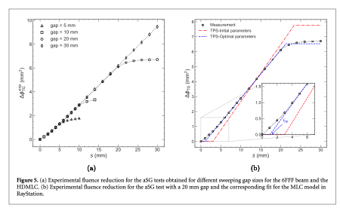
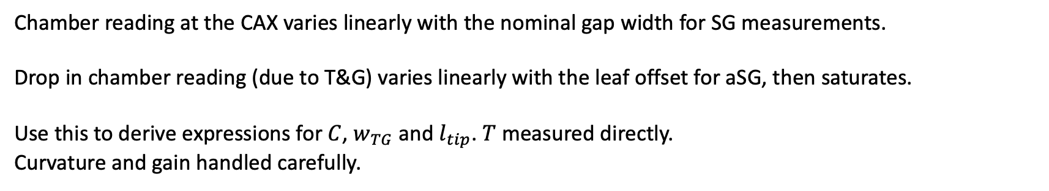
Measuring the MLC modelling parameters
Chamber reading at the CAX varies linearly with the nominal gap width for SG measurements.
Drop in chamber reading (due to T&G) varies linearly with the leaf offset for aSG, then saturates.
Use this to derive expressions for $C$, $w_{TG}$ and $l_{tip}$. $T$ measured directly.
Curvature and gain handled carefully.
Saez, J. et al. (2020) ‘A novel procedure for determining the optimal MLC configuration parameters in treatment planning systems based on measurements with a Farmer chamber’, Physics in Medicine & Biology, 65(15), p. 155006. Available at: https://doi.org/10.1088/1361-6560/ab8cd5.

Slide 16
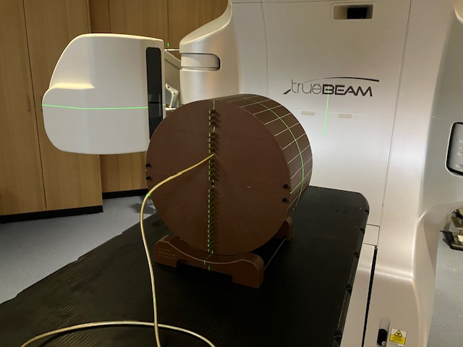
Sweeping gap fields
Method:
Modified Varian DLG plans
Load in Machine QA mode
Measurements:
A1SL Cheese Phantom
EPID
Dosimetry mode

Slide 17
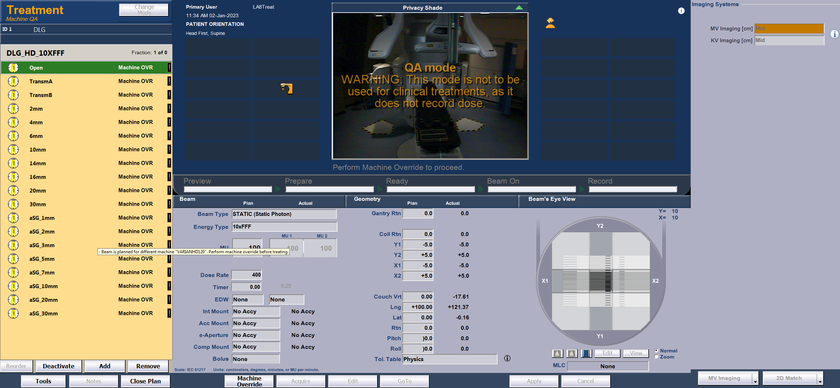
Sweeping gap fields

Slide 18
RESULTS: Summary
Chamber readings analysed in MS Excel.
EPID images using combination of ImageJ & MS Excel.
Square ROI centre of field
Normalise by int. den. for 10x10 open.
Checked, analysis insensitive to changes in ROI width ~ 1%.
Comments:
Using the EPID to measure transmission might not be best practice
EPID measurements may include electron contamination
May provide useful starting point

Slide 19
RayStation Profile & PDD extraction
Objective:
Automatic extraction of PDDs and Profiles from RayStation phantom
Convert to .mcc format
Advantages:
Manual method is time consuming & limited by manual dexterity
Make use of Scanned Data Analysis & BEAMSCAN tools

Slide 20
RayStation Profile & PDD extraction
Run phantom_curves.py script using Script creation in RayStation 12A
Project directory structure
root/
phantom_curves.py
mcc/
template/
PROFILE.mcc
PDD.mcc
raystation_data_out/
ptw_mcc.py
rs_macros/
raystation_curves.py

Slide 21
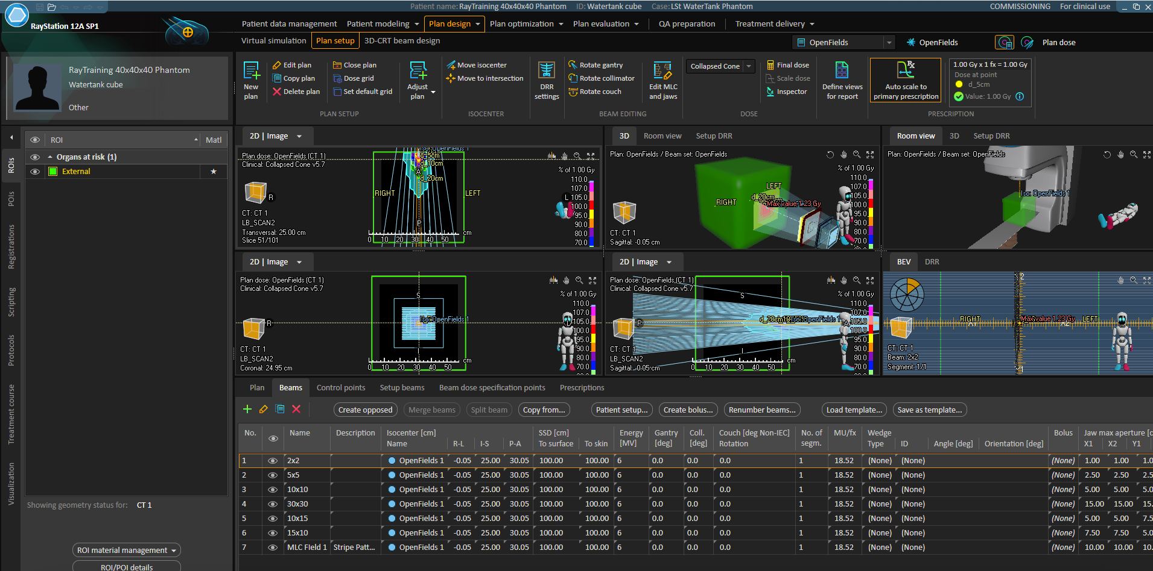
RayStation Profile & PDD extraction
Patient Name: RayTraining 40x40x40 Phantom Case: LSt WaterTank Phantom

Slide 22
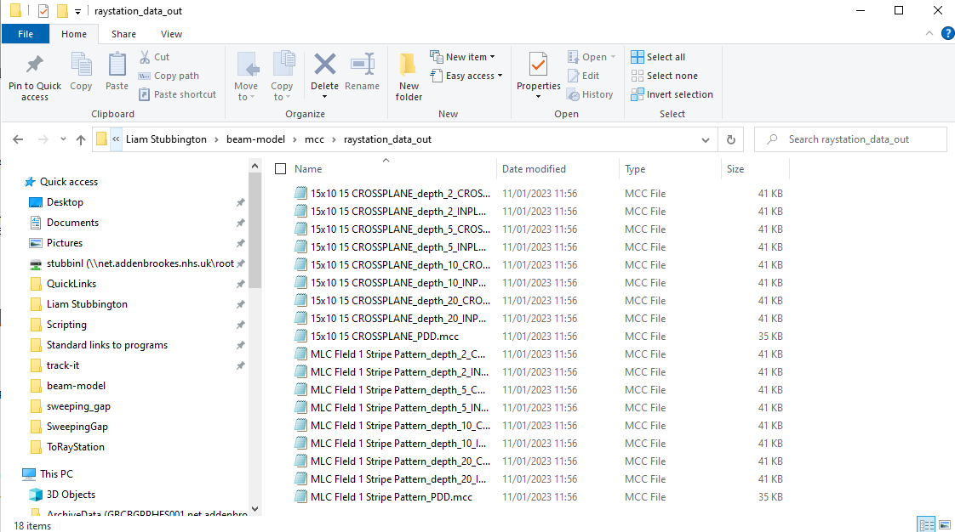
RayStation Profile & PDD extraction
Patient Name: RayTraining 40x40x40 Phantom Case: LSt WaterTank Phantom
3D-CRT Beams
Add POIs
GUN, TARGET, RIGHT, LEFT, AXIS
Depths for profile extraction
All Beams in current BeamSet written to .mcc
File name includes:
Beam Name & Description
Curve Type (PDD, Profile)
Depth
Use descriptive beam names!

Slide 23
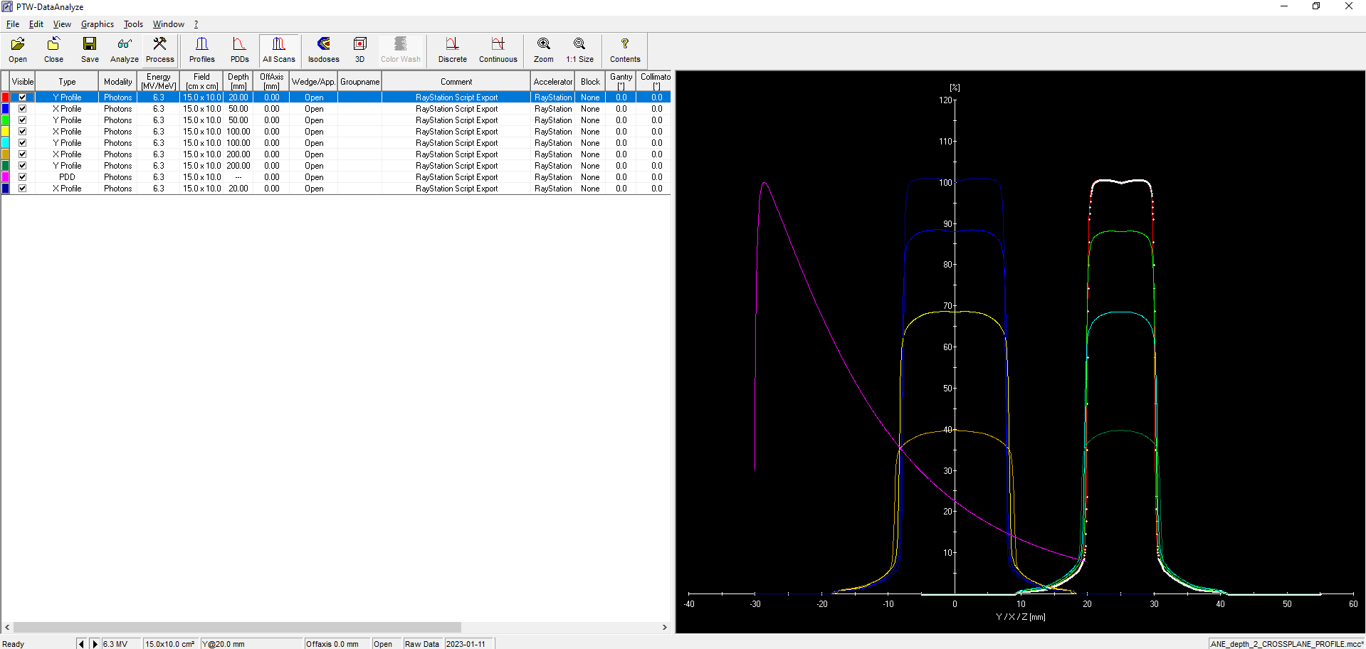
RayStation Profile & PDD extraction
Beams.mcc files can be opened in Scanned Data Analysis for review

Slide 24
RayStation Profile & PDD extraction
Location of POIs is key:
Crossplane profiles go from RIGHT POI to LEFT POI.
Inplane profiles go from GUN to TARGET POI.
Profiles are taken at the depths of all POIs that have "cm" in their label.
PDDs are taken from the AXIS POI in the ANT POST direction.
Known limitations:
Bare bones template.mcc files are manipulated Some PTW functionality may not be supported
Energy – 6X FFF comes in as 6.3 etc.
Initial Jaw Positions used as Field Size label
3D-CRT only
Resulting .mcc will have:
Collimator and gantry at zero
Measured in water
Field type: IRREGULAR
Reference field: 10x10, 5cm deep, ISOCENTER
SCD = 1000mm

Slide 25
RayStation Profile & PDD extraction
Validation
Two Beams 15x10cm and MLC Striped pattern
Verified manually in Excel
See spreadsheet for details.

Slide 26
RayStation Profile & PDD extraction

Slide 27
RayStation Profile & PDD extraction
CROSSPLANE

Slide 28
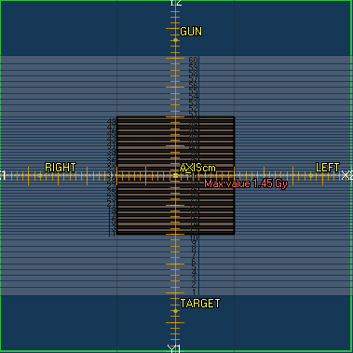
RayStation Profile & PDD extraction

Slide 29
Thanks for listening!
What have I missed?

Slide 30
Some useful tools
BeamCommissioningFieldsList
Only accessibly via scripting
Allows you to add arbitrary fields to the dose curve computation process
Very useful for MLC characterization
Impossible to do with square fields
BEAMSCAN has a button to
Auto-centre
Denoise diode measurements, deconvolve chamber volume

Slide 31
Some useful tools
Varian Golden Beam Data
Use our own measured data
HomeBrew
Automatic extraction of profiles, PDDs from water phantom & export as .mcc
Avoids the need for pixel accuracy with the cursor
Use the 1D Gamma analysis button in PTW software
Calculation of 1D Gamma between calculated and measured curves
PyMedPhys

Slide 32
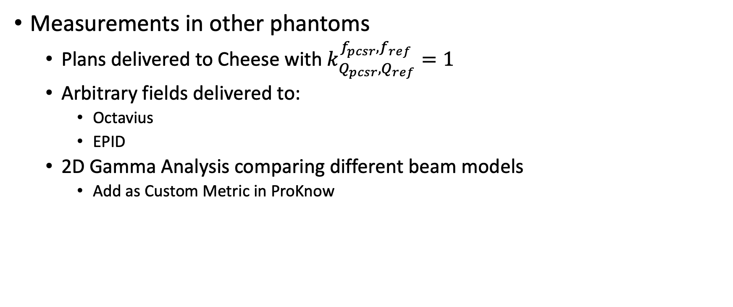
Some useful tools
Measurements in other phantoms
Plans delivered to Cheese with $k_{Q_{pcsr},Q_{ref}}^{f_{pcsr},f_{ref}}=1$
Arbitrary fields delivered to:
Octavius
EPID
2D Gamma Analysis comparing different beam models
Add as Custom Metric in ProKnow

