Slide 1
6FFF vs 10FFF
10FFF
Notes:
And the main reason for this, I think is that a Varian 10FFF is basically and Elekta 6FFF
6FFF Elekta could replace both 10X and 6X, Elekta 10FFF could not
It is also consistent with Tomo machines and Varian SRS work.

Slide 2
6FFF vs 10FFF
10FFF
Unless we get 2 more Elekta’s
In which case 6FFF…
Notes:
And the main reason for this, I think is that a Varian 10FFF is basically and Elekta 6FFF
6FFF Elekta could replace both 10X and 6X, Elekta 10FFF could not
It is also consistent with Tomo machines and Varian SRS work.

Slide 3
FFF impacts what?
FFF beams:
Higher dose rate → shorter fractions
Decrease in treatment head leakage per MU → lower dose outside the field
Photon spectrum more uniform across profile → easier to model in TPS
Decrease in beam quality with Varian machines
Higher dose per pulse → higher ion recombination
Reduced output factor variation with field size
Beam profile
Notes:
Shorter fractions are good for intra-fractional motion and patient comfort

Slide 4
Varian vs Elekta
So, in some way, Elekta 6FFF is more like Varian 10FFF
Elekta
10FFF & 10MV ~ same TPR20,10
6FFF & 6MV ~ same TPR20,10
Varian
10FFF ~ 8MV
6FFF ~ 4MV
Dose rates ~ 1400MU/min 6FFF, 2400MU/min 10FFF
Notes:
Dose-rates
10FFF 2400 MU/min
6FFF 1400 MU/min

Slide 5
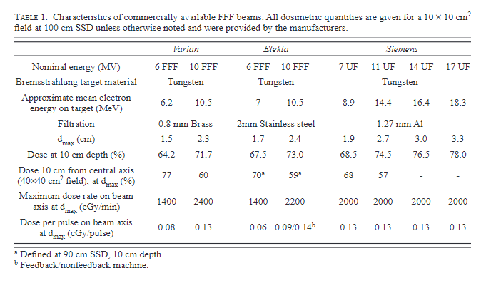
Varian vs Elekta
Xiao, Ying, Stephen F. Kry, Richard Popple, Ellen Yorke, Niko Papanikolaou, Sotirios Stathakis, Ping Xia, et al. “Flattening Filter-Free Accelerators: A Report from the AAPM Therapy Emerging Technology Assessment Work Group.” Journal of Applied Clinical Medical Physics 16, no. 3 (2015): 12–29. https://doi.org/10.1120/jacmp.v16i3.5219.
Notes:
Dose-rates
10FFF 2400 MU/min
6FFF 1400 MU/min

Slide 6
UK Mailbase
Who? | Said what?
Viv Cosgrove, Leeds | Elekta – 6FFF & 10FFF #Fractions 6FFF:10FFF 15:1 10FFF for larger volume IMRT breast planning
Graham Chalmers, Birmingham | Elekta – 6FFF only Avoids 10FFF shielding considerations
Keith Langmack, Nottingham | As above
Kevin Burke, South Tees | Elekta – 6FFF & 10FFF 10FFF used exclusively for large volume tangential dmlc breast plans – low patient #s 2/5 LINACs
Robin Laney, Plymouth | Varian – 10FFF only, 10FFF dose-rate ~1.5×6FFF, shorter treatment times → less intra-fraction motion for lung SABR
Jenny Marsden, Hull | As above (https://doi.org/10.1088/2057-1976/2/6/065016)
Jonny, Poole | Varian – 10FFF only, SABR
Ipswich | As above
UK mailbase
Notes:
Elekta 6FFF is a bit like Varian 10FFF
6FFF Elekta could replace both 10X and 6X, Elekta 10FFF could not
Interestingly, I cannot find a Varian centre that uses only 6FFF…?
Thou not an exhaustive search.

Slide 7
6FFF vs 10FFF
Laoui, Samir, Dante E. Roa, Jeffrey Kuo, Maxim Baldytchev, Jonathan Gonzales, Salam Dietrich, Nilam Ramsinghani, Parima Daroui, and Hanako Farol. “Flattening Filter Free Beam Energy Selection and Its Impact in Multitarget Intracranial Stereotactic Radiosurgery Treatments.” Medical Dosimetry 45, no. 4 (December 1, 2020): 363–67. https://doi.org/10.1016/j.meddos.2020.05.001.
“The main dosimetric improvement of a 6 MV FFF over a 10 MV FFF beam is the sharper dose fall-off which directly correlates with less normal brain tissue volume irradiation.”
6FFF advantages
Narrow penumbra
SRS work
Small field output factors
More easily modulated by MLCs
I think, needs testing
Palmans, Hugo, Pedro Andreo, M. Saiful Huq, Jan Seuntjens, Karen E. Christaki, and Ahmed Meghzifene. “Dosimetry of Small Static Fields Used in External Photon Beam Radiotherapy: Summary of TRS-483, the IAEA–AAPM International Code of Practice for Reference and Relative Dose Determination.” Medical Physics 45, no. 11 (2018): e1123–45. https://doi.org/10.1002/mp.13208.
Notes:
Lower energy beams are less impacted by interfacial phenomena – width of lateral charged particle equilibrium is less for 6FFF than for 10FFF
Lower MLC transmission is something that I couldn’t find written or reported, but may be assumed? Ideally measured

Slide 8
6FFF vs 10FFF
10FFF
2400MU/min vs 1400MU/min → Shorter treatment times
Greater penetration power → treat deeper targets, relative skin sparring
Arcs?
Lung tissue?
Prostate VMAT w/ 6X?
Notes:
Effective treatment time for a VMAT delivery depends on MLC and gantry movement

Slide 9
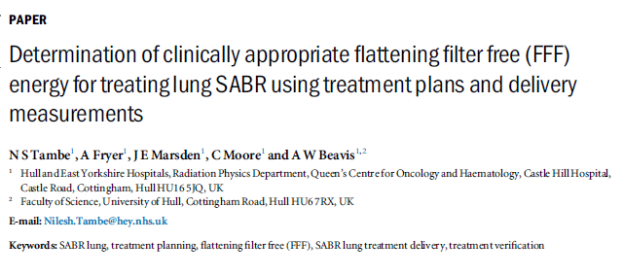
6FFF vs 10FFF
U:\Liam Stubbington\FFF
Notes:
These guys actually come to the opposite conclusion – but this is mostly dealing with SABR – I wonder if we could use 6FFF to replace everything?

Slide 10
6FFF vs 10FFF
15 6MV lung SABR plans, replanned at 6FFF and 10FFF
2 half arcs, MU objective, Eclipse™, TrueBeams
DQA - Compass™ dosimetry system
Of note
6FFF statistically significantly better organ sparing wrt 10FFF & 6wFF
Skin sparring superior in 10FFF plans
Beam on time (adjusted for gating duty cycle)
61%, 51% reduction in BoT 10FFF, 6FFF vs 6wFF
15% reduction in average treatment time 10FFF vs 6FFF
Tambe, N. S., A. Fryer, J. E. Marsden, C. Moore, and A. W. Beavis. “Determination of Clinically Appropriate Flattening Filter Free (FFF) Energy for Treating Lung SABR Using Treatment Plans and Delivery Measurements.” Biomedical Physics & Engineering Express 2, no. 6 (December 2016): 065016. https://doi.org/10.1088/2057-1976/2/6/065016.

Slide 11
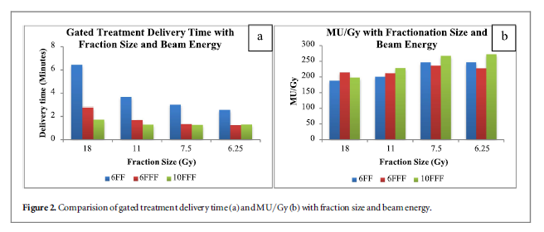
6FFF vs 10FFF
Big win in terms of BoT is from wFF to FFF
#MU/Gy ~ uniform for fraction dose < 8Gy → MU objective
Tambe, N. S., A. Fryer, J. E. Marsden, C. Moore, and A. W. Beavis. “Determination of Clinically Appropriate Flattening Filter Free (FFF) Energy for Treating Lung SABR Using Treatment Plans and Delivery Measurements.” Biomedical Physics & Engineering Express 2, no. 6 (December 2016): 065016. https://doi.org/10.1088/2057-1976/2/6/065016.
Notes:
Effective treatment time for a VMAT delivery depends on MLC and gantry movement

Slide 12
6FFF vs 10FFF (USA)
Varian center
11 characteristic cases – various clinical sites
6MV DMLC IMRT vs VMAT 6FFF & VMAT 10FFF
Measured
Beam on time, delivery time, MUs,Integral dose
Conclusion:
“FFF beams significantly reduced treatment delivery time.”
“In cases that benefit from respiratory motion management, beam-on/field was reduced to a time for which most patients can comfortably maintain deep inspiratory breath hold.”
Thomas, E. M. et al. Effects of flattening filter-free and volumetric-modulated arc therapy delivery on treatment efficiency. J Appl Clin Med Phys 14, 4328 (2013).
Notes:
Broadly in line with UK study,

Slide 13
6FFF vs 10FFF stage 1 NSCLC
N = 11 patients, 6FFF, 10FFF vs 6FF VMAT plans for NSCLC
RTOG-0915 protocol
Delta⁴, Gafchromic film in a thorax phantom
Integral lung dose
V20Gy, V12.5Gy reduced by 5.5% & 4.5%, 6FFF vs 6wFF
Not seen with 10FFF
Mean beam on times: 111±11s 10FFF, 128±19s for 6FFF vs 269±71s for 6wFF
Hrbacek, Jan, Stephanie Lang, Shaun N. Graydon, Stephan Klöck, and Oliver Riesterer. “Dosimetric Comparison of Flattened and Unflattened Beams for Stereotactic Ablative Radiotherapy of Stage I Non-Small Cell Lung Cancer.” Medical Physics 41, no. 3 (2014): 031709. https://doi.org/10.1118/1.4866231.

Slide 14
6FFF vs 10FFF stage 1 NSCLC
“The use of FFF beams for stereotactic radiation therapy of non-small cell lung cancer patients yielded dose distributions qualitatively comparable to flattened beams and significantly reduced treatment delivery time.
Utilizing the 6XFFF beam improved conformity of dose distribution.
On the other hand, 10XFFF beam offered a slight improvement in treatment efficiency, and lower skin and peripheral dose. All effects were relatively small.”
Hrbacek, Jan, Stephanie Lang, Shaun N. Graydon, Stephan Klöck, and Oliver Riesterer. “Dosimetric Comparison of Flattened and Unflattened Beams for Stereotactic Ablative Radiotherapy of Stage I Non-Small Cell Lung Cancer.” Medical Physics 41, no. 3 (2014): 031709. https://doi.org/10.1118/1.4866231.

Slide 15
Summary
FFF beam model would be good!
Get rid of brainlab
Reduced treatment times
Comparable inverse treatment plans
UK
Elekta consensus is 6FFF, Varian is 10FFF
Elekta 6FFF is something like a Varian 10FFF anyway

Slide 16
Summary
Some evidence of better normal tissue sparring with 6FFF
SRS work
NSCLC
Narrower penumbra
10FFF leads to shorter treatment times
Biggest reduction is with respect to wFF beams
Tambe, N. S., A. Fryer, J. E. Marsden, C. Moore, and A. W. Beavis. “Determination of Clinically Appropriate Flattening Filter Free (FFF) Energy for Treating Lung SABR Using Treatment Plans and Delivery Measurements.” Biomedical Physics & Engineering Express 2, no. 6 (December 2016): 065016. https://doi.org/10.1088/2057-1976/2/6/065016.

Slide 17
Thanks for listening
Any questions?

Slide 18
Bunker shielding requirements
LINAC bunker shielding requirements…?
MC simulation
FFF reduced required primary & secondary barriers by 10–20%
Translates into a reduction in occupational exposure and/or the cost and space of shielding.
Kry SF, Howell RM, Polf J, Mohan R, Vassiliev ON. Treatment vault shielding for a flattening filter-free medical linear accelerator. Phys Med Biol. 2009 Mar 7;54(5):1265-73. doi: 10.1088/0031-9155/54/5/011. Epub 2009 Feb 3. PMID: 19190359.
Notes:
I crossed out shielding requirements, have you ever heard of anybody retro actively adjusting shielding because of FFF commissioning?
Dose-rates – TADR 2000 may be adjusted by occupancy and use factors
IMRT energies usually reduced with respect to 3D-CRT for example 18MV

Slide 19
FFF with RA or DCA for SABR
24 PTVs from 1.52-445.24cm³
Dynamic conformal arc, RapidArc plans created with 6FFF & 10FFF
Virtual phantom, lung and liver sites
The goal of this study was to obtain some criteria to enable a conscious choice of the employment of FFF beams and of the DCA or RA technique, depending on the PTV size
Vieillevigne, Laure, Sandra Bessieres, Monia Ouali, and Christel Lanaspeze. “Dosimetric Comparison of Flattened and Unflattened Beams for Stereotactic Body Radiation Therapy: Impact of the Size of the PTV on Dynamic Conformal Arc and Volumetric Modulated Arc Therapy.” Physica Medica: European Journal of Medical Physics 32, no. 11 (November 1, 2016): 1405–14. https://doi.org/10.1016/j.ejmp.2016.10.007.

Slide 20
FFF with RA or DCA for SABR
No difference in conformity and gradient indices
DCA less suitable for larger PTVs
6FFF slightly better in terms of healthy tissue mean doses
FFF beams significantly reduced beam on times
More pronounced for larger volumes, especially RA plans
FFF increased MUs
More pronounced for larger volumes, especially RA plans
FFF beams provide better sparing of healthy-tissues compared to wFF, except 10FFF with DCA
Vieillevigne, Laure, Sandra Bessieres, Monia Ouali, and Christel Lanaspeze. “Dosimetric Comparison of Flattened and Unflattened Beams for Stereotactic Body Radiation Therapy: Impact of the Size of the PTV on Dynamic Conformal Arc and Volumetric Modulated Arc Therapy.” Physica Medica: European Journal of Medical Physics 32, no. 11 (November 1, 2016): 1405–14. https://doi.org/10.1016/j.ejmp.2016.10.007.

Slide 21
FFF with RA or DCA for SABR
“FFF showed better results than FF beams for the considered plans. 10FFF used with DCA should be used with caution for medium and large volumes.”
Vieillevigne, Laure, Sandra Bessieres, Monia Ouali, and Christel Lanaspeze. “Dosimetric Comparison of Flattened and Unflattened Beams for Stereotactic Body Radiation Therapy: Impact of the Size of the PTV on Dynamic Conformal Arc and Volumetric Modulated Arc Therapy.” Physica Medica: European Journal of Medical Physics 32, no. 11 (November 1, 2016): 1405–14. https://doi.org/10.1016/j.ejmp.2016.10.007.

Slide 22
Breast planning
“Flattening filter free (FFF) beams may increase dose rates and lower peripheral dose.”
“We investigated FFF for left-sided breast irradiation, comparing 4 intensity-modulated radiation therapy techniques in 10 patients using flattened or FFF beams.”
Calculated target volume, heart, and ipsilateral lung doses were similar.”
“FFF shortened delivery time” – But near double Mus
[FFF] “potentially lower peripheral dose” that “may be underestimated by the treatment planning system”
“For breast irradiation, FFF was comparable to flattened beams.”
Spruijt, K. H. et al. Flattening Filter Free vs Flattened Beams for Breast Irradiation. International Journal of Radiation Oncology, Biology, Physics 85, 506–513 (2013).

Slide 23
FFF 3D-CRT
52 CT studies
Breast, neurocranium, lung, bone mets, prostate
All planned with 3D-CRT FiF
More fields needed with FFF, but no significant differences between FFF FF plans in mean dose to PTV
“This study has shown that the exclusive use of a linear accelerator in FFF mode is feasible in 3D-CRT”.
Kretschmer, M. et al. The impact of flattening-filter-free beam technology on 3D conformal RT. Radiat Oncol 8, 133 (2013).

