Slide 1
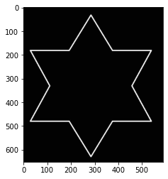
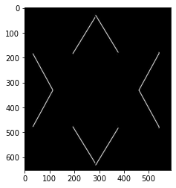
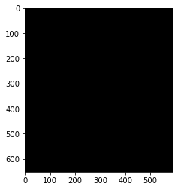
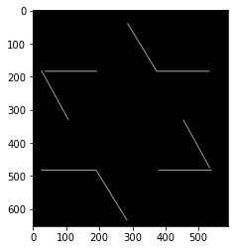

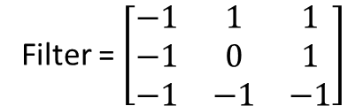
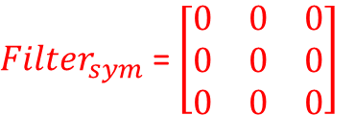
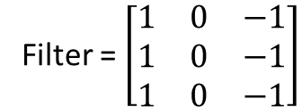
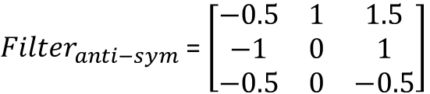
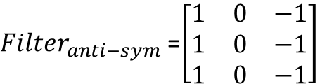
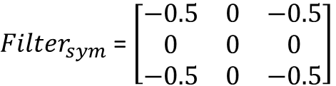
Input Image
Filter = $\left[\begin{matrix}1 & 0 & −1 \\ 1 & 0 & −1 \\ 1 & 0 & −1\end{matrix}\right]$
${Filter}_{sym}$ = $\left[\begin{matrix}0 & 0 & 0 \\ 0 & 0 & 0 \\ 0 & 0 & 0\end{matrix}\right]$
${Filter}_{anti−sym}$ =$\left[\begin{matrix}1 & 0 & −1 \\ 1 & 0 & −1 \\ 1 & 0 & −1\end{matrix}\right]$
Filter = $\left[\begin{matrix}−1 & 1 & 1 \\ −1 & 0 & 1 \\ −1 & −1 & −1\end{matrix}\right]$
${Filter}_{sym}$ = $\left[\begin{matrix}−0.5 & 0 & −0.5 \\ 0 & 0 & 0 \\ −0.5 & 0 & −0.5\end{matrix}\right]$
${Filter}_{anti−sym}$ = $\left[\begin{matrix}−0.5 & 1 & 1.5 \\ −1 & 0 & 1 \\ −0.5 & 0 & −0.5\end{matrix}\right]$

Slide 2
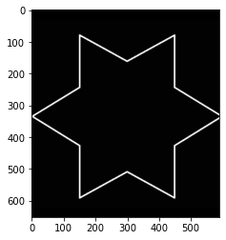

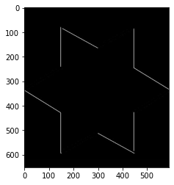

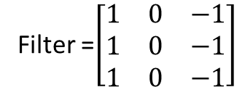
Input Image (rotated 90deg)
Filter =$\left[\begin{matrix}1 & 0 & −1 \\ 1 & 0 & −1 \\ 1 & 0 & −1\end{matrix}\right]$
${Filter}_{sym}$ = $\left[\begin{matrix}0 & 0 & 0 \\ 0 & 0 & 0 \\ 0 & 0 & 0\end{matrix}\right]$
${Filter}_{anti−sym}$ =$\left[\begin{matrix}1 & 0 & −1 \\ 1 & 0 & −1 \\ 1 & 0 & −1\end{matrix}\right]$
Filter = $\left[\begin{matrix}−1 & 1 & 1 \\ −1 & 0 & 1 \\ −1 & −1 & −1\end{matrix}\right]$
${Filter}_{sym}$ = $\left[\begin{matrix}−0.5 & 0 & −0.5 \\ 0 & 0 & 0 \\ −0.5 & 0 & −0.5\end{matrix}\right]$
${Filter}_{anti−sym}$ = $\left[\begin{matrix}−0.5 & 1 & 1.5 \\ −1 & 0 & 1 \\ −0.5 & 0 & −0.5\end{matrix}\right]$

