Slide 1

WINE RATING
DATA MINING AND MACHINE LEARNING
FINAL PROJECT
NOY UZAN
LIAM AVARGIL

Slide 2
A Little background
A wine rating is a score assigned by one or more wine critics to a wine tasted as a summary of that critic's evaluation of that wine. A wine rating is therefore a subjective quality score, typically of a numerical nature, given to a specific bottle of wine. In most cases, wine ratings are set by a single wine critic, but in some cases a rating is derived by input from several critics tasting the same wine at the same time. A number of different scales for wine ratings are in use.
Also, the practices used to arrive at the rating can vary. Over the last couple of decades, the 50–100 scale introduced by Robert M. Parker, Jr. has become commonly used. This or numerically similar scales are used by publications such as Wine Enthusiast, Wine Spectator, and Wine Advocate. Other publications or critics, such as Jancis Robinson and Michael Broadbent, may use a 0–20 scale, or a 0–5 scale (often in terms of numbers of stars) either with or without half-star steps.

Slide 3
Our research - Intro
Research question:
how a wine characteristics affect its rating?
We will do it by reffering the wine sweet level, tannic level, bold level, and allergic components.

Slide 4
sources
Wikipedia:
https://en.wikipedia.org/wiki/Wine_rating
Vivino:
https://www.vivino.com/

Slide 5
Data collection process
We used web crawling for collecting and obtaining the data. We used ‘selenium’ library to build the crawler and a built-in function from ‘pandas’ to crawl the relevant information about every wine type which we wanted to explore. We did the crawling process on “vivino.com”- a source that contained all the required information for our research question.
The crawling process took around 5 hours, finally, the records saved into ‘data’ dataframe.

Slide 6

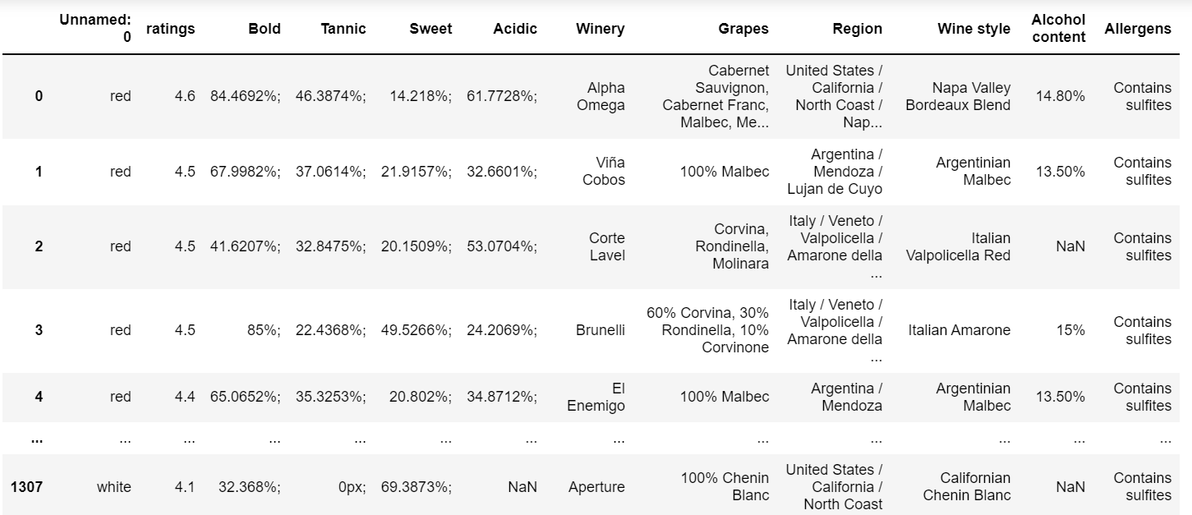
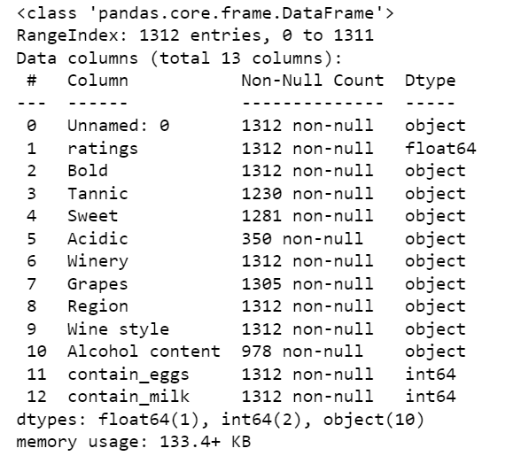

Slide 7
Data cleaning and storing
First we concatenation of all the information into one table while adjusting the columns into a uniform format.
Then with ‘pandas’ functions we filtered duplicates and empty values. Some of the parameters were not relevant to our research, and some parameters appeared only in one or two specific wine types, so we had to remove it from our dataset.
Some columns were missing only several values so in this case we put the column average value in it.
Some columns included more than one parameter so we had to separate it.
In order to use the numerical values we had to convert it from string to an integer.
In that way we manipulated our data in order to prepare it for modeling.

Slide 8
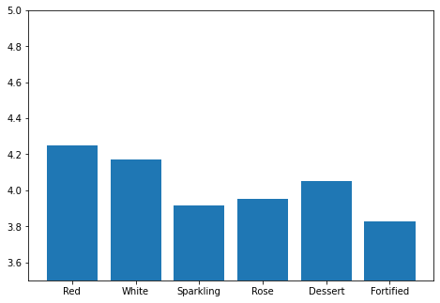
EDA – visualization and conclusions
This graph visualize wine types ratings by ‘vivino’ usres.

Slide 9
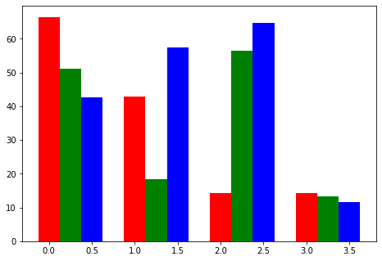
This graph visualize the wine taste characteristics divided by wine types.

Slide 10
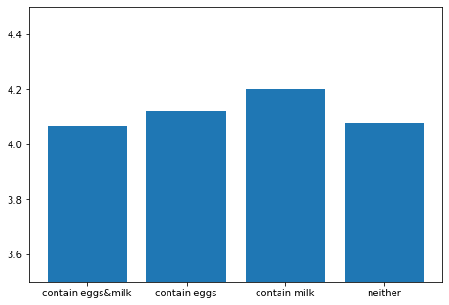
This graph visualize wine ratings in relation to allergens components.

Slide 11
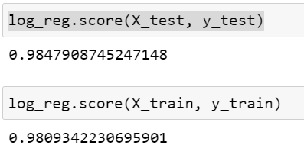
Machine learning model
We used logistic regression model to determine how a wine characteristics affect its rating. We included sweet level, tannic level, bold level, and allergic components
Eventually we came up with a model that is able to predict with a 0.98 certainty the effect of wine characteristics on its rating.

