Slide 1
Module code | FC315
Group | A
Module Title | Intermediate Digital Applications
Assessment Type | Smartphone App Pitch & Product Development Journal
Student ID Number | T0502402, T0491906, T0501429,T0453311
Date of Submission | 2 April, 2026
We confirm that this assignment is our own work. Where we have referred to academic sources we have provided in text citations.
Where we have used AI, we have cited and referenced appropriately.

Slide 2

LingoLedger
Introducing
LingoLedger App
Presented by:
Chau, Liam, Melvin, Andy

Slide 3

The
Problem
International students often struggle to manage daily life in a new country.
They face language barriers in real-life situations, have difficulty controlling their spending, and often do not know where to find reliable student discounts.
Most existing apps solve these problems separately - one app for language learning, another for budgeting, and another for student deals.
The result? Confusion, wasted time, missed savings, and unnecessary stress.

Slide 4

LINGOLEDGER
“ YOUR LIFE ABROAD, SIMPLIFIED ”
SLOGAN
A SIMPLE DIGITAL SOLUTION FOR INTERNATIONAL STUDENTS

Slide 5

What Is
LingoLedger?
LingoLedger is a smart mobile app designed for international students living abroad.
It helps users manage their budget, learn practical local language, and discover student deals - all in one place.
It’s designed for anyone who wants to work smarter, not harder.

Slide 6
Main Functions
Budget:
Language learning:
Student deals:
Monitor spending and manage monthly budget
Discover local discounts and promotions
Practical phrases for real-life situations

Slide 7


How users use Lingo-Ledger
Managing life abroad shouldn’t be complicated.
Example uses
• Track daily spending and manage monthly budgets
• Learn practical local phrases for shopping, transport, or daily situations
• Discover student discounts and nearby deals
Notes:
LingoLedger helps international students handle daily challenges in one place.

Slide 8




Who?
Not knowing where to find reliable student discounts
Language barriers in real-life situations
Most existing apps solve these problems separately, forcing students to switch between multiple tools.
Difficulty managing personal finances
Notes:
International students often struggle with daily life in a new country.

Slide 9
TARGET AUDIENCE
Primary Audience
18–25 years old
Living Abroad
Students studying abroad who need support managing daily life, language communication, and personal finances.
Foundation, undergraduate, or early postgraduate students who are living independently for the first time.
Students adapting to a new country, culture, and language while managing their own expenses and responsibilities.
LingoLedger focuses on international students, while also supporting local students with similar budgeting and daily spending challenges.
Daily Life Support
Secondary Audience
Managing personal budgets, learning practical local language, and finding affordable student deals.
Local students who also want help with budgeting, finding student discounts, or organising their daily spending.

Slide 10

LINGOLEDGER
MARKET LANDSCAPE
Market Landscape
THE MARKET LANDSCAPE DESCRIBES THE INDUSTRY WHERE THE APP OPERATES AND THE OPPORTUNITIES WITHIN THAT MARKET.
IT HELPS EXPLAIN THE DEMAND FOR THE PRODUCT AND THE POTENTIAL USERS IT CAN SERVE.

Slide 11
LINGOLEDGER
MARKET OVERVIEW
Market Overview
EVERY YEAR, MILLIONS OF STUDENTS CHOOSE TO STUDY ABROAD AND MUST ADAPT TO NEW LANGUAGES, FINANCIAL RESPONSIBILITIES, AND EVERYDAY CHALLENGES.
THIS CREATES STRONG DEMAND FOR DIGITAL TOOLS THAT HELP STUDENTS MANAGE THEIR MONEY, LEARN PRACTICAL LANGUAGE SKILLS, AND DISCOVER AFFORDABLE STUDENT SERVICES.
AS JUNE 2025
6.9M
INDUSTRY TRENDS:
INTERNATIONAL EDUCATION
STUDENT LIFESTYLE APPS
DIGITAL BUDGET MANAGEMENT
LANGUAGE LEARNING TECHNOLOGY
(GLOBAL QUALIFICATIONS RECOGNITION IN ACTION - VIELKY’S STORY, 2020)
Notes:
a number that has tripled since 2000.

Slide 12



LINGOLEDGER
COMPETITORS
Competitors
A SNAPSHOT OF THE CURRENT COMPETITIVE LANDSCAPE
“FREE LANGUAGE EDUCATION FOR THE WORLD”
"SPLIT BILLS, IOUS, AND OTHER EXPENSES WITH YOUR FRIENDS, STRESS-FREE"
"BIG SAVINGS WITH STUDENT DISCOUNTS"
Notes:
Duolingo
• Popular language learning app
• Gamified lessons and daily practice
• Helps users learn new languages quickly
❌ Does not include budgeting tools
❌ No student deal discovery
• Expense tracking and cost sharing
• Helps users manage personal spending
• Useful for budgeting with friends
❌ No language learning support
❌ No student discount features
• Provides verified student discounts
• Access to deals from popular brands
• Helps students save money
❌ No budgeting tools
❌ No language learning support

Slide 13
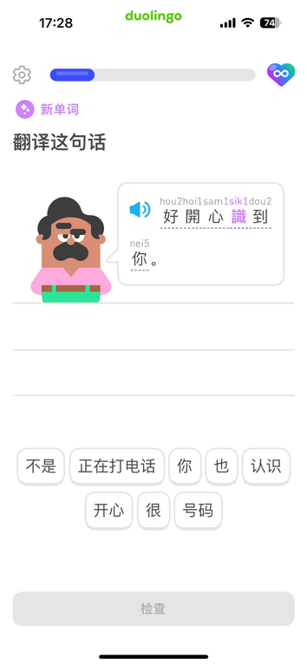
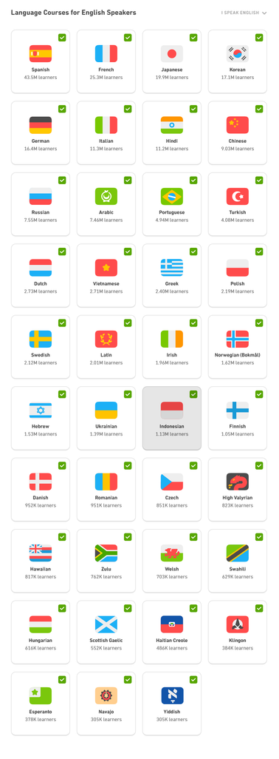
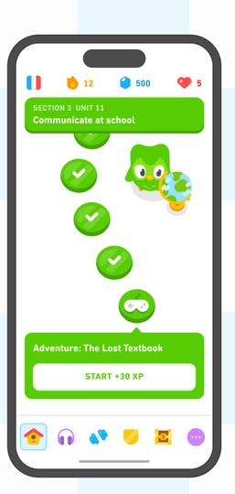
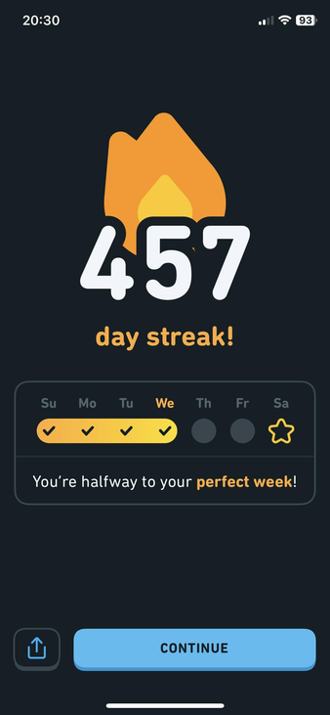
“The free, fun, and effective way to learn a language.”
DUOLINGO
“Free language education for the world”
Daily practice and
streak system
Progress tracking
Gamified language
lessons
Multiple languages
available

Slide 14
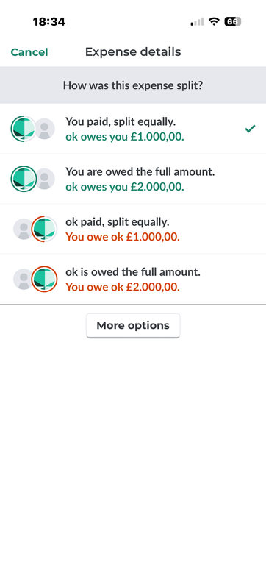
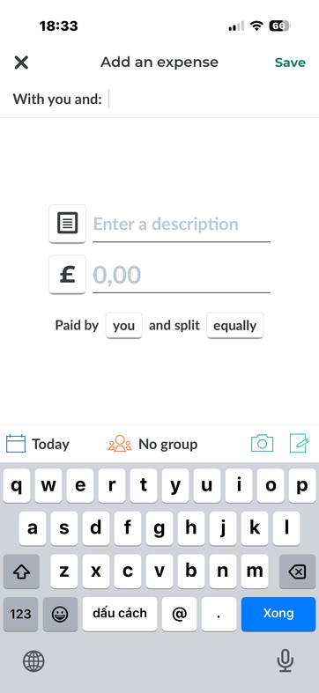
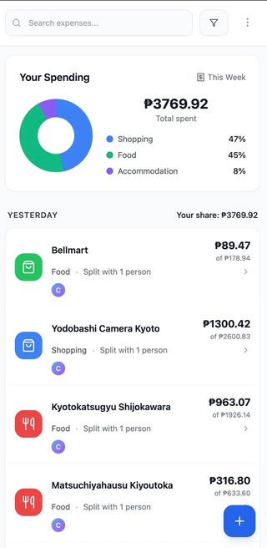
“Less stress when sharing expenses.”
splitwise
“Split bills,...”
  Track shared expenses with friends or roommates
  Automatic bill splitting
  Expense history and reports
  Simple spending tracking

Slide 15
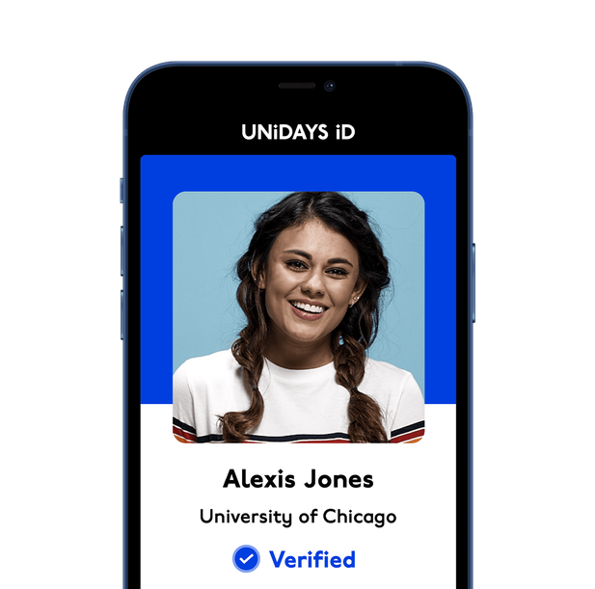
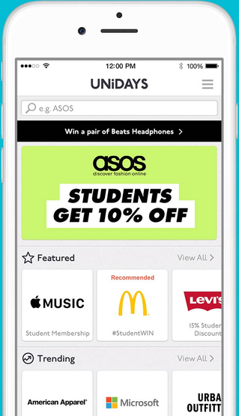
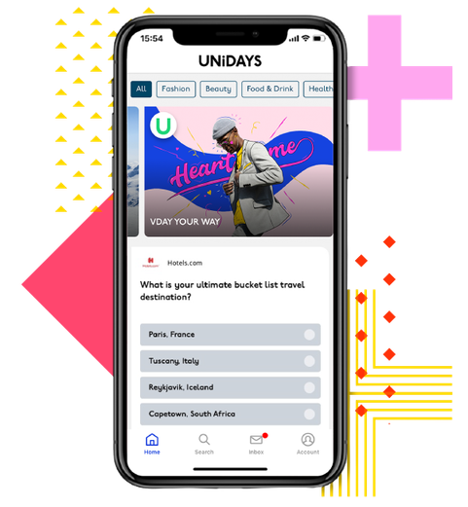
“The free, fun, and effective way to learn a language.”
UNiDAYS
"Big Savings with Student Discounts"
Deals on fashion, technology,
food and services
Student verification
system
Mobile access to
exclusive offers

Slide 16

LINGOLEDGER
USP
UNIQUE SELLING POINT
BUDGET MANAGEMENT
Track and manage daily spending
PRACTICAL LANGUAGE LEARNING
Learn useful phrases for real-life situations
STUDENT DEALS DISCOVERY
Find verified discounts and promotions
3
1
in
Notes:
“While competitors solve individual problems, LingoLedger brings these solutions together in one platform tailored for international students.”

Slide 17
COMPARISON
FEATURES
DUOLINGO
SPLITWISE
UNiDAYS
LINGOLEDGER
Language learning
Budget management
Student deals
All-in-one platform

Slide 18
“ONE APP THAT HELPS INTERNATIONAL STUDENTS MANAGE MONEY, LEARN LOCAL LANGUAGE, AND FIND STUDENT DEALS.”

Slide 19
OUR
MAIN FEATURES
A closer look at how each feature functions through user-focused wireframes.

Slide 20
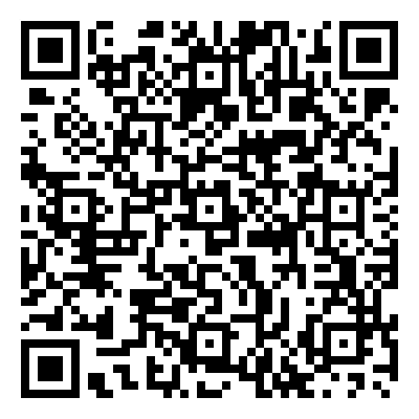
Native
Native
Language
Language
Learning
Learning
First Feature

Slide 21
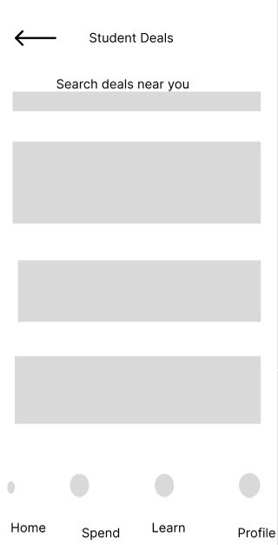
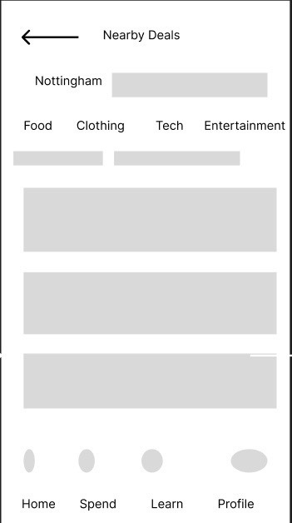
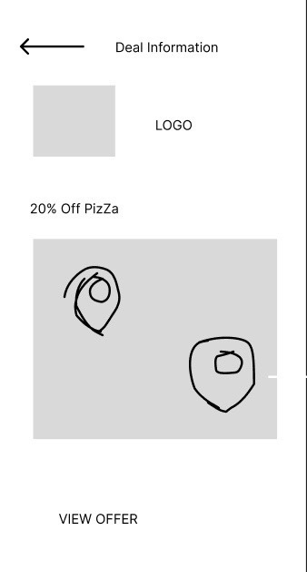
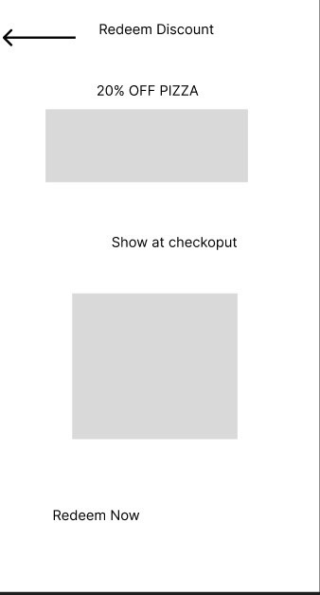
How It Works
How to access student discount?
1
Tap a deal
2
Tap a deal
3
Tap view offer
4
Tap redeem deal

Slide 22
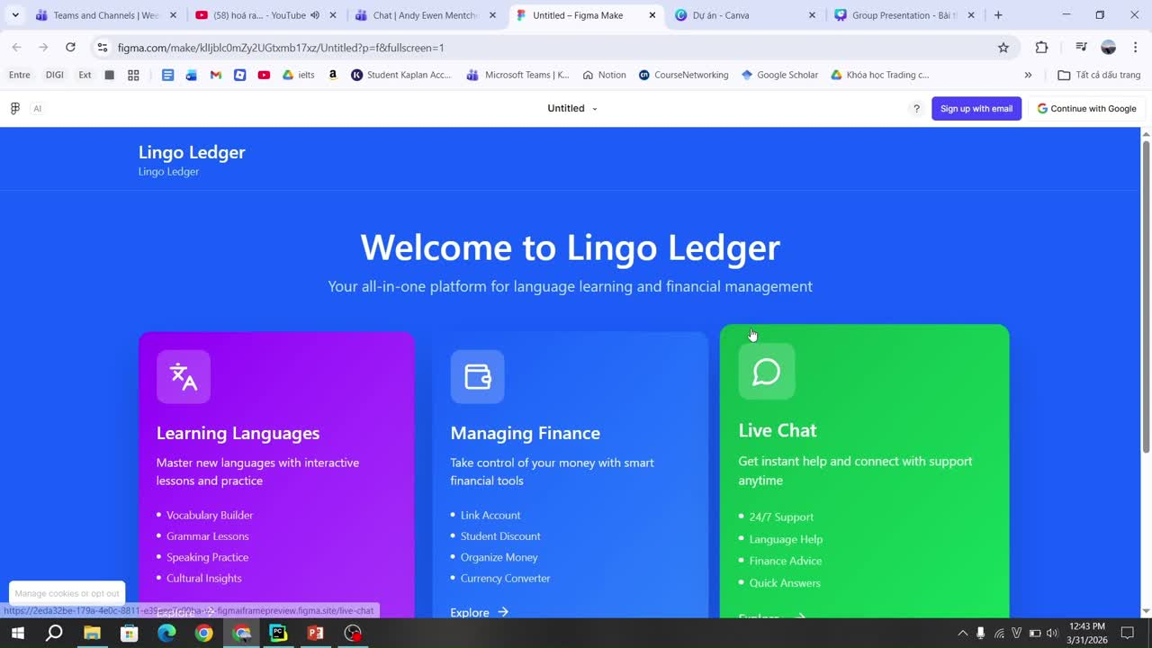

Financial savings

Slide 23
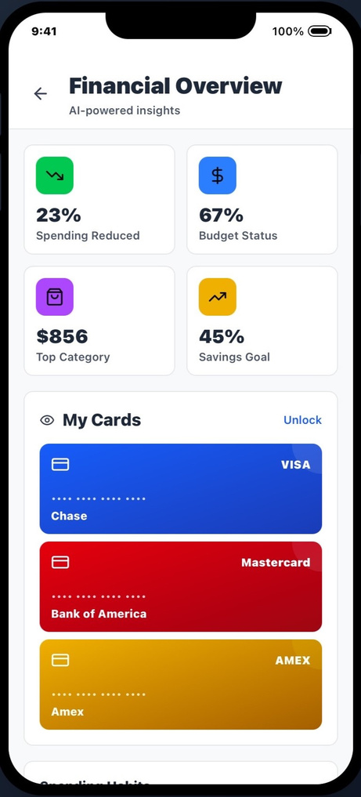
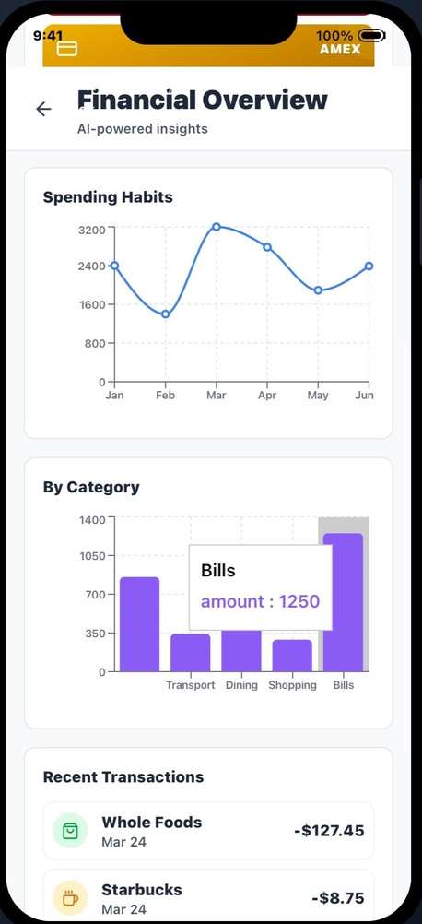
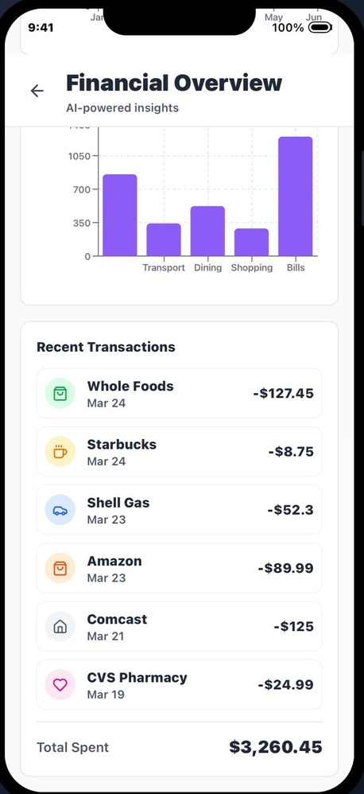
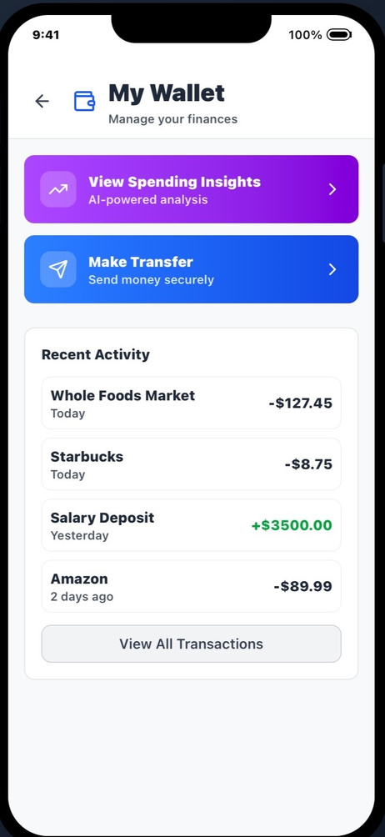
How It Works
How to track the spent categories?

Slide 24

LingoLedger
WHY SHOULD YOU INVEST?
  Strong Value Proposition
  LingoLedger solves 3 major student problems in ONE app:
  → language barriers, budgeting, and access to deals
  Unlike competitors (Duolingo, UNiDAYS, Splitwise), we integrate all functions
  Market Opportunity
  International students are increasing globally
  High demand for:
    daily language support
    cost-saving tools
    local adaptation solutions
  This creates a scalable and growing user base
  Business Potential
  Partner with:
    local businesses (cafes, supermarkets, transport)
    student platforms
  Revenue streams:
    commission from deals
    premium features (advanced learning, insights)
  Businesses gain direct access to student customers

Slide 25
  Unesco.org. (2020). Global qualifications recognition in action - Vielky’s story. [online] Available at: https://www.unesco.org/en/articles/record-number-higher-education-students-highlights-global-need-recognition-qualifications. [Accessed: 16 March, 2026]
  OpenAI. (2025). ChatGPT. ChatGPT; OpenAI. https://chatgpt.com/
Prompt: “ From the uploaded presentation, check if the grammar and spelling is correct?”
REFERENCE

Slide 26
APP
Name
Release date
Developers
Download links
Function/purpose
Luis von Ahn (CEO) and Severin Hacker (CTO)
https://apps.apple.com/us/app/duolingo-language-chess/id570060128
Duolingo
June 19, 2012
Compeititor - Compare with our app
Splitwise
February 2011
Jonathan Bittner
https://apps.apple.com/us/app/splitwise/id458023433
Compeititor - Compare with our app
https://apps.apple.com/dk/app/unidays-student-discount-app/id599608562
Compeititor - Compare with our app
UniDays
2011
Josh Rathour

Slide 27
APP
Name
Release date
Developers
Download links
Function/purpose
Visily
April 2022
Visily
https://www.visily.ai/
Used to generate high-fidelity wireframes for language learning feature
Figma
September 27, 2016
Figma Dev Mode
https://www.figma.com/downloads/
Wireframes for Financial savings - interactive prototype

Slide 28
THANK YOU FOR YOUR TIME

