Slide 1

The Effects of Virtual Reality on Posture and Balance
Presented by: Liam Banda
FC300 Extended Projects
18/03/2026

Slide 2
Contents
Introduction and Research Focus
Methodology (Process & Sources)
Key findings
Implications
Reflection
Conclusion and References

Slide 3
Introduction and research focus
Virtual reality (VR) is widely used in gaming, training, and education
Increased use has raised concerns about potential health effects
This project focuses on:
Postural stability (balance)
Spatial awareness (distance judgement)
Aim: To investigate how prolonged VR use affects real-world physical performance

Slide 4
Initial challenges
Initial topic was too broad (VR in entertainment industry)
Difficulty narrowing focus to a specific research area
Academic sources were complex and difficult to understand
Large number of sources made selection challenging
Lack of confidence in forming clear research questions

Slide 5
Research questions
Initial Questions:
How has VR developed in the entertainment industry?
What factors contributed to its popularity?
Final Questions:
To what extent does prolonged VR use affect postural stability?
How does VR affect spatial awareness and distance judgement?
Do experienced users show fewer effects than first-time users?
Focus refined from general VR growth to physiological effects

Slide 6
Methodology - Research process
Research conducted using secondary sources
Main tools:
Google Scholar
Academic journals
Key search terms:
Virtual reality
Postural stability
Spatial awareness
Cybersickness
Sources selected based on:
Relevance
Reliability
Recency

Slide 7
Methodology sources
Academic journals were the most reliable sources
Key source:
Stanney et al. (2020) on cybersickness and VR effects
Sources provided:
Scientific data
Experimental evidence
Limitations:
Complex language
Required careful analysis and paraphrasing

Slide 8
Key findings
Prolonged VR use reduces postural stability
Caused by sensory conflict between:
Visual input
Physical movement
Users may experience:
Loss of balance
Instability after VR sessions
Supported by Stanney et al. (2020)

Slide 9
Key findings
VR affects spatial awareness and distance judgement
Immersive environments alter depth perception
Users may misjudge distances after VR use
Can affect navigation in real-world environments
Impacts both perception and cognitive processing

Slide 10
Implications
Experience level influences VR effects
First-time users experience stronger symptoms
Common effects include disorientation and instability
Experienced users show reduced effects over time
Suggests adaptation to VR environments

Slide 11
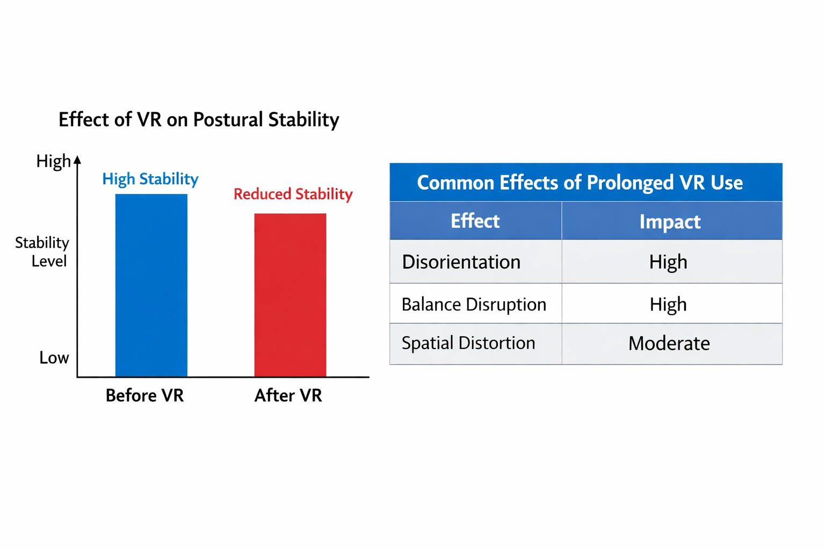
Effects of VR on postural stability and user impact
The graph shows a clear decrease in postural stability after VR exposure
This supports research that VR disrupts the body’s balance system due to sensory conflict
The table highlights common effects such as disorientation and balance disruption
Overall, the data suggests prolonged VR use negatively impacts both physical stability and perception

Slide 12
Conclusion and references
VR may create safety risks after prolonged use
Important for industries:
Gaming
Training simulations
Highlights need for:
Regular breaks
Improved VR system design
Raises awareness of long-term health effects

Slide 13
Reflection
Improved ability to find and evaluate academic sources
Developed academic writing and research skills
Gained confidence in analysing complex information
Learned importance of narrowing a research topic
If repeated:
Start with a clearer focus
Improve time management

Slide 14
Conclusion
Prolonged VR use negatively affects:
Postural stability
Spatial awareness
Evidence shows both physical and perceptual impacts
Effects may decrease with user experience
VR remains valuable but requires careful use
Further research is needed on long-term effects

Slide 15
References
Stanney et al. (2020)
Weech et al. (2019)
Keshavarz et al. (2015)
Additional academic journal sources

