Slide 1

Sdg 12- Responsible consumption and production
By Rishiraj, Liam, Melvin, Mohmed Osman, Owen

Slide 2
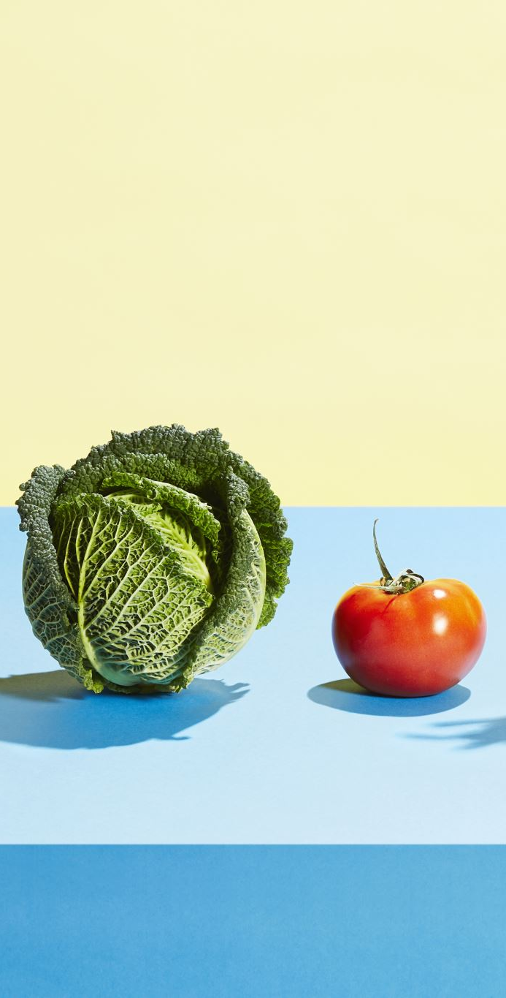
Food management and consumption: Challenges, Solutions and sustainable food systems.
How can countries improve food production, distribution and consumption to reduce food waste and ensure resources are used sustainably?

Slide 3
What is food management and responsible consumption and management
Food management is the planning and control of food production, storage, distribution and consumption to reduce waste and ensure food is used effectively and sustainably.

Slide 4
The global food management problem
Food insecurity:2.3 billion people faced food security in 2024.
Food loss: 13.3% of food was lost before retail in 2023.
Food waste: 1.05 billion tonnes wasted in 2022.
Poor distribution- inadequate storage and transport limit food access.
Unsustainable consumption- wastes food and valuable resources.
Key message: Better food management reduces waste and supports SDG12.

Slide 5
Countries facing food management challenges
Sub- Saharan African- around 23% of food chain is lost along the supply chain.
Conflict-affected countries- war disrupts farming and food distribution.
Countries facing economic hardship- high food prices make food harder to afford.
Areas with poor infrastructure: limited storage and transportation cause food losses.
Key message: better storage, transport and investment can reduce food loss and improve access to food.

Slide 6
Food distribution AND SUPPLY CHAINS
poor transport: delays can cause food to spoil before reaching markets
inadequate storage: lack of refrigeration increases food loss.
inefficient supply chains: food may not reach areas where there is demand
High distribution costs: transport expenses can increase food prices.
Key message: better transport, storage and distribution help food reach people more secure and affordably.

Slide 7
Food consumption and waste
household waste: people throw away food that could have been eaten by others
retail waste: shops discard unpurchased food.
restaurant waste: uneaten meals and excess food are thrown away
resource waste: wasted food also wastes water, energy and land
Key statistics: around 1.05 billion tonnes of food were wasted in 2022
Key message: planning meals, managing portions and donating surplus food can reduce

Slide 8
Expected outcomes and conclusion
less food waste: more food is saved instead of thrown away.
improved food access: efficient distribution helps food reach more people
lower costs: reducing losses can save money for businesses and consumers
environment benefits: less wasted food means fewer wasted resources
sustainable future: responsible consumption supports SDG 12
Conclusion: better food management requires cooperation between governments, businesses and consumers to reduce waste and use resources responsibly.

Slide 9
References
Food and Agriculture Organization of the United Nations (FAO) (n.d.) 12.3.1 Global food losses. Available at: https://www.fao.org/sustainable-development-goals-data-portal/data/indicators/1231-global-food-losses (Accessed: 14 October 2026).
Food Security Information Network (FSIN) and Global Network Against Food Crises (GNAFC) (2025) Global Report on Food Crises 2025. Available at: https://www.fsinplatform.org/report/global-report-food-crises-2025/ (Accessed: 14 October 2026).
United Nations (2025) The Sustainable Development Goals Report 2025: Goal 2 – Zero Hunger. Available at: https://unstats.un.org/sdgs/report/2025/goal-02/ (Accessed: 14 October 2026).
United Nations (n.d.) Goal 12: Ensure sustainable consumption and production patterns. Available at: https://sdgs.un.org/goals/goal12 (Accessed: 14 October 2026).
United Nations Environment Programme (UNEP) (2024) Food Waste Index Report 2024. Available at: https://www.unep.org/resources/publication/food-waste-index-report-2024 (Accessed: 14 October 2026).

Slide 10


