Slide 1
Liam De Barra
Data Supplied by
National Cancer Registry Of Ireland
Cancer Incidence Rates in Ireland 1994-2015

Slide 2
Foreword
Incidence figures are quoted in annual new diagnoses per 100,000
Risk is cumulative; e.g. an incidence of 500 per 100,000 confers a lifetime risk of ~ 1 in 2.5 (.005 x 80) often reported in the media
Age is the single biggest risk factor and proper interpretation of cancer incidence figures should be viewed in the context of population demographics
Median age in Ireland increased from 30.1 to 36.9 years in the study period
Screening programs have improved massively since 1994 and a portion of new diagnoses should be attributed to more sophisticated detection methods

Slide 3
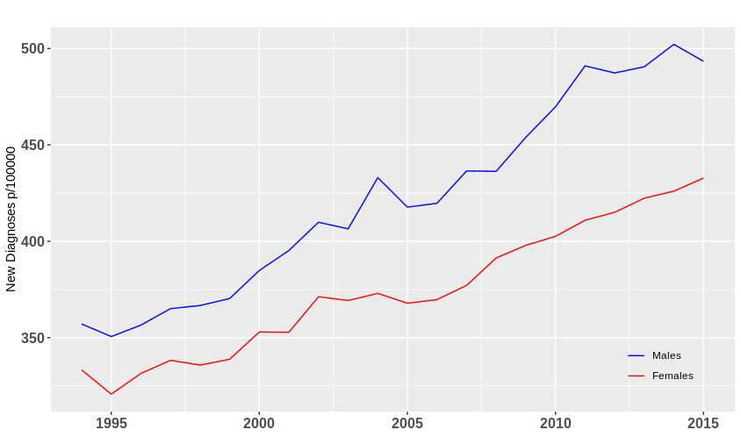
Upward Trend in Diagnosis Rates
Combined cancer diagnoses increased by 38.16% in males and 29.86% in females during the study period
The gap between male & female cancer incidence widened substantially from 7.2% to 13.85%

Slide 4
Geographical Variation
While cancer incidence increased across Ireland from 1994 to 2015; substantial variation in the extent of the increase was found between counties (μ = 34.05%, σ = 11.7%)
Largest Increase | Smallest Increase
Louth 61.1% | Cavan 12.2%
Offaly 54.3% | Laois 20.7%
Wexford 49.3% | Leitrim 22.7%
Carlow 48.8% | Longford 23.8%
Galway 48.7% | Dublin 24.5%

Slide 5
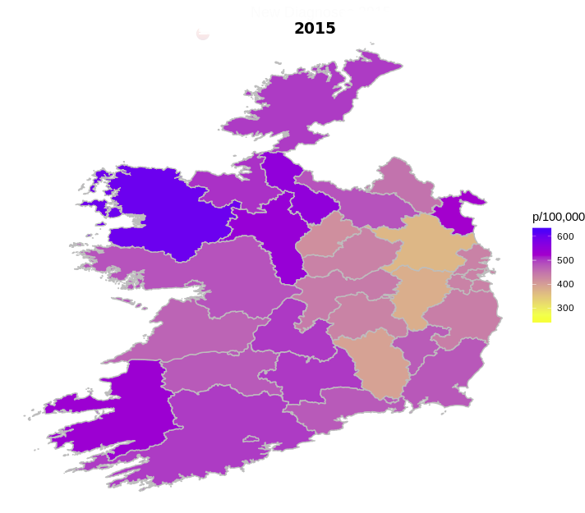
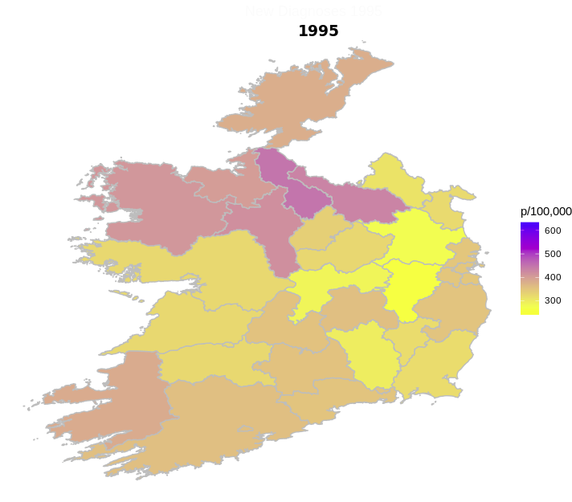
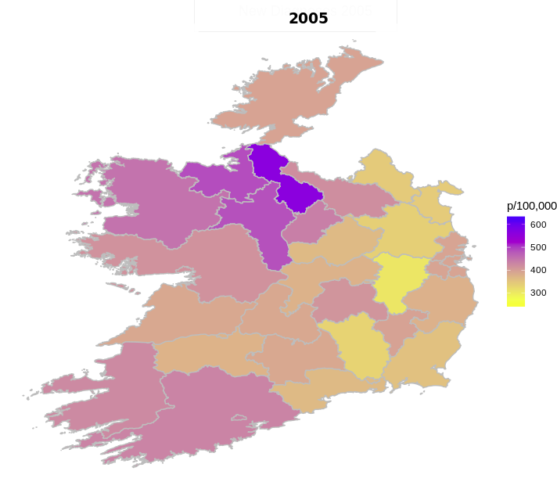
Geographical Variation
Inter-county rates also varied substantially from 368 per 100,000 in Meath to 600 in Mayo at the end of 2015
A surprising pattern of higher cancer incidence in the West & North West of the country was uncovered that persisted and intensified during the study period
A pocket of low incidence also emerged in the East Midlands (Meath, Kildare & Longford)

Slide 6
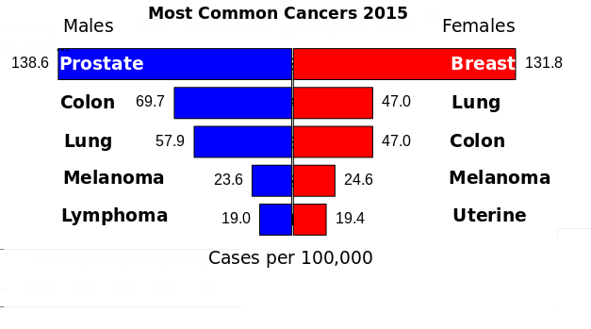
Most Common Cancers
Prostate & breast cancer emerged as the most common cancers
Five most common cancers accounted for 62.6% of total cancer diagnoses in males and 62.3% in females

Slide 7
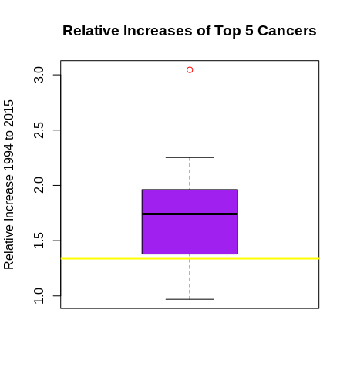
Changes in Common Cancer Rates
Abnormally sharp increases were observed in several common cancers but analysis of their distribution identified a clear outlier in male melanoma
Male lung cancer was the only cancer type to undergo a decrease
Relative Change 1994-2015 (μ = 1.34)
1.Melanoma (M) 3.05 | 6.Lung (F) 1.66
2.Prostate 2.25 | 7.Breast 1.52
3.Uterine 1.92 | 8.Colon (M) 1.21
4.Melanoma (F) 1.78 | 9.Colon (F) 1.05
5.Lymphoma (M) 1.74 | 10.Lung (M) 0.97

Slide 8
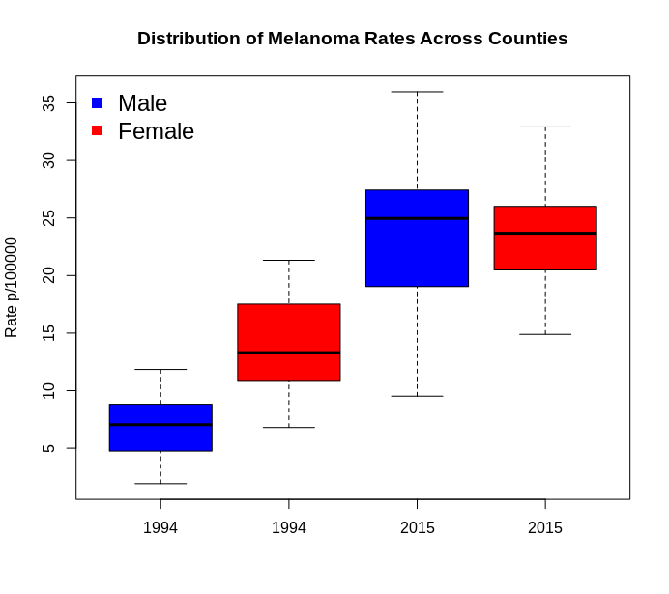
Narrowing of Gender Gap
Melanoma was historically a female dominated cancer with incidence approximately double in women
Rates in males increased dramatically and actually surpassed female rates in several counties by the end of the study period

Slide 9
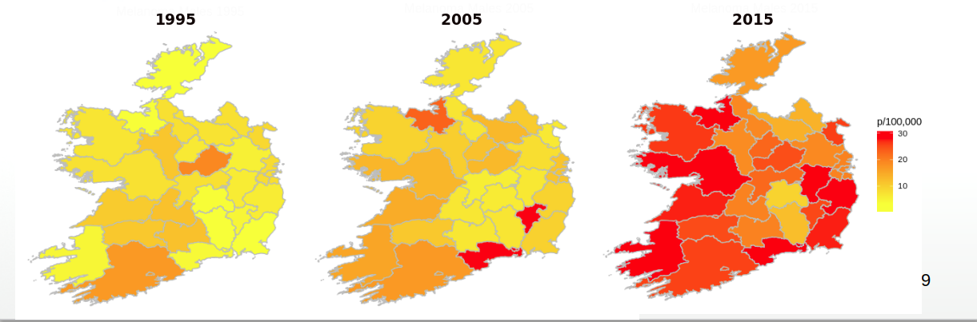
Distribution of Male Melanoma
Geographical distribution was analysed to investigate a suspected link with beach & outdoor recreation in coastal regions
Exceptionally high rates were observed in Waterford & Kerry and a general trend of higher incidence along the coast did emerge

Slide 10
Conclusions
Cancer diagnosis rates underwent a substantial increase between 1994 and 2015 with a particularly sharp rise among males
Large variation between counties occurred in both overall and specific cancer rates with a pocket of high incidence in the West & North West
Alarming increases in male melanoma rates were observed across the country but particularly along the south coast
Reduction in male lung cancer diagnoses was attributed to success of public health campaigns such as the smoking ban

