Slide 1
Chapter 1
Language and Data Fundamentals

Slide 2
Objectives
Distinguish between computing languages
Identify uses of Assembly programming
Convert values between number systems
Solve basic arithmetic problems
Describe character storage methods
Evaluate Boolean expressions
Explain the basics of computer operation

Slide 3
Web Resources
Wikis
https://en.wikibooks.org/wiki/X86_Assembly (Assembly Programming Overview)
https://en.wikibooks.org/wiki/X86_Disassembly (Assembler and Disassembler Overview)
https://en.wikipedia.org/wiki/X86-64 (x86_64 Overview)
Developer
http://www.unicode.org
http://www.unicode.org/charts/PDF/U0000.pdf (ASCII)
http://devimages.apple.com/llvm/videos/LLVM_Assembler_Infrastructure.mov (LLVM-MC Overview)
Videos
Video 1.1: Welcome (https://youtu.be/HBwgXY88hyc)
Video 1.2: Signing Integers (https://youtu.be/vHijiZMbj9E)
Video 1.3: A 3-bit Computer Example (https://youtu.be/gYczcmDywag)

Slide 4
Chapter Roadmap (Figure 1.1)

Slide 5
Translation Pipeline (Figure 1.2)
High-level: if…else control structure
Interpreting
Compiling

Slide 6
ISA (Figure 1.3)
Complex Instruction Set Computing (CISC)
Reduced Instruction Set Computing (RISC)
Common 32-bit x86 ISA names: x86, IA-32, i386
Common 64-bit x86 ISA names: x64, x86_64, Intel 64, AMD64

Slide 7
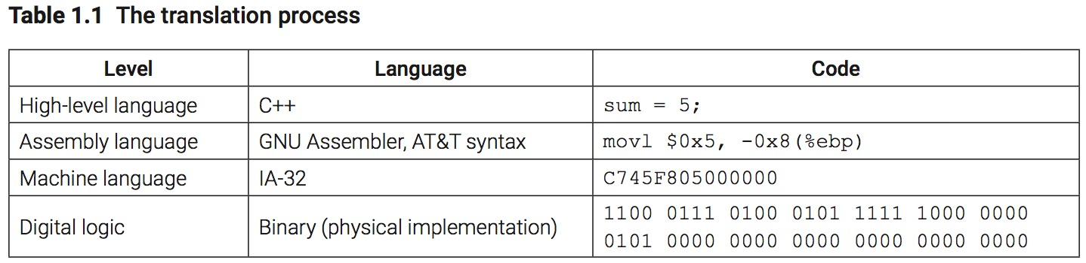
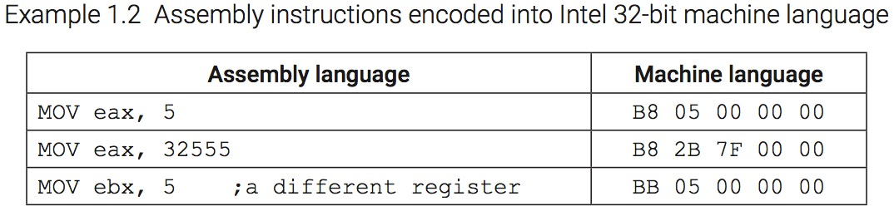
The Translation Process

Slide 8
File and Utility Relationships (Figure 1.4)

Slide 9
Why learn Assembly?
Enhance your understanding of computer operation
Debugging
Informed decision-making when programming in high-level languages
Removes layers of abstraction
Some areas of software development rely on knowledge of Assembly

Slide 10
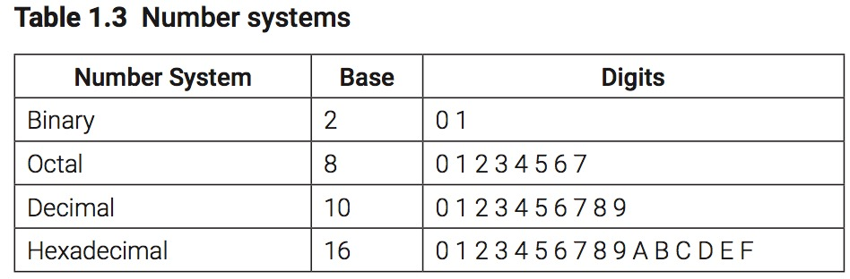
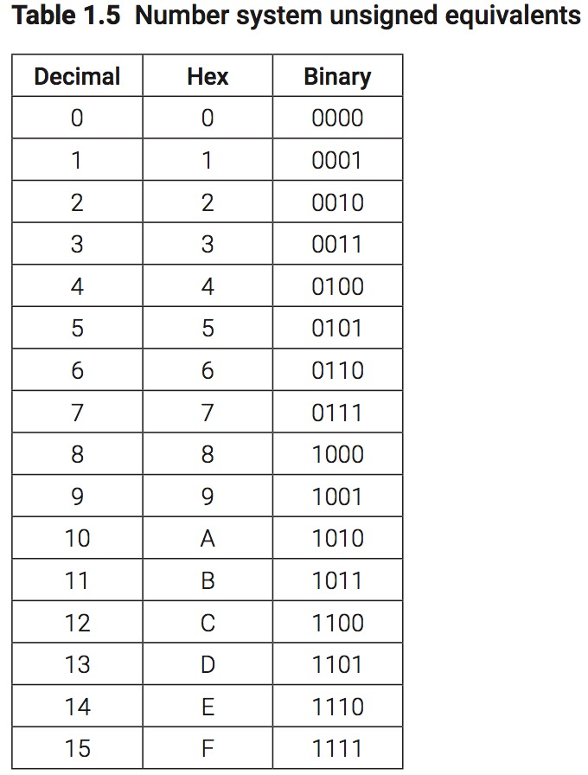
Number Systems – Why Binary?
Reliability…
Two stable states
States separated by a barrier
State can be sensed
State can be switched

Slide 11
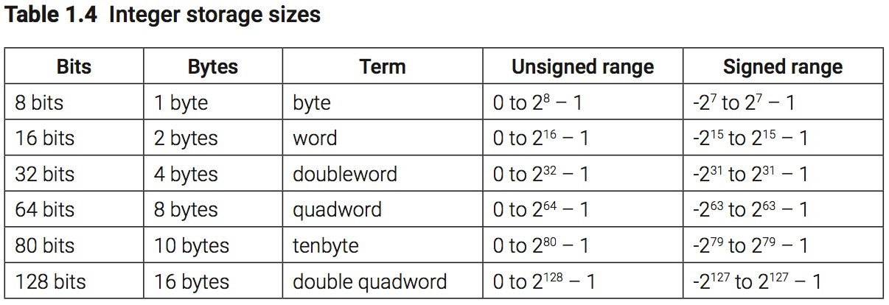
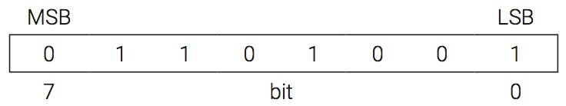
Integer Storage

Slide 12
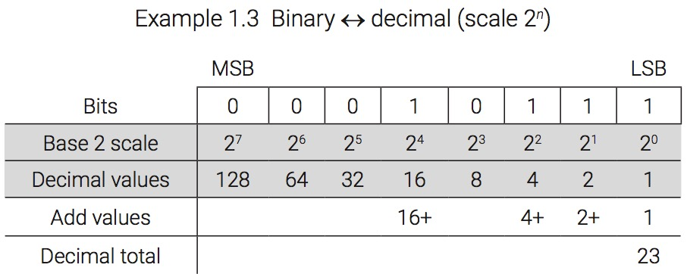
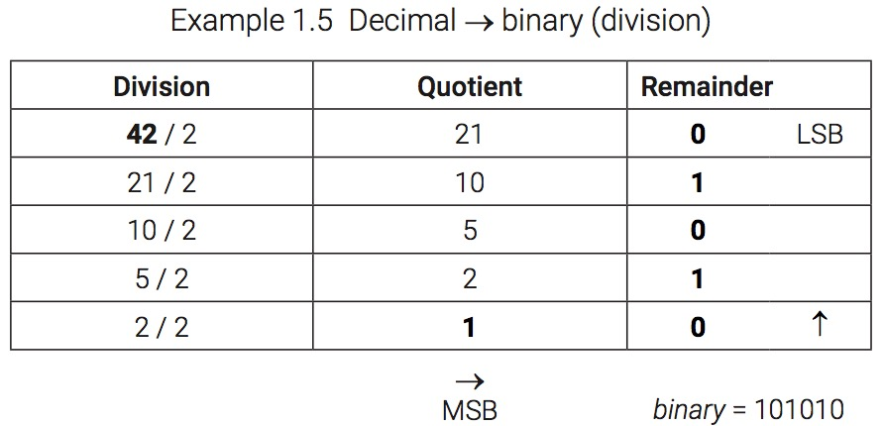
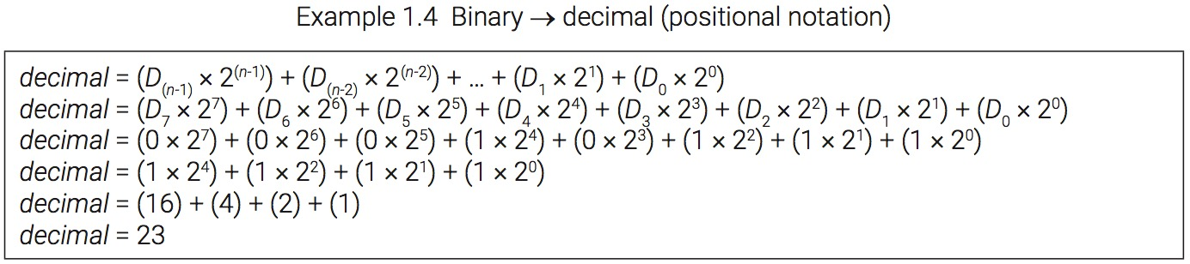
Unsigned Binary-Decimal Conversions

Slide 13
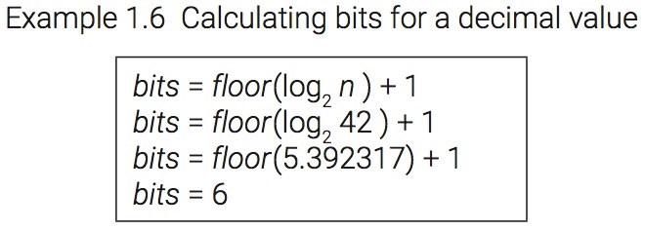
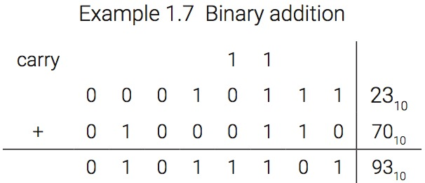
Bits needed and Binary Addition

Slide 14
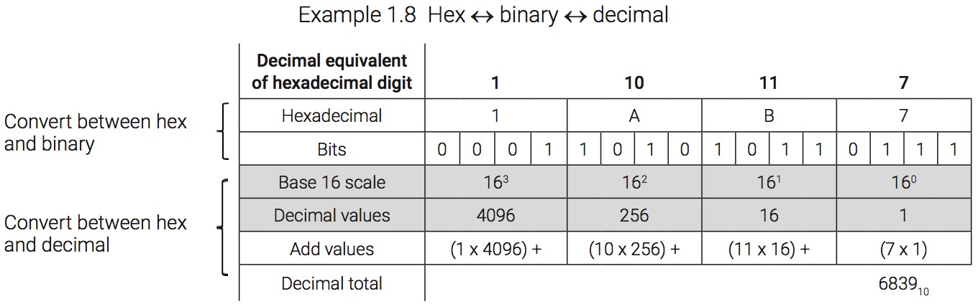
Unsigned Hexadecimal Conversions

Slide 15
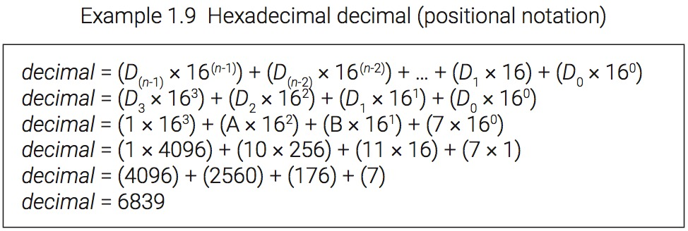
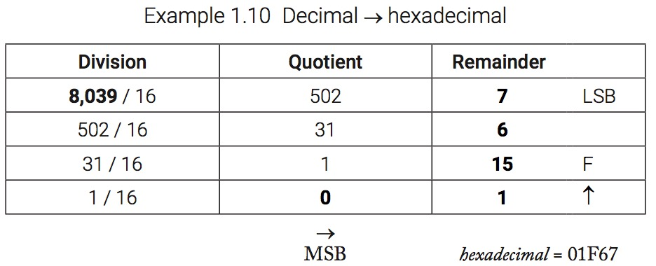
Unsigned Hex-Decimal Conversions

Slide 16
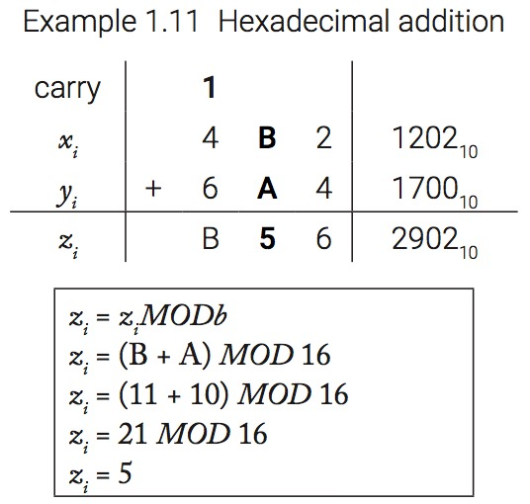
Hexadecimal Addition

Slide 17
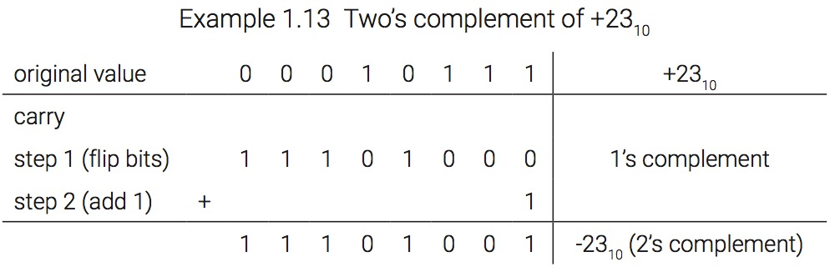
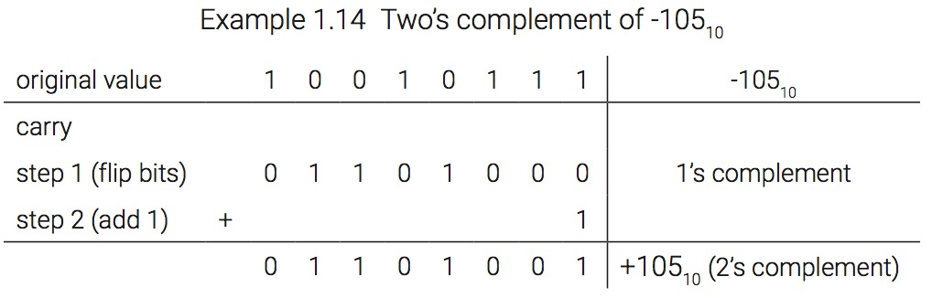
Signed Integers – Two’s Complement

Slide 18
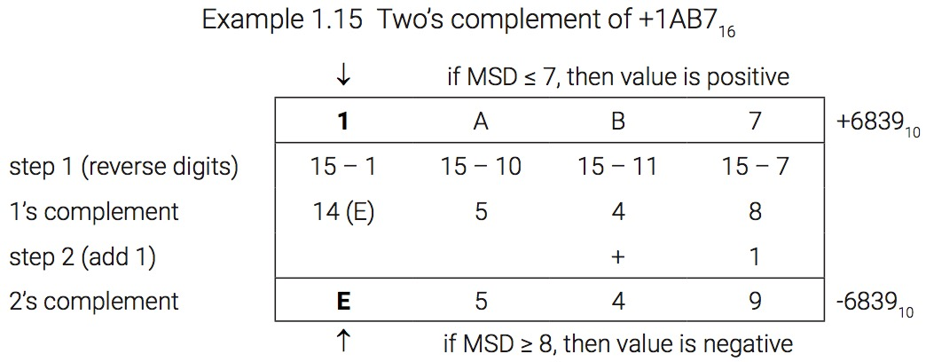
Two’s Complement in Hexadecimal

Slide 19
Character Storage
Character Sets (map a logical symbol to an integer or code point)
American Standard Code for Information Interchange (ASCII), 7-bit
Unicode
Character Encodings (algorithmic translation of code point to a binary sequence)
UTF-8
UTF-16
UTF-32

Slide 20
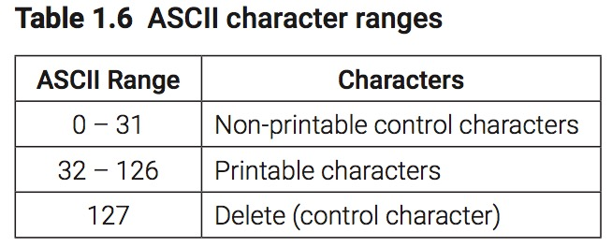
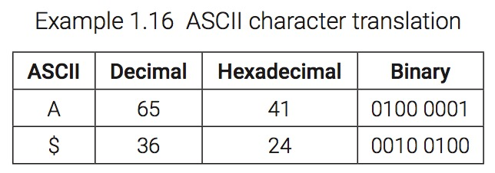
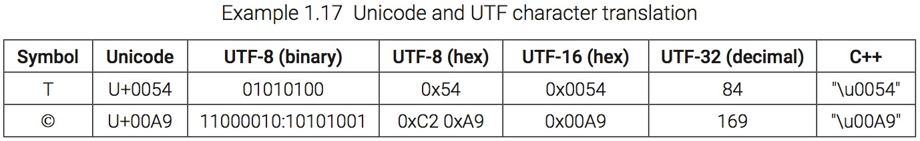
Character Storage

Slide 21
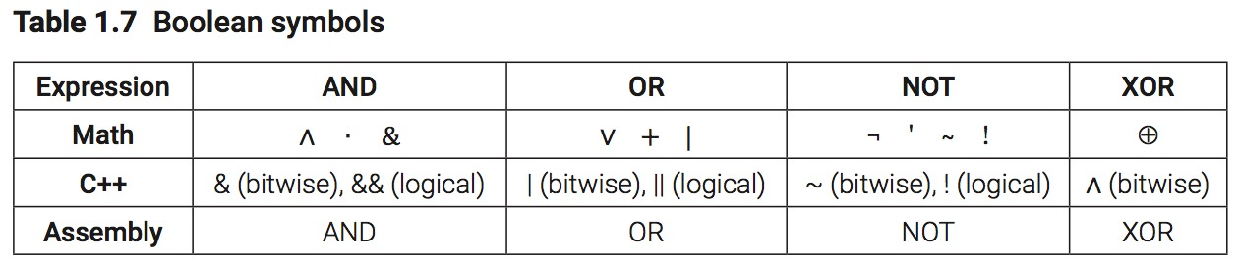
Boolean Expressions - Symbols

Slide 22
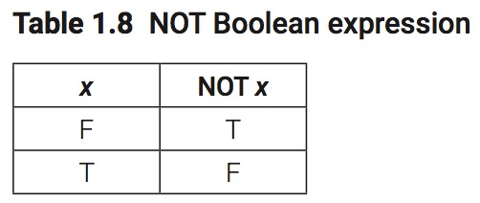
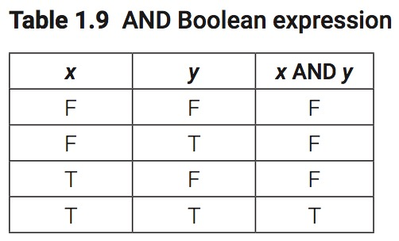
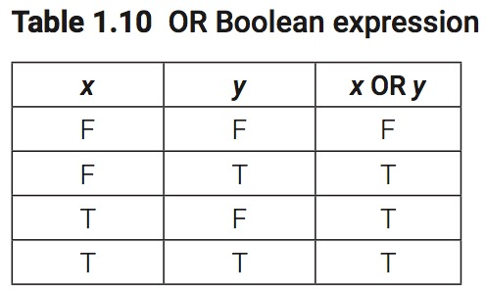
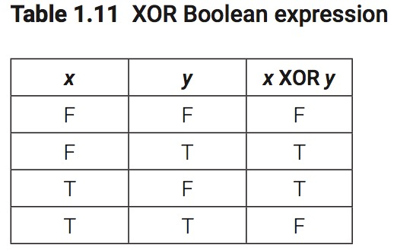
Boolean Expressions – Truth Tables

Slide 23
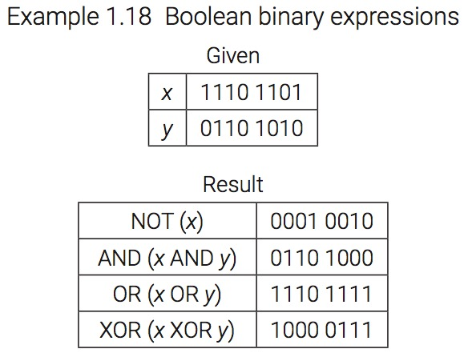
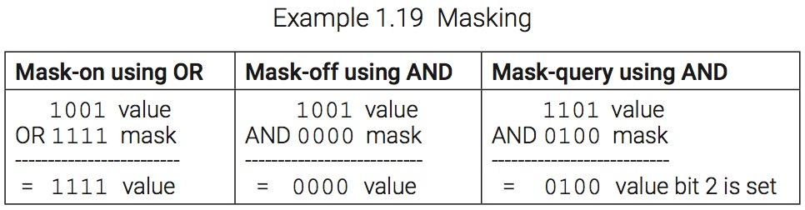
Boolean Expressions and Masking

Slide 24
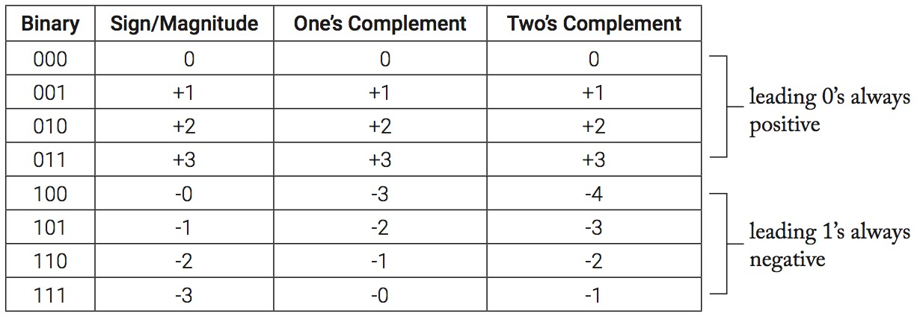
3-bit Computer – Signing Integers

Slide 25
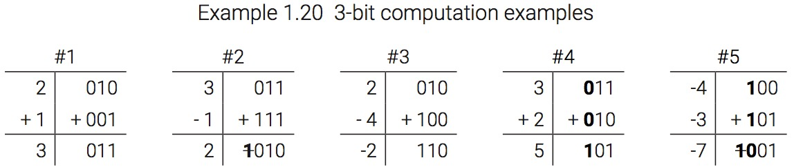
3-bit Computer – Computation

Slide 26
Chapter 1 Key Terms
American Standard Code for Information Interchange (ASCII)
assembler
bit
byte
character encoding
character set
compiler
compiling
complex instruction set computing (CISC)
computer architecture
debugger
disassembly
high-level language
instruction set architecture (ISA)
interpreting
linker
loader
machine-level
mask
microarchitecture
object code
one’s complement
reduced instruction set computing (RISC)
signed
translation pipeline
two’s complement
Unicode
unsigned

Slide 27
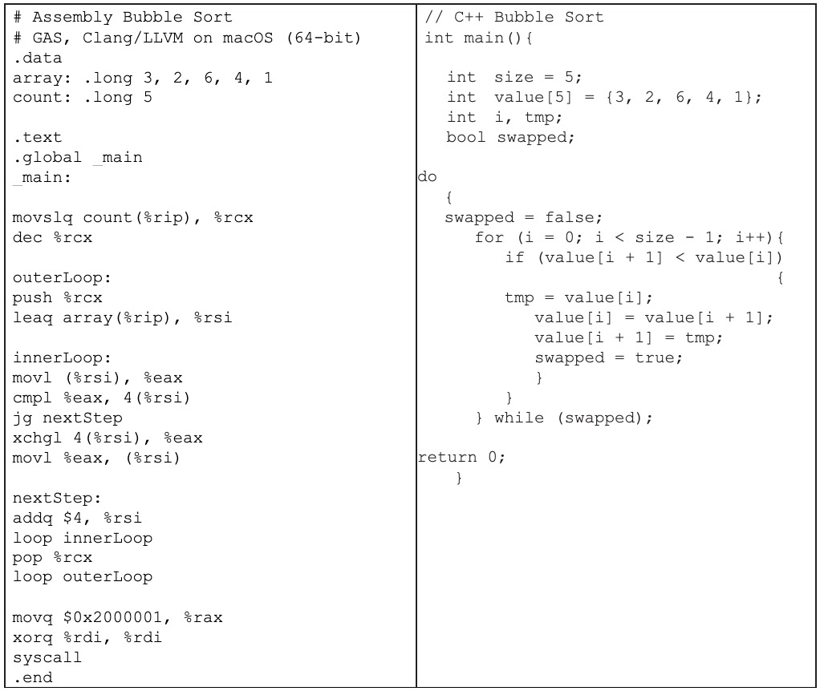
Bubble Sort – Assembly and C++

