Slide 1
Chapter 2
Processor and System Architecture

Slide 2
Objectives
Recognize components of computer architecture
Distinguish between memory types and location
Identify CPU sub-components
Describe CPU register use in Assembly programming
Evaluate various Input and Output methods

Slide 3
Web Resources
Wikis
https://en.wikipedia.org/wiki/X86
https://en.wikipedia.org/wiki/X86-64
Developer
https://software.intel.com/content/www/us/en/develop/articles/intel-sdm.html
https://developer.amd.com/resources/developer-guides-manuals/

Slide 4
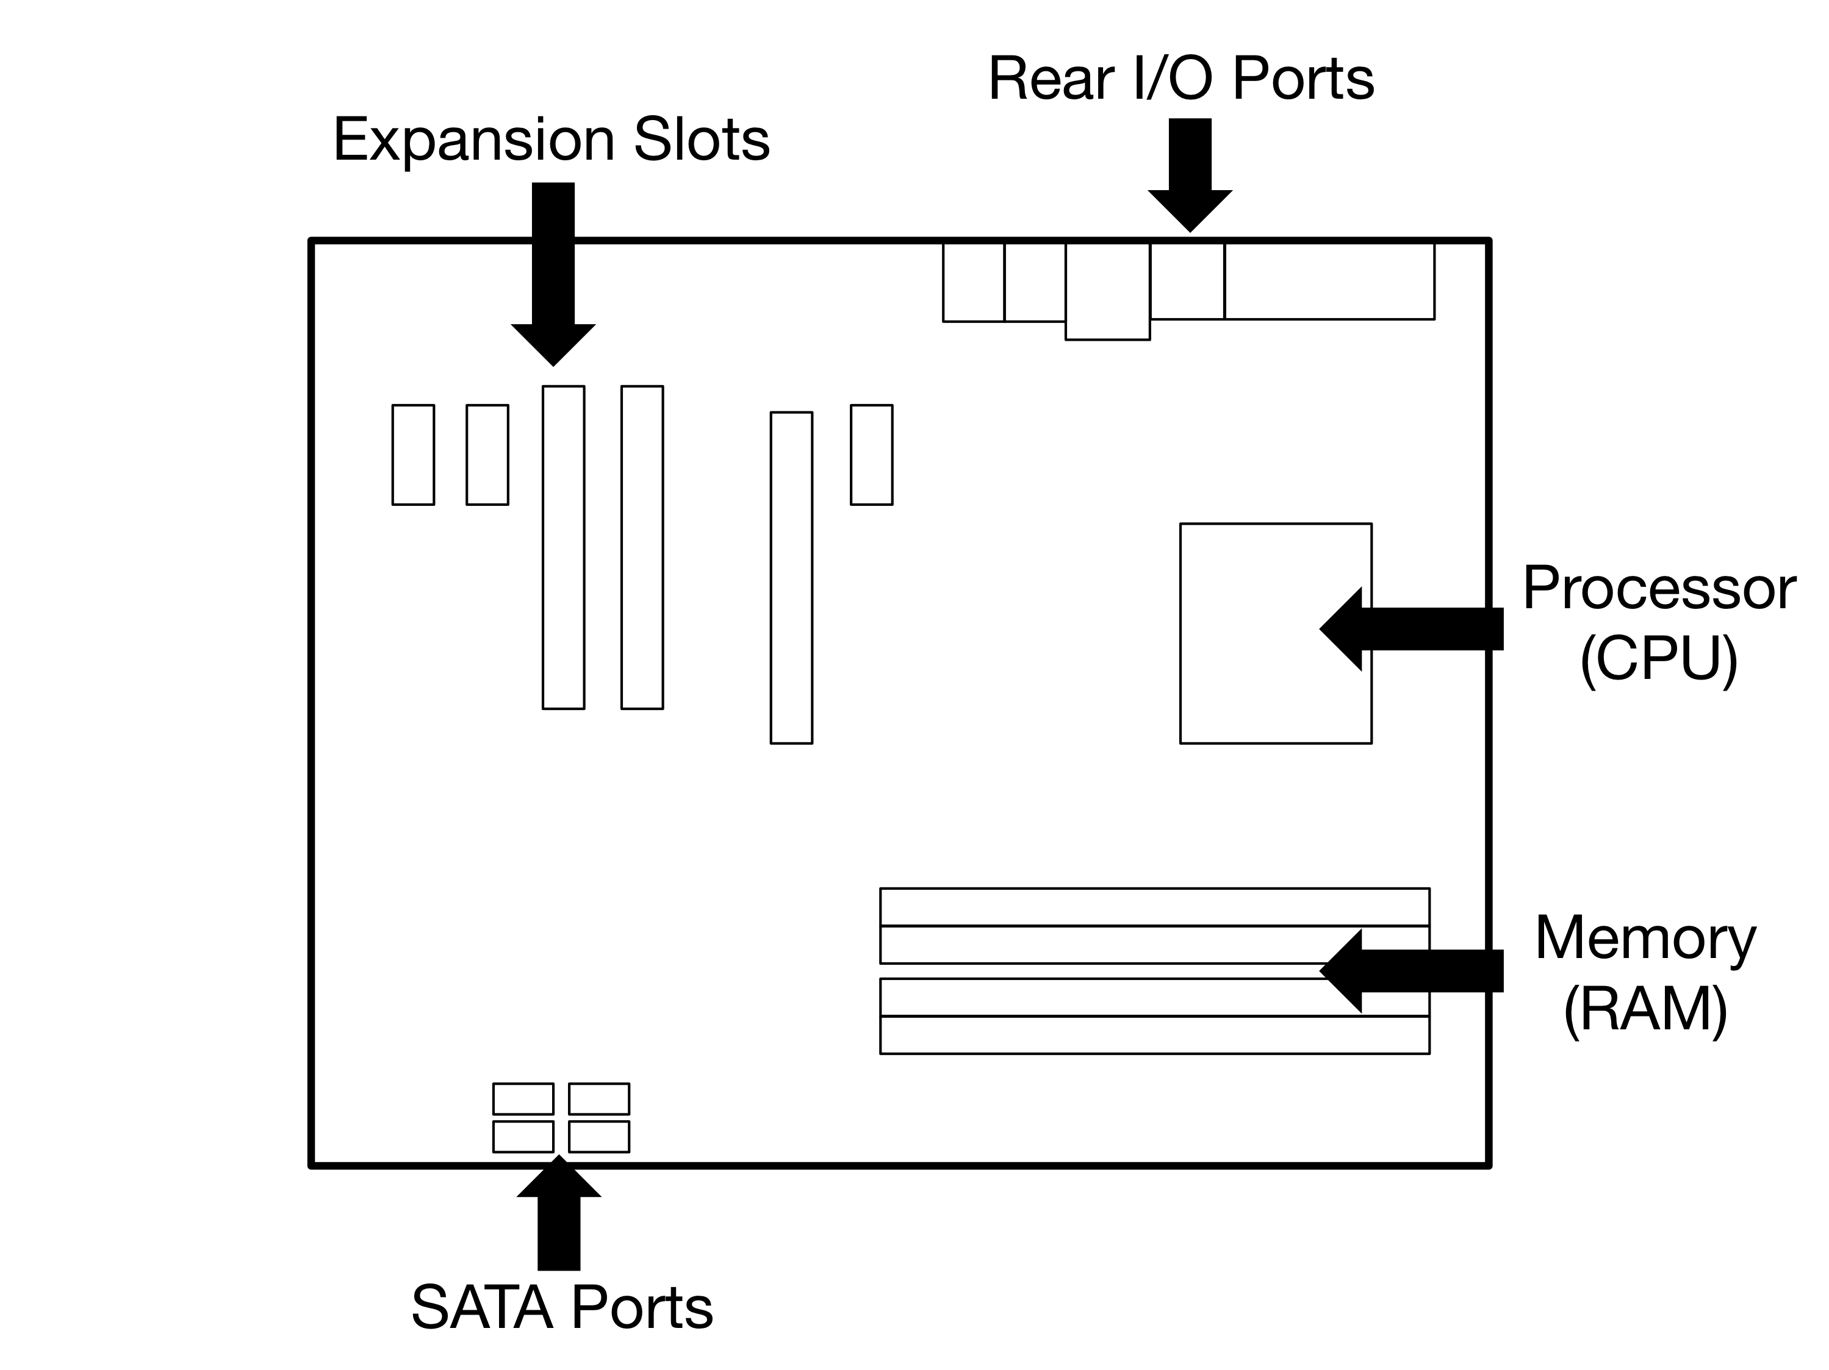
Motherboard (Figure 2.1)

Slide 5
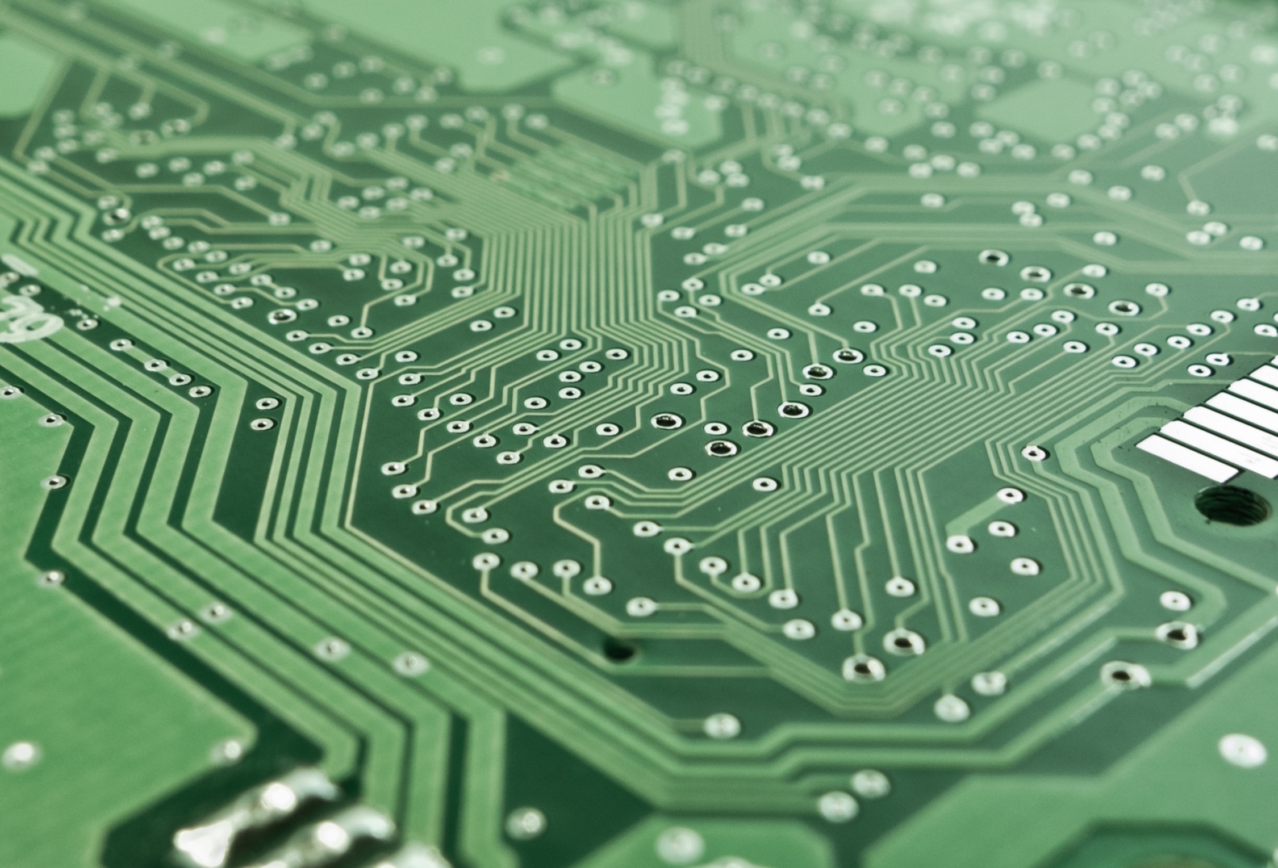
Motherboard Underside (Figure 2.2)

Slide 6
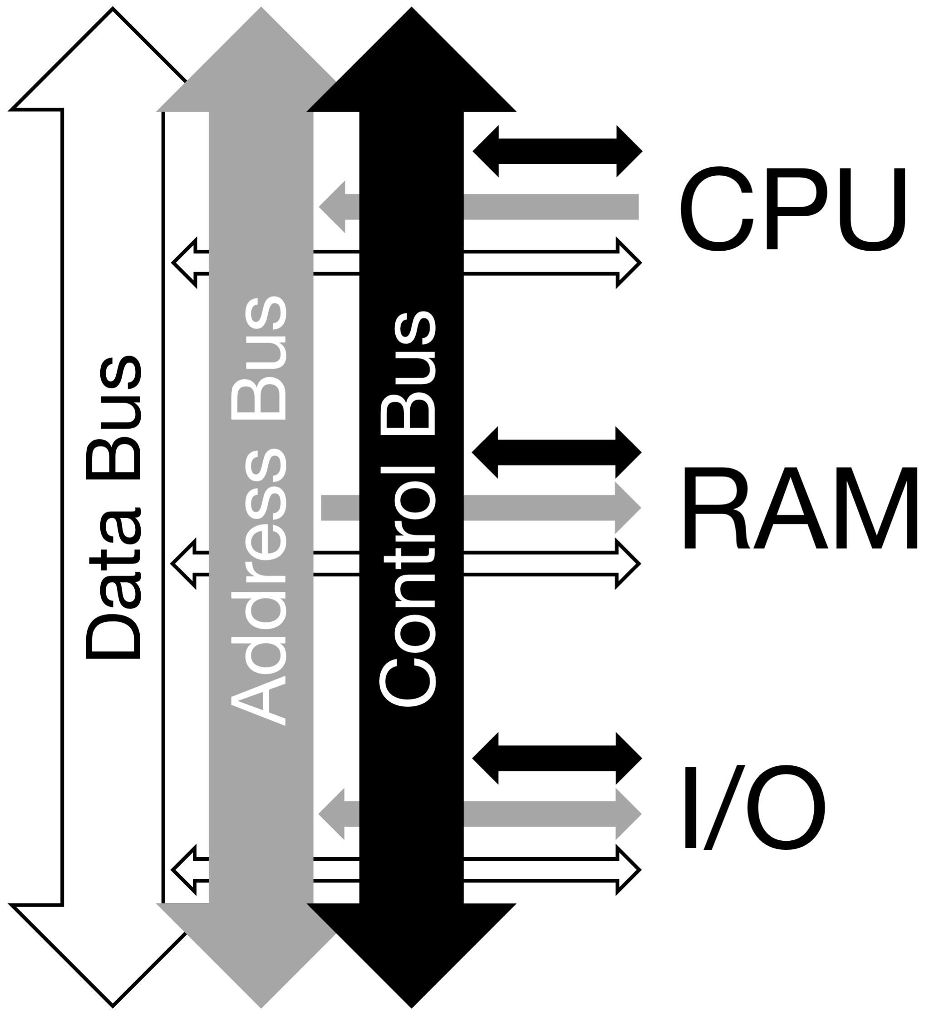
System Bus (Figure 2.3)

Slide 7
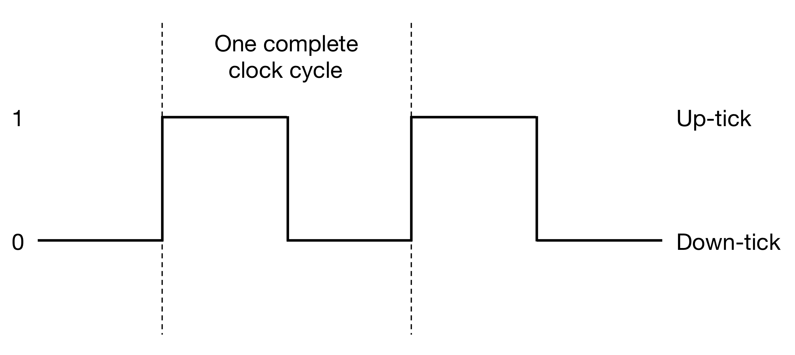
Clock Cycle (Figure 2.4)

Slide 8
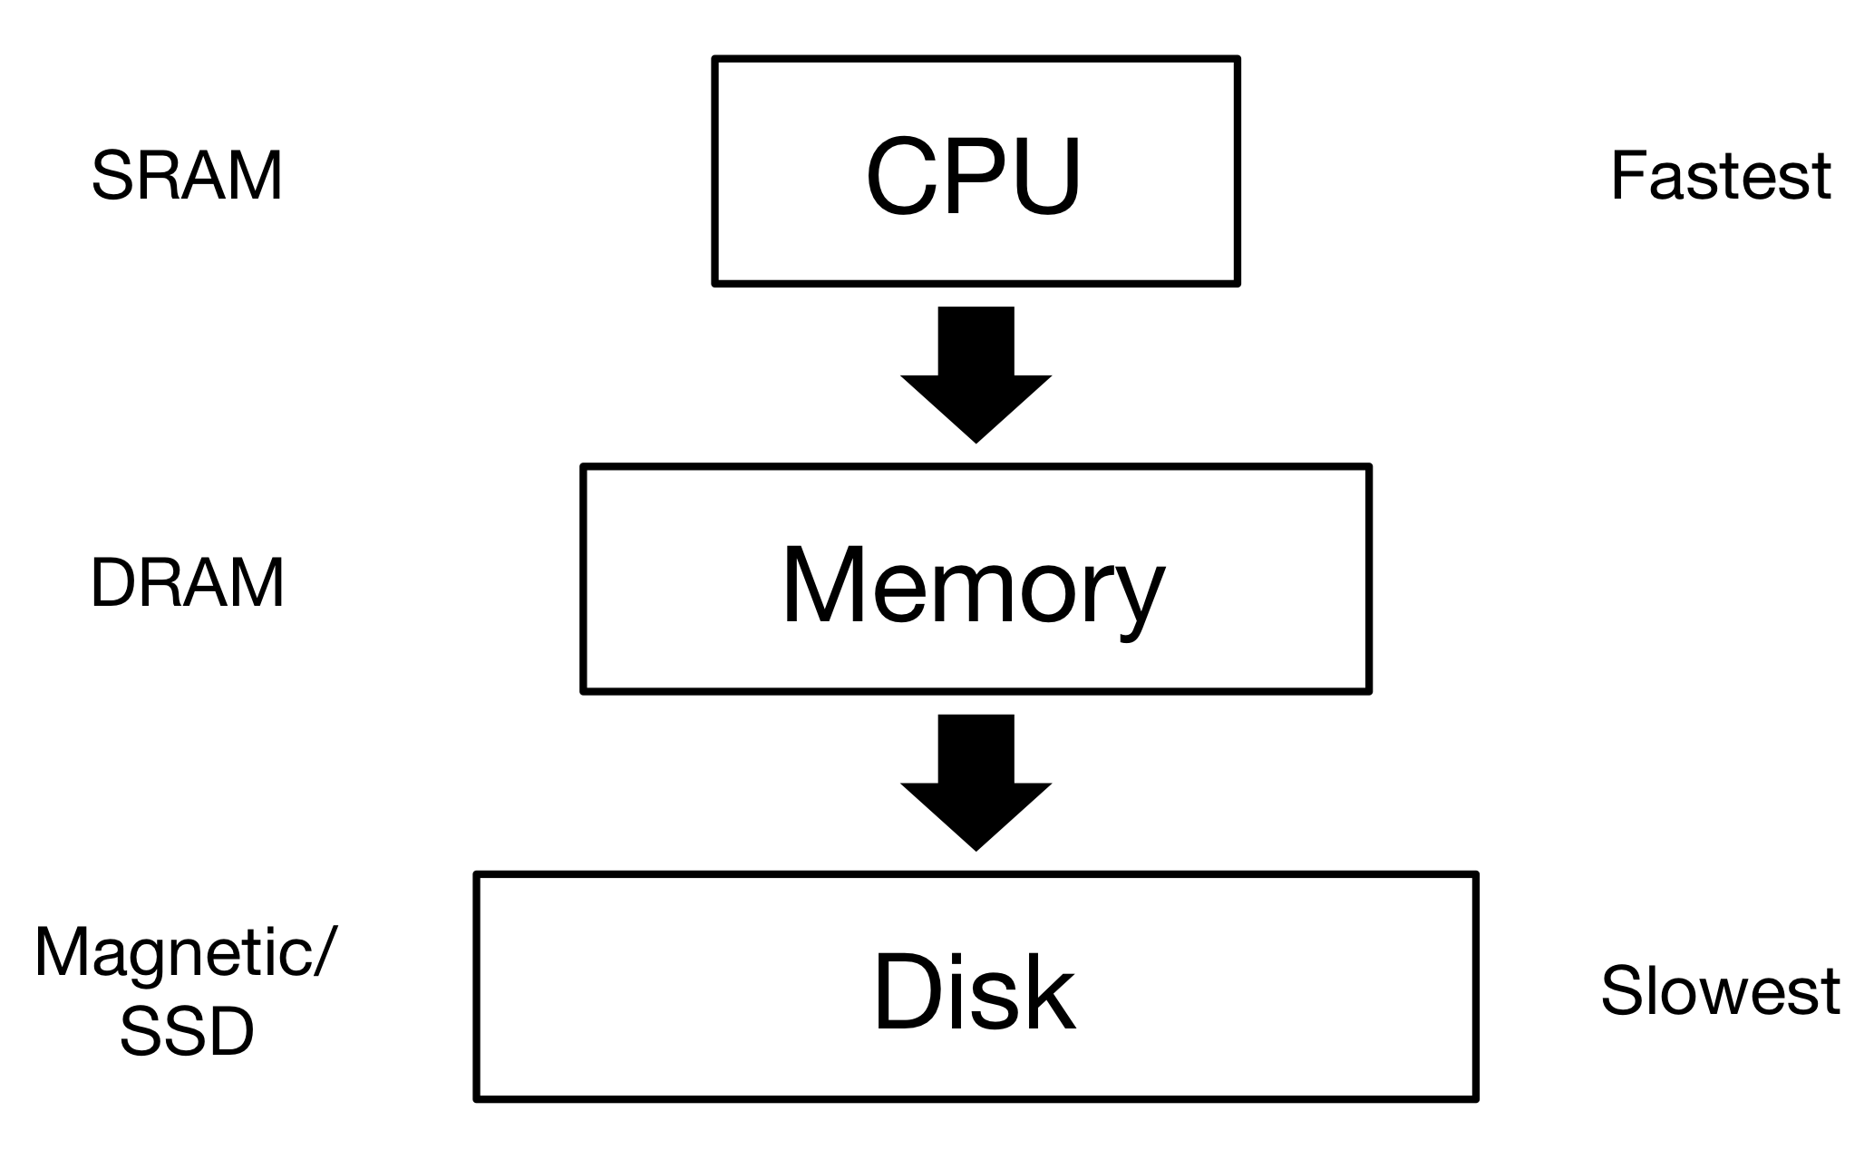
Memory Hierarchy (Figure 2.5)

Slide 9
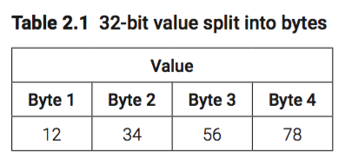
12345678h

Slide 10
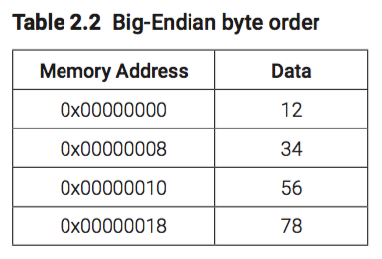
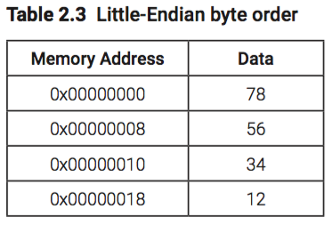
Big/Little Endian

Slide 11
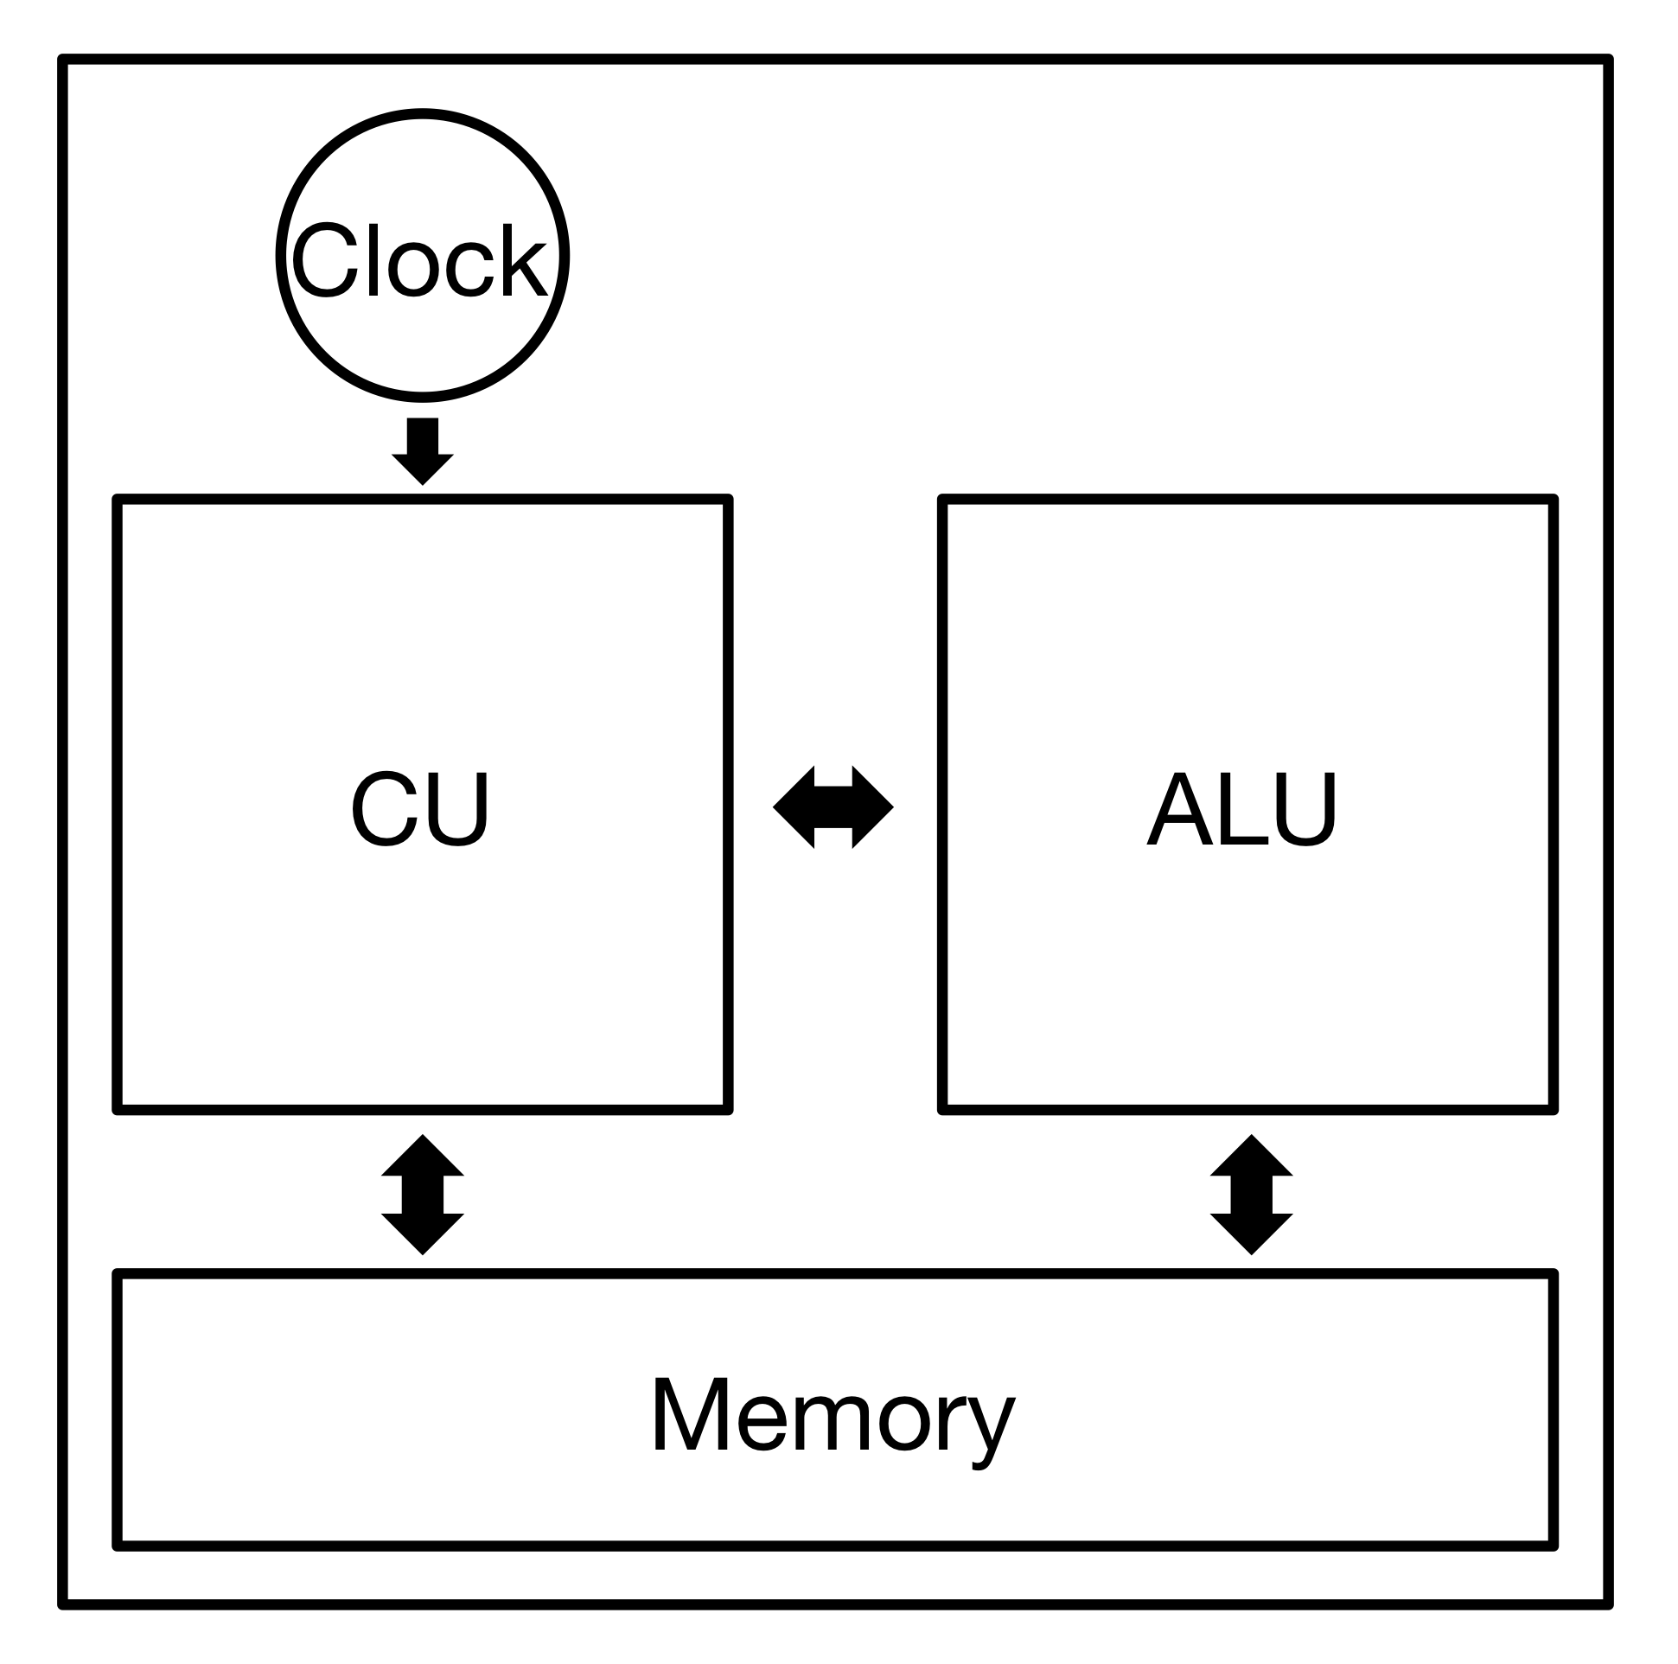
CPU Components (Figure 2.6)
ALU -> integer operations
CU -> synchronizing operations
Clock speed based on multiplier
Cache memory

Slide 12
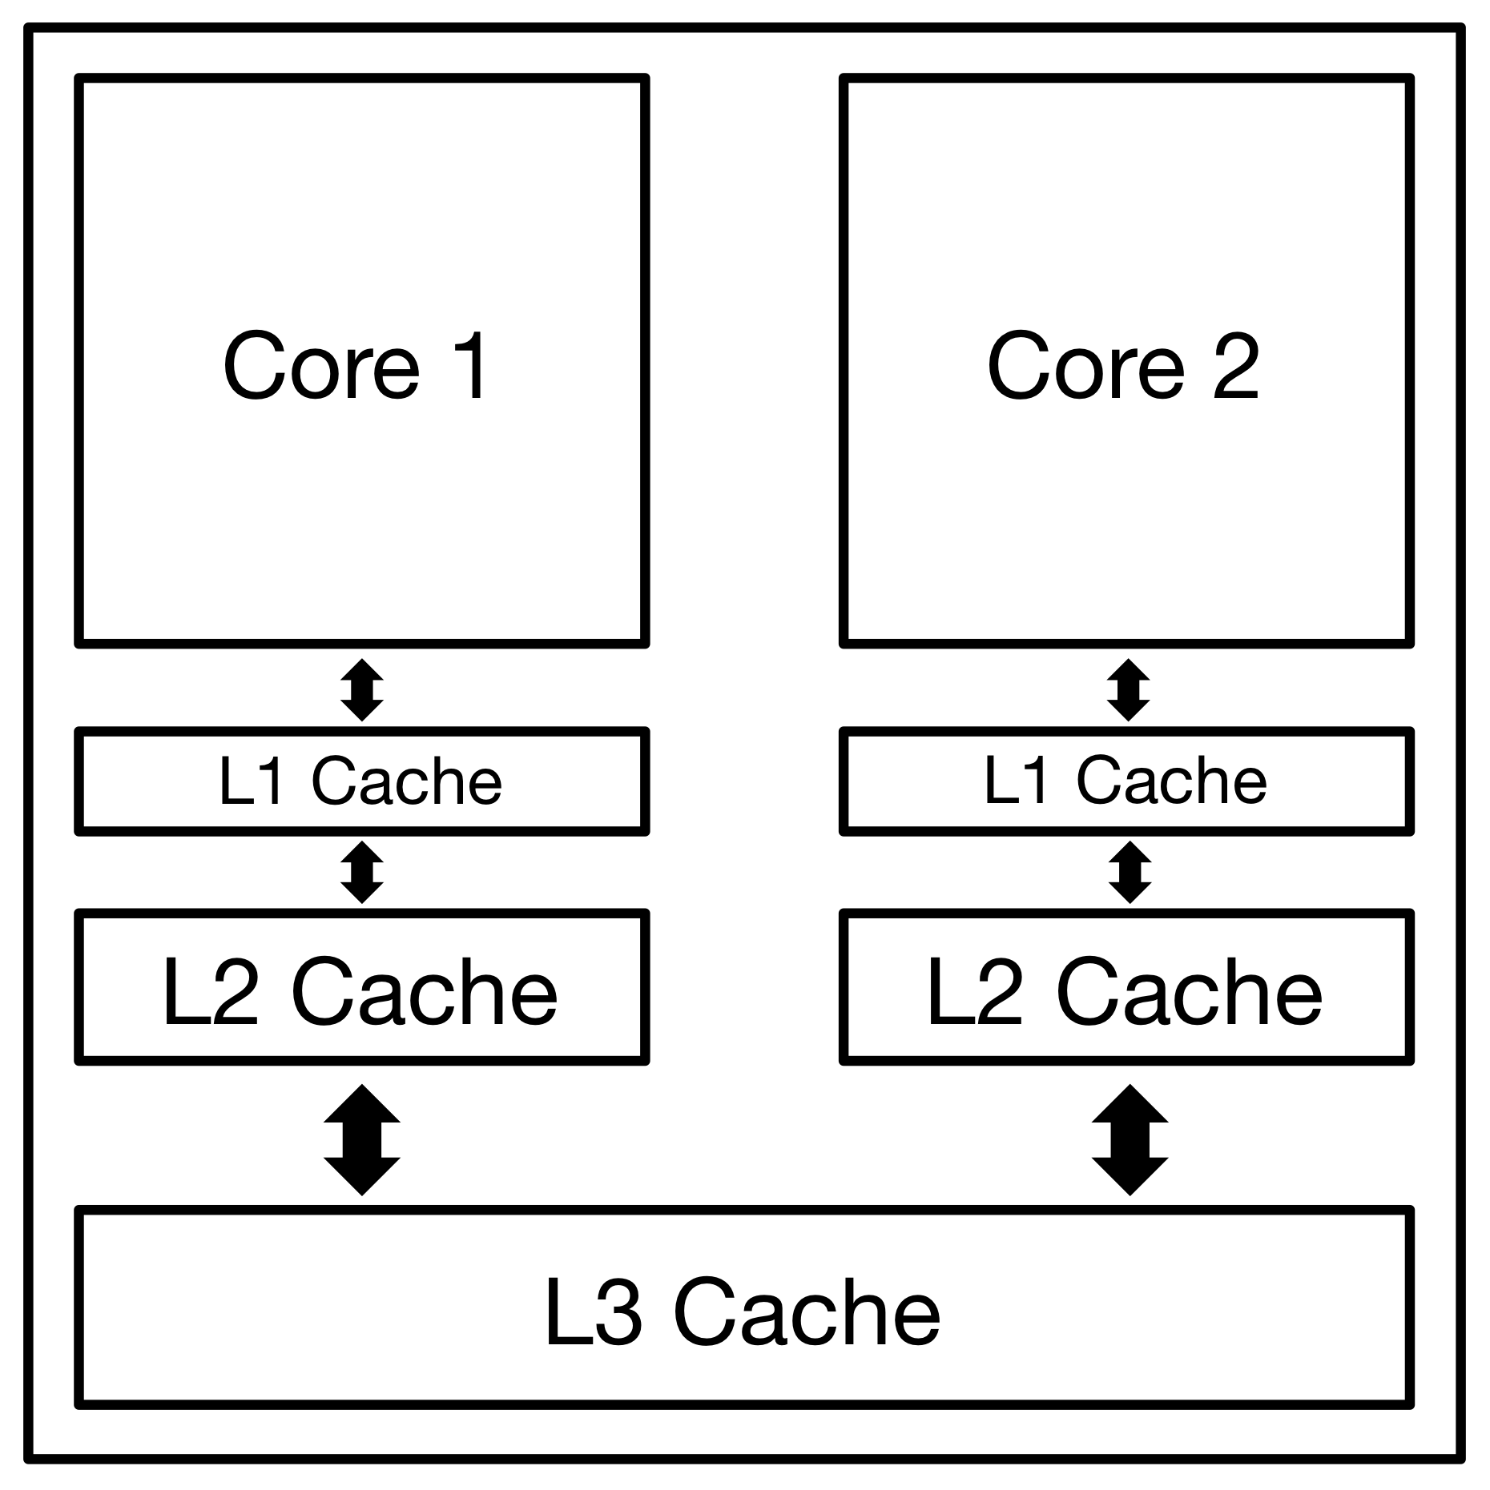
CPU Cache (Figure 2.7)

Slide 13
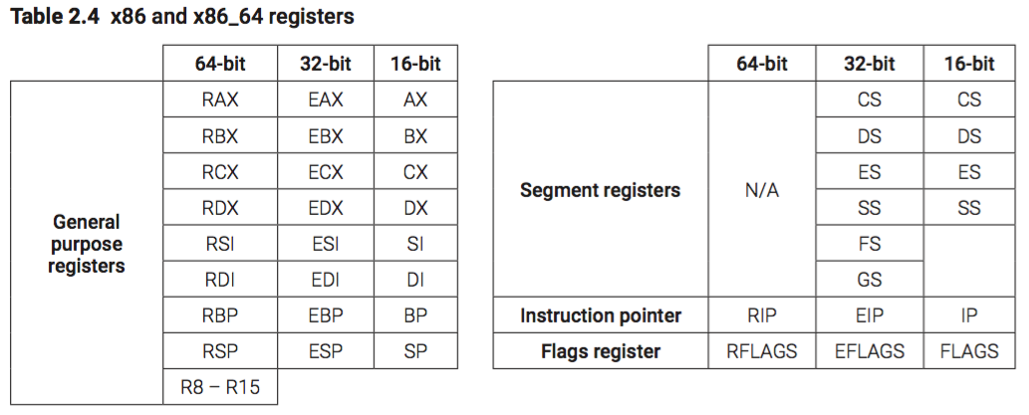
Registers

Slide 14
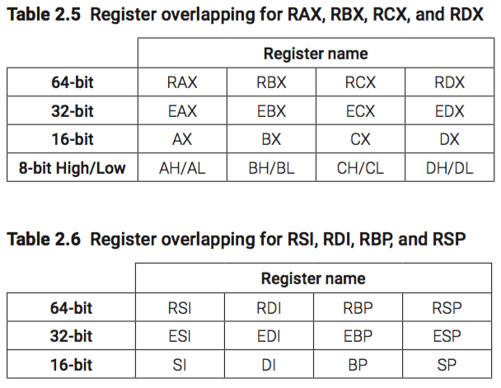
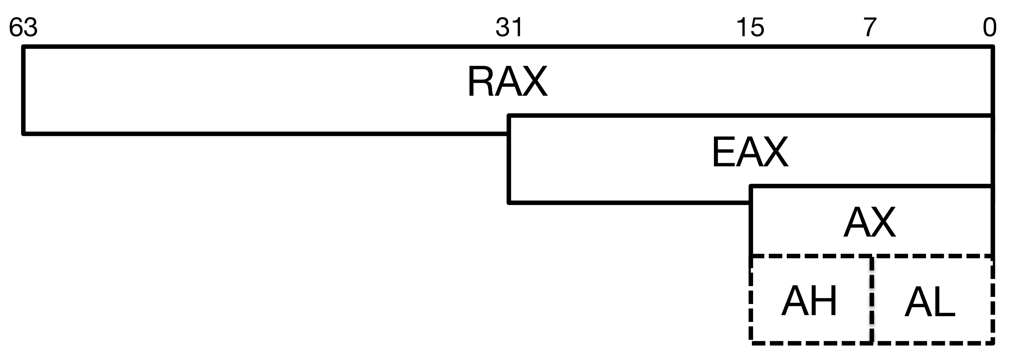
Register Addressing (Figure 2.8) / Overlapping

Slide 15
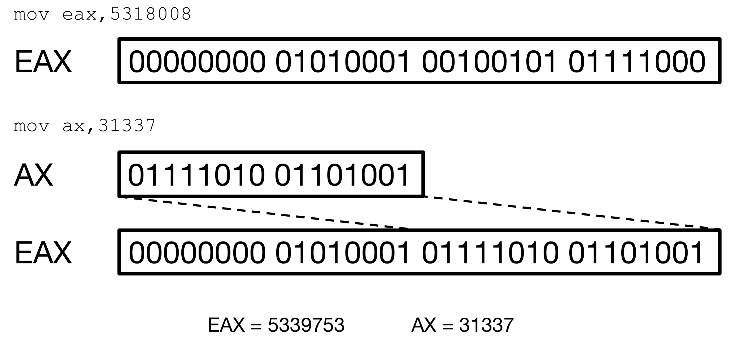
Register Writing/Destroying (Figure 2.9)

Slide 16
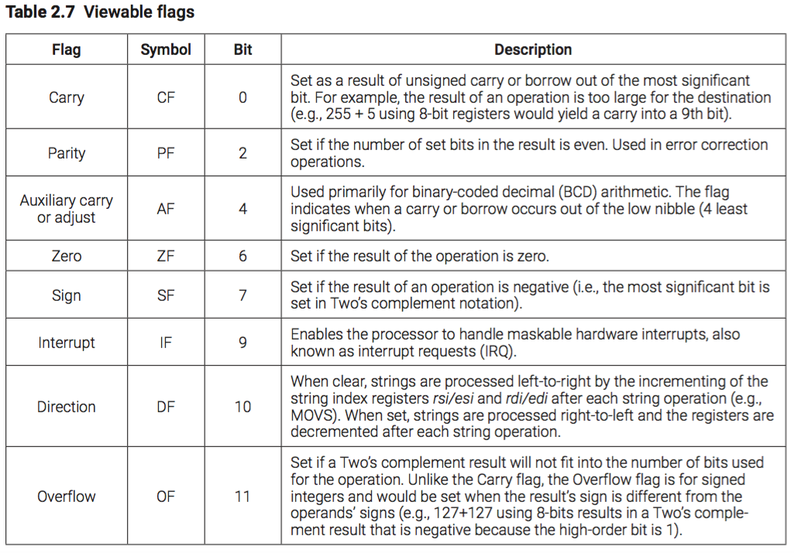
CPU Flags

Slide 17
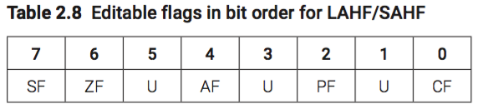
Editable Flags

Slide 18
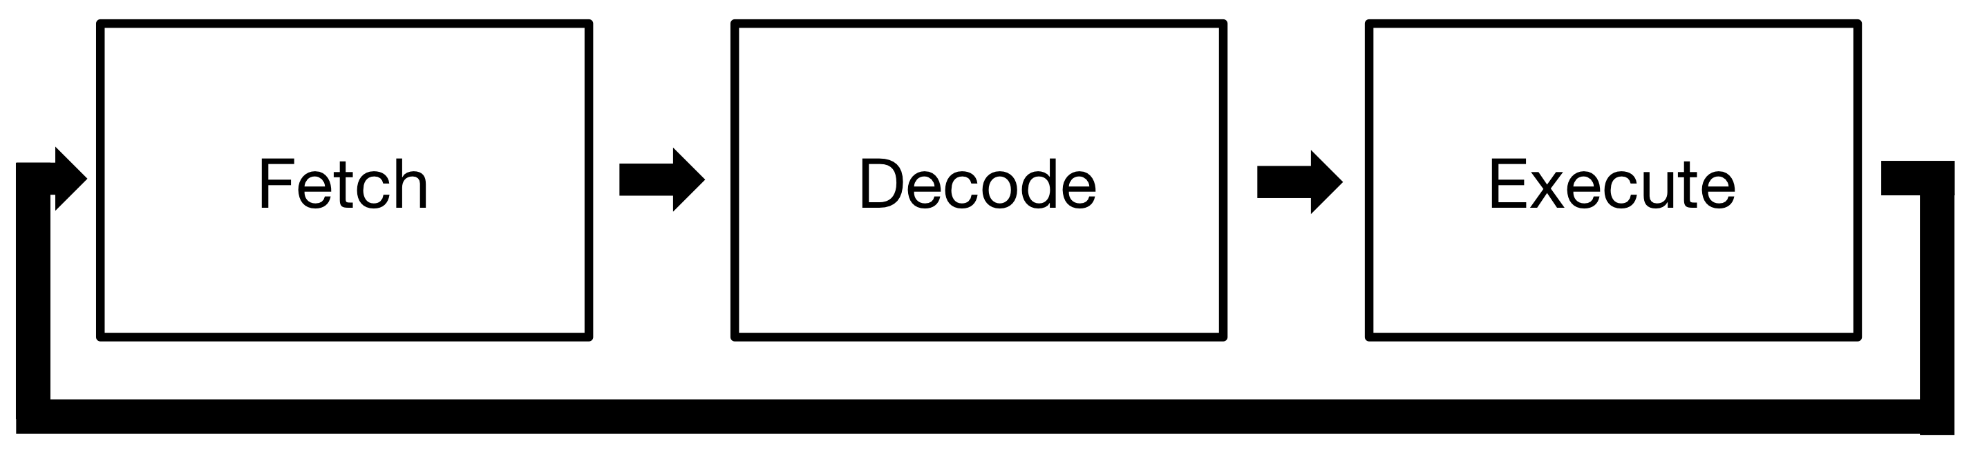
Instruction Execution Cycle (Figure 2.10)

Slide 19
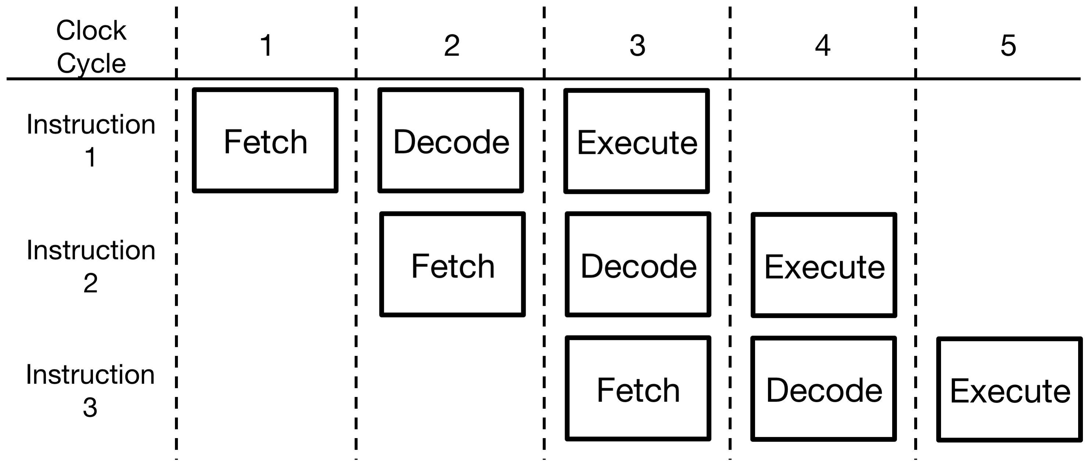
Pipelining (Figure 2.11)

Slide 20
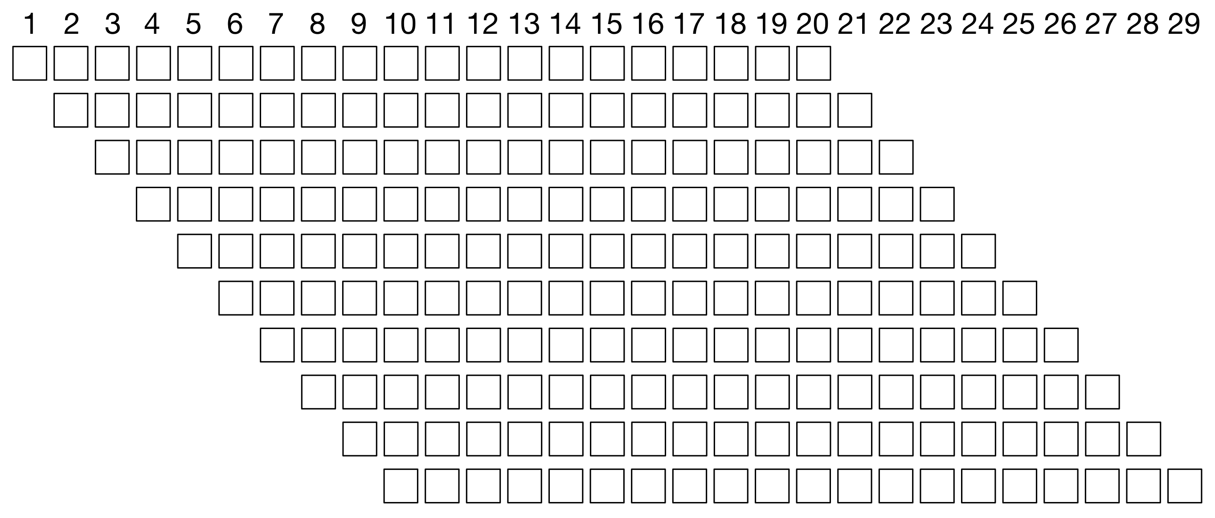
Superpipeline (Figure 2.12)

Slide 21
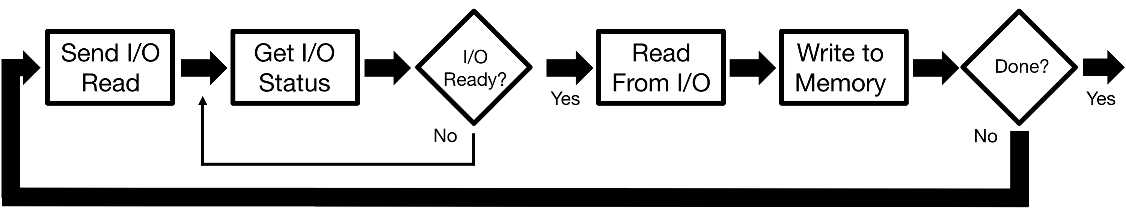
Programmed I/O (Figure 2.13)

Slide 22
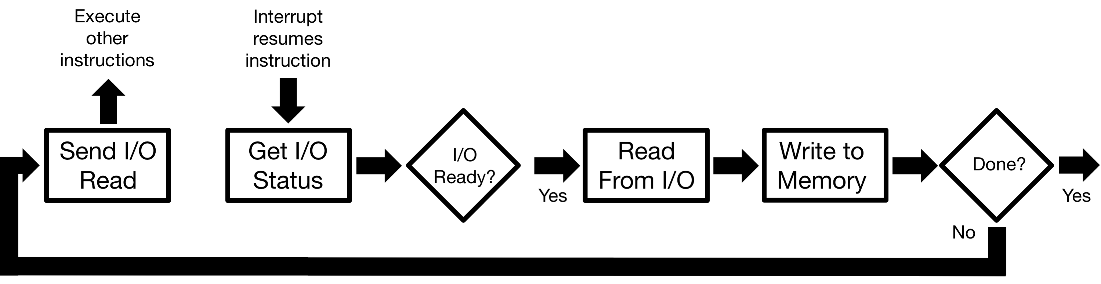
Interrupt-driven I/O (Figure 2.14)

Slide 23
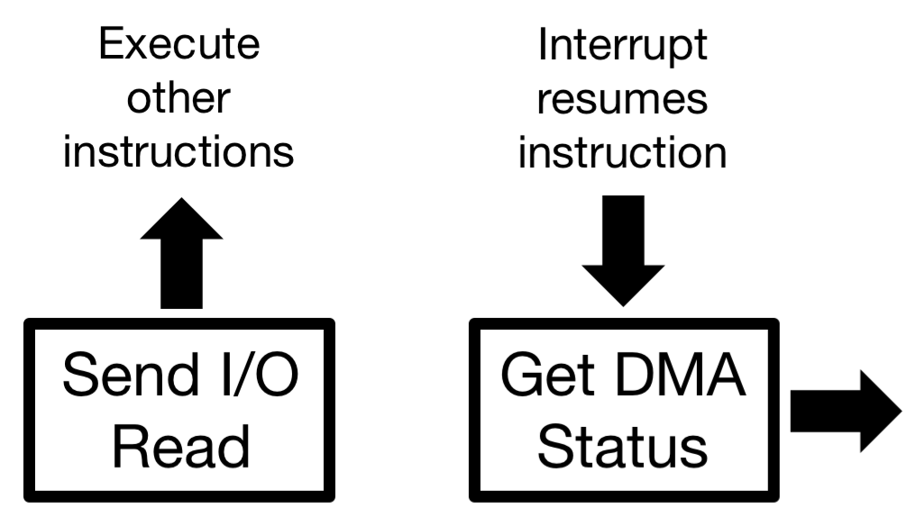
DMA (Figure 2.15)

Slide 24
Chapter 2 Key Terms
address bus arithmetic logic unit (ALU)
Big-Endian bus cache central processing unit (CPU)
clock cycle control bus control unit (CU) CPU Clock data bus Decode
direct memory access (DMA)
disk dynamic RAM (DRAM)
Execute
Fetch flags frequency
I/O channel input/output (I/O) module
instruction execution cycle
interrupt-driven I/O
Little-Endian memory motherboard multiplier pipelining programmed I/O (PIO)
registers
static random access memory (SRAM) superpipeline system bus system clock

