Slide 1
Chapter 3
Assembly and Syntax Fundamentals

Slide 2
Objectives
Distinguish differences in Assembly syntaxes
Identify sections of Assembly code and explain the use of each
Construct semantically correct data definitions
Create working Assembly programs

Slide 3
Web Resources
https://sourceware.org/binutils/docs/as/ (GAS Reference)
https://docs.microsoft.com/en-us/cpp/assembler/masm/microsoft-macro-assembler-reference (MASM Reference)
https://www.nasm.us/doc/nasmdoc0.html (NASM Reference)

Slide 4
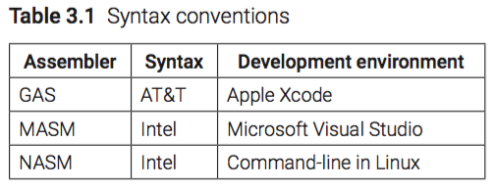
Syntax Conventions

Slide 5
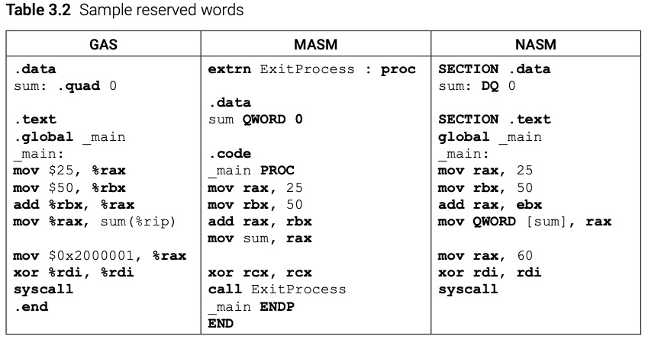
Reserved Words

Slide 6
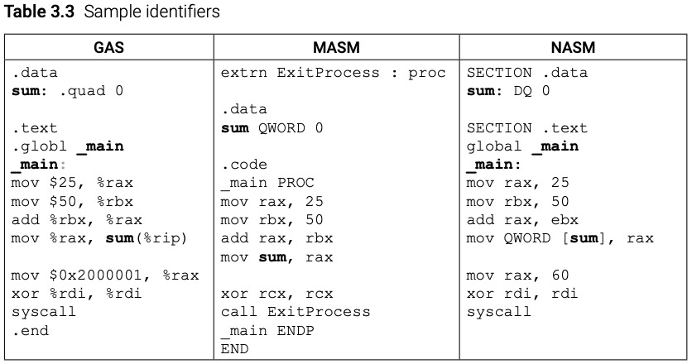
Identifiers
Letters (A-Z, a-z)
Underscore (_)
Question Mark (?)
At-symbol (@)
Dollar Sign ($)
Recommend against ?, @, and $

Slide 7
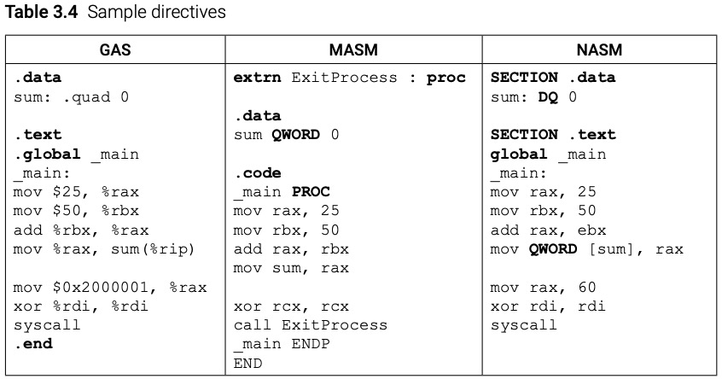
Directives

Slide 8
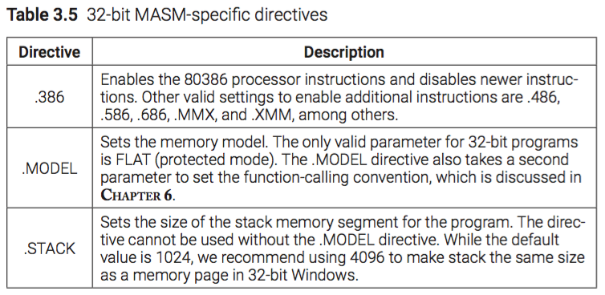
MASM-specific Directives

Slide 9
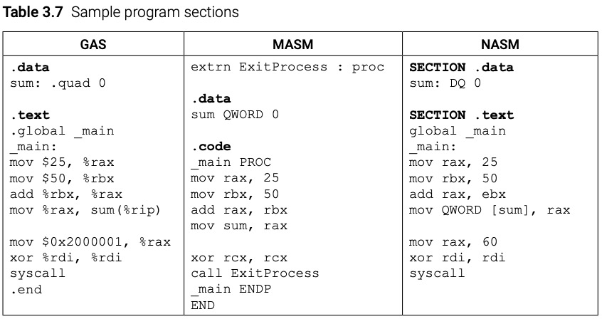
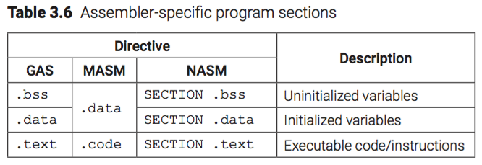
Program Sections

Slide 10
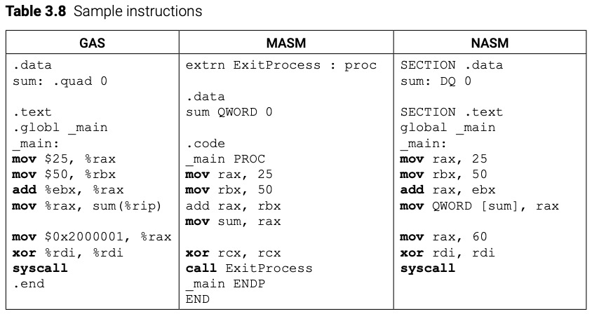
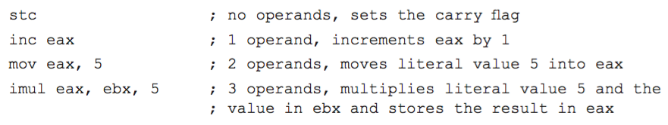
Instructions

Slide 11
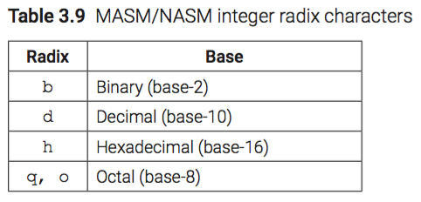
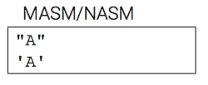
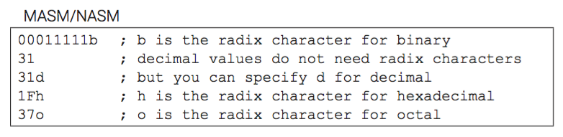
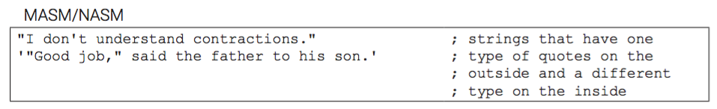
Literals (MASM/NASM)

Slide 12
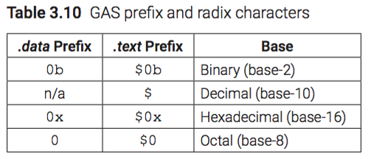
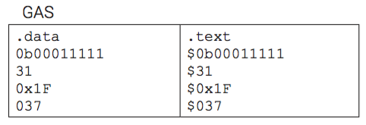
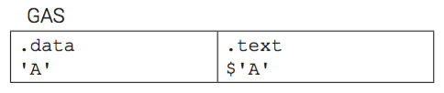

Literals (GAS)

Slide 13
String Storage

Slide 14
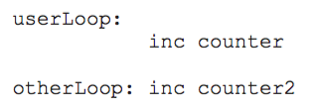
Labels

Slide 15
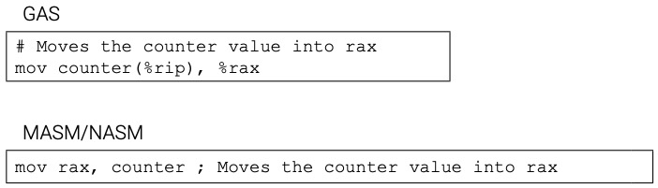
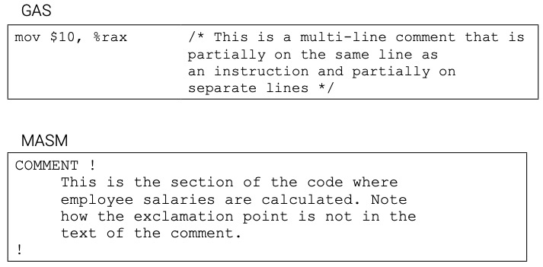
Comments

Slide 16
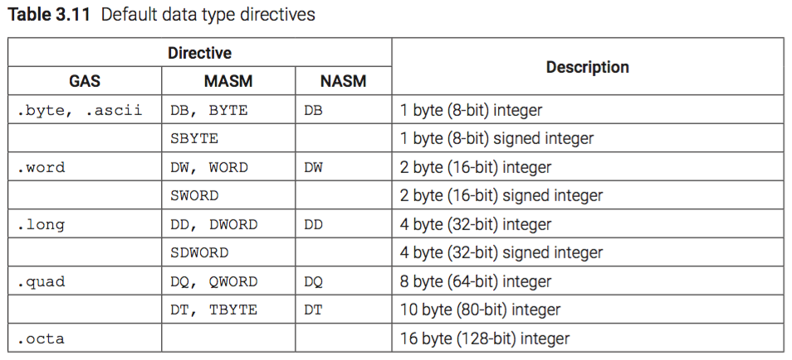
Data Types

Slide 17
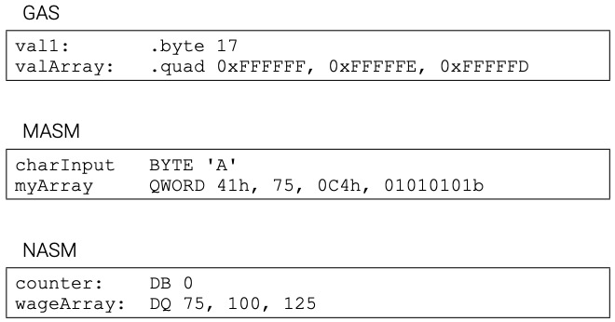
Data Definition

Slide 18
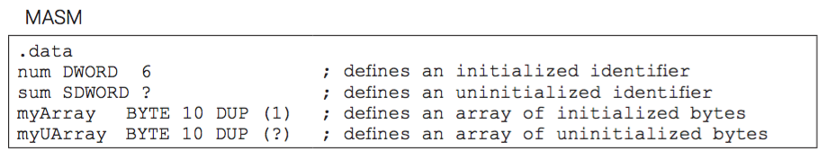
Uninitialized Variables (MASM)

Slide 19
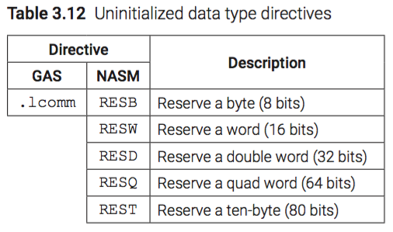
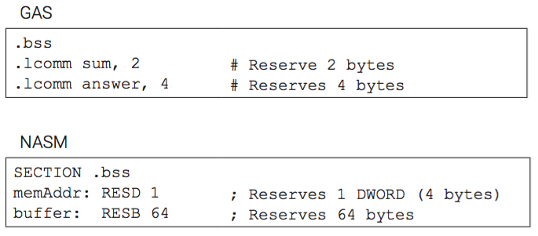
Uninitialized Variables (GAS/NASM)

Slide 20
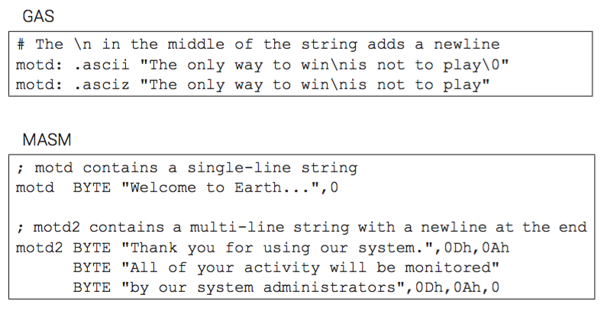
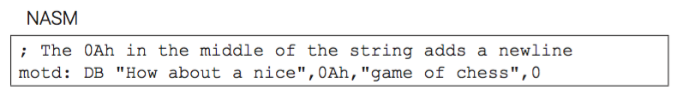
Strings

Slide 21
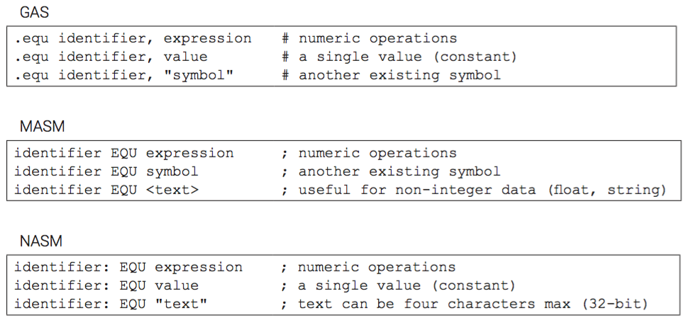
EQU

Slide 22
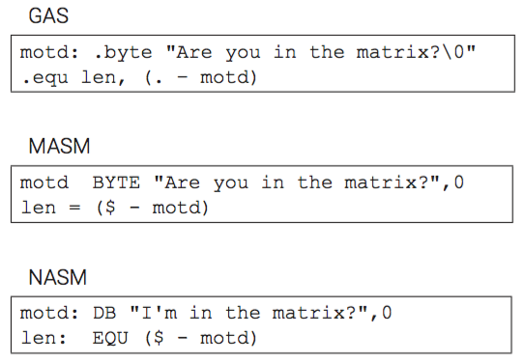
EQU (Array Length)

Slide 23
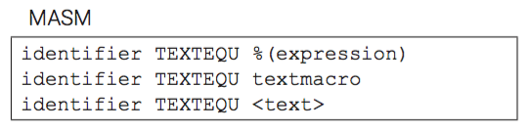
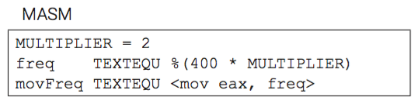
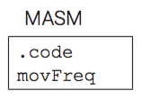
TEXTEQU (MASM)

Slide 24
Chapter 3 Key Terms
array character literals
comments current location counter
directives DUP EQU identifiers
immediate
instructions integer literals labels mnemonic
multi-line comments
program sections
real numbers
reserved words
single-line comments
string literals strings symbolic constants
TEXTEQU
uninitialized variables
variable

