Slide 1
Chapter 4
Basic Instructions

Slide 2
Objectives
Perform integer arithmetic
Manipulate data at the bit level
Explain different addressing modes
Construct arrays
Convert data to different data sizes and types

Slide 3
Web Resources
Assembler References
https://sourceware.org/binutils/docs/as/ (GAS Reference)
https://docs.microsoft.com/en-us/cpp/assembler/masm/microsoft-macro-assembler-reference/ (MASM Reference)
https://www.nasm.us/doc/nasmdoc0.html (NASM Reference)
x86 Instruction Set Listings
https://software.intel.com/content/www/us/en/develop/articles/intel-sdm.html (Volume 1, Chapter 5 Instruction Set Summary, Section 5.1)
https://www.felixcloutier.com/x86/
https://en.wikipedia.org/wiki/X86_instruction_listings
https://www.nasm.us/doc/nasmdocb.html
https://developer.apple.com/library/archive/documentation/DeveloperTools/Conceptual/MachOTopics/1-Articles/x86_64_code.html

Slide 4
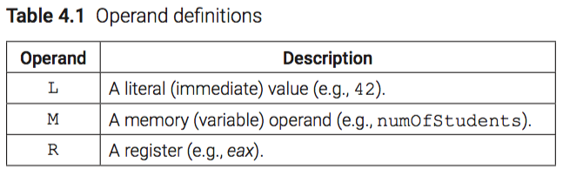
Operand Definitions
Specific sizes in bits
L8
M16
M32/R32
etc.

Slide 5
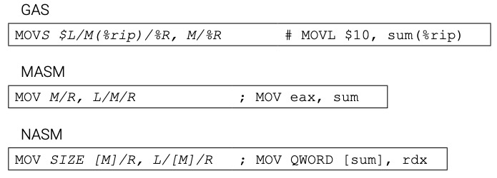
Data Movement
Rules
Operands must be the same size
Operands can’t both be memory
IP can not be the destination

Slide 6
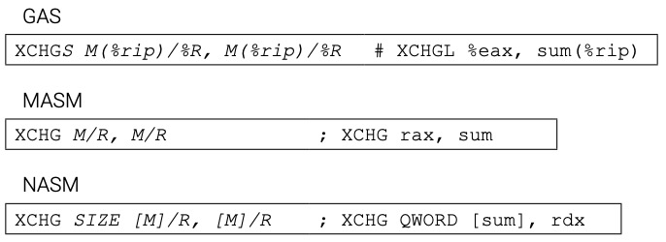
Data Movement

Slide 7
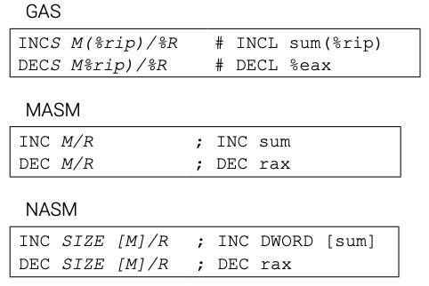
Increment/Decrement

Slide 8
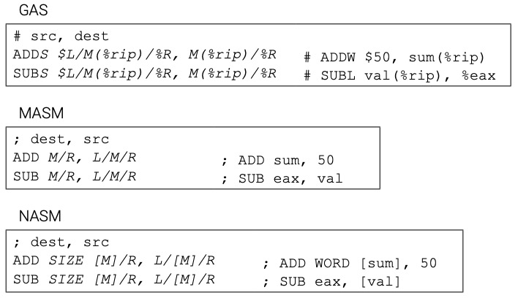
Add/Subtract

Slide 9
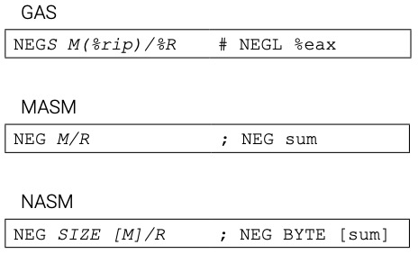
Negate
Reverses the sign of a value
Two’s Complement

Slide 10
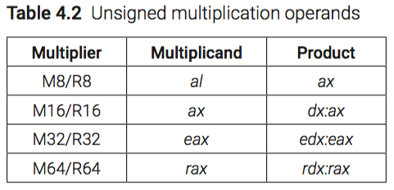
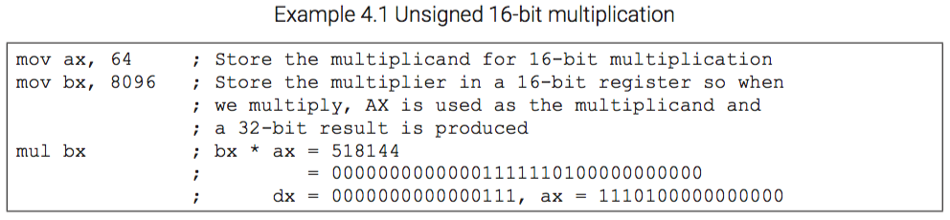
Unsigned Multiplication

Slide 11
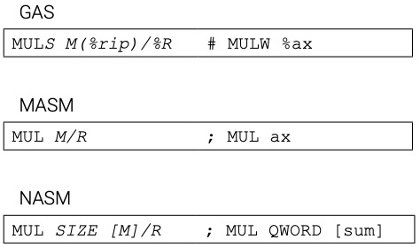
Unsigned Multiplication

Slide 12
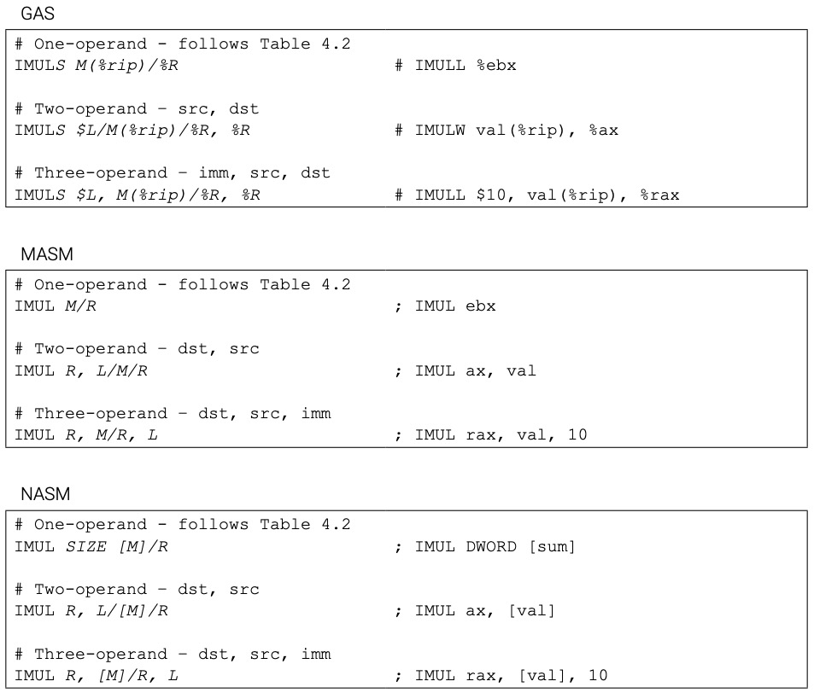
Signed Multiplication

Slide 13
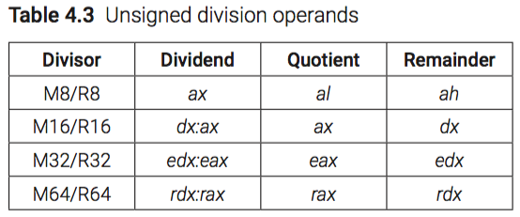
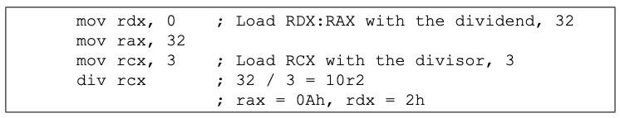
Unsigned Division
Example 4.2 Unsigned 64-bit division

Slide 14
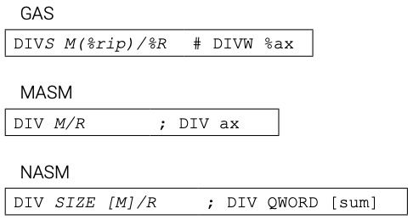
Unsigned Division

Slide 15
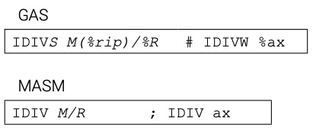

Signed Division

Slide 16
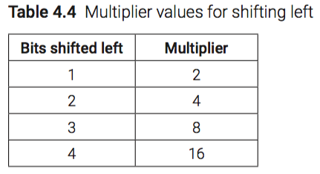
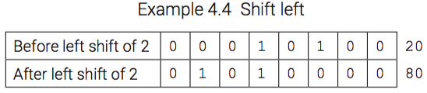
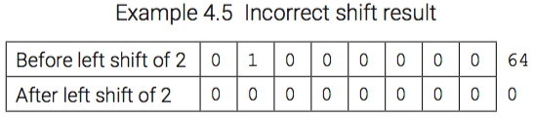
Bit Shifting (Logical)

Slide 17
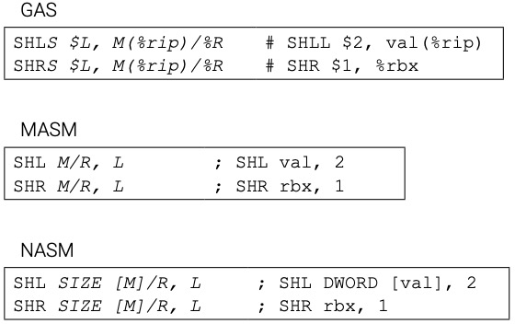
Bit Shifting (Logical)

Slide 18
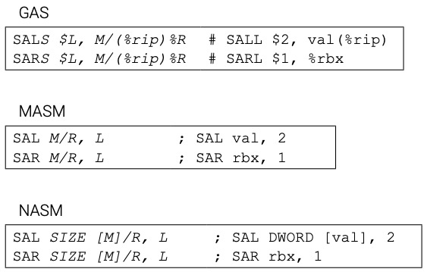
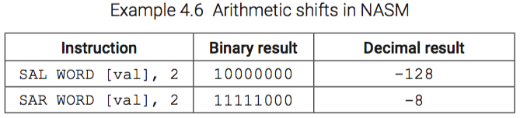
Bit Shifting (Arithmetic)

Slide 19
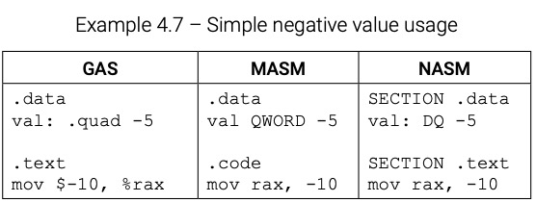
Negative Values

Slide 20
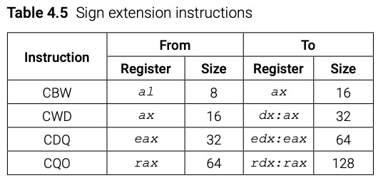
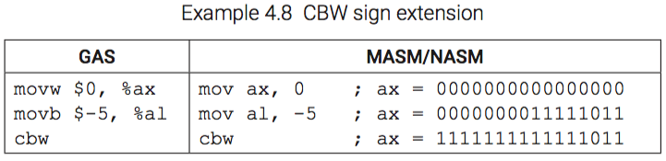
Sign Extension

Slide 21
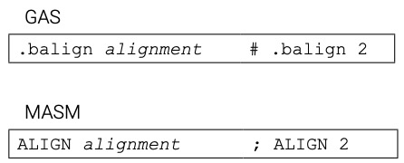

Data Alignment

Slide 22
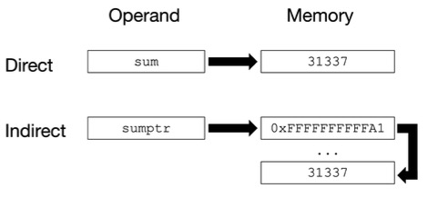
Data Addressing (Figure 4.1)

Slide 23
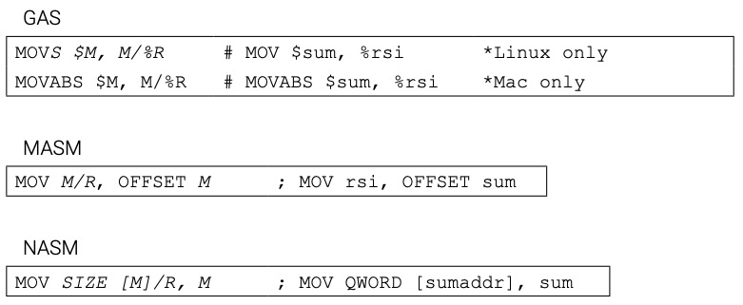
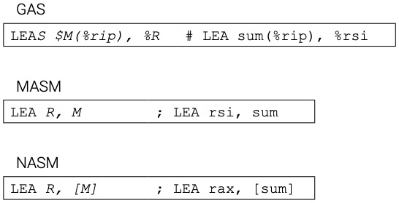
Storing an Operand’s Address

Slide 24
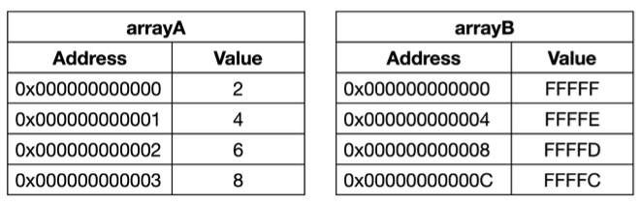
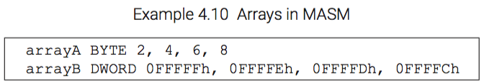
Arrays (Figure 4.2)

Slide 25
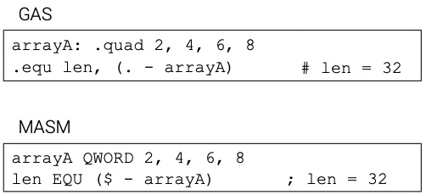

Array Size

Slide 26
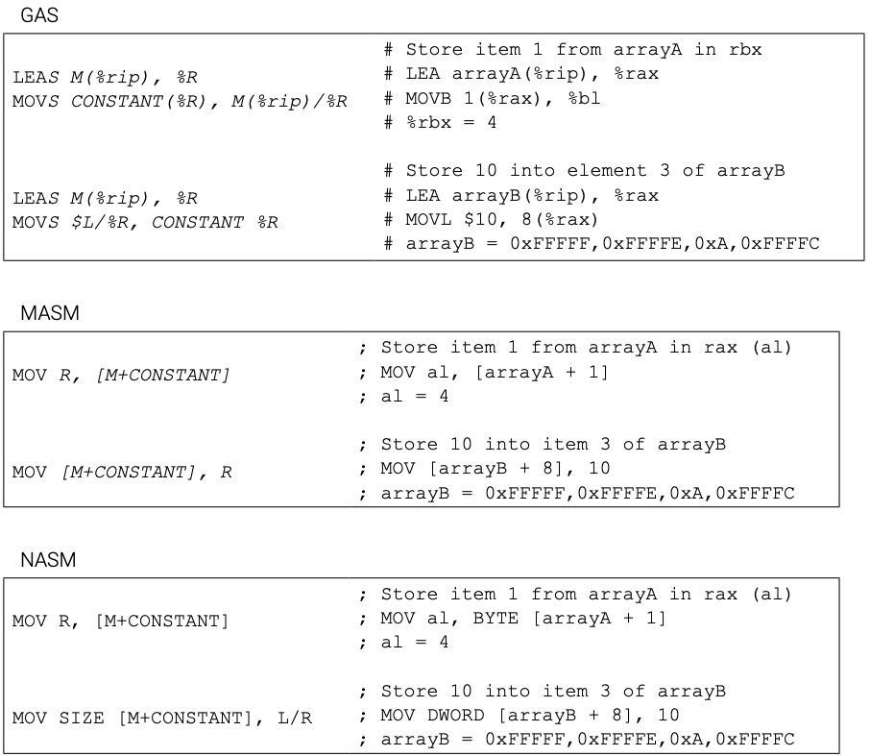
Array Usage with Byte Offsets

Slide 27
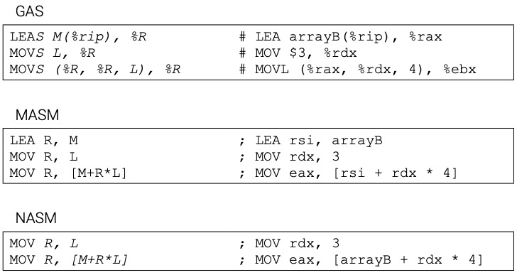
Array Usage with High-Level Indices

Slide 28
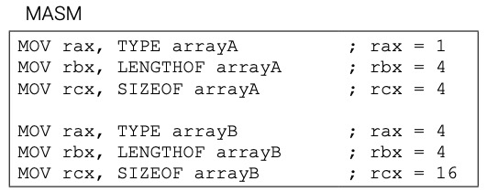
Array Usage (MASM-specific)

Slide 29
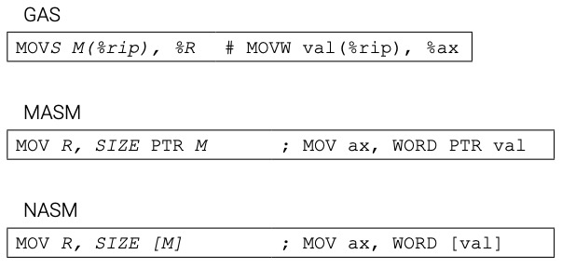
Changing Data Sizes (Large -> Small)

Slide 30
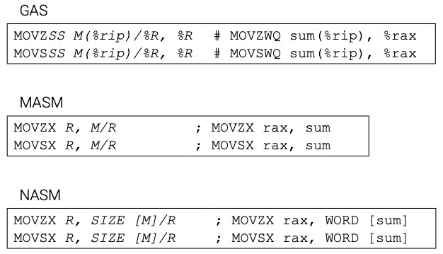
Changing Data Sizes (Small-> Large)

Slide 31
Chapter 4 Key Terms
.balign ADD ALIGN ALIGNB arithmetic bit shifting
array
CBW CDQ CQO CWD DEC direct addressing
DIV
IDIV
IMUL
INC
indirect addressing
LEA
LENGTHOF
logical bit shifting
MOV
MOVS/MOVSX
MOVZ/MOVZX
MUL
NEG
OFFSET
PTR
SAL
SAR
SHL
SHR
SIZEOF
SUB
TYPE
XCHG

