Slide 1
Chapter 5
Intermediate Instructions

Slide 2
Objectives
Identify efficient uses of bitwise Boolean instructions
Create control and decision structures for branching
Create repeatable code blocks

Slide 3
Web Resources
Assembler References
https://sourceware.org/binutils/docs/as/ (GAS Reference)
https://docs.microsoft.com/en-us/cpp/assembler/masm/microsoft-macro-assembler-reference/ (MASM Reference)
https://www.nasm.us/doc/nasmdoc0.html (NASM Reference)
x86 Instruction Set Listings
https://software.intel.com/content/www/us/en/develop/articles/intel-sdm.html (Volume 1, Chapter 5 Instruction Set Summary, Section 5.1)
https://www.felixcloutier.com/x86/
https://en.wikipedia.org/wiki/X86_instruction_listings
https://www.nasm.us/doc/nasmdocb.html

Slide 4
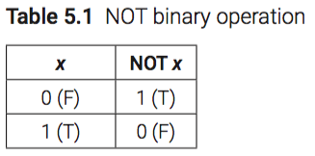
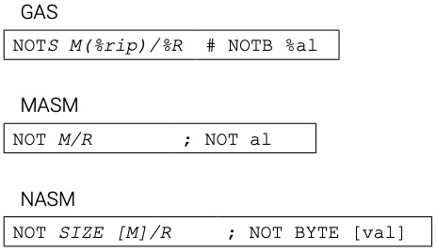
Bitwise NOT

Slide 5
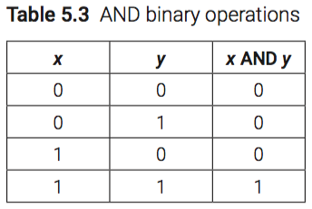
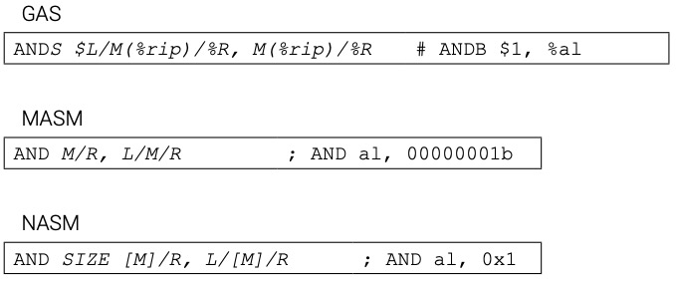
Bitwise AND

Slide 6
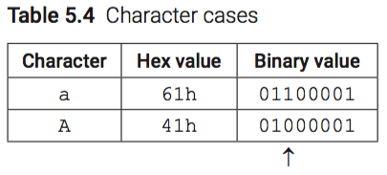

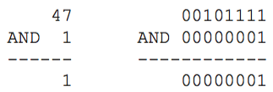
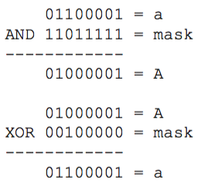
Bitwise AND

Slide 7
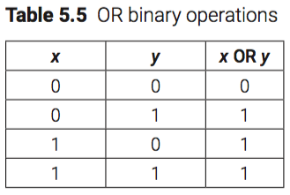
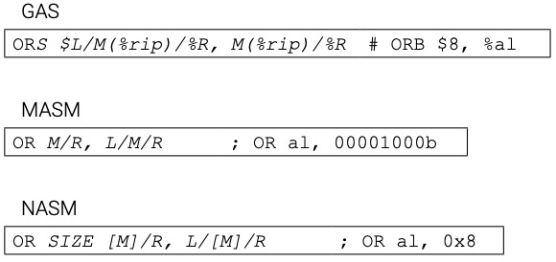
Bitwise OR

Slide 8
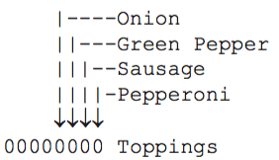
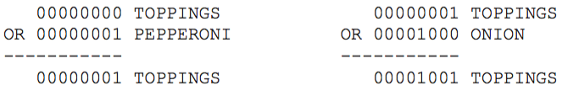
Bitwise OR

Slide 9
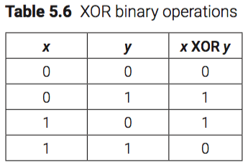
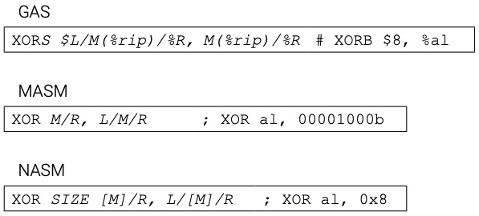
Bitwise XOR

Slide 10
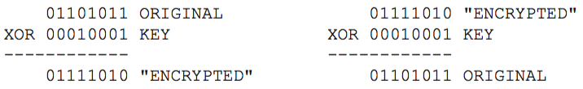
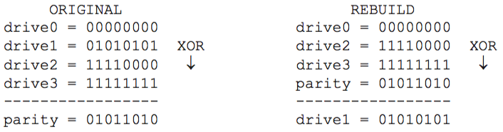
Bitwise XOR

Slide 11

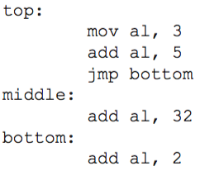
Unconditional Jump

Slide 12
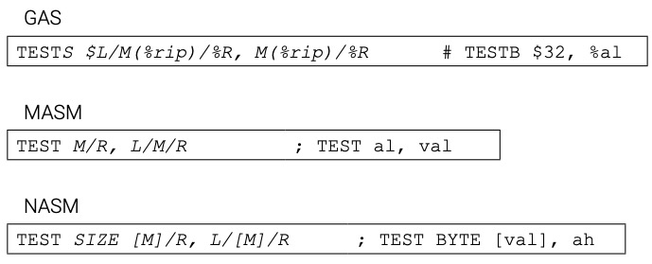
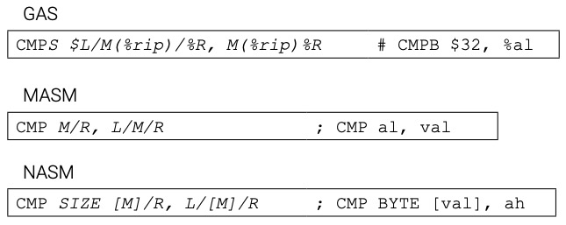
Conditional Jump

Slide 13
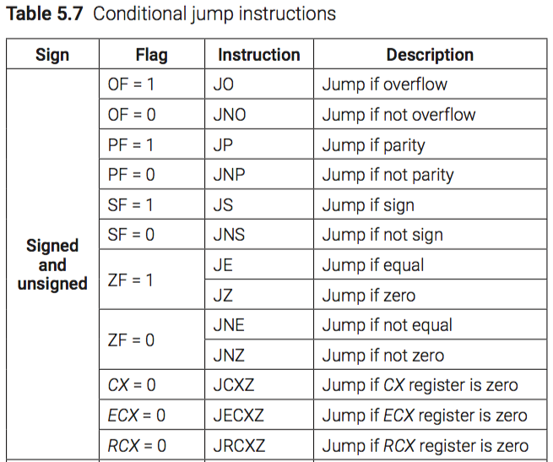
Conditional Jump

Slide 14
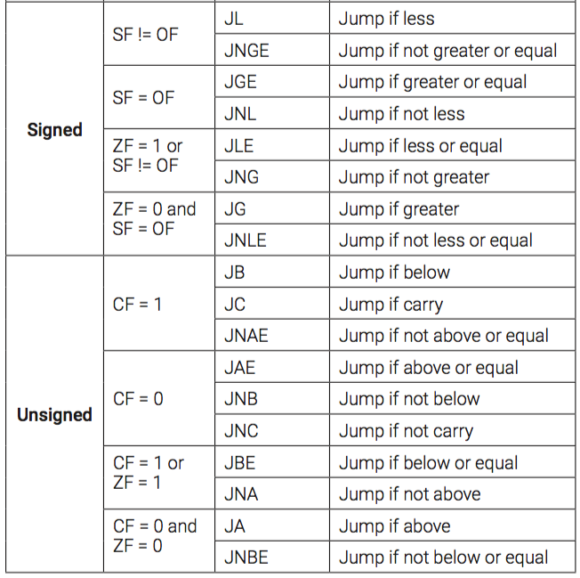
Conditional Jump continued

Slide 15
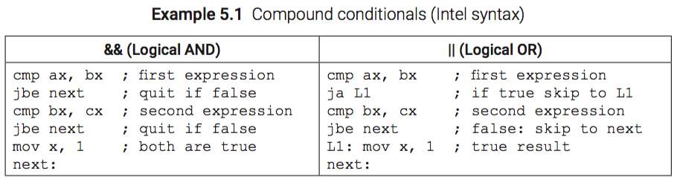
Compound Conditionals

Slide 16

Looping using CX/ECX/RCX

Slide 17
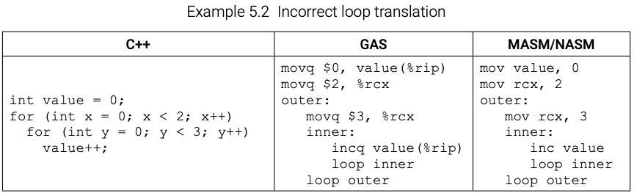
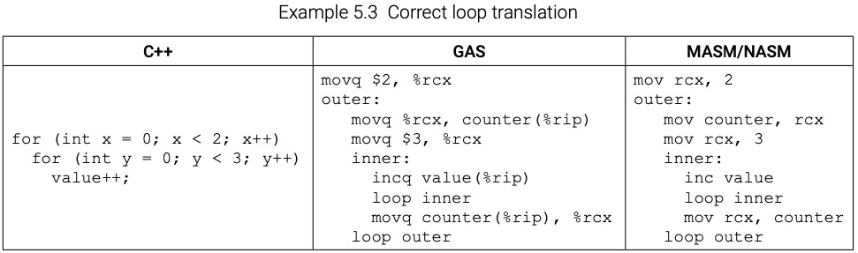
Looping using CX/ECX/RCX

Slide 18
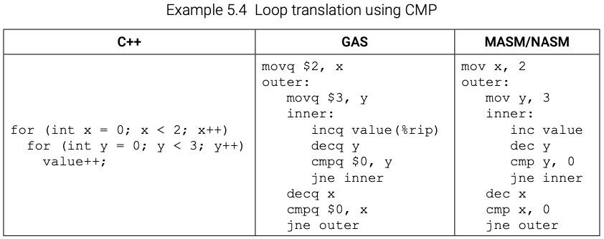
Programmer-defined Counters

Slide 19
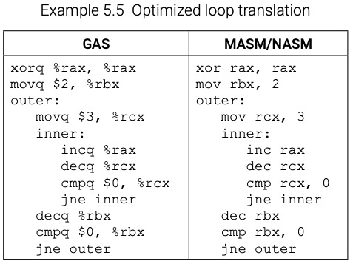
Using Registers

Slide 20
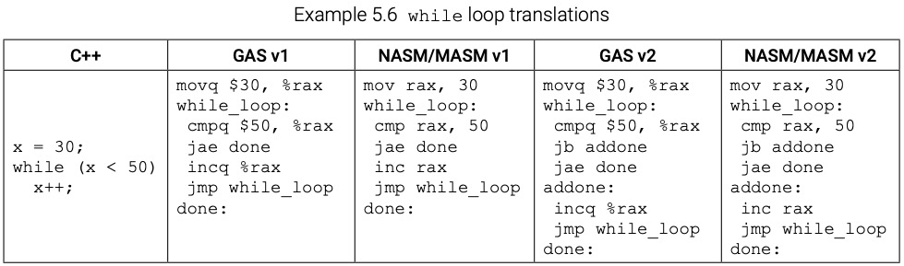
Translating While Loop

Slide 21
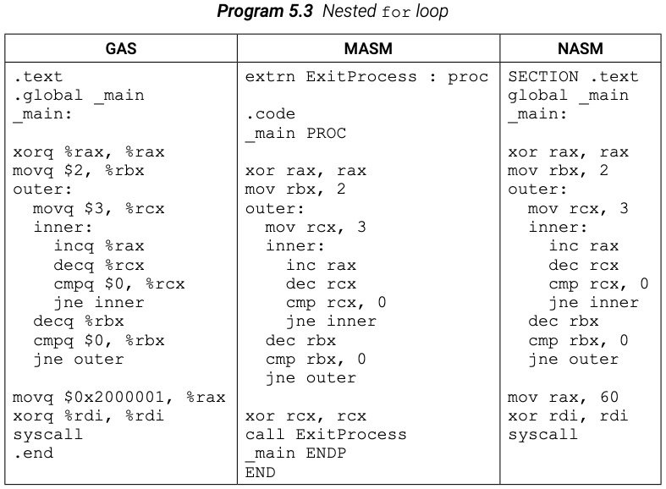
Nested For Loop

Slide 22
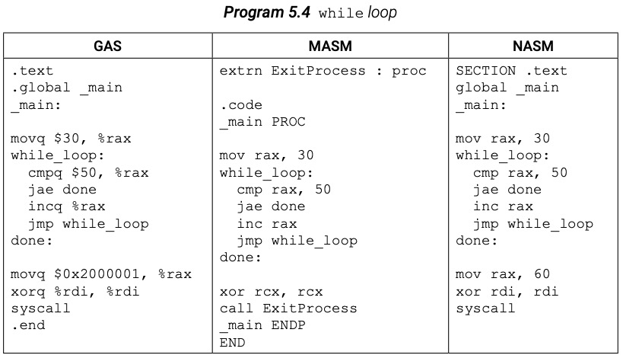
Nested While Loop

Slide 23
Chapter 5 Key Terms
AND Boolean bitwise operations
Boolean logical expressions
branching CMP counter JMP
LOOP NOT OR repetition (looping)
short-circuit evaluation
TEST
XOR

