Slide 1
Chapter 6
Functions

Slide 2
Objectives
Deconstruct function implementations
Compare function calling conventions
Manipulate stack memory
Create functions in Assembly

Slide 3
Web Resources
Wikis
https://en.wikipedia.org/wiki/Calling_convention
https://en.wikipedia.org/wiki/X86_calling_conventions
https://en.wikibooks.org/wiki/X86_Disassembly/Calling_Conventions
https://wiki.osdev.org/Calling_Conventions
Developer
https://developer.apple.com/library/archive/documentation/DeveloperTools/Conceptual/LowLevelABI/000-Introduction/introduction.html#/apple_ref/doc/uid/TP40002521 (OS X ABI Function Call Guide)
https://docs.microsoft.com/en-us/cpp/cpp/calling-conventions (x86 Calling Conventions)
https://docs.microsoft.com/en-us/cpp/build/x64-calling-convention (x64 Calling Convention)
https://refspecs.linuxfoundation.org/elf/x86_64-abi-0.99.pdf (AMD64 ABI)
https://www.agner.org/optimize/calling_conventions.pdf (Calling Conventions)

Slide 4
Stack Memory Primer
Stack grows and shrinks as functions are called and return.
Stack grows and shrinks as local variables are created (pushed) and dereferenced (popped).
Stack has an OS-dependent size limit per process/thread.
Every function call, including main() and recursive calls, has a stack frame.
A stack frame is used to store a function’s local variables.
Stack memory grows down, with addresses descending.
Every memory slot holds 4 bytes in 32-bit mode or 8 bytes in 64-bit mode.
Values are stored by default in Little-Endian form.
In x86_64, all functions must be 16-byte aligned.

Slide 5
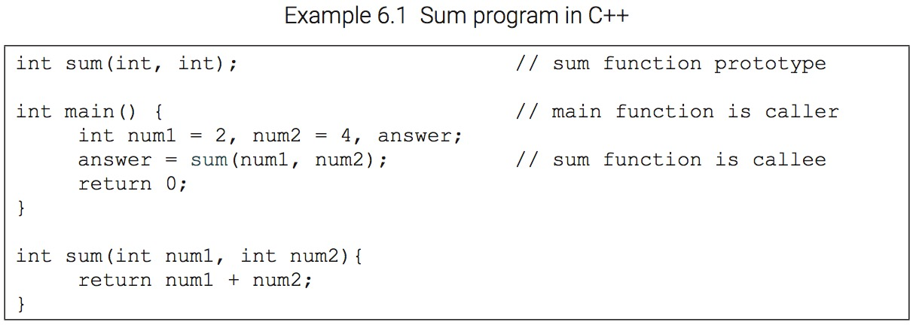
Caller and callee

Slide 6
x86_64 Calling Conventions
Parameters are passed in left to right order up to the maximum registers supported. Any remaining parameters are passed in reverse order from right to left via the stack
Some registers are caller-saved (volatile), while others are callee-saved (non-volatile). Consequently, if you want to save caller-saved register values, you need to do so in the calling function because they will likely be overwritten during function execution (e.g., rax).
rax is used as the return register in most cases, while x/y/zmm0 is used for a floating-point return.
The caller is responsible for cleaning up stack

Slide 7
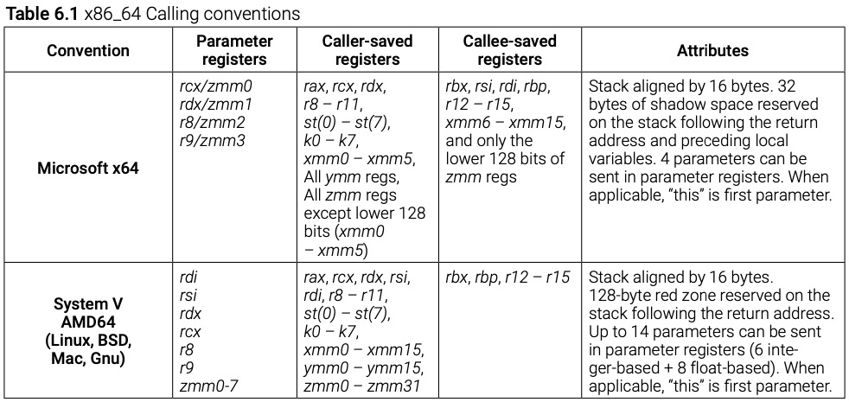
x86_64 Calling Conventions

Slide 8
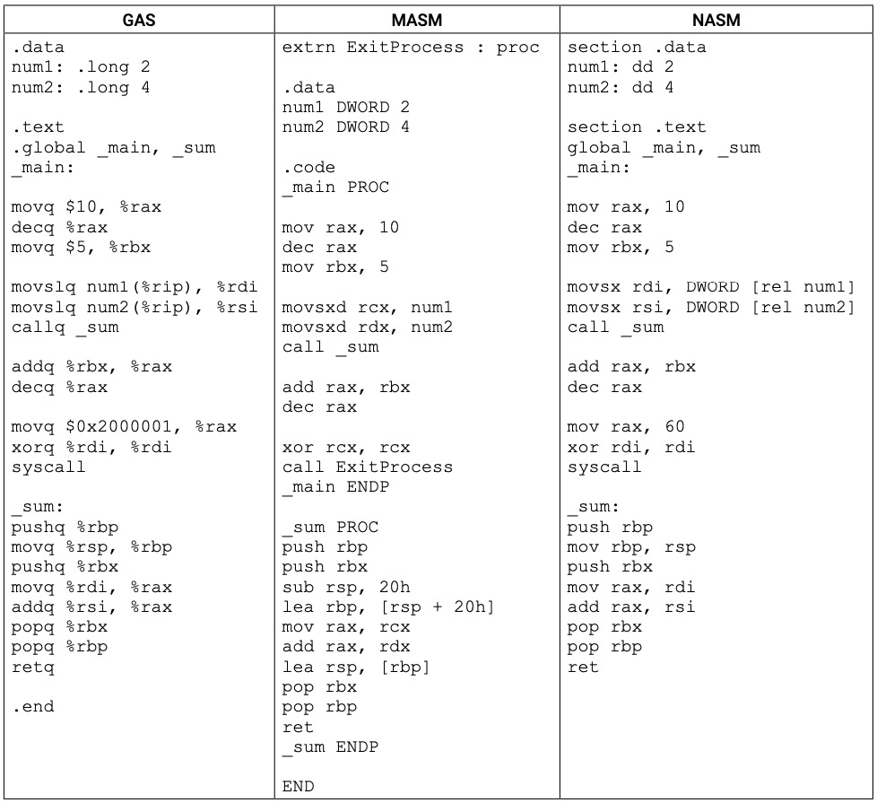
Program 6.1 – Sum in x86_64

Slide 9
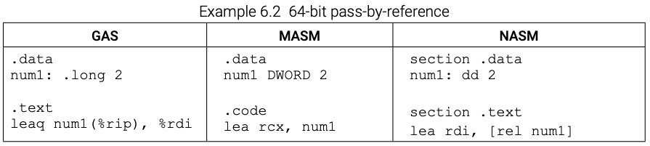
Pass-by-reference

Slide 10
Before parameters are passed (Figure 6.1)

Slide 11
After CALL instruction (Figure 6.2)

Slide 12
After establishing frame and saving rbx (Figure 6.3)

Slide 13
After RET instruction (Figure 6.4)

Slide 14
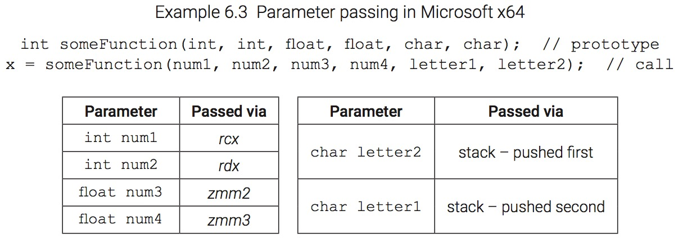
Parameter passing in MS x64

Slide 15
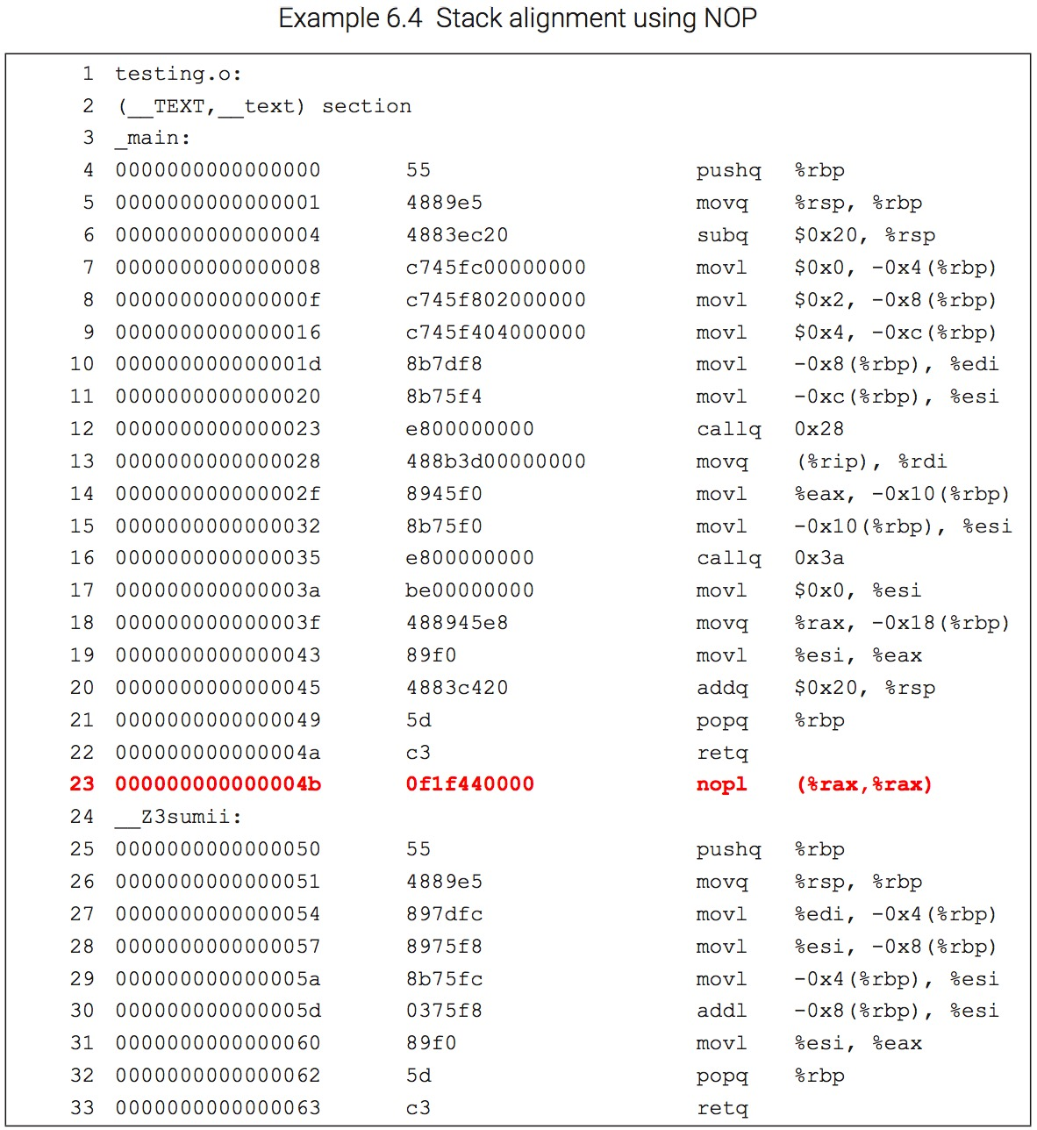
Stack alignment
Required in 32-bit macOS
Required in 64-bit for all platforms
Methods include using NOP, subtracting from rsp, using AND, and using compiler flags

Slide 16
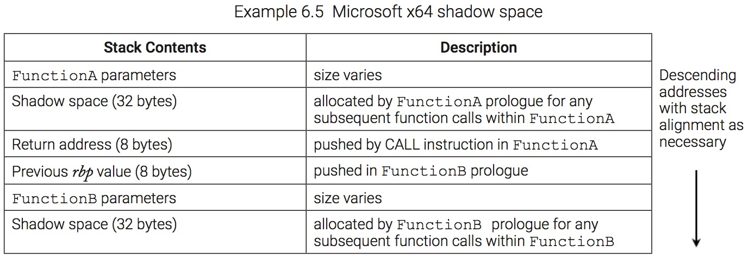
Microsoft x64 shadow space

Slide 17
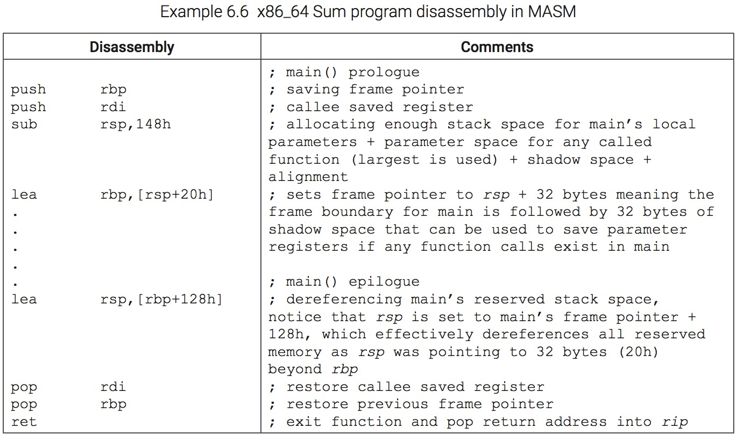
x86_64 Sum disassembly (MASM)

Slide 18
x86 Calling Conventions – cdecl
Parameters are passed in reverse order (right to left) via the stack
eax, ecx, and edx are caller-saved (volatile), while the rest of the general purpose registers are callee-saved (non-volatile)
eax is used as the return register in most cases and st(0) is used for a floating-point return
The caller is responsible for cleaning up stack

Slide 19
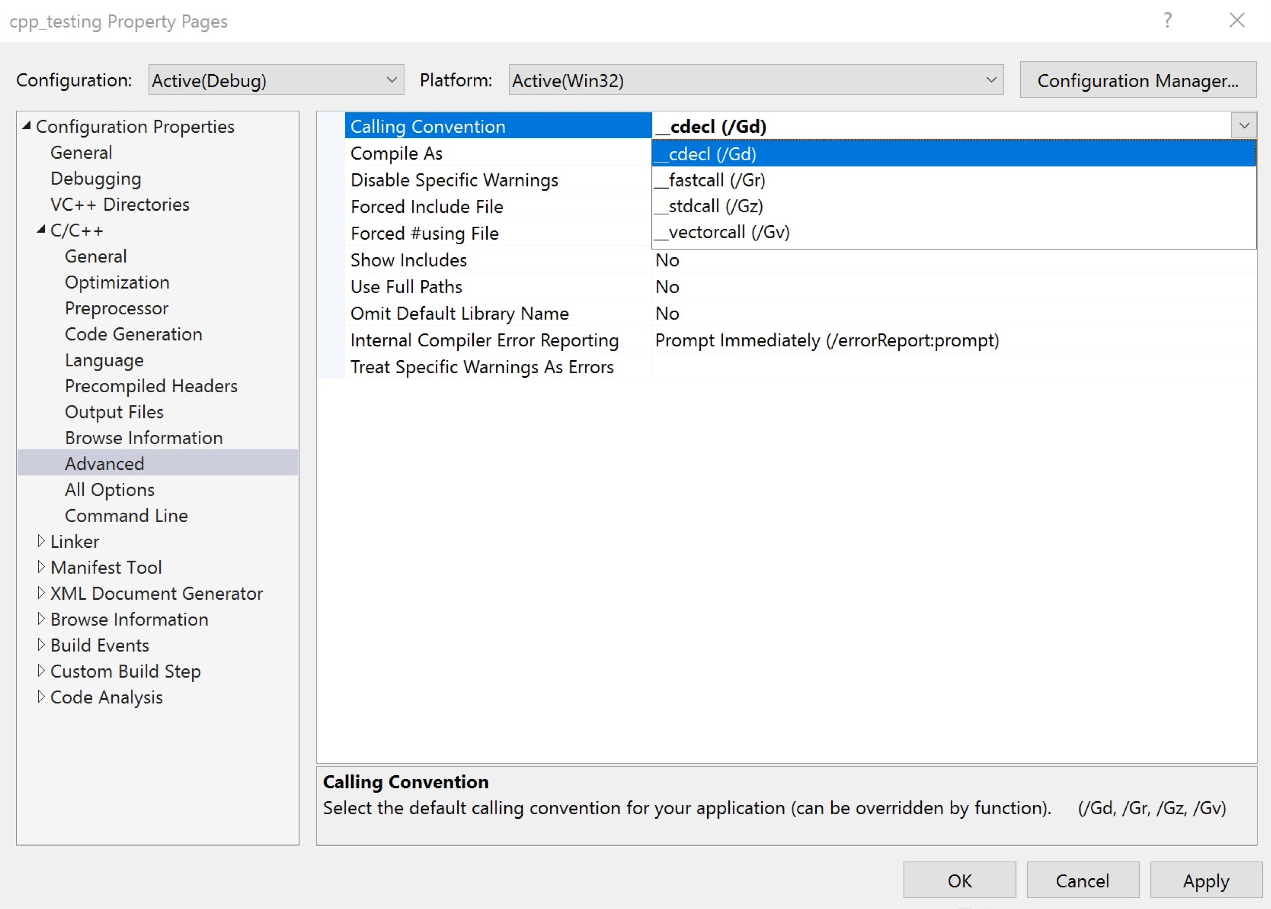
Visual Studio Calling Convention Settings

Slide 20
x86 Calling Conventions – stdcall
Parameters are passed in reverse order (right to left) via the stack
eax, ecx, and edx are caller-saved (volatile), while the rest of the general purpose registers are callee-saved (non-volatile)
eax is used as the return register in most cases and st(0) is used for a floating-point return
The callee is responsible for cleaning up stack

Slide 21
Some useful details
If the Floating-Point Unit (FPU) stack is used, it must be clear upon entry into a function and upon exit, except for st(0), which may be holding the return value. The FPU is discussed in Chapter 8.
In 32-bit, addresses for pass-by-reference are passed on the stack. Registers serve as an intermediary to obtain the parameter address at run-time using the LEA instruction, which is then moved or pushed to the stack.
lea -0x8(%ebp), %eax # a parameter address is loaded into eax
mov %eax, (%esp) # address copied to where esp is pointing
In 64-bit, the address can be moved directly to a register for pass-by-reference.
lea -0x8(%rbp), %rdi # a parameter address is loaded into rdi
In 64-bit, if using varargs functions such as printf(), the al register, which is the low 8 bits of rax, is used to store the number of SSE registers used.
Refer to the Web resources for further detail on calling conventions. In particular, the reference by Agner Fog (https://www.agner.org/optimize/calling_conventions.pdf) and the application binary interface (ABI) documents such as https://refspecs.linuxfoundation.org/elf/x86_64-abi-0.99.pdf are the most useful in terms of comparing calling conventions and providing detailed overviews.

Slide 22
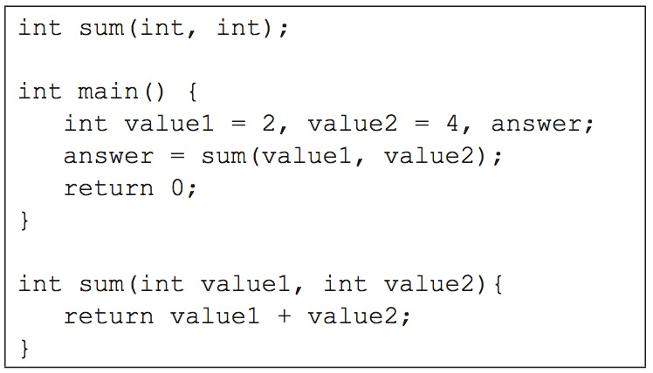
Program 6.2 – Sum in C++

Slide 23
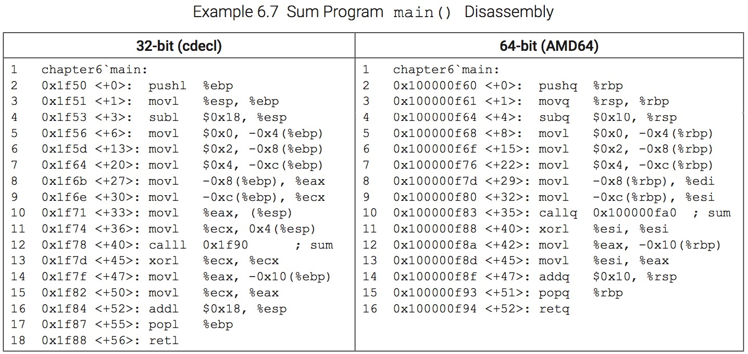
Sum main() disassembly

Slide 24
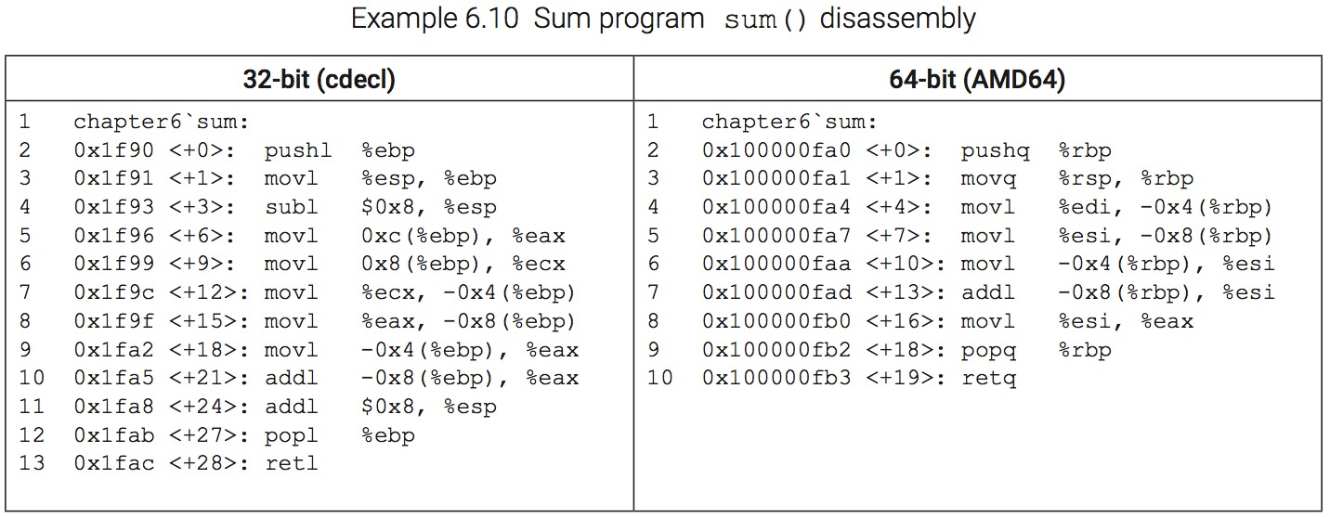
Sum sum() disassembly

Slide 25
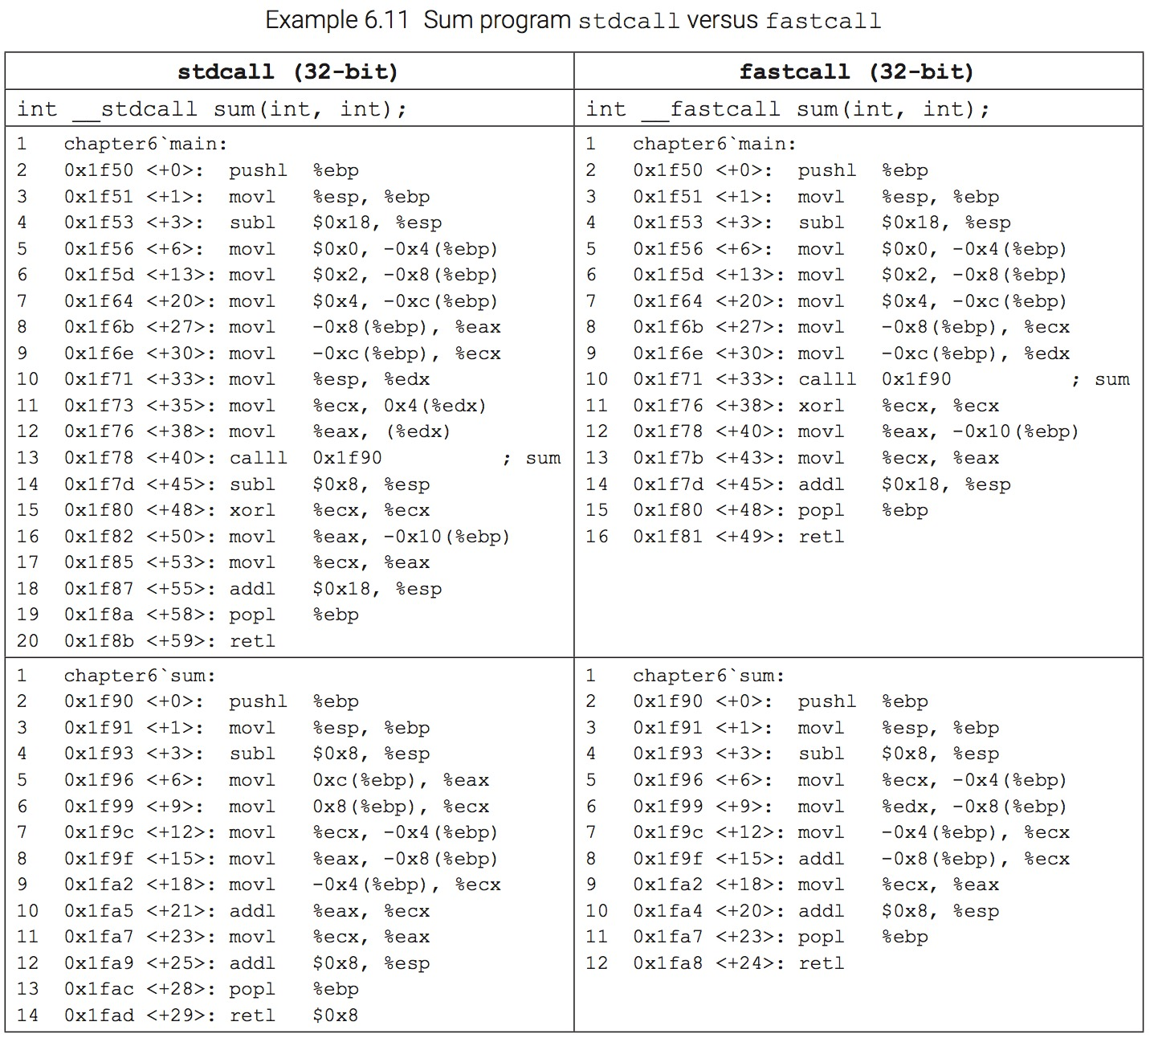
Sum stdcall versus fastcall

Slide 26
Chapter 6 Key Terms
application binary interface (ABI)
callee
caller
calling conventions
cdecl
epilogue
fastcall
functions
leaf functions
Little-Endian
Microsoft x64
procedures
prologue
red zone
shadow (home) space
stack frame
stack memory
stdcall
Streaming SIMD Extentions (SSE)
System V AMD64 (AMD64)

