Slide 1
Agenda today
We are going to look at 3 behavioural design patterns
1. strategy pattern
2. observer pattern
3. state pattern (this week’s lab)

Slide 2
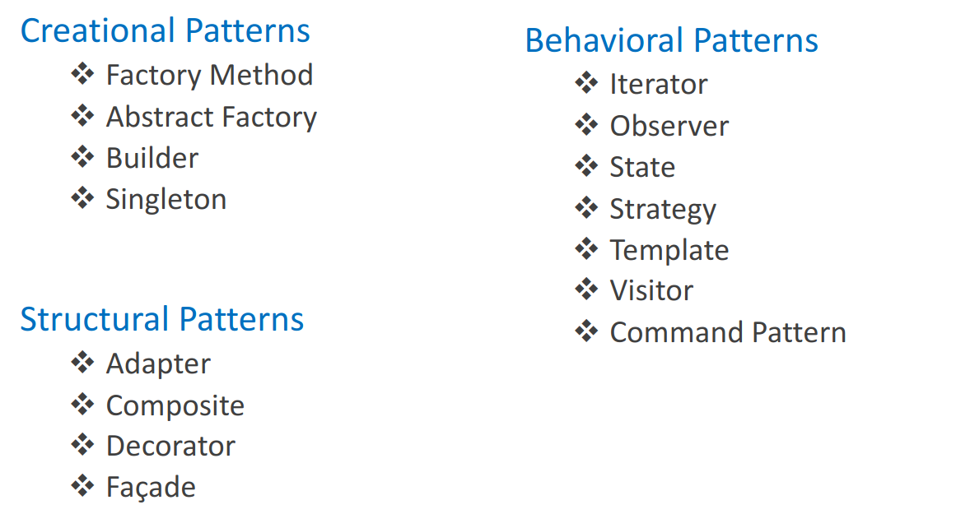
What’s a design pattern
A design pattern is structured way of approaching some problems

Slide 3
Q1.What’s the code smell here?
Type checking?
Open-closed principle?
Long method?
Reusable?

Slide 4
Strategy Design Pattern
Use the Strategy pattern when you want to use different variants of an algorithm within an object
Able to switch from one algorithm to another during runtime.
Use the Strategy when you have similar classes that only differ in the way they execute some behaviours.

Slide 5
Benefits
Open/Closed Principle: Program is open to extension closed to modification
We can swap behaviour at runtime: i.e. sorting algorithm
We replace inheritance with composition

Slide 6
Q2.Observer Pattern
What classes are we gonna need from just these requirements?
Subject interface(add(Observer), remove(Observer), and notify(Observer List))
Observer interface(update(Subject))
Concrete Subject (implement Subject interface and maintain a list of observers)
Concrete Observer

Slide 7
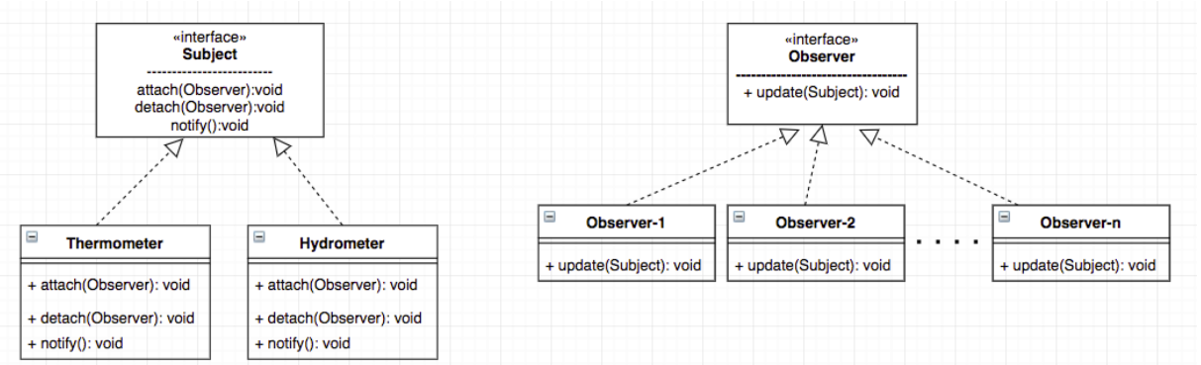
Observer Pattern

Slide 8
Benefits
Open/Closed Principle: Program is open to extension closed to modification
We can establish relations between classes at run-time
Loosely coupled objects, easier to maintain
** Subscribers are notified in random order. Don’t depend on a specific order

Slide 9
Q3. State Pattern
State is a behavioural design pattern that lets an object alter its behaviour when its internal state changes. It appears as if the object changed its class.

Slide 10
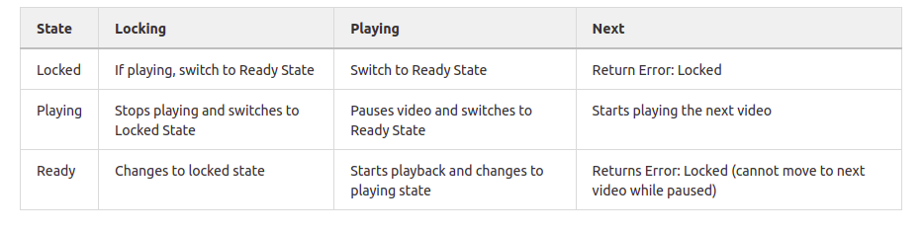
State Transition Diagram
In this example, the row is the state and the column is the transition

Slide 11
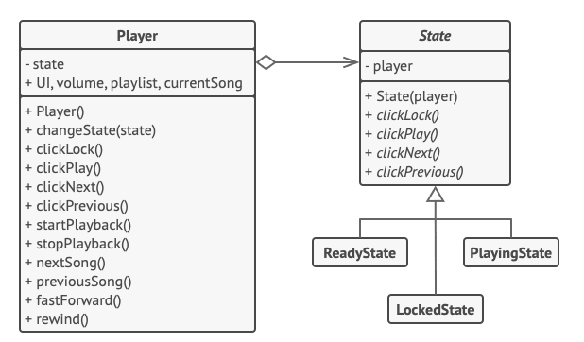
Q3. State Pattern

Slide 12
Benefits
Single Responsibility Principle. Organise the code related to particular states into separate classes
Open/Closed Principle
Simplify the code

Slide 13
Strategy vs State
State pattern is used when an object changes its behaviour depending on the internal state. It is a clean way of an Object to partially change its type or behaviour at run-time.
Strategy Pattern is used when there are multiple algorithms for a specific object and context implementations are decided at run-time.

