Slide 1
Fitting a Bayesian Linear Regression Model
BIOSTAT 615, Fall 2015 – Final Project
David Reynolds and Liam Abbott

Slide 2
Bayesian Inference
In the Bayesian framework, parameters are random variables with prior distributions and posterior distributions given the observed data
To fit a linear regression model, our goal is to obtain sample draws from the posterior distributions of the betas given the observed data
We can use these sample draws from the posterior distributions to summarize the distributions graphically, compute posterior statistics, calculate posterior intervals, or predict response variable values for new observations

Slide 3
Bayesian Inference
Gaussian linear regression model:
where:
Likelihood function of the data:

Slide 4
Bayesian Inference
Assume prior distributions for parameters:
Then the joint prior density is given by:

Slide 5
Bayesian Inference
Using Bayes Theorem and with some algebra, can show then that the joint posterior density of the parameters given the data is:
This is the density that we want to sample from

Slide 6
Gibbs Sampler
An alternative method for sampling from the joint posterior distribution is the Gibbs sampler
In the Gibbs sampler, the only requirement is that we are able to sample from the conditional posterior distributions:

Slide 7
Gibbs Sampler
Gibbs sampling algorithm:
Start with initial beta estimates (can be all betas = 0)
Sample from conditional posterior distribution of sigma squared given betas and the observed data
Sample from the conditional posterior distribution of betas given new sigma squared sample and the observed data
Using new sample of betas, repeat from step 2

Slide 8
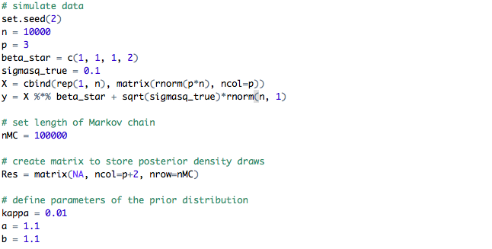
Gibbs Sampler Setup

Slide 9
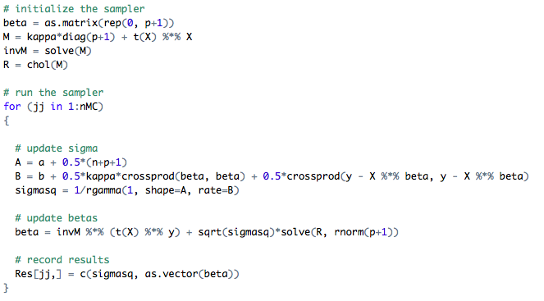
Gibbs Sampler Implementation in R

Slide 10
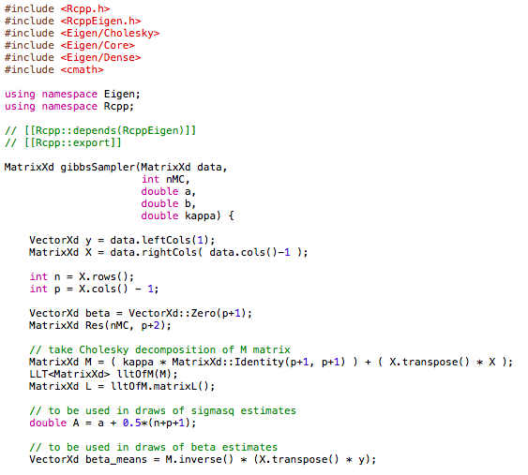
Gibbs Sampler Implementation in C++

Slide 11
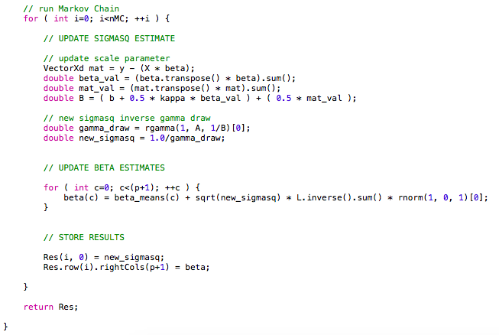
Gibbs Sampler Implementation in C++

Slide 12


Gibbs Sampler R vs. C++ Runtimes

