Slide 1
Recitation 1

Slide 2

Recitation Overview
TAs: Daniel Karalnik & Liam Tal
Reception hours
Daniel: Wednesday, 13:30 – 14:30 via Zoom
Liam: Friday, 10:30 - 11:30 via Zoom
E-mails
Daniel.karalnik@post.runi.ac.il
liam.tal@post.runi.ac.il
Contact guidelines:
Post questions on Piazza (can also do this anonymously)
Attend the reception hour (recommended to e-mail ahead of time)
E-mail directly

Slide 3
Zoom Guidelines
Mics are generally off
There will be time for questions between topics
Use the chat and the Raise Hand ability to raise technical issues
Recitations are recorded and will be published
Reception hours are not recorded

Slide 4
Recitation Structure
Review of select topics from previous lecture
Live demonstrations
Your turn - live, short practice sessions

Slide 5
Linux/UNIX file system
Files in the Linux operating system are arranged in a hierarchical structure
Path components are separated by a forward slash – '/' (not by a backslash - '\')
At the top of the structure there is the root directory: ‘/’ (Linux doesn't have drive letters like in windows -> 'c:\', 'd:\')
Under the root directory there are various system directories
Each user has their own hierarchy of files
File system treats file and directory names as case-sensitive for example, file.txt and File.txt will be treated as distinct files.

Slide 6
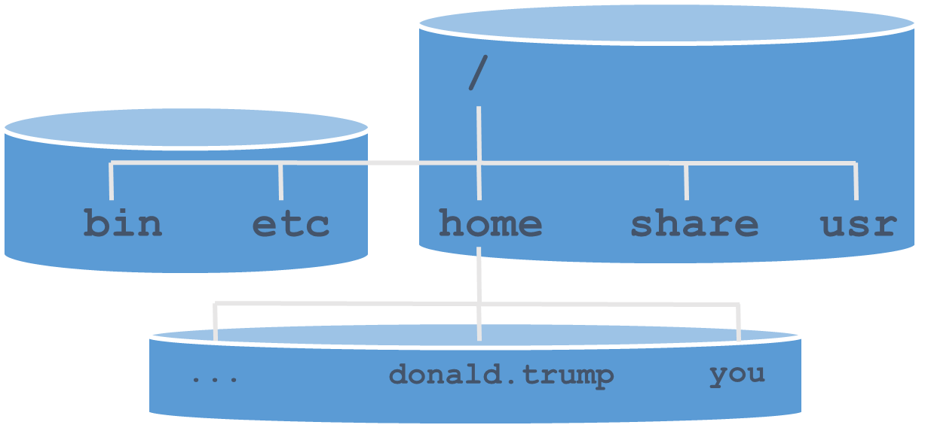
User home directory
The home directories of users normally reside under /home (e.g., /home/donald.trump)
For your own homedir, use ~ ‘~‘ <==> ‘/home/donald.trump’

Slide 7
Changing / displaying the current directory
The pwd (Print Working Directory) command displays the absolute path of the current directory:
The cd (Change Directory) command changes the current directory. Its general form is:
With no parameters, cd changes the current directory to your home directory
pwd
/home/donald.trump/exercises
cd [directory-name]

Slide 8
ls – Listing directory contents
The ls command lists the contents of some directory. Examples:
List the content of current directory
List the contents of directory bin (relative path)
If there exists a file called a.txt (relative path), then list it
Combination of the above
ls
ls bin
ls a.txt
ls a.txt bin

Slide 9
Command demo
pwd # (to see location of homedir)
cd recitations
cd recitation01
pwd
cd .. # (move up)
pwd
cd recitation01

Slide 10
Workout of the day
This class assignment consist of 10 file manipulation tasks for implementation
Each task should be implemented using a single Linux command
Use only relative paths – the only exception is when you access the shared data directory (/share/recitations/recitation01/ in task #2)
Type these commands into a file named commands.t01.txt, which you can execute using the source command

Slide 11
pico
A simple and ubiquitous Unix text editor
A short guide is available on Piazza
You can get a full list of commands by pressing ^G (Control-G)
PC and Mac might behave differently regarding the M (Meta) key:
On PC, this is Alt – press it and the other combo keys simultaneously
On Mac, this is Esc – press and release it and then press the other combo keys
There might be more differences, even between PCs or Macs; be alert; read the documentation, as necessary.

Slide 12
Task 1
Create a subdirectory called dir1 inside the current directory

Slide 13
Task 2
Copy the contents of the directory /share/recitations/recitation01 into the newly created dir1 directory. After your operation, your dir1 directory should contain a file (some_file.txt) and a directory (subdir) that contains two files

Slide 14
Copying directories
cp source_path dest_path
If you wish to copy entire directories, specify the directory paths in source_path, and use recursive mode (option –r or –R)
If source_path contains directory paths and recursive mode is not used, the operation will fail.
Example: cp –r /share/ex_data README.txt ~/exercises/ex1/
Directory /share/ex_data and file README.txt will be copied into directory ~/exercises/ex1/
directory
file
destination directory
Notes:
Best to demonstrate on console
Mention combination of absolute and relative paths

Slide 15
Task 3
Make a copy of the dir1 directory, named dir2

Slide 16
Two modes for cp and mv
cp source_path dest_path
mv source_path dest_path
Mode I: If dest_path is an existing directory then all files and dirs in source_path are copied/moved into directory dest_path with their original names.
Note: source_path may be a list of paths
Mode II: If dest_path is not an existing directory then source_path is copied/moved into the parent directory of dest_path with its name changed.
Note: source_path must be a single path, and dest_path must be a path under an existing directory
Notes:
Go over the two modes and demonstrate on console.
cp file1 file2 newDir # mode 1 (dest_path is a directory)
cp file1 file3 # mode 2 (dest_path does not exist)
cp file1 newDir3/file3 # doesn’t work because newDir is not an existing directory (parent dir)
cp file1 newDir3 # mode 2 (will create file named newDir3)
Can also explain “algorithm”:
Determine parent_path of dest_path (remove the string after last slash in dest_path)
If parent path does not exist, then operation fails
If dest_path exists and is a directory (not file!), then copy/move all items in source_path into that directory with their original name
If dest_path does not exist and source_path is a single item, then copy it into parent dir with dest_path’s name
If dest_path does not exist and source_path contains multiple items, then operation fails
Subtle point: If dest_path exists and is a file (not directory), then operation is successful only if source_path is a single file (not directory).

Slide 17
Task 4
Enter directory dir2

Slide 18
Task 5
Move file myfile from directory subdir to the current directory.

Slide 19
Moving or renaming files/directories
mv source_path dest_path
Command mv simply copies and removes original
No need for recursive mode (–r or –R) when moving directories
File/directory can be renamed by using the same directory and different file name in source_path and dest_path.
Example: mv ~/exercises/ex1/ ~/exercises/ex1-bak/
Directory ex1 in ~/exercises/ is renamed ex1-bak
Notes:
Best to demonstrate on console
Mention combination of absolute and relative paths

Slide 20
Task 6
Change the name of file hello.world in subdir to hello.

Slide 21
Task 7
Add write permission to yourself and your group for all files in the current directory and its subdirectories. Use an alphabetic permission specifier for this.

Slide 22
ls -l – Example
ls -l
-rw------- 1 demo students 317 Oct 19 04:35 backup.tar.gz
drwx------ 2 demo students 4096 Oct 19 04:31 bin
-rwxr----- 1 demo students 35 Oct 19 13:46 create_backup
drwx------ 2 demo students 4096 Oct 19 04:30 my_documents
-rw-r--r-- 1 demo students 17 Oct 19 04:31 phone_list
drwx------ 3 demo students 4096 Oct 19 04:32 solutions
-rwxrw-r-- 2 demo students 4096 Oct 19 04:30 temp
Permissions
User
Group
Size
Date/Time
Name
The –l option is used for printing a detailed account for each file
Notes:
2nd column (after permissions) is the number of “links”. The meaning varies with system and it’s not important. They may ignore this column.
Date also varies. If it is this year (2019), then format will be month-day-time, and if it is from a previous year it will be month-day-year.
You can demonstrate on console with old directories – Sara: ls –l ../../spring2018/classes/class04

Slide 23
File permissions
The permissions to a file have three types:
Read (r) – file contents can be read and displayed
Write (w) – file contents can be changed + file can be moved or deleted
Execute (x) – file can be executed as a program (directories must be executable to be entered into)
Permissions are granted in three layers:
Owner – the user who created the file
Group – users within a specified group containing the owner
Others – all users in the system
drwxrwxrwx
Directory flag
Owner
Group
Other
Notes:
Dir permissions:
Meaning of permissions for directories:
r - listing contents
w - creating and removing files
x - accessing contents; cd-ing into the directory and subdirectories

Slide 24
File permissions – examples
Permissions
User
Group
Size
Date/Time
Name
1)
2)
3)
4)
5)
6)
7)
-rw------- 1 demo students 317 Oct 19 04:35 backup.tar.gz
drwx------ 2 demo students 4096 Oct 19 04:31 bin
-rwxr----- 1 demo students 35 Oct 19 13:46 create_backup
drwxr----- 2 demo students 4096 Oct 19 04:30 my_documents
-rw-r--r-- 1 demo students 17 Oct 19 04:31 phone_list
drwxr-x--- 3 demo students 4096 Oct 19 04:32 solutions
-rwxrw-r-- 2 demo students 4096 Oct 19 04:30 temp
1) File can be read/modified only by owner
2) Directory can be read/modified/entered by owner
3) File can be read/modified/executed by owner + read by group (all users in students)
4) Directory has full access by owner + contents can only be read by group
5) File can be read by anyone + modified only by owner
6) Directory has full access by owner + it can be read and entered by group
7) File can be read by anyone + modified by owner and group + executed by owner
Notes:
Go over a few examples here. #1, #5, #6

Slide 25
chmod – Changing file permissions
The chmod command changes the permissions associated with a file or directory
The format of the mode is:
ugoa user (a.k.a. owner), group, other or all
+- add or remove permission
rwx read, write or execute
chmod [options] mode file...
[ugoa][+-][rwx]
Notes:
Online: ~ 30 minutes before class ends. Give 5 minute break now.

Slide 26
Task 8
Change permissions to file myfile such that all users (you, your group, and others) have read permissions, only you and your group have writing permissions, and only you have executing permissions. Use an octal permission mode for this.

Slide 27
Reminder for numeric representation
Base 10 (decimal):
(84)₁₀ = 8*10¹ + 4*10⁰
Base 2 (binary):
(84)₂ = 1010100 = 1*2⁶ + 0*2⁵ + 1*2⁴ + 0*2³ + 1*2² + 0*2¹ + 0*2⁰
Base 8 (octal):
(84)₈ = 112 = 1*8² + 1*8¹ + 2*8⁰
Base 16 (hexadecimal):
(84)₁₆ = 54 = 5*16¹ + 4*16⁰

Slide 28
File permissions
The permission setting of a given file or directory can be represented by a binary vector of length 9
-rw------- 1 demo students 317 Oct 19 04:35 backup.tar.gz 110000000
drwxr-x--- 3 demo students 4096 Oct 19 04:32 solutions
111101000
We can directly specify the permission of a given file or directory by specifying this binary vector using “octal digits” (base 8)
Each octal digit (0-7) represents 3 binary flags for the r/w/x/ permissions of owner, group, or others.
Example:
Owner
Group
Other
rw-r--r--
110100100
6 4 4
chmod 644 phones
Notes:
New slide to better explain the idea of octal mode for setting permissions

Slide 29
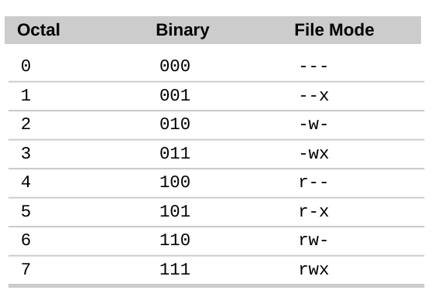
File permissions – examples
binary
octal
-rw------- . . . backup.tar.gz
drwx------ . . . bin
-rwxr----- . . . create_backup
drwxr----- . . . my_documents
-rw-r--r-- . . . phone_list
drwxr-x--- . . . solutions
-rwxrw-r-- . . . temp
110 000 000
111 000 000
111 100 000
111 100 000
110 100 100
111 101 000
111 110 100
600
700
740
740
644
750
764
Notes:
Added examples to illustrate conversion to binary and to octal

Slide 30
chmod – common octal modes
Mode | Meaning
777 | Owner, group and public can read, write and execute file
755 | Owner can read, write and execute file; group and public can read and execute file
644 | Owner can read and write file; group and public can read file
700 | Owner can read, write and execute file; group and public have no access to the file

Slide 31
Task 9
Remove subdirectory subdir from your current directory (dir2)

Slide 32
Task 10
Use echo to add (append) a line containing the text "Hello world" (without the quotes) to myfile (file myfile should contain exactly two lines after this)

Slide 33
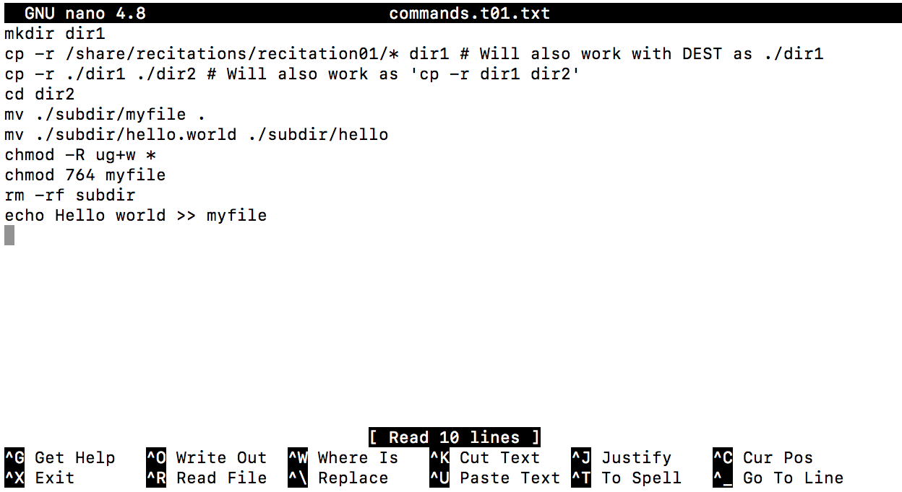
Solution – pico screenshot

