Slide 1
Data structures
Amortized Analysis & Binary Heaps

Slide 2
Amortized analysis
Amortized analysis averages the cost of operations over a sequence, smoothing out rare expensive operations.
Array-Doubling Example:
Best case: O(1) (regular insertion, no resizing)
Worst case: O(n) (resizing array and copying data)
But resizing only occurs rarely (only when the number of elements is a power of 2). Hence, the expensive cost gets “spread out”:
Amortized Cost = O(1)

Slide 3
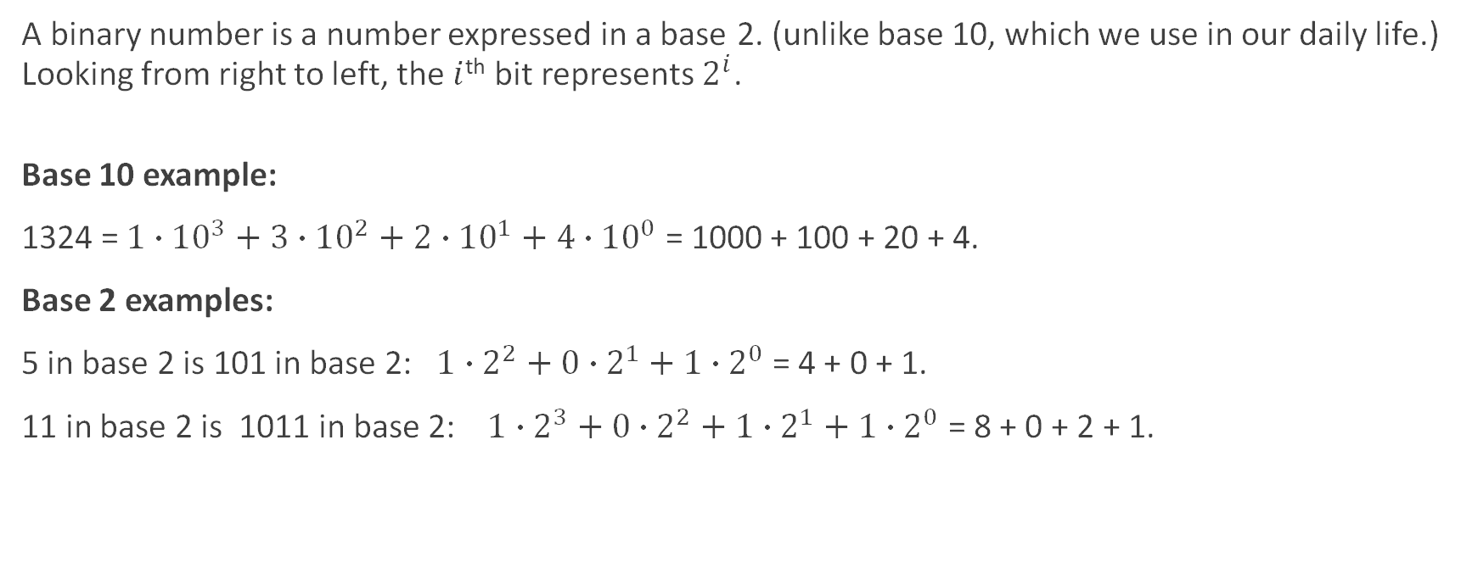
Binary Representation of Integers
A binary number is a number expressed in a base 2. (unlike base 10, which we use in our daily life.) Looking from right to left, the $i$^{th} bit represents $2^{i}$.
Base 10 example:
1324 = $1∙{10}^{3}+3∙{10}^{2}+2∙{10}^{1}+4∙{10}^{0}$ = 1000 + 100 + 20 + 4.
Base 2 examples:
5 in base 2 is 101 in base 2: $1∙2^{2}+0∙2^{1}+1∙2^{0}$ = 4 + 0 + 1.
11 in base 2 is 1011 in base 2: $1∙2^{3}+0∙2^{2}+1∙2^{1}+1∙2^{0}$ = 8 + 0 + 2 + 1.

Slide 4
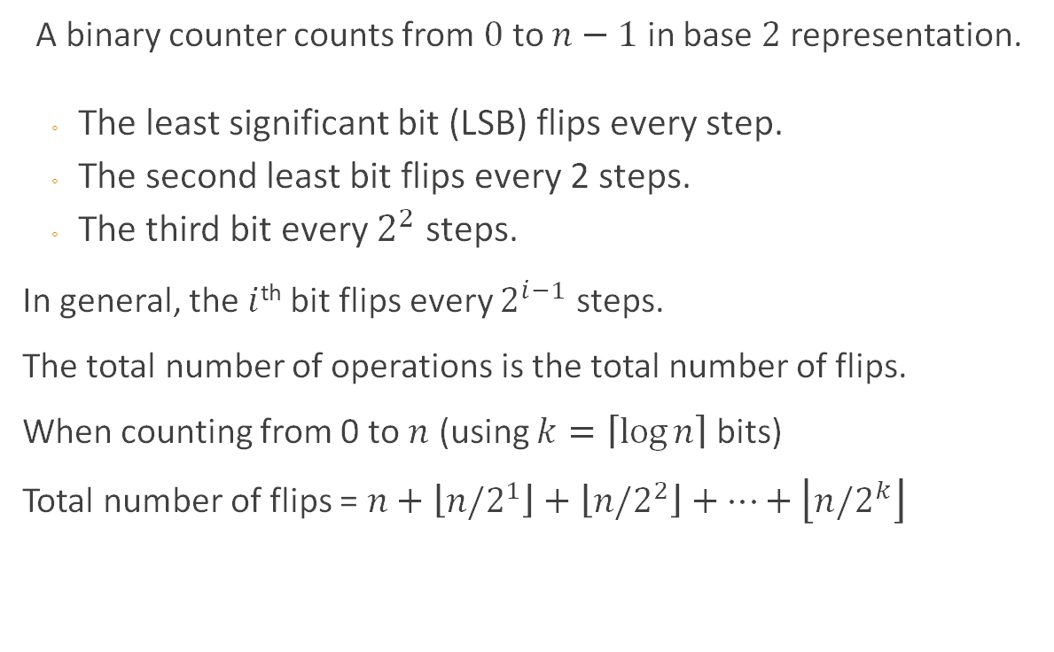
Binary counter
A binary counter counts from $0$ to $n−1$ in base $2$representation.
The least significant bit (LSB) flips every step.
The second least bit flips every 2 steps.
The third bit every $2^{2}$ steps.
In general, the $i$^{th} bit flips every $2^{i−1}$ steps.
The total number of operations is the total number of flips.
When counting from 0 to $n$ (using $k=\left\lceil \log{n}\right\rceil$ bits)
Total number of flips = $n+\left\lfloor n/2^{1}\right\rfloor +\left\lfloor n/2^{2}\right\rfloor +⋯+\left\lfloor n/2^{k}\right\rfloor$
Example: counting from 0 to 7, using array size 3. 0 = [0,0,0] 1 = [0,0,1] 2 = [0,1,0] 3 = [0,1,1] 4 = [1,0,0] 5 = [1,0,1] 6 = [1,1,0] 7 = [1,1,1]

Slide 5
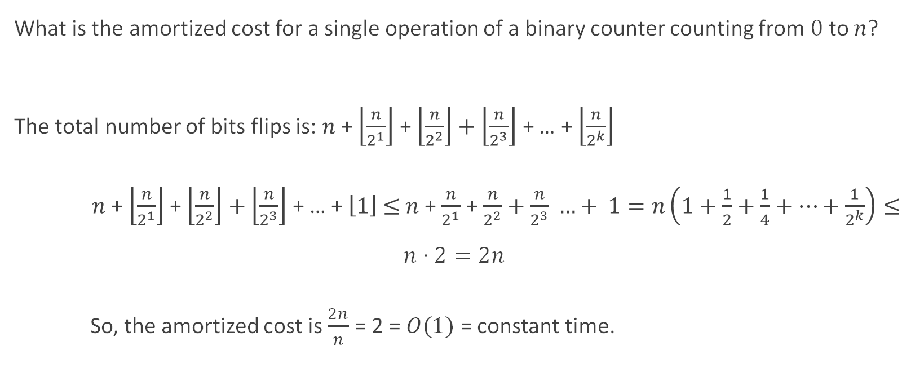
Binary counter – amortized analysis
What is the amortized cost for a single operation of a binary counter counting from $0$ to $n$? The total number of bits flips is: $n$ + $\left\lfloor \frac{n}{2^{1}}\right\rfloor$ + $\left\lfloor \frac{n}{2^{2}}\right\rfloor +\left\lfloor \frac{n}{2^{3}}\right\rfloor$ + … + $\left\lfloor \frac{n}{2^{k}}\right\rfloor$
$n$ + $\left\lfloor \frac{n}{2^{1}}\right\rfloor$ + $\left\lfloor \frac{n}{2^{2}}\right\rfloor +\left\lfloor \frac{n}{2^{3}}\right\rfloor$ + … + $\left\lfloor 1\right\rfloor$ $≤$ $n$+ $\frac{n}{2^{1}}$ + $\frac{n}{2^{2}}+\frac{n}{2^{3}} …+ 1=n\left(1+\frac{1}{2}+\frac{1}{4}+…+\frac{1}{2^{k}}\right)≤n⋅$ $2=2n$
So, the amortized cost is $\frac{2n}{n}$ = 2 = $O(1)$ = constant time.

Slide 6
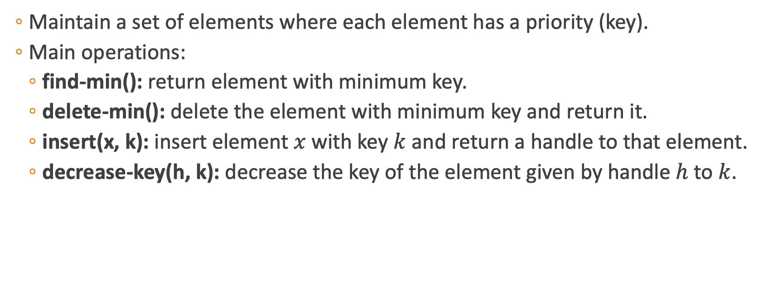
Priority Queue (ADT)
Maintain a set of elements where each element has a priority (key).
Main operations:
find-min(): return element with minimum key.
delete-min(): delete the element with minimum key and return it.
insert(x, k): insert element $x$ with key $k$ and return a handle to that element.
decrease-key(h, k): decrease the key of the element given by handle $h$ to $k$.
Notes:
A priority queue differs from a regular queue in that elements have associated priorities, and we always access the element with the highest priority (or lowest value in a min-priority queue) first, regardless of insertion order.

Slide 7
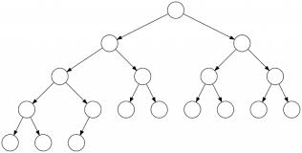
Binary Tree
An ordered tree where each node has at most two children
Such a tree is composed of nodes.
A childless node is called a leaf.
In a complete tree, all leaves are on the same level.
Notes:
we'll now examine Binary Trees, which serve as one of the most efficient implementations for priority queues.
The example shown on the right illustrates a complete binary tree. This structure allows us to implement all priority queue operations efficiently

Slide 8
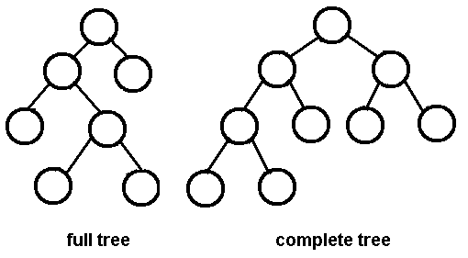
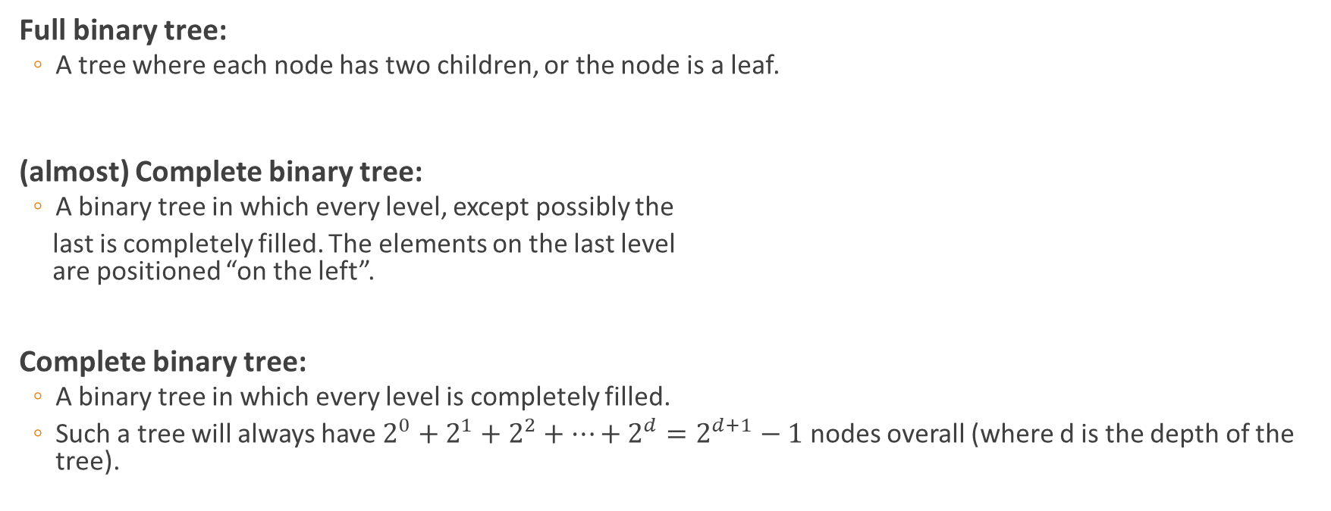
Definitions - Reminder
Full binary tree:
A tree where each node has two children, or the node is a leaf.
(almost) Complete binary tree:
A binary tree in which every level, except possibly the
last is completely filled. The elements on the last level are positioned “on the left”.
Complete binary tree:
A binary tree in which every level is completely filled.
Such a tree will always have $2^{0}+2^{1}+2^{2}+…+2^{d}=2^{d+1}−1$ nodes overall (where d is the depth of the tree).
almost

Slide 9
Binary Heap
A heap is a data structure that supports priority queue operations.
A binary heap is an almost complete binary tree.
All leaves on the lowest level occur “to the left”.
All levels except the lowest one are completely filled.
Notes:
לציין את הגובה

Slide 10
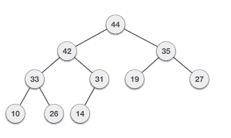
Binary Heap
In addition to being an almost complete binary, nodes in a binary heap satisfy the heap property.
The element at each node is always smaller (or equal) to all its descendants.
In this case, we call the structure a min-heap.
Analogously, we could define a max-heap by requiring that the element at each node be bigger (or equal) than all of its descendants.
We only draw the key associated with each element to simplify the diagrams. Elements can include any data so long as they have a key.
Example: max heap
Notes:
Each element includes both the data and the key. The data always goes with the key. But we are going to ignore the fact that there is data over there for now.

Slide 11

Question 1
Prove: in every almost complete binary tree with $n$ vertices, exactly $\left\lceil \frac{n}{2}\right\rceil$ of the vertices are leaves.
Notes:
In a nearly complete binary tree, approximately half of the vertices end up being leaves because every internal node (non-leaf) typically has exactly two children.

Slide 12
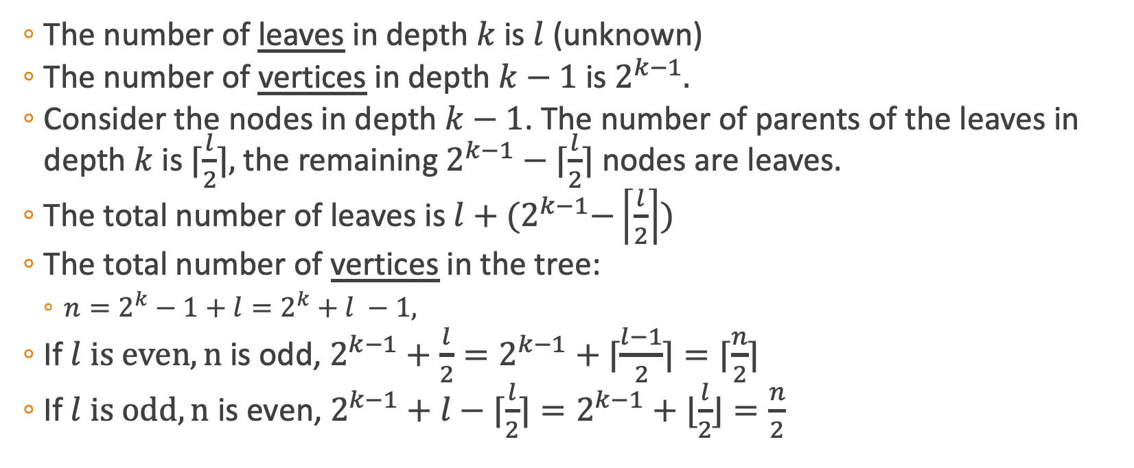


Question 1 – Solution
The number of leaves in depth $k$ is $l$ (unknown)
The number of vertices in depth $k−1$is $2^{k−1}.$
Consider the nodes in depth $k−1$. The number of parents of the leaves in depth $k$ is$⌈\frac{l}{2}⌉,$ the remaining $2^{k−1}−⌈\frac{l}{2}⌉$ nodes are leaves.
The total number of leaves is $l+{(2}^{k−1}−\left\lceil \frac{l}{2}\right\rceil )$
The total number of vertices in the tree:
$n=2^{k}−1+l=2^{k}+l −1,$
If $l is even, n$ is odd, $2^{k−1}+\frac{l}{2}=2^{k−1}+⌈\frac{l−1}{2}⌉=⌈\frac{n}{2}⌉$
If $l is odd, n$ is even, $2^{k−1}+l−⌈\frac{l}{2}⌉=2^{k−1}+⌊\frac{l}{2}⌋=\frac{n}{2}$
# | depth
1 | 0
2 | 1
4 | 2
2^{k-1} | k-1
$$2^{k−1}−⌈\frac{l}{2}⌉$$
$$l$$
Notes:
• A complete binary tree at depth k-1 clearly has exactly:
• (2^k) - 1 vertices (since it has 1 + 2 + 4 + … + 2^{k-1} nodes).
• A almost complete binary tree explicitly means we add some leaves at the next depth (depth k). Clearly, let’s say explicitly that at depth k, we have exactly l leaves.
Thus, explicitly and clearly, the total number of vertices is:
n = ({full tree at depth } k-1) + ({leaves at depth } k) = (2^k - 1) + l

Slide 13
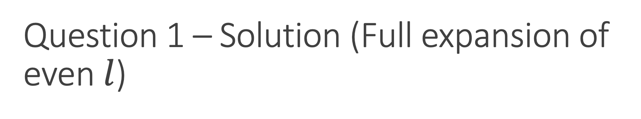
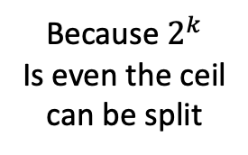
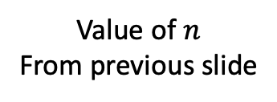
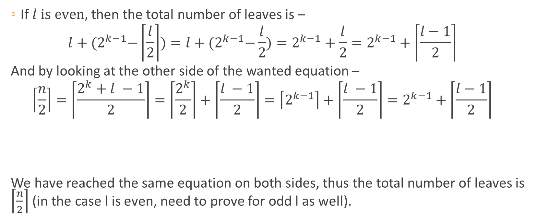
Question 1 – Solution (Full expansion of even $l$)
If $l is even,$then the total number of leaves is –
$$l+{(2}^{k−1}−\left\lceil \frac{l}{2}\right\rceil )=l+{(2}^{k−1}−\frac{l}{2})=2^{k−1}+\frac{l}{2}=2^{k−1}+\left\lceil \frac{l−1}{2}\right\rceil$$
And by looking at the other side of the wanted equation –
$$\left\lceil \frac{n}{2}\right\rceil =\left\lceil \frac{2^{k}+l −1}{2}\right\rceil =\left\lceil \frac{2^{k}}{2}\right\rceil +\left\lceil \frac{l −1}{2}\right\rceil =\left\lceil 2^{k−1}\right\rceil +\left\lceil \frac{l −1}{2}\right\rceil =2^{k−1}+\left\lceil \frac{l−1}{2}\right\rceil$$
We have reached the same equation on both sides, thus the total number of leaves is $\left\lceil \frac{n}{2}\right\rceil$ (in the case l is even, need to prove for odd l as well).
Value of $n$
From previous slide
Because $2^{k}$
Is even the ceil
can be split
Notes:
Full expansion of one of the cases from the previous slide.

Slide 14
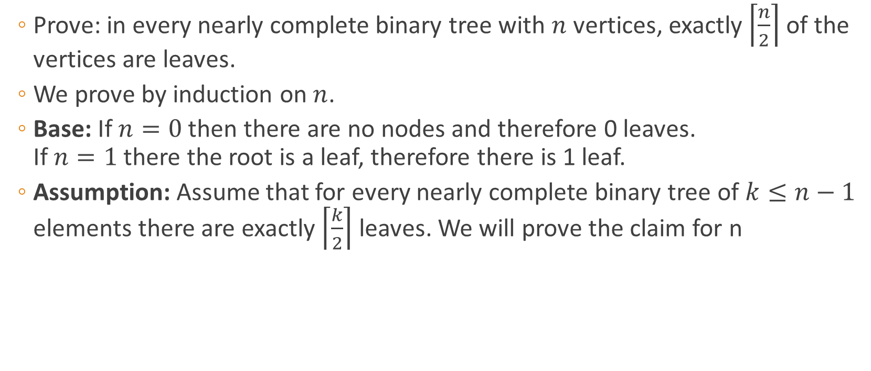
Question 1 – Solution II
Prove: in every nearly complete binary tree with $n$ vertices, exactly $\left\lceil \frac{n}{2}\right\rceil$ of the vertices are leaves.
We prove by induction on $n$.
Base: If $n=0$ then there are no nodes and therefore 0 leaves. If $n=1$ there the root is a leaf, therefore there is 1 leaf.
Assumption: Assume that for every nearly complete binary tree of $k≤n−1$ elements there are exactly $\left\lceil \frac{k}{2}\right\rceil$ leaves. We will prove the claim for n

Slide 15
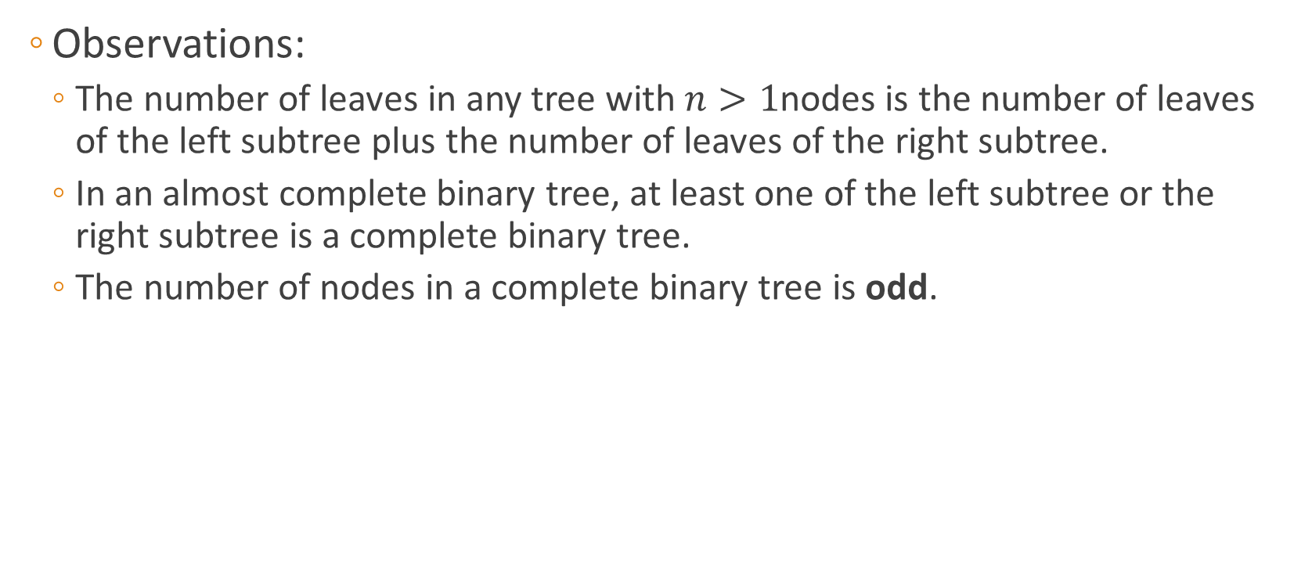
Question 1 – Solution II
Observations:
The number of leaves in any tree with $n>1$nodes is the number of leaves of the left subtree plus the number of leaves of the right subtree.
In an almost complete binary tree, at least one of the left subtree or the right subtree is a complete binary tree.
The number of nodes in a complete binary tree is odd.

Slide 16
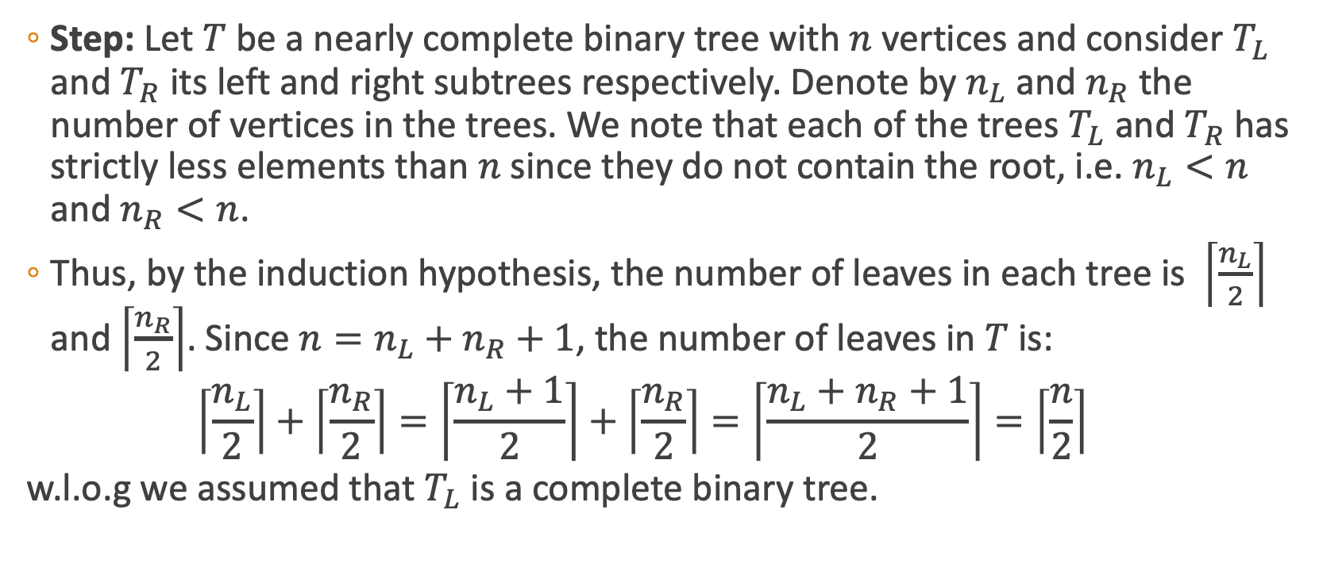
Question 1 – Solution II
Step: Let $T$ be a nearly complete binary tree with $n$ vertices and consider $T_{L}$ and $T_{R}$ its left and right subtrees respectively. Denote by $n_{L}$ and $n_{R}$ the number of vertices in the trees. We note that each of the trees $T_{L}$ and $T_{R}$ has strictly less elements than $n$ since they do not contain the root, i.e. $n_{L}<n$ and $n_{R}<n$.
Thus, by the induction hypothesis, the number of leaves in each tree is $\left\lceil \frac{n_{L}}{2}\right\rceil$ and $\left\lceil \frac{n_{R}}{2}\right\rceil$. Since $n=n_{L}+n_{R}+1$, the number of leaves in $T$ is:
$$\left\lceil \frac{n_{L}}{2}\right\rceil +\left\lceil \frac{n_{R}}{2}\right\rceil =\left\lceil \frac{n_{L}+1}{2}\right\rceil +\left\lceil \frac{n_{R}}{2}\right\rceil =\left\lceil \frac{n_{L}+n_{R}+1}{2}\right\rceil =\left\lceil \frac{n}{2}\right\rceil$$
w.l.o.g we assumed that $T_{L}$ is a complete binary tree.

Slide 17
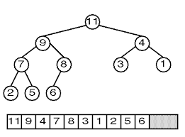
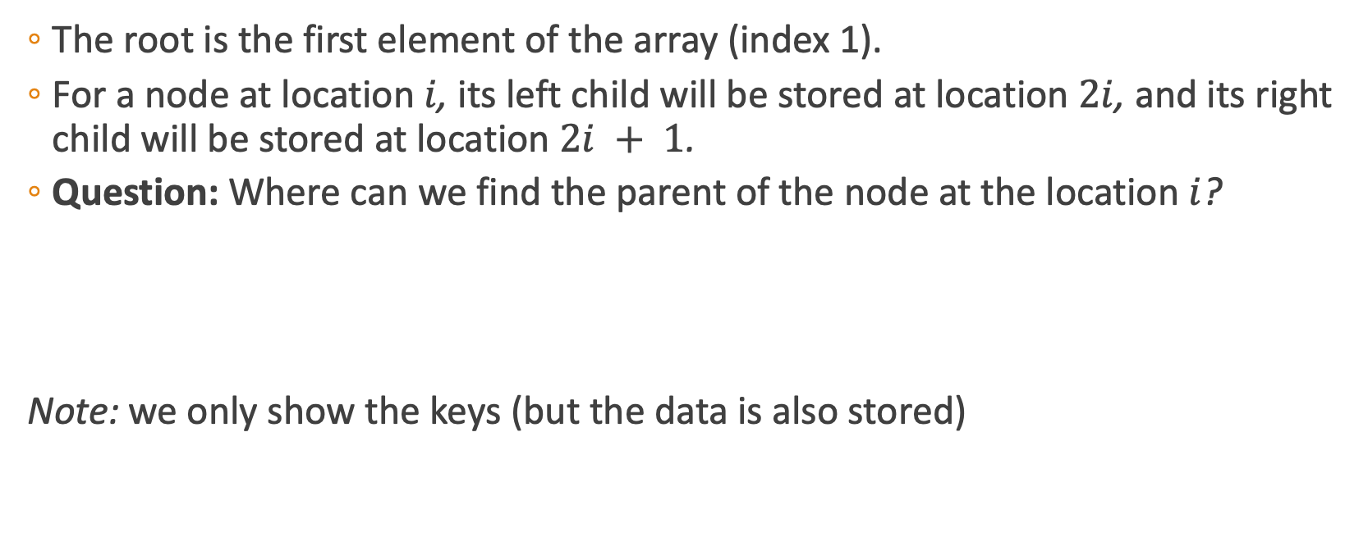
Heap – Array Implementation
The root is the first element of the array (index 1).
For a node at location $i$, its left child will be stored at location $2i$, and its right child will be stored at location $2i + 1$.
Question: Where can we find the parent of the node at the location $i$?
Note: we only show the keys (but the data is also stored)
Notes:
Solution
In a binary heap implemented as an array:
• The left child of a node at index i is at 2i.
• The right child of a node at index i is at 2i + 1.
This implies that the parent of a node must be at an index that, when multiplied by 2, can produce the child's index i (for the left child) or i - 1 (for the right child). Mathematically:
• If i = 2p (where p is the parent's index), then the node at p is the parent of the left child at 2p.
• If i = 2p + 1, then the node at p is the parent of the right child at 2p + 1.
To generalize, the parent of a node at index i can be found by taking the integer division of i by 2,
which is floor(i/2).
This works because:
• For a left child at 2p, floor(2p/2) = p.
• For a right child at 2p + 1, floor((2p + 1) / 2) = p (since the division truncates the remainder).

Slide 18
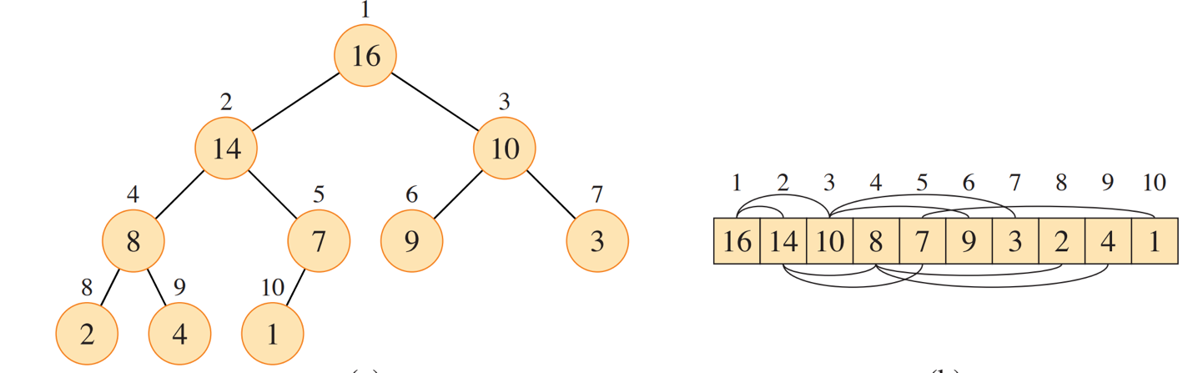
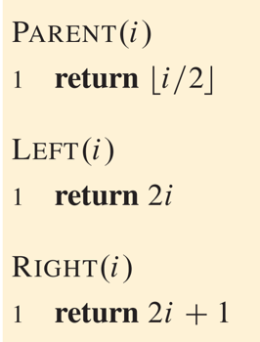
Max heap implementation
An almost complete binary tree + an array
Notes:
Notice how the tree visualization shows the max heap property in action - the root value 16 is the maximum, and each parent is greater than its children throughout the structure.
The array implementation on the right directly corresponds to the tree structure on the left. The index positions (1-10) at the top of the array show where each element is stored.
At the bottom of the slide, we have the three fundamental navigational functions for our heap:
Parent(i) returns ⌊i/2⌋ - the index of node i's parent
Left(i) returns 2i - the index of node i's left child
Right(i) returns 2i+1 - the index of node i's right child
This implementation is described as an 'almost complete binary tree' because while the tree is filled at all levels except possibly the bottom level, which is filled from left to right. This property ensures the heap remains balanced, which gives us O(log n) time complexity for key operations.

Slide 19
Percolate up and down
Two important operations on a heap are:
Percolate up – Move a node up the tree, as long as needed, until it reaches a valid location (where the node satisfies the max—heap property)
Percolate down – Move a node down the tree, as long as needed, until it reaches a valid location.
Both methods visit at most one node in each level of the tree.
PercolateDown(i): [for a max-heap]
while(A[i] is smaller than one of its children)
j ← index of maximal child
switch A[i] and A[j]
i ← j
PercolateUp(i): [for a max-heap]
while(A[i] is bigger than its parent)
j ← index of parent
switch A[i] and A[j]
i ← j
Notes:
Pseudocode Improvement Suggestion: For PercolateDown(i), add: if (2i > n) break; (where n is the heap size) to handle leaves.
For PercolateUp(i), add: if (i ≤ 1) break; to handle the root.

Slide 20
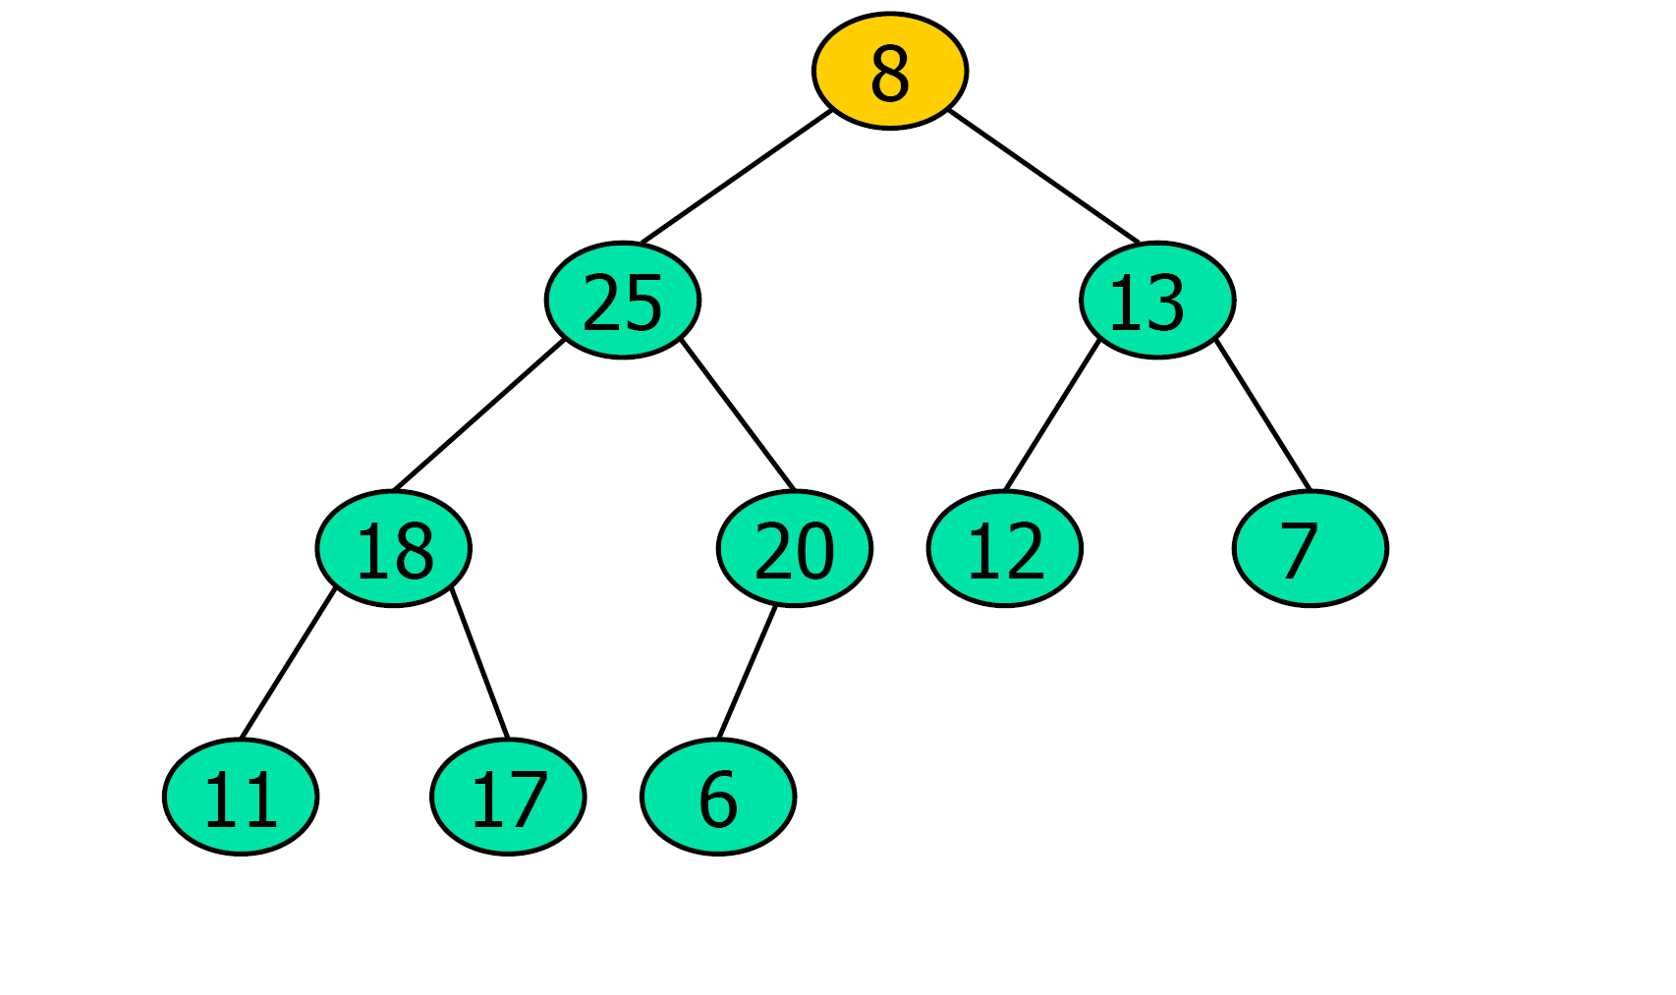
Percolate down
How will the tree look after percolating down the root?
PercolateDown(i):
while(A[i] is smaller than one of its children)
j ← index of maximal child
switch A[i] and A[j]
i ← j
Notes:
Starting with the root (i = 1):
Compare A[1] = 8 with its children:
Left child A[2] = 25
Right child A[3] = 13
The maximal child is 25 at index j = 2
Since 8 < 25, swap A[1] and A[2]:
A[1] = 25
A[2] = 8
Set i = 2
Now we're at position i = 2 with value 8, compare with its children:
Left child A[4] = 18
Right child A[5] = 20
The maximal child is 20 at index j = 5
Since 8 < 20, swap A[2] and A[5]:
A[2] = 20
A[5] = 8
Set i = 5
Now we're at position i = 5 with value 8, compare with its children:
Left child A[10] = 6 (if it exists)
No right child
The maximal child is 6 at index j = 10
Since 8 > 6, no swap is needed. The algorithm terminates.
The final max heap after percolating down will have:
25 at the root
20 and 13 as the children of the root
18, 8, 12, and 7 at the next level
11, 17, and 6 at the bottom level
The tree structure maintains the max heap property with each parent being greater than or equal to its children.

Slide 21
Common operations (max heap)
find-max():
Return the value of the root.
Runs in time O(1).
delete-max():
Delete the element with the maximum key and return it.
Put the last element in place of the root.
Percolate down the root.
insert(x, k):
Insert element x with key k as the last element.
Percolate up the last element.

Slide 22
Add an Element - Example
What will the heap look like after adding 43?
44
42
35
33
31
19
27
10
26
14

Slide 23
Add an Element - Example
What will the heap look like after adding 43?
44
42
35
33
31
19
27
10
26
14
43

Slide 24
Add an Element - Example
What will the heap look like after adding 43?
44
42
35
33
43
19
27
10
26
14
31

Slide 25
Add an Element - Example
What will the heap look like after adding 43?
👍
44
43
35
33
42
19
27
10
26
14
31

Slide 26
Extract Maximum - Example
What will the heap look like after extracting the maximum, twice?
44
42
35
33
31
19
27
10
26
14

Slide 27
Extract Maximum - Example
What will the heap look like after extracting the maximum, twice?
Copy max element:
44
44
42
35
33
31
19
27
10
26
14

Slide 28
Extract Maximum - Example
What will the heap look like after extracting the maximum, twice?
Copy max element:
44
44
42
35
33
31
19
27
10
26
14

Slide 29
Extract Maximum - Example
What will the heap look like after extracting the maximum, twice?
Copy max element:
44
14
42
35
33
31
19
27
10
26

Slide 30
Extract Maximum - Example
What will the heap look like after extracting the maximum, twice?
Copy max element:
44
?
14
?
42
35
33
31
19
27
10
26

Slide 31
Extract Maximum - Example
What will the heap look like after extracting the maximum, twice?
Copy max element:
44
?
14
?
Always choose the bigger child
42
35
33
31
19
27
10
26

Slide 32
Extract Maximum - Example
What will the heap look like after extracting the maximum, twice?
Copy max element:
44
42
Always choose the bigger child
14
35
33
31
19
27
10
26

Slide 33
Extract Maximum - Example
What will the heap look like after extracting the maximum, twice?
Copy max element:
44
42
Always choose the bigger child
33
35
14
31
19
27
10
26

Slide 34
Extract Maximum - Example
What will the heap look like after extracting the maximum, twice?
Copy max element:
44
42
Always choose the bigger child
33
35
26
31
19
27
10
14
👍

Slide 35
Extract Maximum - Example
What will the heap look like after extracting the maximum, twice?
Copy max element:
44
42
33
35
26
31
19
27
10
14

Slide 36
Extract Maximum - Example
What will the heap look like after extracting the maximum, twice?
Copy max element:
44
42
14
33
35
26
31
19
27
10

Slide 37
Extract Maximum - Example
What will the heap look like after extracting the maximum, twice?
Copy max element:
44
42
35
33
14
26
31
19
27
10

Slide 38
Extract Maximum - Example
What will the heap look like after extracting the maximum, twice?
Copy max element:
44
42
35
33
27
26
31
19
14
👍
10

Slide 39

Common operations
BuildHeap (arr):
Create a heap out of a given array of elements.
$n$ ← length(arr)
For $i$ ← $n/2$ to 1:
percolate down the element at location $i$

Slide 40
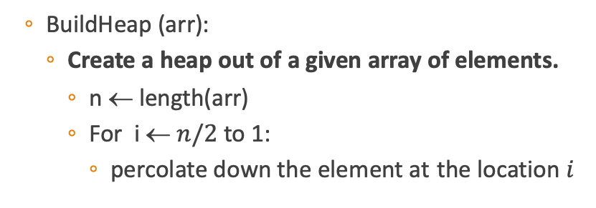
BuildHeap - Example
1 2 3 4 5 6
35 | 31 | 19 | 26 | 44 | 10
BuildHeap (arr):
Create a heap out of a given array of elements.
n ← length(arr)
For i ← $n/2$ to 1:
percolate down the element at the location $i$
35
31
19
26
44
10

Slide 41
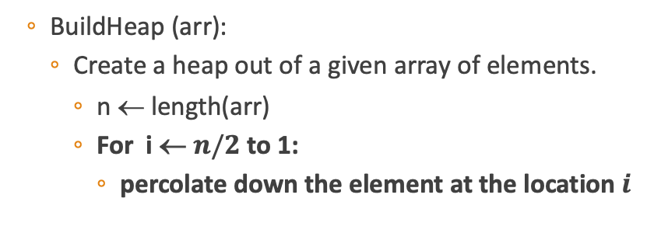
BuildHeap - Example
1 2 3 4 5 6
35 | 31 | 19 | 26 | 44 | 10
BuildHeap (arr):
Create a heap out of a given array of elements.
n ← length(arr)
For i ← $n/2$ to 1:
percolate down the element at the location $i$
35
31
19
26
44
10
Notes:
Step 1: i = 3 (element 19)
Percolate down the element at index 3:
Compare 19 with its only child at index 6: 10
Since 19 > 10, no swap needed
Current array: [35, 31, 19, 26, 44, 10]

Slide 42
BuildHeap - Example
1 2 3 4 5 6
35 | 31 | 19 | 26 | 44 | 10
BuildHeap (arr):
Create a heap out of a given array of elements.
n ← length(arr)
For i ← $n/2$ to 1:
percolate down the element at the location $i$
35
31
19
26
44
10
Notes:
Step 2: i = 2 (element 31)
Percolate down the element at index 2:
Compare 31 with its children at indices 4 and 5: 26 and 44
The maximal child is 44 at index 5
Since 31 < 44, swap them
After swap: [35, 44, 19, 26, 31, 10]

Slide 43
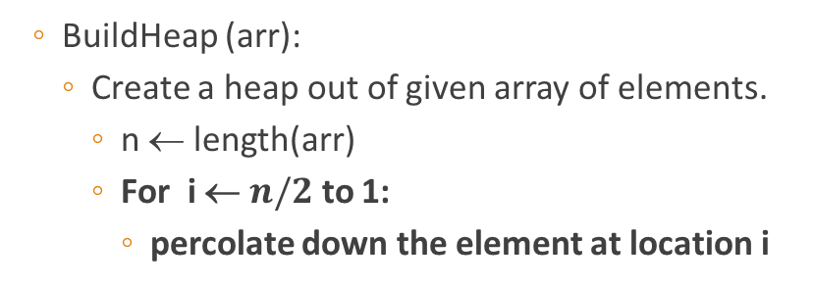
BuildHeap - Example
1 2 3 4 5 6
35 | 44 | 19 | 26 | 31 | 10
BuildHeap (arr):
Create a heap out of given array of elements.
n ← length(arr)
For i ← $n/2$ to 1:
percolate down the element at location i
35
44
19
26
31
10

Slide 44
BuildHeap - Example
1 2 3 4 5 6
35 | 44 | 19 | 26 | 31 | 10
BuildHeap (arr):
Create a heap out of given array of elements.
n ← length(arr)
For i ← $n/2$ to 1:
percolate down the element at location i
35
44
19
26
31
10
Notes:
Step 3: i = 1 (element 35)
Percolate down the element at index 1:
Compare 35 with its children at indices 2 and 3: 44 and 19
The maximal child is 44 at index 2
Since 35 < 44, swap them
After swap: [44, 35, 19, 26, 31, 10]
Continue percolation at index 2 (35):
Compare 35 with its children at indices 4 and 5: 26 and 31
The maximal child is 31 at index 5
Since 35 > 31, no further swaps needed
Final array: [44, 35, 19, 26, 31, 10]

Slide 45
BuildHeap - Example
1 2 3 4 5 6
44 | 35 | 19 | 26 | 31 | 10
BuildHeap (arr):
Create a heap out of given array of elements.
n ← length(arr)
For i ← $n/2$ to 1:
percolate down the element at location i
44
35
19
26
31
10

Slide 46
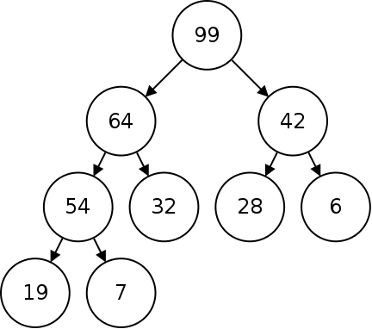
Question 2.1
Finding the value of the maximal element in the heap is trivial.
How can we find the value of the second largest element?

Slide 47
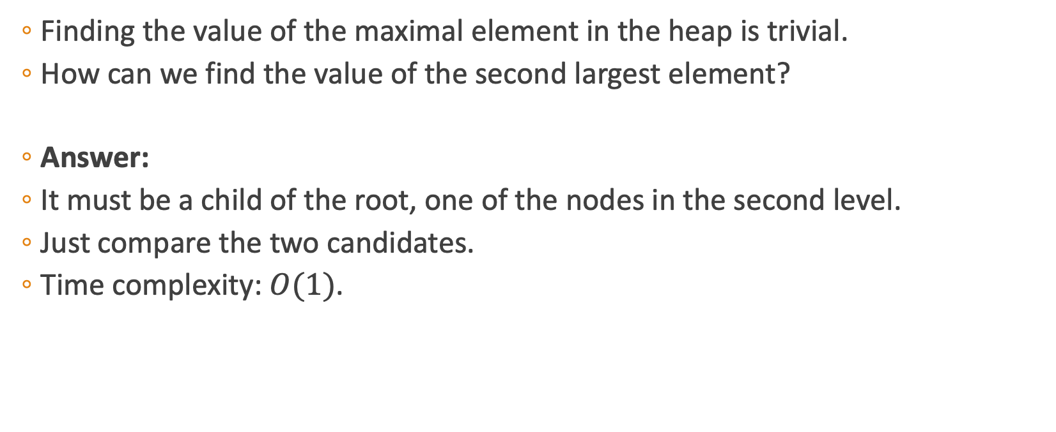
Question 2.1
Finding the value of the maximal element in the heap is trivial.
How can we find the value of the second largest element?
Answer:
It must be a child of the root, one of the nodes in the second level.
Just compare the two candidates.
Time complexity: $O(1)$.

Slide 48
Question 2.2
How about the third largest?

Slide 49
Question 2.2
How about the third largest?
This time it could either be in the second level, but also on the third level.
Answer:
The third largest element is either a child of the largest element (not counting the second largest element) or a child of the second largest element.
Just compare the three candidates.
Time complexity: O(1).

Slide 50

Question 2.3
Given $1≤k≤n$find the value of the $k$-th largest element.

Slide 51
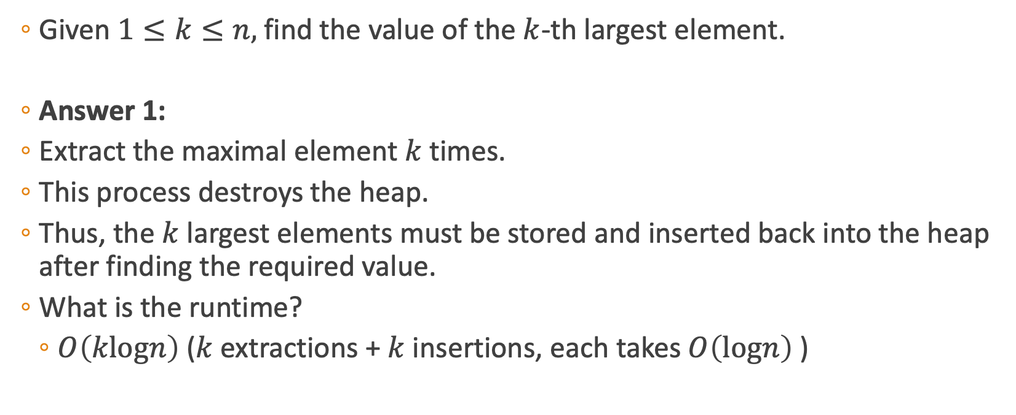
Question 2.3
Given $1≤k≤n,$find the value of the $k$-th largest element.
Answer 1:
Extract the maximal element $k$ times.
This process destroys the heap.
Thus, the $k$ largest elements must be stored and inserted back into the heap after finding the required value.
What is the runtime?
$O\left(klogn\right)$($k$ extractions + $k$ insertions, each takes $O\left(logn\right)$ )
Notes:
O(klogn)

Slide 52
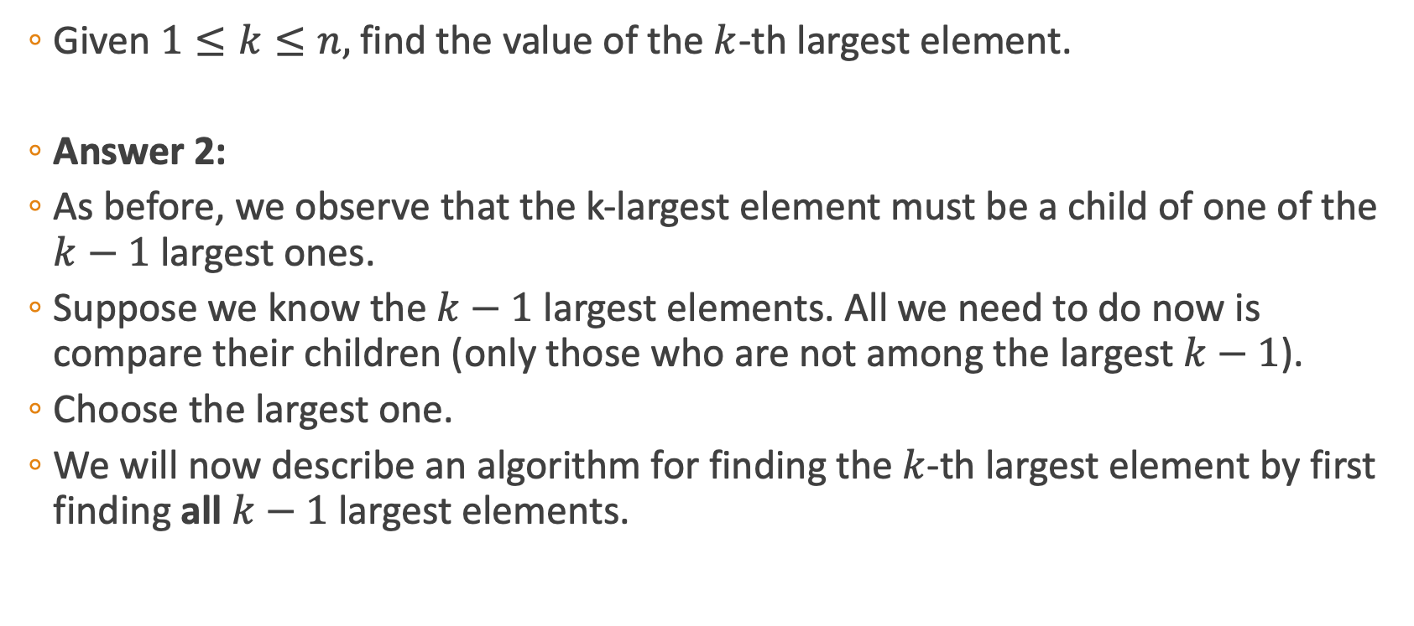
Question 2.3
Given $1≤k≤n,$find the value of the $k$-th largest element.
Answer 2:
As before, we observe that the k-largest element must be a child of one of the $k−1$ largest ones.
Suppose we know the $k−1$ largest elements. All we need to do now is compare their children (only those who are not among the largest $k−1$).
Choose the largest one.
We will now describe an algorithm for finding the$k$-th largest element by first finding all $k−1$ largest elements.

Slide 53
Solution 2
Child collection
44
42
35
33
31
19
27
10
26
14

Slide 54
Solution 2
Child collection
Create a list of pointers to the heap
44
42
35
33
31
19
27
10
26
14

Slide 55
Solution 2
Child collection
Create a list of pointers to the heap
0
1
44
2
42
35
3
4
5
6
33
31
19
27
7
8
9
10
26
14

Slide 56
Solution 2
Child collection
Create a list of pointers to the heap
0
1
44
2
42
35
3
4
5
6
33
31
19
27
7
8
9
10
26
14
Children of i: 2i+1, 2i+2

Slide 57
Solution 2
Child collection
Create a list of pointers to the heap
Step 1: initiate the collection with a pointer to the root
0
0
That’s the child collection
1
44
2
42
35
3
4
5
6
33
31
19
27
7
8
9
10
26
14
Children of i: 2i+1, 2i+2

Slide 58
Solution 2
Child collection
Create a list of pointers to the heap
Step 1: initiate the collection with a pointer to the root
Step 2: repeat k-1 times:
0
0
1
44
2
42
35
3
4
5
6
33
31
19
27
7
8
9
10
26
14
Children of i: 2i+1, 2i+2

Slide 59
Solution 2
Child collection
Create a list of pointers to the heap
Step 1: initiate the collection with a pointer to the root
Step 2: repeat k-1 times:
Find the pointer to the biggest element
0
0
1
44
2
42
35
3
4
5
6
33
31
19
27
7
8
9
10
26
14
Children of i: 2i+1, 2i+2

Slide 60
Solution 2
Child collection
Create a list of pointers to the heap
Step 1: initiate the collection with a pointer to the root
Step 2: repeat k-1 times:
Find the pointer to the biggest element
Remove pointer from collection
0
0
1
44
2
42
35
3
4
5
6
33
31
19
27
7
8
9
10
26
14
Children of i: 2i+1, 2i+2

Slide 61
Solution 2
Child collection
Create a list of pointers to the heap
Step 1: initiate the collection with a pointer to the root
Step 2: repeat k-1 times:
Find the pointer to the biggest element
Remove pointer from collection
Add its children
0
0
1
44
2
42
35
3
4
5
6
33
31
19
27
7
8
9
10
26
14
Children of i: 2i+1, 2i+2

Slide 62
Solution 2
Child collection
Create a list of pointers to the heap
Step 1: initiate the collection with a pointer to the root
Step 2: repeat k-1 times:
Find the pointer to the biggest element
Remove pointer from collection
Add its children
0
0
1
44
2
42
35
3
4
5
6
33
31
19
27
7
8
9
10
26
14
Children of i: 2i+1, 2i+2

Slide 63
Solution 2
Child collection
Create a list of pointers to the heap
Step 1: initiate the collection with a pointer to the root
Step 2: repeat k-1 times:
Find the pointer to the biggest element
Remove pointer from collection
Add its children
0
1
44
2
42
35
3
4
5
6
33
31
19
27
7
8
9
10
26
14
Children of i: 2i+1, 2i+2

Slide 64
Solution 2
Child collection
Create a list of pointers to the heap
Step 1: initiate the collection with a pointer to the root
Step 2: repeat k-1 times:
Find the pointer to the biggest element
Remove pointer from collection
Add its children
0
1
2
1
44
2
42
35
3
4
5
6
33
31
19
27
7
8
9
10
26
14
Children of i: 2i+1, 2i+2

Slide 65
Solution 2
Child collection
Create a list of pointers to the heap
Step 1: initiate the collection with a pointer to the root
Step 2: repeat k-1 times:
Find the pointer to the biggest element
Remove pointer from collection
Add its children
0
1
2
1
44
2
42
35
3
4
5
6
33
31
19
27
7
8
9
10
26
14
Children of i: 2i+1, 2i+2

Slide 66
Solution 2
Child collection
Create a list of pointers to the heap
Step 1: initiate the collection with a pointer to the root
Step 2: repeat k-1 times:
Find the pointer to the biggest element
Remove pointer from collection
Add its children
0
2
1
44
2
42
35
3
4
5
6
33
31
19
27
7
8
9
10
26
14
Children of i: 2i+1, 2i+2

Slide 67
Solution 2
Child collection
Create a list of pointers to the heap
Step 1: initiate the collection with a pointer to the root
Step 2: repeat k-1 times:
Find the pointer to the biggest element
Remove pointer from collection
Add its children
0
3
2
4
1
44
2
42
35
3
4
5
6
33
31
19
27
7
8
9
10
26
14
Children of i: 2i+1, 2i+2

Slide 68
Solution 2
Child collection
Create a list of pointers to the heap
Step 1: initiate the collection with a pointer to the root
Step 2: repeat k-1 times:
Find the pointer to the biggest element
Remove pointer from collection
Add its children
0
3
2
4
1
44
2
42
35
3
4
5
6
33
31
19
27
7
8
9
10
26
14
Children of i: 2i+1, 2i+2

Slide 69
Solution 2
Child collection
Create a list of pointers to the heap
Step 1: initiate the collection with a pointer to the root
Step 2: repeat k-1 times:
Find the pointer to the biggest element
Remove pointer from collection
Add its children
0
3
4
1
44
2
42
35
3
4
5
6
33
31
19
27
7
8
9
10
26
14
Children of i: 2i+1, 2i+2

Slide 70
Solution 2
Child collection
Create a list of pointers to the heap
Step 1: initiate the collection with a pointer to the root
Step 2: repeat k-1 times:
Find the pointer to the biggest element
Remove pointer from collection
Add its children
0
3
5
4
6
1
44
2
42
35
3
4
5
6
33
31
19
27
7
8
9
10
26
14
Children of i: 2i+1, 2i+2

Slide 71
Solution 2
Child collection
Create a list of pointers to the heap
Step 1: initiate the collection with a pointer to the root
Step 2: repeat k-1 times:
Find the pointer to the biggest element
Remove pointer from collection
Add its children
Step 3: return max(collection)
0
3
5
4
6
1
44
2
42
35
3
4
5
6
33
31
19
27
7
8
9
10
26
14
Children of i: 2i+1, 2i+2

Slide 72
Solution 2
Child collection
Create a list of pointers to the heap
Step 1: initiate the collection with a pointer to the root
Step 2: repeat k-1 times:
Find the pointer to the biggest element
Remove pointer from collection
Add its children
Step 3: return max(collection)
Complexity?
0
3
5
4
6
1
44
2
42
35
3
4
5
6
33
31
19
27
7
8
9
10
26
14
Children of i: 2i+1, 2i+2

Slide 73
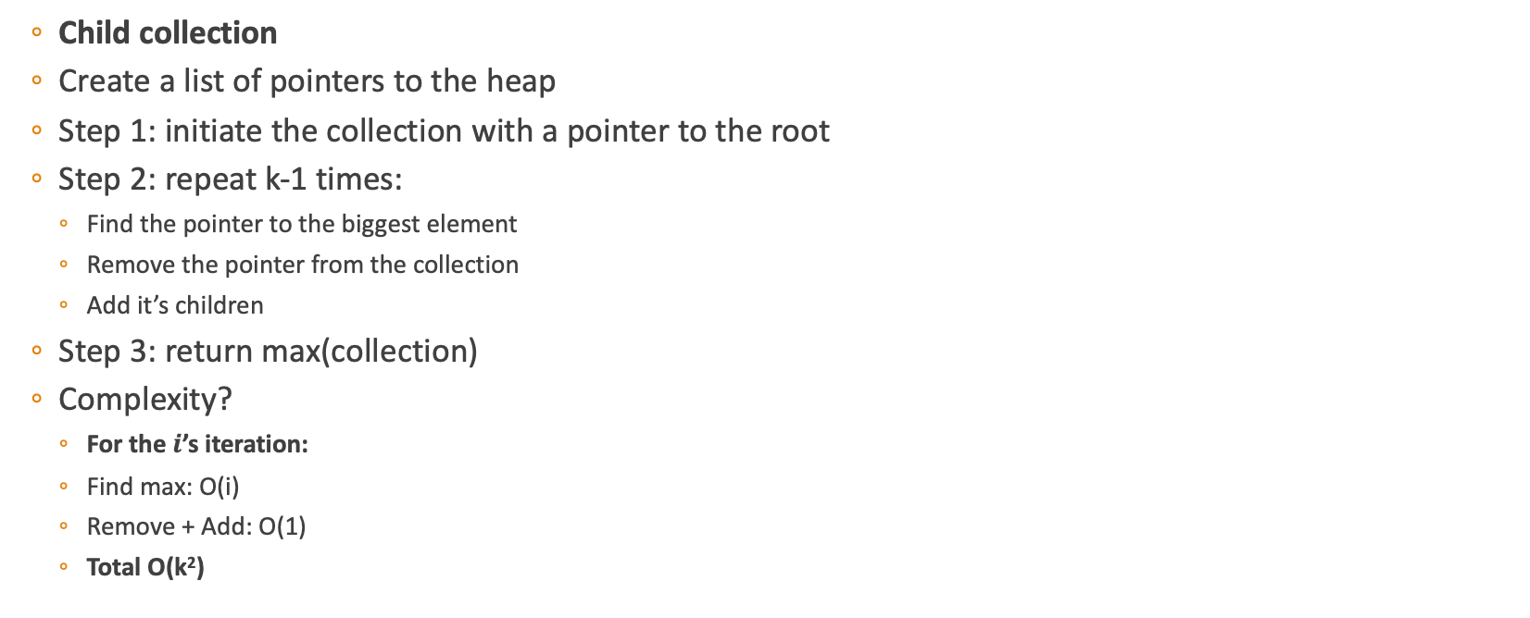
Solution 2
Child collection
Create a list of pointers to the heap
Step 1: initiate the collection with a pointer to the root
Step 2: repeat k-1 times:
Find the pointer to the biggest element
Remove the pointer from the collection
Add it’s children
Step 3: return max(collection)
Complexity?
For the $i$’s iteration:
Find max: O(i)
Remove + Add: O(1)
Total O(k²)
0
3
5
4
6
1
44
2
42
35
3
4
5
6
33
31
19
27
7
8
9
10
26
14
Children of i: 2i+1, 2i+2
Notes:
Space requirements:
We need to store at most k pointers in the collection (initially 1, then we remove 1 and add at most 2 in each iteration)
In the worst case, the collection contains O(k) elements
Finding the maximum in the collection:
Without any special data structure, finding the maximum would take O(k) time
Overall time complexity:
⁠Why O(i)? Because in the i-th iteration the max number of elements is i
So, why O(k^2)? ⁠Each iteration takes O(i), so \sum_{i=1}^{k-1} O(i) = O(k^2} (arithmetic sequence)

Slide 74
Question 2.3 – Answer 2 Implementation
FindAllKLargestElements(k):
Initialize array
put root in array
for i←2 to k:
max ← maximum among all children of nodes in array which are not already in array
add max to array
return array
Point to consider: Suppose we’ve implemented the heap as an array.
How can we check efficiently if a node is already in the array?
Notes:
Additional Boolean array – True for every element that is in the maximum array

Slide 75
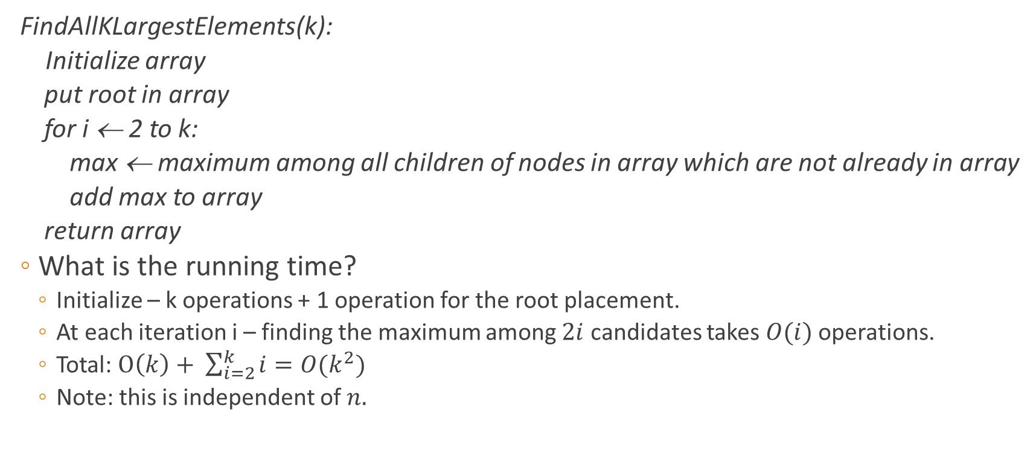
Question 2.3 – Time Complexity Analysis
FindAllKLargestElements(k):
Initialize array
put root in array
for i ← 2 to k:
max ← maximum among all children of nodes in array which are not already in array
add max to array
return array
What is the running time?
Initialize – k operations + 1 operation for the root placement.
At each iteration i – finding the maximum among $2i$ candidates takes $O(i)$ operations.
Total: $O\left(k\right)+ \sum_{i=2}^{k}{i}=O(k^{2})$
Note: this is independent of $n.$

Slide 76
Question 2.3 – Improvement of the solution
Can we improve on the construction above?

Slide 77
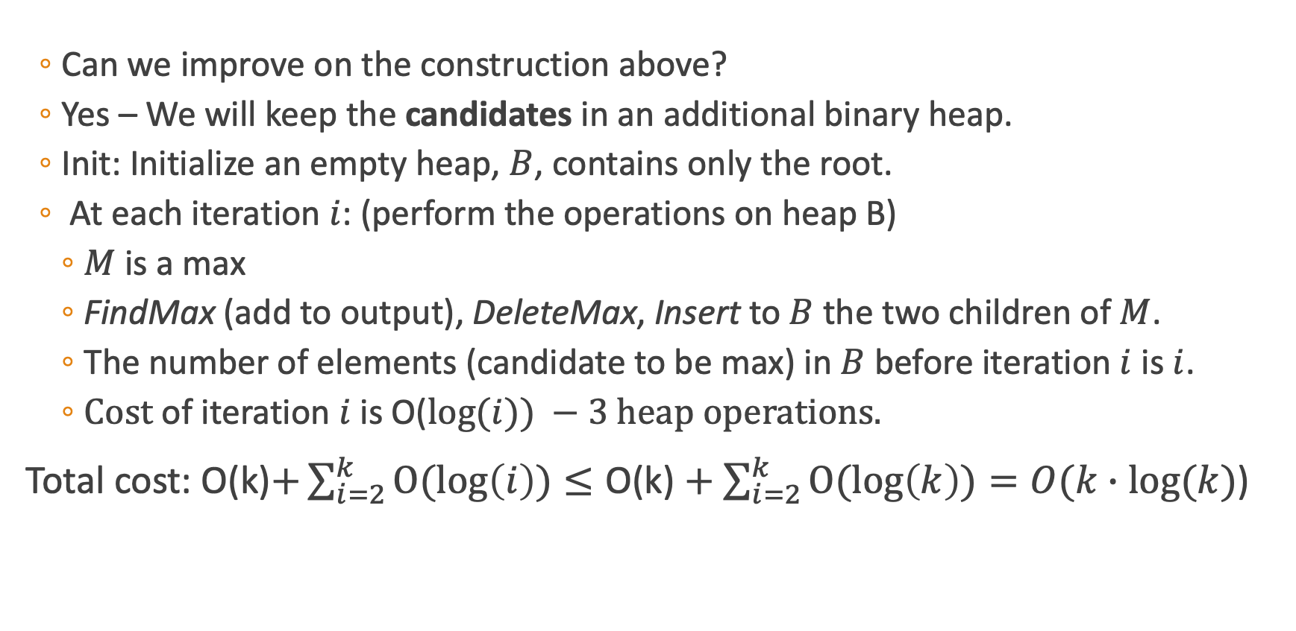
Question 2.3 - Improvement of the solution
Can we improve on the construction above?
Yes – We will keep the candidates in an additional binary heap.
Init: Initialize an empty heap, $B$, contains only the root.
At each iteration $i$: (perform the operations on heap B)
$M$ is a max
FindMax (add to output), DeleteMax, Insert to $B$ the two children of $M$.
The number of elements (candidate to be max) in $B$ before iteration $i$ is $i$.
$Cost$ of iteration $i$ is O($log⁡(i)) −3 heap operations.$
Total cost: O(k)$+\sum_{i=2}^{k}{O(\log\left(i\right))}≤\text{O}\text{(}\text{k}\text{)}+\sum_{i=2}^{k}{O(log\left(k\right))}=O(k∙log(k)$)

Slide 78
Queue (ADT) - Reminder
Linear order: insert at one end of List, remove at the other end.
Queues are “FIFO” – first in, first out.
A queue ensures “fairness”.
Two main operations:
Enqueue, which adds an element to the one end of List, and
Dequeue, which removes the element at the other end.

Slide 79
Stack (ADT) - Reminder
Linear order: the push and pop operations occur only at one end of List.
Stacks are “LIFO” – last in, first out.
Two main operations:
Push, which adds an element to the List, and
Pop, which removes the most recently added element that was not yet removed.

Slide 80
Question 3- If time permits
Suggest a way to implement a queue using two stacks.
You may only use the basic stack operations.
Try to keep runtime to a minimum.

Slide 81
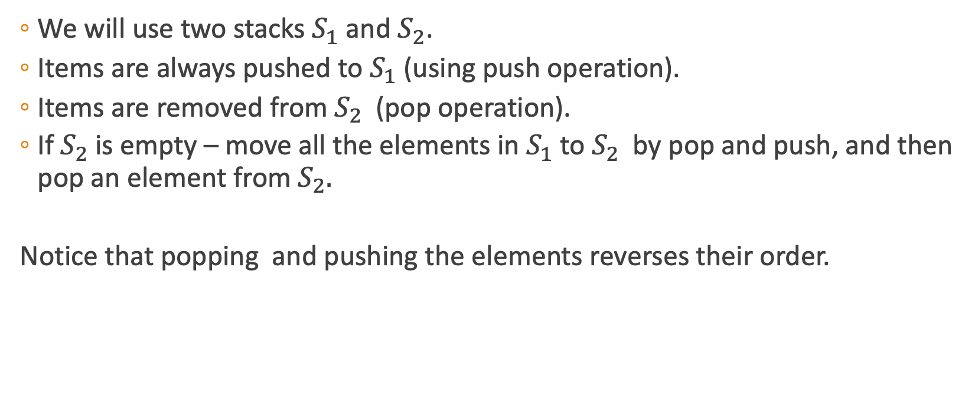
Question 3 - Solution
We will use two stacks $S_{1}$ and $S_{2}$.
Items are always pushed to $S_{1}$ (using push operation).
Items are removed from $S_{2}$ (pop operation).
If${ S}_{2}$ is empty – move all the elements in $S_{1}$ to $S_{2}$by pop and push, and then pop an element from $S_{2}.$
Notice that popping and pushing the elements reverses their order.

Slide 82


Example
Enqueue(5)
Enqueue(2)
Enqueue(3)
After performing the above three enqueue operations, the queue would look like this:
3
2
5
$$S_{1}$$
$$S_{2}$$

Slide 83


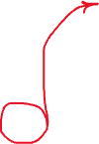

Example
Dequeue()
After performing the above dequeue operation, the queue would look like this:
Pop()
5
2
3
2
3
$$S_{1}$$
$$S_{2}$$
$$S_{2}$$

Slide 84


Example
Enqueue(6)
Enqueue(4)
After performing the above enqueue operations, the queue would look like this:
4
6
2
3
$$S_{1}$$
$$S_{2}$$

Slide 85






Example
Dequeue()
Dequeue()
After performing the above dequeue operations, the queue would look like this:
Pop()
Pop()
4
6
2
3
3
$$S_{1}$$
$$S_{2}$$
$$S_{2}$$
$$S_{2}$$

Slide 86

Example
Dequeue()
After performing the above dequeue operation, the queue would look like this:
Pop()
6
4
4
$$S_{1}$$
$$S_{2}$$
$$S_{2}$$

Slide 87

Question 3 - Solution
enqueue(x):
$S_{1}$.push(x)
dequeue():
if${ (S}_{2}$.isEmpty()):
while(${!S}_{1}$.isEmpty()):
$S_{2}$.push($S_{1}$.pop())
$S_{2}$.pop()
Time complexity:
Enqueue:
O(1)
Dequeue:
The while loop may have many iterations, however, every element is moved from S₁ to S₂ at most once during the whole operation of the data structure, therefore, the amortized cost of dequeue is O(1).

