Slide 1
Introduction to ML with Hands-On Machine Learning
01. model-based learning (l)
Gyuhyeon Sim
Department of Computer Science and Engineering, Korea University, DB Lab
gyuhyeon1999@gmail.com, github.com/liamgak

Slide 2
Contents
01
Example of Model-based learing
02
Introduction to Linear Regression
Errors in analysis
03

Slide 3
01. Example of Model-based learning

Slide 4
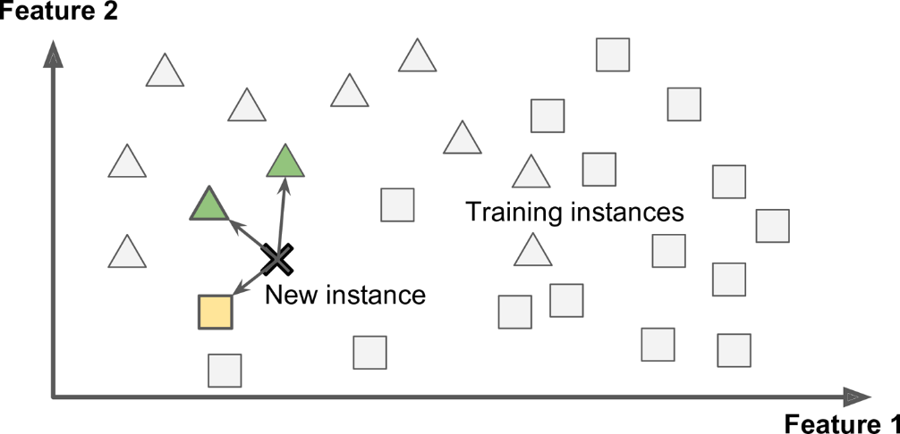
What is Model-based learning
Model-based learning – developing model which is used to predict class to which the new model belongs
“ what is the class to which new instance belongs”

Slide 5
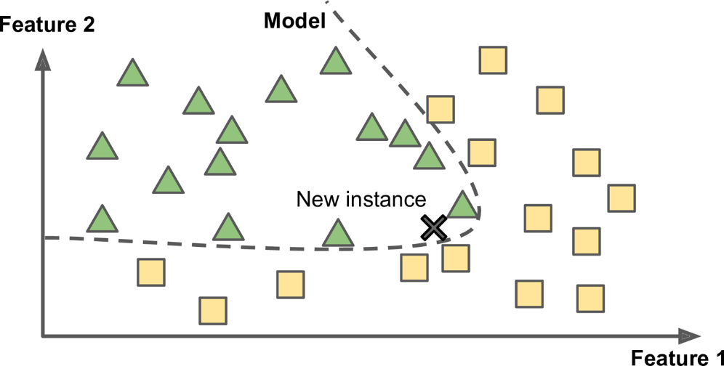
What is Model-based learning
Model-based learning – developing model which is used to predict class to which the new model belongs
“ what is the class to which new instance belongs”

Slide 6
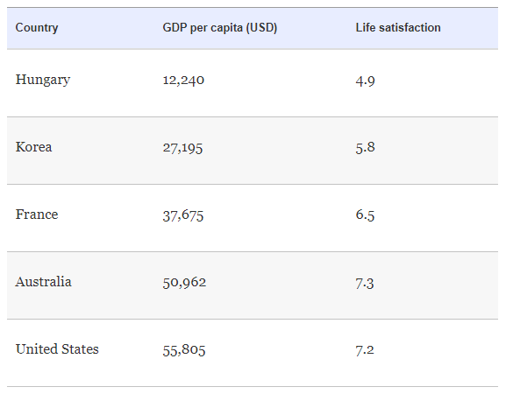
What is Model-based learning
Example of Model-based learning

Slide 7
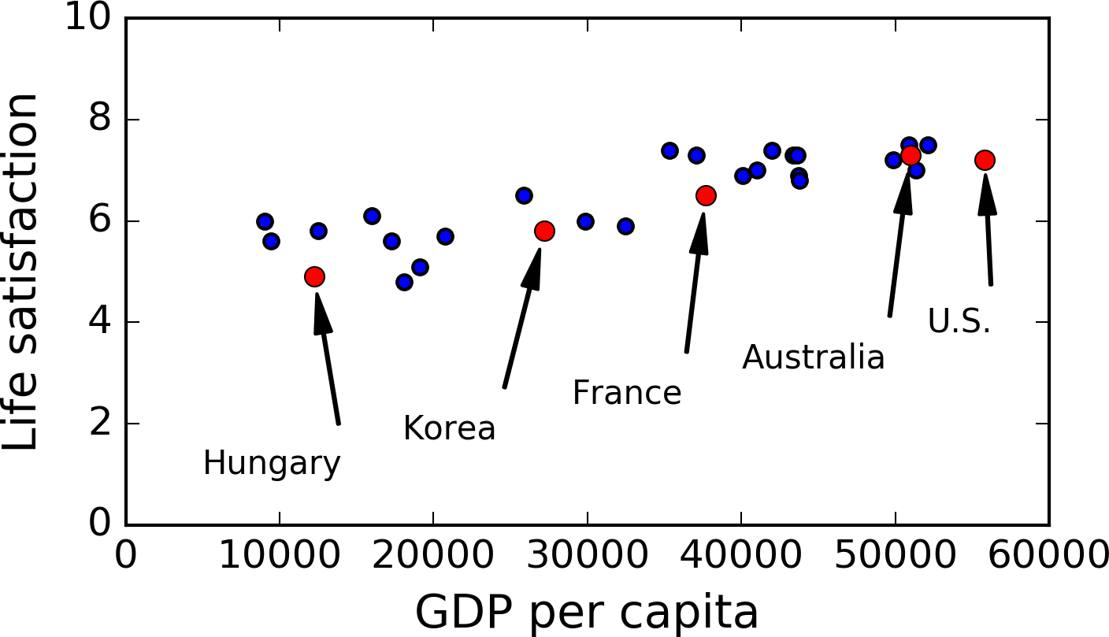
What is Model-based learning
Example of Model-based learning

Slide 8
What is Model-based learning
Example of Model-based learning

Slide 9
What is Model-based learning
Example of Model-based learning

Slide 10
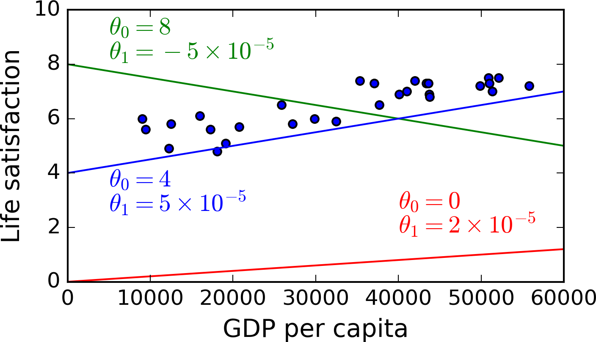
What is Model-based learning
Example of Model-based learning

Slide 11
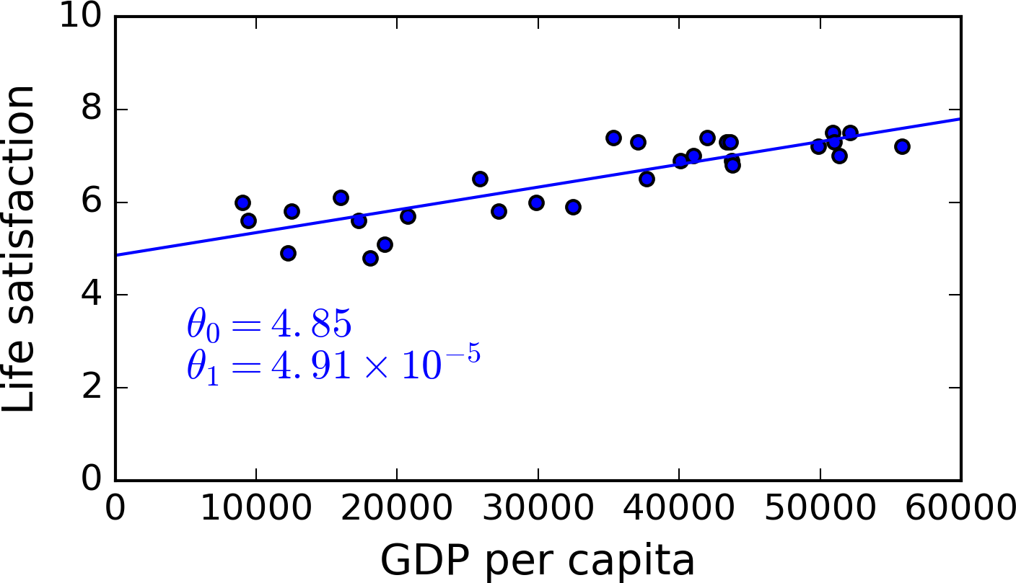
What is Model-based learning
Example of Model-based learning

Slide 12
What is Model-based learning
Example of Model-based learning
Q1. We want to predict life satisfaction of Cyprus that has 22,587 GDP per capita

Slide 13
What is Model-based learning
Example of Model-based learning
Q1. We want to predict life satisfaction of Cyprus that has 22,587 GDP per capita
Solution. Optimal function that include optimal parameters is
Life_satisfaction=4.85+4.91*10^-5*GDP_per_capita.
Thus, 4.85+22,587*4.91*10^-5=5.96(Life satisfaction)

Slide 14

What is Model-based learning
Example of Model-based learning
We can fine optimal function that consists of two optimal parameters using Linear Regression.

Slide 15
02. Introduction to Linear Regression

Slide 16
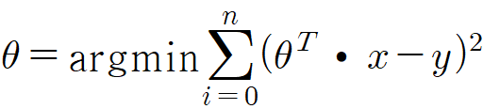
Linear Regression
Linear Regression
In statistics, linear regression is a linear approach to modelling the relationship between a scalar response (or dependent variable) and one or more explanatory variables (or independent variables).

Slide 17
Linear Regression
Linear Regression
Geometric Interpretation of Linear Regression
y
Xθ-y
Xθ
0
Xθ1

Slide 18

Linear Regression
Linear Regression
Minimize Mean Square Error(MSE)
The objective is to fine out two parameters included in a linear function that represent all datasets. In other words, we should minimize Mean Square Error.

Slide 19

Linear Regression
Linear Regression
Derivation of the Normal Equation for linear regression
X is matrix of m rows, in which each row is the i-th sample. With this, we can rewrite the least-squares cost as following, replacing the explicit sum by matrix multiplication:

Slide 20

Linear Regression
Linear Regression
Derivation of the Normal Equation for linear regression
To find where the above function has a minimum, we will derive by theta and compare to 0.

Slide 21
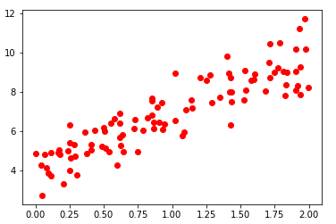
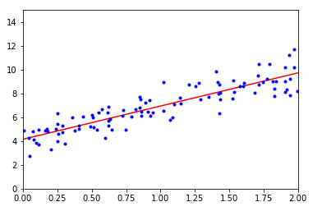
Linear Regression
Linear Regression
Practice for understanding Linear Regression using numpy, sklearn moudule in python
git clone Github.com/liamgak/ML/ML_01

Slide 22
THANK YOU

