Slide 1
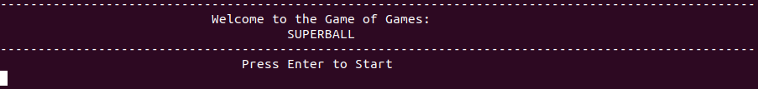
Superball
The objective of Superball is simple advance up the field and score in your opponents goal.

Slide 2
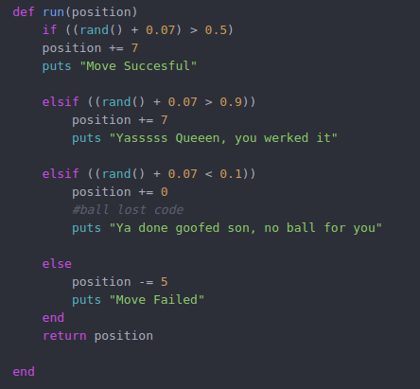
Random
It’s a random game, Literally

Slide 3
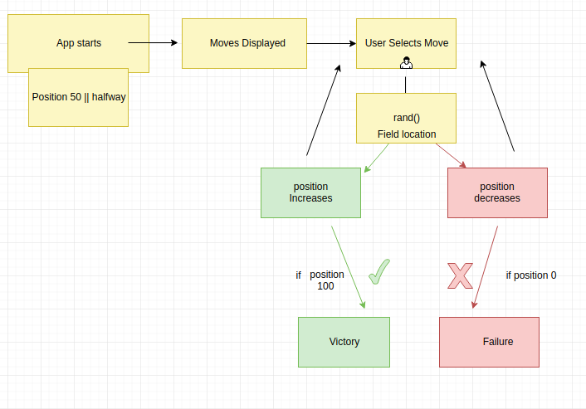
The Gist of It

Slide 4

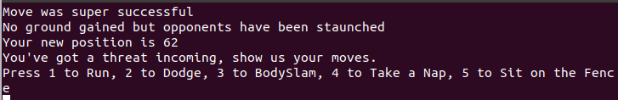
Make Your Move
Super Moves, Easter Eggs and Memes

Slide 5
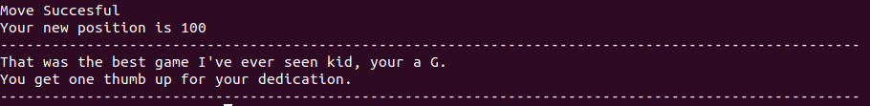
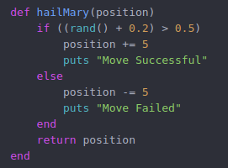
Position Based
1D
0
100

Slide 6
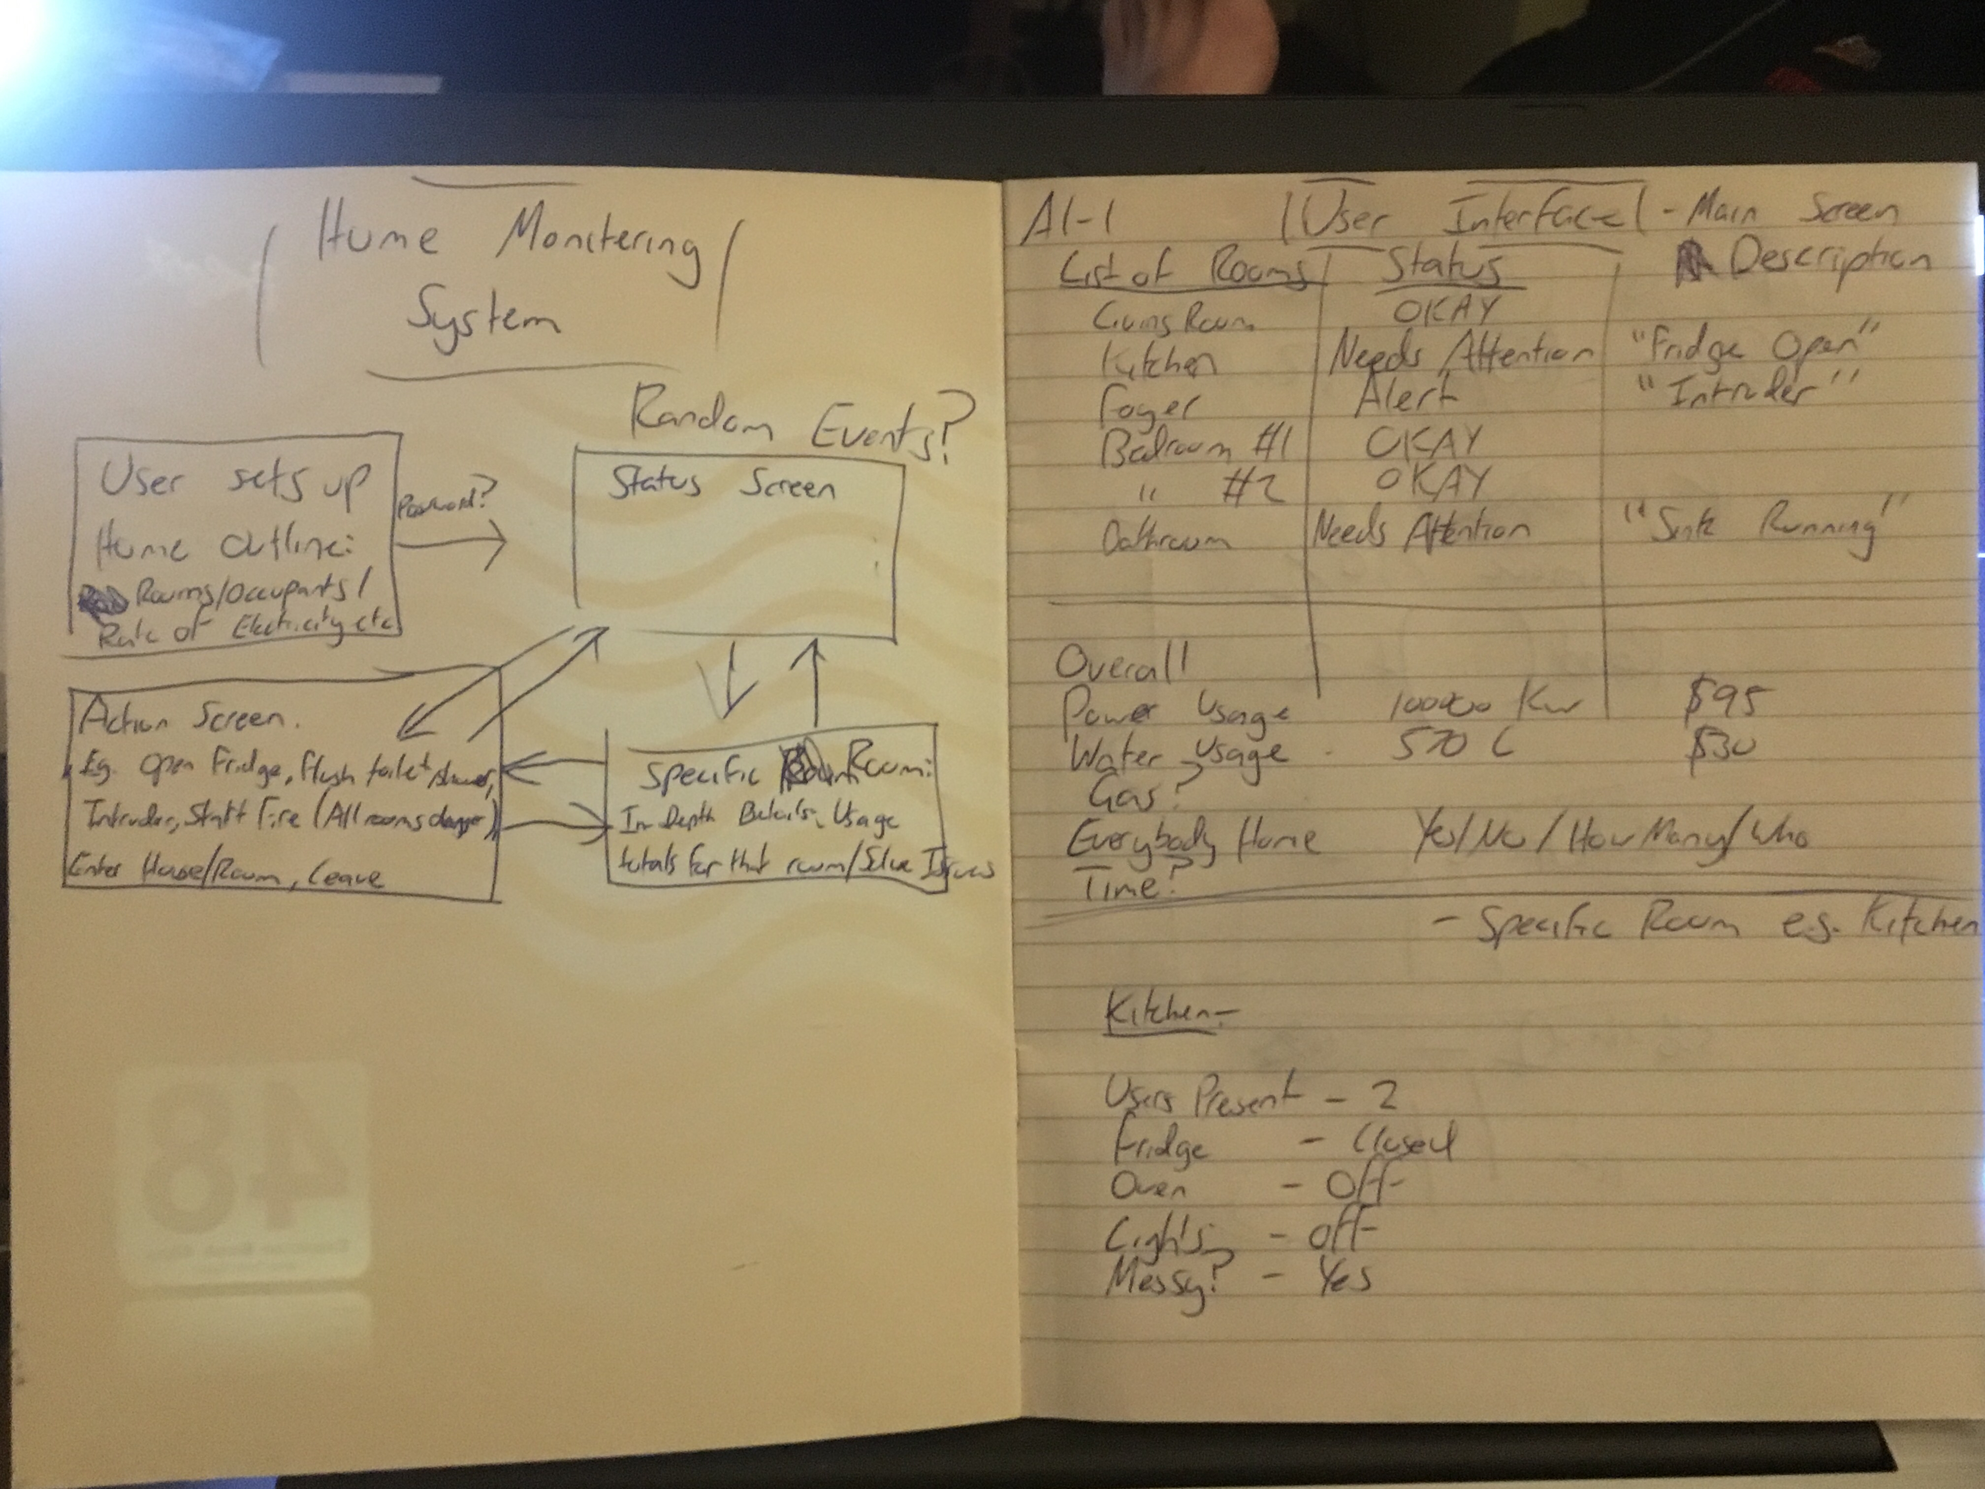
Build Process

Slide 7
Challenges
Objects are confusing / Why no return?
Time constraints
Technical difficulties

