Slide 1
FlexPoint Funding
Forecast Model v2
Progress Update — Weekly Standup
Liam Harvey & Ajer Sher
February 2026

Slide 2
What Augie Asked For
More Sophistication
Add product type and loan purpose — "I guarantee those will add value"
Focus, Not Noise
Only variables with real explanatory power — height matters, food preferences don't
Backtest Against Actuals
Predict January from December data. Compare to what actually happened.
3–5 Models, Best Wins
Run multiple approaches, compare predictive power, go with the best

Slide 3
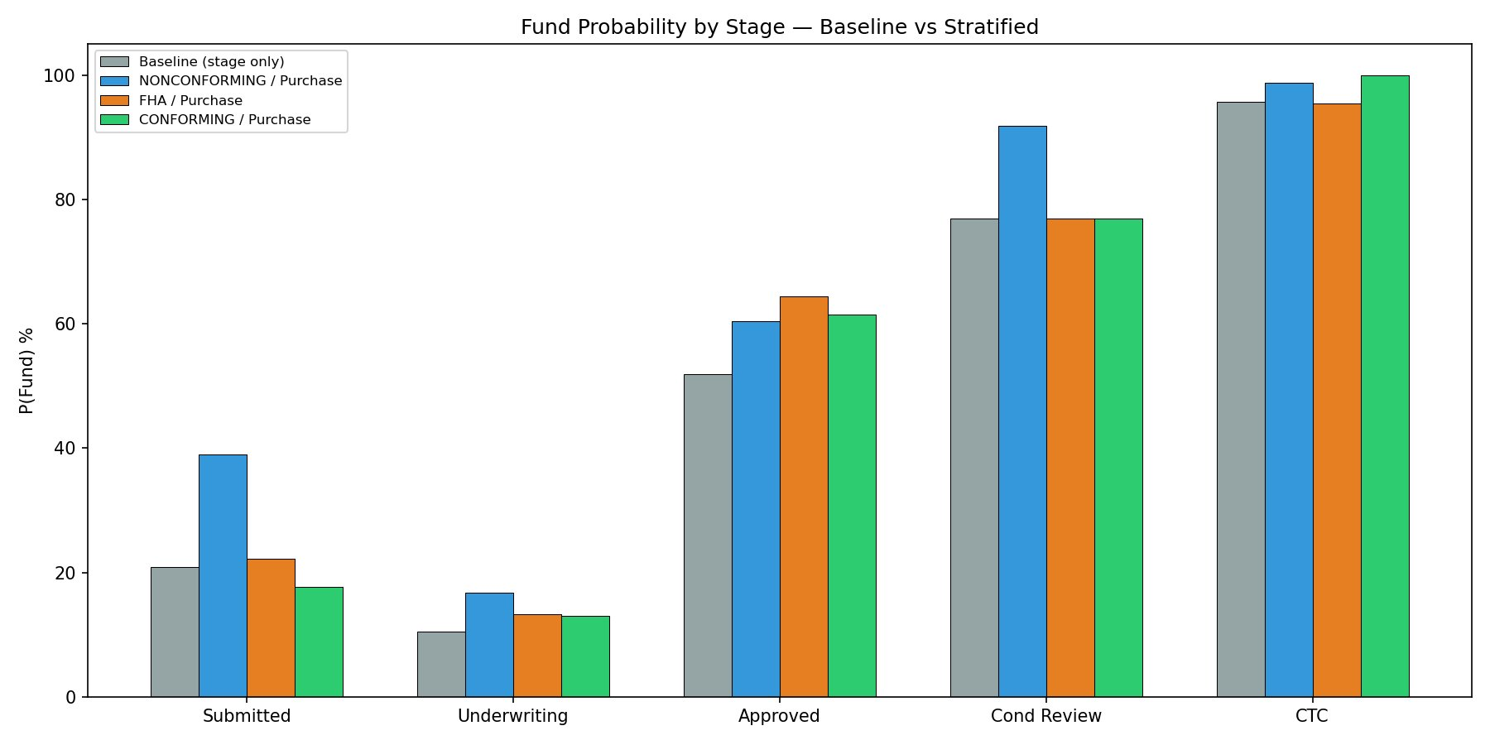
Product & Purpose Matter
Stratifying by product type and loan purpose shifts funding probabilities by up to 59 percentage points
At the Approved stage: NONCONFORMING Purchase funds 60% vs Refinance CashOut at 47% — a 13pp gap the old model missed entirely

Slide 4
How the Model Works
1
Snapshot the Pipeline
On any date, determine every active loan's current stage, product type, purpose, and how long it's been sitting there.
2
Score Each Loan
Assign a probability of funding by month-end based on stage, product, purpose, time-at-stage, credit score, and loan characteristics.
3
Sum to Projection
Multiply each loan's probability × amount, add what's already funded this month. That's the monthly forecast.
Like checking if someone can dunk: we now measure height AND whether they play basketball — not just counting heads.

Slide 5
What Drives the Prediction
Feature importance from Gradient Boosting model (top 7 of 35 features)
Pipeline stage probability
59.5%
Where the loan is in the pipeline
Days at current stage
9.9%
How long it's been sitting
Days remaining in month
8.4%
Time left to close
Stage rank
6%
How far along (ordinal)
Credit score
3.5%
Borrower quality
Loan amount
3.5%
Size of the loan
Lock period
3%
Commitment signal
Top 4 features capture 84% of signal. Categoricals (product, purpose, channel) appear small individually because their signal is already embedded in the stage probability through stratification.

Slide 6
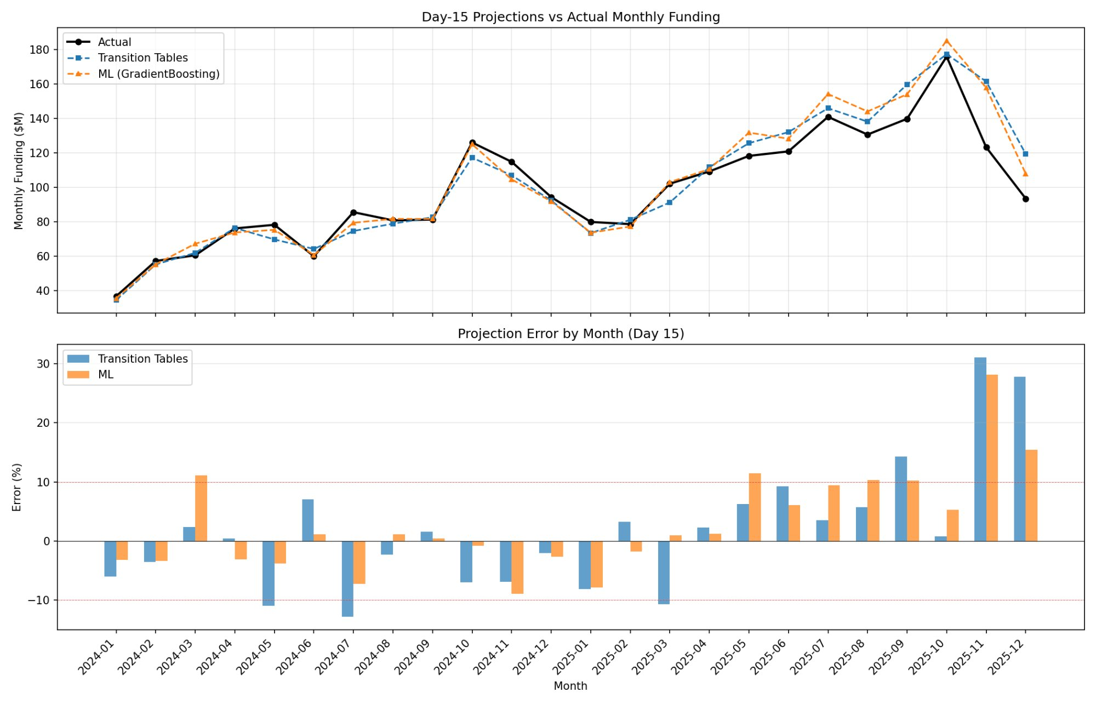
Backtest: 24 Months Projected vs Actual
6.4%
18 / 24
9.3%
ML MAPE
(Day 15)
Months Within
10% Error
Overall MAPE
(All Days)
Trained on 2024 data, tested on 2025. Nov–Dec 2025 are outliers (+28%, +16%) — possible year-end seasonal effect worth investigating.

Slide 7
Sample Output: October 2025
Scored as of October 15 — matches the dashboard format
$185.3M
$74.3M
$111.0M
Already Funded
Projected Remainder
Oct 1–15
Oct 16–31
Projected Total
$5.9M
$179.4M
Actual: $176.0M | Error: +5.3%
Retail
Wholesale
4.3% projected
95.7% projected
Weekly Breakdown
$35.7M
$32.3M
$52M
$45.7M
$19.6
Week 1
Week 2
Week 3
Week 4
Week 5
Actual
Actual
Partial
Projected
Projected
Actual
Projected
Pipeline: 1,285 active loans | $604.6M total pipeline value

Slide 8
Open Questions & Next Steps
?
Rate Lock Status
79% fund rate when locked vs 0.6% when not. Is this a leading signal or does it reflect the outcome? Need your input on whether it's knowable at prediction time.
!
Nov–Dec Anomaly
Both months over-projected by 15–28%. Is there a year-end seasonal effect (holidays, budget cycles) the model should learn?
→
Calibration Improvement
Model is overconfident in the 30–80% probability range. Platt scaling or isotonic regression would tighten this — straightforward next step.
◆
Integration Path
Scorer outputs match the ThoughtSpot dashboard format. Next: connect to the live database for daily pipeline scoring.

