Slide 1
FLEXPOINT FORECAST MODEL
v2 Update
Liam Harvey & Ajer Sher
Gallus Insights | February 25, 2026
Prepared for Augie, Mariana & Israel — FlexPoint
Notes:
AJER PRESENTS (~15 sec) "Thanks everyone for joining. Today we're presenting v2 of the funding forecast model." "Quick agenda: we'll show how we incorporated Augie's feedback from last week, the new results across 24 months of backtesting, and then we have some open questions for discussion."

Slide 2
What We Changed — Your Four Requests
1
Separated Product & Purpose
2
Added Rate Lock Features
Now independent features — no longer hidden inside the stage probability. Each variable's contribution is visible on its own.
5 new features: lock status, days until expiry, whether expired, days since lock, lock expiry vs month-end.
3
Day-0 Projection
4
Rolling Training Window
Each month projected from prior month-end. Dec from Nov 30, Nov from Oct 31. Most current pipeline, no stale data.
12-month rolling window so the model adapts when market conditions shift. No longer stuck on 2024 data.
The University of Chicago
Notes:
LIAM PRESENTS (~45 sec) "From our last call, Augie laid out four priorities. We executed all four." Walk through each card briefly. Emphasize card #3: 'Each month is now projected from the last day of the prior month — Dec from Nov 30, Nov from Oct 31 — using the most current pipeline available. No stale data. This is the consistent framework you asked for.' Don't linger — this is setup, not content.

Slide 3
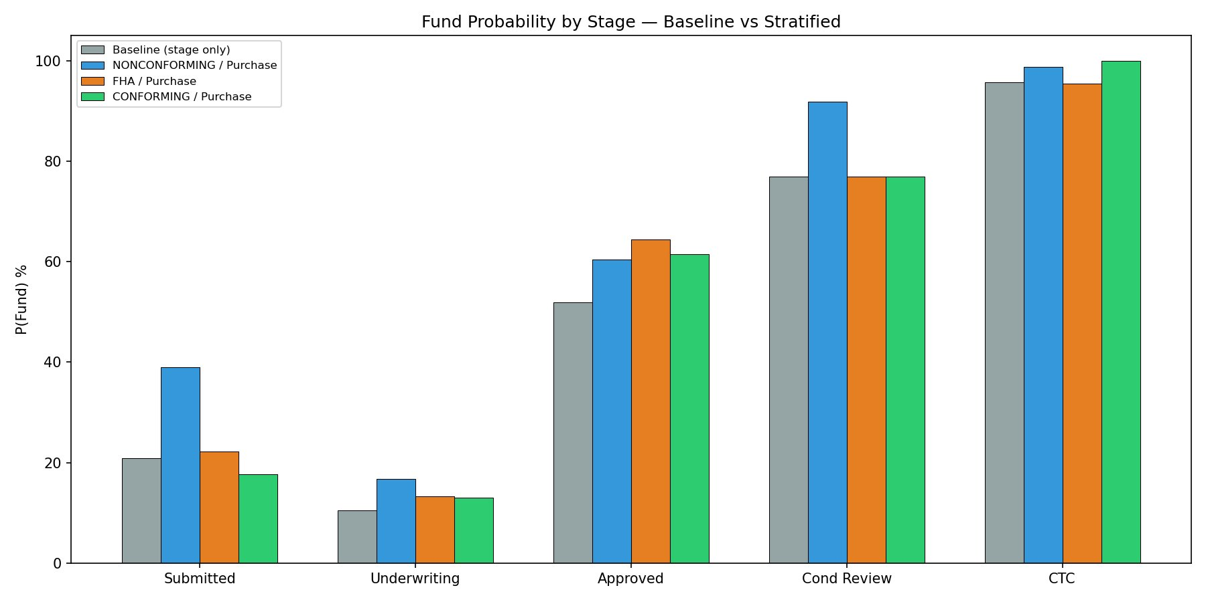
Product & Purpose — Now Independent
Key Takeaways
At Approved (where most active loans sit):
Baseline: 52%
NONCONF / Purchase: 60%
FHA / Purchase: 64%
Refi CashOut: 47%
Product & purpose now visible as independent features. Their standalone weight is modest (~0.1–0.2%), because most signal was already captured by stage — but they're now auditable.
The University of Chicago
Notes:
AJER PRESENTS (~90 sec) "Augie, you were right. Adding product and purpose shifts funding probabilities by up to 12 percentage points." Point to Approved stage: baseline 52%, NONCONF/Purchase 60%, FHA/Purchase 64%, Refi CashOut 47%. "At Submitted, NONCONFORMING loans are almost double baseline — 39% vs 21%." "Product and purpose now appear as their own features. Their standalone importance is modest because the signal was already in the stage probability — but they're visible and auditable now, which is what you asked for." If asked 'How did you calculate these?': 'Stratified transition tables from all 15,272 loans. For each stage × product × purpose combination, we computed the historical funding rate. Where cell sizes were under 20 loans, we smoothed back to stage-only.'

Slide 4
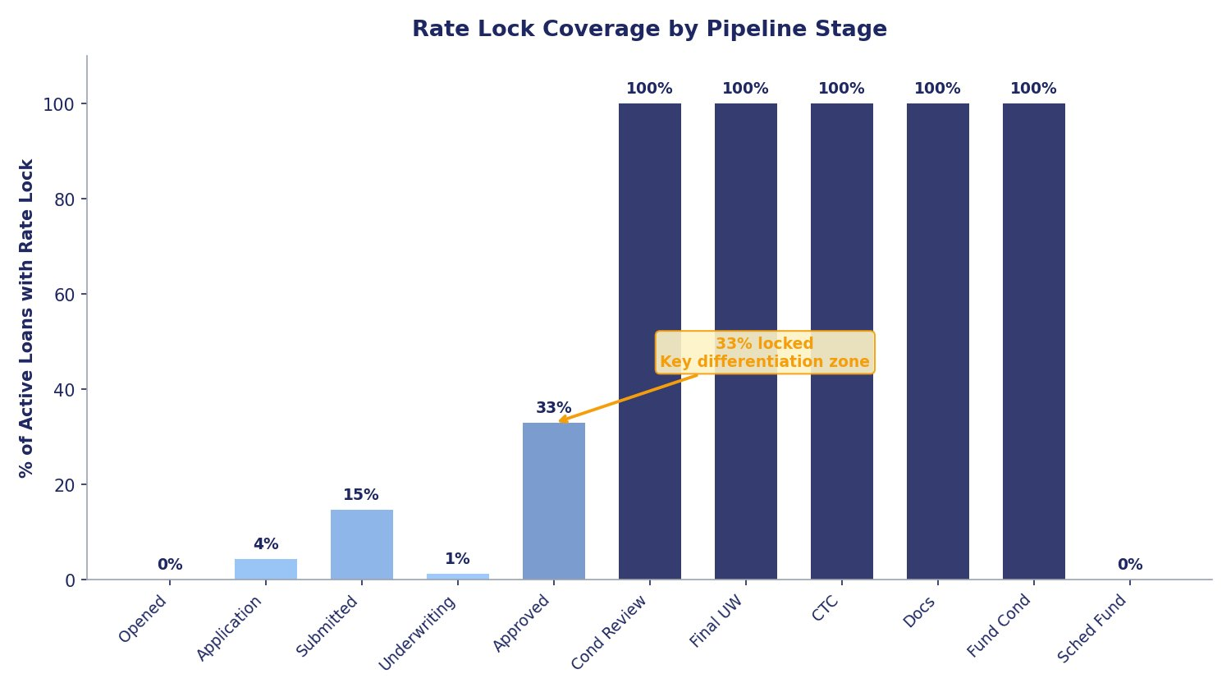
Rate Lock — Your Insight
The Lock Story
99.3%
of funded loans have a rate lock
0.6%
of unlocked loans end up funding
33%
lock rate at Approved — the key differentiation zone
Lock features improved MAPE from 6.5% → 4.8%, but 68% of model weight lands on lock timing.
The University of Chicago
Notes:
LIAM PRESENTS (~90 sec) "This is where it gets nuanced. Lock coverage goes from ~0% at early stages to 100% past Condition Review." "The Approved stage at 33% is the key differentiation zone — it splits loans that are actively progressing from ones that are stalling. That's real, independent information." "99.3% of funded loans have a lock. Only 0.6% of unlocked loans fund. So lock is almost a perfect proxy — powerful but potentially circular." "Lock features improved our accuracy from 6.5% to 4.8%, but 68% of the model's weight lands on lock timing. We'll come back to what this means on the decision slide." If Augie asks about his Loan A vs Loan B example: 'That's exactly what the model learned. Lock expiry vs month-end is the #1 feature — a loan whose lock is about to expire is under pressure to close, which is exactly the signal you described.'

Slide 5
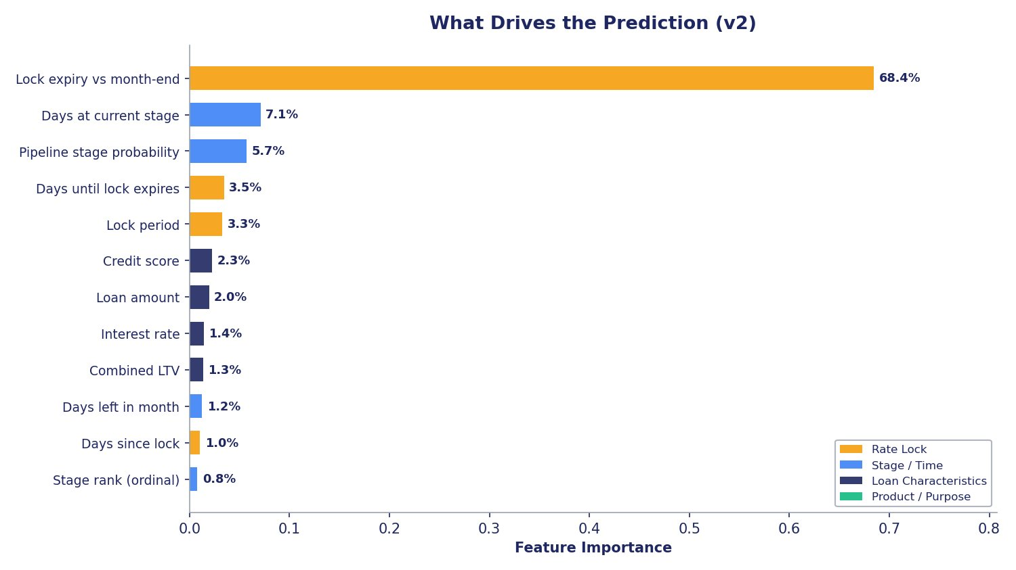
What Drives the Prediction
v1 → v2 shift
Stage probability dropped from 59.5% → 5.7% because lock absorbed that signal.
Lock expiry vs month-end alone carries 68% — this is the Loan A vs Loan B signal Augie described.
Rate Lock
Stage / Time
Loan Characteristics
Product / Purpose
The University of Chicago
Notes:
AJER PRESENTS (~60 sec) "Here's what the model relies on, ranked by importance." "Lock expiry vs month-end dominates at 68% — this is exactly the signal Augie described with his Loan A vs Loan B example on the Excel blackboard. A loan whose lock expires before month-end is under pressure to close." "Pipeline stage probability dropped from 59.5% in v1 to just 5.7% in v2 — because lock absorbed that signal." "Days at current stage is #2 at 7.1%. Credit score, loan amount trail at 2-3% each." If asked about product/purpose not ranking high: 'Same story as v1 — their signal is upstream in the stage probability. They matter, they're just embedded.'

Slide 6
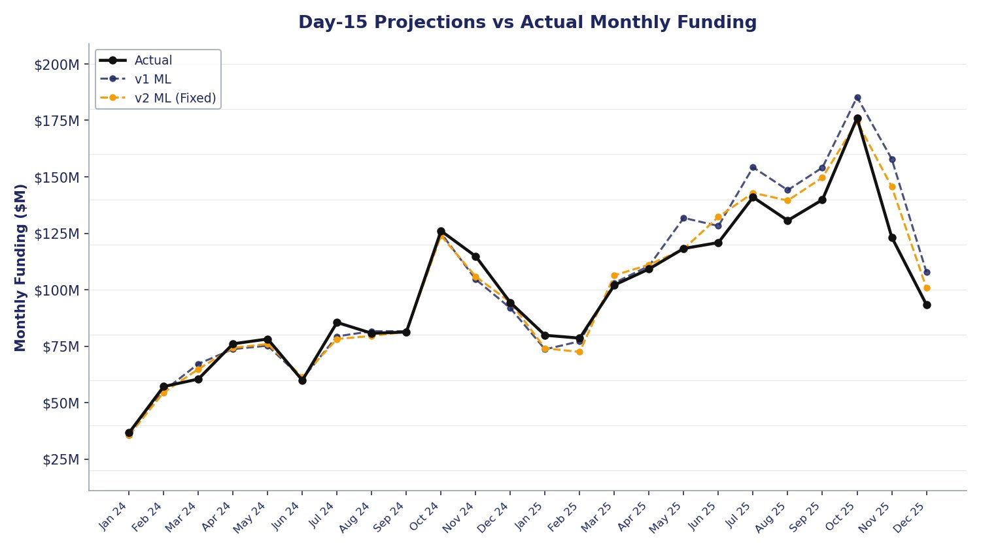
Backtest Results — 24 Months
4.8%
23/24
25%
Mid-Month MAPE
Months Within 10%
MAPE Reduction
v2 with locks (day 15)
up from 18/24 in v1
6.4% → 4.8% vs v1
The University of Chicago
Notes:
LIAM PRESENTS (~90 sec) "This is the proof. We backtested across 24 months — January 2024 through December 2025." Point to KPIs: 4.8% MAPE at mid-month, 23/24 months within 10% target, 25% reduction vs v1. "The orange dashed line is v2, black is actual. You can see it tracks tighter than v1, especially in the second half of 2025 where volumes ramped up." "Two months still over 10%: November at +12.7% with rolling. We'll dig into that next." Numbers to have ready: Day 1 MAPE: 15.8% (v2) vs 15.7% (v1) Day 8 MAPE: 7.3% (v2) vs 9.7% (v1) Day 15 MAPE: 4.8% (v2) vs 6.4% (v1) Day 22 MAPE: 4.0% (v2) vs 5.3% (v1)

Slide 7
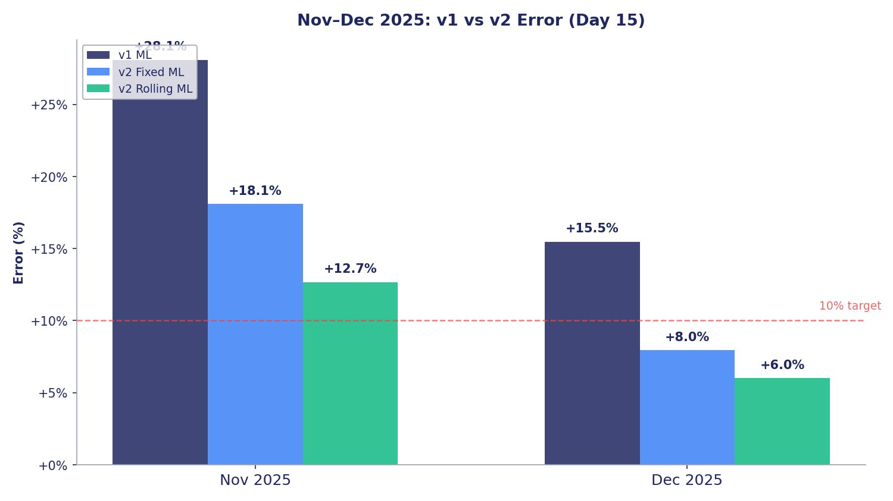
Nov/Dec 2025 — The Weak Spot, Fixed
Rolling Window Wins
November 2025
v1: +28.1% → v2 rolling: +12.7%
Error cut by more than half
December 2025
v1: +15.5% → v2 rolling: +6.0%
Now inside the 10% target
The rolling window trains on the most recent 12 months, so it had seen the higher volumes from mid-2025. This improvement is independent of the lock question.
The University of Chicago
Notes:
AJER PRESENTS (~60 sec) "These were our two worst months in v1. The rolling window cut November's error in half and brought December inside the 10% target." "The key insight: the rolling window trains on the most recent 12 months, so when predicting December 2025, it's seen the higher volumes from mid-2025. The fixed window was still calibrated to 2024 levels." "This improvement is completely independent of the lock question — it's a clean win we recommend regardless." If asked about the rolling window: 'Instead of always training on 2024 data, we tested training on the most recent 12 months. So when predicting December 2025, the model trains on Dec 2024 through Nov 2025.'

Slide 8
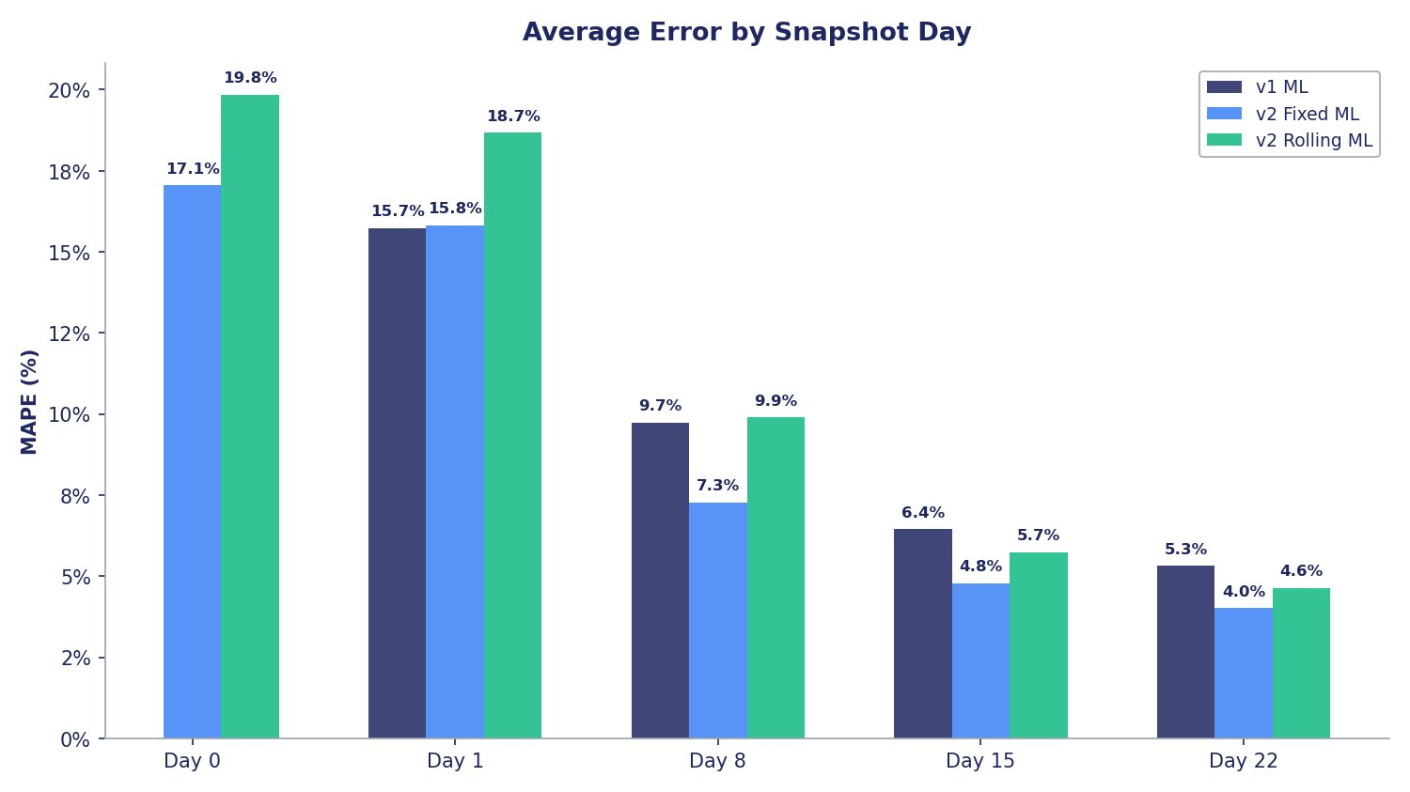
Accuracy by Snapshot Day
Reading the Chart
Day 0
Prior month-end. Full month projected. ~17% error — directional read.
Day 8
One week of actuals + 3 weeks projected. Under 10%.
Day 15
Half actual, half projected. 4.8% — the headline number.
Day 22
Mostly known. 4.0% error.
Consistent framework: each month projected from its prior month-end.
The University of Chicago
Notes:
LIAM PRESENTS (~60 sec) "This is the new slide. Day 0 is the test you asked for — projecting an entire month from the last day of the prior month. Nothing has funded yet, it's all forward-looking." "Day 0 gives you a directional read — 17% error. By Day 8 you're under 10%. By mid-month you're at 4.8%." "Each month is projected from its prior month-end — Dec from Nov 30, Nov from Oct 31 — using the most current pipeline. This is the consistent framework you described on the call." If asked 'why is Day 0 rolling worse than fixed?': 'The rolling window is optimized for mid-month accuracy. At Day 0, the fixed window's more conservative probabilities happen to overshoot less, but by Day 8 the rolling window catches up and wins from there.'

Slide 9
Two Paths Forward
Version A — Conservative
Version B — With Locks
6.5%
Mid-Month MAPE
No lock features
Clean, defensible, no leakage risk
Product & purpose now independent
Rolling window included
4.8%
Mid-Month MAPE
5 lock features included
68% of model weight on lock timing
Better accuracy, but lock may encode
pipeline progression, not new info
For you, Augie: Is rate lock an independent signal in this business — or is it encoding what the stages already tell us?
Both versions use rolling window and separated product/purpose
Notes:
AJER PRESENTS, LIAM FRAMES THE QUESTION (~2 min) Ajer: 'We want to present two options and let you decide.' Walk through Version A (clean, conservative) and Version B (better accuracy, lock question). Liam frames the question: 'The lock features improved accuracy a lot, but we found they're mostly capturing how far along a loan is — which we already know from the stage. The main place they add genuinely new information is at the Approved stage, where about 33% of loans are locked and 67% aren't.' 'We wanted your input: is rate lock an independent signal in the business — does locking cause a loan to get priority processing? Or does a loan just get locked along the way because it's already progressing?' If he says use it: 'Great — we'll move forward with Version B. We'll flag the lock dependency in documentation.' If he says don't use it: 'Understood — Version A is clean and still a meaningful improvement over v1 with the rolling window.' If he's unsure: 'No rush on this — we can deploy Version A now and test Version B in parallel.'

Slide 10
Next Steps
Lock Decision
Your call on Version A or B determines which model we move forward with. Rolling window recommended regardless.
Seasonality
We looked at it — summer pull-through ~41% vs winter ~36%, volume +25% higher. Speed is flat. Natural next feature to add.
Error-by-Month Chart
Full month-by-month error breakdown available (v1, v2 fixed, v2 rolling). Happy to walk through if useful.
Integration
Scorer module matches ThoughtSpot format. 1–2 week effort to connect to production DB and run daily scoring.
The University of Chicago| Liam Harvey & Ajer Sher
Notes:
LIAM PRESENTS (~60 sec + discussion) "Four things going forward." 1. Lock decision: 'Your call. We're comfortable with either version.' 2. Seasonality: 'You flagged this last week — summer months are more competitive. We ran the numbers: pull-through is about 5 points higher in summer, volume is 25% higher. But days-to-fund is remarkably flat year-round — the speed doesn't change, it's the conversion rate and volume that fluctuate. This is a natural next feature.' 3. Error chart: 'We have the full month-by-month error breakdown if you want to see it — it's in the appendix.' 4. Integration: 'The scorer module produces the same format as ThoughtSpot today. Connecting it to the production DB is a 1-2 week effort.' If asked 'when can this go live': 'The model is code-complete. Integration is 1-2 weeks depending on DB access.' If asked 'can you predict further out': 'Same architecture, just extend the time horizon. We'd build transition tables for 30-60 day windows.'

