Slide 1
FLEXPOINT FORECAST MODEL
v3 Update — Week 3
Liam Harvey & Ajer Sher
University of Chicago | March 2026

Slide 2
Here's What You Told Us
Your four requests from the Week 2 call — and what we built for each.
1 Combination Logic
2 Elimination Rules
"Use lock timing in conjunction with stage and other variables." We built 12 interaction features capturing lock × stage × time-at-stage combinations.
"Identify what will NOT fund." We built a 5-rule filter that flags dead loans — historically <0.1% funding rate — and removes them before projection.
3 Timing Prediction
4 Explain the Failures
"When in the month, not just whether." We built a timing model that predicts funding week. Funding is heavily back-loaded: 38% in Week 4.
"Show what unfunded loans have in common." We segmented 9,611 unfunded loans into 8 named failure archetypes with clear patterns.

Slide 3
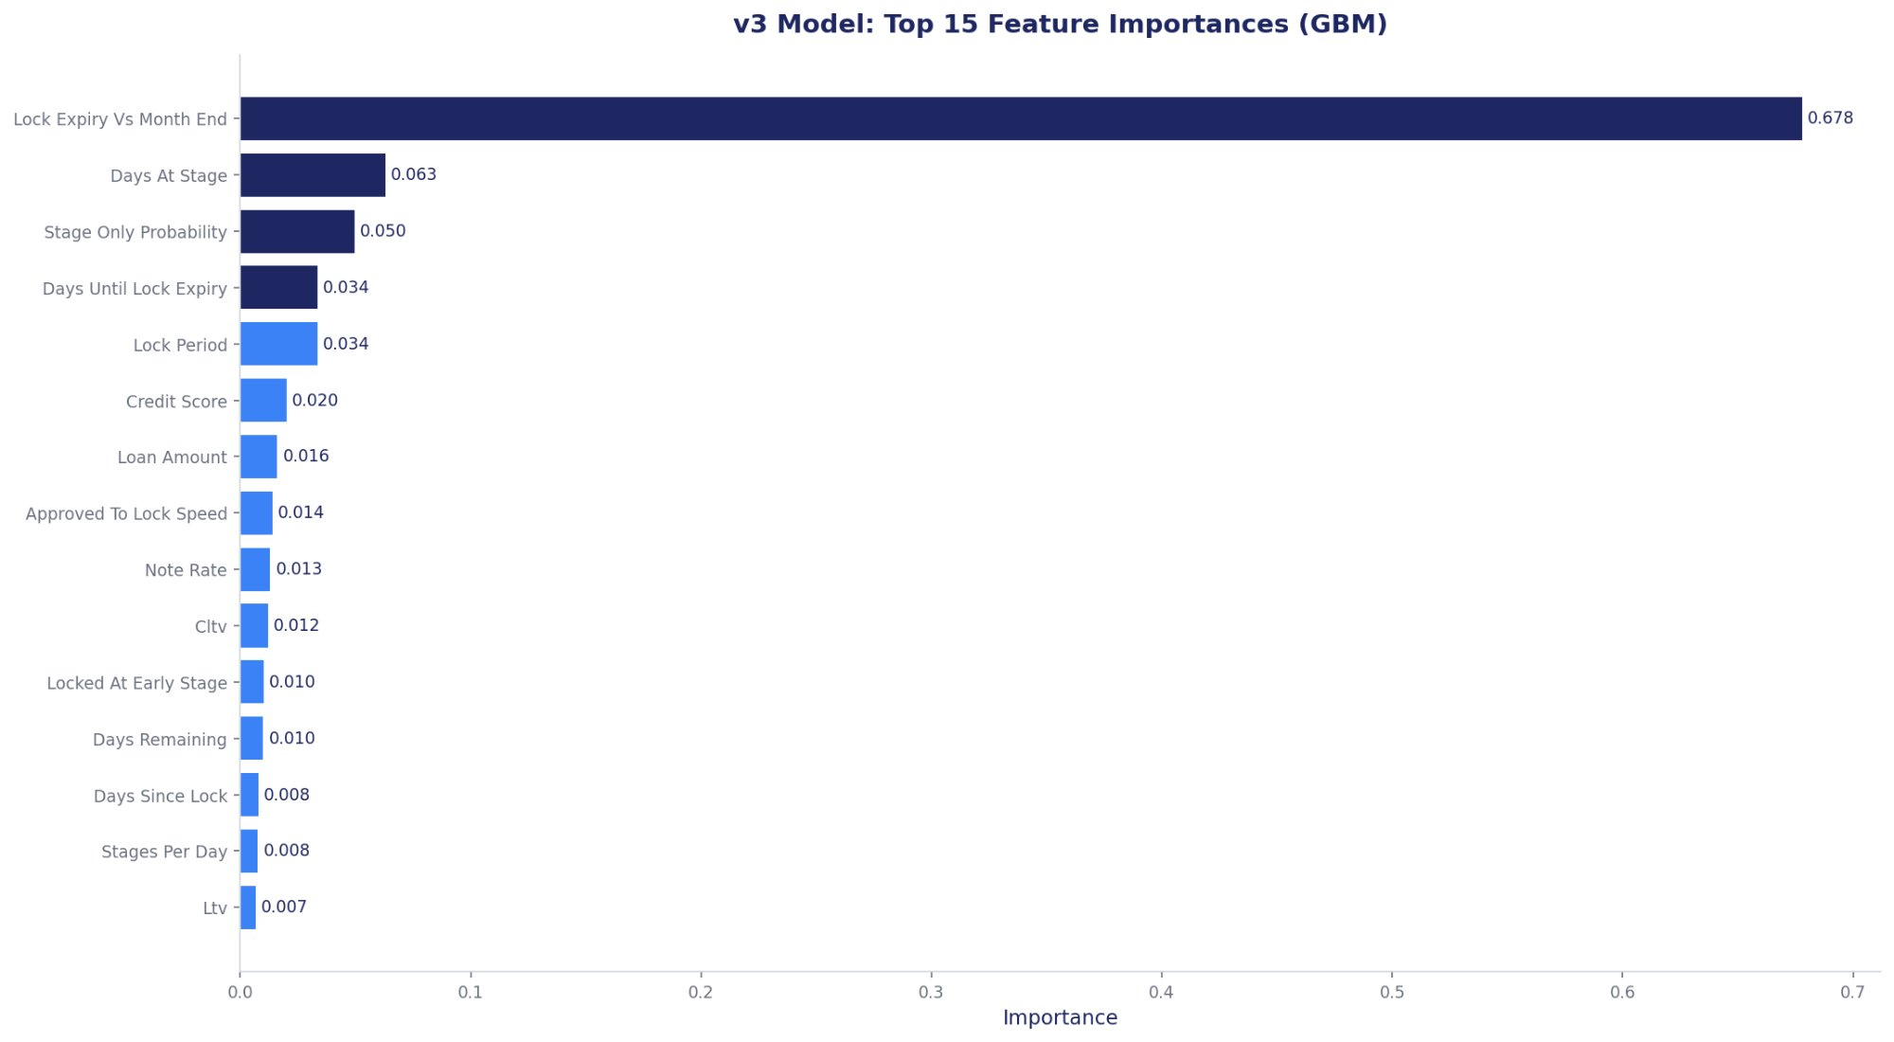
Combination Logic — Lock × Stage × Time
What We Found
Built 12 interaction features
Lock × stage, lock × time-at-stage, velocity, lock extension proxy
3 earned real importance:
#8 approved_to_lock_speed (1.4%)
#11 locked_at_early_stage (1.0%)
#14 stages_per_day (0.8%)
MAPE maintained at 4.8%
No degradation — the tree already finds these splits internally
The model already captures the combinations you described. The interaction features make this auditable.

Slide 4
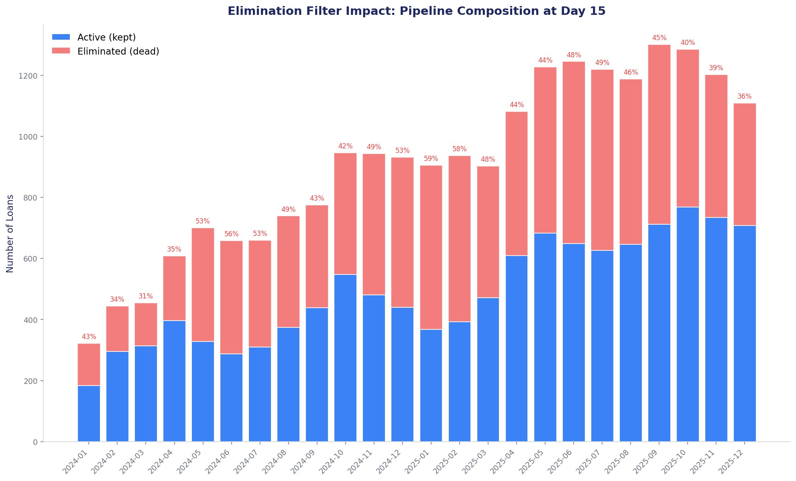
Pipeline Hygiene — Elimination Filter
46%
0
4.7%
of pipeline is dead weight
false negatives (120 snapshots)
MAPE with filter applied
Rule | Condition | Hist. Rate
Opened Stale | Opened stage, 30+ days | 0.006%
Application Stale | Application stage, 30+ days | 0.0%
Submitted Unlocked | Submitted + unlocked, 22+ days | 0.1%
UW Unlocked | Underwriting + unlocked, 22+ days | 0.1%
Approved Expired | Approved + expired lock | 0.0%
Filter only activates when ≤20 days remain in the month. Loans at CTC or later are never eliminated.

Slide 5
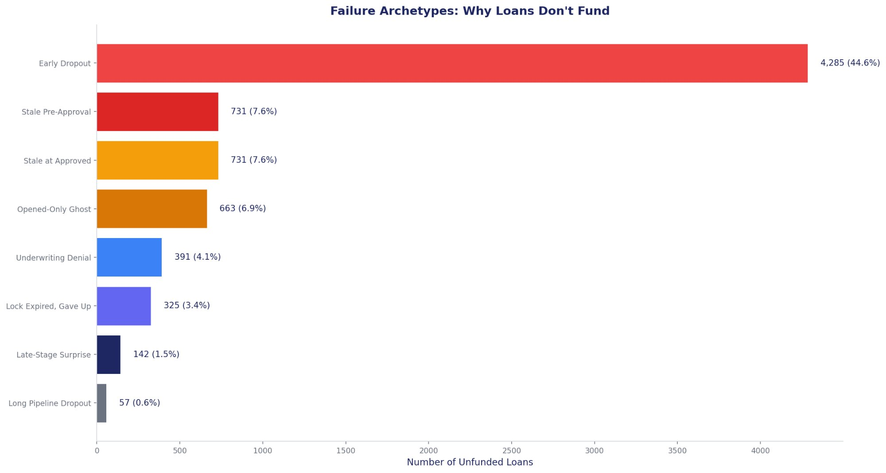
Where Loans Die — Failure Archetypes
The 9,611 Unfunded Loans
44.6%
Early Dropout
Gone in 4 days, never past Submitted
7.6%
Stale Pre-Approval
Stuck at Submitted/UW 30+ days, unlocked
7.6%
Stale at Approved
Approved but never locked, sat 30+ days
6.9%
Opened-Only Ghost
File opened, never hit Application
3.4%
Lock Expired
Locked a rate, expired, never progressed
1.5%
Late-Stage Surprise
Past CTC then failed — rare but painful
94% of failures never get past Approved. The kill zone is Approved — 27% of all failures die there.

Slide 6
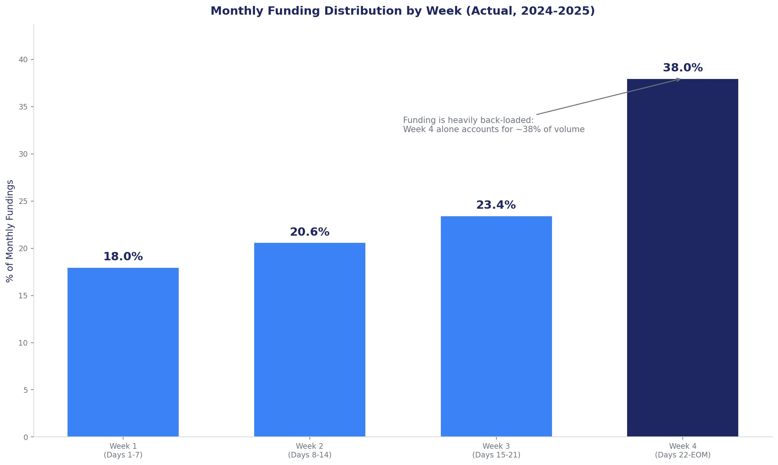
When Loans Fund — Timing Model
Funding Is Back-Loaded
Week 1 (Days 1-7)
18%
Week 2 (Days 8-14)
21%
Week 3 (Days 15-21)
23%
Week 4 (Days 22-end)
38%
Best Approach by Snapshot
Day 0: Historical distribution wins (22% weekly MAPE)
Day 8+: GBM regressor takes over (18% → 9.8% MAPE)
Recommended blend: historical early, GBM mid-month
38% of monthly funding lands in the last week. This explains why Day 0 accuracy is 17% — most of the action hasn't happened yet.

Slide 7
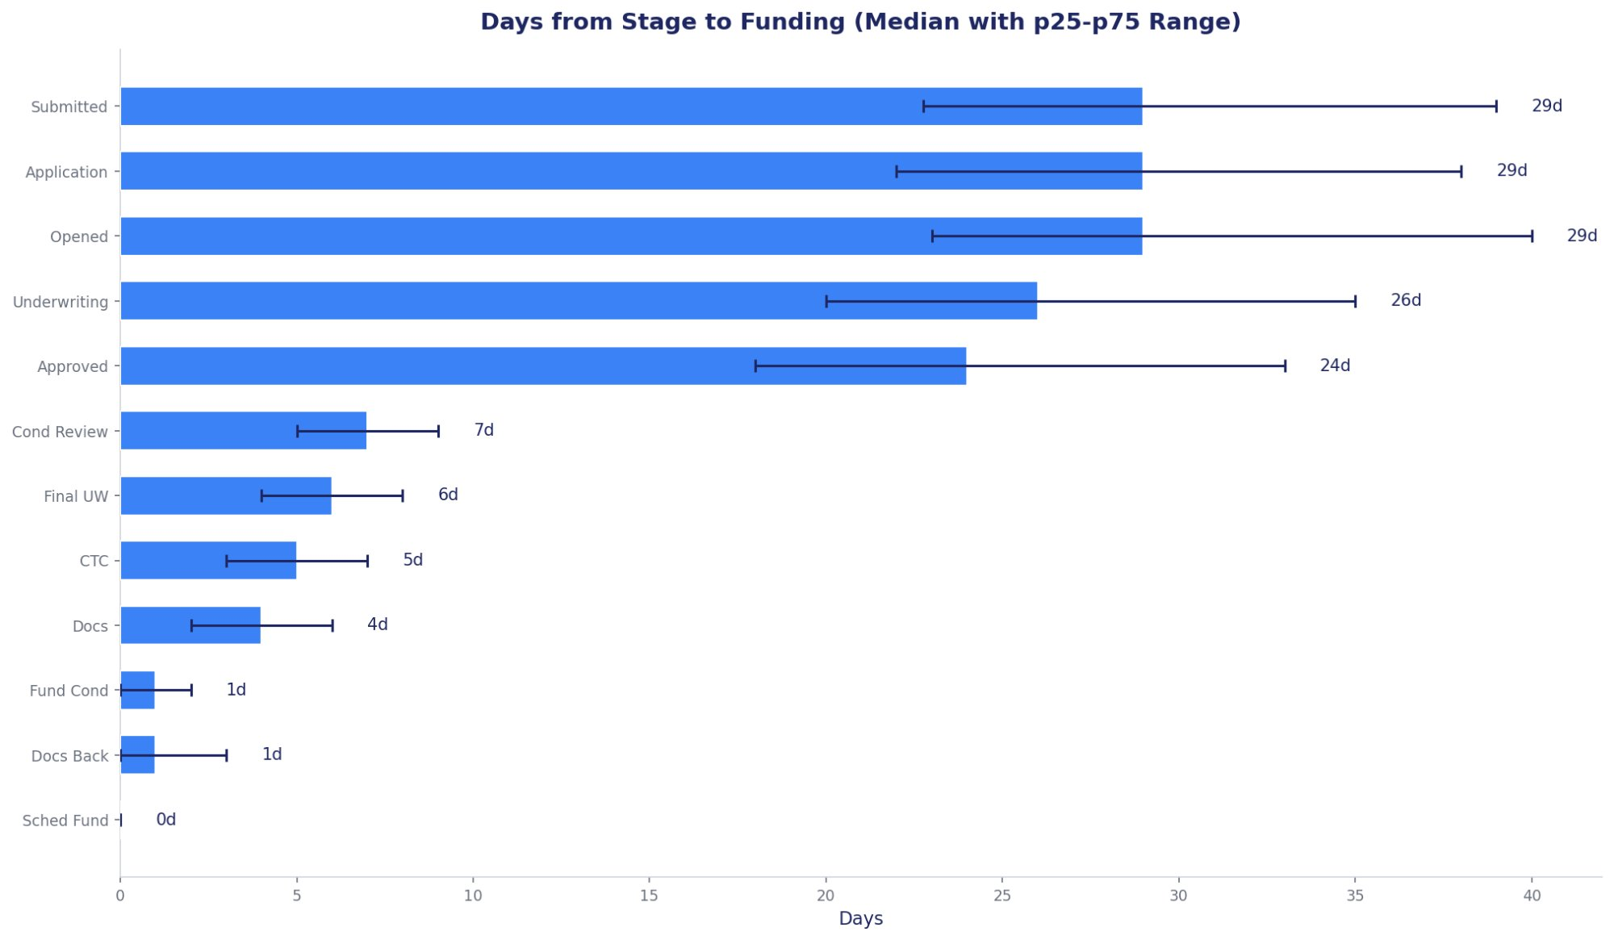
How Long From Here to Funded?
Operational Reference
CTC → Funded
5 days (p25: 3, p75: 7)
Approved → Funded
24 days (p25: 18, p75: 33)
Submitted → Funded
29 days (p25: 23, p75: 39)
Opened → Funded
29 days (p25: 23, p75: 40)
Speed is flat year-round. Summer doesn't close faster — it just closes more.

Slide 8
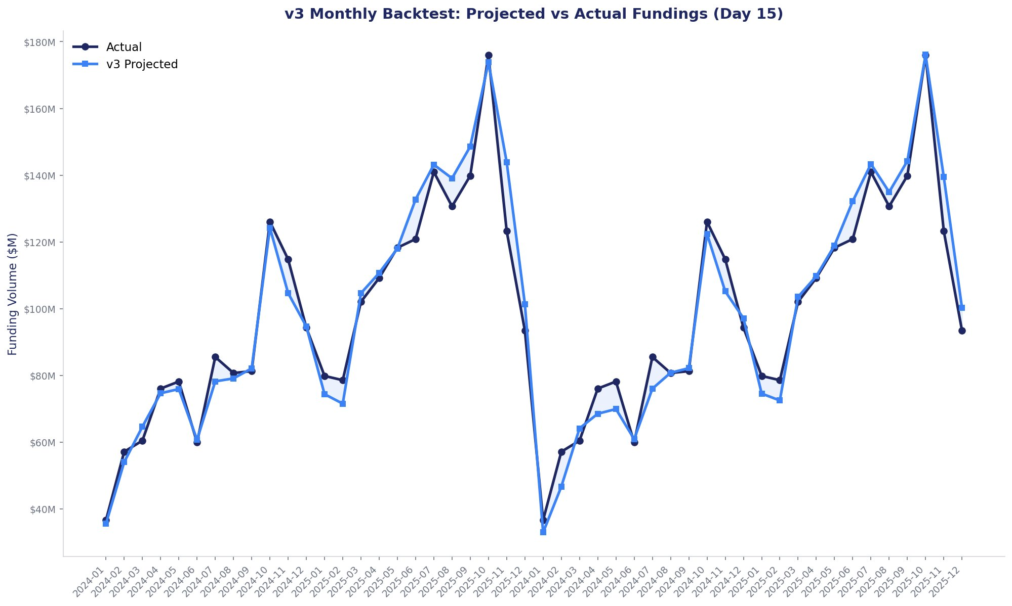
v3 Backtest — 24 Months
4.8%
23/24
4.7%
Mid-Month MAPE (maintained)
Months Within 10%
MAPE with Elimination Filter
What v3 Adds Over v2
Same core accuracy
4.8% MAPE preserved from v2
Pipeline hygiene
46% dead weight now visible and flagged
Weekly timing
Funding week projections (22% MAPE at Day 0)
Failure explanations
8 named archetypes, auditable patterns

Slide 9
What We Learned
1
Lock expiry vs month-end is still king
68% of model importance. The lock question from Week 2 is settled — it's the dominant signal.
2
46% of the pipeline is dead on arrival
Stale, unlocked, early-stage loans that historically never fund. Filter makes this visible and auditable.
3
94% of failures never get past Approved
The Approved stage is the kill zone. 27% of all failures die there — often unlocked and sitting for 30+ days.
4
Funding is back-loaded: 38% in Week 4
Structural month-end push. Use historical distribution at Day 0, switch to GBM at Day 8.
5
GBM already finds the combination logic
Interaction features don't improve MAPE but make the model's internal reasoning visible and auditable.

Slide 10
Next Steps
1
Seasonality Features
Summer pull-through ~41% vs winter ~36%. Volume +25% higher. Days-to-fund flat. Natural next feature to add to the model.
2
Lock Extension Data
No extension history in the current dataset. If FlexPoint can provide lock relock/extension records, it would strengthen the elimination filter and timing model.
3
Production Integration
Scoring module matches ThoughtSpot format. 1–2 week effort to connect to production DB and run daily scoring.
4
Reporting Cadence
Day 0 → directional read (17% error). Day 8 → operational forecast (7.5%). Day 15 → precise (4.8%). Recommend weekly report starting Day 8.
Liam Harvey & Ajer Sher | University of Chicago

