Slide 1
SLEJD
Assignment 3
Finance Tracker
Liam H, Darian N, Eliza P, Joshua L, Suhaib A.

Slide 2
Overview
Finance Planner
How can we describe our idea?
Where did we see the issue to solve?
Goal
What is our goal that we wish to achieve through the creation of our application
Features
Platforms
Technology
Integration

Slide 3
Our Roles and Scope
Individual roles
Time frame
Requirements
Functions
Risks/Security
Contracting of Security Expert

Slide 4
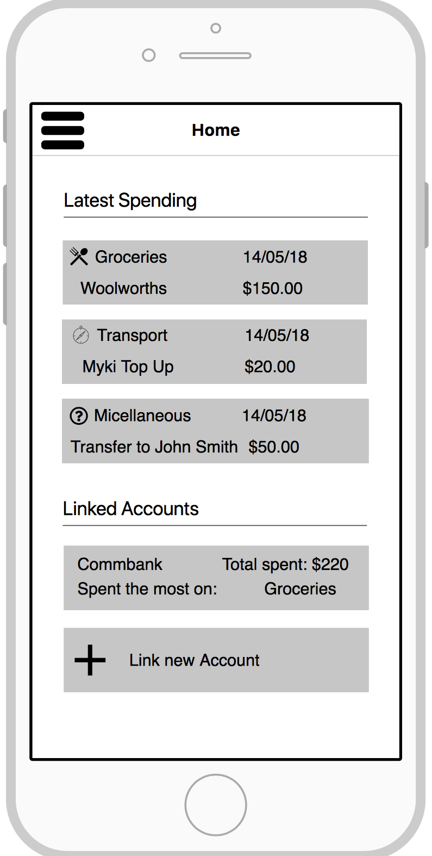
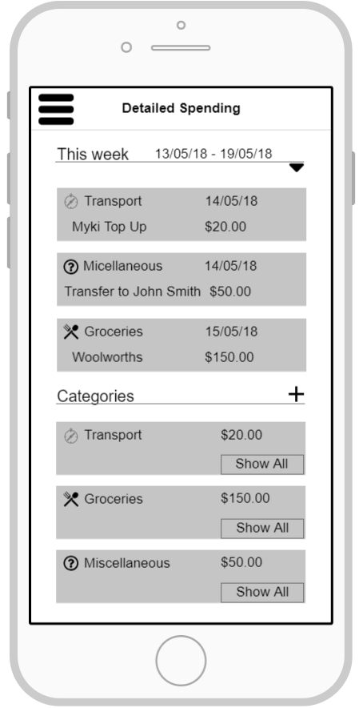
Prototype

Slide 5
Testing
Usability testing
- Who are our test users?
- What is the purpose?
Acceptance testing
- How we can ensure the functionality
is proficient.

Slide 6
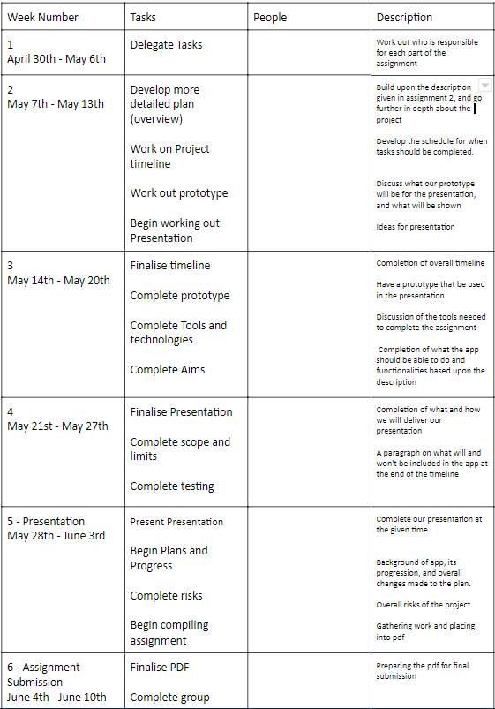
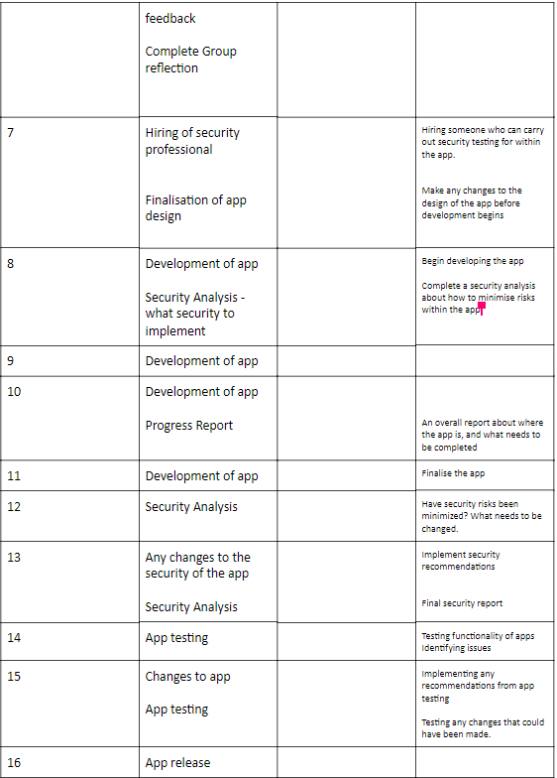
Project Plan

