Slide 1
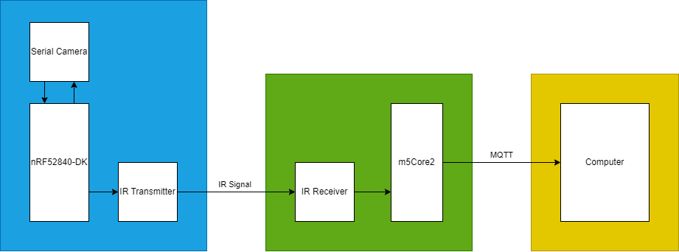
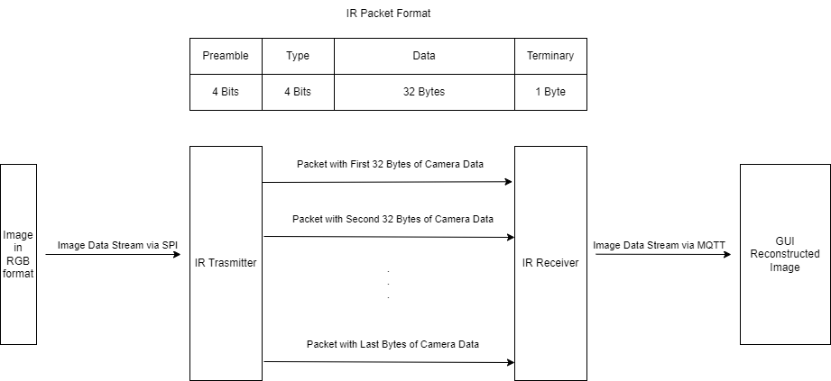
CU2 - Transmit camera image via Infrared (IR) link
Liam Hemmett – Marco Day – Apollo Green
Project Overview
KPIs
Image is transmitted in less than 1 minute
Image retains 90% original pixels
Less than 10 packets are lost per image
Transmission can occur at 5m minimum
Current image is displayed to user
System Overview 3 Nodes Deployed
Base node (nrf4580-dk)
Communications node (m5Core2)
PC node (PC GUI)
Sensors
Arducam Serial Camera
IR 38kHz Transmitter
IR Receiver
Algorithms
Time Syncronisation
Results
IR communication achieved
IR comms experienced
- Unintentional bit shifting
- Corrupted packets
- Lost packets due to line of sight
issues
IR comms achieved 800 B/s rate
Camera failed to operate over SPI
- MISO and SCK pins constantly
high
Conclusions
KPIs not achieved
Potential to achieve image transfer rate KPI if CRC implemented
Communications
Custom IR protocol
- Uses 32 data bytes
- 2 bytes of header and CRC bits
MQTT used for Comms node and PC node communication

