Slide 1
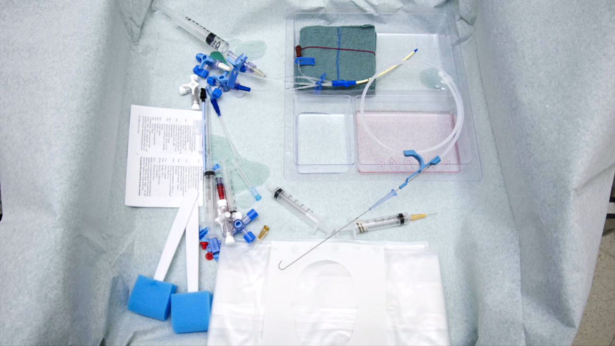
CAN WE DETECT EXPERT AND NOVICE ANAESTHETISTS BY HOW THEY WATCH VIDEO?
INTRODUCTION
How would you look at the picture below? As someone with no experience in medicine, particularly in the department of Anaesthetics, there isn’t much

