Slide 1
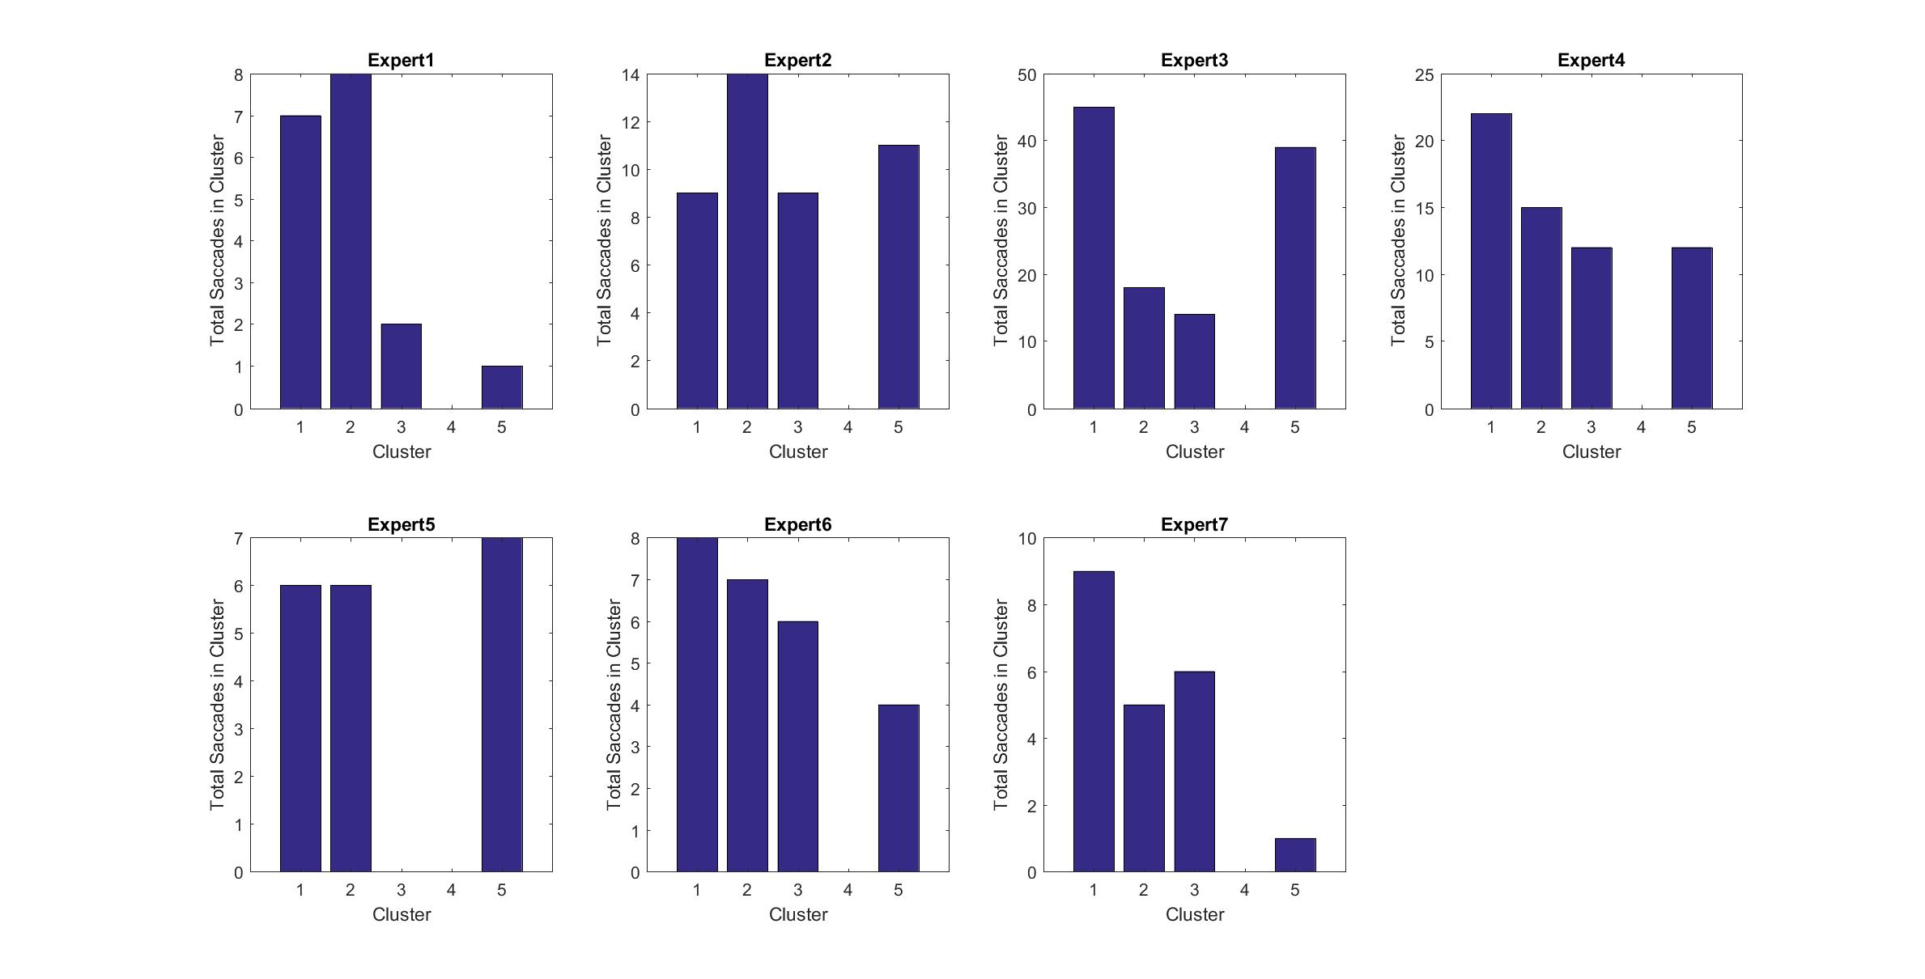
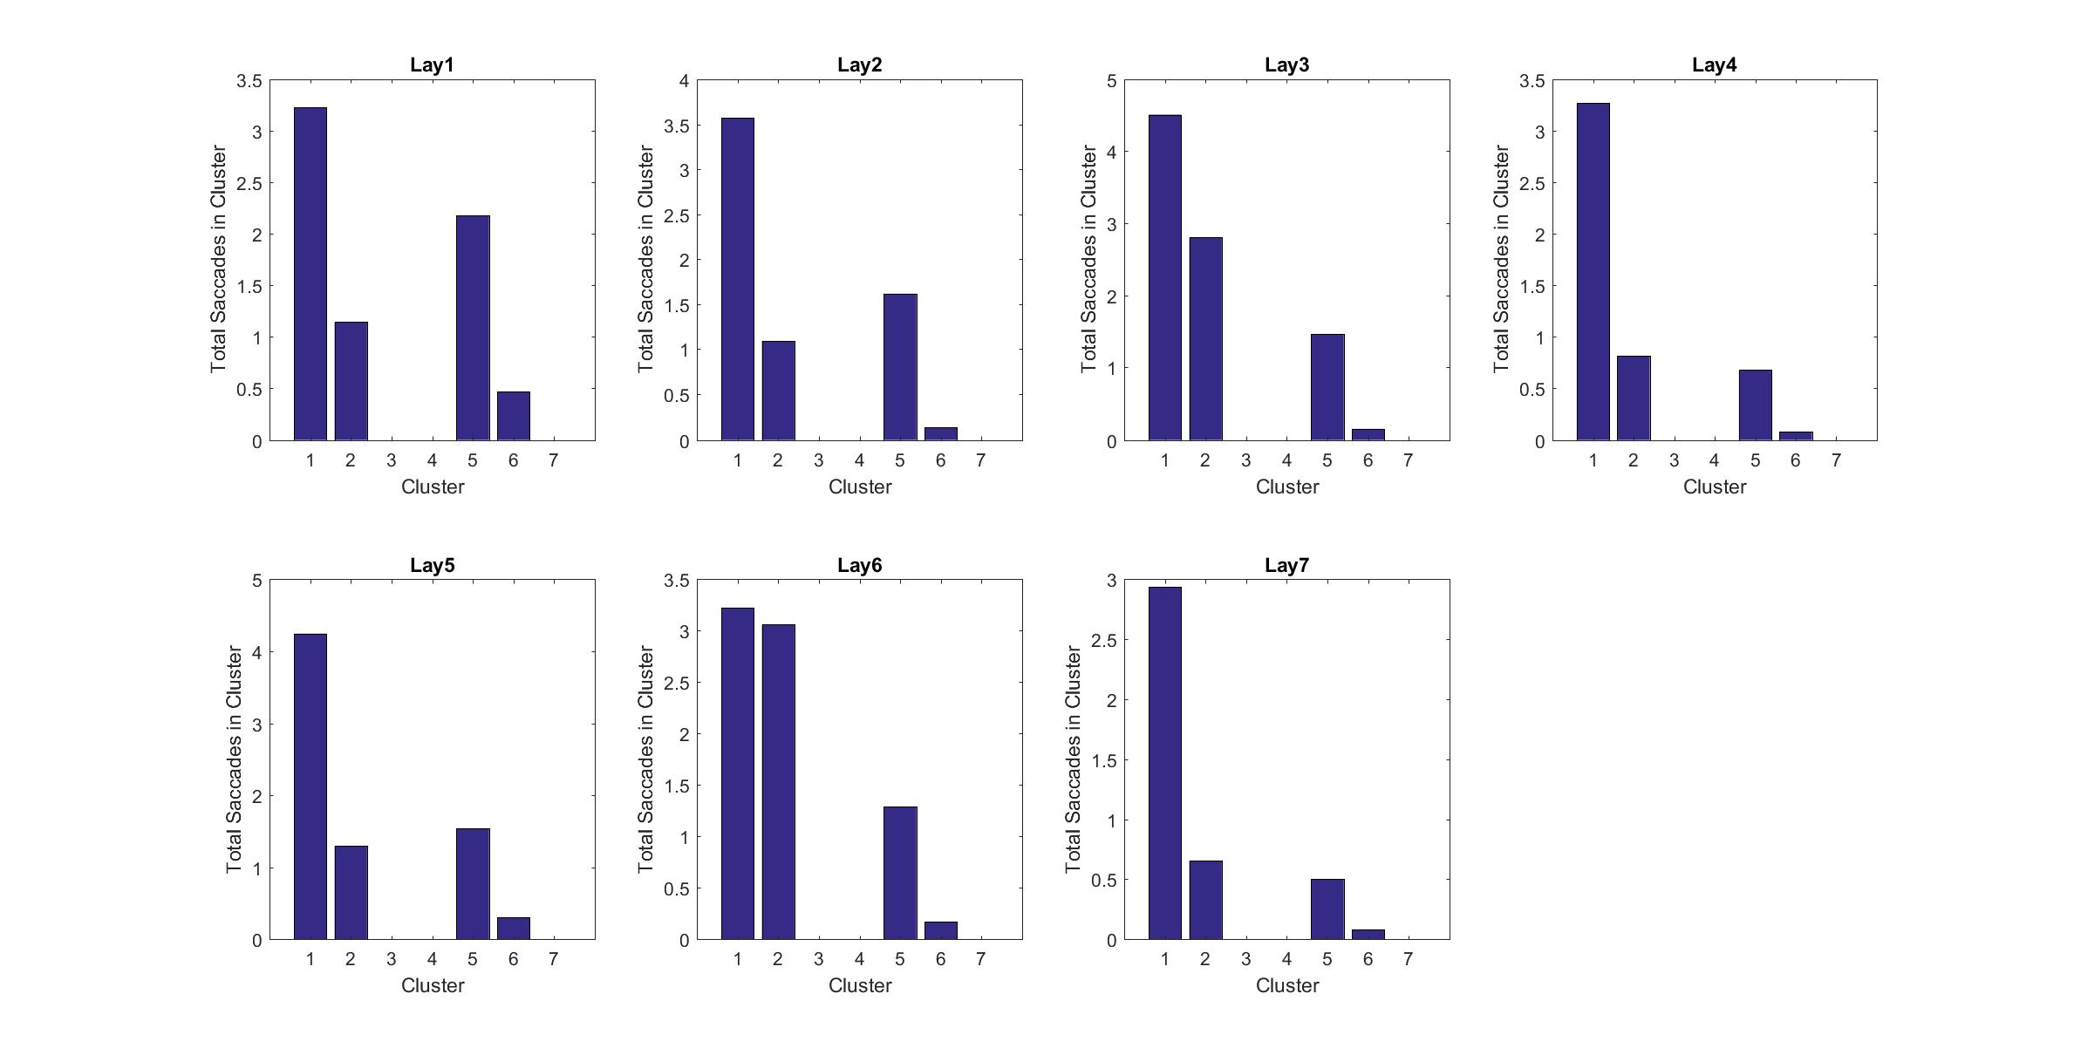
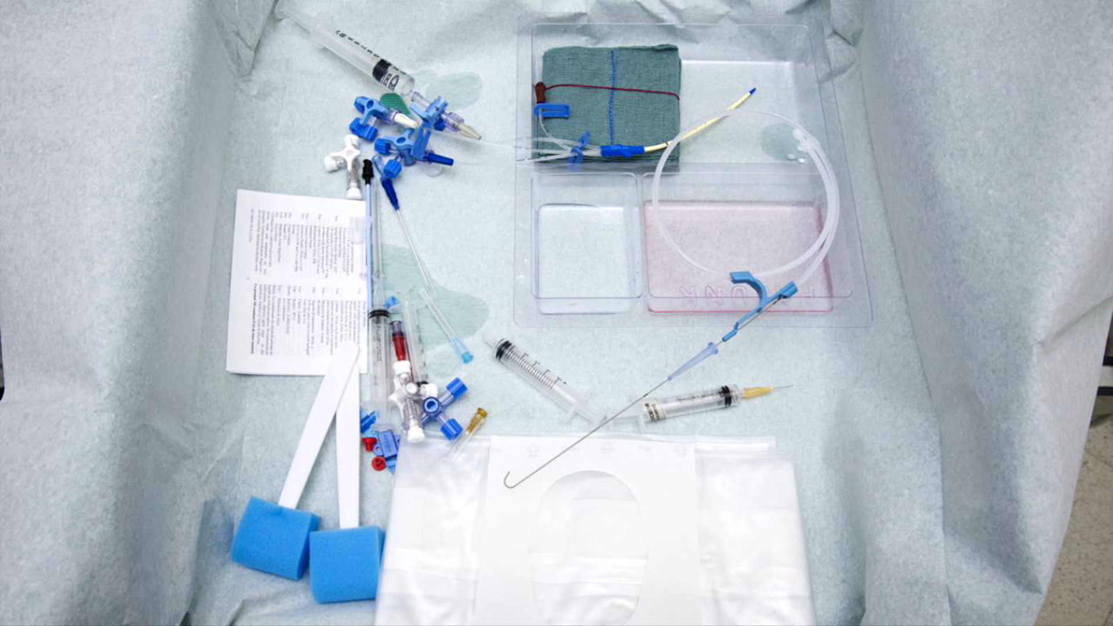
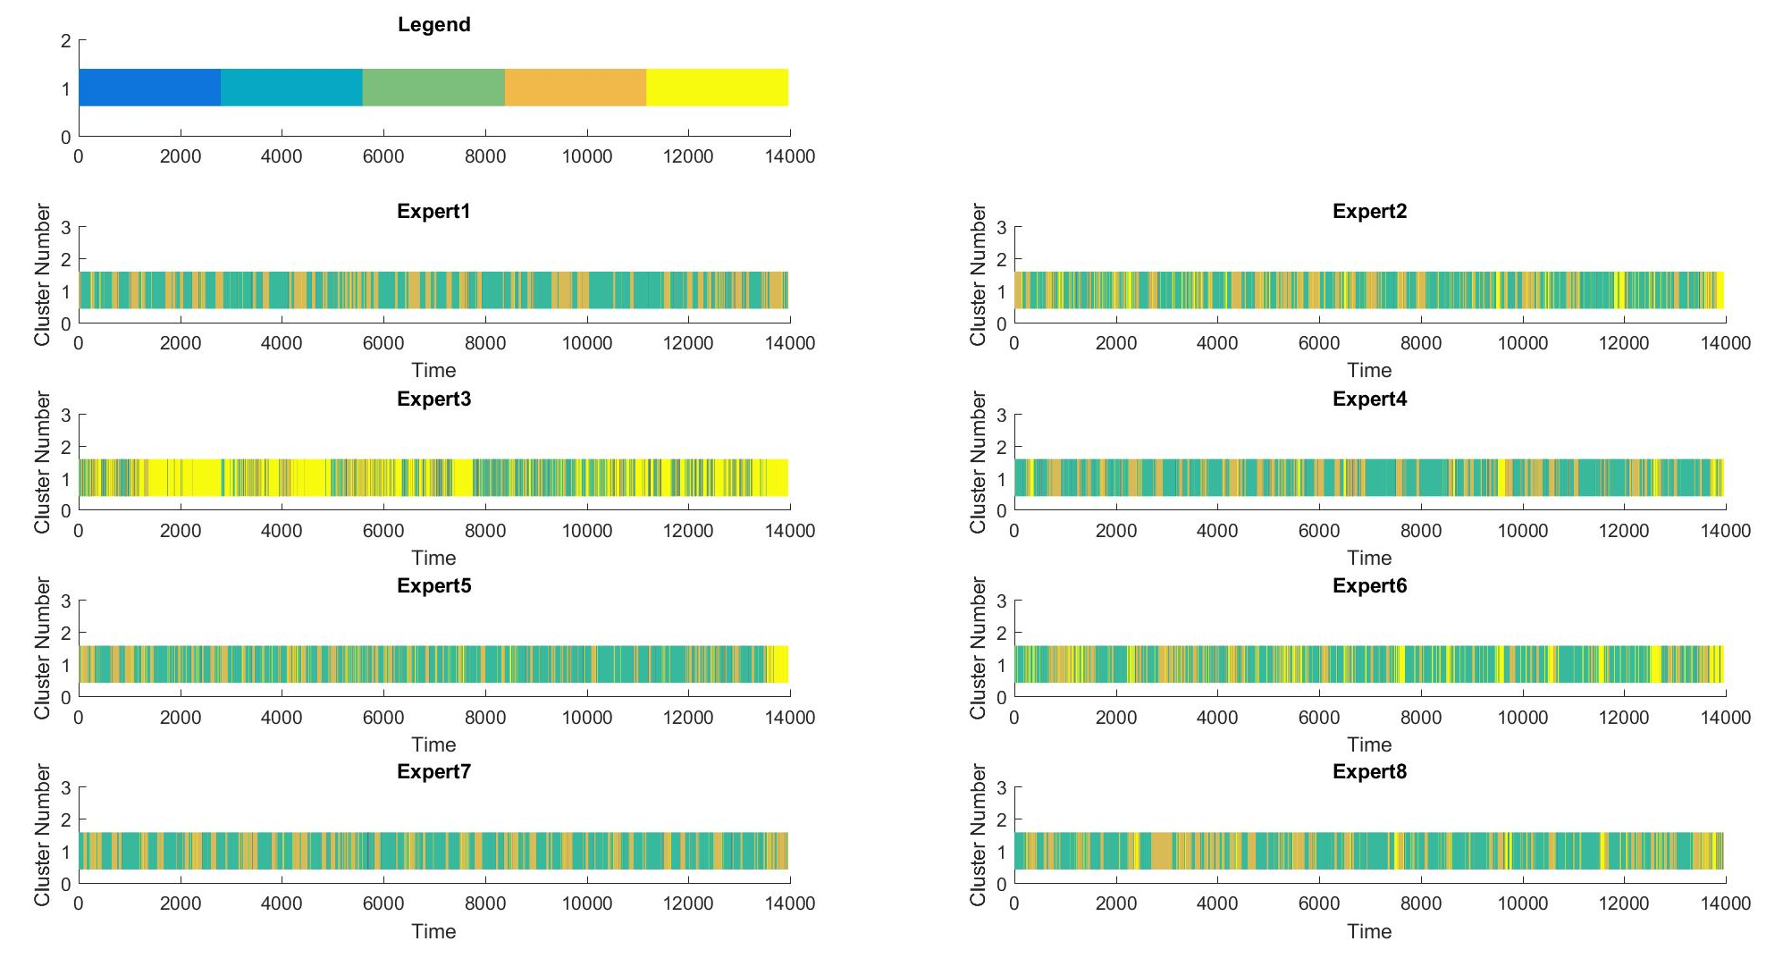
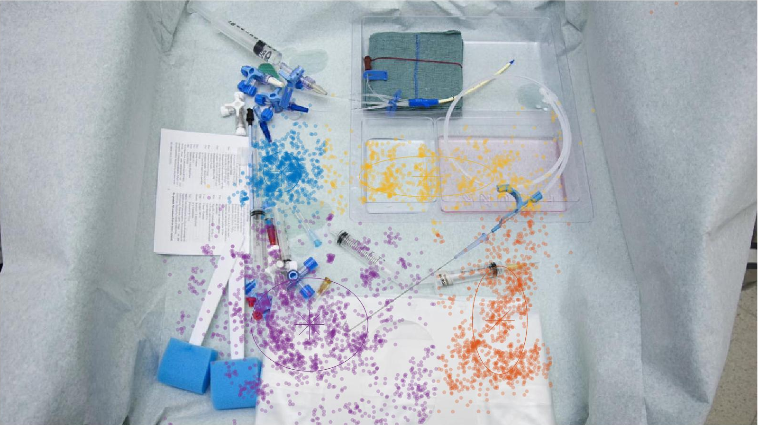

CAN WE DETECT EXPERT AND NOVICE ANAESTHETISTS BY HOW THEY WATCH VIDEO?
INTRODUCTION
How would you look at the picture below?
How do you, with no medical experience, view this:
How would a medical expert view this?
We can record eye tracking data as experts/novices view this scene:
We then build a model to determine how expert the viewer is.
My task was:
to compile data for just such a task,
build a computer model - look some traceable pattern throughout experts.
WHY DO THIS?
The end goal for all this, is to design a program that can track a trainee anaesthetist as they view clip after clip of scenario, and at the end score the trainee against the average expert. This would be
RESULTS
The gaze data was clustered using the Gaussian Mixture model The data was then validated using statistics based on the models created. I found some interesting properties shared by experts. Below is the number of times an expert vs. a layman focused on each object group:
TOOLS
I was also able to find some similarity between experts in the order in which they look at each object group:
The raw data I needed was recorded as part of a previous CUROP so I my task was to process this information and mould it into a statistical model. The tools used for this were:
Tobi camera used by the previous student to record gaze of the subject.
Sample videos provided by the Dept. of Anaesthetics.
MATLAB using a student license with additional toolboxes:
Netlab - a free toolbox provided by with multiple learning algorithms for clustering.
Hidden Markov Model Toolbox – A free toolbox from mathworks
There were some distinct patterns which show promise for building a general model.
PROJECT STRUCTURE
FURTHER STEPS
Collect and convert data from original format.
Visualise data – overlay gaze data over source videos.
Extract characteristics from data:
Identify objects in the picture.
Order in which each object group is viewed.
Time spent outside of recognisable objects.
Translate as many of the useful properties into a temporal domain.
Generate one/two models (based on results of previous step).
CLUSTERING
Due to the use of clustering as a basis for both measured properties, it was impossible to measure either for clips with moving elements. One task moving onward would be to find a method for identifying dynamic objects within a video programmatically and tracking gaze on these objects.
CLASSIFICATION
Due to set backs in the project, I could not in time, run the statistics I had gathered through any classification algorithms, and instead had to complete the project before testing my hypothesis that these were classifiable attributes.
IMPLEMENTATION
The intended application of this project, given it’s success would have been to implement it in an educational app for use in developing countries, namely Zambia
REFERENCES
Netlab – Free Toolbox provided by Aston University
Hidden Markov Model – Authored by Mo Chen
Previous Eye Recording Data – from Ameen Ul-Haq’s CUROP of the same title.
This research project was funded and facilitated by Cardiff University. It was
supervised by Prof. Judith Hall, Dr. Michael Lim from the Dept. of Anaesthetics,
and Professor David Marshall of the Dept. of Computer Science.
All research not attributed otherwise carried out by Liam Hiley

