Slide 1
A Structuralist approach
Writing to express

Slide 2
A Structuralist Approach
Consider this:
Ideas are only meaningful because they have opposing ideas. Day only means something if there is night. Happiness is meaningless without sadness.
Meaning exists in binaries (pairs of opposing ideas). Another word for this kind of pair of ideas is a dichotomy.
Examples of dichotomies in stories might include:
Freedom/entrapment
Connection/isolation
Acceptance/rejection
Science/religion

Slide 3
A Structuralist Approach
Short story writers can use this theory to improve efficiency and depth in a story.
If you wanted to write about the importance of sadness, you don’t need to write about happiness as well, because that idea is already contained within ‘sadness’ as its opposite.
Alternatively, an author can use symbolism to express the dichotomy so that they don’t have to explicitly mentioned either.
For example, if an author wanted to focus on the dichotomy of life and death, they might include descriptions of seedlings and eggs hatching, along with rotting things and bones.
A dichotomy of freedom/imprisonment might describe birds and fences, chains and the sky.

Slide 4
A Structuralist Approach
Hills like White Elephants
Ernest Hemingway’s short story ‘Hills like White Elephants’ is, on the surface, a conversation between a man and a woman about a ‘simple operation’ that the woman is about to have, and where they drink and discuss the scenery while waiting for a train.
But once we unlock the symbolism, the story takes on a much deeper meaning.
The hills on one side of the valley are green and verdant, while the hills to the other side are bare, like ‘white elephants.’ One side is fertile, and the other is barren. The drink is called ‘anise del toro,’ or loosely translated, the ‘seed of the bull’. The bull (not to mention the bull’s ‘seed’) are commonly used symbols pertaining to male potency.
So given the dichotomy of fertility/potency and infertility, what do you think the ‘simple operation’ is that the man is encouraging the woman to have?
The story has taken on a much deeper, and emotional meaning.

Slide 5
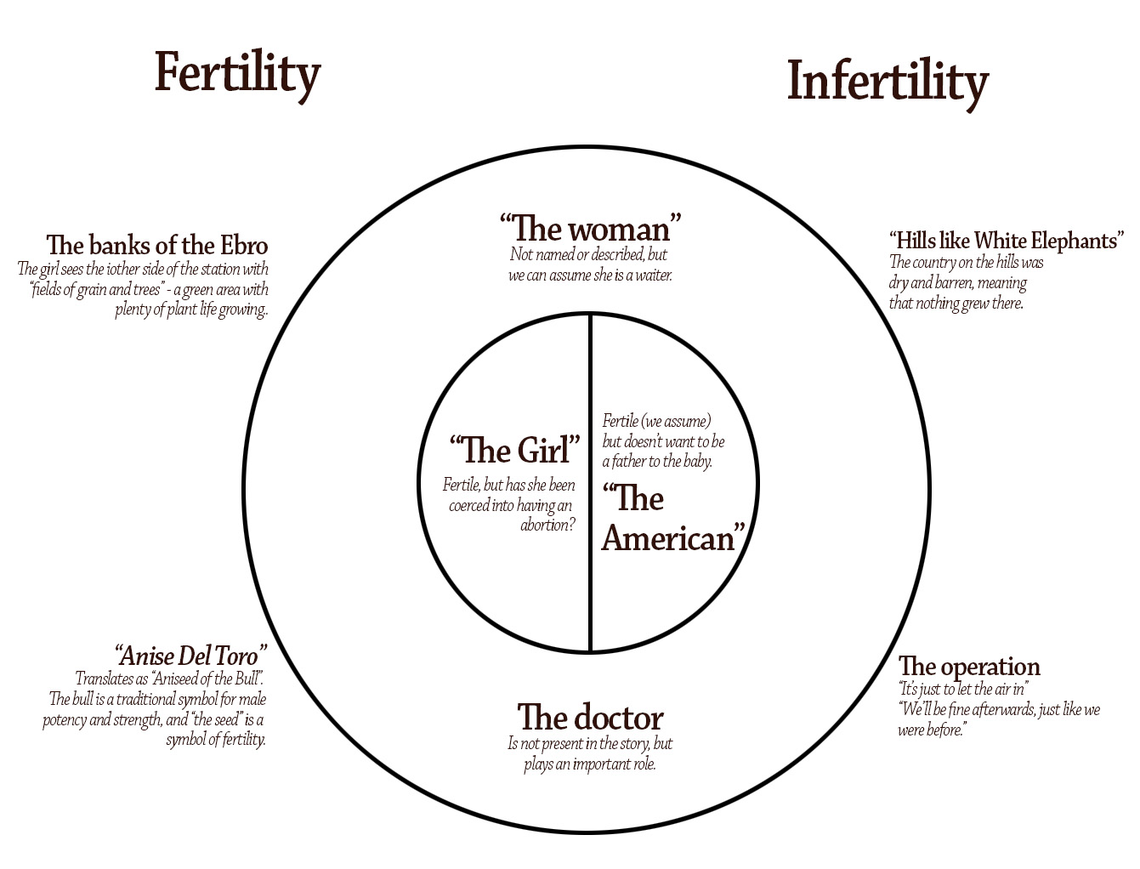
Hills like White Elephants
We can map the use of the dichotomy fertile/infertile.
In the circle, we can see the central characters and the external characters.
Outside the circle we can explore the symbolism that represents each side of the binary.

Slide 6
Ideas around protest
Think of some dichotomies that relate to protests and protesting.
Silence vs activism
The voiceless vs the loudest
Violence vs peace
Money vs morality
Belonging vs exclusion

Slide 7
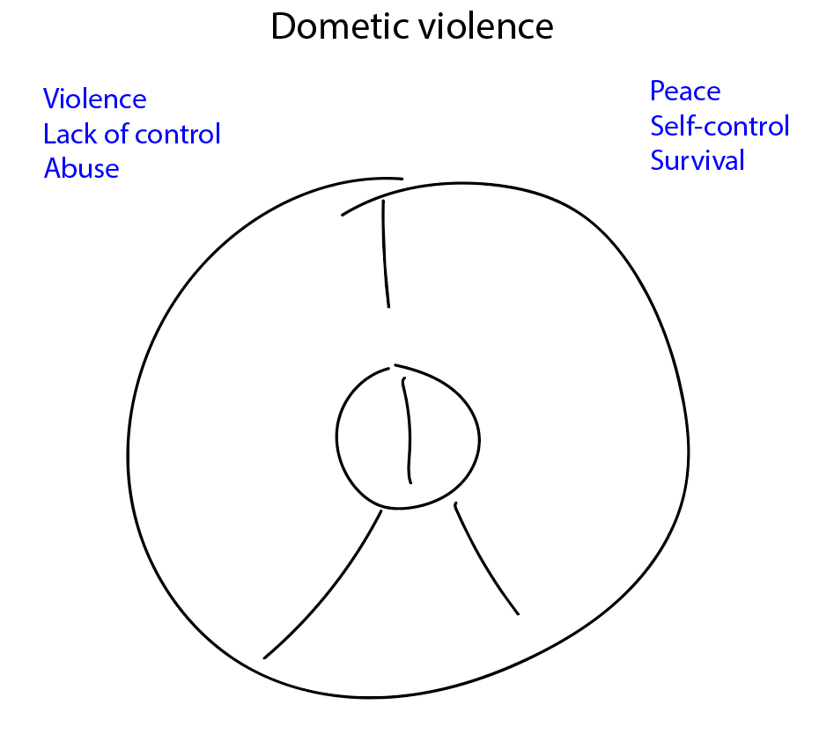
A Structuralist Approach
We can map our story using a structuralist approach.
Let’s the binary of peace and violence to write a story about domestic abuse.
We start with a circle inside a circle. On one side we have peace, self-control and survival, and on the other, violence, lack of control and abuse.

Slide 8
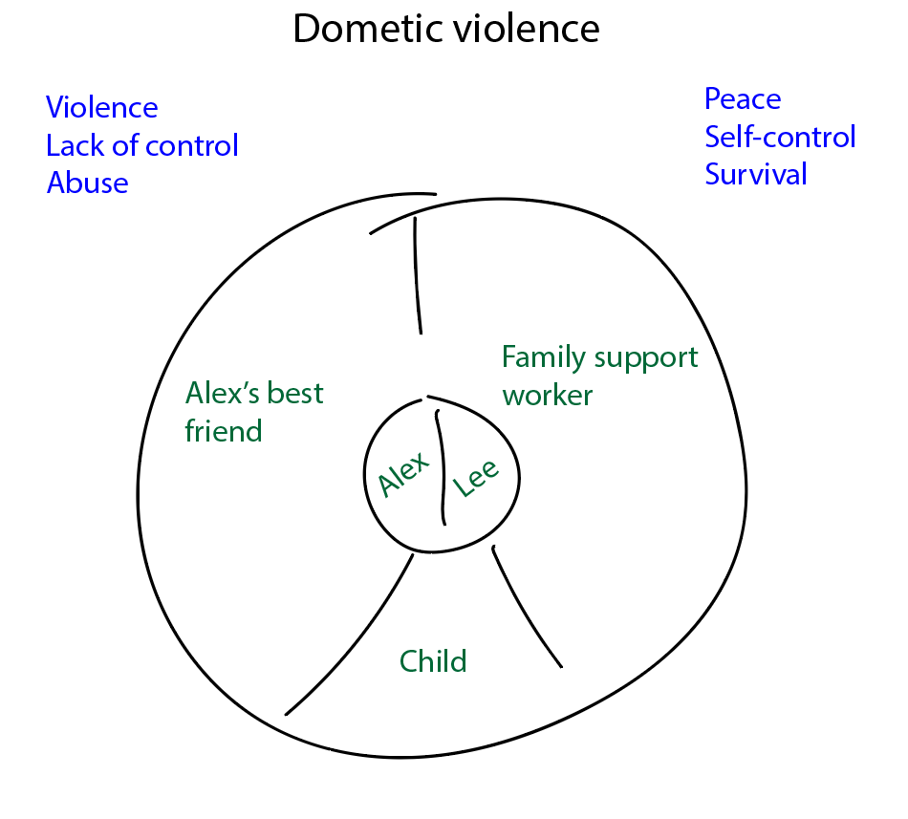
A Structuralist Approach
A short story should have a maximum of 2-3 main characters. If we need others, then we don’t give them names or descriptions.
In this story, we’ll have two central characters, each representing a different side of the conflict.
Let’s add a child that is caught in the middle.
We might also have some minor characters on the outside. These don’t get names or descriptions in the story.

Slide 9
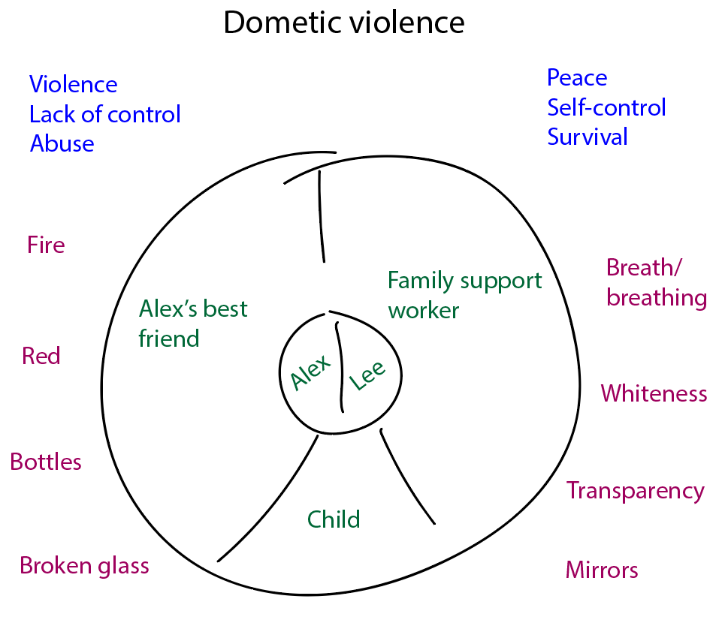
A Structuralist Approach
Lastly, we need to include symbols and motifs to help explore the conflict.
To represent peace and self-control, we might use a white, bright colour palette, the symbol of the mirror and the motif of breath.
On the side of violence, we’ll use fire, the colour red, bottles and broken glass.

Slide 10
A structuralist approach
Once you have the story mapped out like this, then it almost tells itself.
There’s two people in a relationship. The setting is described as bright, with glass and mirrors in the house. Tension builds, leading to a violent escalation. Glass breaks, peace is shattered, etc.
But this is just one model.

Slide 11
External conflict
In this case, we are creating a story with an external conflict. This conflict is represented in the inner circle.
This one is a person vs person conflict.
You could also write a story containing a person vs machine or person vs nature conflict.

Slide 12
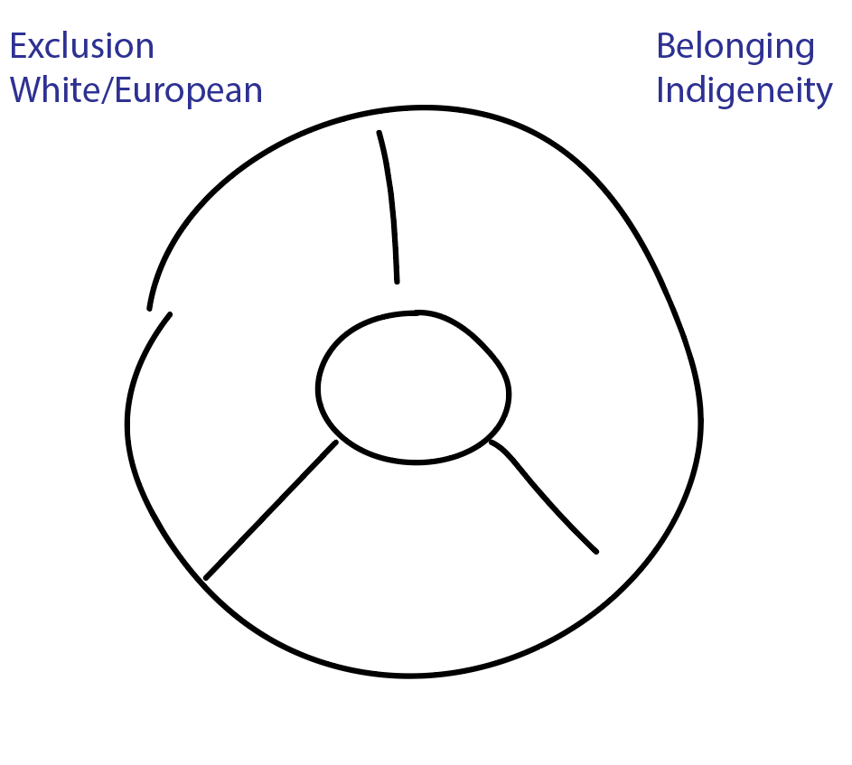
Internal conflict
The other model is based on a sole central character and deals with an internal conflict.
The tension is created when a character is stuck, or pulled between two ideas.
Consider this story, where we explore the conflict between belonging and exclusion for an indigenous character.

Slide 13
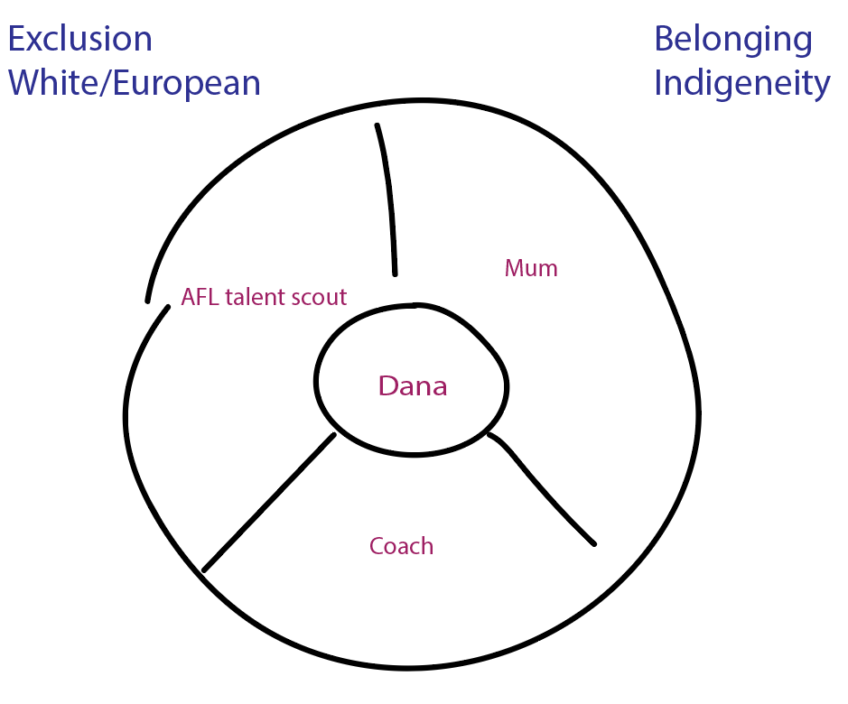
Internal conflict
The character (Dana) goes in the centre.
They are pulled between two ideas. In this case, they are pulled between staying at home where they feel a sense of belonging, and moving to the city to play football for a club.
Their coach occupies the tension with them. They want the best for the player no matter what they decide.

Slide 14
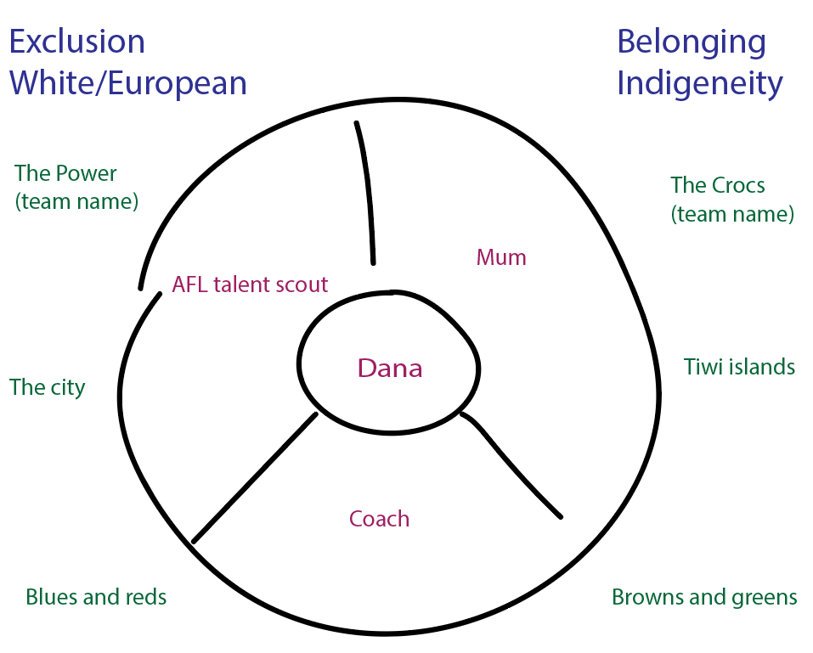
Internal conflict
We can flesh out the story with symbols and a colour palette.
Again, the story almost writes itself.

Slide 15
The point of climax
How to build the structure

Slide 16
The point of climax
According to the basic rules of a short story, your narrative should:
Only describe 2-3 characters. If there are other characters required to tell the story of the main character, then avoid giving them names or descriptions. They’re not needed.
Only describe the events of a few hours at a maximum – especially in an extra short piece like the one you’ll be writing.
There needs to be a point of maximum tension.

Slide 17
The point of climax
Think about the point of maximum tension.
This will be the point at which both sides of your dichotomy come together.
Freedom/entrapment? Someone is caught, or someone breaks out.
Peace/violence? The exact moment when the protest becomes a riot.
Connection/isolation? All connection is lost. Or they finally fall in love.

