Slide 1
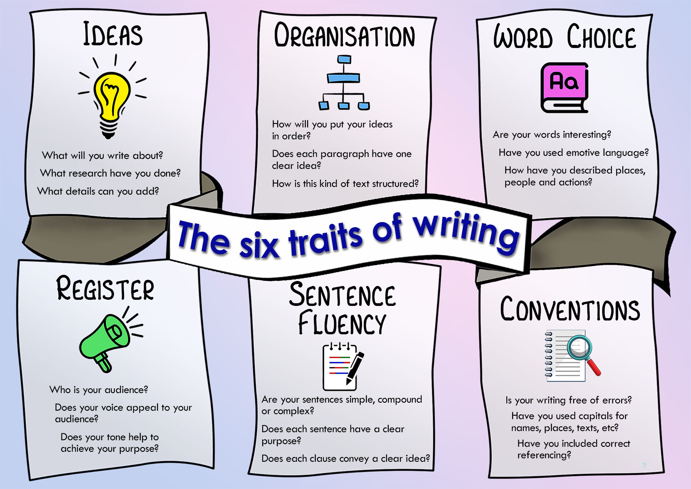

Slide 2
Learning outcomes
Learning intentions:
I will be successful when:
To understand the “six traits of writing” framework.
To improve our ability to scaffold students at different stages of a writing task.
I can identify each of the six traits in a text.
I can think of ways to support students at each stage.

Slide 3

1. Ideas
All the learning that takes place before the writing task.
In Science, this might include the experiment and the results.
In Humanities, the ideas might be students’ historical understanding.
Questions for students might include:
What will you write about?
What research have you done?
What details can you add

Slide 4

2. Organisation
The way the ideas will be sequenced and structured.
In English, this might be the structure of a hard news article.
In Foods, students might write their own recipe.
Questions for students might include:
How will you put your ideas in order?
Does each paragraph have one clear idea?
How is this kind of text structured?

Slide 5

4. Register
Sometimes called voice, this is about using right language for the audience and purpose of the text.
In Humanities, this might involve the use of formal analytic language in an essay.
In English, students might create characters that speak using different words.
Questions for students might include:
Who is your audience?
Does your voice appeal to your audience?
Does your tone help to achieve your purpose?

Slide 6

3. Word Choice
Choosing the right words to convey an idea with sophistication, detail and clarity.
In a narrative, this might include descriptive language, simile and metaphor.
In Health, this might include using the new jargon or metalanguage.
Questions for students might include:
Are your words interesting?
Are your words specific or general?
Have you used emotive language?
How have you described places, people and actions?

Slide 7

5. Sentence Fluency
Students must understand how to write simple, compound and complex sentences and how these involve different types of clauses.
In Design, this might include writing fragmented instructions that begin with a verb.
In History, students will use complex sentences to explain cause and effect.
Questions for students might include:
Are your sentences simple, compound or complex?
Does each sentence have a clear purpose?
Does each clause convey a clear idea?

Slide 8

6. Conventions
The proof-reading process to make sure that the writing is clear and accurate.
This includes spelling, grammar and punctuation and formatting.
Questions for students might include:
Is your writing free of errors?
Have you used capitals for names, places, texts, etc?
Have you included correct referencing?

Slide 9
Scaffolding students
using the six traits of writing

Slide 10

Ideas
This is the area that we do really well!
What do we already do?
Discuss ideas
Brainstorms, mindmaps, etc
Have students complete short-answer exercises
Experiment with ideas and concepts
Read a range of information
Low-stakes writing tasks

Slide 11
Ideas
“I don’t know what to write!”
How do we support those students?
How else can we help them to get started with an idea?
Common language:
Identify, describe, explain, analyse
Argument, contention, claim, intention
Low-stakes writing

Slide 12

Organisation
You probably have a clear idea of how ideas should be structured in your written tasks.
These structures must be taught explicitly and reinforced throughout the unit.
Students should be given a chance to experiment and receive feedback on their structured writing.
What do you already provide for your written tasks?
Mentor texts
Templates

Slide 13
Organisation
Other scaffolds might include:
Providing annotated mentor texts
Reverse outlining
Partly completed writing tasks
Common language:
Mentor text
TEEL paragraphs
Paragraph vs argument or claim
Aristotelean, Rogerian and Toulmin arguments

Slide 14
Register
Register refers to the way we make choices about how we express our ideas.
But how much do we actively teach the connection between language, audience and purpose when preparing students for a writing task?
Advice that we currently give students might include:
Don’t use “I” in an essay.
Always use the active voice.
Don’t editorialise

Slide 15
Register
We need to explicitly teach the why behind these snippets of advice.
Who is the audience of this writing?
What does the audience already know, and what do they need to know?
What is your intention? What does this writing need to achieve?
Other explicit teaching could involve:
Using modal words
Formal and casual registers
When to use clear and simple writing, and when to expand
How to analyse without value judgments

Slide 16
Word Choice
This connects closely with the subject knowledge that is already taught explicitly in the unit.
Scaffolding at this stage is about reminding students of new words and giving them the opportunity to incorporate them into their writing.
How do we already do this in our LAs?
Glossary building
Word walls
Modality and verb lists
Cloze exercises

Slide 17
Word Choice
What kinds of problems do you find in student writing when it comes to their choice of words?
Other scaffolds might include:
Re-writing tasks
“Write-like” or emulation tasks
Word games
Word bank chart

Slide 18
Sentence Fluency
This is where the most work needs to be done, not just for students, but also for us as instructors.
Students need to be able to write with clarity and for different audiences and purposes.
We need to eventually get to a point where we all understand and can explicitly teach:
Subject, verb and object
Dependent and independent clauses
Conjunctions
Simple, compound and complex sentences

Slide 19
Sentence Fluency
This will be a long-term goal, not a short-term stressor!
Common language will eventually include:
Subject, verb, object
Noun group and nominalisation
Process, circumstantial phrase
Simple, compound, complex sentences
For now, scaffolds might include:
Cut-up sentences
Write-like tasks
Sentence starters that use a variety of noun groups
Posters, reminders and guides

Slide 20
Conventions
How do we explicitly teach or embed the process of editing, revising and proofreading?
Do we teach and model expectations around what finished texts should look like on the page?
Do we explicitly teach spelling of new subject-specific vocabulary?
Do students learn how to use software to present texts?
What do you already include in your tasks?

Slide 21
Conventions
Common understandings to aim for:
The drafting process (“draft” as a verb, not a noun)
“No excuses” writing (capital letters, boundary punctuation, apostrophes)
Paragraphing
Other scaffolds might include:
Checklists
Peer editing and workshopping
Visual reminders and guides

