Slide 1
Parts of a sentence
Active and passive voice

Slide 2
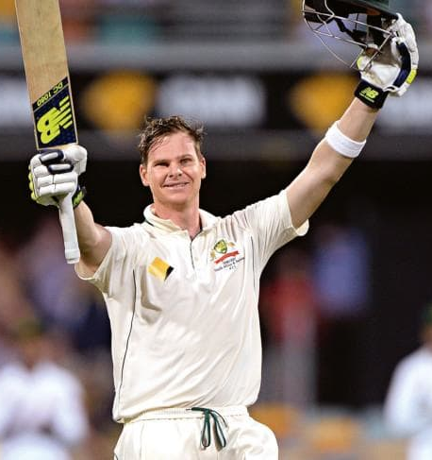
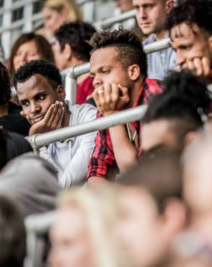
What would you rather do?
Watch Steve Smith batting?
Watch somebody who is watching Steve Smith batting?

Slide 3
How does it make you feel?
“Mr Williams locked Mr Coleman in the basement before the police arrived.”
What do you think might have happened? Who is the villain here?

Slide 4
How does it make you feel?
“Mr Coleman was locked in the basement by Mr Williams before the police arrived.”
How does this change things?

Slide 5
How does it make you feel?
“Police arrived to find Mr Coleman locked in the basement.”
How about now?

Slide 6
Active and passive voice
We are going to learn how to use the active and the passive voice.
We will learn how playing with the participants in a sentence can change the effect of the writing in a range of ways.

Slide 7
Learning Intention
This lesson is designed to help you improve your ability to write with purpose.
At the end you should be able to identify the difference between active and passive voice, and begin to explain the effect of each.

Slide 8
Recap
A clause must have a participant and a process.
It might also have a circumstance and a target participant.

Slide 9
Main Participant
The Who or What of the sentence.
The ‘doer’ of the process. The person or thing that makes the process happen.
The goalkeeper kicked the ball.
The goalie made the kicking happen. They are the ‘doer.’

Slide 10
Target Participant
The Whom or What the process is ‘done to.’
The goalkeeper kicked the ball.
The ball didn’t do the kicking. It was the thing that the kicking was ‘done to.’

Slide 11
Nominalisation
Nominalisation is the process of changing the main participant group.
We can change it by adding more detail:
The enormous blonde goalkeeper kicked the ball.

Slide 12
Nominalisation
Or can change it by swapping elements around.
Lets swap the participants:
The ball was kicked by the goalkeeper.
Now the ‘done to’ is the focus of the sentence.

Slide 13
Passive Voice
The ball was kicked by the goalkeeper.
What we have done is written a sentence using the passive voice.
This changes the tone of the writing. It takes the emphasis away from the person kicking the ball.

Slide 14
Passive Voice
In fact, we don’t need the goalkeeper at all!
The ball was kicked.
This is still a complete sentence because it contains the participant and the process.

Slide 15
Active Voice
To write using the active voice, make sure you focus on the person or the thing that’s making the action happen.
The doer.

Slide 16
Active Voice
Smith grabbed Longmire in a head-high tackle and took Longmire out of the game.
Active voice conveys a sense of action and urgency, and lets the reader know that Smith is responsible for the action.

Slide 17
Passive Voice
Longmire was taken out of the game by Smith’s head-high tackle.
Passive voice places the emphasis on the ‘done to’, which makes the reader feel more sympathetic towards them.
It can also make the action seem less urgent and dramatic.

Slide 18
Changing processes
When you change from the active to the passive voice (or vice versa) you will also need to change the form of the process.
The goalkeeper kicked the ball to the centre of the pitch.
Becomes
The ball was kicked to the centre of the pitch by the goalkeeper.

Slide 19
Changing processes
Active |  | Passive
kicked |  | had been kicked (by)
grabs |  | Is being grabbed (by)
completed |  | was completed (by)
should have taken |  | should have been taken (by)
can see |  | can be seen (by)

Slide 20
Identify which are active and passive.
Example | Active (A) or Passive (P)
Donahue lifted the cup high above her shoulders.
The banner was torn to shreds by the players running through.
The match was won.
In the stands, only a single member of the audience yelled out.
That single voice was heard by everybody there.
The dancer was majestic.
Nobody in the room dared to make a sound.

Slide 21
Rewrite the following as active sentences
Active | Passive
 | The match has been won by the Falcons.
 | Three unforced errors were made by Nadal.
 | The uniforms have been left in the locker room.
 | At the end of the game, not a single piece of rubbish had been left by the Japanese fans.
 | The morning of the game, I’d been woken up by my dad.
 | Similar themes were covered in the 1970s by journalist Michael Covington.

Slide 22
Rewrite the following as passive sentences
Active | Passive
The groundskeeper has immaculately prepared the pitch.
Fleming broke the ribbon with a final lunge.
They had broken the record for the highest total in a tournament.
Bluey dodges the defender very skilfully.
The ball hit the Wing Defence right in the face.
The crowd gave an enormous cheer.

Slide 23
Reflection:
In your notebooks, respond to the following in as much detail as you can:
What is the effect of writing in the active voice?
Why might an author choose to write in the passive voice?

