Slide 1
Six Traits of Writing
Word Choice

Slide 2
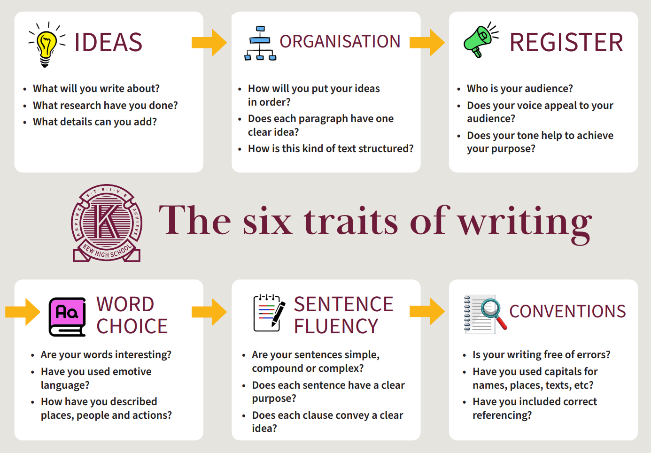
Notes:
We started in term 3 looking at using the Six Traits framework to scaffold our teaching of writing.
Remember:
We scaffold for developing ideas really well
We learned some new strategies for scaffolding organisation
We’re going to skip register for now and move on to Word Choice

Slide 3
Vocabulary building
Our job:
To developing students’ access to a broader and more nuanced vocabulary
To develop vocab specific to each subject and context
This will improve:
Writing and outcomes
Understanding of content
Notes:
This will improve our students’ writing and achievements, but more importantly, improve their understanding of the content.

Slide 4
NAPLAN
Writing:
Vocabulary is assigned a maximum of 5 marks.
KHS students:
3/5 (year 7)
4/5 (year 9)
But this is not the whole picture.
Notes:
THE DATA SAYS
Within the writing assessment, vocabulary is assigned a maximum of 5 marks
KHS students score an average of 3 (at year 7) and 4 (at year 9).
This is pretty good, but it isn’t the whole picture.

Slide 5
NAPLAN
When we look at the reading data:
Qs that ask students to interpret meaning of specific words.
Qs that ask about content using synonyms.
These are the Qs we frequently get wrong.
Notes:
When we dig into the NAPLAN reading data, there are questions that ask students to interpret the explicit meaning or implied meaning of specific words, or that ask questions about the content using different words or phrases.
It’s these questions that fewer than half our students answer correctly.

Slide 6
NAPLAN
This suggests:
lacking a nuanced understanding of a range of words and synonyms,
students have difficulty interpreting subtle differences between meanings.
Notes:
This suggests that they don’t have a nuanced understanding of a range of words and synonyms, which makes it much more difficult to interpret texts correctly.

Slide 7
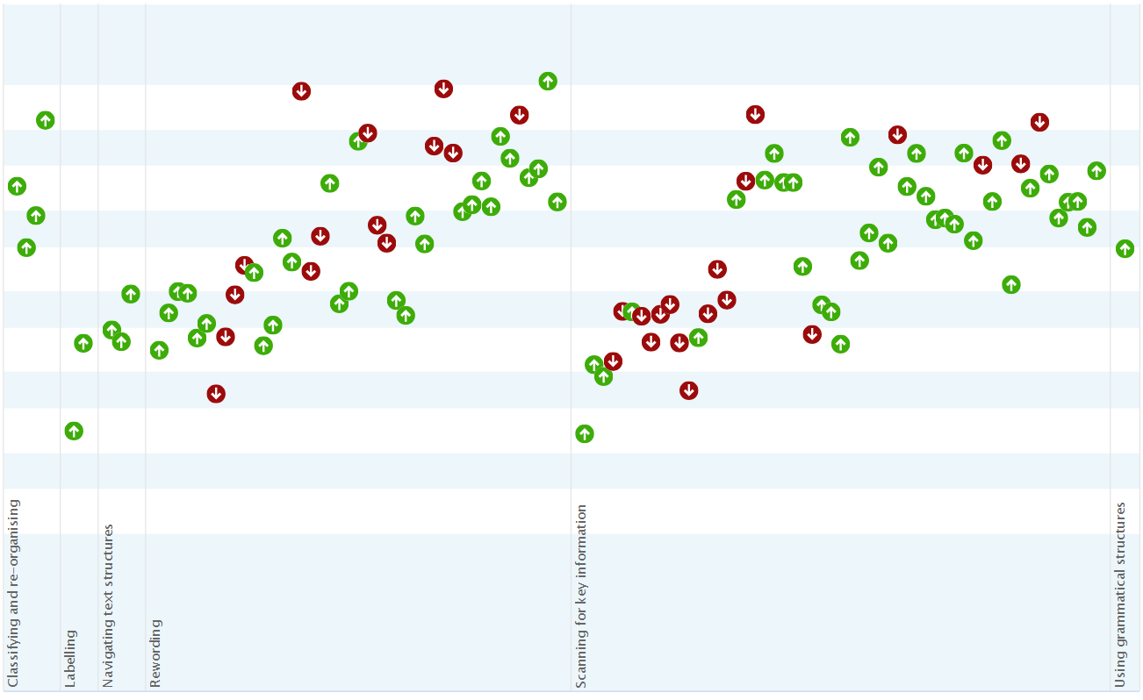
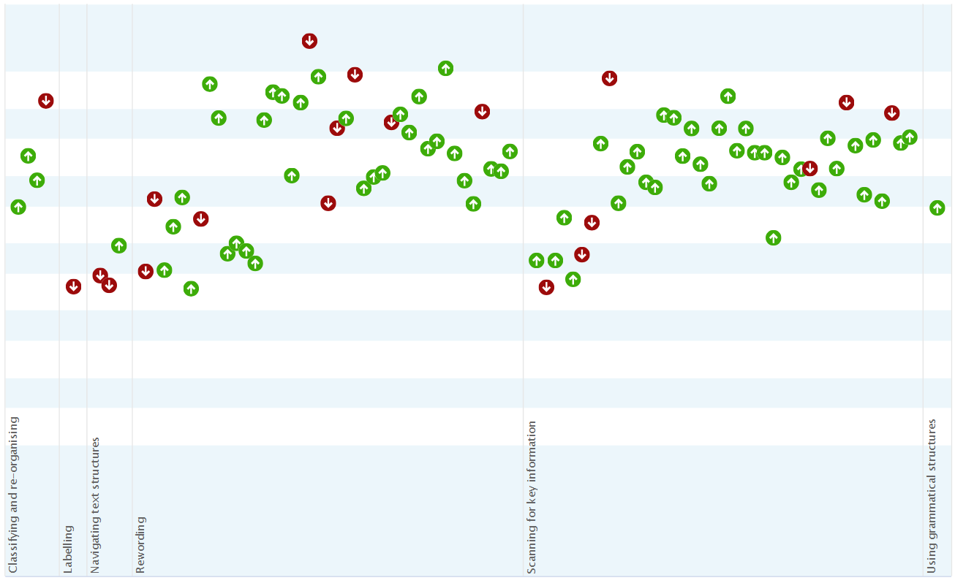
PAT-R
This is supported by PAT data.
Year 7 2023
Year 9 2023
Notes:
This interpretation is supported by our PAT data.
The clusters of incorrect responses at year seven relate to skills in rewording, and scanning texts for key (often inferred) information.

Slide 8
Data says…
Year 7s need particular support to develop vocab
We’re currently doing some really good work!
Notes:
Both PAT and NAPLAN show that our year sevens needs additional support when it comes to developing their vocabularies.
These also suggest that we’re currently doing some good work.

Slide 9
Existing work
Quick SSK with your table group:
What currently exists in your units to develop a nuanced understanding of tier 2 and tier 3 words?
Stop | Start | Keep
Notes:
I want to take a moment to try to reflect on some of that good work that we do.
At your tables, try to brainstorm some strategies that you currently have in place.
Quick refresher: tier 2 and tier 3 words:

Slide 10
Tier 1 | Everyday words | dog go happy drink phone play sad | Explicit teaching should be considered in your ILPs and modifications.
Tier 2 | Academic words. Multiple topics and subject areas. Increasingly complex. | Precision terms Command terms Descriptive terms | Must be explicitly taught. Useful for multiple purposes, Taught and reinforced across different contexts and exposures.
Tier 3 | Specific or context-specific. Distinct meanings and purposes. | carburettor legislature circumference aorta polyglot sonata isosceles | Explicit teaching in particular content areas. Does not mean given preference over tier 2 words. Students must understand the nuances of Tier 3 words in specific contexts.
Notes:
Tier 2
Required in an academic context across multiple topic and subject areas.
Allows for discission of increasingly complex topics.
Precision terms, such as relative vary formulate specificity accumulate
command terms like identify, describe, explain, analyse
descriptive terms misfortune dignified faltered distinctly resolve
Tier 3 Words that have distinct meanings and purposes, relevant to a specialised topic or discourse.
Students should learn these for the particular content areas.
Does not mean that these should be given preference over tier 2 words.
Focus must still be on clarity of expression, but students must learn to use and understand the nuances of Tier 3 words in their specific contexts.

Slide 11
Existing work
Quick SSK with your table group:
What currently exists in your units to develop a nuanced understanding of tier 2 and tier 3 words?
Stop | Start | Keep
Notes:
On to brainstorming.

Slide 12
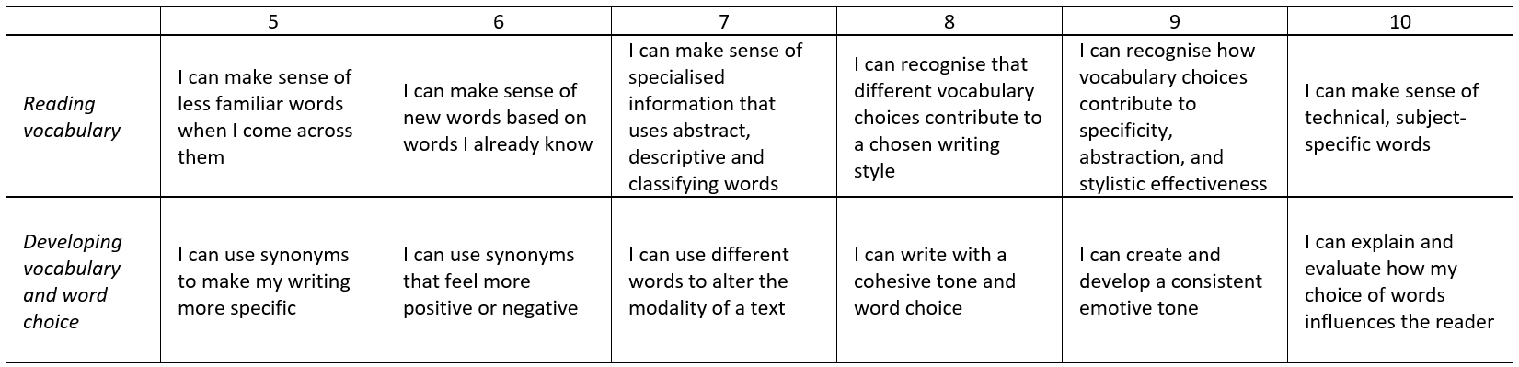
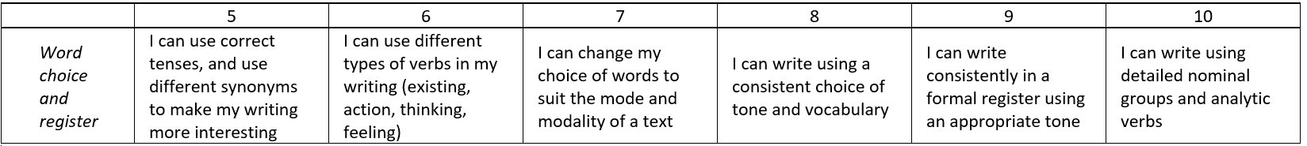



























How does it align?
From the VC/ English LC:
From our cross-curricular literacy continuum:
Notes:
English learning continuum (taken from the Victorian curriculum)
And the cross-curricular literacy continuum
At year 7 – use synonyms and different types of verbs, beginning to use precise and specialised words (tier 2)
By year 10 – using technical tier 3 words and analytic verbs

Slide 13
How does it align?
Arts
Curriculum documents include detailed glossary.
Descriptors include:
Describe how ideas are expressed (7-8 vis art)
Analyse and interpret artworks - explore different forms of expression (9-10 vis art)
Identify and connect specific features (7-8)
Identify and describe methods, media, materials, design elements and design (7-8 vis com)
“Analyse and evaluate” the same (9-10)
Notes:
Those tier 2 and 3 words are specified in the subject glossary, but also in curriculum descriptors
We’re explicitly teaching words that relate to describing and analysing how ideas are expressed

Slide 14
How does it align?
History
Curriculum documents include detailed glossary.
Specified in descriptors:
Causes/effects of contacts/conflicts with other societies/ peoples … expansion of trade, colonisation, war and beliefs
Causes leading to Industrial Revolution … industrialisation of Britain and of Australia
Analyse/corroborate sources, evaluate accuracy, usefulness and reliability
Implied in descriptors:
Qualification, quantification, primary and secondary sources, conservative, revisionist, neo-conservative
Notes:
Again, tier 2 and 3 words outlined in subject glossary
Some vocabulary specified in curriculum:
Causes, effects, conflicts, expansion of trade, colonisation, industrialisation
Analyse, corroborate, evaluate their accuracy, usefulness, reliability
Other descriptors rely on an implied vocabulary
Qualification, quantification, primary and secondary sources, conservative, revisionist, neo-conservative

Slide 15
How does it align?
What tier 2 words does your subject require students to use?
What tier 3 words are unique or specific to your subject?
Notes:
How might this apply to your subject?
As we look at the strategies on the next few slides, think about the tier 2 and tier 3 words that students often need support developing.

Slide 16
Is the juice worth the squeeze?
The juice:
To improve students’ ability to communicate ideas with precision,
To enable students to understand increasingly complex ideas in texts
To develop confidence
To ultimately improve ATAR scores.
The squeeze:
To implement strategies for the explicit teaching of tier 2 and tier 3 words.
Notes:
What is the juice? What’s the outcome we’re chasing?

Slide 17
Strategies
A non-comprehensive, non-compulsory list of suggestions, mostly developed by people much smarter than me.

Slide 18
Student glossaries
Even better if:
Student created – students build their own glossary of terms in the back of their notebooks with teacher support.
Word wall – unit-specific words are displayed visibly around the classroom.
Groupwork – with teacher support, students work together to define and find examples of words without the use of the internet.
Notes:
We probably all use student glossaries before and during units of work.
These will be even more effective if you can spare the extra few minutes to try some of these approaches:

Slide 19
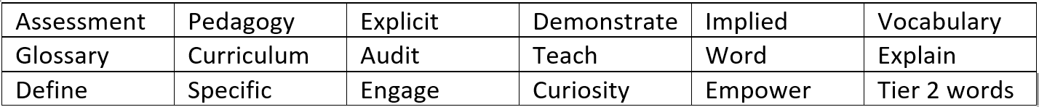
Concept attainment
Students are given a list/table of words from all three tiers, including subject metalanguage, analytic verbs, concrete and abstract nouns.

Slide 20


















Concept attainment
Students use different coloured highlighters to categorise the words
Basic – give them the categories (metalanguage, analytic verbs, concrete nouns, abstract nouns, descriptive words)
Advanced – have students work together to define and describe the categories.

Slide 21
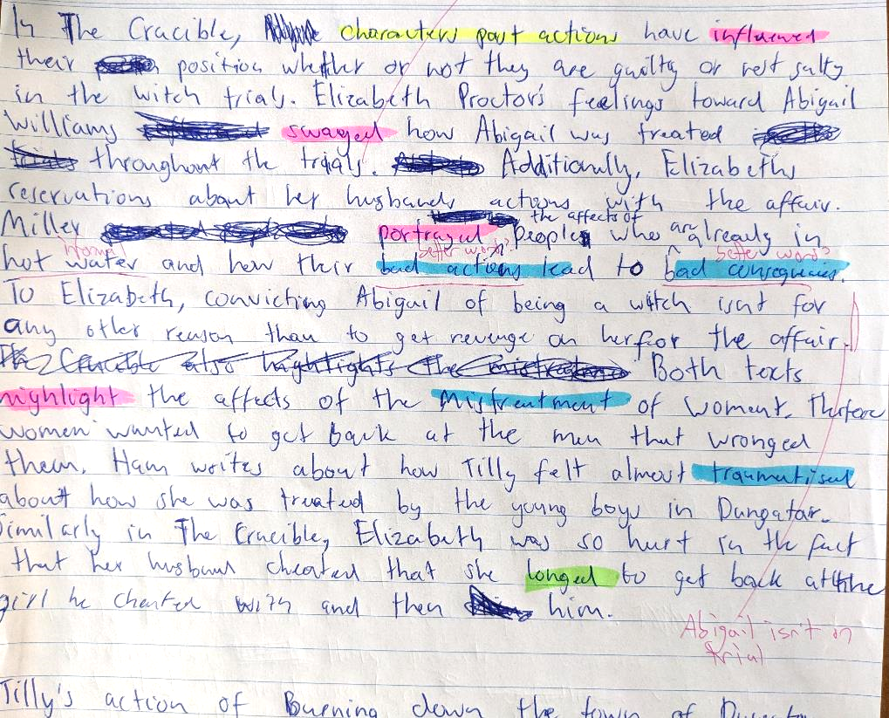
Concept attainment
Follow-up task:
Students to use the same colour coding to highlight the same word classes in their own writing.

Slide 22
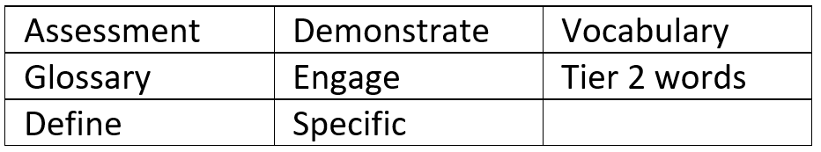
Cloze
An oldie but a goodie, especially for differentiated or ILP tasks.
Rather than an onerous _______________ task, you can ___________ your students and allow them to _________ their knowledge using a short Cloze exercise. This allows them to develop their ______________ without needing to ____________ _______________ in a time-consuming ___________________ - especially if their ILP requires _____________ modifications.
Notes:
Give students a word list, and they use them to fill in the blanks.

Slide 23
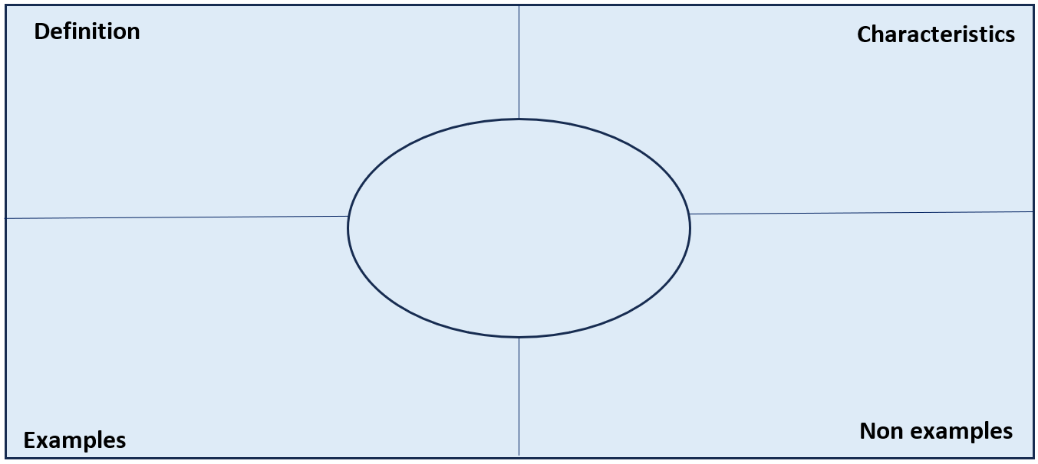
Freyer chart
Develops vocab using concept-attainment.
Allows students to develop own understanding of a word or a concept
Before or during reading.
Notes:
This model allows students to develop their vocabulary skills and draws from concept-attainment research.
Students determine and clarify their own understanding of a word or a concept either before or during the reading of a text.

Slide 24

Freyer chart
Word in centre
Characteristics of the idea
Brainstorm examples
Brainstorm non-examples
Write own definition
Check definition
Notes:
Students write the word in the centre of the chart.
They write the characteristics of the word (i.e. the idea represented by the word).
Students brainstorm examples of the idea.
Students brainstorm non-examples (things that don’t fit the definition).
Students end by writing their own definition based on the information in the chart.
Only then do students consult a dictionary to check their definition.

Slide 25
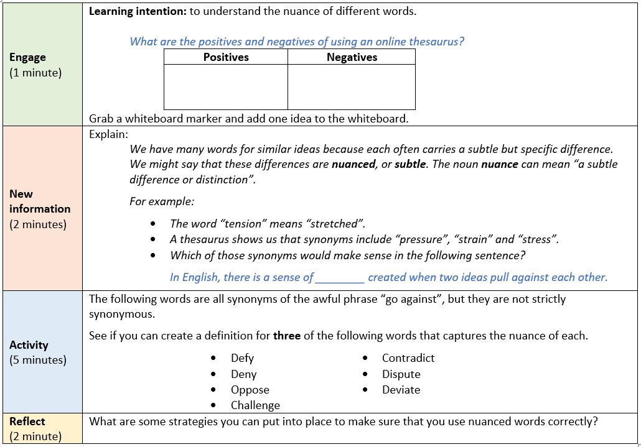
10-minute mini-lessons
Embed a series of 5- or 10-minute vocab mini lessons.
Creates a culture of learning and using new words.
Notes:
Any one of these approaches can be embedded into a five- or ten-minute mini lesson at the beginning of a lesson.
This one explicitly teaches the idea of nuance, and allows students to practise using different synonyms instead of “go against”.

Slide 26
Existing work
Quick SSK with your table group:
What currently exists in your units to develop a nuanced understanding of tier 2 and tier 3 words?
Stop | Start | Keep
Notes:
To reflect,
Take another minute or two to add any ideas that might work for your subject – either from the presentation, or that you maybe thought of during.

